Slide 1




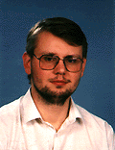







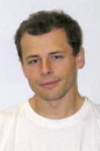



1.stránka
otevrena informatika

Slide 2
  CTU in Prague, FEE
  study program Open Informatics
  a high level of flexibility allowing the student to configure his/her own course of studies
  availability of minor specializations
  a wide range of offered courses, taught not only by top experts from FEE CTU but also from collaborating companies (e.g. Google)
  orientation towards standards recognized by international tests in the field of informatics, namely GRE Computer Science
  collaboration with foreign universities
  graduates of the bachelor program are able to continue with their successive magisterial studies anywhere in the world

Slide 3
  Bachelor program specializations:
  Computer Systems
  Software Systems
  Computer and Information Science
Master program specializations:
  Computer Engineering
  Software Engineering
  Artificial Intelligence
  Computer Graphics and Interaction
  Computer Vision and Image Processing

Slide 4
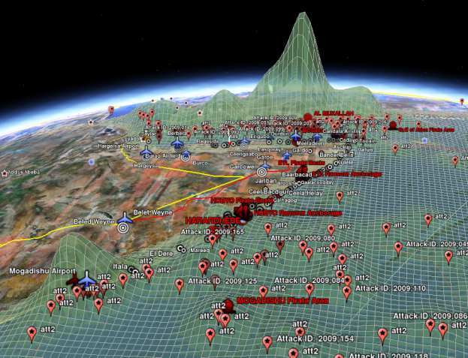
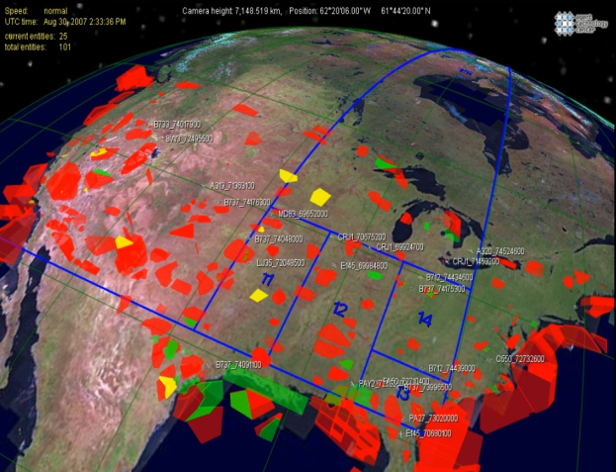
  OI is interconnected with research done at FEE
  for example
  AgentC - Adversarial Modeling
  and Reasoning in the Maritime Domain
  Simulation of air traffic over the area of the U.S.

Slide 5
  running since 2009/2010
  a selective program – numbers of enrolled vs. accepted students: 1051/335
  the survey among bachelor students of Open Informatics shows that
  93 % of them are satisfied with their choice
  of the study program

