Slide 1
Functional Magnetic Resonance Imaging (fMRI)
Jan Petr

Slide 2
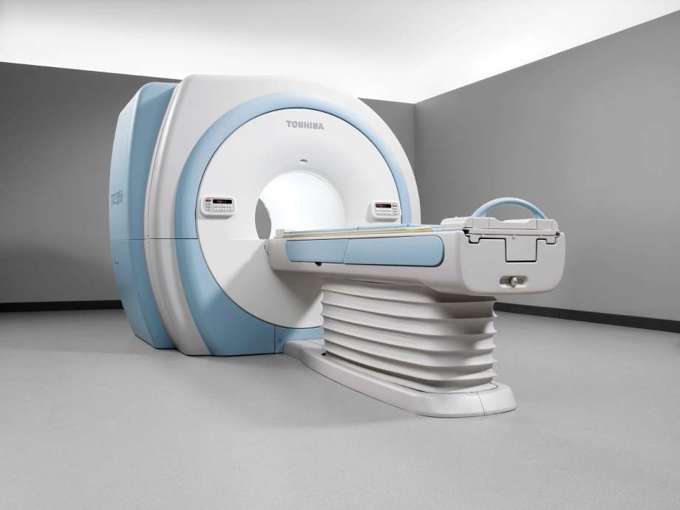
MRI quick summary
Spin property of hydrogen atoms
Using strong B₀ magnetic field
  1.5 T, 3T – clinical scanners
  7T – experimental scanners
Notes:
MRI is a medical imaging modality that uses the spin property of hydrogen atoms, though other atoms are used experimentally.
Measurement cannot be really done in normal Earth‘s magnetic field, but a very strong magnetic field is needed.
For human scanners, 1.5 a 3T are typically used fields.

Slide 3
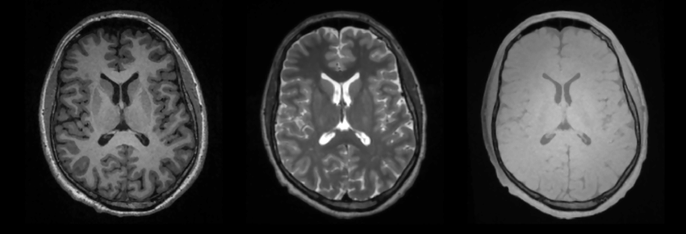
MRI quick summary
Imaging magnetic properties of tissue
  Proton density
  T1-weighted relaxation
  T2-weighted relaxation
PD
T1
T2

Slide 4
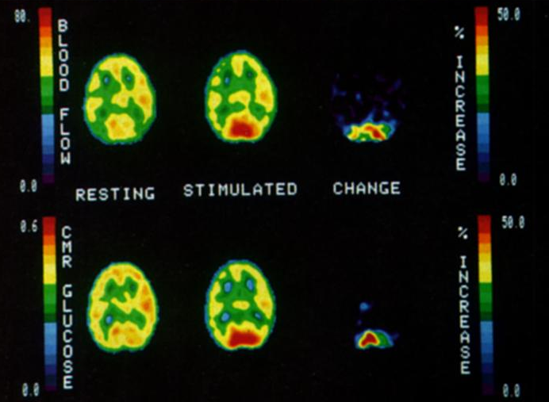
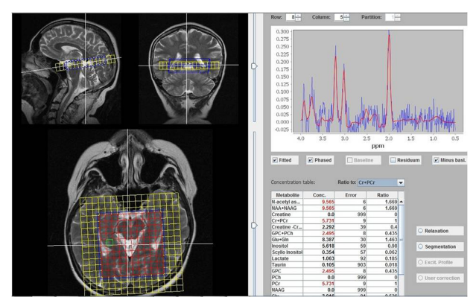
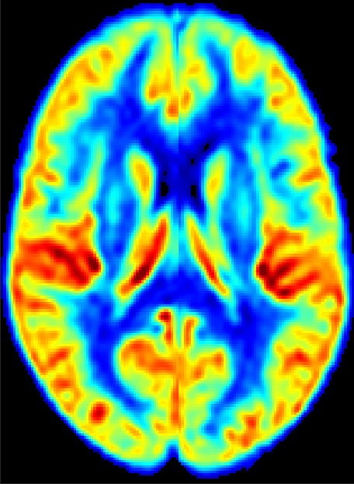
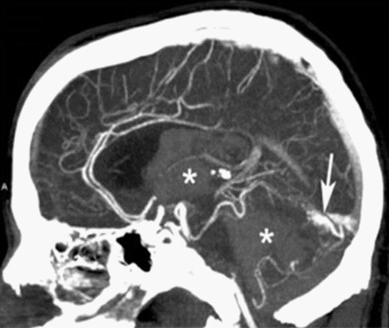
Brain imaging with different modalities
PET (Positron emission tomography)
CT (Computed tomography)
MRI
Structure
  Soft tissue
  Bones
  Vessels
Physiology
Metabolism
Function
Notes:
Q: Which of the modalities are able to take images of which structures or processes?

Slide 5
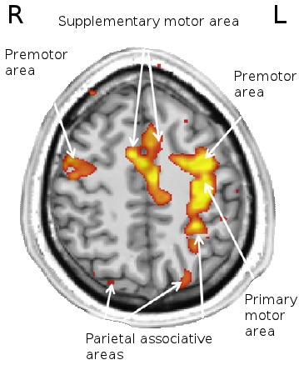
Functional MRI
Image brain activity
Spatial resolution ~mm
Temporal resolution ~s
Notes:
Q: What does functional MRI image

Slide 6
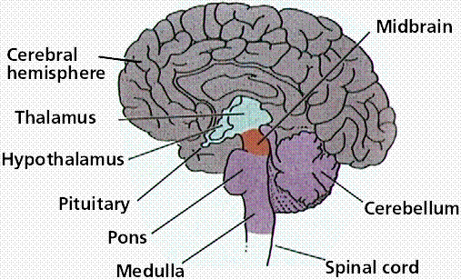
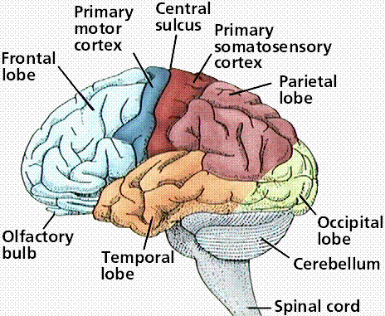
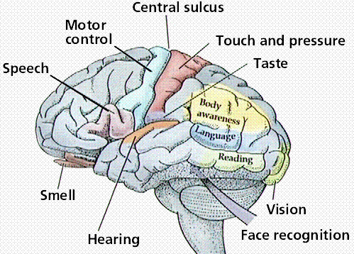
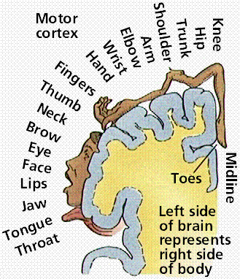
Brain regions
Anatomical regions
Individual difference
  size?
  shape?
  topology?
  Functional regions
Notes:
Q: Who thinks that there are individual differences between brains of different people when it comes to the following properties:

Slide 7
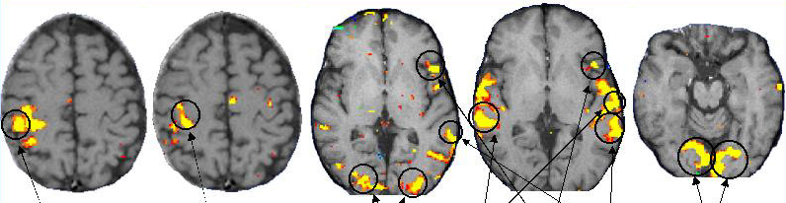
Brain regions
Examples of brain activation regions
Sensory | Motor | Language |  | Vision
Touch | Finger tapping | Picture naming | Listening to words | Reversing checkerboard
Passive | active | active | passive | passive

Slide 8
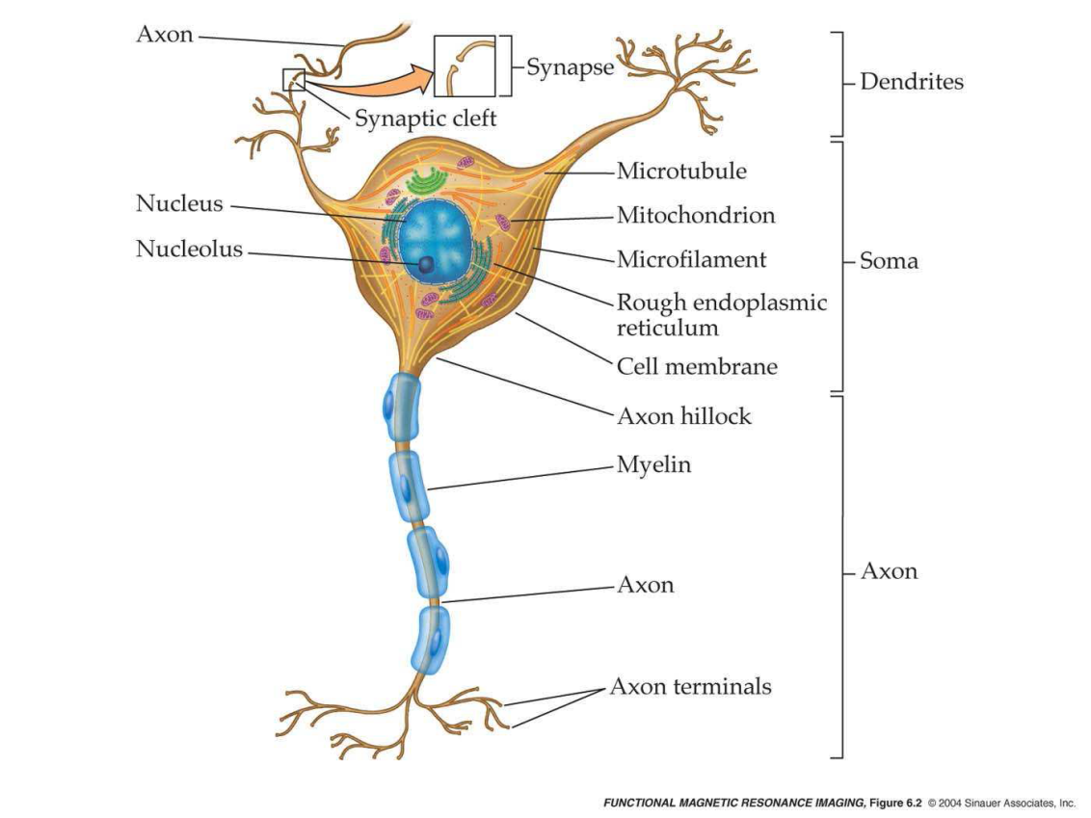
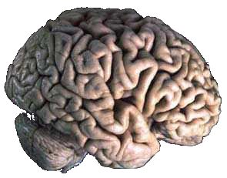
Brain anatomy
Neurons and glial cells
Neurons communicate through axons
  Through electrochemical processes

Slide 9
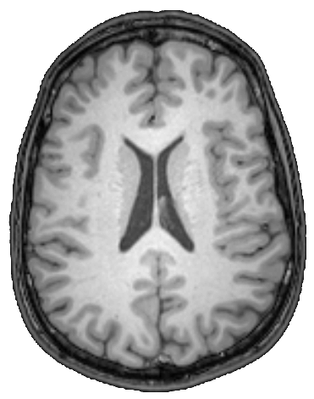
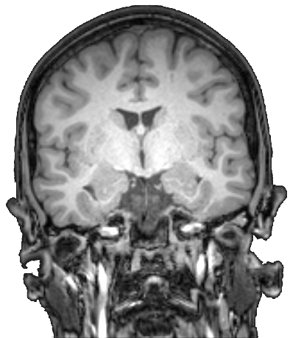
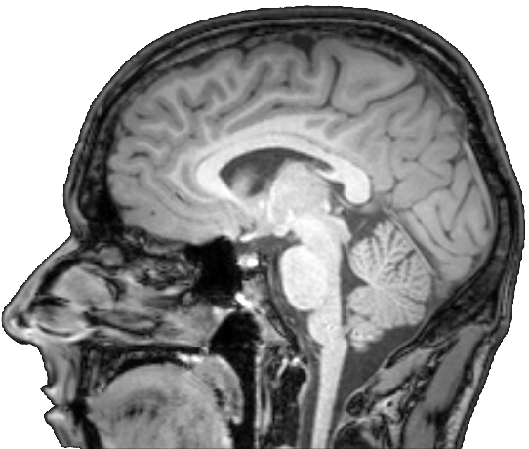
Brain anatomy
Gray matter
  Consists mostly of neurons
White matter
  Consists mostly of axons
Gray matter
White matter

Slide 10
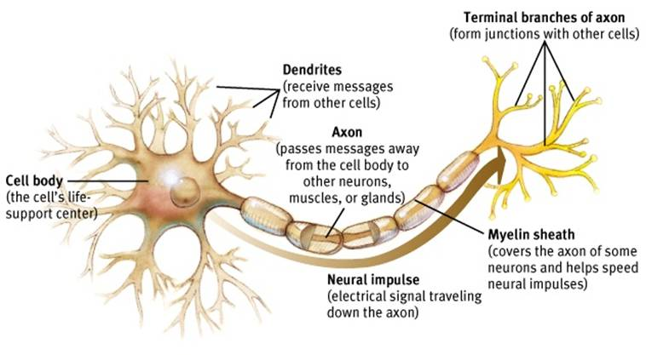
Neuronal activation
Integrative and signalling activity
  Change cell membrane potential
  Release of neurotrasmitters
Ionic pumps to restore concentration gradients
  Requires glucose and oxygen
Notes:
Neurons have two primary roles:
Integration -> collects inputs from other neurons through connections on dendrites and soma
Signalling -> transmits this outcome to other neurons
Both rely on changes in the cell membrane potential and the release of neurotransmitters
While the integrative and signalling processes themselves do not require external sources of energy, the restoration of ionic concentration gradients following these activities do.
Q: so where does glucose and oxygen come from?

Slide 11
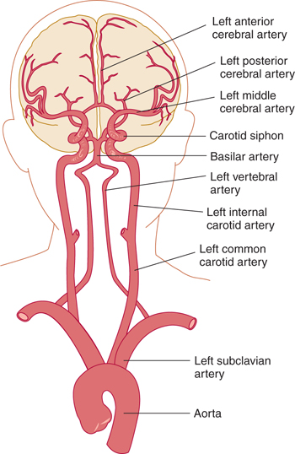
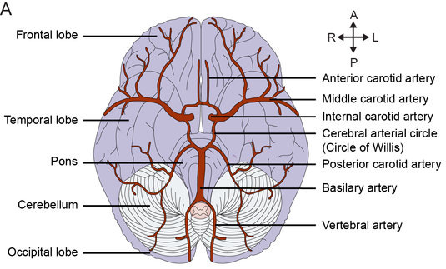
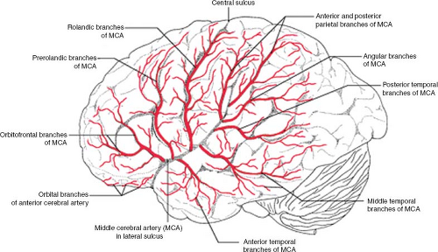
Brain vasculature
Blood supplies brain with oxygen and glucose
Internal carotid and vertebral arteries
Further branching to microvessels and capillaries

Slide 12
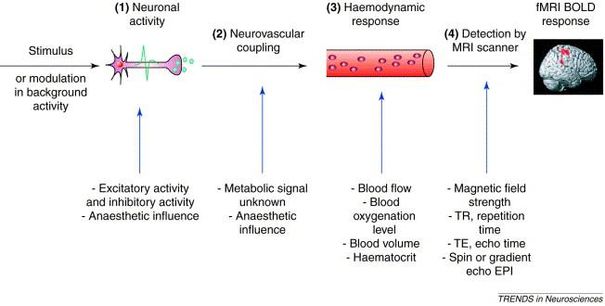
Neurovascular coupling
Neurovascular coupling
  Vasoactive substances → Dilate vessels
  → Reduces resistance
  → Increase blood flow

Slide 13
fMRI physiology
What is measured in fMRI?
  Electrical impulses?
  Neurotransmitters?
  Blood perfusion?
Blood perfusion through the level of oxygenation
Notes:
Q: What is measured in fMRI

Slide 14
History of BOLD imaging
BOLD – Blood Oxygenation Level Dependent
Ogawa et al., 1990
  Mice and rats at 7T MRI
  Contrast on gradient-echo images influenced by proportion of oxygen in breathing gas
  Increasing oxygen content → increased contrast
Ogawa et al., 1992
  Humans at 4T MRI
  Visual stimulation
  Changes of contrast in visual cortex

Slide 15
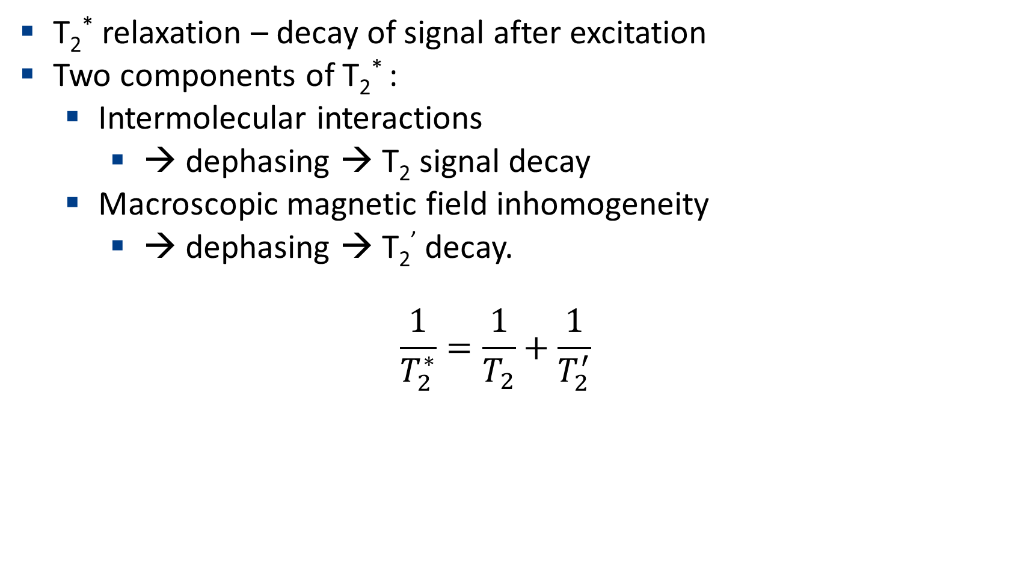
BOLD signal and T₂*
T₂* relaxation – decay of signal after excitation
Two components of T₂* :
  Intermolecular interactions
    → dephasing → T₂ signal decay
  Macroscopic magnetic field inhomogeneity
    → dephasing → T₂’ decay.
  $$\frac{1}{T_{2}^{∗}}=\frac{1}{T_{2}}+\frac{1}{T_{2}^{′}}$$

Slide 16
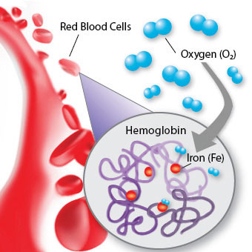
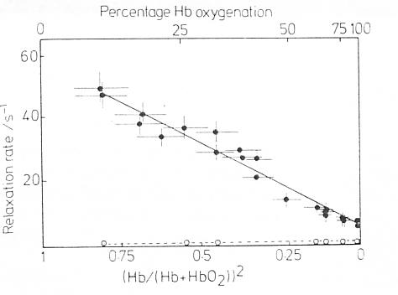
BOLD signal and T₂*
Why does blood oxygenation affect the BOLD MRI signal?
Hemoglobin contains iron to bind the oxygen
  Oxyhemoglobin (oxHb) is diamagnetic
  Deoxyhemoglobin (dxHb) is paramagnetic
Higher dxHb concentration
  → increased magnetic susceptibility
  → increased magnetic field inhomogeneities
  → decrease T₂*
  → lower BOLD MRI signal
Notes:
Q: Why would oxygenation of blood affect the MRI signal?

Slide 17
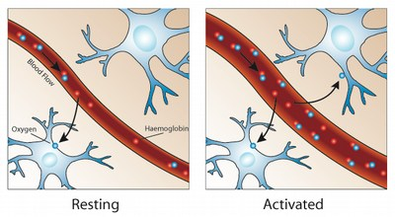
Hemodynamic response
Neuronal activity
  → Increased O₂ metabolism → Increased dxHb → lower BOLD signal?
  → Neurovascular coupling → Vessel dilation → increased CBF
→ dxHb concentration decreases → higher BOLD signal
Notes:
Q: What happens during brain activation?

Slide 18
Hemodynamic response
Brain function
Metabolic rates
Physiological effects
Physical effects
MR properties
Neuronal activity
Glucose and oxygen metabolism
Cerebral blood volume (CBV)
Magnetic field uniformity
Decay Time (T₂*)
Cerebral blood flow (CBF)
Blood oxygenation
T₂* weighted image intensity
-
+

Slide 19
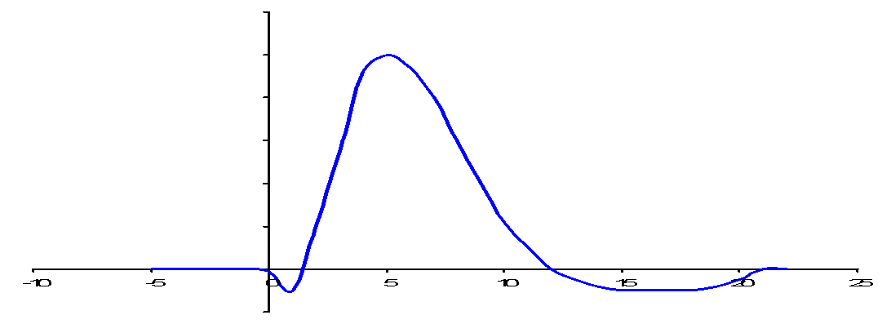
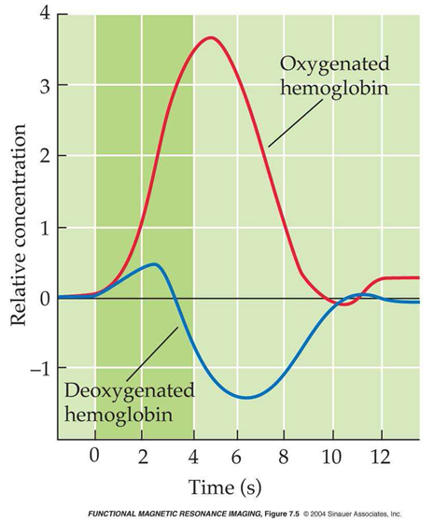

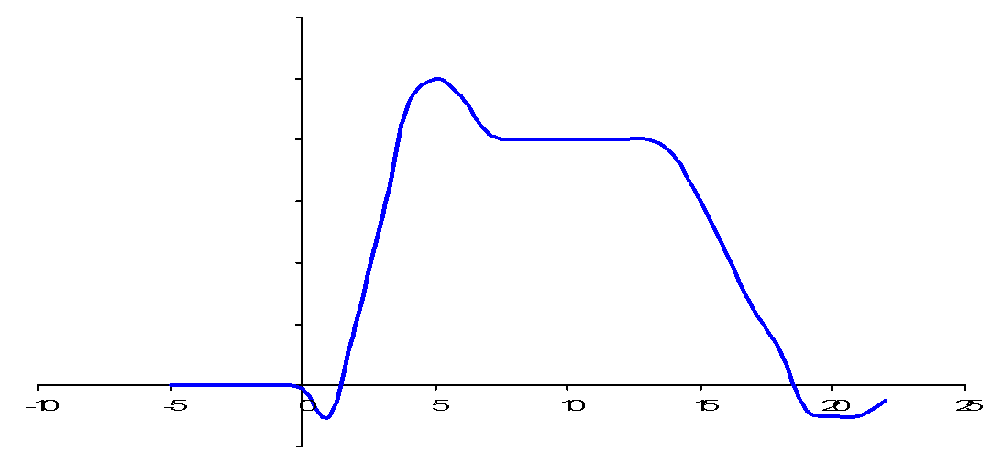

Hemodynamic response
Delay in BOLD signal change after activation
Initial dip – increase in oxygen consumption before CBF increase
Undershoot – CBF decrease faster than CBV
Peak
Rise
Baseline
Undershoot
Peak
Sustained
response
Rise
Baseline
Initial dip
Undershoot

Slide 20
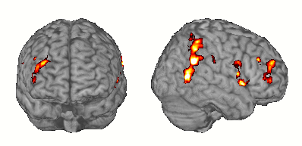
fMRI experimental design
Goal: To detect what regions/voxels are active during a specific task

Slide 21
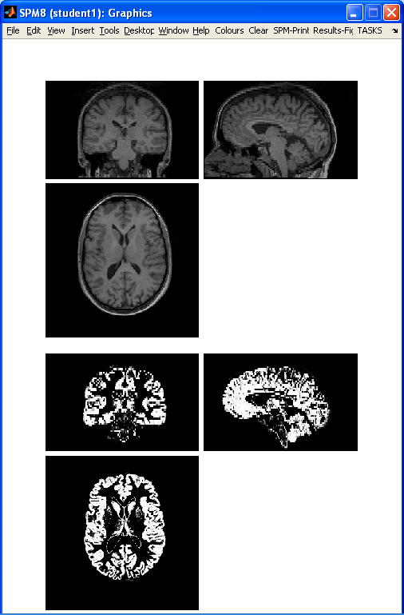
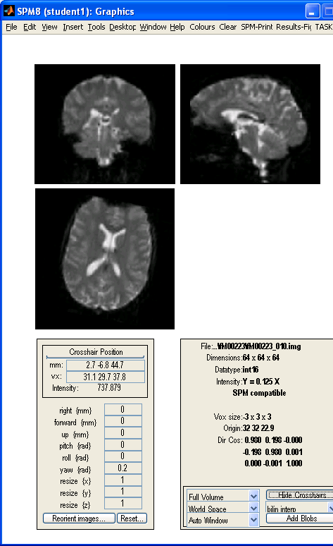
What sequence should be used for fMRI
Neuronal response - 200-500ms
Hemodynamic response – ~s
Standard whole brain sequence
  ~1mm spatial resolution
  Time resolution ~mins
Fast single shot sequences
  Echo planar imaging (EPI)
  500ms-2s acquisition
Notes:
Q:Can we use the standard sequence?

Slide 22
fMRI task design
Detect brain signals
associated with that state
Create a desired
cognitive state

Slide 23
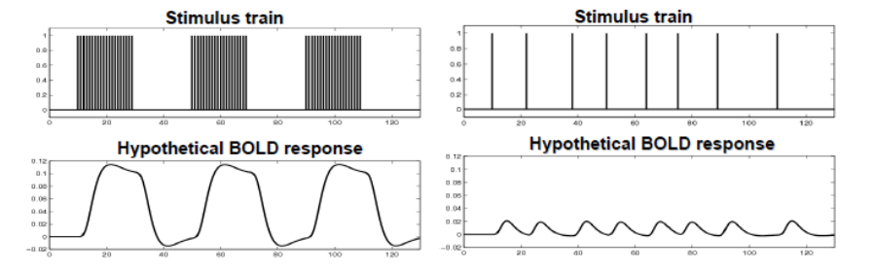
Types of fMRI designs
Block-design
  Detection power
Event-related design
  More flexible
Mixed design
Block design
Event-related design
Notes:
Three types of design
Block design
Multiple trials of the same conditions are presented sequentially
Event-related design
Trials of different conditions are (pseudo)randomized
Mixed design
Dependent on research question!

Slide 24
Readout in fMRI design
↑ spatial resolution:
  ↓ time resolution
  ↓ coverage (number of slices)
↑ temporal resolution requires:
  ↓ spatial resolution
  ↓ coverage (number of slices)
↑ SNR (signal-to-noise ratio):
  ↓ Decreased spatial resolution
  ↑ Increased scan time via averaging
Spatial resolution
Temporal resolution
SNR

Slide 25
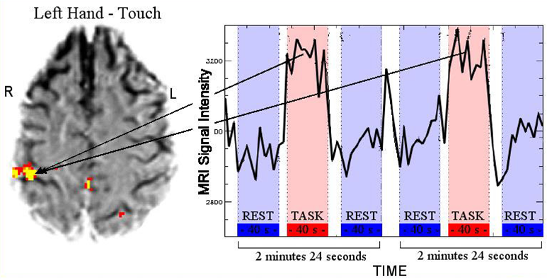
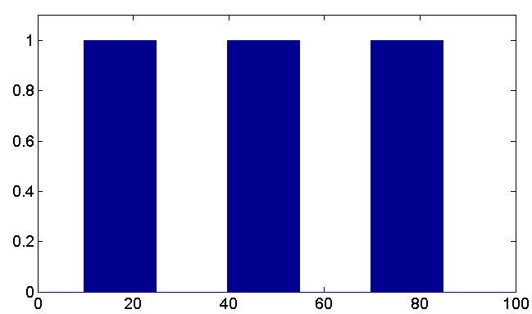
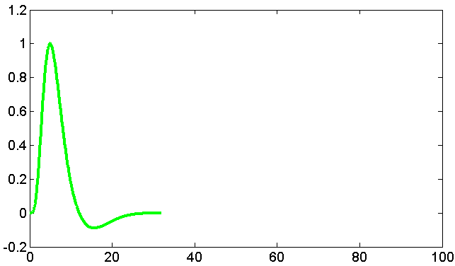
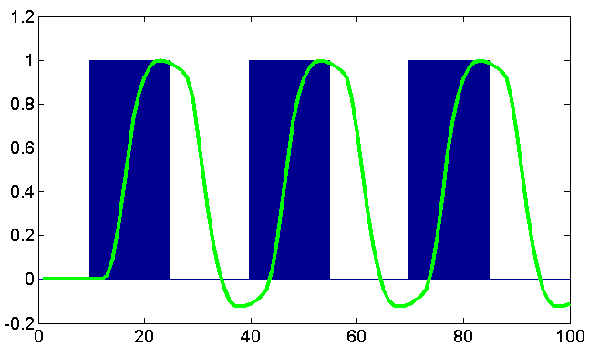
fMRI study design
BOLD signal – combination CBV, CBF, CMRO₂
Observe change of BOLD signal as a reaction on a task or event
Stimulus
HRF
Expected
response

Slide 26
I have my data, now what?
Data pre-processing
Structural MRI
functional MRI

Slide 27
Why pre-process fMRI data
Data are noisy (task-related change <5%)
Subjects move
Things change during the experiment
Preprocessing:
  → Increase signal to noise ratio
  → Helps to meet assumptions for statistical analysis
Notes:
Important:
1) because the BOLD signal is very small compared to the total signal intensity of the MR signal. At most, in a very strong task, such as visual stimulation or fingertapping, we see a 5% increase in the BOLD signal. (not necessarily an issue -> if you have sensitive measurements this is fine)
2) The task-related change in BOLD signal is very small compared with other sources of spatial and temporal variability across and within images.
Sources of noise are:
Thermal noise – thermal motion of electrons within the sample or scanner hardware
System noise – fluctuations of MR signal due to imperfect functioning of scanner hardware (e.g. scanner drift).
Physiological noise and motion
Non-task-related neural variability
Behavioral and cognitive variability in task performance

Slide 28
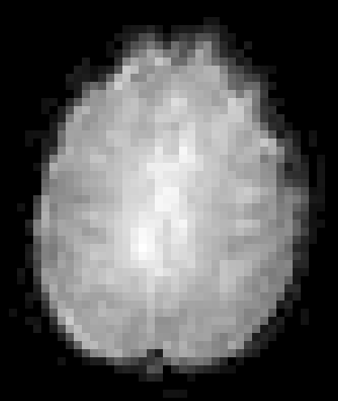


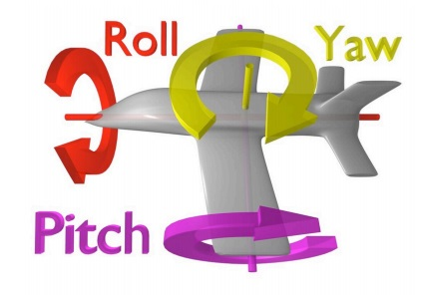
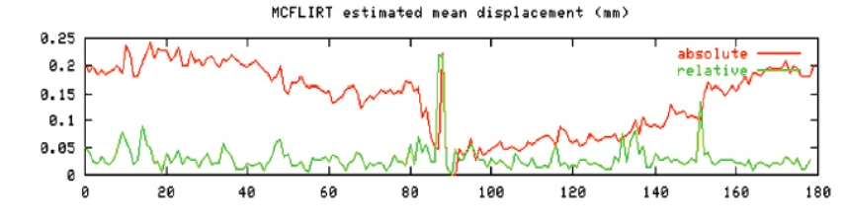
Subject motion
Correct for head motion
  6 parameters rigid transformation
    3 rotations
    3 translations
Lie very still
Exclude subjects

Slide 29
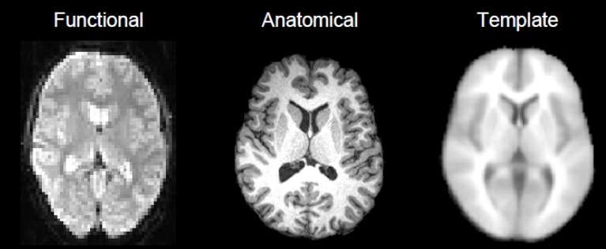
Spatial normalization
Register functional vs. anatomical per subject
Register to average brain (MNI)
Larger population
  Higher power
6 DOF
> 6 DOF
Within-subject
Between-subject

Slide 30
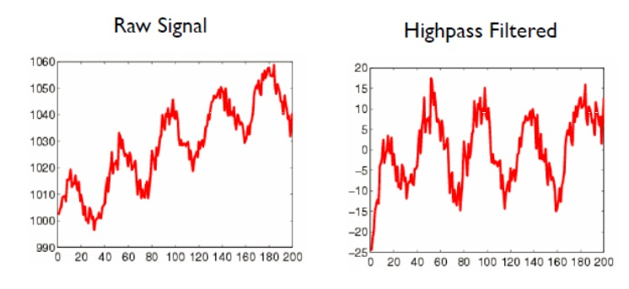
Temporal filtering
Temporal drift from scanner
  High-pass filter
Physiological cycles (cardiac, respiratory)

Slide 31
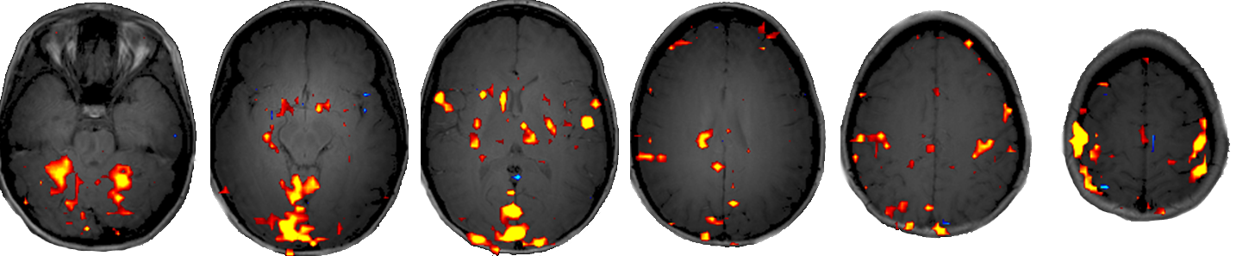
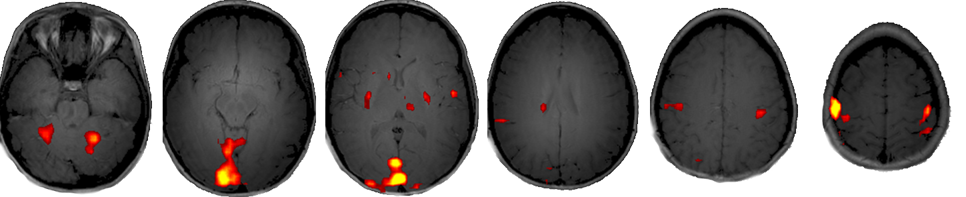
Spatial filtering
Convolution with a Gaussian kernel
  Improves
    SNR
    Specificity
  Reduces
    Spatial resolution
    Sensitivity

Slide 32
Is there an activation?
A finger tapping example

Slide 33
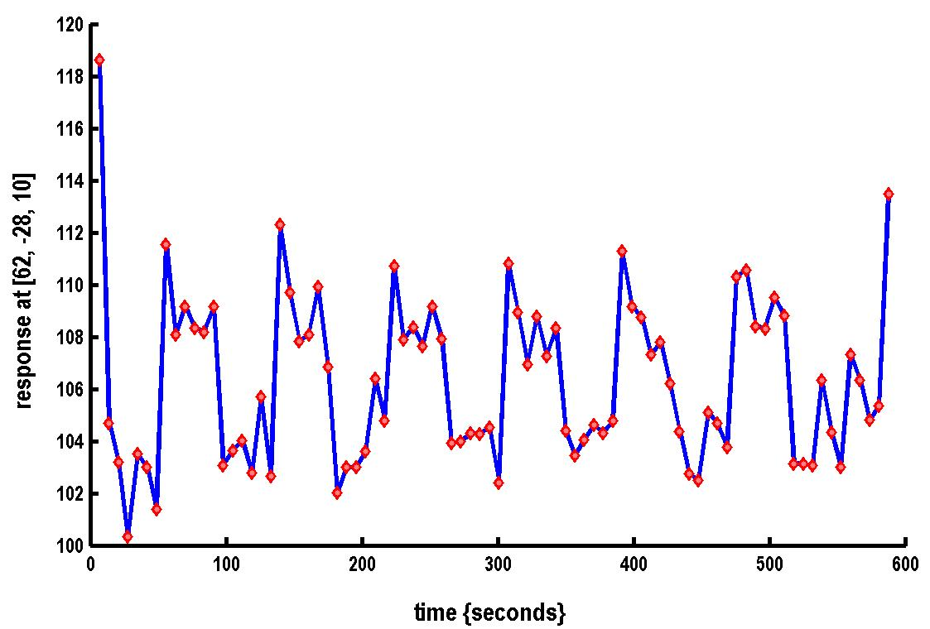

A simple fMRI experiment
Passive tapping vs rest (7 cycles)
Blocks of 6 scans per cycle
Is there a change in the BOLD response between finger tapping and rest?
Stimulus function

Slide 34
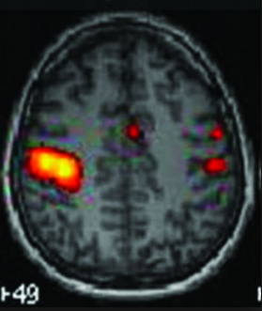



A simple fMRI experiment
Activation → compare:
  Magnitude of response
  Measurement noise
T-test
Signal from one voxel
Stimulus function
Compare tap in green vs rest

Slide 35
General linear model
Experimental data (Y) - linear combination (β) of different model factors (x), along with uncorrelated noise (ε)
Testing slope (β) against null hypothesis
  Y = βx + β₀ + ε
β₀

Slide 36
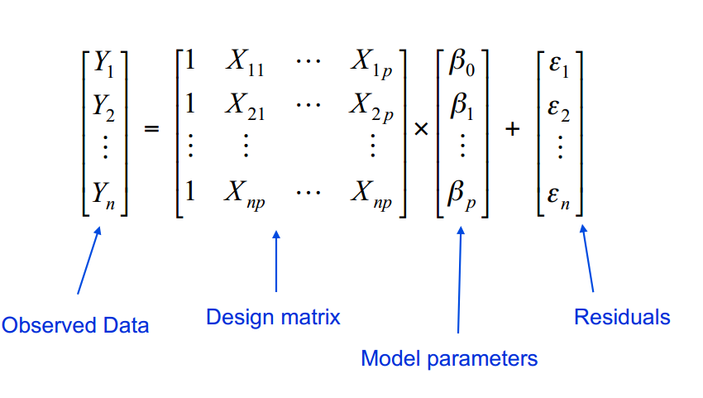
General linear model for fMRI
Y = X * β + ε
timepoints
Observed data (known)
BOLD signal in a single voxel
Design matrix
(known)
Components that can explain the data
Model parameters
(unknown)
Contribution of each component of X to Y
Error
Difference between the observed data and model prediction

Slide 37
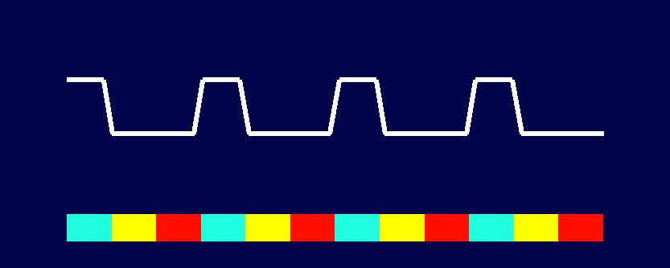

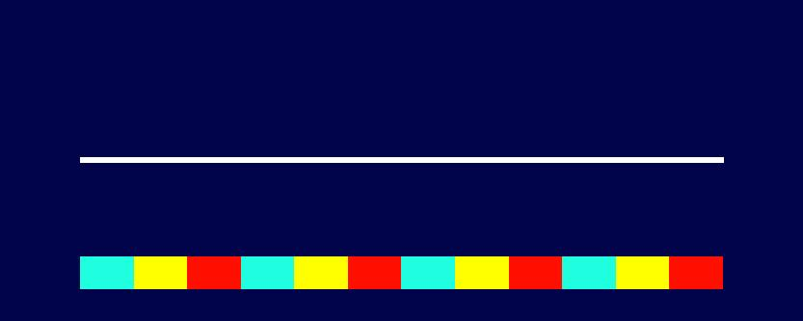
GLM example: Design
Block design, language task
  Word generation (noun presented, verb generated)
  Word shadowing (verb presented, thinking on it)
  Rest
  Design matrix:
generation
shadowing
rest

Slide 38
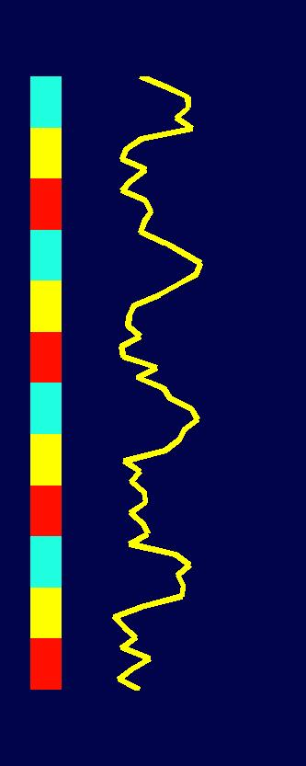




GLM example: Estimating betas
Fitting model to data – ordinary least squares – minimizing $ε^{T}ε$
    $y=Xβ+ε$
    $\hat{β}={(X^{T}X)}^{−1}X^{T}y$
2
3
4
0
1
0
1
0
1
2
≈
β₁∙
+ β₂∙
+ β₃∙

Slide 39


GLM example: Estimating betas
Suboptimal fit
$β=[0,0,3]$
2
3
4
0
1
0
1
0
1
2
≈
β₁∙
+ β₂∙
+ β₃∙
0
0
3

Slide 40


GLM example: Estimating betas
Active in word generation$β=[0.83, 0.16, 2.98]$
2
3
4
0
1
0
1
0
1
2
≈
β₁∙
+ β₂∙
+ β₃∙
0.83
0.16
2.98

Slide 41

GLM example: Estimating betas
Active in word generation and shadowing 𝛽=[0.68, 0.82, 2.17]
1
2
3
0
1
0
1
0
1
2
≈
β₁∙
+ β₂∙
+ β₃∙
0.68
0.82
2.17

Slide 42

GLM example: Estimating betas
Voxel not active 𝛽=[0.03, 0.06, 2.04]
1
2
3
0
1
0
1
0
1
2
≈
β₁∙
+ β₂∙
+ β₃∙
0.03
0.06
2.04

Slide 43










GLM example: Voxelwise fit
Calculate fit for every voxel
beta1
Time-series
...
beta2
$$β=\left[\begin{matrix}0.83 \\ 0.16 \\ 2.98\end{matrix}\right]$$
beta3
...
$$σ^{2}∝\sum_{i=1}^{n}{e^{2}=9.47}$$
residuals

Slide 44




GLM example: Significance
Which of these series should we trust?
Noise, effect size, number of measurements
β₁=1
σ=0.2
n=60
β₁=1
σ=0.5
n=60
β₁=0.3
σ=0.2
n=60
β₁=1
σ=0.2
n=15
Notes:
Q:Which of those time-series is more likely to show activation in word generation?

Slide 45
GLM example: Contrast
Weights c of model parameters β
  c = [c₁ c₂ c₃] for β = [β₁ β₂ β₃]
c = [1 0 0]
  Active in word generating
c = [1 -1 0]
  More active in generating than in shadowing

Slide 46

GLM example: Hypothesis testing
Null hypothesis (H₀) – there is no effect
Alternative hypothesis (H_{a}) – we find the effect in data
Reject the null hypothesis → activation
$$c^{T}β=\left[\begin{matrix}1 & 0 & 0\end{matrix}\right]\left[\begin{matrix}0.83 \\ 0.16 \\ 2.98\end{matrix}\right]=0.83$$
$$H_{0}: c^{T}β=0$$
$$H_{a}: c^{T}β≠0$$

Slide 47



GLM example: t-contrast
$t=\frac{c^{T}β}{σ\sqrt{c^{T}{(X^{T}X)}^{−1}c}}$
follows Student’s distribution (N-1 degrees of freedom)
Probability that the null hypothesis is true
p-value <0.05 we reject the null hypothesis

Slide 48

GLM example: t-contrast example

Slide 49

GLM example: t-contrast example
Voxels active in word generation
c=[1 0 0]

Slide 50

GLM example: t-contrast example
Voxel active more in generating than shadowing
c=[1 -1 0]

Slide 51



fMRI applications
Surgery planning
Volunteer
Patient with glioblastoma

Slide 52
fMRI application
Addiction
  Understanding of brain effects of long-term use
  Development of treatment strategies for abusers
Pharmacological studies
  Effects on cognition
Neuropsychological disorders
  Disease markers may help in treatment
Aging and brain development
  Normal and pathological changes

Slide 53
fMRI summary
Simple and non-invasive
Very good time and spatial resolution
Wide range of applications
Problems with noise
Limited clinical use

