Slide 1
fMR Processing(2)
Ing. Jan Šanda

Slide 2
Today goal: Group analysis of functional activity during FingerTapping task in eight subjects using SPM12
Looking for average activity in group of eight measured subjects
Is there any common activation? Are the subject‘s activations on the same place in the brain
Do the processing of fMR data for subjects Subj01 to Subj08 following the pipeline
Do the group statistics and display the results

Slide 3
fMR processing (1. excercise) Pipeline
Conversion of data: DICOM -> NIFTI ✓ (done; *.nii suffix)
Slice Timing: temporal correction (TR vs. HRF) ✗ (skipping this step)
Realignment of functional data - spatial correction of data in time
Smoothing with Gauss filter kernel
Model specification + Review
Estimate Model
Results + Display

Slide 4
fMR processing (2. excercise) Pipeline
Conversion of data: DICOM -> NIFTI ✓ (done; *.nii suffix)
Realignment of functional data - spatial correction of data in time
Segment – mean fMR segmentation (WhiteMatter, GrayMatter, CSF)
Normalise – functional data to a standard MNI space (non/linear transformation)
Smoothing functional data with Gauss filter kernel
Model specification + Review
Estimate Model
Results + Display
DO IT FOR EACH SUBJECT Subj01 – Subj08
… 2nd- level analysis

Slide 5
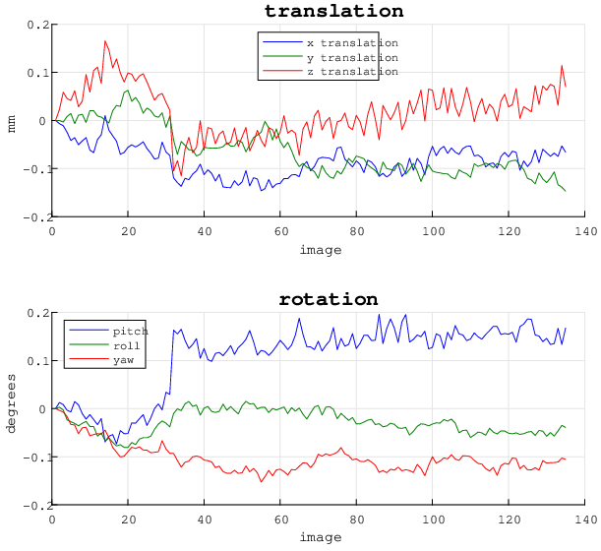
1. Realign data
MENU: Realign (Estimate & Reslice)
BATCH EDITOR:
Data – Session … select all fMR files (fMR*.nii)
Run batch
Output:
Resliced files (prefix „rfMR*.nii“)
„meanfMR*.nii“ file (mean of all fMR files)
Realignment parameters file „rp_*.txt“

Slide 6
2. Segment structural data
MENU: Segment
BATCH EDITOR:
Volumes … select mean data (meanfMR*.nii)
Deformation fields (last parameter)… Forward (transform from functional to MNI152)
All other parameters as default!
Run batch (could be time consuming little bit ☺ )
Display or Check Reg output files
Output:
c1meanfMR*.nii (gray matter probability)
c2meanfMR*.nii (white matter prob.)
c3meanfMR*.nii (CSF prob.)
y_meanfMR*.nii (deformation field)
C4mean*.nii, c5mean*.nii (non brain tissue)

Slide 7
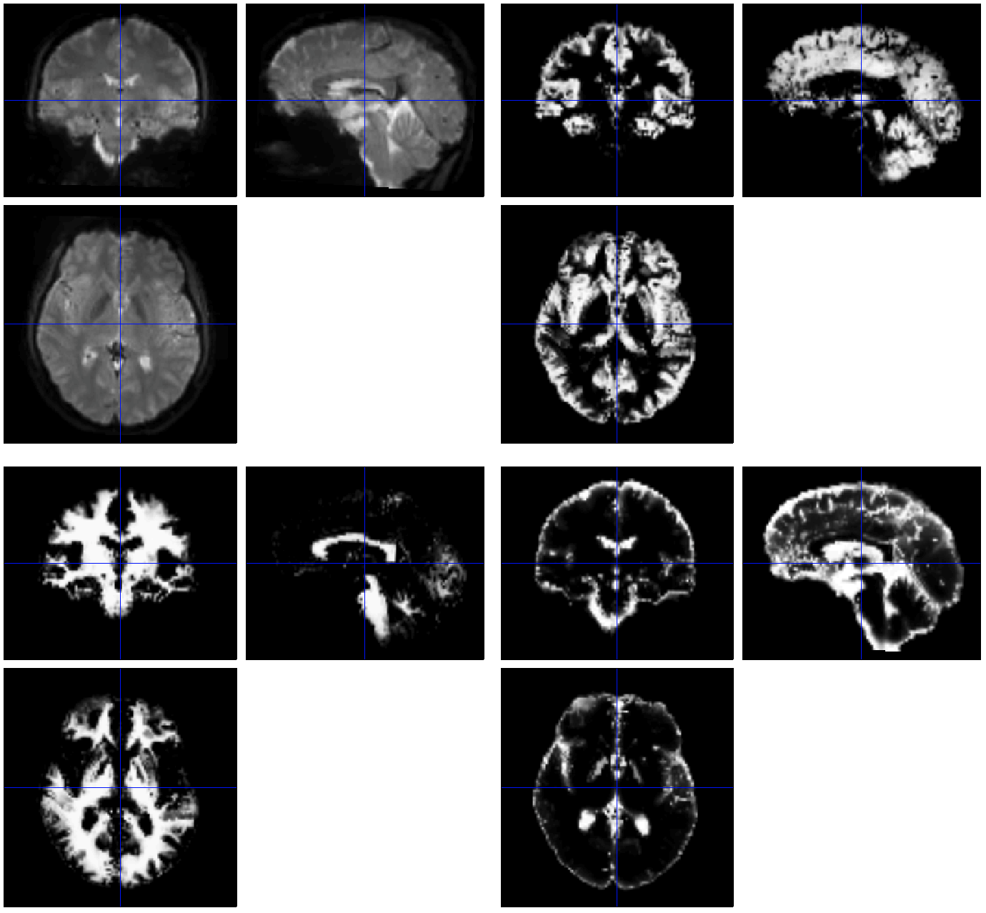
meanfMR
c1* = gray matter
C3* = cerebro-spinal fluid
C2* = white matter

Slide 8
3. Normalise functional data
MENU: Normalise (Write)
BATCH EDITOR:
Data – Subject – Deformation Field … select Forward deformation Field (y_meanfMR*.nii)
Images to Write … all realigned functional images (rfMR*.nii)
meanfMR*.nii
Voxel sizes … [2 2 2]
Run batch
Display output files
Output:
150 volumes of wrfMR*.nii (functional data in standard MNI152 space)
1 volume wmeanfMR*.nii

Slide 9
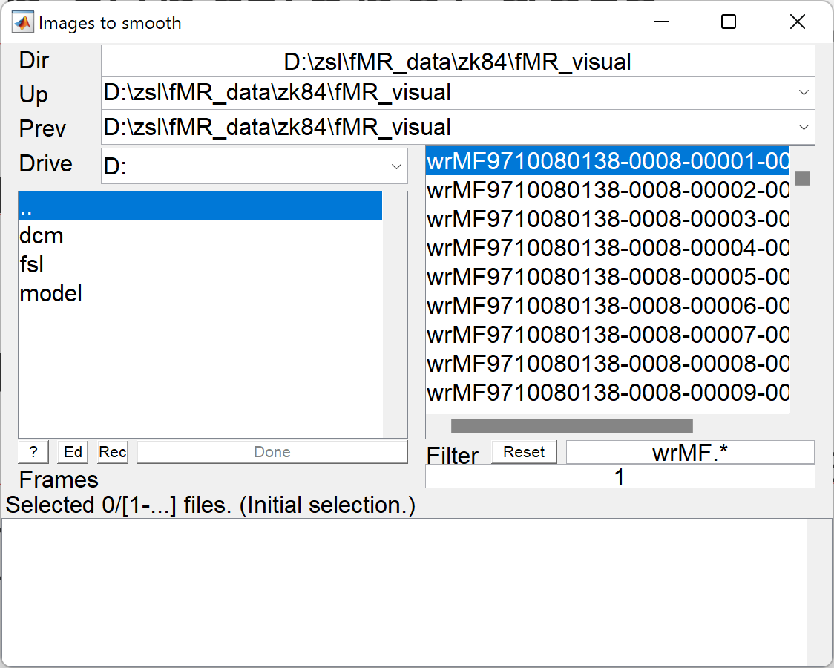
4. Smooth functional data (realigned and normalised data)
MENU: Smooth
BATCH EDITOR:
Images to smooth … select all wrfMR*.nii files
FWHM … [8 8 8] (FWHM of the Gaussian smoothing kernel in mm)
Run batch
Output:
Smoothed functional files (all with prefix „swrfMR*.nii“)

Slide 10
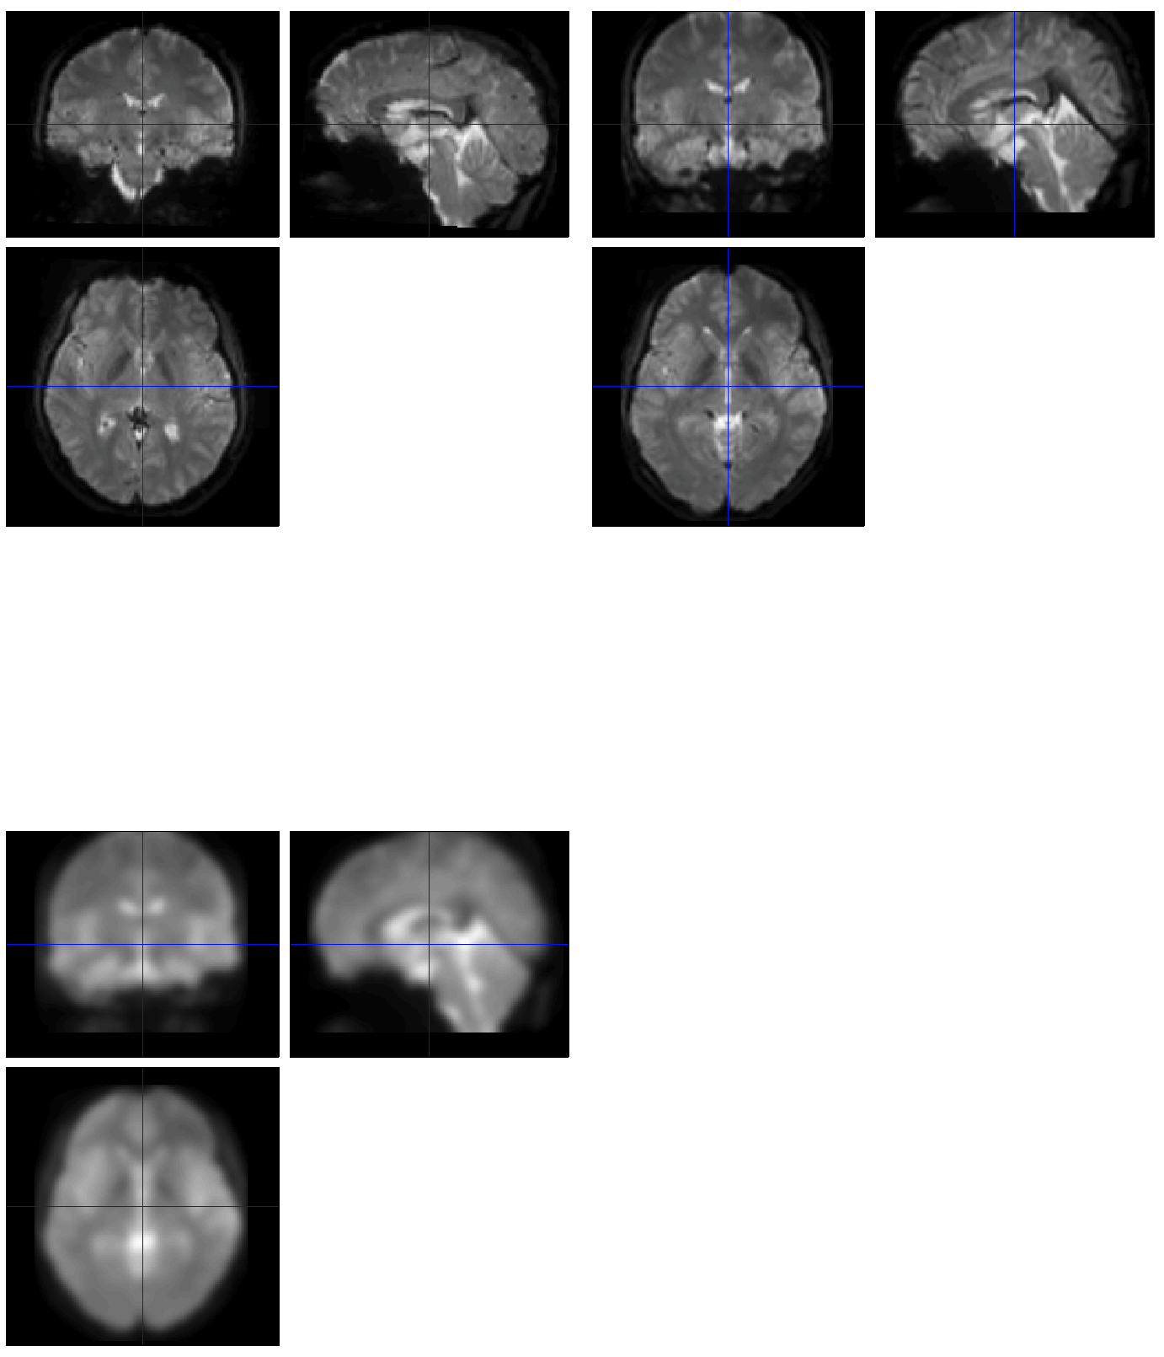
meanfMR
wmeanfMR
swmeanfMR

Slide 11
5. Model specification (1st-level)
MENU: Specify 1st-level
BATCH EDITOR:
Directory … select (pre-created) folder „model“to store model and statistics results
Units for design … Scans
Interscan interval … 2 (equals to TR)
Data & Design
Scans … select swr*.nii data
Conditions
Condition
Name … name of processed paradigm, for example LeftHandFingerTapping / RightHandFingerTapping
Onset … vector of scans where the activations begin
Durations … duration of activation (in scans)
Run batch
Output:
SPM.mat file (GLM model)

Slide 12
fMR Statistics 5. Model specification - Conditions
Condition LeftHand
Name … LeftHandFingerTapping
Onset … [16 61 106]
Durations … 15
Condition RightHand
Name … RightHandFingerTapping
Onset … [31 76 121]
Durations … 15

Slide 13
6. Model estimation
MENU: Estimate
BATCH EDITOR:
Select SPM.mat … select SPM.mat
Run batch

Slide 14
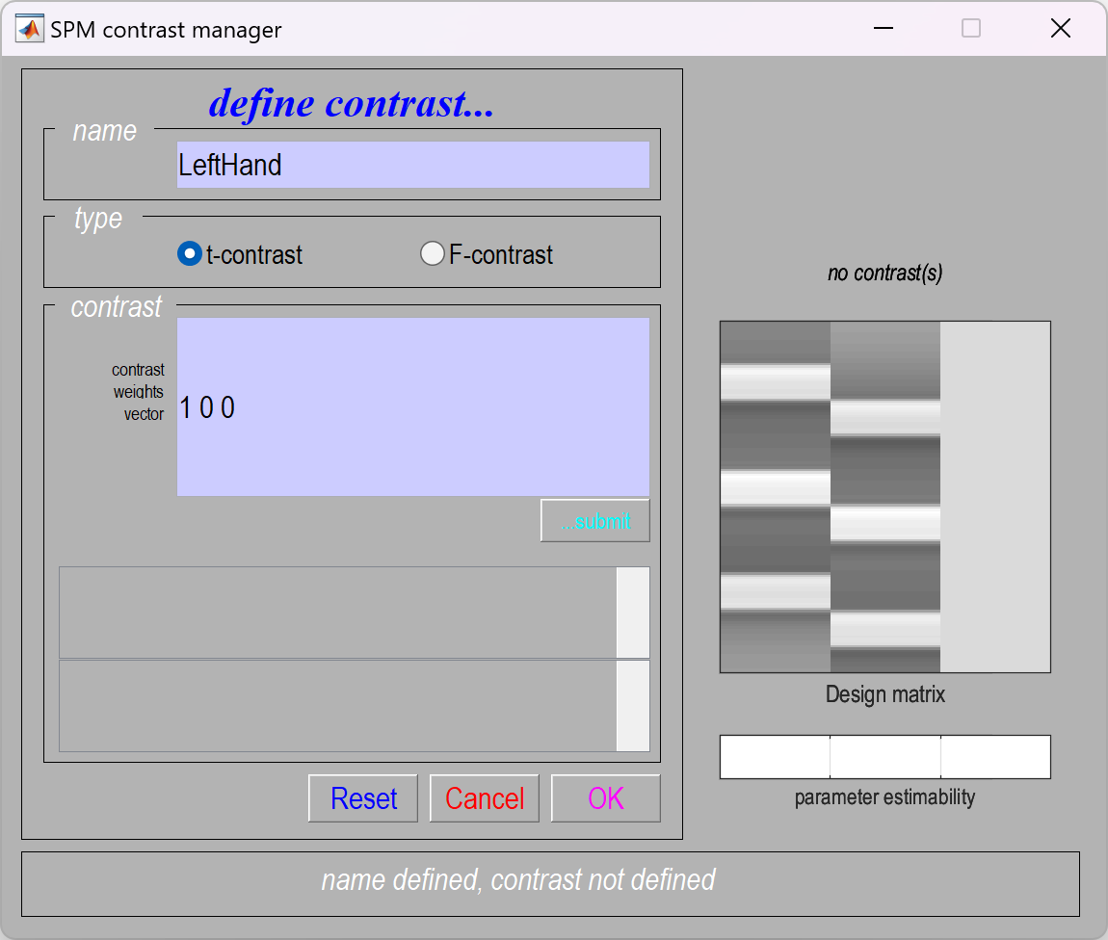
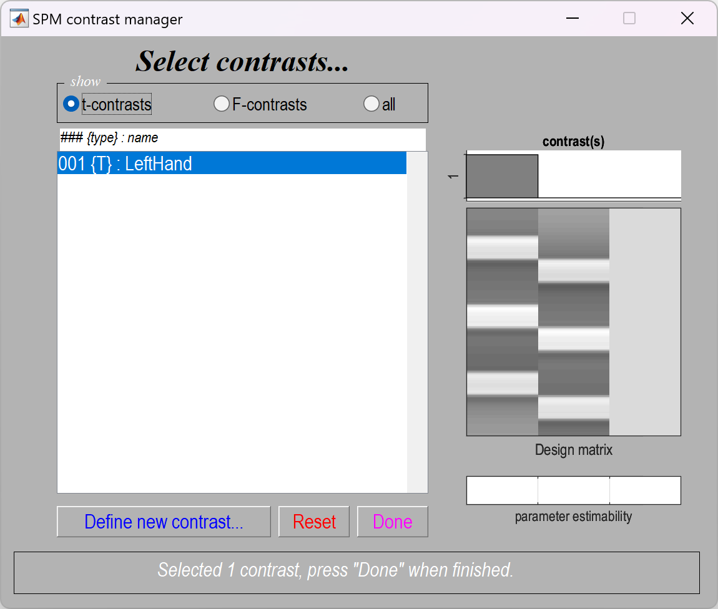
7. Results (define contrast)
MENU: Results
Select SPM.mat
SPM contrast manager:
Define new contrast
Name: LeftHand / RightHand
type: t-contrast
contrast: 1 0 0 / 0 1 0 …submit
OK
Done

Slide 15
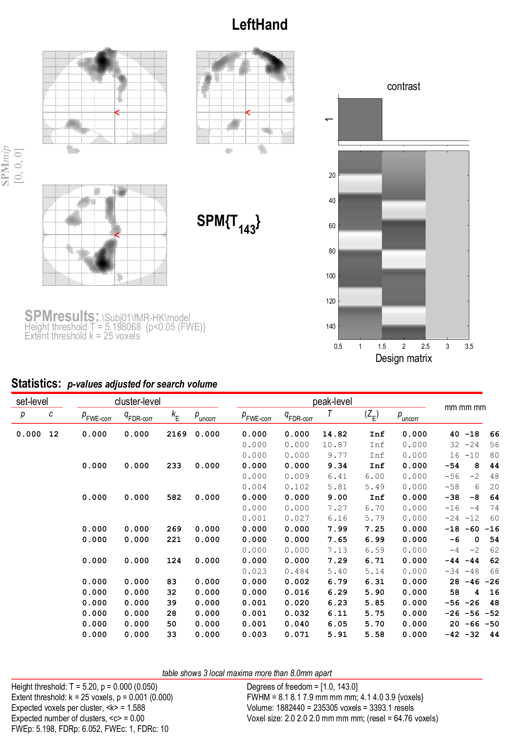
8. Results
RESULTS:
apply masking … none
P value adjustment to control … none/FWE
Threshold {T or p value} … 0.001/0.05
& extent threshold {voxels} … 25

Slide 16
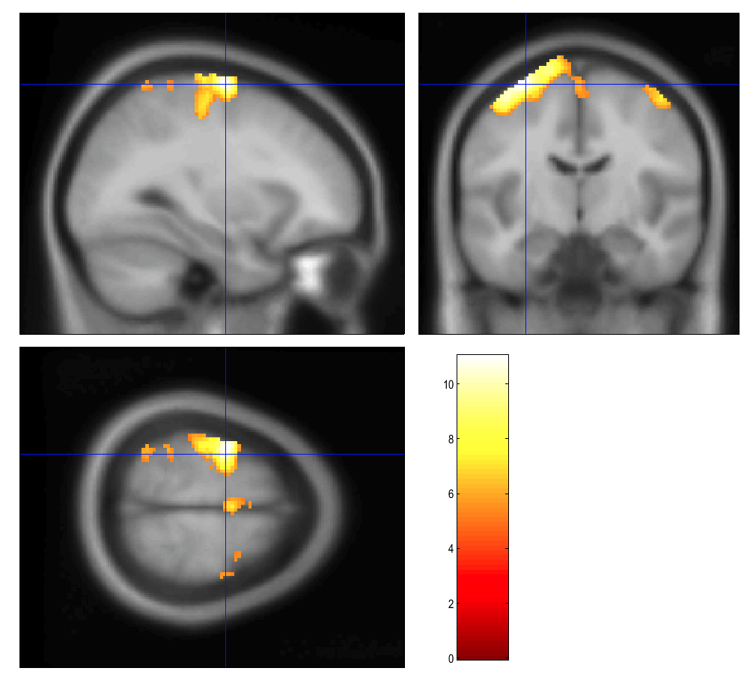
Display Results
Results can be displayed with overlay command (in results window, Slices, Section, Montage)
As a background image use the MNI template
images from the
%SPM12%/canonical/avg*.nii

Slide 17
… do the preview pipeline for subjects
Subj01
Subj02
Subj03
Subj04
Subj05
Subj06
Subj07
Subj08

Slide 18
File structure for each subject
SubjXX
fMR_hk
fMR_hk*.nii (150 origin files)
rfMR _hk*.nii (150 realigned files)
rp_fMR _hk*.txt 1 realignment parameters txt-file
meanfMR _hk*.nii 1 mean functioanl file
wrfMR _hk*.nii (150 realigned and normalised files)
swrfMR _hk*.nii (150 realigned, normalised and smoothed files)
model
beta_0001.nii beta values of GLM model, for first predictor (predictor of acitavtions)
beta_0002.nii beta values of GLM model, for second predictor (predictor of acitavtions)
beta_0003.nii beta values of GLM model, for third predictor (constant predictor)
con_0001.nii contrast file for first predictor IMPORTANT FOR GROUP ANALYSIS!!!
con_0002.nii contrast file for second predictor IMPORTANT FOR GROUP ANALYSIS!!!
mask.nii binar mask file, created automaticaly
ResMS.nii residuals file, errors of the GLM model
RPV.nii ressels per voxel file
SPM.mat mat-file, where GLM model is stored
spmT_0001.nii t-statistics T-values
t1
t1.nii 1 structural t1-weighted image

Slide 19
2nd- level (GROUP ANALYSIS)

Slide 20
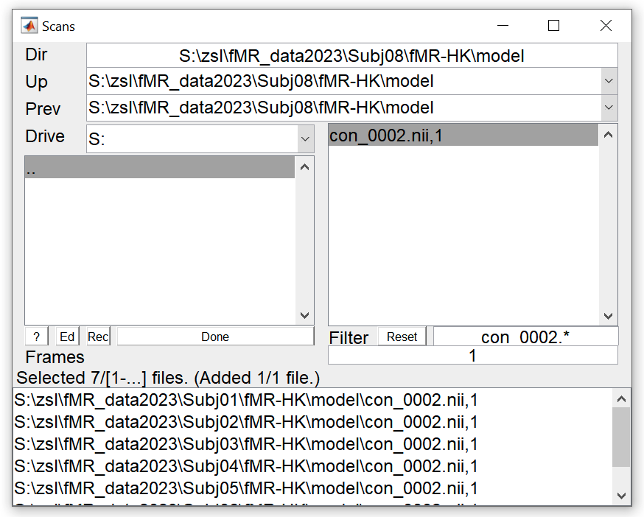
8. Model specification (group mean)
MENU: Specify 2nd-level
BATCH EDITOR:
Directory … select folder (for example „group_mean_Left“)
Design – One-sample t-test – Scans … select all con_0001.nii files from model folder of each subject (8x con_0001.nii)
Run batch

Slide 21
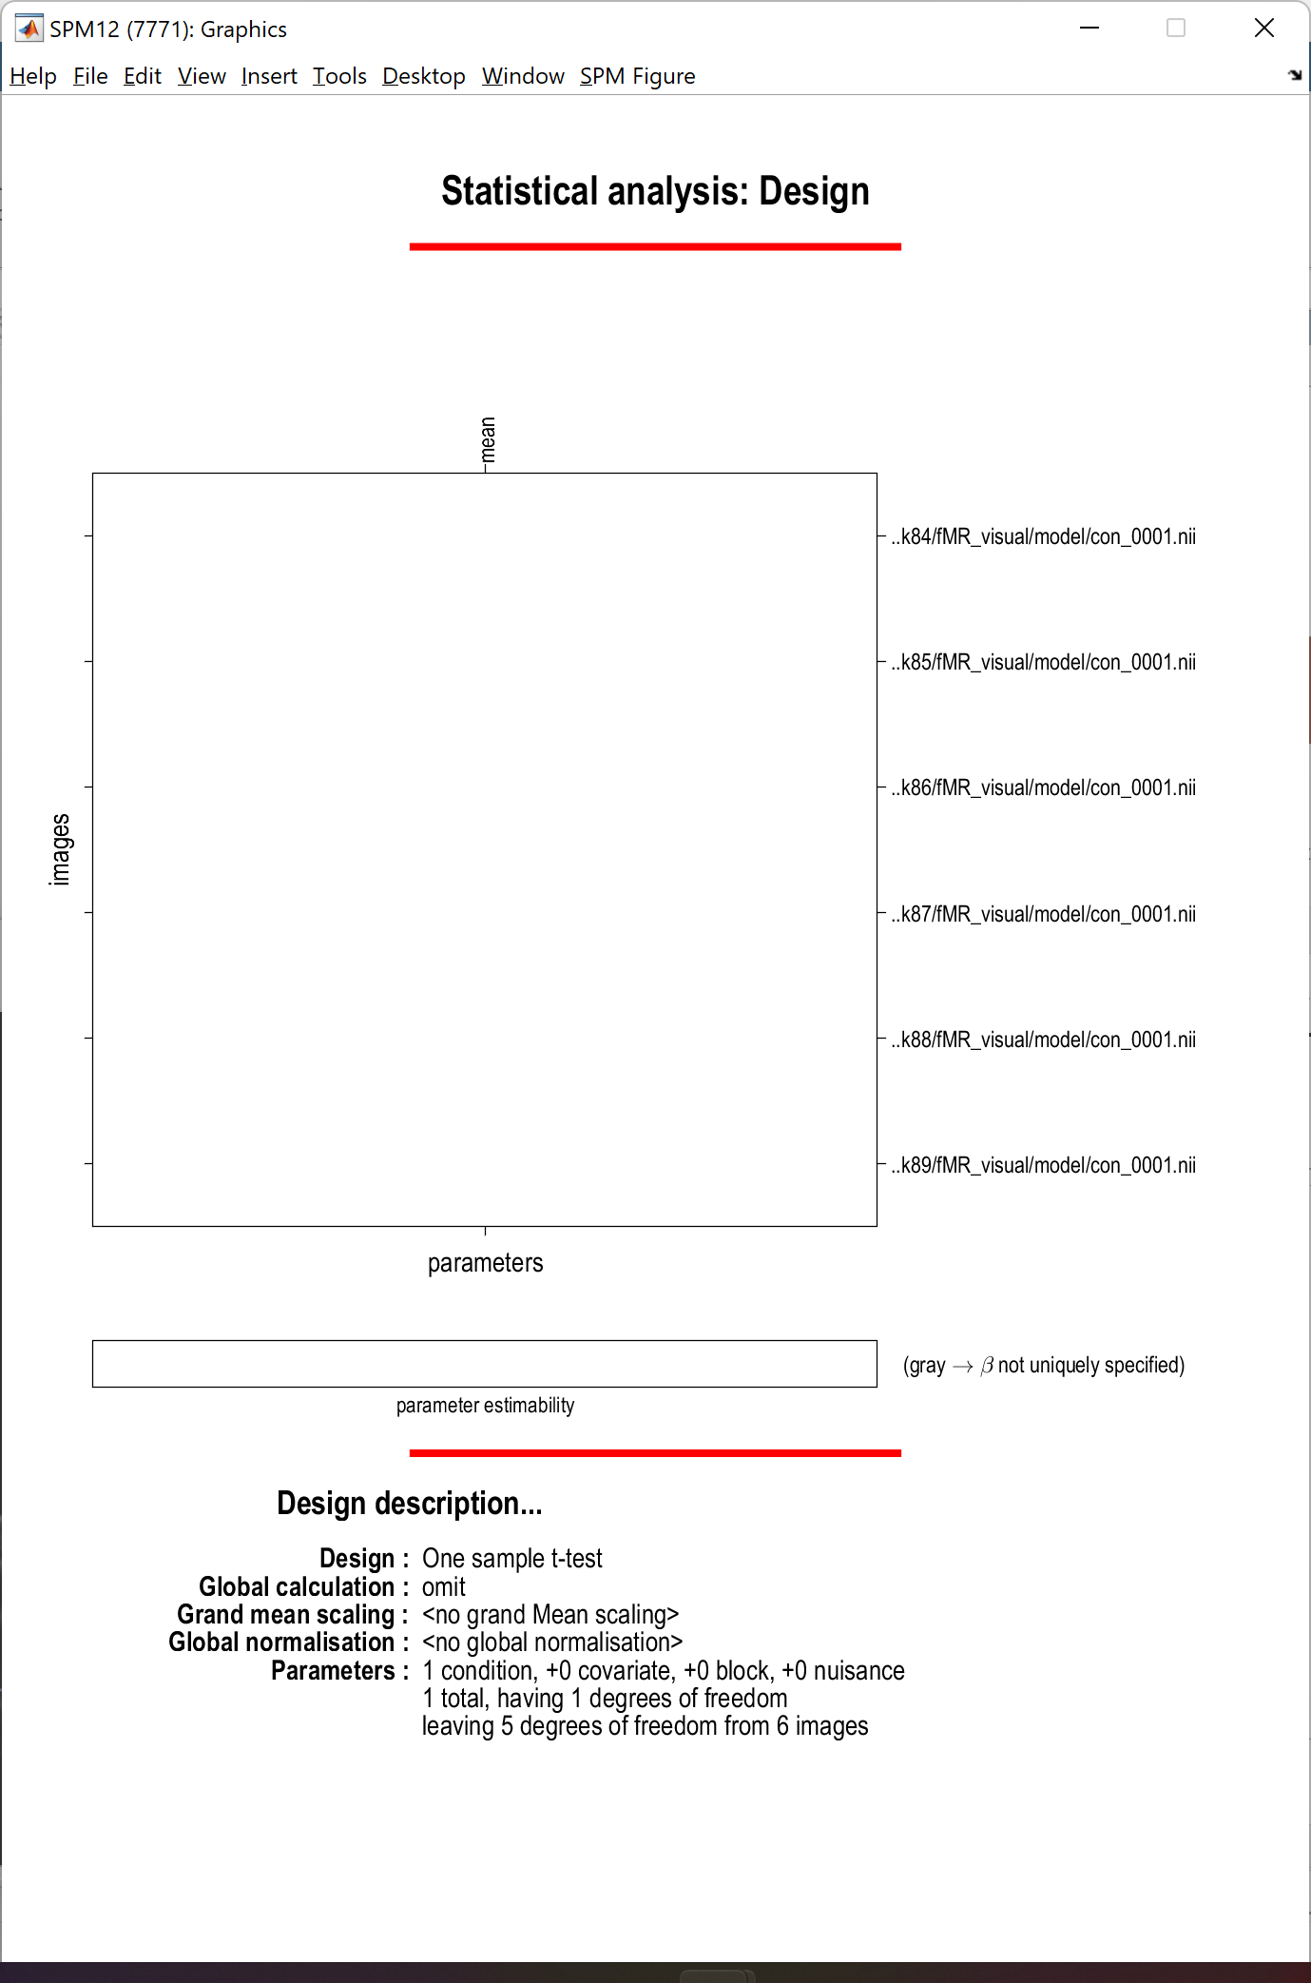

Slide 22
9. Model estimation (group mean)
MENU: Estimate
BATCH EDITOR:
Select SPM.mat … select SPM.mat
Run batch

Slide 23
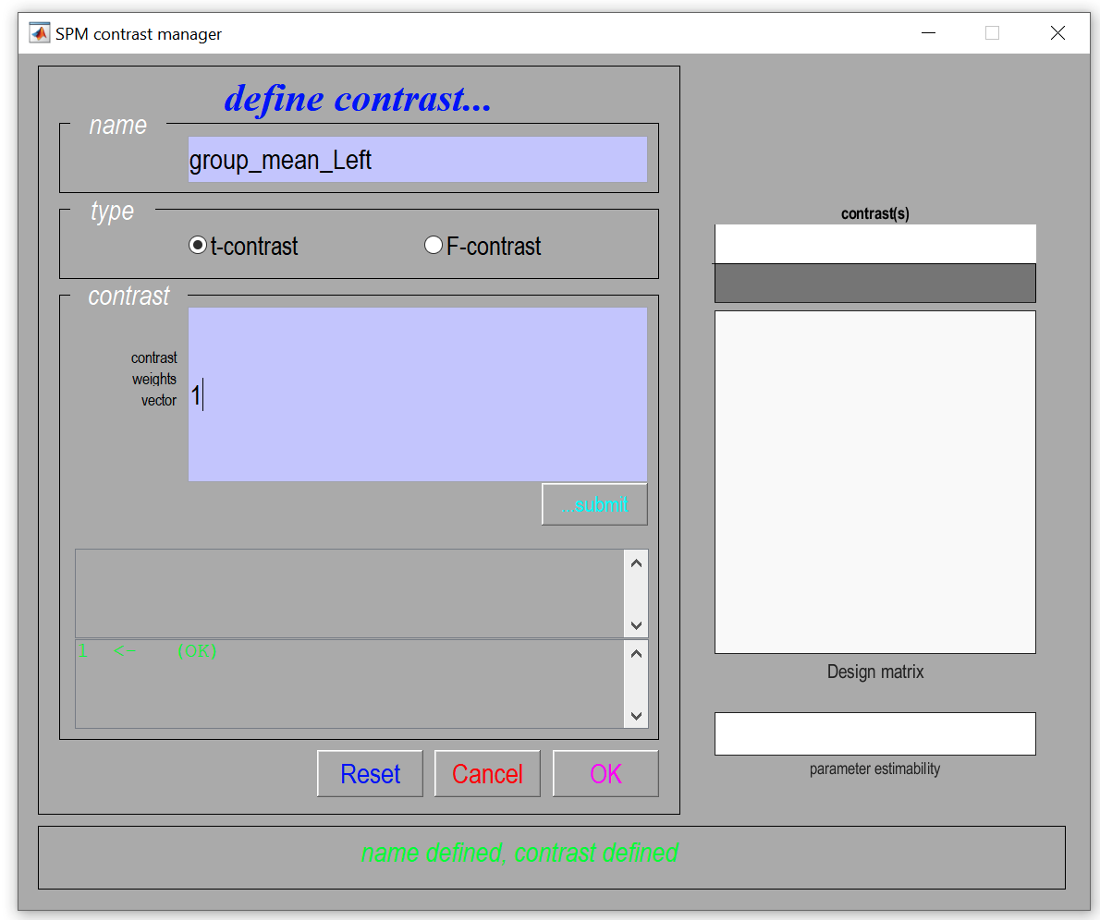
10. Results – define contrast (group mean)
MENU: Results
Select SPM.mat
SPM contrast manager:
Define new contrast
Name: group_mean_Left
type: t-contrast
contrast: 1 …submit
OK
Done

Slide 24
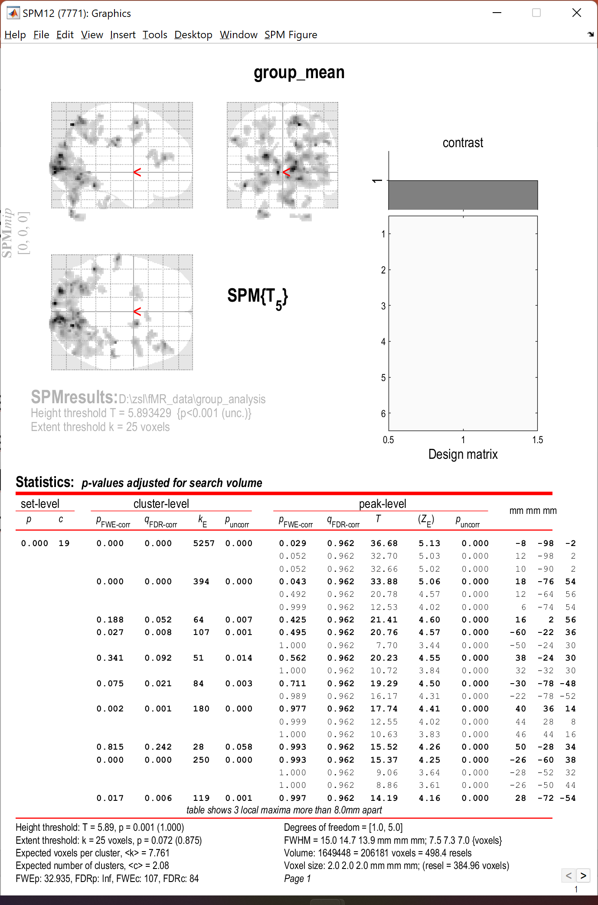
11. Results (group mean)
RESULTS:
apply masking … none
P value adjustment to control … none
Threshold {T or p value} … 0.001
& extent threshold {voxels} … 25

Slide 25
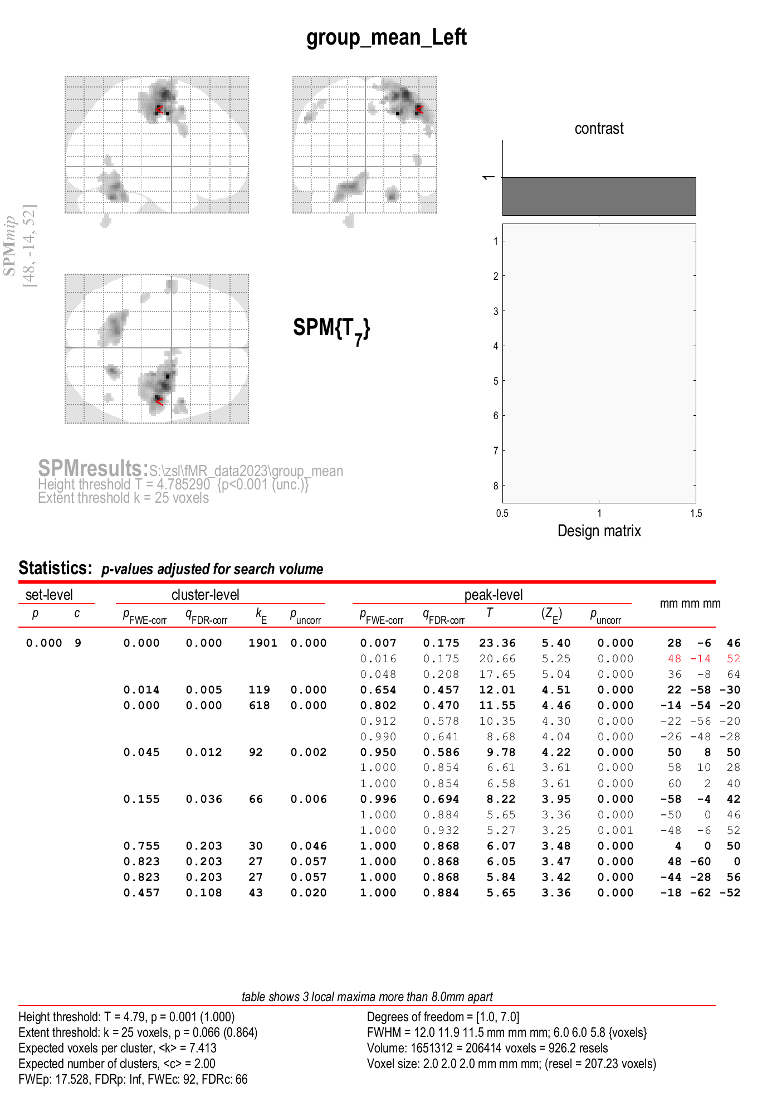
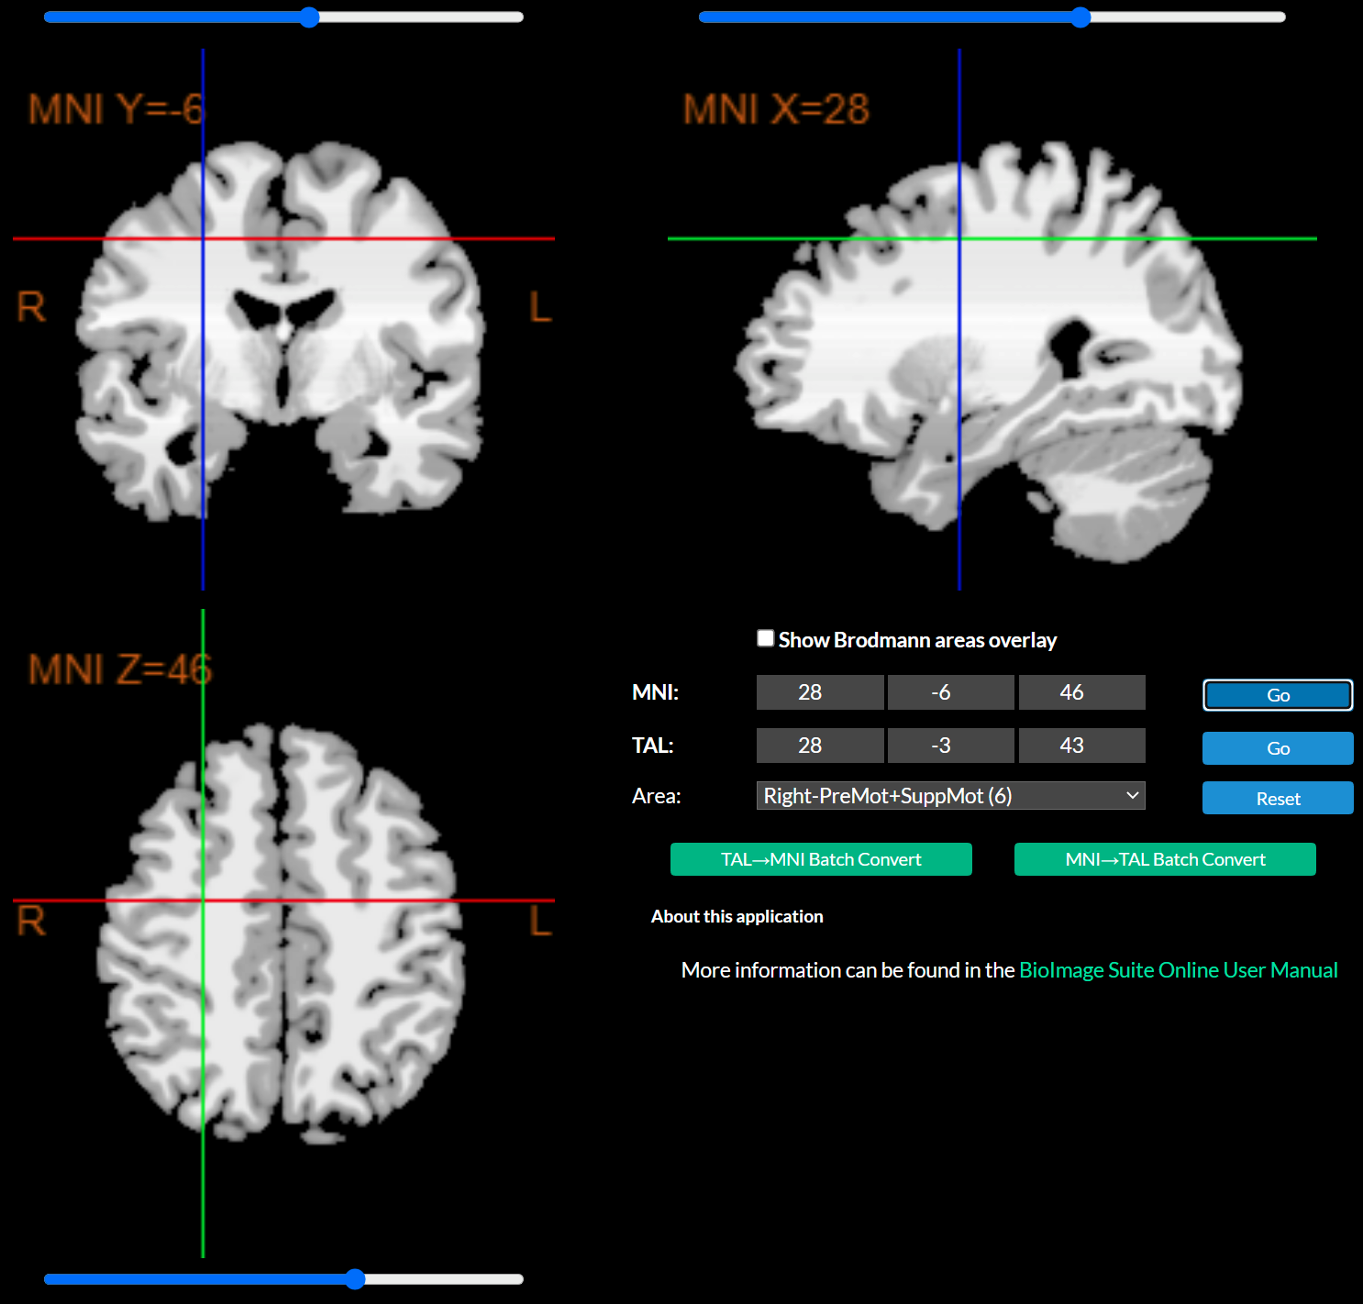
Coordinates of maximal activation in MNI space
Use
https://bioimagesuiteweb.github.io/webapp/mni2tal.html
To find the brain area, which is activated:
List of Brodmann areas:
https://en.wikipedia.org/wiki/Brodmann_area

Slide 26
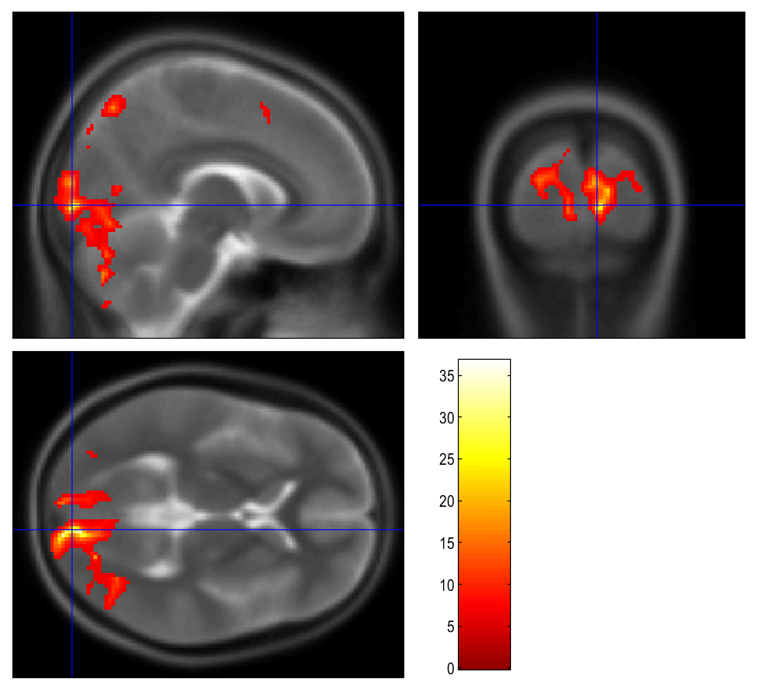
Display Results
Results can be displayed with overlay command (in results window, Slices, Section, Montage)
As a background image use the MNI template
images from the
%SPM12%/canonical/avg*.nii

Slide 27
Homework
Do the 1st-level analysis for both hands in all eight measured subjects. Folow the pipeline from the 2nd excercise (2 points)
Do the group analysis folowing the pipeline from the 2nd excercise. Show the mean activation in the group for left (con_ 0001) and right (con_0002) hand (2 points)
Display results of the 2nd-level analysis for both tasks (2 points)
Find main areas with statisticaly significant activations for both tasks (up to three main areas). Use MNI atlas by your own choice. Describe expected/real results. Consult your results with Brodmann areas atlas (4 points)
Homework protocol is mainly about results. Showing the 1st-level analysis is not necessary. Please use common formats (pdf, word docuemtns, …)
Hint: batch editor is programable and could be helpful with the repeating commands

