Slide 1
Combinatorial algorithms computing graph isomorphism, computing tree isomorphism
Jiří Vyskočil, Radek Mařík
2013

Slide 2
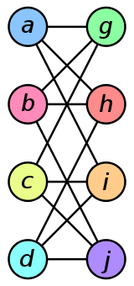
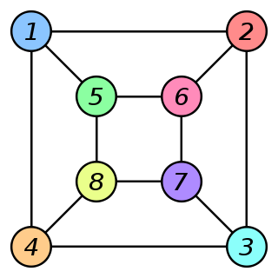
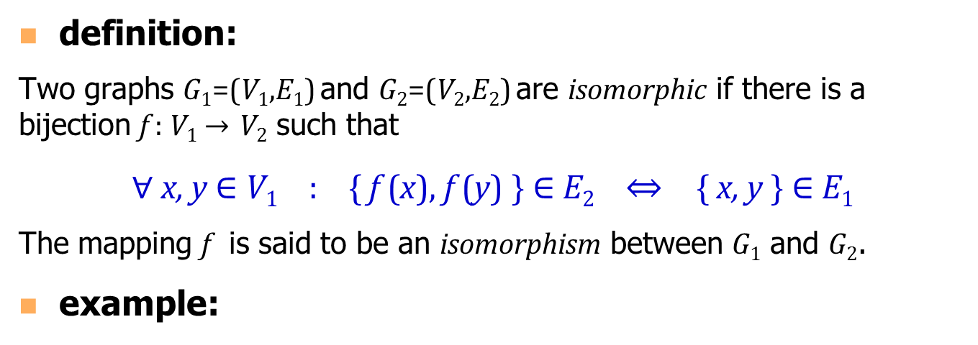
Computing Graph Isomorphism
definition:
Two graphs G₁=(V₁,E₁) and G₂=(V₂,E₂) are isomorphic if there is a bijection f : V₁ → V₂ such that
∀ x, y $∈$ V₁ : { f (x), f (y) } $∈$ E₂ ⇔ { x, y } $∈$ E₁
The mapping f is said to be an isomorphism between G₁ and G₂.
example:
ƒ ( a ) = 1 f ( b ) = 6 f ( c ) = 8 f ( d ) = 3 f ( g ) = 5 f ( h ) = 2 f ( i ) = 4 f ( j ) = 7
G₁ :
G₂ :
f :

Slide 3
Computing Graph Isomorphism
problem:
  The graph isomorphism problem is the computational problem of determining whether two finite graphs are isomorphic.
  The graph isomorphism problem is one of a very small number of problems belonging to NP neither known to be solvable in polynomial time nor NP-complete.
  However, there is a number of important special cases of the graph isomorphism problem that have efficient, polynomial-time solutions: trees, planar graphs, some bounded-parameter graphs, etc.

Slide 4
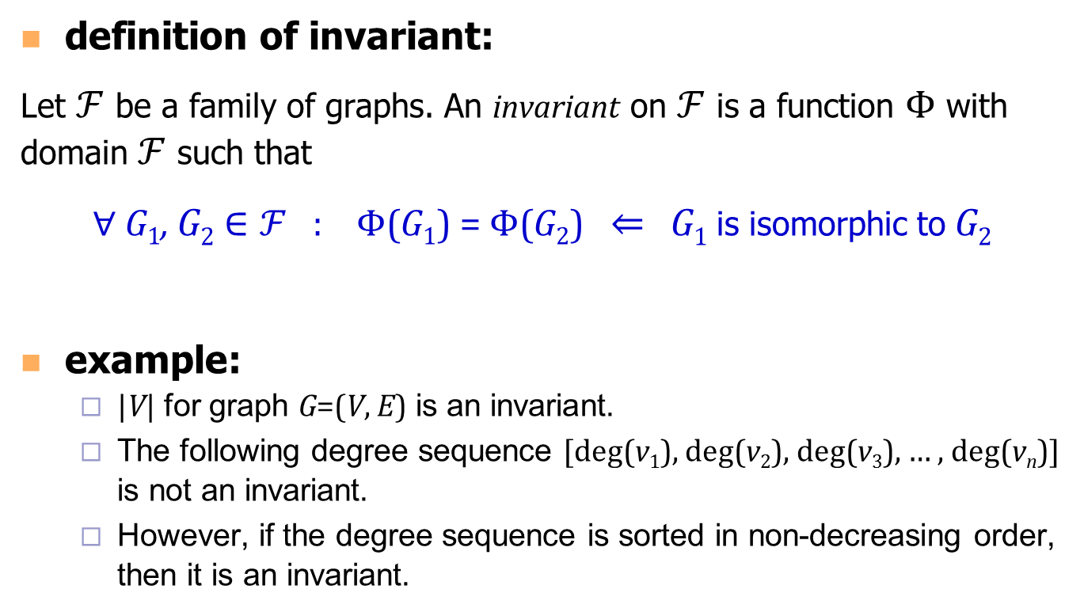
Computing Graph Isomorphism
definition of invariant:
Let $ℱ$ be a family of graphs. An invariant on $ℱ$ is a function $Φ$ with domain $ℱ$ such that
∀ G₁, G₂ $∈ℱ$ : $Φ$(G₁) = $Φ$(G₂) ⇐ G₁ is isomorphic to G₂
example:
  |V| for graph G=(V, E) is an invariant.
  The following degree sequence [deg(v₁), deg(v₂), deg(v₃), … , deg(v_{n})] is not an invariant.
  However, if the degree sequence is sorted in non-decreasing order, then it is an invariant.

Slide 5
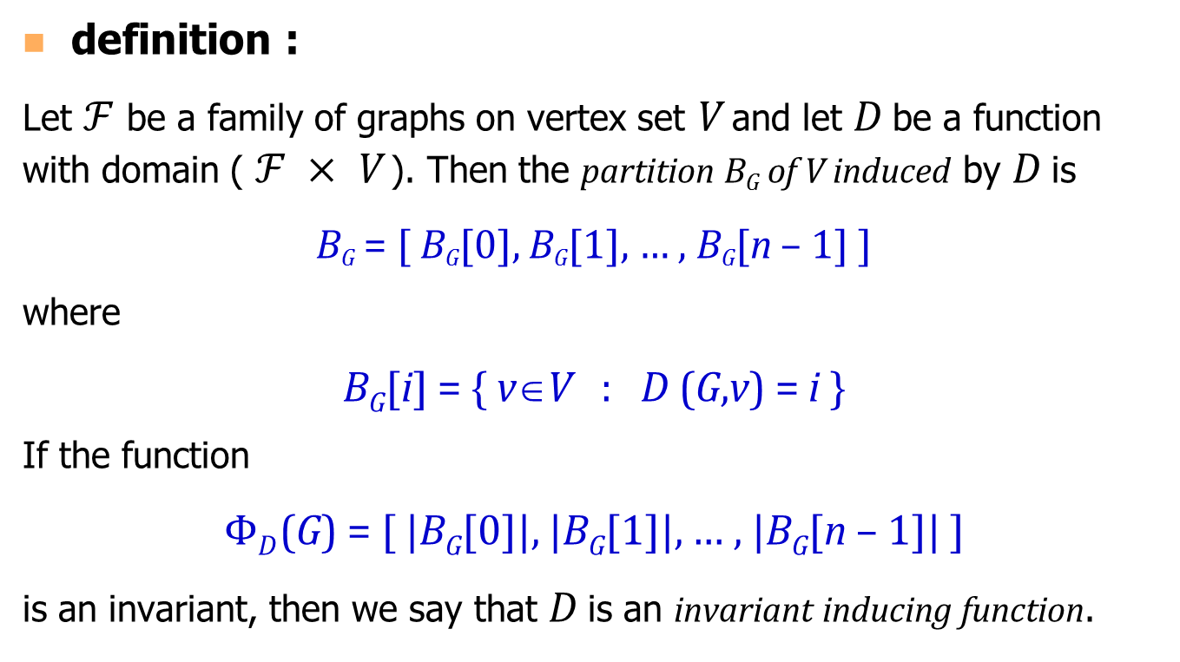
Computing Graph Isomorphism
definition :
Let $ℱ$ be a family of graphs on vertex set V and let D be a function with domain ( $ℱ ×$ V ). Then the partition B_{G} of V induced by D is
B_{G} = [ B_{G}[0], B_{G}[1], … , B_{G}[n – 1] ]
where
B_{G}[i] = { v∈V : D (G,v) = i }
If the function
$ΦD$(G) = [ |B_{G}[0]|, |B_{G}[1]|, … , |B_{G}[n – 1]| ]
is an invariant, then we say that D is an invariant inducing function.

Slide 6
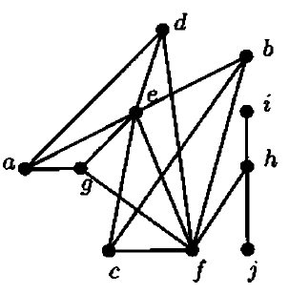
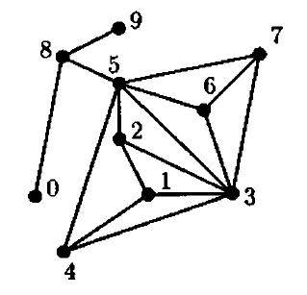
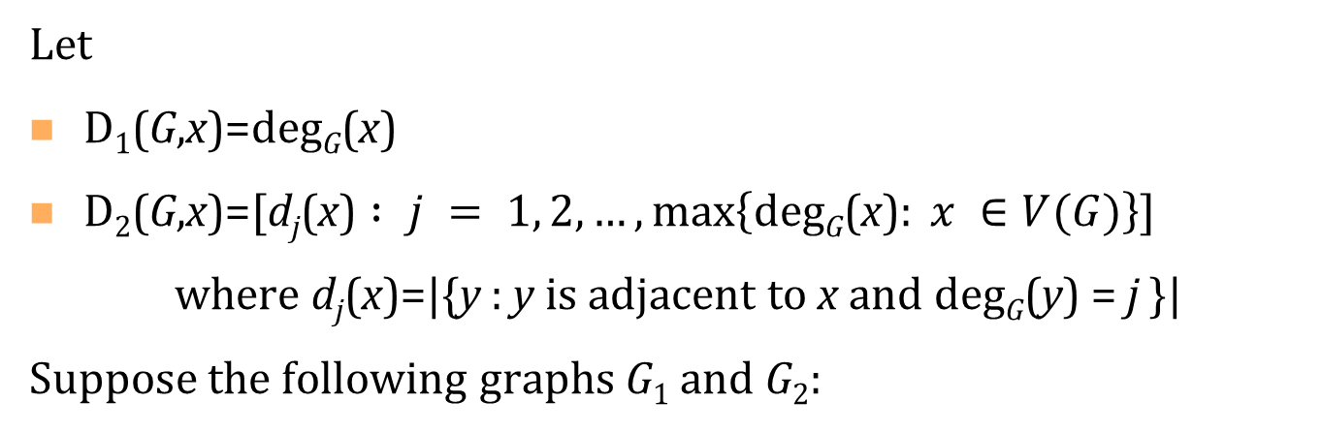
Computing Graph Isomorphism - Example
Let
D₁(G,x)=deg_{G}(x)
D₂(G,x)=[$\text{d}\text{j}\text{(}\text{x}\text{)} : j = 1, 2, …,\max\left\{\text{deg}\text{G}\text{(}\text{x}\text{)}: x ∈V(G)\right\}$]
where d_{j}(x)=|{y : y is adjacent to x and deg_{G}(y) = j }|
Suppose the following graphs G₁ and G₂:

Slide 7
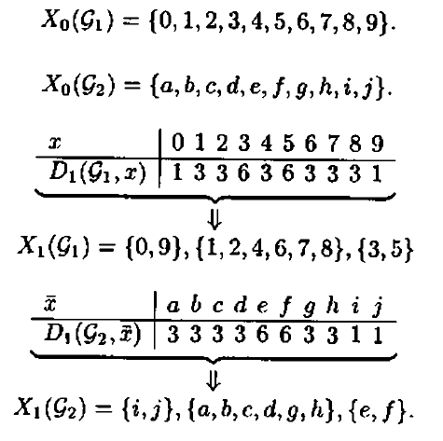
Computing Graph Isomorphism - Example

Slide 8
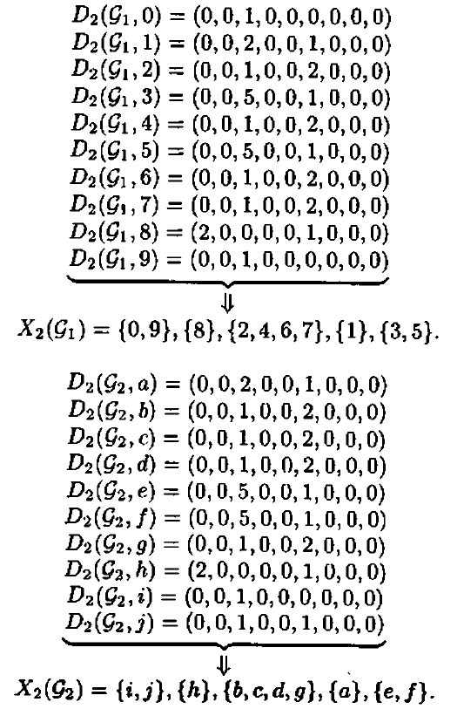
Computing Graph Isomorphism - Example

Slide 9
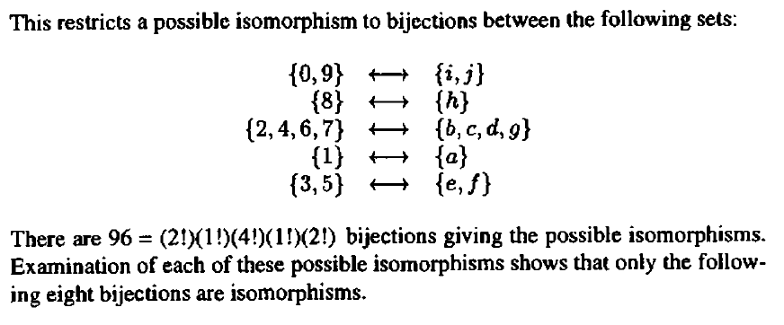
Computing Graph Isomorphism - Example

Slide 10
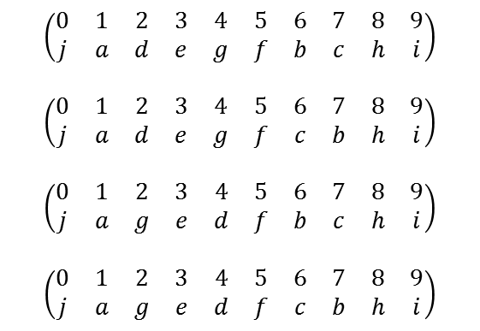
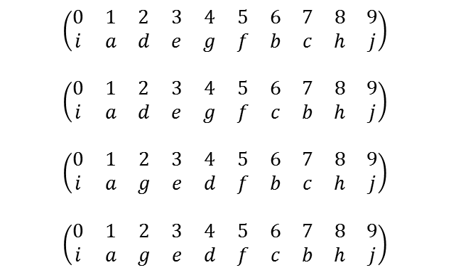
Computing Graph Isomorphism - Example
$$\left(\begin{matrix}0 & 1 & 2 & 3 & 4 & 5 & 6 & 7 & 8 & 9 \\ i & a & d & e & g & f & b & c & h & j\end{matrix}\right)$$
$$\left(\begin{matrix}0 & 1 & 2 & 3 & 4 & 5 & 6 & 7 & 8 & 9 \\ i & a & d & e & g & f & c & b & h & j\end{matrix}\right)$$
$$\left(\begin{matrix}0 & 1 & 2 & 3 & 4 & 5 & 6 & 7 & 8 & 9 \\ i & a & g & e & d & f & b & c & h & j\end{matrix}\right)$$
$$\left(\begin{matrix}0 & 1 & 2 & 3 & 4 & 5 & 6 & 7 & 8 & 9 \\ i & a & g & e & d & f & c & b & h & j\end{matrix}\right)$$
$$\left(\begin{matrix}0 & 1 & 2 & 3 & 4 & 5 & 6 & 7 & 8 & 9 \\ j & a & d & e & g & f & b & c & h & i\end{matrix}\right)$$
$$\left(\begin{matrix}0 & 1 & 2 & 3 & 4 & 5 & 6 & 7 & 8 & 9 \\ j & a & d & e & g & f & c & b & h & i\end{matrix}\right)$$
$$\left(\begin{matrix}0 & 1 & 2 & 3 & 4 & 5 & 6 & 7 & 8 & 9 \\ j & a & g & e & d & f & b & c & h & i\end{matrix}\right)$$
$$\left(\begin{matrix}0 & 1 & 2 & 3 & 4 & 5 & 6 & 7 & 8 & 9 \\ j & a & g & e & d & f & c & b & h & i\end{matrix}\right)$$

Slide 11
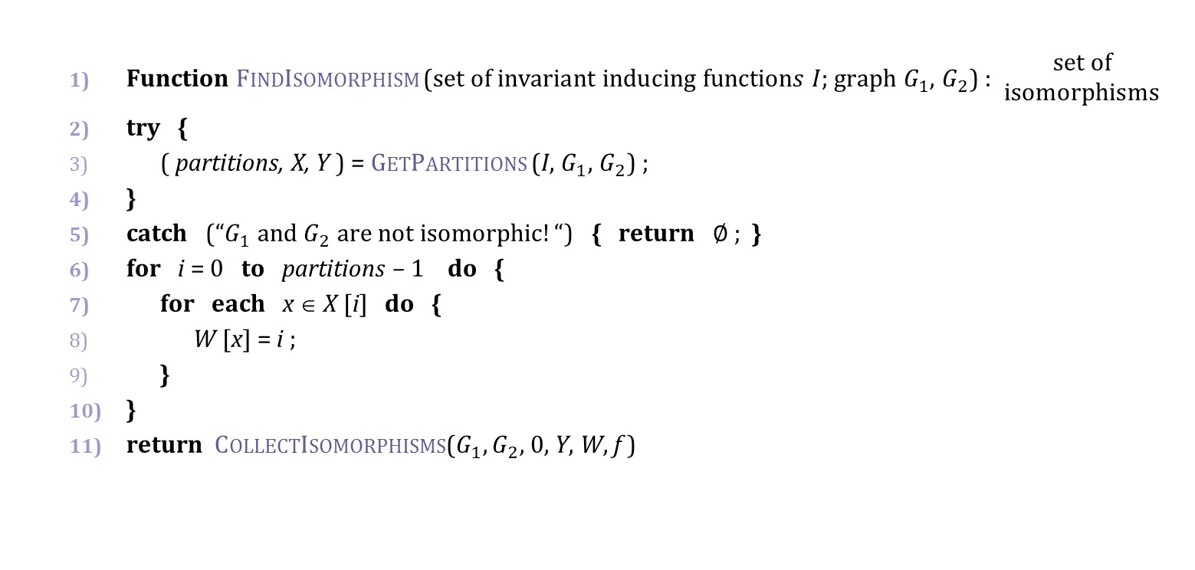
Computing Graph Isomorphism
  Function FindIsomorphism ($\text{set} \text{of} \text{invariant} \text{inducing} \text{function}s I$; graph $G_{1},$ $G_{2}$) : $\begin{matrix}set of \\ isomorphisms\end{matrix}$
  try {
  ( partitions, X, Y ) = GetPartitions (I, $G_{1},$ $G_{2}$) ;
  }
  catch (“$G_{1}$ and $G_{2}$ are not isomorphic$!“$) { return ∅ ; }
  for i = 0 to partitions – 1 do {
  for each x ∈ X [i] do {
  W [x] = i ;
  }
  }
  return CollectIsomorphisms$\text{(}G_{1},G_{2}\text{,} \text{0}\text{,} \text{Y}\text{, }\text{W}\text{, }\text{f} \text{) }$

Slide 12
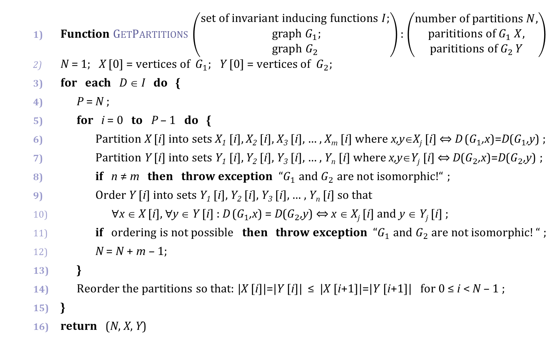
Computing Graph Isomorphism
  Function GetPartitions $\left(\begin{matrix}\text{set} \text{of} \text{invariant} \text{inducing} \text{functions} I; \\ graph G_{1}; \\ graph G_{2}\end{matrix}\right)$: $\left(\begin{matrix}number of partitions N, \\ parititions of G_{1} X, \\ parititions of G_{2 }Y\end{matrix}\right)$
  N = 1; X [0] = vertices of $G_{1}$; Y [0] = vertices of $G_{2}$;
  for each D ∈ I do {
  P = N ;
  for i = 0 to P – 1 do {
  Partition X [i] into sets X₁ [i], X₂ [i], X₃ [i], … , X_{m} [i] where x,y∈X_{j} [i] ⇔ D ($G_{1}$,x)=D($G_{1}$,y) ;
  Partition Y [i] into sets Y₁ [i], Y₂ [i], Y₃ [i], … , Y_{n} [i] where x,y∈Y_{j} [i] ⇔ D($G_{2}$,x)=D($G_{2}$,y) ;
  if n ≠ m then throw exception “$G_{1}$ and $G_{2}$ are not isomorphic!$“$ ;
  Order Y [i] into sets Y₁ [i], Y₂ [i], Y₃ [i], … , Y_{n} [i] so that
  ∀x ∈ X [i], ∀y ∈ Y [i] : D ($G_{1}$,x) = D($G_{2}$,y) ⇔ x ∈ X_{j} [i] and y ∈ Y_{j} [i] ;
  if ordering is not possible then throw exception “$G_{1}$ and $G_{2}$ are not isomorphic$!“$ ;
  N = N + m – 1;
  }
  Reorder the partitions so that: |X [i]|=|Y [i]| ≤ |X [i+1]|=|Y [i+1]| for 0 ≤ i < N – 1 ;
  }
  return (N, X, Y)

Slide 13
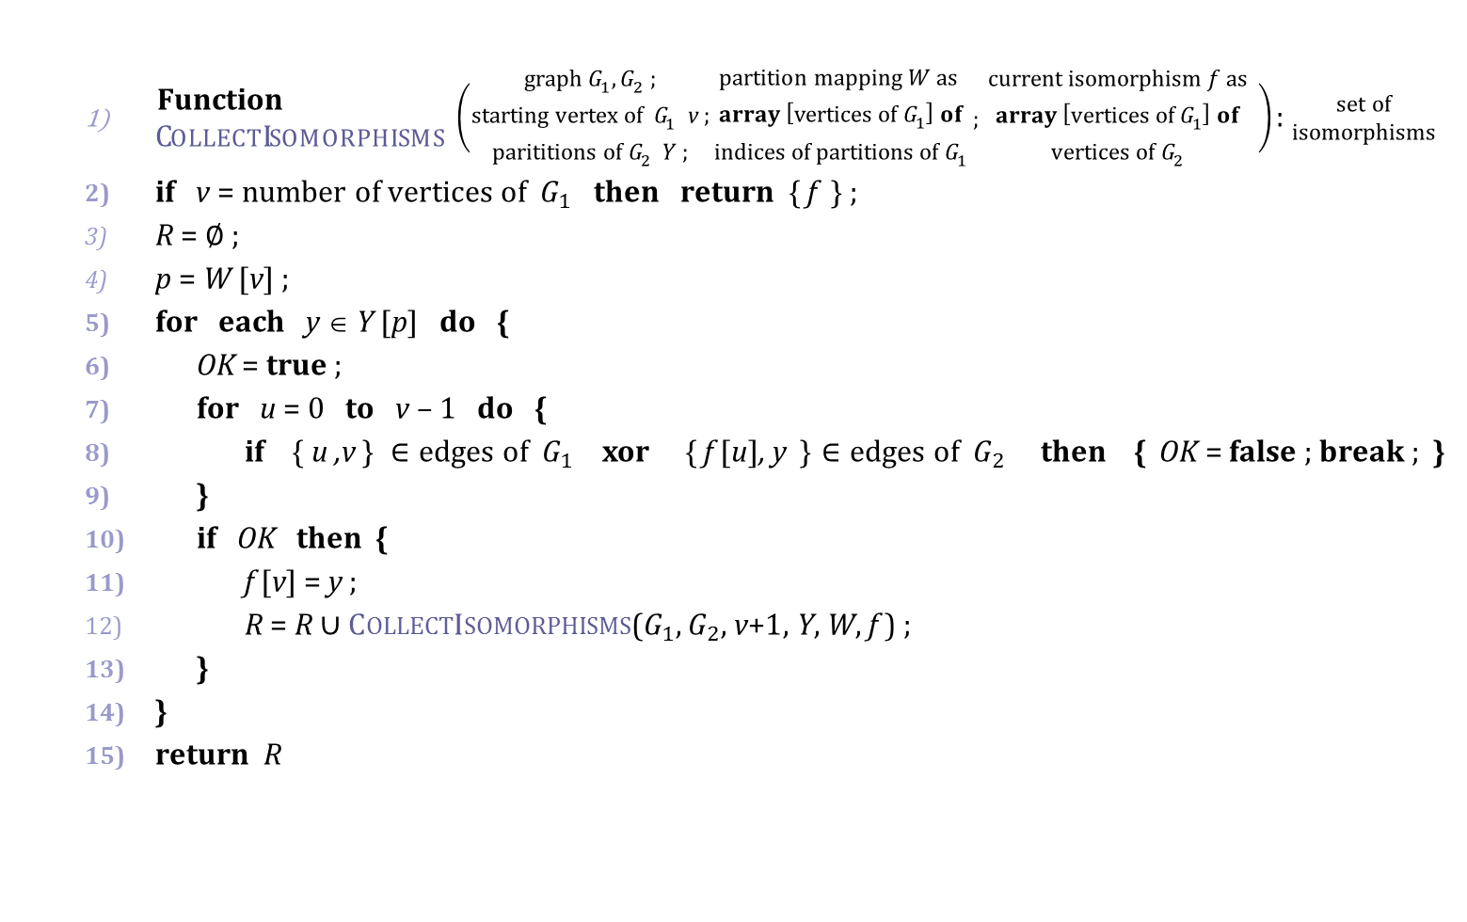
Computing Graph Isomorphism
  $\begin{matrix}\text{Function} \\ \text{Collect}\text{Isomorphism}\text{s}\end{matrix} \left(\begin{matrix}graph G_{1},G_{2} ; \\ starting vertex of{ G}_{1} \text{v} \text{;} \\ parititions of G_{2} Y ;\end{matrix}\begin{matrix}partition mapping W as \\ array \left[vertices of{ G}_{1}\right] of \\ {indices of partitions of G}_{1}\end{matrix} ; \begin{matrix}current isomorphism f as \\ array \left[vertices of{ G}_{1}\right] of \\ vertices of G_{2}\end{matrix} \right)$ : $\begin{matrix}set of \\ isomorphisms\end{matrix}$
  if v = number of vertices of $G_{1}$ then return { f } ;
  R = ∅ ;
  p = W [v] ;
  for each y ∈ Y [p] do {
  OK = true ;
  for u = 0 to v – 1 do {
  if $\text{\{ }\text{u}\text{ ,}\text{v} \text{\}} ∈\text{edges} \text{of} G_{1} \text{xor} \text{\{} \text{f}\text{ [}\text{u}\text{]}\text{,} \text{y}\text{ \}}∈\text{edges} \text{of} G_{2}$ then { OK = false ; break ; }
  }
  if OK then {
  $\text{f}\text{ [}\text{v}\text{]} \text{=} \text{y} \text{;}$
  R = R ∪ CollectIsomorphisms$\text{(}G_{1},G_{2}\text{,} \text{v}\text{+1}\text{,} \text{Y}\text{,} \text{W}\text{, }\text{f} \text{) ; }$
  }
  }
  return R

Slide 14
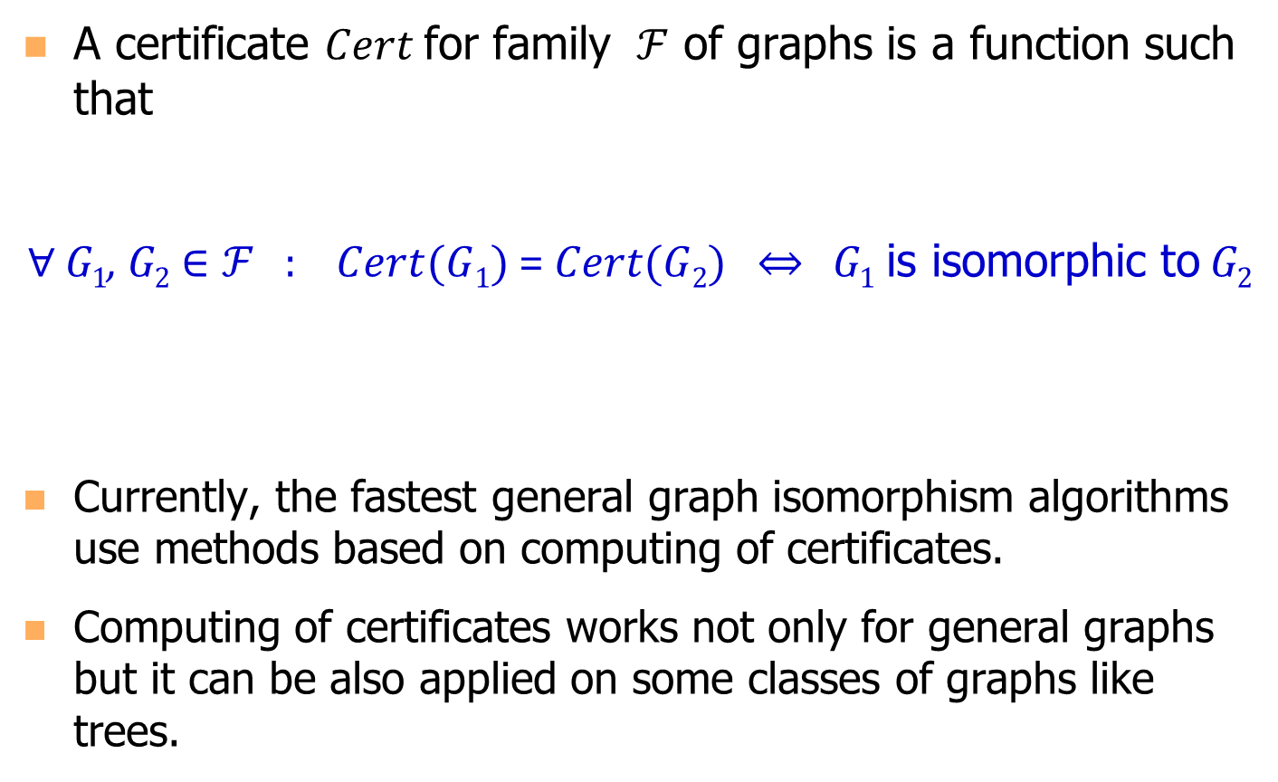
Certificate
A certificate $Cert$for family $ℱ$ of graphs is a function such that
∀ G₁, G₂ $∈ℱ$ : $Cert(G1)$ = $Cert(G2)$ $⇔$ G₁ is isomorphic to G₂
Currently, the fastest general graph isomorphism algorithms use methods based on computing of certificates.
Computing of certificates works not only for general graphs but it can be also applied on some classes of graphs like trees.

Slide 15
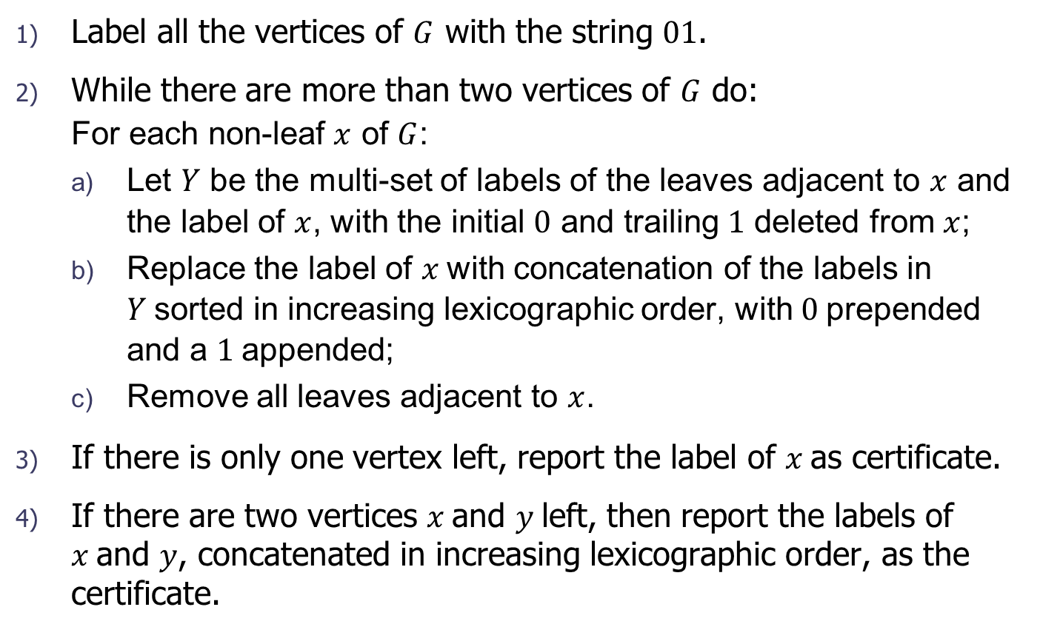
Computing Tree Certificate
Label all the vertices of $G$ with the string $01$.
While there are more than two vertices of $G$ do:
  For each non-leaf $x$ of $G$:
  Let $Y$ be the multi-set of labels of the leaves adjacent to $x$ and the label of $x$, with the initial $0$ and trailing $1$ deleted from $x$;
  Replace the label of $x$with concatenation of the labels in $Y$sorted in increasing lexicographic order, with $0$prepended and a $1$appended;
  Remove all leaves adjacent to $x$.
If there is only one vertex left, report the label of $x$as certificate.
If there are two vertices $x$and $y$left, then report the labels of $x$and $y$, concatenated in increasing lexicographic order, as the certificate.

Slide 16





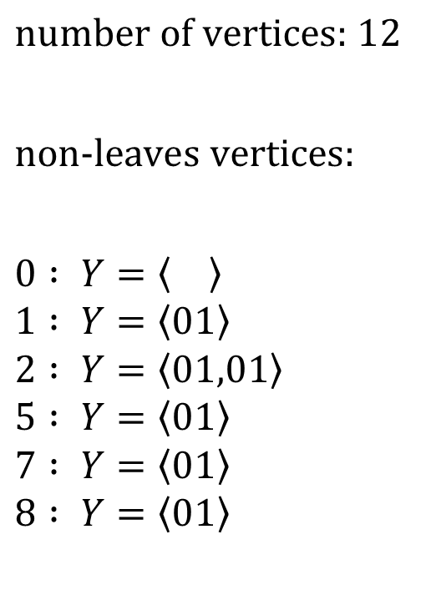







Computing Tree Certificate - Example
$$11 : 01$$
$$\text{n}\text{umber} \text{of} \text{vertices}\text{: }\text{1}\text{2}$$
$$\text{n}\text{on}\text{−}\text{leaves} \text{vertices}\text{:}$$
$$0 : Y=\left\langle \right\rangle$$
$$1 : Y=\left\langle 01\right\rangle$$
$$2 : Y=\left\langle 01,01\right\rangle$$
$$5 : Y=\left\langle 01\right\rangle$$
$$7 : Y=\left\langle 01\right\rangle$$
$$8 : Y=\left\langle 01\right\rangle$$
$$1 : 01$$
$$10 : 01$$
$$2 : 01$$
$$3 : 01$$
$$6 : 01$$
$$0 : 01$$
$$7 : 01$$
$$9 : 01$$
$$5 : 01$$
$$8 : 01$$
$$4 : 01$$

Slide 17






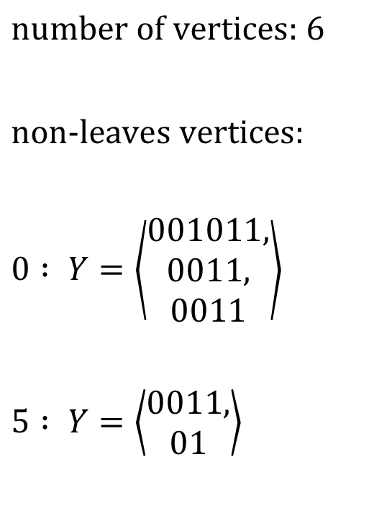
Computing Tree Certificate - Example
$$\text{n}\text{umber} \text{of} \text{vertices}\text{: 6}$$
$$\text{n}\text{on}\text{−}\text{leaves} \text{vertices}\text{:}$$
$$0 : Y=\left\langle \begin{aligned}001011, \\ 0011, \\ 0011\end{aligned}\right\rangle$$
$$5 : Y=\left\langle \begin{aligned}0011, \\ 01\end{aligned}\right\rangle$$
$$1 :0011$$
$$2 : 001011$$
$$0 :01$$
$$7 : 0011$$
$$5 :0011$$
$$8 : 0011$$

Slide 18



Computing Tree Certificate - Example
$$\text{n}\text{umber} \text{of} \text{vertices}\text{: 2}$$
$$0 :0001011001100111$$
$$5 :00011011$$
$$\text{Certificate}\text{=}000101100110011100011011$$

Slide 19
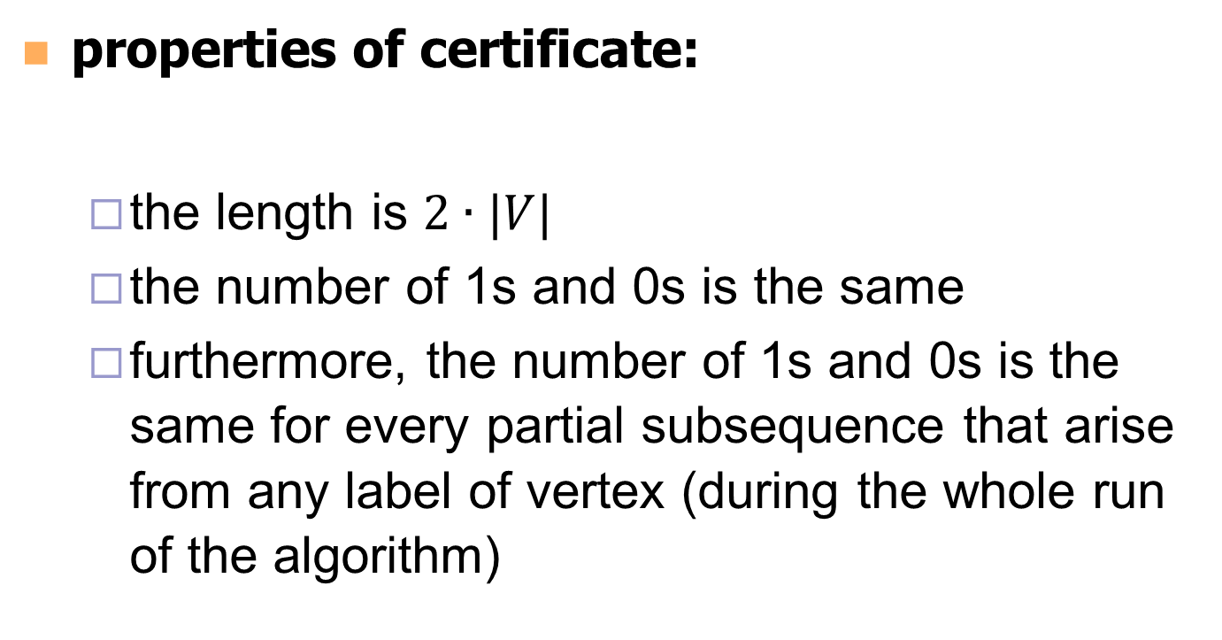
Computing Tree Certificate
properties of certificate:
  the length is $2∙|V|$
  the number of 1s and 0s is the same
  furthermore, the number of 1s and 0s is the same for every partial subsequence that arise from any label of vertex (during the whole run of the algorithm)

Slide 20
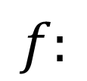
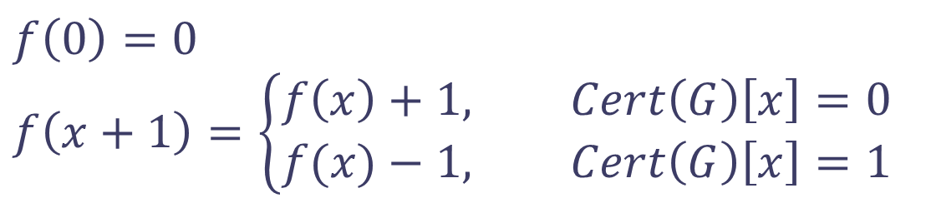
Reconstruction of Tree from Certificate - Example
$$f\left(0\right)=0$$
$$f\left(x+1\right)=\left\{\begin{aligned}&f\left(x\right)+1, Cert\left(G\right)\left[x\right]=0 \\ &f(x)−1, Cert\left(G\right)\left[x\right]=1\end{aligned}\right.$$
$$f:$$
$$Cert\left(G\right)=000101100110011100011011$$

Slide 21
Reconstruction of Tree from Certificate - Example
$$f:$$
$$Cert\left(G\right)=000101100110011100011011$$

Slide 22
Reconstruction of Tree from Certificate - Example
$$f:$$
$$Cert\left(G\right)=000101100110011100011011$$

Slide 23
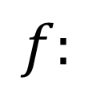
Reconstruction of Tree from Certificate - Example
$$f:$$
$$Cert\left(G\right)=000101100110011100011011$$

Slide 24
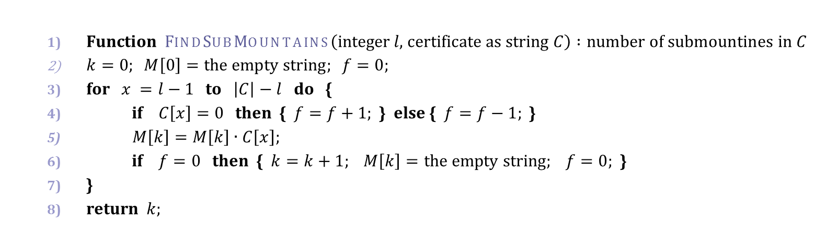
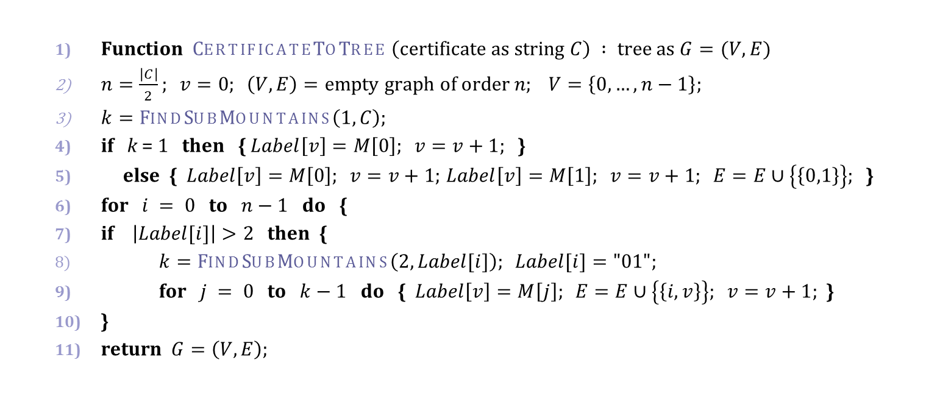

Reconstruction of Tree from Certificate
  $\text{Function} FindSubMountains\left(\text{integer} l\text{, }\text{certificate} \text{as} \text{string} C\right) :\text{number} \text{of} \text{submountines} \text{in} C$
  $k=0; M\left[0\right]=\text{the} \text{empty} \text{string}; f=0;$
  for $x =l−1$ to $\left|C\right|−l$ do {
  if $C\left[x\right]=0$ then { $f=f+1;$ } else { $f=f−1;$ }
  $M\left[k\right]=M\left[k\right]∙C\left[x\right];$
  if $f=0$ then { $k=k+1; M\left[k\right]=\text{the} \text{empty} \text{string}; f=0;$ }
  }
  return $k;$
  $\text{Function} \text{CertificateToTree} \left(\text{certificate} \text{as} \text{string} C\right) : \text{tree} \text{as} G=(V,E)$
  $n=\frac{\left|C\right|}{2}; v=0; \left(V,E\right)=\text{empty} \text{graph} \text{of} \text{order} n; V=\left\{0,…,n−1\right\};$
  $k=FindSubMountains\left(1,C\right);$
  if k = 1 then { $Label\left[v\right]=M\left[0\right]; v=v+1;$}
  else {$Label\left[v\right]=M\left[0\right]; v=v+1;$ $Label\left[v\right]=M\left[1\right]; v=v+1; E=E∪\left\{\left\{0,1\right\}\right\};$ }
  for $i = 0$ to $n−1$ do {
  if $\left|Label[i]\right|>2$ then {
  $k=FindSubMountains\left(2,Label[i]\right); Label[i]="01";$
  for $j = 0$ to $k−1$ do {$Label\left[v\right]=M\left[j\right]; E=E∪\left\{\left\{i,v\right\}\right\}; v=v+1;$}
  }
  return $G=\left(V,E\right);$
$$Ο({\left|C\right|}^{2})$$

Slide 25


Reconstruction of Tree from Certificate
  $\text{Function} \text{FastC}\text{ertificateToTree} \left(\text{certificate} \text{as} \text{string} C\right) : \text{tree} \text{as} G=(V,E)$
  $\left(V,E\right)=\text{empty} \text{di}\text{graph} \text{of} \text{order} \frac{\left|C\right|}{2}; V=\left\{0,…,\frac{\left|C\right|}{2}\right\};$
  $n=0;$
  $p=n;$
  for $x =1$ to $\left|C\right|−2$ do {
  if $C\left[x\right]=0$ then {
  $n=n+1;$
  $E=E∪\left\{(p,n)\right\}$;
  $p=n;$
  } else {
  $p=parent\text{†}\left(p\right);$
  }
  }
  return $G=\left(V,remove_orientation(E)\right);$
  $†parent(x)$ returns the parent of a node x. It returns x in the case where x has no parent.
$$Ο(\left|C\right|)$$

Slide 26
References
D.L. Kreher and D.R. Stinson , Combinatorial Algorithms: Generation, Enumeration and Search , CRC press LTC , Boca Raton, Florida, 1998.

