Slide 1
B4M36SAN
Linear regression III
Anh Vu Le

Slide 2
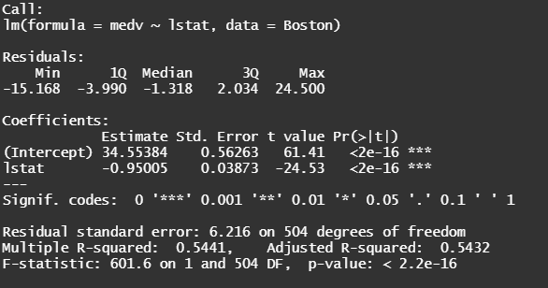
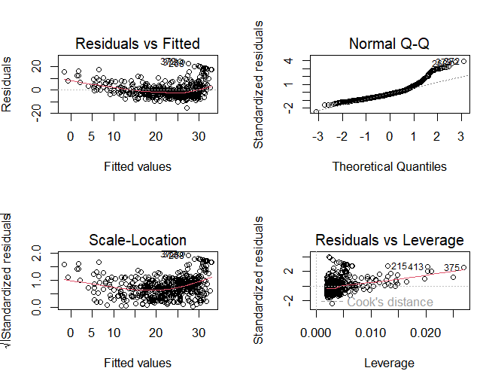
Outline
Last last time
  Evaluating the regression fit from the summary (F-test, R2)
Last time
  Assumptions of linear regression on their graphical validation
  Simple polynomial regression
Today
  Multiple regression, feature selection methods
  Regularization methods (Lasso, Ridge)

Slide 3
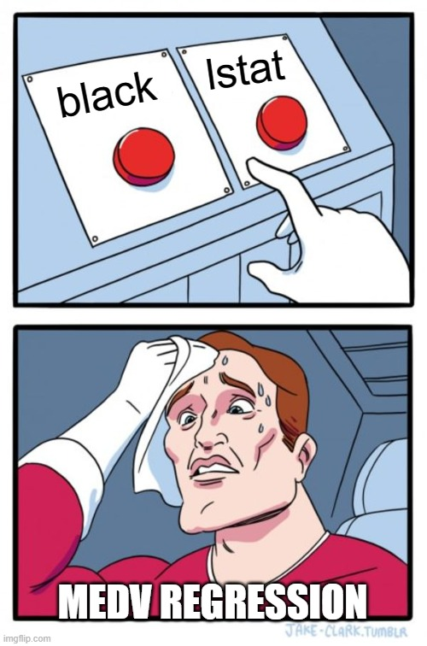


Why we shouldn’t consider predictors separately
$$β=−0.95 ∗∗∗$$
$$β=−0.45 ∗∗∗$$
Suppose that in reality:
black does not affect house prices (medv)
But black correlates with lstat
You want to assess the importance of the predictors by:
  lm(medv ~ black)
  lm(medv ~ lstat)
Interpretation of muliple regression coefficients
  lm(medv ~ lstat + black + ...)
(Multi)Collinearity
To be continued…

Slide 4
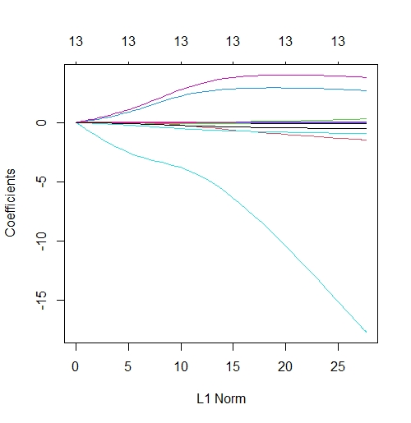
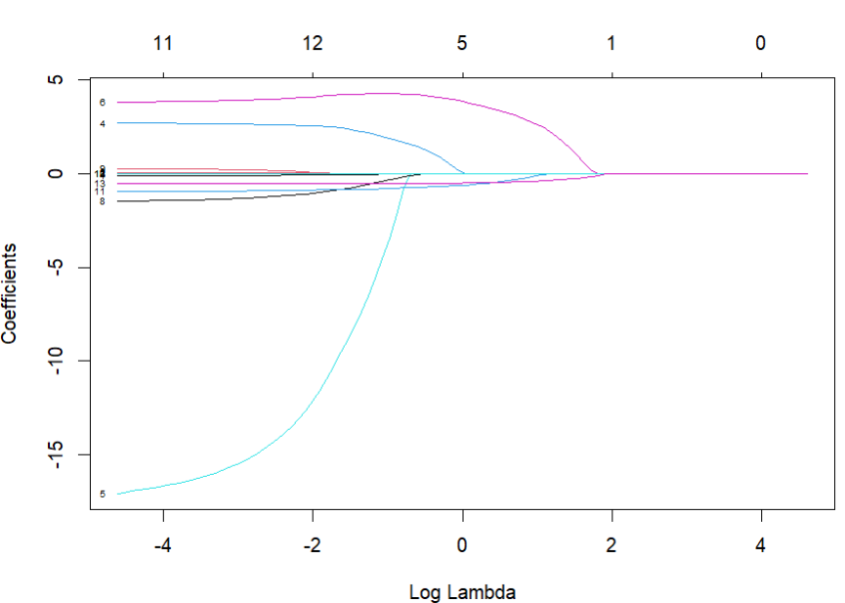
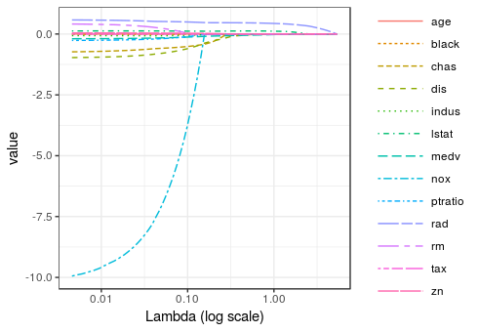
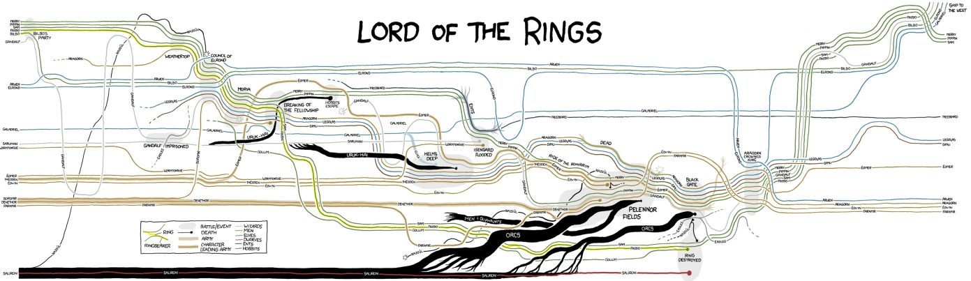
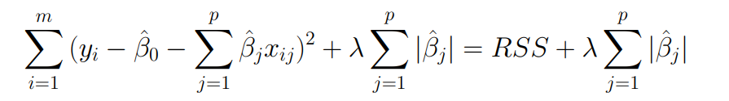
machine learning - R: Plotting lasso beta coefficients - Stack Overflow
https://xkcd.com/657/large/

Slide 5
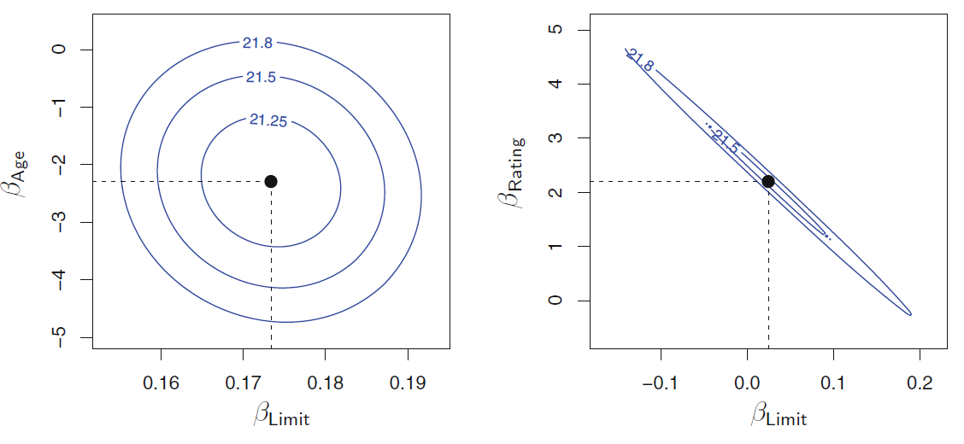
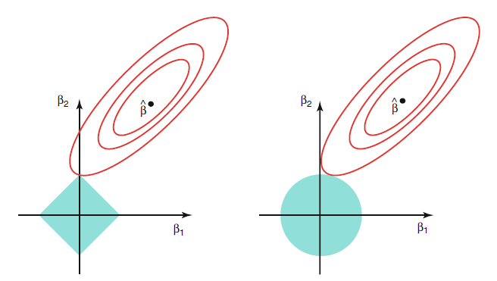
Previously on
(Multi)Collinearity
black
black
lstat
lstat
How ridge regression treats multi-collinearity
Driver.dvi (unica.it)

Slide 6
Summary
How coefficients of multiple regression differ in meaning from coefficients of simple regression
How Lasso performs feature selection?
  What trade-off needs to be discussed?
What is multicollinearity and how it is manifested?
  How does Ridge help to mitigate the issues?
What is the connection between splines and polynomial regression?
  What are the differences?

