Slide 1
B4M36SAN
Linear regression II
Anh Vu Le

Slide 2
Outline
Last time
  Linear regression – important questions
  Finding the answers in the model summary
Today
  Diagnostic plots – validating assumptions of linear regression
  Polynomial regression

Slide 3
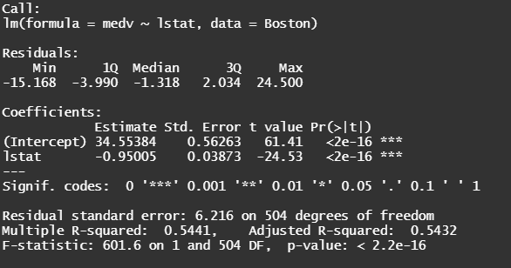
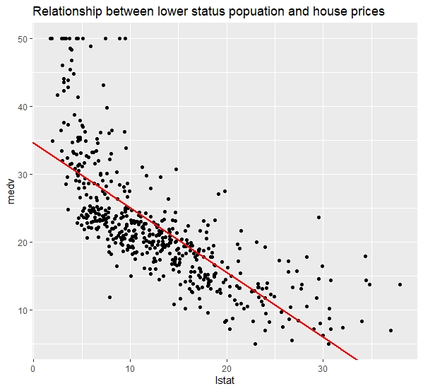
Is there a relationship between independent variables X and a response variable y?
Which of the independent variables contribute to predicting the response?
How accurate are the predictions?
Is the relationship linear? (Today’s topic)

Slide 4
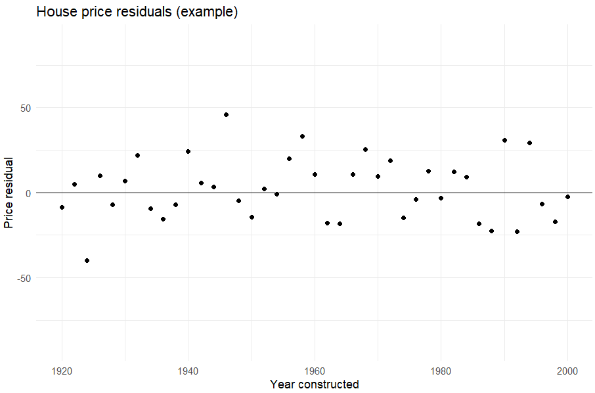
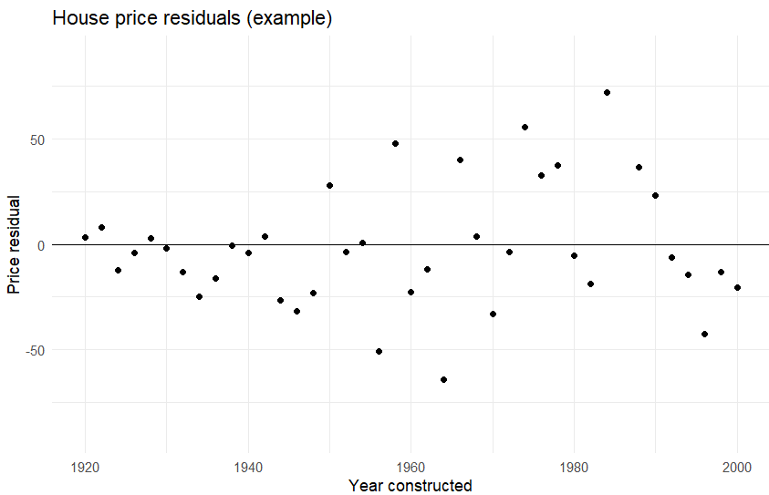
Linear regression assumptions
Linearity
Residuals normally distributed with 0 mean, the same variance
  Normality
  Homoscedascity

Slide 5
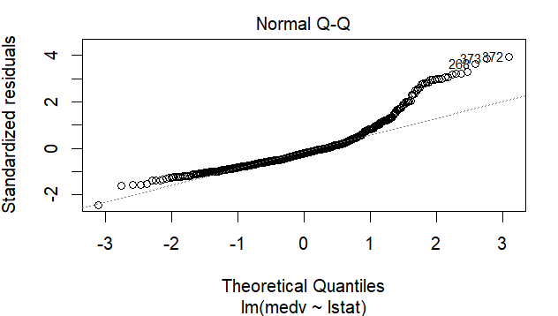
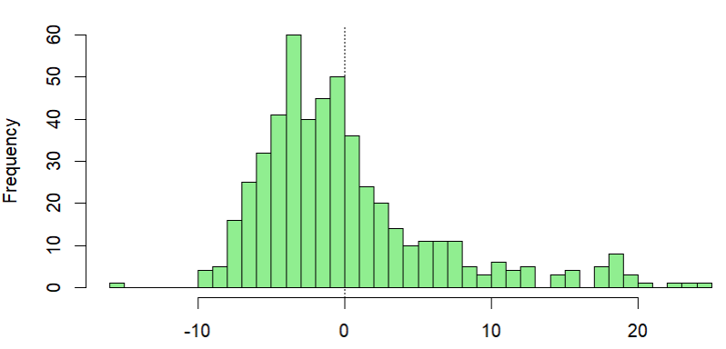
Q-Q plot idea
Residual
9
12
6
5
7
2
4
…
Sorted r.
12
9
7
6
5
4
2
…
Perc.
100%
90%
80%
70%
60%
50%
40%
…
Norm. z-score
3.1*
1.3
0.84
0.52
0.25
0
-0.24
…

Slide 6
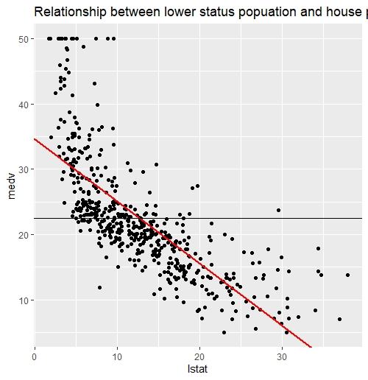
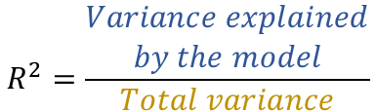
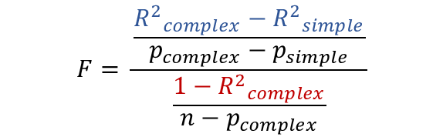
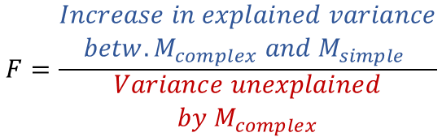
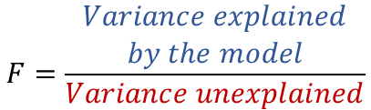

$$R^{2}=\frac{Total var −Unexplained var}{Total variance}$$
$$R^{2}=\frac{\begin{aligned}Variance explained \\ by the model\end{aligned}}{Total variance}$$
Error of the fit
Error of the baseline model
$$F=\frac{\begin{aligned}Variance explained \\ by the model\end{aligned}}{Variance unexplained}$$
Baseline model
$$F=\frac{\begin{aligned}Increase in explained variance \\ betw. {M_{complex} and M}_{simple} \end{aligned}}{\begin{aligned}Variance unexplained \\ by M_{complex}\end{aligned}}$$
$$F= \frac{\frac{{R^{2}}_{complex}−{R^{2}}_{simple}}{p_{complex}−p_{simple}}}{\frac{1−{R^{2}}_{complex}}{n−p_{complex}}}$$

Slide 7
Summary
What can diagnostic plots tell us about the model?
  Residual plot
  Q-Q plot
  Leverage plot
How can we compare models using F-test?
Check out the SAN_solved.pdf for additional materials

