Slide 1
B4M36SAN Linear regression
Anh Vu Le

Slide 2
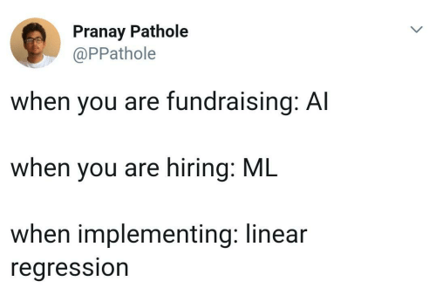
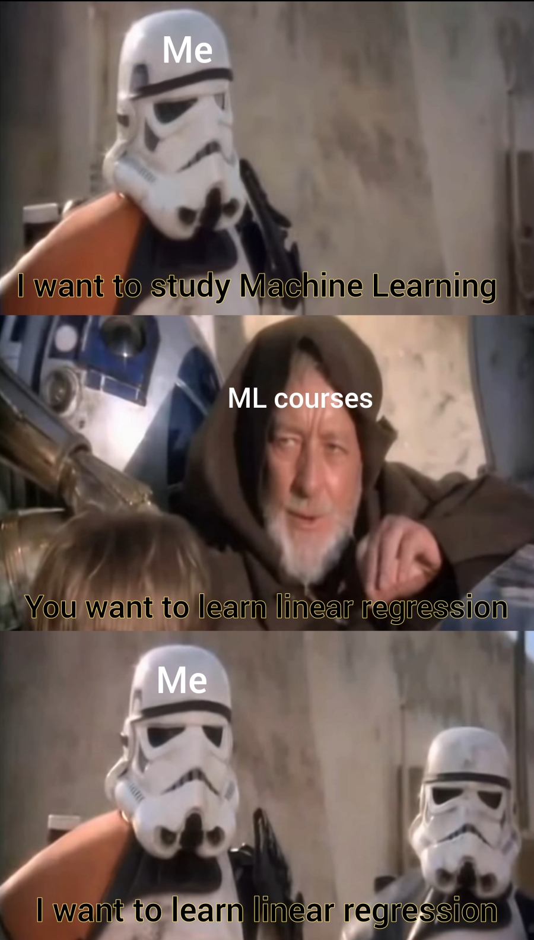
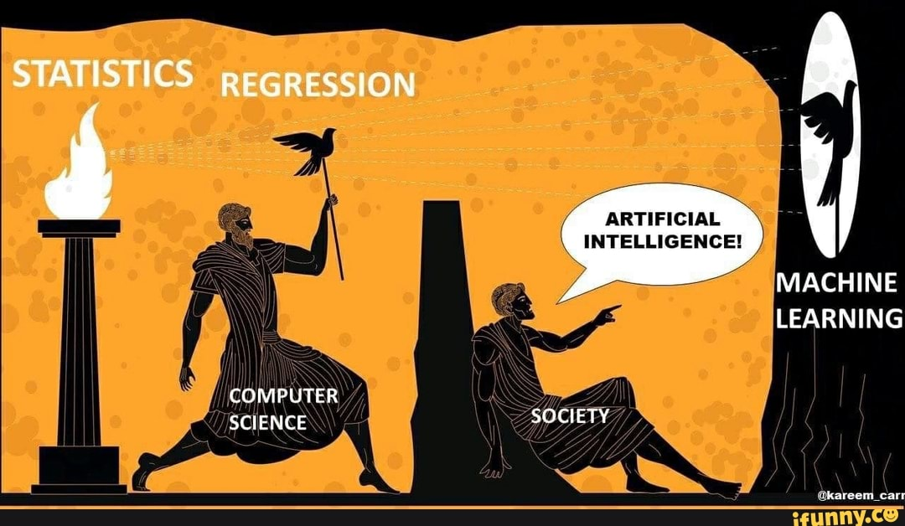
What is Linear regression?

Slide 3
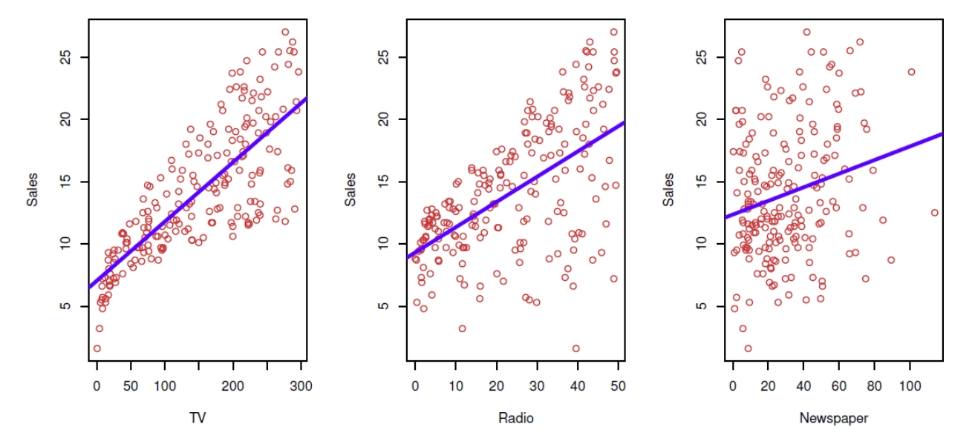
What is linear regression (for real)?

Slide 4
Important questions
How do we find the coefficients?
Is there a relationship between independent variables X and a response variable y?
Which of the independent variables contribute to predicting the response?
How accurate are the predictions?
Is the relationship linear?

Slide 5
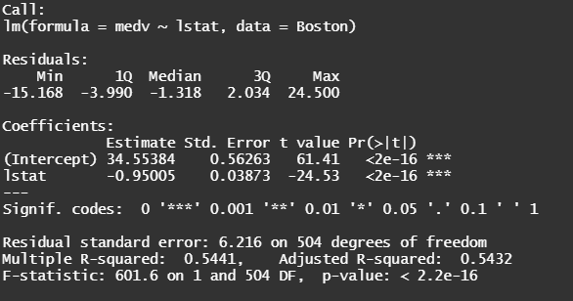
Distribution of residuals (ignore for now)
β coefficients
Their values
Their std. error
Associated t-static
Associated p-value of the statistic
Model “usefulness”
Standard error of residuals (absolute measure of “accuracy”)
R-squared statistics (relative measures of “accuracy”)
F-statistic (“is the model significantly better, than averaging?”)

Slide 6
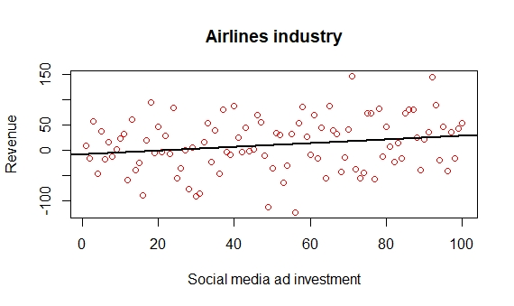
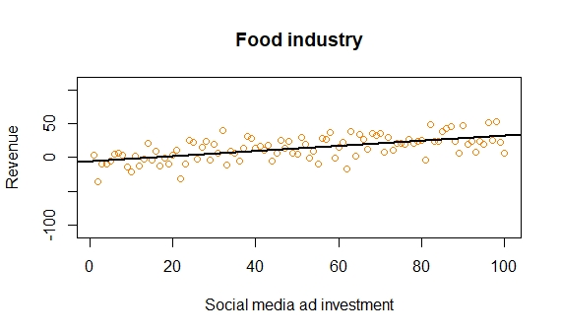
Why Betas have a distribution?
Which regression do you “trust” more?

Slide 7
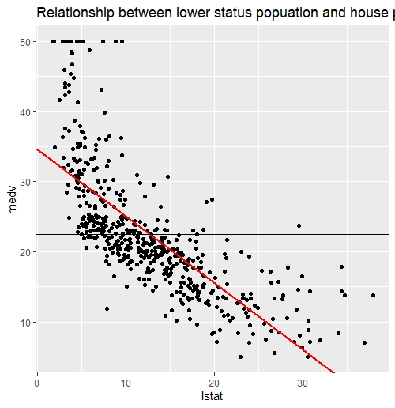
Error of the baseline model
Error reduced by the fit
$$R^{2}=\frac{Error reduced}{Error total}$$
Baseline model
$$R^{2}=\frac{\begin{aligned}Variance explained \\ by the model\end{aligned}}{Total variance}$$

Slide 8
Summary
Is there a relationship between independent variables X and a response variable y?
F-score
Which of the independent variables contribute to predicting the response?
examine the p-values of individual coefficients of predictors
How accurate are the predictions?
R² and RMSE
Is the relationship linear?
Residual plots

Slide 9
Sources
https://pics.me.me/pranay-pathole-ppathole-when-you-are-fundraising-al-when-you-45081339.png
https://img.ifunny.co/images/b0dc8a639e4406c6d5e2a206287d4d978b0f629037a8607eaa4154ef5e61903a_1.jpg
cs-undergrads-problem-that-can-be-solved-with-linear-regression-44588611.png (500×420) (me.me)
https://i.redd.it/ew62nqmlkur41.jpg

