Slide 1
Advanced algorithms topological ordering, minimum spanning tree,
Union-Find problem
Jiří Vyskočil, Radek Mařík
2012

Slide 2
Subgraph
subgraph
  A graph H is a subgraph of a graph G, if the following two inclusions are satisfied:
  In other words, a subgraph is created so that:
    Some vertices of the original graph are removed.
    All edges incident to the removed vertices and possible some other edges are removed.

Slide 3
DFS for the entire graph recursively
input: Graph G.
  procedure DFS (Graph G) {
  for each Vertex v in V(G) { state[v ] = UNVISITED; p[v ] = null; }
  time = 0;
  for each Vertex v in V(G)
  if (state[ v ] == UNVISITED) then DFS-Walk(v );
  }
  procedure DFS-Walk(Vertex u ) {
  state[u ] = OPEN; d[u ] = ++time;
  for each Vertex v in Neighbors(u )
  if (state[v ] == UNVISITED) then {p[v ] = u; DFS-Walk(v ); }
  state[u ] = CLOSED; f[u ] = ++time;
  }
output: array p pointing to predecessor vertex, array d with times of vertex opening and array f with time of vertex closing.

Slide 4
Topological ordering
topological ordering (topological sorting) of graph vertices
  Let graph G be DAG. Let’s define binary relation R of topological ordering over vertices of graph G such as R(x,y) is valid iff there exists a directed path from x to y, that is, whenever y is reachable from x.
  In other words: All vertices of graph G are assigned with numbers so that x ≤ y holds for every pair of vertices x and y iff there is a directed path from x to y.
  Then relation ≤ is a topological ordering over graph G with numbered vertices.
an implementation using the previous DFS algorithm
  The numbering vertices through array f with relation ≤ is a topological order.

Slide 5
Other uses of modified DFS
Testing graph acyclicity
Testing graph connectivity
Searching for graph connected components
Transformation of a graph to a directed forest.

Slide 6
Connected component
A connected component of graph G =(V,E ) with regard to vertex v is a set
C(v ) = {u ∈ V | there exists a path in G from u to v }.
In other words: If a graph is disconnected, then parts from which is composed from and that are themselves connected, are called connected components.
b
C(a)=C(b)={a,b}
c
a
C(c) =C(d) =C(e)={c,d,e}
e
d

Slide 7
Spanning tree
graph spanning tree
  Let G=(V,E) be a graph. A Spanning tree of the graph G is such a subgraph H of the graph G that V(G)=V(H) and H is a tree.

Slide 8
Minimum spanning tree
Minimum spanning tree
  Let G=(V,E ) be a graph and w : E→ℝ be its weight function.
  A minimum spanning tree of the graph G is such a tree K=(V,E_{K}) of the graph G, that
  is minimal.
3
2
3
2
1
1
2
2
2
1
2
1
2
2
3
3

Slide 9
Cut of graph
cut
  A cut of graph G = (V,E ) is a subset of edges F ⊆ E such that
  ∃U ⊂ V : F = {{u,v }∈ E | u ∈ U, v ∉ U}.
Lemma: Let G be a graph, w be its injective real-valued weight function, F be a cut of graph G and f be its lightest edge of cut F (crossing), then every minimum spanning tree K of graph G contains f ∈E(K).
  Proof by contradiction: Let K be a minimum spanning tree and f = {u,v } ∉ E(K). Then there is a path P ⊆ K connecting u and v. The path has to cross the cut at least once. Therefore there is an edge e ∈ P ∩ F and furthermore w(f ) < w(e ). Let’s consider K’ ′ = K − e + f. This graph is also a spanning tree of graph G, because the graph splits into two components by removing of the edge e and it merges back by adding of the edge f . Then w(K’) = w(K) − w(e ) + w(f ) < w(K). K’ is also a minimum spanning tree.

Slide 10
Jarník (Prim)’s algorithm
input: A graph G with a weight function w : E(G)→ℝ.
  Select an arbitrary vertex v₀∈V(G).
  K := ({v₀}, ∅).
  while |V(K)| ≠ |V(G)| {
  Select edge {u,v }∈E(G),
  where u ∈V(K) and v ∉V(K) so that
  w({u,v }) is minimum.
  K := K + edge {u,v }.
  }
output: a minimum spanning tree K.

Slide 11
Jarník (Prim)’s algorithm
8
15
13
7
11
18
27
2
26
3
20
12
14
17
10
5
22
9
23
24
25
19
21
4
1
16
6

Slide 12
Jarník (Prim)’s algorithm
Lemma: Jarník’s algorithm stops after maximum |V(G)| steps and the result is a minimum spanning tree of the graph G.
  In every iteration just one vertex is added to K, so the loop must stop after |V(G)| iteration in maximum.
  The result graph K is a tree because only a leaf is always added to the tree. Furthermore, K has |V(G)| vertices – it is a spanning tree.
  The edges among vertices of the tree K and the rest of the graph G determines a cut. The algorithm always adds the lightest edge of this cut to K. Following the previous lemma, all edges of K must belong to every minimum spanning tree. As K is a tree, then it must be a minimum spanning tree.

Slide 13
Jarník (Prim)’s algorithm
implementations:
  „straightforward”
    Maintain which vertices and edges belong to the tree K and which not.
    The time complexity is O(n⋅m) where n=|V(G)| and m=|E(G)|.
  improvements
    Store D(v ) = min{w({u,v }) | u ∈ K } for v ∉ V (K) . During every iteration of the main loop we search through all D(v ) (it takes O(n) time) and we check all neighbors D(s ) for {v,s } ∈ E when a vertex v is added to K and its value is decreased if necessary (O(1) for each edge).
    Time complexity is improved to O(n²+ m) = O(n²).
    The time complexity might be further improved using a suitable type of heap up to O(log (n)⋅m) (technically up to O(m + log (n)⋅n) with so called Fibonacci heap).

Slide 14
Borůvka’s algorithm
input: A graph G with a weight function w : E(G)→ℝ, where all weights are different.
  K := (V(G), ∅).
  while K has at least two connected components {
  For all components T_{i} of graph K
  the light incident edge ¹ t_{i} is chosen.
  All edges t_{i} are added to K.
  }
output: a minimum spanning tree K.
¹ A light incident edge is an edge connecting a connected component T_{i} with another connected component while a weight of this edge is the lowest.

Slide 15
Borůvka’s algorithm
8
15
13
7
11
18
27
2
26
3
20
12
14
17
10
5
22
9
23
24
25
19
21
4
1
16
6

Slide 16
Borůvka’s algorithm
theorem: Borůvka’s algorithm stops after max. ⌈log₂ |V(G)|⌉ and the result is a minimum spanning tree of the graph G.
  After k iterations all components of the graph K have at least 2^{k} vertices.
    induction: Initially, all components consist of just one vertex.
    In each iteration, each component is merged with at least another neighboring one so that the size of components is at least doubled.
  Therefore, after ⌈log₂ |V(G)|⌉ iterations, the size of any component must be at least a number of all vertices of graph G and then the algorithm stops.
  The edges between each connected component and the rest of graph determines a cut. Then all edges added to K must belong to a unique minimum spanning tree. Graph K ⊆ G is always a forest (= a set of trees disconnected to each other) and when the algorithm stops it will be equal to a minimum spanning tree.

Slide 17
Borůvka’s algorithm
Iteration implementation:
  The forest is decomposed to connected components using DFS. Each vertex is assigned to a number of its component.
  For each edge we find out to which component it belongs and we store the lightest edge only.
  Therefore each iteration takes O(|E(G)|) time and the entire algorithm running time is O(|E(G)|⋅ log|V(G)| ).

Slide 18
Kruskal’s („greedy“) algorithm
input: A graph G with a weight function w : E(G)→ℝ.
  Sort all edges e₁,…, e_{m=|E(G)|} from E(G) so that
  w(e₁) ≤ … ≤ w(e_{m}).
  K := (V(G), ∅).
  for i := 1 to m {
  if K+edge {u,v } is an acyclic graph then K := K+edge {u,v }.
  }
output: a minimum spanning tree K.

Slide 19
Kruskal’s („greedy“) algorithm
8
15
13
7
11
18
27
2
26
3
20
12
14
17
10
5
22
9
23
24
25
19
21
4
1
16
6

Slide 20
Kruskal’s („greedy“) algorithm
theorem: Kruskal’s algorithm stops after |E(G)| iterations and returns a minimum spanning tree.
  Each iteration of the algorithm processes just one edge, so the number of iterations is |E(G)| .
  By induction we prove that K is always a subgraph of a minimum spanning tree: the empty initial K is a subgraph of anything (including a minimum spanning tree). Each added edge has the lowest weight in the cut separating a component of K from the rest of the graph (the remaining unprocessed edges of this cut are heavier). In opposite way, no edge that is not added to K cannot belong to a minimum spanning tree because it creates a cycle with edges already assigned to a minimum spanning tree.

Slide 21
Kruskal’s („greedy“) algorithm
implementation
  Sorting time is O(|E(G)| ⋅ log|E(G)| ) = O(|E(G)| ⋅ log|V(G)| ).
  We can stop the main loop earlier. When we successfuly add |V(G)| -1 edges to K then we can stop the algorithm because K has already reached a spanning tree.
  We need to maintain connected components of graph K so that we can recognize quickly if the current processed edge creates a cycle.
  Thus we need a structure for connected component maintenance which we can ask |E(G)|-times if two vertices belong to the same component (operation Find), and we merge just (|V(G)| −1)-times two components to a single one (operation Union).

Slide 22
Union-Find problem
Let’s have graph G =(V,E ).
Question: „Do vertices u and v belong to the same connected component of graph G?”.
Sometimes the problem is called as incremental connected components or equivalence maintenance.
One representative is selected in each connected component. For sake of simplicity the representative of component C(v ) is labeled as r (v ). If u and v belong to the same component then r (u ) = r (v ). The task might be accomplished using the following operations:
FIND(v ) = r (v ), the operation returns the representative of connected component C(v ).
UNION(u, v ) merges connected components C(u ) and C(v ). This reflects adding edge {u, v } into the graph.

Slide 23
Union-Find problem
A simple solution:
  Let’s assume all vertices are assigned with a number from 1 to n. Let’s use an array R [1..n ], whereR [i ] = r (i ), i.e. the number of component C (i ) representative.
  Operation FIND(v ) just returns value R [v ] and so it takes O(1).
  To perform UNION(u, v ) we find representatives
  r (u ) = FIND(u ) and r (v ) = FIND(v ).
  If they are different then we process all items of array R . Any value of r (u ) is rewritten to r (v ). It takes O(n ) time.

Slide 24
Union-Find problem
An improved solution (using a directed tree):
  Each component is stored as a tree directed towards the root – every vertex has a pointer to its father, every root stores the size of the component. The root of each component serves as its representative.
  Operation FIND(v ) climbs from vertex v to the root that is returned.
  To perform UNION(u, v ) we find representatives
  r (u ) = FIND(u ) and r (v ) = FIND(v ).
  If they different then the root of smaller component is merged to the root of the bigger component. The size of new component is updated in its root.

Slide 25
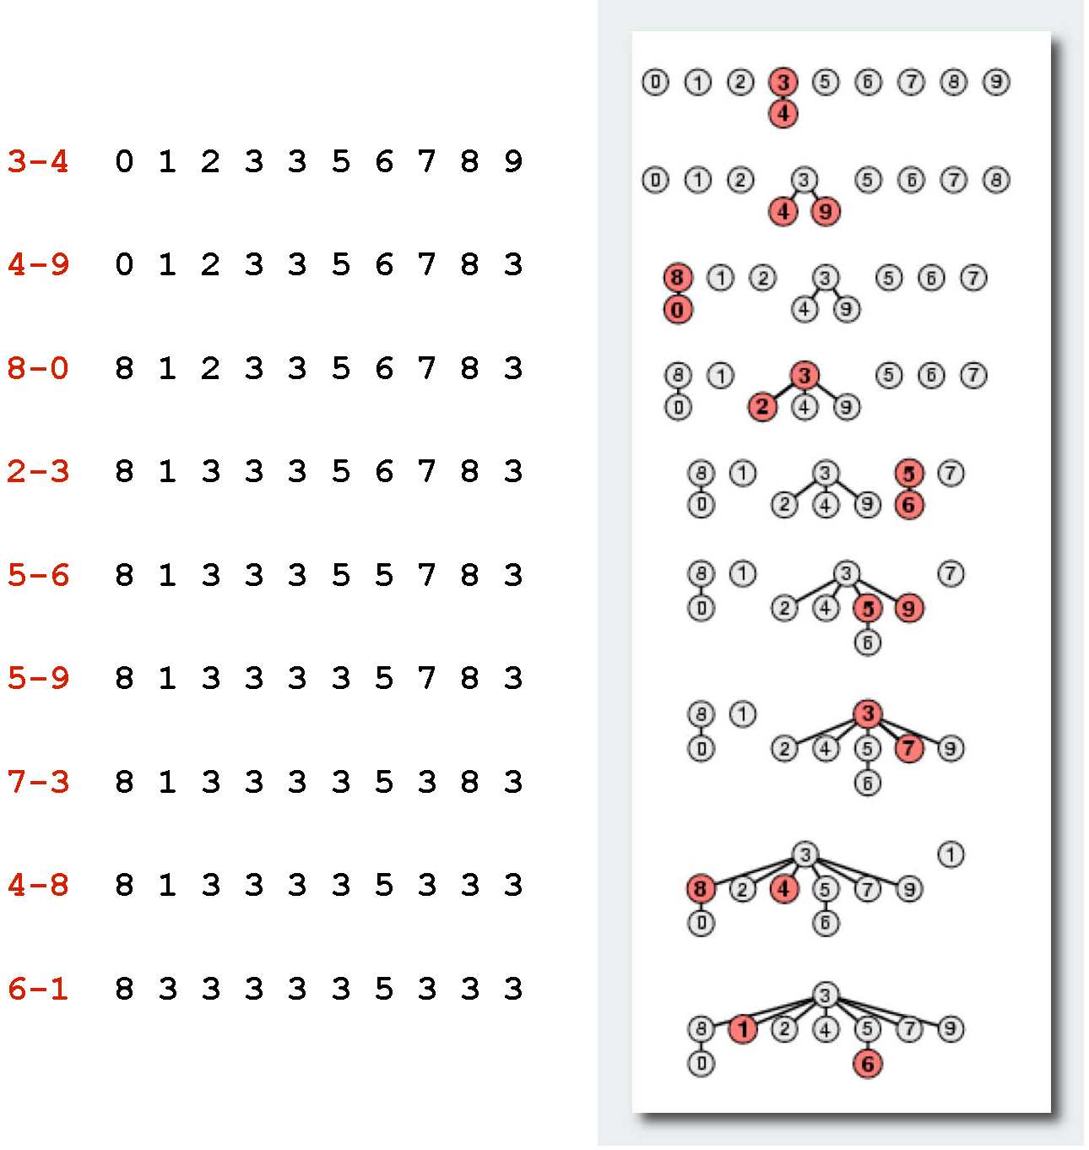
Union-Find problem

Slide 26
Union-Find problem
An improved solution (using a directed tree):
  lemma: Union-Find tree of a depth h has at least 2^{h} items.
  By induction: If UNION merges a tree of the depth h with another tree of a depth smaller than h, then a depth of the result tree remains h. If two trees of the same depth h are merged, then the result tree has a depth h+1. By induction assumption we know that a tree of depth h has at least 2^{h} vertices. Therefore the result tree of a depth h+1 has at least 2^{h+1} vertices.
  A consequence: Time complexity of operation UNION and FIND is O(log|V |).
The best known solution is amortized O(α|V |) for both operations, where function α is inverse Ackermann function.

Slide 27
Kruskal’s („greedy“) algorithm
Kruskal’s algorithm complexity:
  Sorting takes time: O(|E(G)| ⋅ log|E(G)| ) = O(|E(G)| ⋅ log|V(G)| ).
  Then we need a structure for connected component maintenance which we can ask |E(G)|-times if two vertices belong to the same component (operation Find), and we merge just (|V(G)| −1)-times two components to a single one (operation Union).
  If the simple solution is used then the complexity of the algorithm is:
  O(|E(G)|⋅log|V(G)| + |E(G)| + |V(G)|² ) = O(|E(G)|⋅log|V(G)| + |V(G)|² )
  If the improved solution using a directed tree is used then the complexity of the algorithm is:
  O(|E(G)|⋅log|V(G)| + |E(G)|⋅log|V(G)| + |V(G)|⋅log|V(G)| ) = O(|E(G)|⋅log|V(G)|)

Slide 28
References
Matoušek, J.; Nešetřil, J. Kapitoly z diskrétní matematiky. Karolinum. Praha 2002. ISBN 978-80-246-1411-3.
Cormen, Thomas H.; Leiserson, Charles E.; Rivest, Ronald L.; Stein, Clifford (2001). Introduction to Algorithms (2nd ed.). MIT Press and McGraw-Hill. ISBN 0-262-53196-8.

