Slide 1
Applications of Evolutionary Algorithms
Applications of Evolutionary Algorithms
Jiří Kubalík
email: kubalik@ciirc.cvut.cz
Czech Technical University in Prague
Czech Institute of Informatics, Robotics, and Cybernetics
Zikova street 1903/4, 166 36 Praha 6
Czech Republic

Slide 2
Evolutionary Algorithms
Evolutionary Algorithms are general-purpose stochastic optimization algorithms.
Problem solution can be represented as binary string, real-valued string, string of symbols, tree or graph.
Optimized objective function can be continuous/discrete, multimodal, nonlinear, multidimensional, noisy.
The problem can involve multiple optimization objectives as well.
A typical evolutionary model:
Selection
Parents
Population
Crossover
+
Mutation
Offspring
Replacement
Evaluation

Slide 3
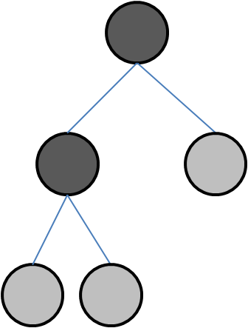
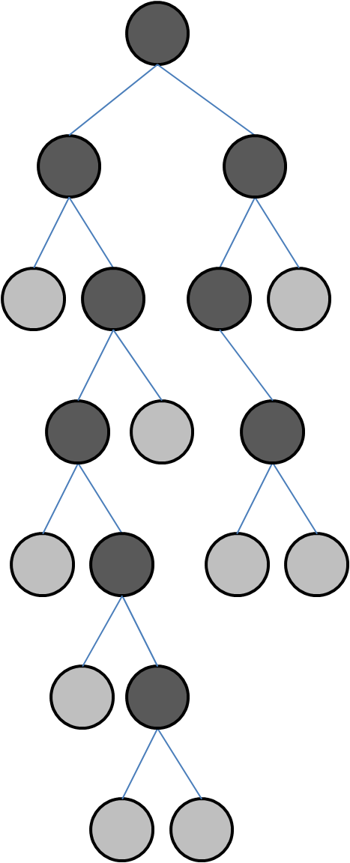
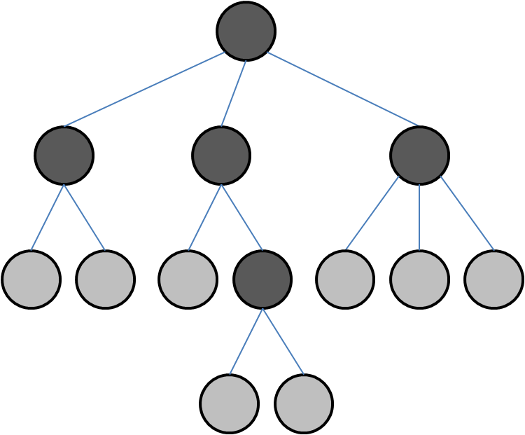
Genetic Programming (GP)
GP shares with GA the philosophy of survival and reproduction of the fittest and the analogy of naturally occurring genetic operators.
GP differs from GA in a representation, genetic operators and a scope of applications.
Structures evolved in GP are trees of dynamically varying size and shape representing hierarchical computer programs.
GA chromosome of fixed length:
GP trees:

Slide 4
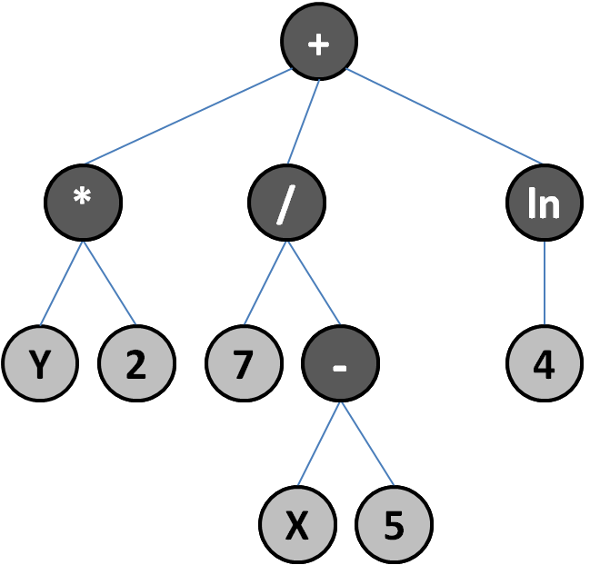
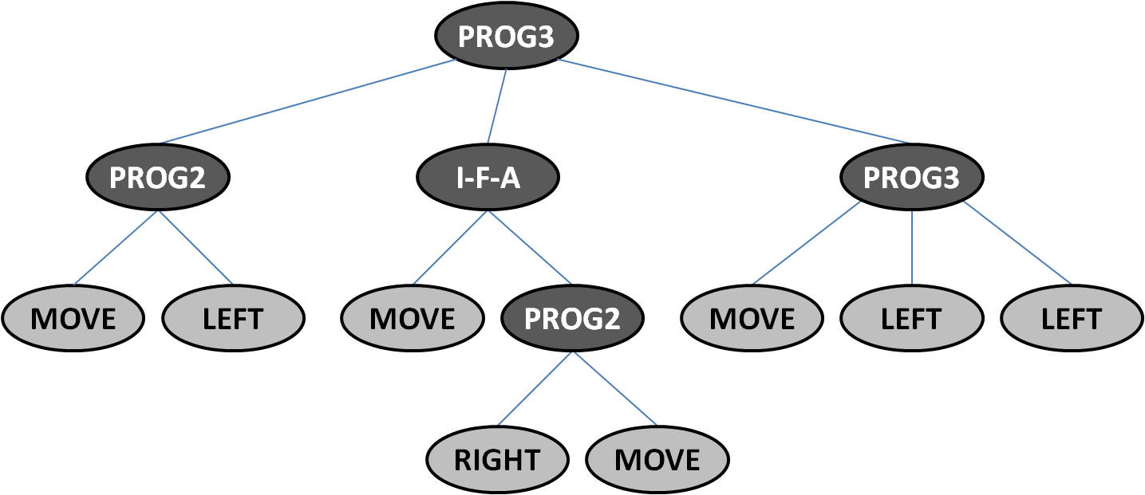
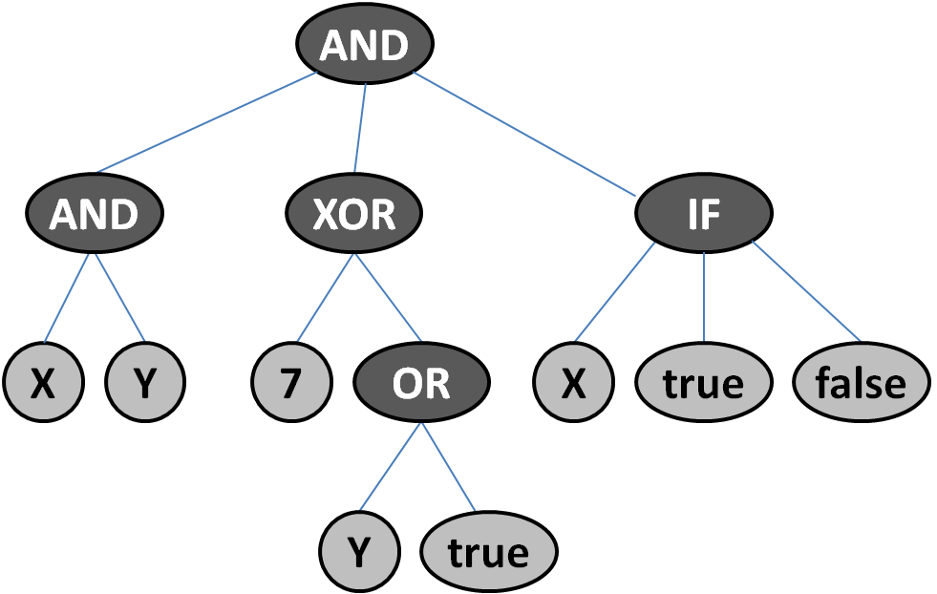
GP: Application Domains
Applications
  learning programs,
  learning decision trees,
  learning rules,
  learning strategies,
  . . .
Arithmetic expressions
Artificial ant strategy
Logical expressions

Slide 5
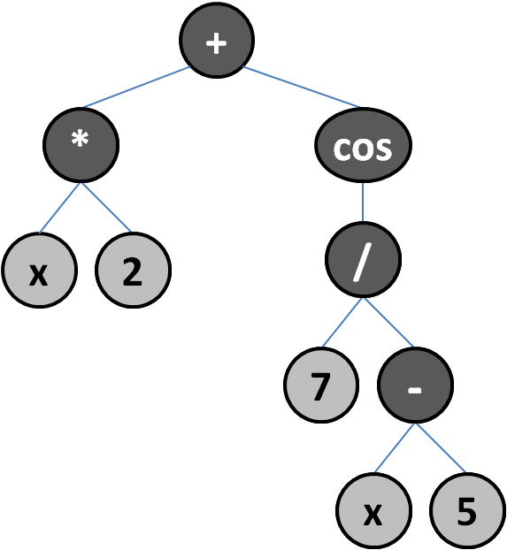
GP: Trigonometric Identity
An illustrative example of GP in action (one of many interesting examples from)
  Koza, J.: Genetic Programming: vol. 1 , On the programming of computers by means of natural selection, MIT Press, 1992
GP used to find an equivalent expression to cos(2x).
GP implementation:
  Terminal set T = {x, 1.0}
  Function set F = {+, –, ∗, %, sin}
  Training cases: 20 pairs (x_{i}, y_{i}), where x_{i} are values evenly
  distributed in interval (0, 2π).
  Fitness: Sum of absolute differences between desired y_{i} and the values returned by generated expressions.
  Stopping criterion: A solution found that gives the error less than 0.01.

Slide 6
GP: Trigonometric Identity
1. run, 13th generation
(– (– 1 (∗ (sin x) (sin x))) (∗ (sin x) (sin x)))
  which equals (after editing) to 1-2∗sin²x.
  2. run, 34th generation
(– 1 (∗ (∗ (sin x) (sin x)) 2))
  which is just another way of writing the same expression.

Slide 7
GP: Trigonometric Identity
1. run, 13th generation
(– (– 1 (∗ (sin x) (sin x))) (∗ (sin x) (sin x)))
  which equals (after editing) to 1-2∗sin²x.
  2. run, 34th generation
(– 1 (∗ (∗ (sin x) (sin x)) 2))
  which is just another way of writing the same expression.
  3. run, 30th generation
(sin (– (– 2 (∗ x 2))
(sin (sin (sin (sin (sin (sin (∗ (sin (sin 1))
(sin (sin 1))
)))))))))

Slide 8
GP: Trigonometric Identity
1. run, 13th generation
(– (– 1 (∗ (sin x) (sin x))) (∗ (sin x) (sin x)))
  which equals (after editing) to 1-2∗sin²x.
  2. run, 34th generation
(– 1 (∗ (∗ (sin x) (sin x)) 2))
  which is just another way of writing the same expression.
  3. run, 30th generation
(sin (– (– 2 (∗ x 2))
(sin (sin (sin (sin (sin (sin (∗ (sin (sin 1))
(sin (sin 1))
)))))))))
  2 minus the expression on the 2nd and 3rd rows is almost π/2, so the discovered identity is cos(2x) = sin(π/2 – 2x).

Slide 9
Human-Competitive Results
John R. Koza, Martin A. Keane, Matthew J. Streeter: What's AI Done for Me Lately? Genetic Programming's Human-Competitive Results. IEEE Intelligent Systems 18(3): 25-31 (2003)
http://www.genetic-programming.com/humancompetitive.html
http://www.cs.bham.ac.uk/~wbl/biblio/cache/http___www.genetic-programming.com_jkpdf_ieee2003intelligent.pdf
  The automated problem-solving technique of genetic programming has generated at least 36 human-competitive results (21 of which duplicate previously patented inventions, 6 of which duplicate functionality of inventions patented after January 1 2000).
  It also covers two automatically synthesized controllers for which the authors have applied for a patent and includes examples of an automatically synthesized antenna, classifier program, and mathematical algorithm.
More recent survey on human-competitive results produced by GP:
http://www.springerlink.com/content/92n753376213655k/fulltext.pdf

Slide 10
Criteria of Human-Competitive Results
We say that an automatically created result is “human-competitive” if it satisfies one or more of the eight criteria below.
The result was patented as an invention in the past, is an improvement over a patented invention, or would qualify today as a patentable new invention.
The result is equal to or better than a result that was accepted as a new scientific result at the time when it was published in a peer-reviewed scientific journal.
The result is equal to or better than a result that was placed into a database or archive of results maintained by an internationally recognized panel of scientific experts.
The result is publishable in its own right as a new scientific result independent of the fact that the result was mechanically created.
The result is equal to or better than the most recent human-created solution to a long-standing problem for which there has been a succession of increasingly better human-created solutions.
The result is equal to or better than a result that was considered an achievement in its field at the time it was first discovered.
The result solves a problem of indisputable difficulty in its field.
The result holds its own or wins a regulated competition involving human contestants (in the form of either live human players or human-written computer programs).

Slide 11

Human-Competitive Results
John R. Koza et al.: What's AI Done for Me Lately? Genetic Programming's Human-Competitive Results.

Slide 12
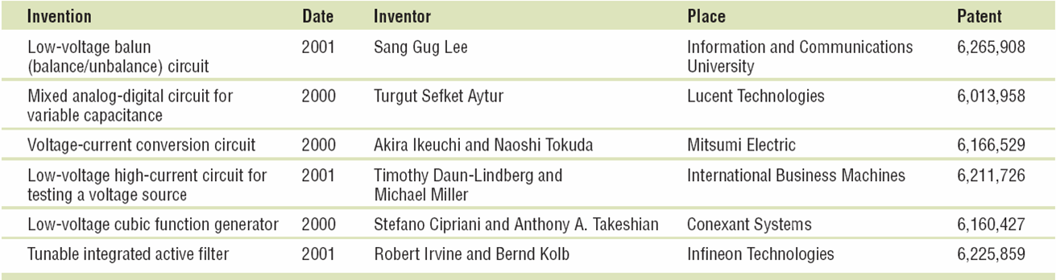
Six Post-2000 patented analog circuits
John R. Koza et al.: What's AI Done for Me Lately? Genetic Programming's Human-Competitive Results.

Slide 13
Automated Design of Electrical Circuits
Automated “What You Want Is What You Get” process for circuit synthesis.
Genetic programming used to synthesize both
  the structure/topology, and
  sizing (numerical component values)
for circuits that duplicate the patented inventions’ functionality.
Method
  Starts from a high-level statement of a circuit’s desired behavior and characteristics and only minimal knowledge about analogue electrical circuits.
  Then, a fitness measure is created that reflects the invention’s performance and characteristics – it specifies the desired time- or frequency-domain outputs, given various inputs.
  Employs a circuit simulator for analyzing candidate circuits, but does not rely on domain expertise or knowledge concerning the synthesis of circuits.

Slide 14
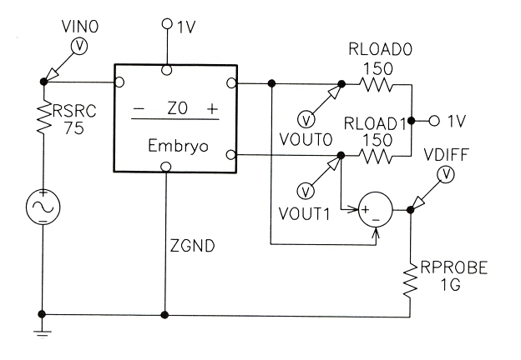
Automated Design of Electrical Circuits
Method
  For each problem, a test fixture consisting of appropriate hard-wired components (such as a source resistor or load resistor) connected to the input ports and desired output ports is used.
Test fixture

Slide 15
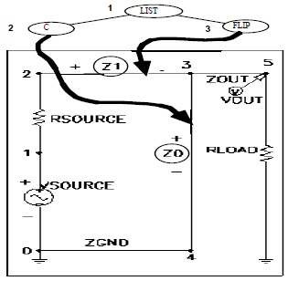
WYWIWYG: Embryonic Electrical Circuit
The Mapping between Program Trees and Electrical Circuits
The growth process used for electrical circuits begins with a very simple embryonic electrical circuit and builds a more complex circuit by progressively executing the functions in a circuit-constructing program tree.
The embryonic circuit used on a particular problem depends on the number of input signals and the number of output signals.
The result of this process is
  the topology of the circuit,
  the choice of the types of components that are situated
  at each location within the topology,
  and the sizing of the components.

Slide 16
WYWIWYG: Fitness Assignment
Circuit-constructing program tree evaluation in the population begins with its execution.
  This execution applies the functions in the program tree to the very simple embryonic circuit, thereby developing the embryonic circuit into a fully developed circuit.
  A netlist that identifies each component of the circuit, the nodes to which that component is connected, and the value of that component is then created.
Circuit is then simulated using SPICE (an acronym for Simulation Program with Integrated Circuit Emphasis) to determine its behavior.
Fitness measure may incorporate many characteristic or combination of characteristics of the circuit, including
  the circuit's behavior in the time domain,
  its behavior in the frequency domain,
  its power consumption,
  or the number, cost, or surface area of its components.

Slide 17
GP Control Parameters Setup
Note, this is far from being a brute force search.
Population size: 640,000
Pcrossover = 89%
Pmutation = 1%
Preproduction = 10%
Maximum 200 nodes for each value-producing branch
Parallel Parsytec computer system
  64 x 80 MHz Power PC 601 processors arranged in a toroidal mesh
Parallel GA
  deme size: 10,000
  64 demes
  Migration rate: 2%

Slide 18
Low-Voltage Balun Circuit
A balun (balance/unbalance) circuit’s purpose is to produce two outputs from a single input
  each having half of the input’s amplitude;
  one output should be in phase with the input while the other should be 180
degrees out of phase with the input, and both should have the same DC offset.
The fitness measure was based on
  a frequency sweep analysis designed to measure the magnitude and phase of the circuit’s two outputs and
  a Fourier analysis designed to measure harmonic distortion.

Slide 19
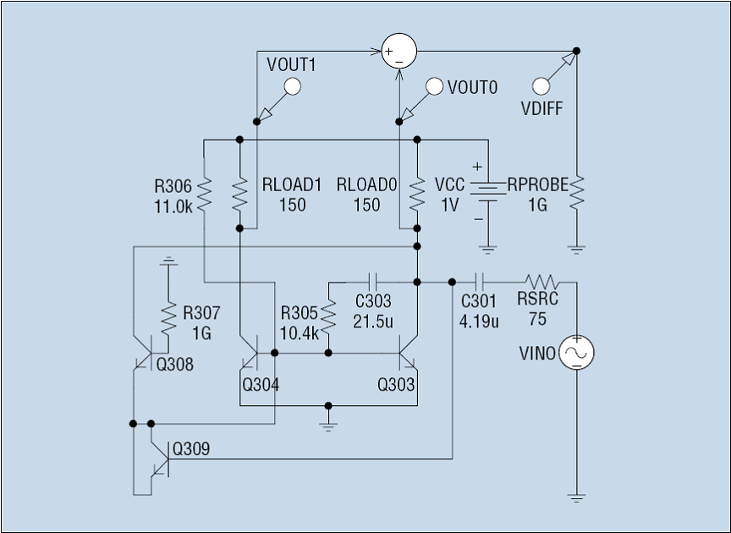
Genetically Evolved Low-Voltage Balun Circuit
Evolved circuit is roughly a fourfold improvement over the patented circuit
in terms of the fitness measure.
  It is superior both in terms of its frequency response and harmonic distortion.
  Test fixture Evolved balun circuit
John R. Koza et al.: What's AI Done for Me Lately? Genetic Programming's Human-Competitive Results.

Slide 20
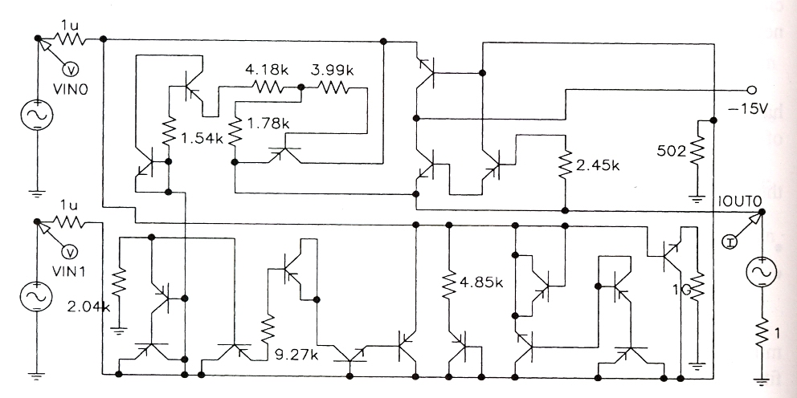
Voltage-Current Conversion Circuit
Voltage-current conversion circuit’s purpose is to take two voltages as input and to produce as output a stable current whose magnitude is proportional to the difference between the voltages.
Fitness measure is based on four time-domain input signals.
Genetically evolved circuit (entirely different than the patented circuit)
  has roughly 62 percent of the average (weighted) error of the patented circuit and
  outperformed the patented circuit on additional previously unseen test cases.
John R. Koza et al.: What's AI Done for Me Lately? Genetic Programming's Human-Competitive Results.

Slide 21
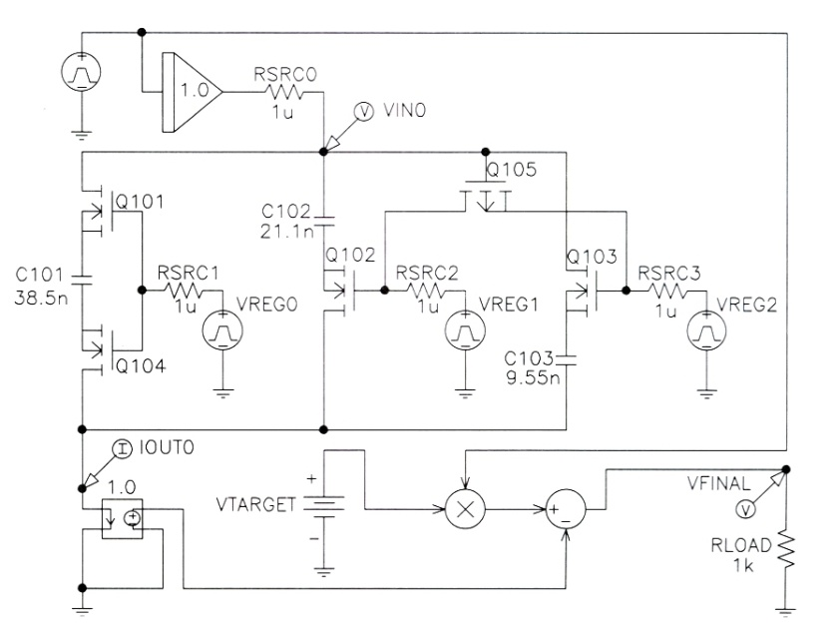
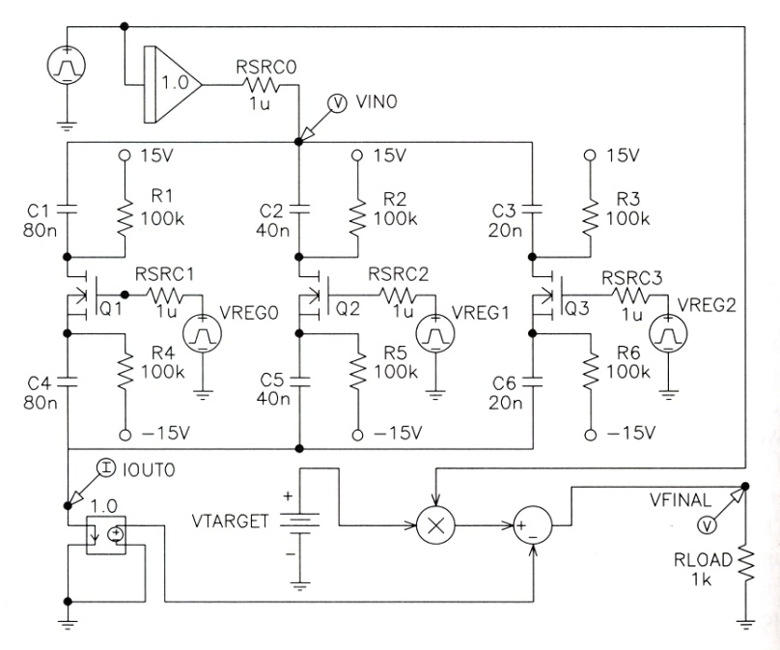
Mixed Analog-Digital Register-Controlled Variable Capacitor
Mixed analog-digital variable capacitor circuit has a capacitance controlled by the value stored in a digital register.
Fitness measure was based on the error accumulated by 16 combinations of time-domain test signals ranging over all eight possible values of a 3-bit digital register for two different analog input signals.
The evolved circuit performs as well as the patented circuit.
Evolved circuit Patented circuit
John R. Koza et al.: What's AI Done for Me Lately? Genetic Programming's Human-Competitive Results.

Slide 22

HUMIES
Annual “HUMIES” awards for human-competitive results produced by genetic and evolutionary computation held at the Genetic and Evolutionary Computation Conference (GECCO)
Entries present human-competitive results that have been produced by any form of genetic and evolutionary computation (including, but not limited to genetic algorithms, genetic programming, evolution strategies, evolutionary programming, learning classifier systems, grammatical evolution, gene expression programming, differential evolution, etc.) and that have been published in the open literature.
Human-competitive results awarded in areas:
- Analog circuit design - Game strategies
- Quantum circuit design - Image processing
- Physics - Antenna design
- Digital circuits/programs - Classical optimization
- Chemistry - …
http://www.genetic-programming.org/combined.html

Slide 23
2004 Human-Competitive Awards in Genetic and Evolutionary Computation
http://www.genetic-programming.org/gecco2004hc.html
$1500 – Gold
  Jason D. Lohn, Gregory S. Hornby, Derek S. Linden: An Evolved Antenna for Deployment on NASA's Space Technology 5 Mission
  Lee Spector: Automatic Quantum Computer Programming: A Genetic Programming Approach
$500 – Silver
  Alex Fukunaga: Evolving Local Search Heuristics for SAT Using GP
  Hod Lipson: How to Draw a Straight Line Using a GP: Benchmarking Evolutionary Design Against 19th Century Kinematic Synthesis
  Bijan Khosraviani, Raymond E. Levitt, John R. Koza: Organization Design Optimization Using Genetic Programming
$500 – Bronze
  Adrian Stoica, Ricardo Zebulum, Didier Keymeulen, Michael Ian Ferguson, Vu Duong, Xin Guo: Taking evolutionary circuit design from experimentation to implementation: some useful techniques and a silicon demonstration

Slide 24
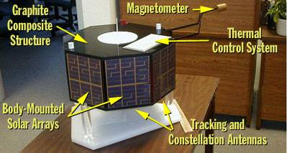
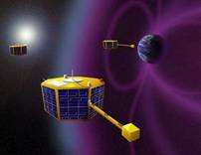
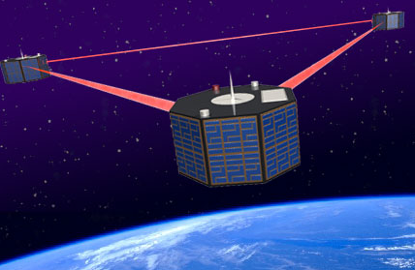
The winner of Humies 2004
Three nanosats (20in diameter).
Measure effect of solar activity on the Earth's magnetosphere.
© Jason D. Lohn, Gregory S. Hornby, Derek S. Linden: Human-Competitive Results: Evolved Antennas for Deployment on NASA’s Space Technology 5 Misson

Slide 25
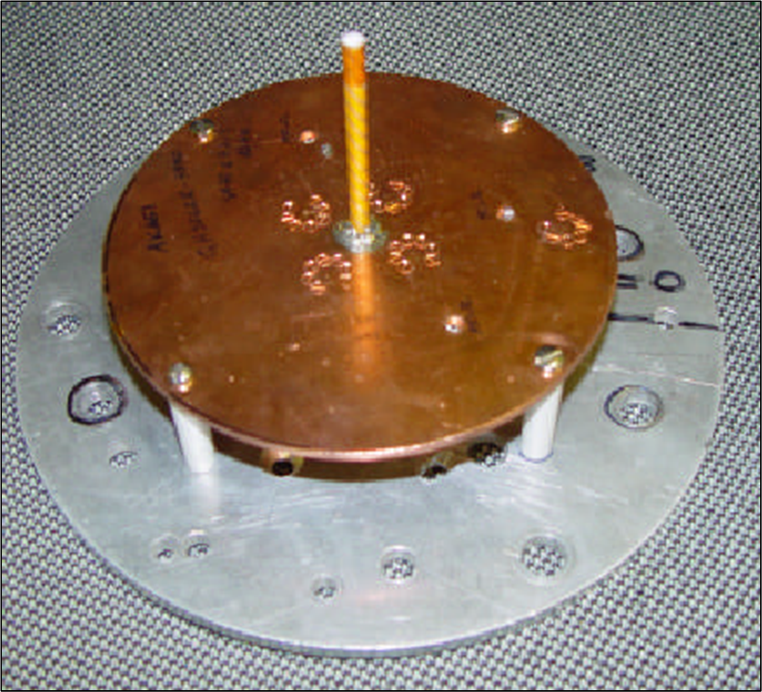
Evolved Antennas for Deployment on NASA’s
Space Technology 5 Mission
Original ST5 Antenna Requirements
  Transmit: 8470 MHz
  Receive: 7209.125 MHz
  Gain:
    >= 0dBic, 40 to 80 degrees
    >= 2dBic, 80 degrees
    >= 4dBic, 90 degrees
  50 Ohm impedance
  Voltage Standing Wave Ratio (VSWR):
    < 1.2 at Transmit Freq
    < 1.5 at Receive Freq
  Fit inside a 6” cylinder
ST5 Quadrifilar Helical Antenna
  designed by a team of human designers
  won the contract
© Jason D. Lohn, Gregory S. Hornby, Derek S. Linden: Human-Competitive Results: Evolved Antennas for Deployment on NASA’s ST5 Misson

Slide 26
Evolved Antenna for Space Technology 5 mission
Branching EA: Antenna Genotype
  Genotype is a tree-structured encoding that specifies the construction of a wire form
  Genotype specifies design of 1 arm in 3D-space:
f
rx
f
f
rz
rx
5.0cm
f
f
Branching in genotype results in branching
in wire form
Feed Wire
2.5cm
© Jason D. Lohn, Gregory S. Hornby, Derek S. Linden: Human-Competitive Results: Evolved Antennas for Deployment on NASA’s Space Technology 5 Misson

Slide 27
Evolved Antenna for Space Technology 5 mission
Branching EA: Antenna Construction Commands
  forward(length radius)
  rotate_x(angle)
  rotate_y(angle)
  rotate_z(angle)
  Forward() command can have 0,1,2, or 3 children.
  Rotate_x/y/z() commands have exactly 1 child (always non-terminal).
Fitness function (to be minimized):
  F = VSWR_Score * Gain_Score * Penalty_Score
f
rx
f
f
rz
rx
f
f

Slide 28
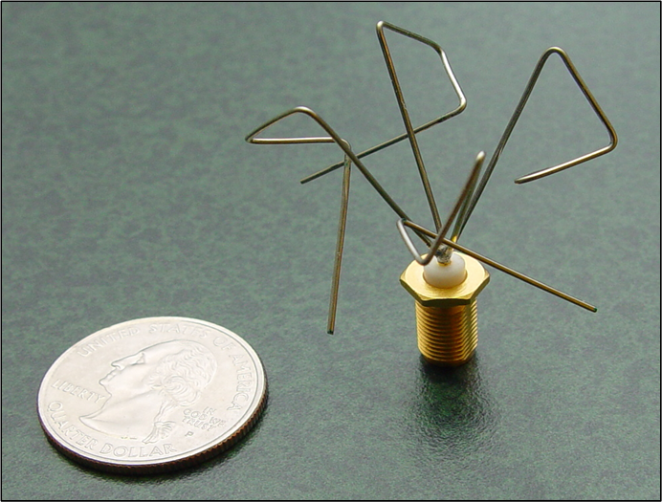
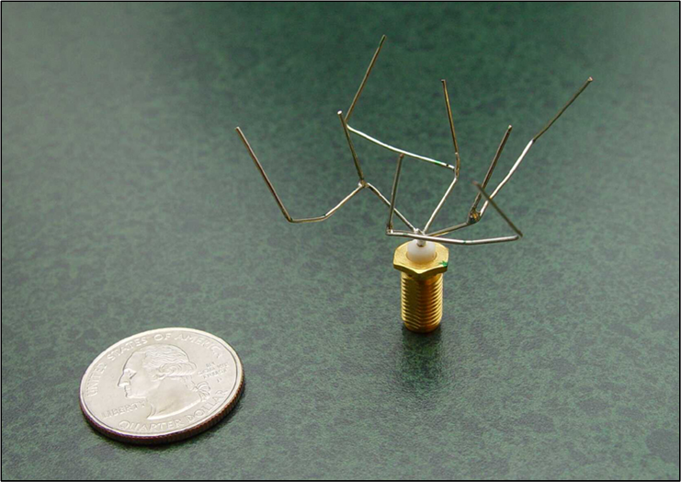
Evolved Antenna for Space Technology 5 mission
1st Set of Genetically Evolved Antennas
© Jason D. Lohn, Gregory S. Hornby, Derek S. Linden: Human-Competitive Results: Evolved Antennas for Deployment on NASA’s Space Technology 5 Misson
Non-branching:
ST5-4W-03
Branching:
ST5-3-10

Slide 29
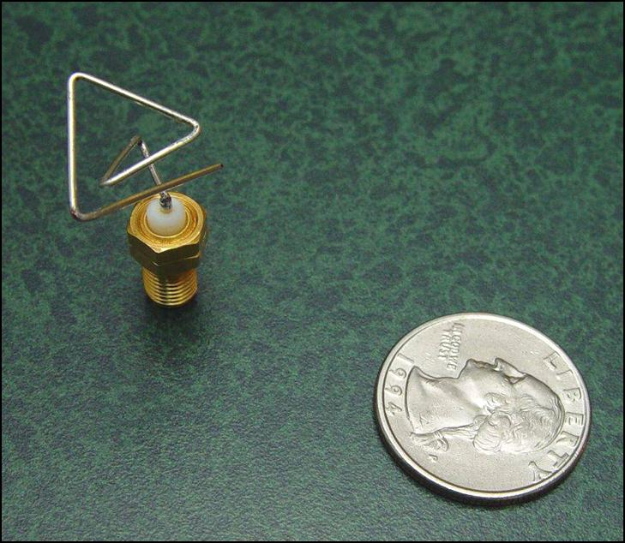
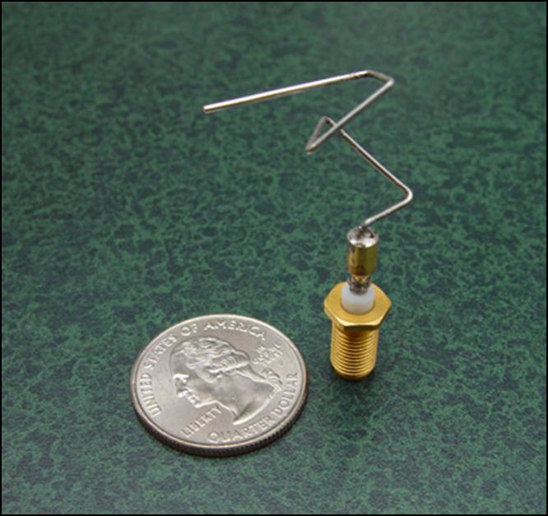
Evolved Antenna for Space Technology 5 mission
2nd Set of genetically evolved antennas for new mission requirements
© Jason D. Lohn, Gregory S. Hornby, Derek S. Linden: Human-Competitive Results: Evolved Antennas for Deployment on NASA’s Space Technology 5 Misson
EA 1 – Vector of Parameters
EA 2 – Constructive Process

Slide 30
Evolved Antenna for Space Technology 5 mission
Conclusion
  Meets mission requirements
  Better than conventional design
  Successfully passed space qualification
  First Evolved Hardware in Space when mission launched in 2005
Direct competition: The antenna designed by the contracting team of human designers for the Space Technology 5 mission - which won the bid against several competing organizations to supply the antenna - did not meet the mission requirements while the evolved antennas did meet these requirements.
Evolutionary design:
  Fast design cycles save time/money (4 weeks from start-to-first-hardware)
  Fast design cycles allow iterative “what-if”
  Can rapidly respond to changing requirements
  Can produce new types of designs
  May be able to produce designs of previously unachievable performance

Slide 31
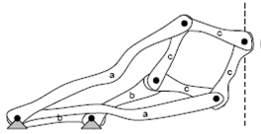
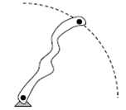
How to Draw a Straight Line Using a GP
Hod Lipson: How to Draw a Straight Line Using a GP: Benchmarking Evolutionary
Design Against 19th Century Kinematic Synthesis
  This entry presents the application of genetic programming to the synthesis of compound 2D kinematic mechanisms, and benchmarks the results against one of the classical kinematic challenges of 19th century mechanical design.
Test Case: The Straight Line Problem
  The straight-line problem seeks a kinematic mechanism that traces a straight line without reference to an existing straight line.
  For example, a circle is easy, a line is a challenge!
line
circle

Slide 32
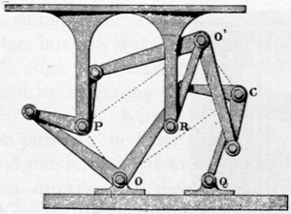
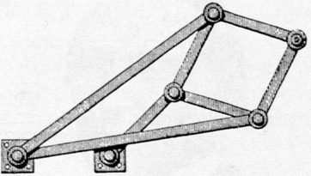
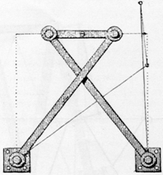
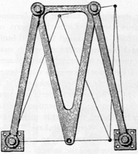
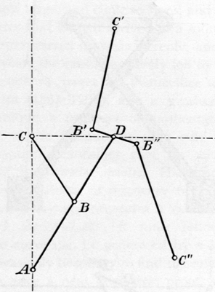
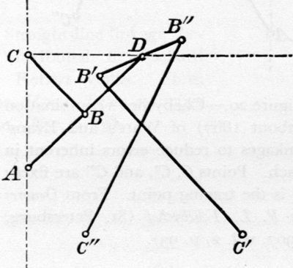
How to Draw a Straight Line Using a GP
Some key straight-line mechanisms
Silverster-Kempe’s
(1877)
Peaucelier
(1873)
Chebyshev
(1867)
Robert
(1841)
See
http://kmoddl.library.cornell.edu
Chebyshev
(1867)
Chebyshev-Evans
(1907)

Slide 33
How to Draw a Straight Line Using a GP
Top down encoding of a mechanism
Start with Embryo with desired # of DoF, e.g. a four-bar mechanism (1 DoF)
Two variation operators maintain DoF
Example: A tree that constructs this 1-DoF compound mechanism
E.g. Transform dyad into tryad
Notes:
Here is a top-down encoding of a mechanism:
Top-down construction of a mechanism starts with an embryonic machine with the desired number of DoF, such as the four-bar (which has one DoF).
A tree of operators then recursively modifies that mechanism by replacing single links with assemblies of links with an equivalent DoF, so that the total number of DoF remains unchanged. Two such transformations are shown The D and T operators.
The D operator creates a new node and connects it to both the endpoints of a given link, essentially creating a rigid triangular component. The T operator replaces a given link with two links that pass through a newly created node. The new node is also connected to some other existing node. In both operators, the position of the new nodes is specified in coordinates local to link being modified. Operators provably DoF invariant
On the right, we see how application of a tree of operators to the embryonic mechanism, will transform it into an arbitrary compound mechanism with exactly one DoF. Terminals of the tree are the actual links of the mechanism.

Slide 34
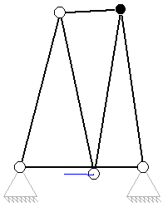
How to Draw a Straight Line Using a GP
Comparison of mechanisms can be difficult
  Equivalent mechanisms may appear very different
  Masked by excess and redundant topology
Two transformations allow moving in “neutral pathways” of mechanisms
  Rigid diagonal swap
  Redundant dyad removal/addition
Notes:
[optional]
Comparison of mechanism can be difficult, as apparently different machines may be functionally equivalent. Complex mechanisms can be reduced to simpler mechanisms with equivalent curve traces by through iterative transformations.
These are essentially neutral operators that can be used in the search as well.

Slide 35
How to Draw a Straight Line Using a GP
Used GP with Top-down tree encoding and 2-bar or 4-bar embryo
  Population size: 100
  Crossover 90%
  Mutation 10% (Node positions, Operator types)
Selection: Stochastic Universal Sampling
Evaluation of an evolved straight-line mechanism
  The mechanism is actuated at an arbitrary handle and the aspect ratios of bounding boxes of node trajectories are measured.
  One node of the evolved machine on the left traces a curve that is linear to 1:5300 accuracy.
  The evolved mechanism on the right traces a curve that is linear to 1:28340 accuracy
Notes:
We used a GP with a population of 100 individuals and fitness proportional selection using stochastic-universal-sampling.
The fitness was the linearity of the most linear curve traced by any of the mechanisms’ vertices, when the crank node was turned 45 degrees.
Linearity is the aspect ratio of the tightest bounding box around node traces.

Slide 36
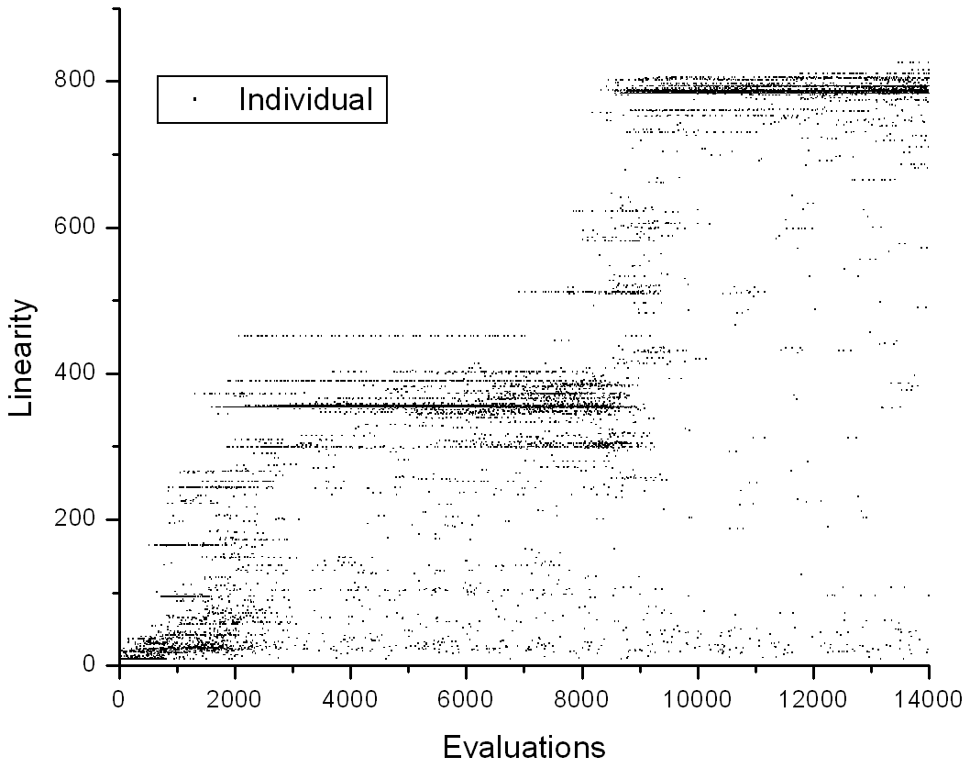
How to Draw a Straight Line Using a GP
A typical run – each dot represents an evaluated individual
Notes:
The search progressed in steps of discovery, as shown in this typical run.
A variety of mechanisms were produced, most with linearity exceeding 1000 (i.e., deviation of one millimeter over a meter) and some as high as 28000 (35μm over a meter).

Slide 37
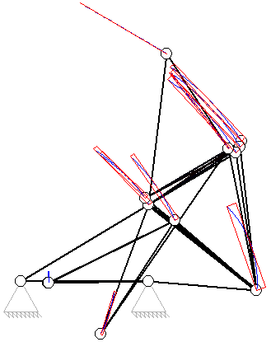
Some results
Linearity 1:4979
Notes:
This machine has a linearity of 4979

Slide 38

Some results
Linearity 1:5300
Infringes on Robert’s Linkage (1841)
Published: Kempe A. B., (1877), How To Draw A Straight Line, London
Notes:
This machine has a linearity of 5300
It clearly infringes on earlier principles of Robert’s Linkage (1841)

Slide 39
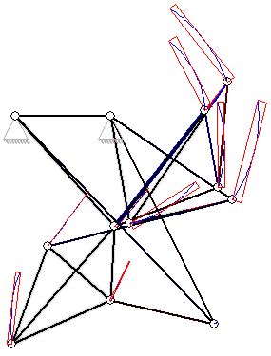
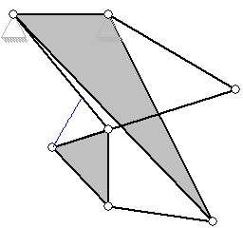
Some results
Linearity 1:12819
Notes:
This machine has a linearity of 12000

Slide 40
Some results
Linearity 1:28340
Notes:
This machine has a linearity of 28000
Many more solutions were evolved

Slide 41
2005 Human-Competitive Awards in
Genetic and Evolutionary Computation cont.
$1000 – Silver
  Richard J. Terrile et al.:
    Evolutionary Computation Technologies for the Automatic Design of Space Systems,
    Evolutionary Computation applied to the Tuning of MEMS gyroscopes,
    Multi-Objective Evolutionary Algorithms for Low-Thrust Orbit Transfer Optimization
$500 – Bronze
  Moshe Sipper et al.: Attaining Human-Competitive Game Playing with Genetic Programming (Backgammon Players, Robocode Players, Chess Endgame)
  Moshe Sipper: Evolved to win
  (http://www.moshesipper.com/evolved-to-win.html)
  Uli Grasemann, Risto Miikkulainen: Effective Image Compression using Evolved Wavelets

Slide 42

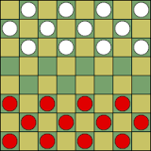
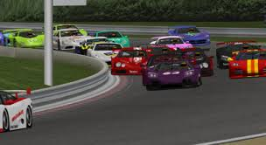
Moshe Sipper: Evolved to Win
Board games
  Checkers
  Chess endgames
  Backgammon
  Simulation games
  Robocode
  Robot Auto Racing Simulator
  Puzzles
  Rush hour
  FreeCell

Slide 43
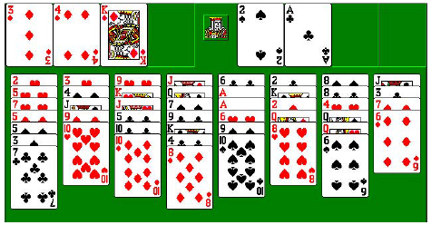
Learning Game Strategies: FreeCell
GP used to evolve heuristics to guide staged deepening search for the hard game of FreeCell.
Trained and tested on 32,000 problems—known as Microsoft 32K—all solvable but one.
FreeCell requires an enormous amount of search, due both to long solutions and to large branching factors.
It remains out of reach for optimal heuristic search algorithms, such as variants of A*.
FreeCell remains intractable even when powerful enhancement techniques are employed, such as transposition tables and macro moves.
The previous top gun is the Heineman’s FreeCell solver
  Heineman’s staged deepening algorithm, based on a hybrid A* / hillclimbing search
  Heineman’s heuristic
solved 96% of Microsoft 32K.
Source: Elyasaf, A. at all.: Evolutionary Design of FreeCell Solvers. 2013

Slide 44
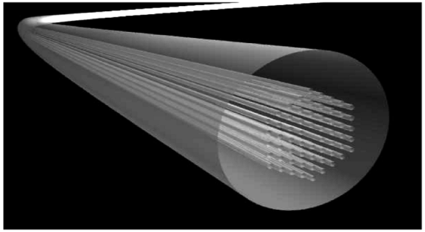
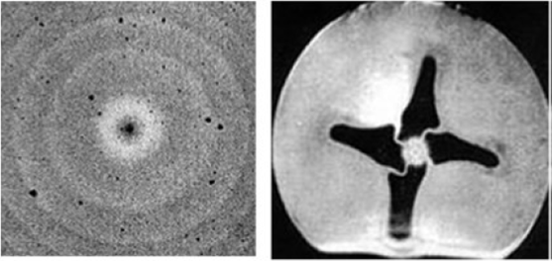
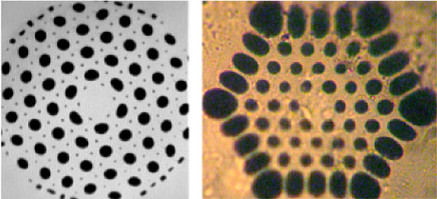
Evolutionary Design of Single-Mode Microstructured Polymer Optical Fibres
Steven Manos, Leon Poladian, Maryanne Large: Evolutionary Design of Microstructured Polymer Optical Fibres using an Artificial Embryogeny Representation
reference: http://www.genetic-programming.org/hc2007/cfe2007.html
Applications of optical fibres
  Long distance telecommunications
  Computer networks
  Automotive and aeronautical
  Electrical current measurement
  Temperature and strain sensing
  Medical (lasers and endoscopy)
The behaviour of light depends on this
internal structure
New functionality = more complex designs?

Slide 45
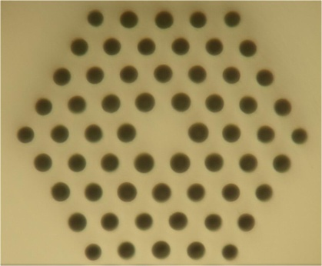
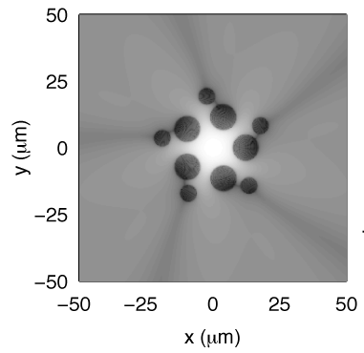
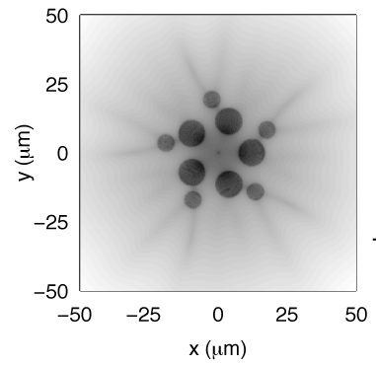
Single-moded fibres
Typical hexagonal design
First mode (confined)
Second mode (leaky)
Standard design since the early 1990’s
Single-moded operation
Single-moded fibres support the propagation of only the fundamental mode.
These fibres are important in applications such as high-bandwidth communications, temperature sensing and strain sensing.
By discovering fibres that don’t have a typical hexagonal design, we can start doing more interesting things with them.

Slide 46
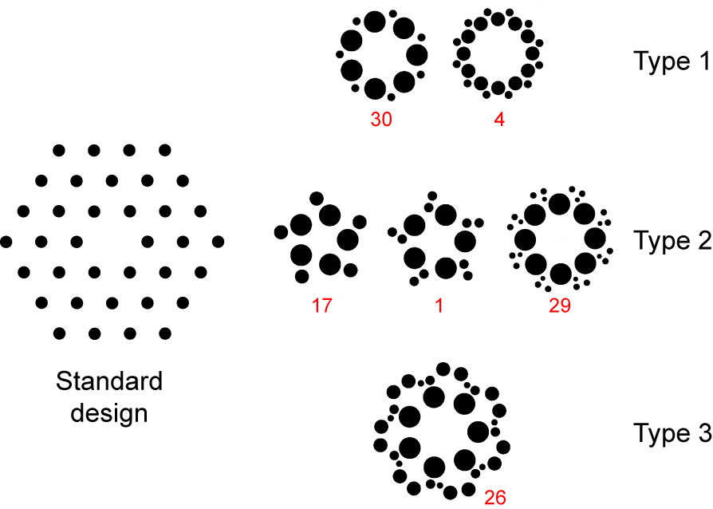
Evolved single-mode designs
All designs have confined fundamental modes with l_{c,1} < 10⁻¹ dB/m, with losses more typically being l_{c,1} < 10⁻³ dB/m.
The loss of the second mode l_{c,2}>10⁴ dB/m in all cases.
All single-moded, yet phenotypically different.

Slide 47
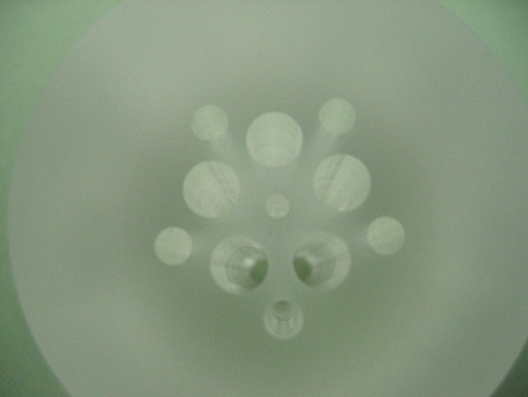
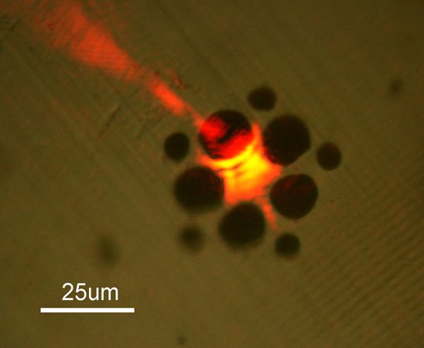
Manufactured single-mode MPOF
Evolved designs are simpler than previous designs, and easier to manufacture.
Provided us with a rich set of never before seen single-moded microstructured fibre designs to investigate further.

Slide 48

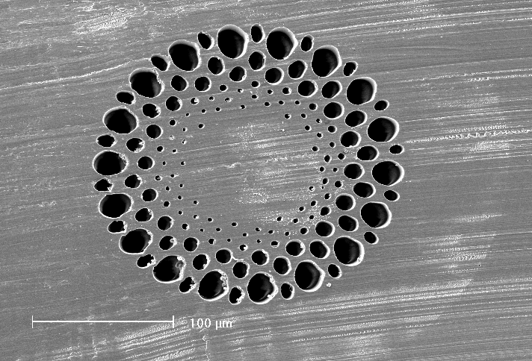

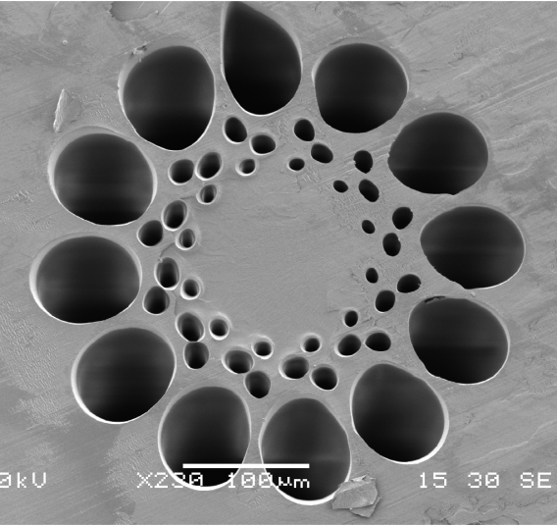
A different fitness function
Highly multi-moded fibres designed for use in LANs and other short-distance high-bandwidth applications.
‘GIMP 1’
Hand-designed fibre
‘GIMP 3’
Patented GA-designed
fewer holes, easier to manufacture.

Slide 49
Automatically Finding Patches Using GP
Fully automated GP-based method for locating and repairing bugs in software
  Set of testcases consists of both
    a set of negative testcases – that characterize a fault
    A set of positive testcases that encode functionality requirements.
  Special GP representation of evolved repaired programs.
    An abstract syntax tree (AST) including all of the statements in the program
    (CIL toolkit for manipulating C programs)
    A weighted path through the program – a list of pairs [statement, weight] where the weight is based on that statement’s occurences in the tescases.
  Genetic operators are restricted to AST nodes visited when executing the negative testcases.
  Genetic operators realize insertion, deletion, and swapping program statements and control flow.
  Insertions based on the existing program structures are favored.
  After a primary repair that passes all negative and positive testcases has been found, it is further minimized w.r.t. the number of differences between the original and repair program.

Slide 50
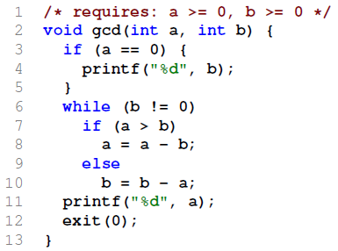
Automatically Finding Patches Using GP
Example: Euclid’s greatest common divisor
Weimer, W. et al.: Automatically Finding Patches Using Genetic Programming
Original program

Slide 51

Automatically Finding Patches Using GP
Example: Euclid’s greatest common divisor
Weimer, W. et al.: Automatically Finding Patches Using Genetic Programming
Original program Primary repair
generated given the bias towards modifying lines that are involved in producing the faults and the preference for insertions similar to existing code.

Slide 52
Automatically Finding Patches Using GP
Example: Euclid’s greatest common divisor
Weimer, W. et al.: Automatically Finding Patches Using Genetic Programming
Original program Primary repair
generated given the bias towards modifying lines that are involved in producing the faults and the preference for insertions similar to existing code.
After repair minimization

Slide 53

Automatically Finding Patches Using GP
10 different C programs of different size totaling 63,000 lines of code (LOC)
Weimer W. et al.: Automatically Finding Patches Using Genetic Programming
Forrest S. et al.: A Genetic Programming Approach to Automated Software Repair, GECCO 2009

Slide 54

Automatically Designing DT Algorithms
  Hyper-heuristic Evolutionary Algorithm for Designing DT algorithms (HEAD-DT)
  automatically seeks for the best combination of the DT components
    Split
      Criterion – index of one of 15 splitting criteria (information gain, Gini, Mantaras, DCSCM, … )
      Binary split - indicates whether the splits of a DT are only binary or multi-way
    Stopping criteria
      Criterion – index of one of 5 strategies
      Parameter of the selected strategy
    Missing values
      Split criterion evaluation – 4 strategies
      Distribution – 7 strategies
      Classification – 3 strategies
    Pruning
      Method – 5 strategies
      Parameter
Barros, R. C. et al.: A hyper-heuristic evolutionary algorithm for automatically designing decision-tree algorithms.
GECCO 2012, 1237-1244.

Slide 55

Automatically Designing DT Algorithms
  Evolutionary Algorithm
  Population size: 100, Generations: 100, Tournament selection: t = 2, 1-point crossover: pc = 0.9, Uniform mutation: pm = 0.1, Elitism: 10
  Example - algorithm designed for the Semeion data set – 1593 inst., 265 att.
 | CART | C4.5 | HEAD-DT
Accuracy | 0.94 ± 0.01 | 0.95 ± 0.02 | 1.0 ± 0.0
F-measure | 0.93 ± 0.01 | 0.95 ± 0.02 | 1.0 ± 0.0
Tree size | 34 ± 12.3 | 55 ± 8.27 | 19 ± 0.0
Very rare

Slide 56

Multiple Traveling Salesman Problem
MTSP – rescue operations planning
  Given N cities and K agents, find an optimal tour for each agent so that every city is visited exactly once.
  The optimization objective is to minimize the overall time spent by the squad (i.e. the slowest team member) during the environment exploration.
VIDEO

Slide 57



Evolutionaty Algorithms for Dynamic Opt.
Dynamic optimizations - a class of problems whose specifications commonly termed
  optimization objectives, and/or
  problem-specific constraints, and/or
  environmental parameters and problem settings
change over time, resulting in continuously moving optima.
    Ex.: Scheduling, manufacturing, trading with stochastic arrival of new tasks, machine faults, climatic change, market fluctuation, economic and financial factors.
    The goal of optimization in dynamic environment is to
  continuously track the optimum, or
  find robust solutions that perform satisfactorily even when the environmental parameters change.

Slide 58

Evolutionary Algorithms for Dynamic Opt.
VIDEO

Slide 59



Floorplanning
Problem: Floorplanning also known as 2D rectangle packing problem.
  Given: A set of N unoriented blocks (rectangles) with fixed dimensions.
  Goal: To place all blocks on a plane so that there is no overlap between any pair of rectangles and the bounding rectangular area is minimal (or the dead space is minimal).
Prototype solution (floorplan)
is encoded by B*-Tree non-slicing
representation.
Each tree is expressed by a linear
string of symbols in a prefix not.
Optimization works on linear structs.
Ex.: Blocks {a, b, c, d, e, f} should be placed in a rectangular area so that the bounding rectangular area is minimal (or the dead space, shown in gray, is minimal).
floorplan
B*-tree representation

Slide 60
Floorplanning
Actions (variation operators used as building blocks of the action sequences)
  Flip – rotates a block of the specified tree node.
  Mirror – swaps the left and right child of the specified tree node.
  Rotate – recursively flips and mirrors child nodes of the specific node.
  ExchangeNodes – exchanges blocks between two specified tree nodes.
  ExchangeSubtrees – exchanges sub-trees rooted in two specified tree nodes.
  MoveSubtree – places a specified node with its sub-tree to a new position in the tree.
  Compared algorithms
  CompaSS - commercially available program.
  B*-Tree/l , B*-Tree/SA – approaches using the same B*-tree representation searching the space of all possible floorplans by means of local search algorithm and simulated annealing, respectively.
  Main achievements
  POEMS generates floorplans comparable and better than the ones generated by B*-Tree/l and B-Tree/SA algorithms.
  POEMS clearly outperforms CompaSS algorithm w.r.t. the quality of the generated floorplans.

Slide 61


Floorplanning
  Examples of results obtained for 300 blocks.
  Hordějčuk, V.: Optimisation of Rectangular Shapes Placement by Means of Evolutionary Algorithms. Master thesis, Czech Technical University in Prague, Faculty of Electrical Engineering, 2011.
3.8% dead space
4.6% dead space

Slide 62

Floorplanning
  Visualization of a POEMS run on data with 300 blocks.
VIDEO
By V. Hordějčuk.

Slide 63


Evolution of Modular Robot Gaits
  Design of an effective and efficient evolutionary-based system for automated generating of modular robot gaits:
  robots composed of a number of simple cubic-shaped robotic blocks,
  each block is endowed with slots (three of them on the main body and one is on the movable arm) that enable them to connect to each other and form more complex robots,
  Approaches:
  Co-evolution of a single leg motion pattern and a coordination strategy
  HyperGP – neuroevolutionary-based approach
  GP with automatically defined functions
  Černý, J. and Kubalík, J.:Analysis of Co-evolutionary Approach for Robotic Gait Generation. In ECTA 2013.
  Černý, J. and Kubalík, J.:Co-evolutionary Approach to Design of Robotic Gait. In EvoRobot 2013.
  Blovský, T.: Robustní genetické programování pro návrh řídící strategie robotu. Diploma Thesis, ČVUT FEL, 2013
  Dvorský, J.: Neuroevolutionary design of control strategy of a multi-legged robot. Bachelor Thesis, ČVUT FEL, 2013

Slide 64



GP for RL: Benchmark
  1-DoF pendulum swing-up
  A weight of mass m attached to an actuated link that rotates
  in a vertical plane.
  The available torque is insufficient to push the pendulum up
  in a single rotation from the majority of initial states.
  It needs to be swung back and forth to gather energy, prior to
  being pushed up and stabilized.
  State vector is [$α$, $\dot{α}$] – position and angular velocity
  Angle $α$ varies in [-π, π]
  Control action u is limited to [-2, 2] V
  The continuous-time model of the pendulum dynamics is
  $\ddot{α}=\frac{1}{J}∙\left[mgl\sin{(α)}−b\dot{α}−\frac{K^{2}}{R}\dot{α}+\frac{K}{R}u\right]$
  where
  $J=1.91∙{10}^{−4}$ kgm² , $m=0.055$ kg, $g=9.81$ ms⁻², $l=0.042$ m
  $b=3∙{10}^{−6}$ Nms/rad, $K=0.0536$ Nm/A, $R=9.5$ Ω
  The sampling period is Ts = 0.01 second.
  The discrete-time transitions are obtained by numerically integrating the continuous-time dynamics using the fourth-order Runge-Kutta method.
  The control goal is to stabilize the pendulum in the unstable equilibrium
  $α=\dot{α=0}$

Slide 65




GP for RL: V function, policy
  Task: Finding a symbolic model from a set of discrete samples of known numerical approximation of the V and policy functions.
Symbolic V function
vs.
Numerical approximation
Symbolic policy
vs.

Slide 66

GP for RL: Learning V function

Slide 67

GP for RL: Learning V function

Slide 68


GP for RL: Fitting Transition Model

Slide 69



Evolutionary design of image filters
Can EA design an image filter which exhibits better filtering properties and lower implementation cost w.r.t. conventional solutions?
Target domain: filters suppressing shot noise, Gaussian noise, burst noise, edge detectors, …

Slide 70

Image filter in CGP
Array of programmable. elements (PE).
No feedbacks.
All I/O and connections on 8 bits.
PE over 8 bits:
  Minimum
  Maximum
  Average
  Constants
  logic operators
  shift
9 x 8bits
1 x 8bits
Sekanina L.: EvoAISP 2002

Slide 71






Burst Noise Filtering
Image corrupted by 5% impulse bursts noise.
CWMF
AMF
evolved
PWMAD
VAŠÍČEK, BIDLO, SEKANINA: Evolution of efficient real-time non-linear image filters for FPGAs. Soft Computing. 17(11), 2013

Slide 72
GP for CNN Architectures Design
  Cartesian genetic programming (CGP) for automatic construction of CNN architectures for an image classification.
  High-level functional modules as the SNGP nodes
  ConvBlock consists of standard convolution processing with a stride of 1 followed by batch normalization and rectified linear units (ReLU)
  ResBlock is composed of a convolution processing, batch normalization, ReLU, and tensor summation
  max and average poolings
  concatenation function concatenates two feature maps in the channel dimension
  summation performs the element-wise addition of two feature maps, channel by channel
  Output node represents the softmax function with the number of classes.
Source: Suganuma, N. at all.: A Genetic Programming Approach to Designing Convolutional Neural Network Architectures. 2017

Slide 73
GP for CNN Architectures Design
  Outline of the method
  CNN architecture are trained on training set
  and assigned the validation accuracy of the trained model as the fitness
Source: Suganuma, N. at all.: A Genetic Programming Approach to Designing Convolutional Neural Network Architectures. 2017

Slide 74
GP for CNN Design: Examples
CGP-CNN (ConvSet)
CGP-CNN (ResSet)
Source: Suganuma, N. at all.: A Genetic Programming Approach to Designing Convolutional Neural Network Architectures. 2017

Slide 75

Surprising Creativity of Digital Evolution
Elbow Walking, Cully et al. (2015)
  an algorithm that enables damaged robots to successfully adapt to damage
  how the evolution solves the case where all six feet touch the ground 0% of the time
Source: Lehman, J. at all.: The Surprising Creativity of Digital Evolution: A Collection of Anecdotes from the Evolutionary
Computation and Artificial Life Research Communities. 2018

Slide 76

Surprising Creativity of Digital Evolution
Evolution of Muscles and Bones, Cheney et al. [68]
  evolution to discover from scratch the benefit of complementary (opposing) muscle groups, similar to such muscle pairs in humans, e.g. biceps and triceps – and also to place them in a functional way
Source: Lehman, J. at all.: The Surprising Creativity of Digital Evolution: A Collection of Anecdotes from the Evolutionary
Computation and Artificial Life Research Communities. 2018

Slide 77

Surprising Creativity of Digital Evolution
Re-enabling Disabled Appendenges, Ecarlat and colleagues [85]
  The goal was to accumulate a wide variety of controllers, to move the cube onto the table, to grasp the cube, to launch it into a basket in front of the robot, …
  Then the robot’s gripper was crippled, preventing it from opening and closing, …
Source: Lehman, J. at all.: The Surprising Creativity of Digital Evolution: A Collection of Anecdotes from the Evolutionary
Computation and Artificial Life Research Communities. 2018

