Slide 1
A New Artificial Intelligence 8
Kevin Warwick

Slide 2
Growing Brains
Biological AI
Cultured Neural Networks
Technical Aspects
What does it involve?
Where does it stand?
Where is it heading?
Problems/issues?

Slide 3
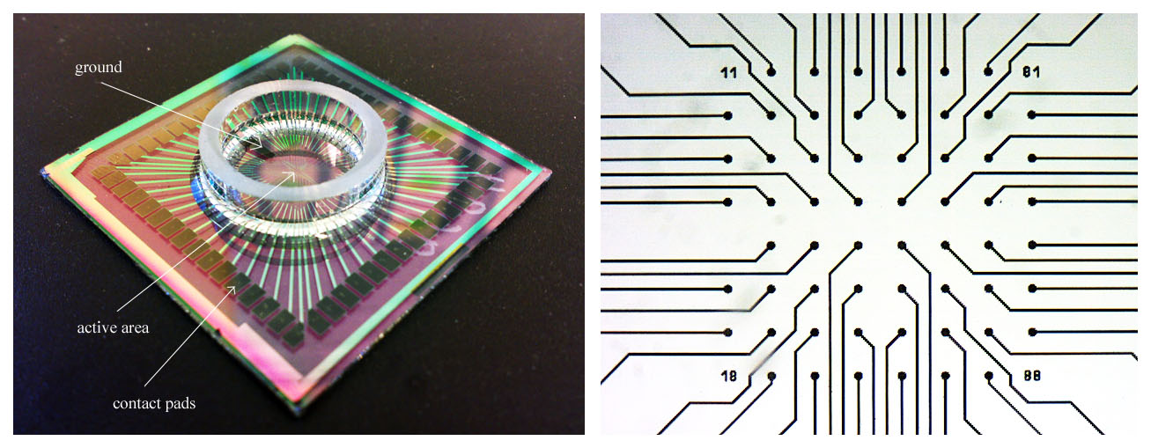
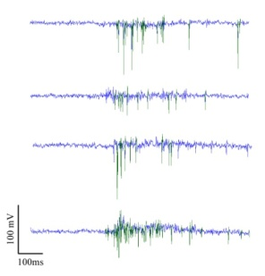
Using multi-electrode arrays to investigate the computational properties of cultured neuronal networks
Notes:
3
here

Slide 4
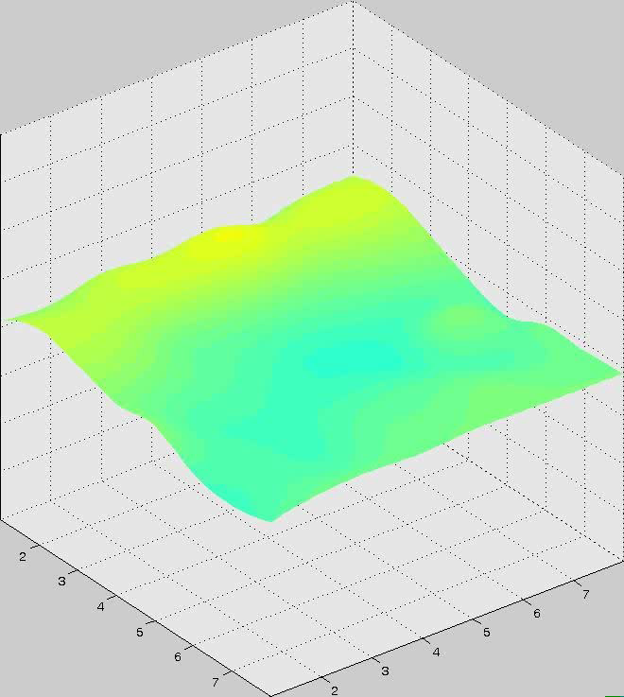
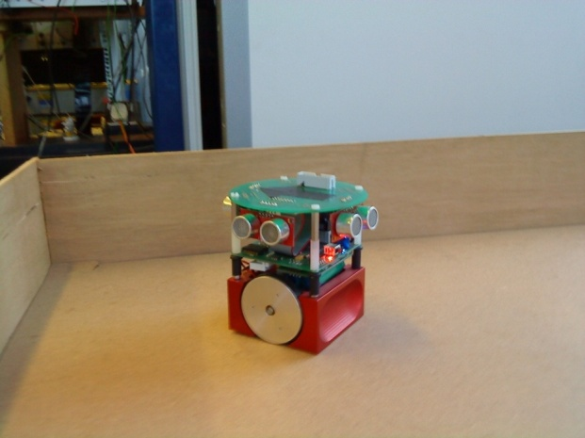
Contents
Project concept: overview
Prior work in this area
Infrastructure building
  Restriction
  Evaporation
  Movement
  Stimulation
Function of the cholinergic system & relevance
Findings
Ongoing work
Future

Slide 5
Why?
Why not?
Understand memory – Alzheimer’s Disease
Understand – neural death/plasticity – Stroke
Regeneration through stem cells – extend memory & life
Understand basic learning
Future robots?

Slide 6
Project Concept
How
Re-embody a culture of neurones using a robot, enabling it to interact with its environment and so influence future ‘sensory’ input.
Investigate cellular level correlates to higher behavioural processing.

Slide 7





Robot with a Biological Brain
A closed loop interface between a biological network and a robot
Biological neural network
Grown directly on to Multi-electrode array
Intranet
Culture – Robot mapping, Machine learning.
Dimensionality reduction, spike train analysis
Robot running on powered floor

Slide 8
Run Down
Neurones from rat embryos
Neurones separated using enzymes
Laid out on an MEA – 2-D
Fed
20 mins – projections
1 week – brain activity

Slide 9
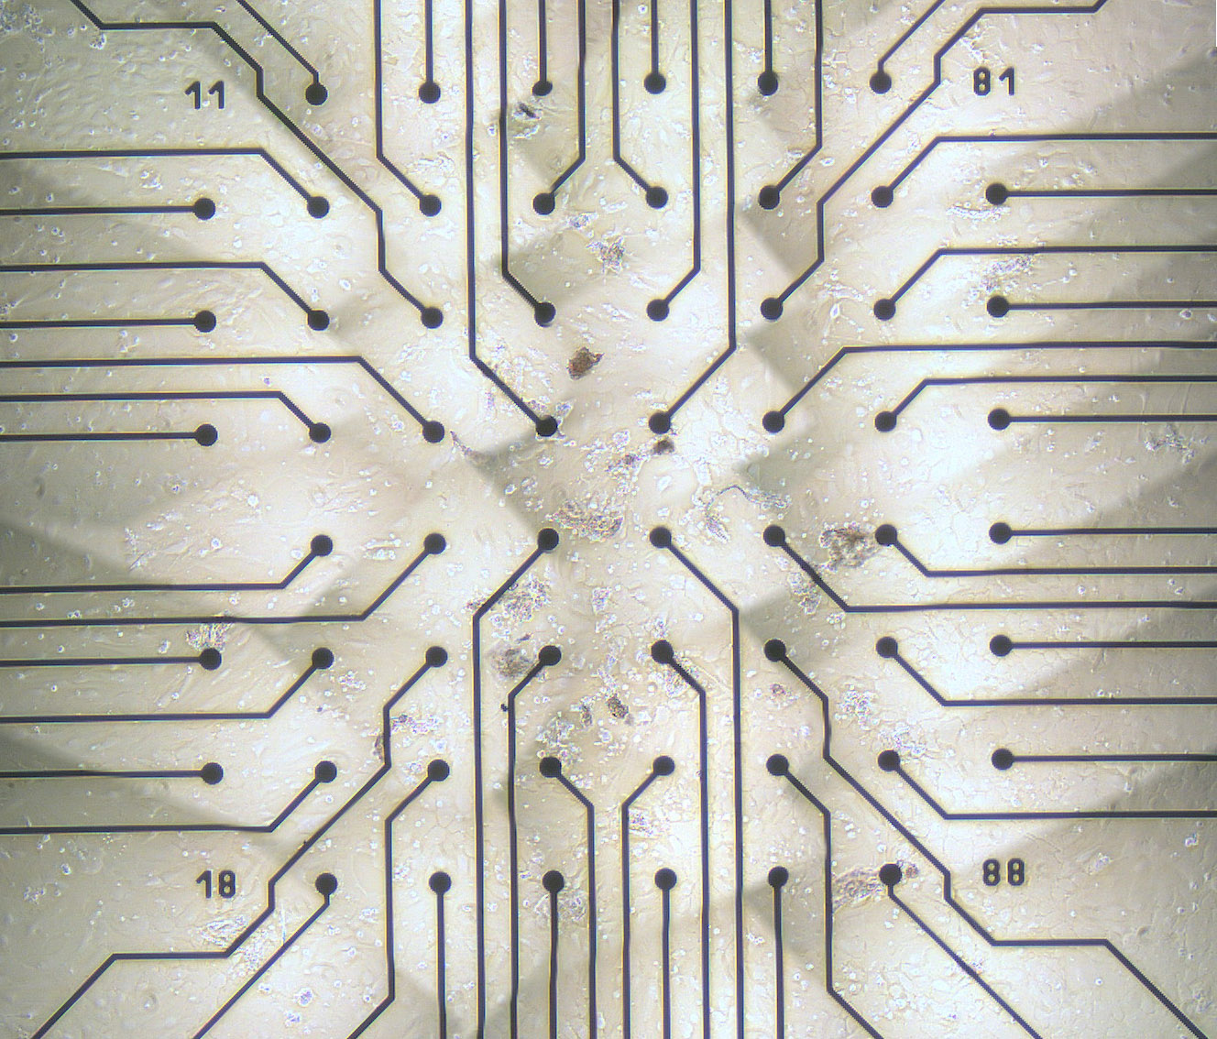
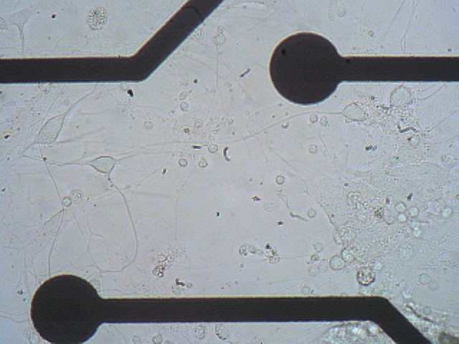
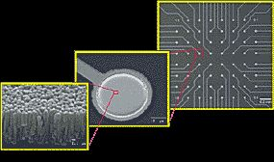
Approach
Culture brain cells directly on to a recording surface and re-embody the ‘brain’ within a robotic body.
  Multi-Electrode Array (MEA) allows recording from 128 electrodes across the entire culture.
200μm
TiN Electrodes
30μm diameter
Neurone

Slide 10
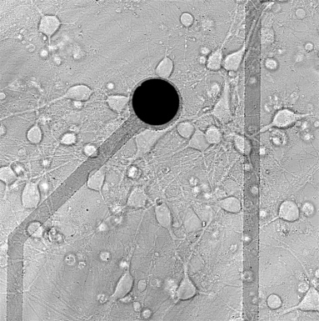
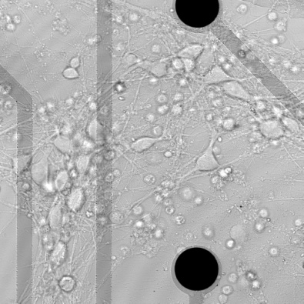
Overview
How do neurones process sensory input to produce useful behaviours?
Culture processes input
…

Slide 11
Why re-embody using a machine system?
  Limited sensory input in vivo results in poorly developed and dysfunctional neural circuitry
  An embodied culture is able to influence its own self.
  Environmental interaction should result in more meaningful activity than internal self-referencing alone?
  Non invasive / non destructive recording.
  Recording from entire structure.
  Circuits develop in the presence of ‘test’ stimuli.
Advantages over in vivo (already embodied)

Slide 12
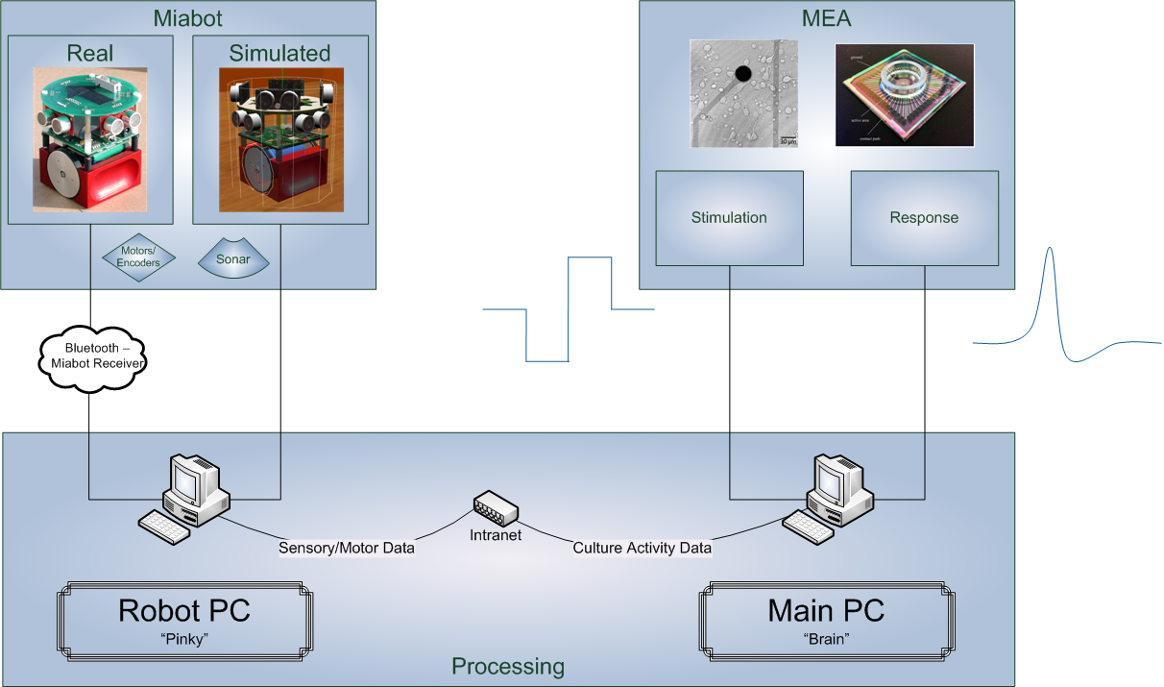
Hardware/software overview

Slide 13
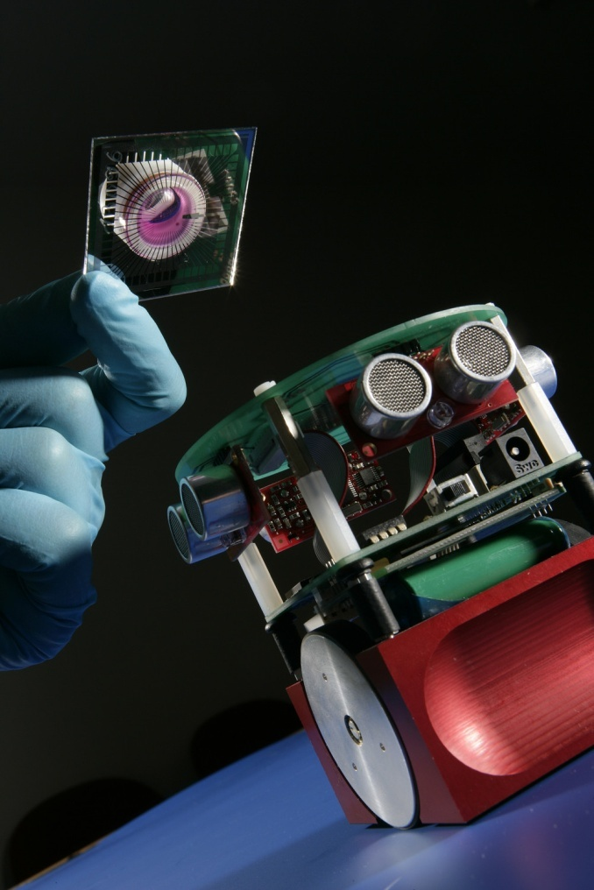
Other work
Steve Potter (Georgia Tech)
  First simulated animat
Ulrich Egert (Freiburg)
  Hardware prototyping
  Analytical tool development (MATLAB)
Takashi Tateno (Osaka)
  Cortical culture characterisation on MEA
Shimon Marom (Haifa)
  Complexity and learning

Slide 14
Validation & Characterisation
Create a stable environment
Clean acquired data
Characterise spontaneous activity
Set up robot – culture interface
Test with simple ‘known response’ mapping
Sort data from electrodes to individual units?
Develop analysis tools
Use computers to automatically train the culture
Map connectivity
Model / simulate the culture
Compare behaviour to model and refine
1) At which point in development?
2) What type of stimulation?
3) How to gain the culture’s attention?
4) Which areas for input / output?
5) How to effectively store memories
Find suitable features to map between culture activity and robot
Can pharmacological manipulation of
cholinergic systems answer
Some of these questions…

Slide 15
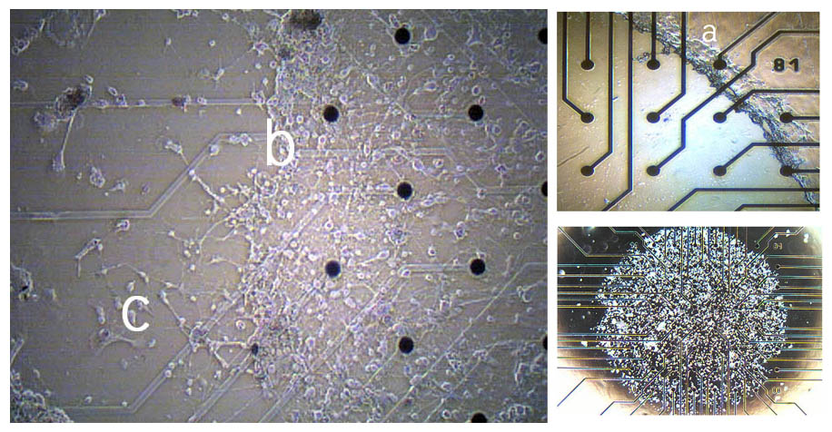
Infrastructure building: culture restriction

Slide 16
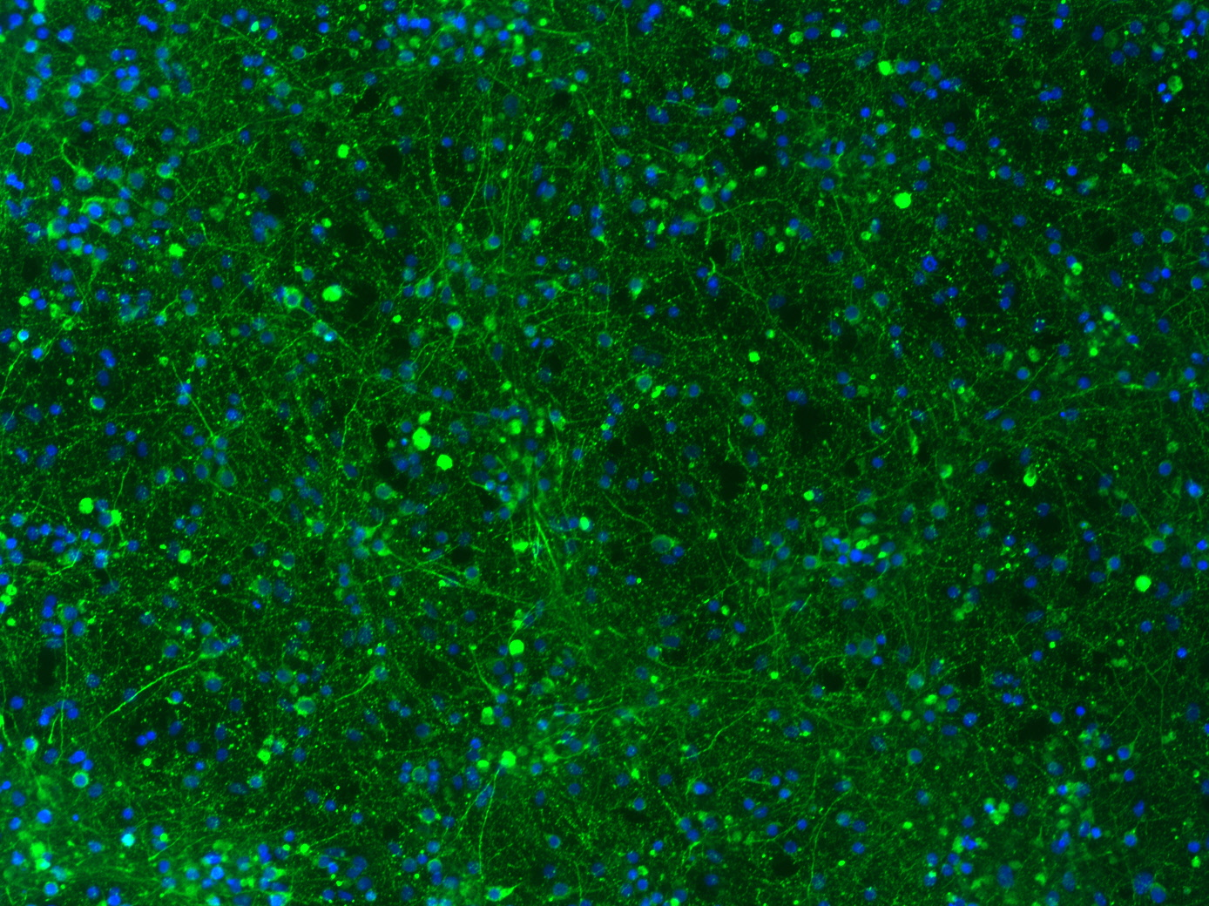
Cell Density

Slide 17
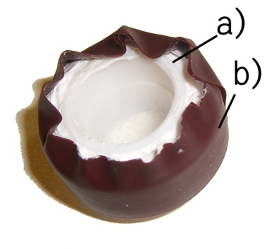
Infrastructure building: evaporation
100
90
80
70
60
50
% max ASDR (5 min bins)
40
30
20
10
0
0
1
2
3
4
5
6
7
8
Hours

Slide 18
Infrastructure building: evaporation
0.006
0.005
0.004
g / hour
*
0.003
μ
0.002
*
0.001
0
Original Potter
Potter Rings -
Modified Potter
Rings
no inlets
Rings
* P<0.05

Slide 19
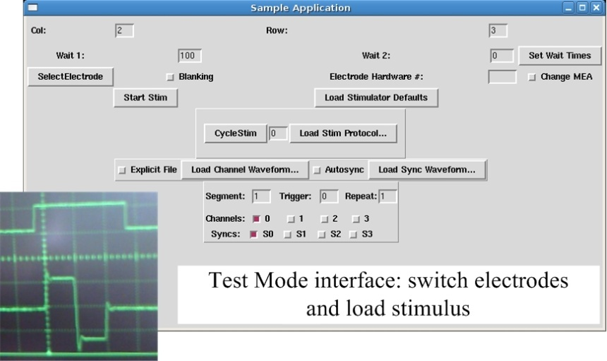
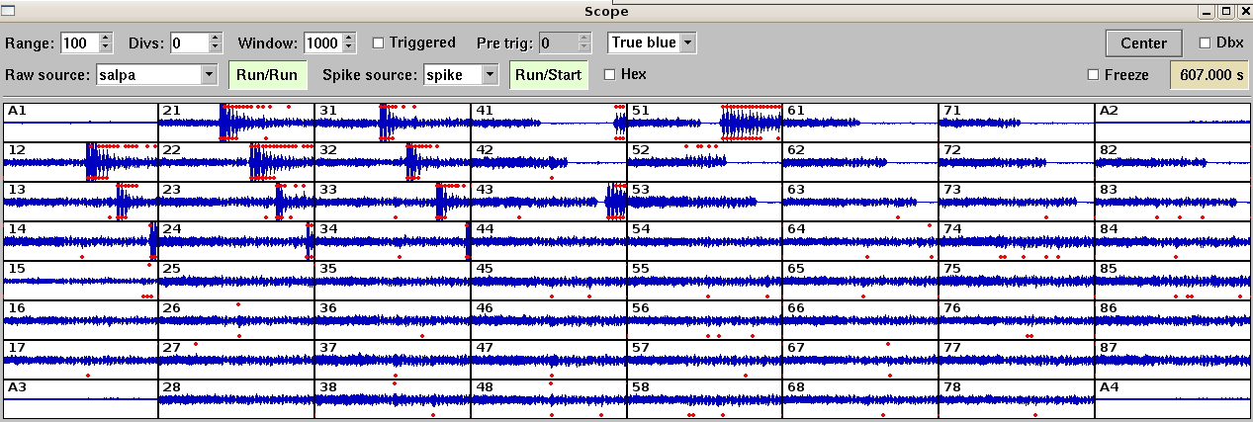
Infrastructure building: stimulation
Linux based
Open Source (GPL2)
Hardware driver and GUI available and tested
Test, live and user modes
Integrated with MEABench

Slide 20
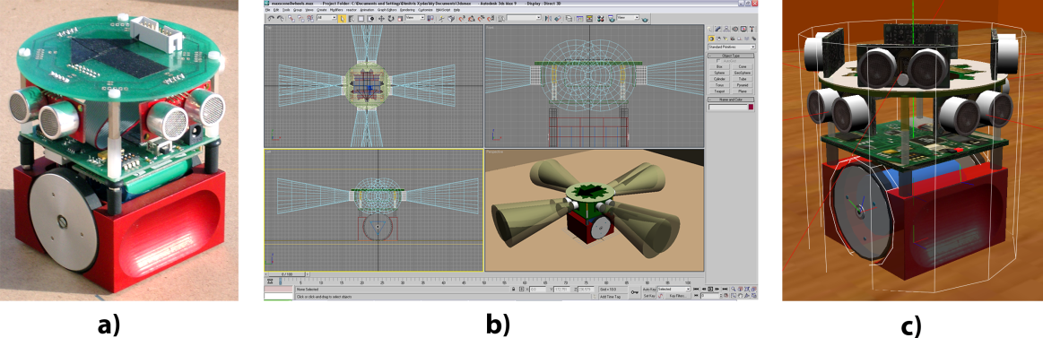
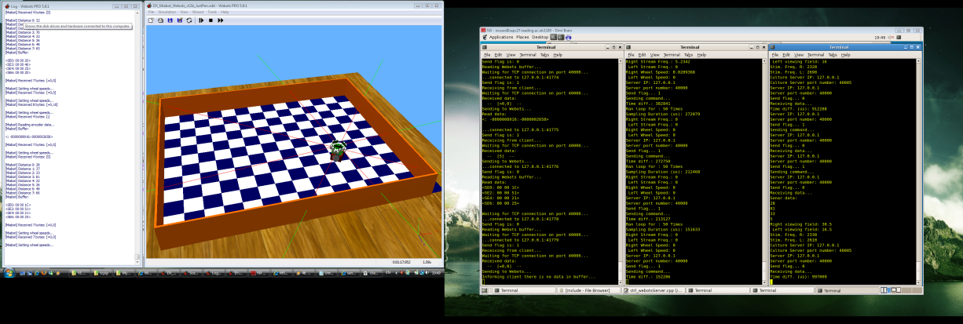
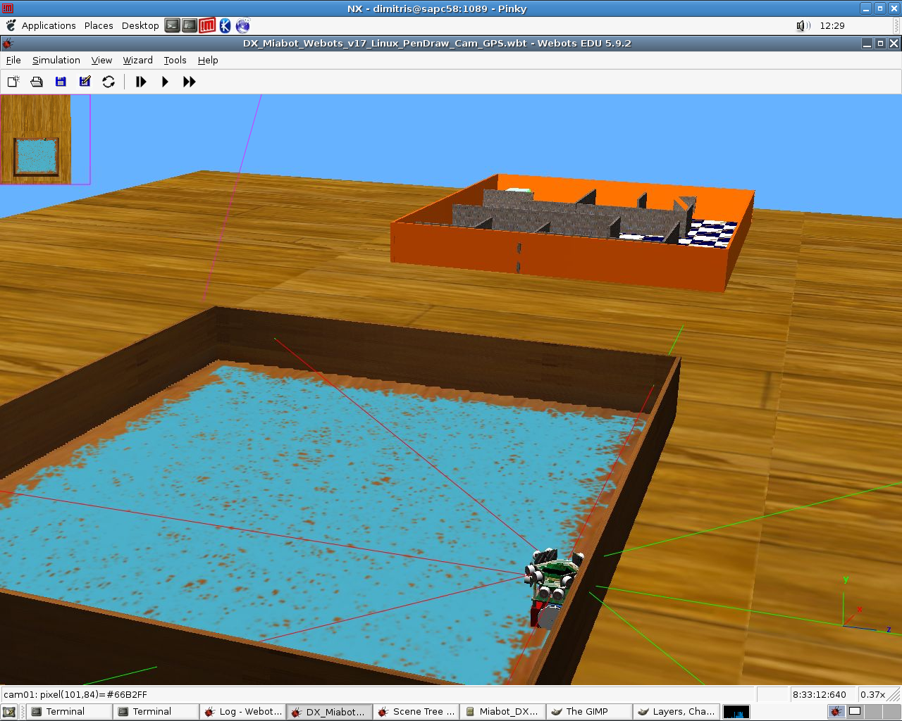
Infrastructure building: simulation
A simulated counterpart is useful for many reasons
  No physical constrictions
  Faster development
  More efficient control
VRML 3D Model
  Imported into Webots robot development software
Linked with closed loop
  Ideal experimental platform for RL

Slide 21
Interim summary
First 3 years:
  Stable environment
  Variability controlled
  Culture seeding and growth restricted
  Ability to take accurate, timestamped measures from all systems
  Long term recordings
  Full control over stimulation
  Real and simulated environments
  What will we do with it?

Slide 22
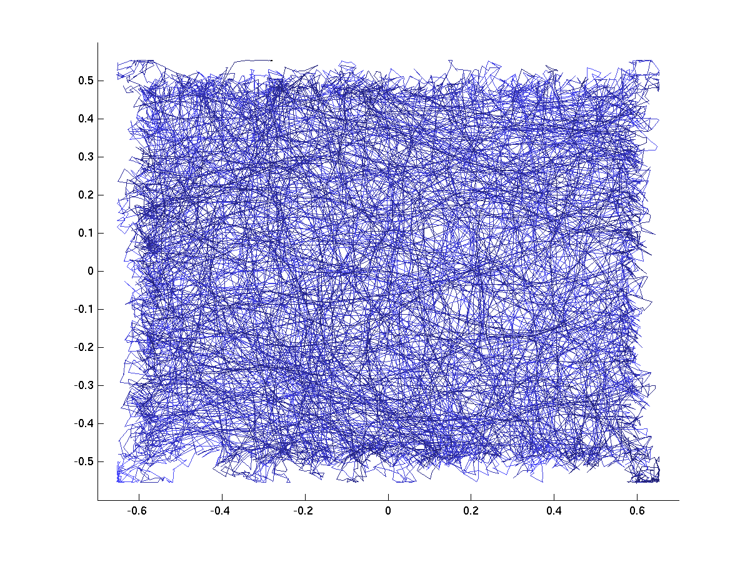
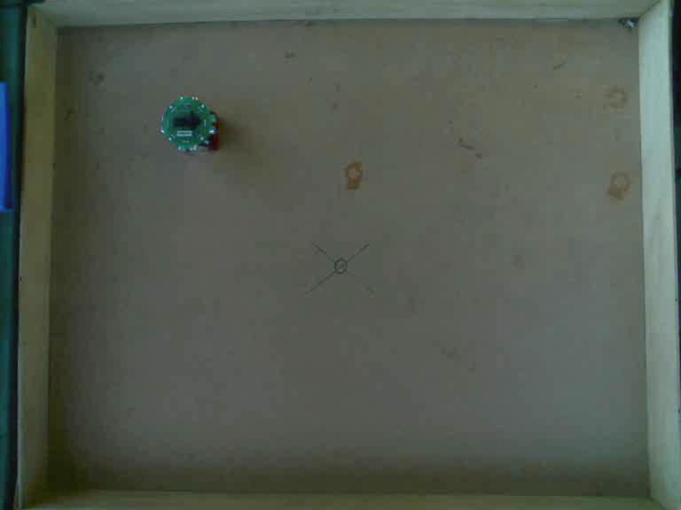
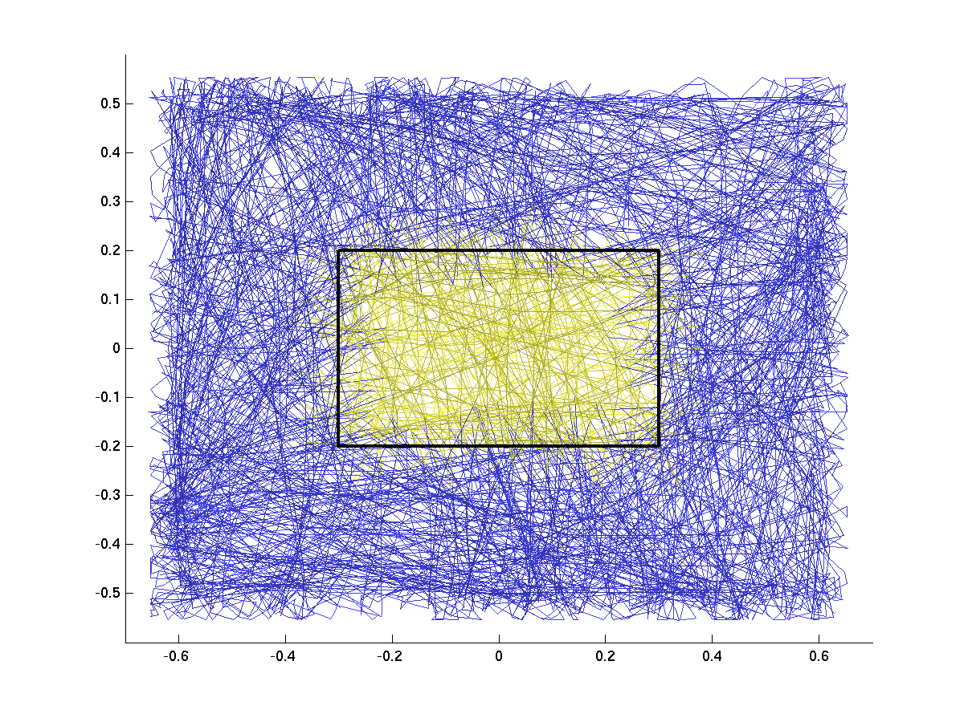
Stability testing: wall avoidance

Slide 23


Slide 24


Slide 25


Slide 26
Current work
Reinforcement learning and hidden Markov models
Functional connectivity maps
Plasticity-induced changes and maintenance

Slide 27
Observations/Conclusions
Hebbian Learning
Sleep time?
100,000 Neurones typical
Neurone Specialisation - Functionality
Old Age?

Slide 28
Information
Youtube – “robot with a rat brain” or “Kevin Warwick” (1 million downloads)
Google – as above
New Scientist

Slide 29
Next
Philosophy of Biological AI

Slide 30
Contact Information
Web site: www.kevinwarwick.com
Email: k.warwick@reading.ac.uk
Tel: (44)-1189-318210
Fax: (44)-1189-318220
Professor Kevin Warwick, Department of Cybernetics, University of Reading, Whiteknights, Reading, RG6 6AY,UK

