Slide 1
Ray Tracing for Games
Dr. Jacco Bikker - FEL/CVUT, Prague, March 9 - 20
Final Lecture

Slide 2
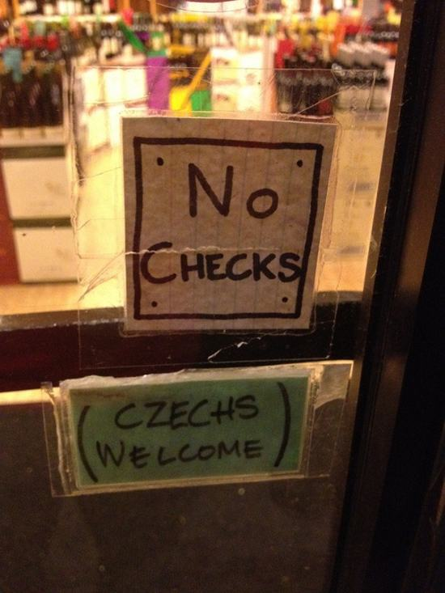
Ray Tracing for Games
Agenda:
Path Classification
Virtual Point Lights
Photon Mapping
Bias
Total Recap

Slide 3
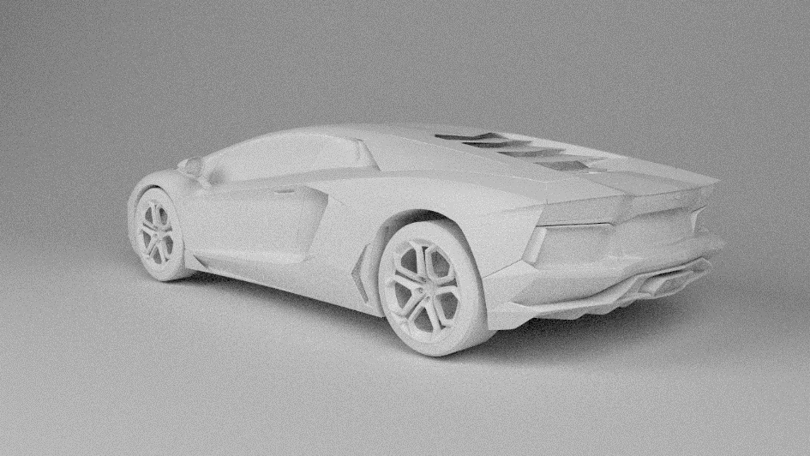
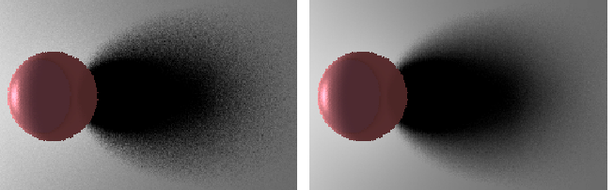
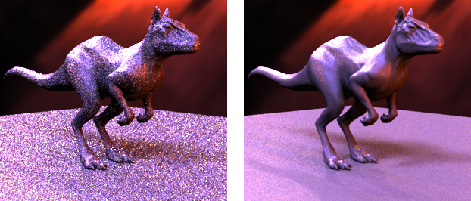
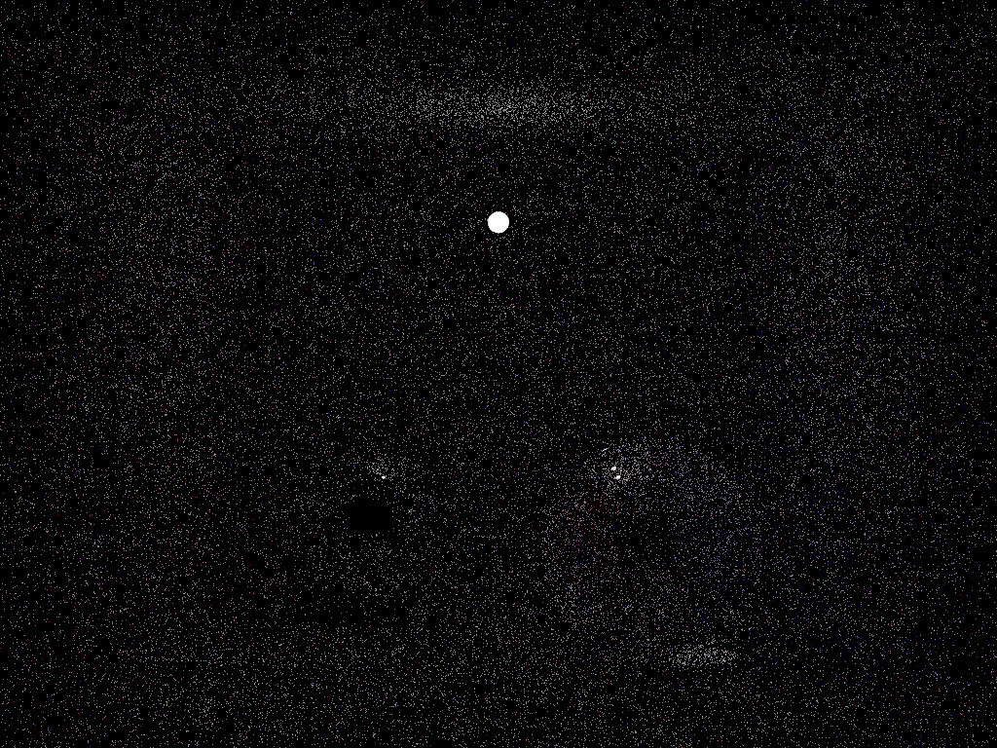
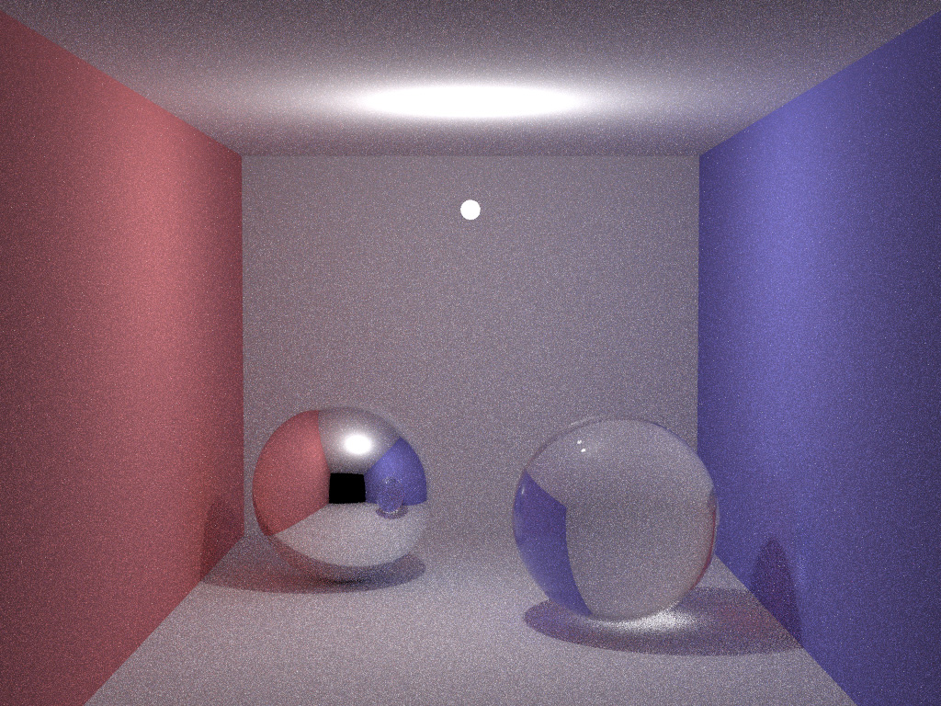
Ray Tracing for Games
Path Classification
Sampling matters
32spp
16spp

Slide 4
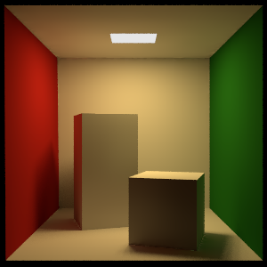
Ray Tracing for Games
Path Classification
EL
Path classification*
E: Eye
L: Light
D: Diffuse
S: Specular
(G: Glossy)
*: Heckbert 1990, “Adaptive radiosity textures for bidirectional ray tracing”
Path tracing:
ED*L
E(D|S|G)*L
E[(D|S|G)*]L
Whitted:
E[S*](D|G)L
EDL
EDDL

Slide 5
Ray Tracing for Games
Path Classification
Path Classification
Whitted: E[S*]DL
Cook: E[[S*]D]L
Kajiya: E[(D|S)*]L
Path classification helps to describe which paths an algorithm can produce, and which it cannot.
It also helps to describe which type of paths an algorithm excels at, and which paths cause problems.

Slide 6
Ray Tracing for Games
Path Classification
Path Classification
Caustics:
EDSL
A path tracer has problems with these paths.
The caustic paths transport a lot of energy, but they have a low probability of being sampled:
Explicit light paths cannot be used, so we end up with the ‘naïve path tracer’ efficiency.
?

Slide 7
Ray Tracing for Games
Path Classification
Path Classification
Nightmare paths:
Diffuse object embedded in glass
ESDSL

Slide 8
Ray Tracing for Games
Agenda:
Path Classification
Virtual Point Lights
Photon Mapping
Bias
Total Recap

Slide 9
Ray Tracing for Games
Instant Radiosity
Basic idea:
Phase 1: Trace random paths from the light sources. Place a ‘virtual point light’ on the first diffuse surface.
Phase 2: Render the scene, and add the illumination of the VPLs to the direct illumination.

Slide 10
Ray Tracing for Games
Instant Radiosity
Spawning paths from the light:
Randomly.
For one point light source, we start paths in all directions, uniformly distributed.
For multiple point lights, each light spawns a fraction of the total, proportional to its intensity.
For an area light, we spawn with a cosine weighted random distribution.

Slide 11
Ray Tracing for Games
Instant Radiosity
Creating the VPLs:
Each VPL carries a portion of the energy of the light it originated from: E_{vpl} = E_{light} / N_{light}.
When the VPL arrives at a surface, we apply N·L.
From here:
The VPL is now a valid light source, representing light reflected by the diffuse surface.

Slide 12
Ray Tracing for Games
Instant Radiosity
Physical basis of Instant Radiosity:
The VPLs represent the indirect illumination in the scene. Their contribution is added in phase 2 to the output of a Whitted style ray tracer (which only registers direct illumination).
Assuming we have an infinite number of VPLs, this yields the correct solution.
Notes:
VPLs do not remember where they came from
VPLs find the first diffuse surface: this may require bounces
Mind the weak singularity!

Slide 13
Ray Tracing for Games
Instant Radiosity
Bidirectional
Instant Radiosity is a bidirectional method:
We trace paths from the eye, as well as from the camera;
Complete paths are formed by:
Direct illumination: eye paths that reach a light
Connection: eye path connected to a light path.
Note that we should count paths twice; eye paths should therefore not even attempt to sample indirect light.
When we obey these rules, Instant Radiosity is physically correct.

Slide 14
Ray Tracing for Games
Instant Radiosity
Path classification
Caustics:
EDSL
VPLs are generated using paths from the eye. Does Instant Radiosity handle this better than path tracing?
Answer: No.
IR improves EDD[S*]L.
?

Slide 15

Ray Tracing for Games
Instant Radiosity

Slide 16
Ray Tracing for Games
Agenda:
Path Classification
Virtual Point Lights
Photon Mapping
Bias
Total Recap

Slide 17
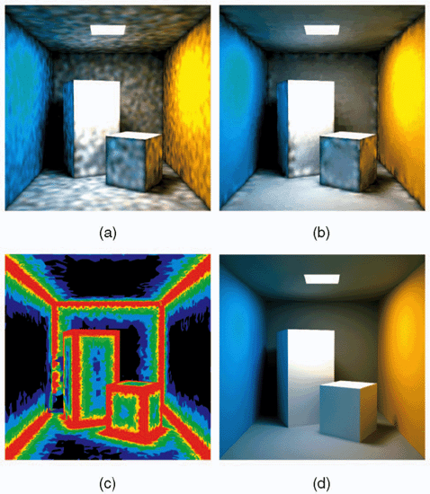
Ray Tracing for Games
Photon Mapping
Core idea:
We shoot a large number of ‘photons’ (energy packets) from the light sources, and record when they encounter a diffuse surface.
Instead of creating a VPL at those locations, we store:
Position
Energy
Incoming direction
The photon map is a structure that allows us to find photons near a point in 3D space (within a certain radius). This is typically a kD-tree (but a grid or octree also works).

Slide 18
Ray Tracing for Games
Photon Mapping
Using the photon map:
Option 1: direct visualization
Trace a path from the eye, and on the first diffuse surface, find entries in the photon map within a small radius. Using the eye ray direction, and the direction stored with each ‘photon’, evaluate the BRDF.
Problem: this only yields smooth illumination if we have a very large number of photons (even in ‘hard to reach’ areas), or if we use a large search radius (which blurs the illumination).
Paths: ED[S*]L

Slide 19
Ray Tracing for Games
Photon Mapping
Using the photon map:
Option 2: final gather
Trace a path from the eye, and on the first diffuse surface, fire N rays in random directions (but proportional to the BRDF). Sample the photon map at the first diffuse surface.
Paths: E(D|G)D[S*]L

Slide 20
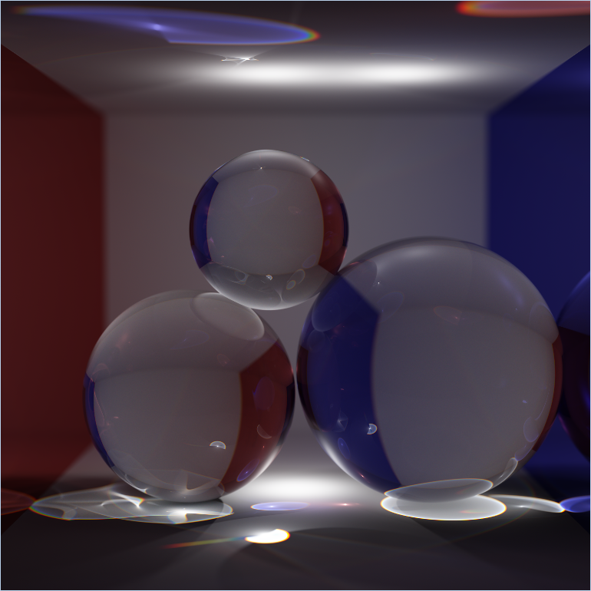
Ray Tracing for Games
Photon Mapping
Photon Mapping
Like Instant Radiosity, Photon Mapping is a bidirectional method.
Unlike Instant Radiosity, Photon Mapping supports non-diffuse BRDFs.
Jenssen proposed to store not one, but two photon maps for a scene.
A low-density photon map, to be used with final gathering:
stores photons that did not arrive via a specular surface.
A high-density photon map, to be visualized directly:
stores photons that arrive via a specular surface (caustics).
Note that the union of the sets of light transport paths for each photon map is empty.

Slide 21
Ray Tracing for Games
Photon Mapping

Slide 22
Ray Tracing for Games
Agenda:
Path Classification
Virtual Point Lights
Photon Mapping
Bias
Total Recap

Slide 23
Ray Tracing for Games
Bias
Bias
When does a stochastic method produce the correct result?
Uniform sampling: picking a random light, scale by N_{lights}.
Importance sampling: picking a light with probability P, scale by N_{lights}/P.
Russian Roulette: at a diffuse bounce kill a path with a 50% probability, amplify survivors by 200%.
These methods have the following properties:
They converge to the same image, as long as P > 0.
We can generate ∞ images using 1 sample and average them; this yields a correct image.
UNBIASED

Slide 24
Ray Tracing for Games
Bias
Bias
Photon mapping does not meet these criteria:
We sample illumination within a certain radius, which means we interpolate samples without taking into account factors that cannot be interpolated (e.g., visibility).
However, if we reduce the search radius to an infinitely small value (>0), the method produces correct results. We call this behavior consistent.
CONSISTENT

Slide 25
Ray Tracing for Games
Bias
Bias
Whitted style ray tracing also does not meet all these criteria:
In Whitted style ray tracing, some paths have a zero probability of being selected. Algorithms that show this behavior (or simply produce wrong answers for the integrals of the rendering equation) are labelled as biased.
(Quick exercise: you wrote a path tracer that allows up to 512 bounces, at which point paths are always terminated. Is this path tracer unbiased?)
(Quick exercise 2: your path tracer sometimes produces bright speckles. To get rid of those, you post process the rendered image to remove extremely bright dots. Is this renderer unbiased?)
(Quick exercise 3: you wrote a rasterizer that, for every point on a polygon, renders its surroundings to a cubemap, which it then uses to shade the point. Is the rasterizer unbiased?)
BIASED

Slide 26
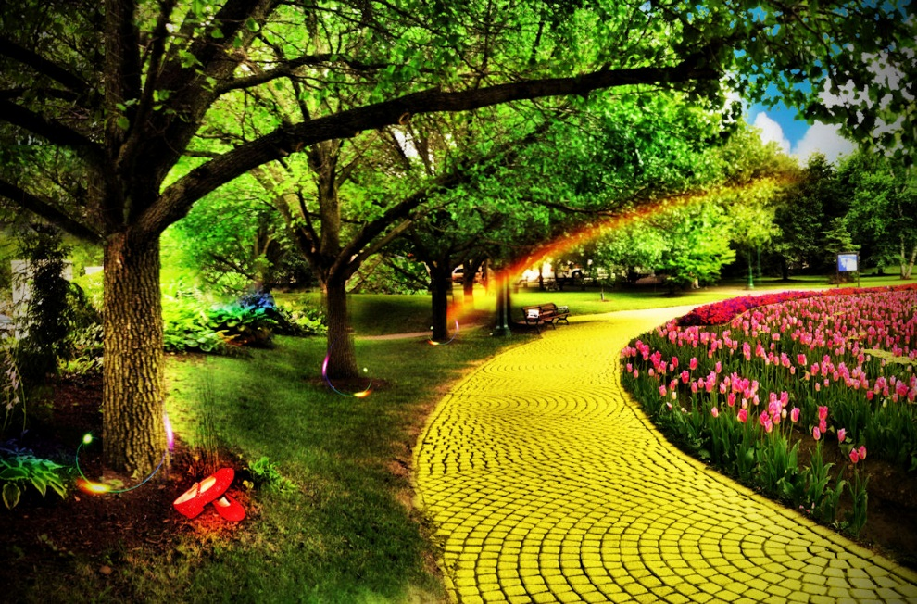
Ray Tracing for Games
Quo Vadis
Where to go from here:
VPLs are great with rasterizers. You can add tiny shadow maps to them, or skip the visibility issue to get some cheap color bleeding in your engine.
VPLs do not have to be generated by uniform sampling. Just make sure that if the direction you spawn them in has a probability P of being selected, their energy is scaled by 1/P.
VPLs are one example of path reuse: many camera paths use the same light paths.
Explicit light sampling is also a form of path reuse.
…

Slide 27
Ray Tracing for Games
Agenda:
Path Classification
Virtual Point Lights
Photon Mapping
Bias
Total Recap

Slide 28
Ray Tracing for Games
TOTAL
RECAP
TOTAL
RECAP

Slide 29
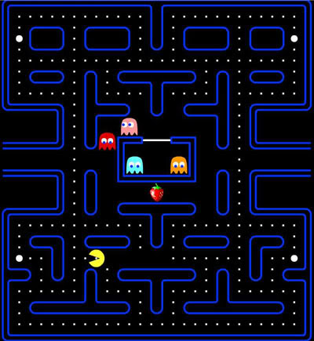
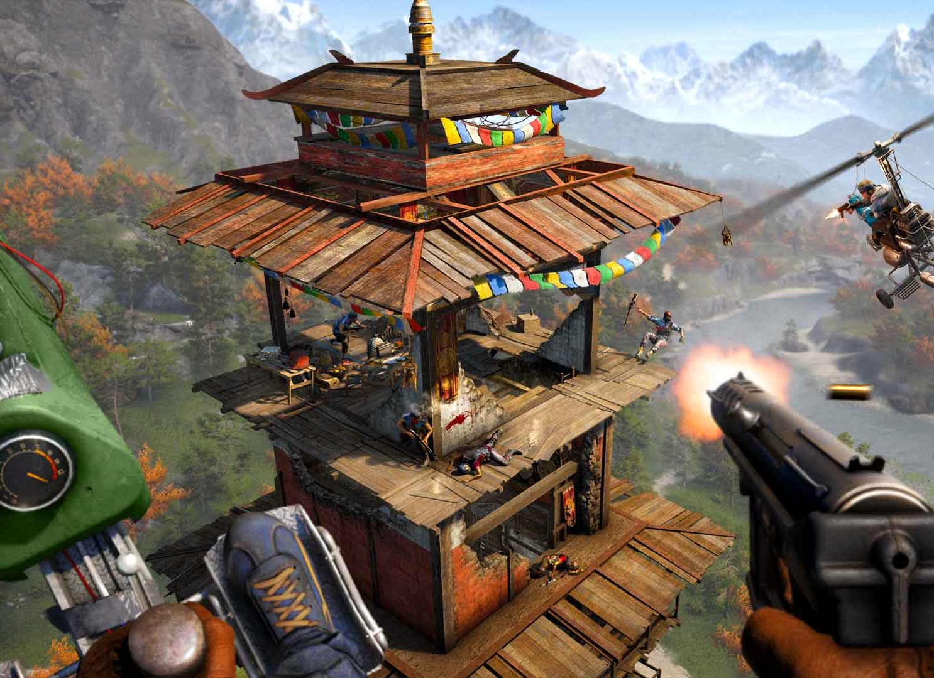
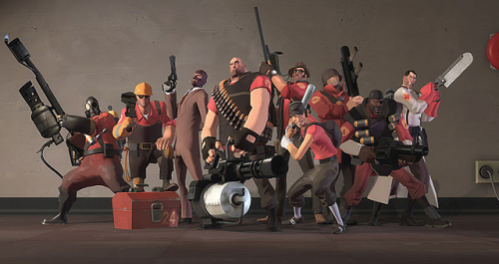
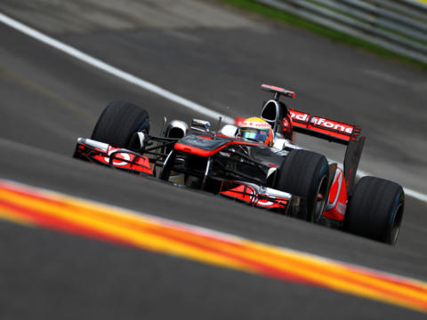
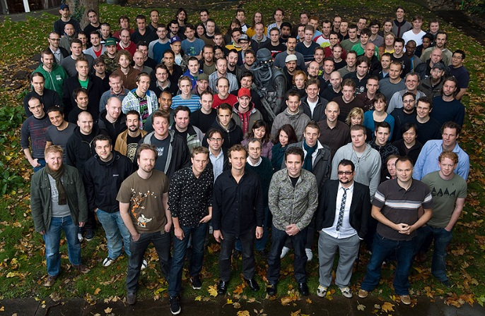
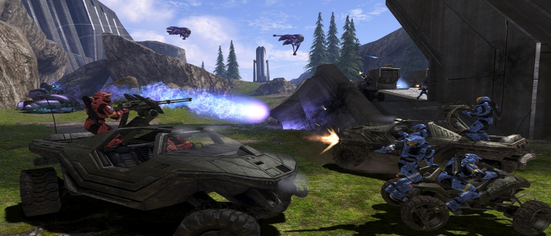
Ray Tracing for Games
Lecture 1
Game development
Game architecture
The Template
Tick
Realtime
Actors
World state
Scene graph
Data ownership
Killing a scene graph

Slide 30
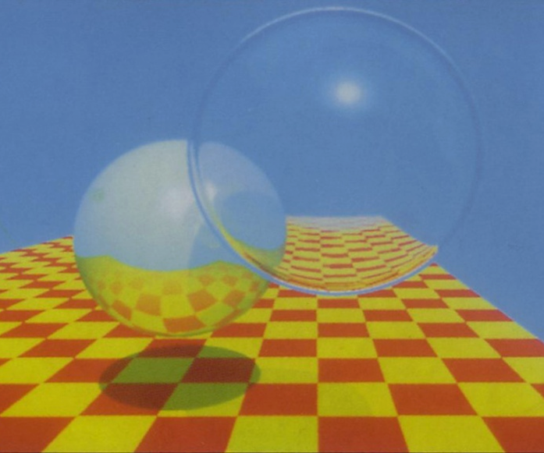
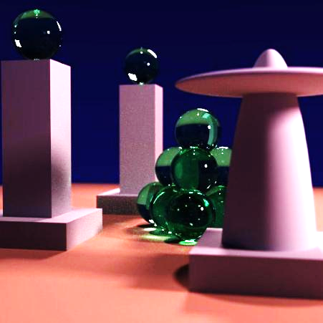
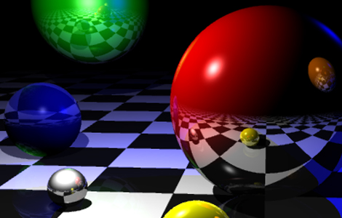
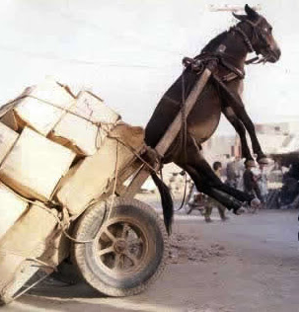
Ray Tracing for Games
Lecture 2
Rasterization: limitations
Millions of LOC
The attraction of ray tracing
RT state of the art
RT ingredients
Intersections
Basic RT algorithm
Building a ray tracer in a day

Slide 31
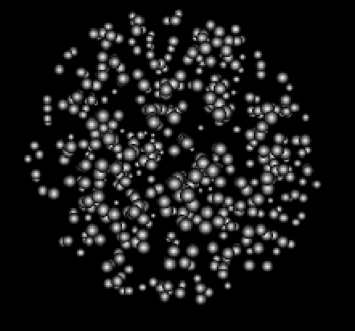
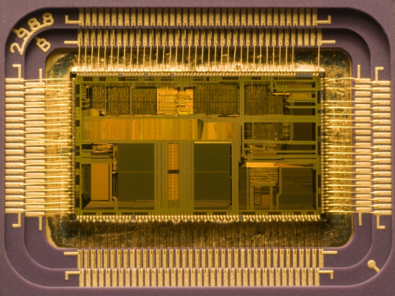
Ray Tracing for Games
Lecture 3
The Art of Optimization
Bottlenecks & scalability
Measure!
The God algorithm
High level optimization
Low level optimization
Data centric & caching
Data locality
Thread level parallelism
Instruction level parallelism

Slide 32
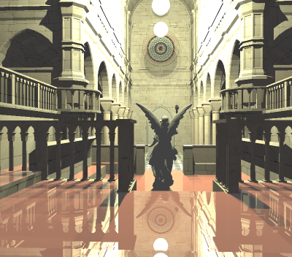

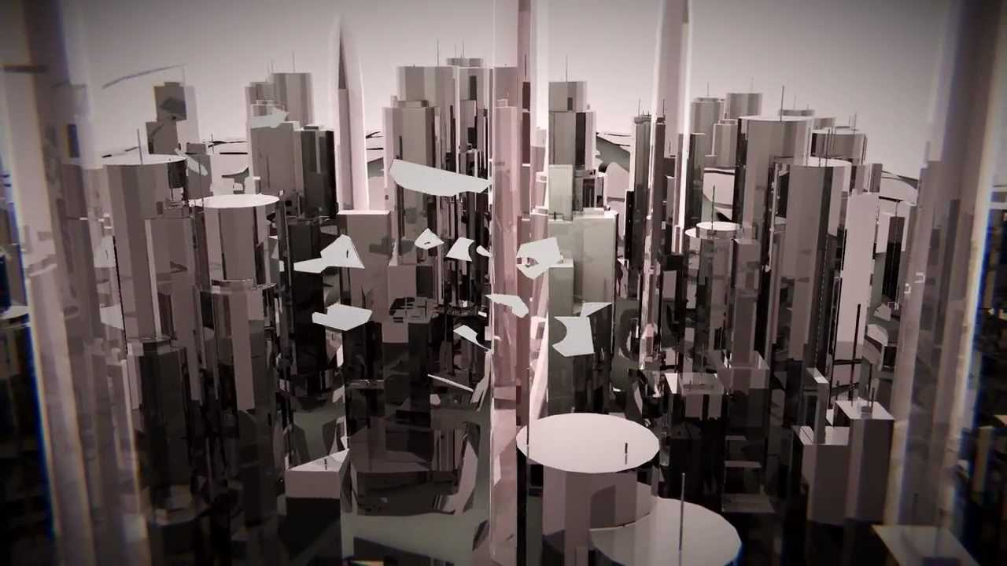

Ray Tracing for Games
Lecture 4
RT: Optimizing high level
Acceleration: grids
Acceleration: nested grids
BVH
BVH data layout
BVH traversal
Packet traversal
Binned BVH building
Ray / box intersection

Slide 33
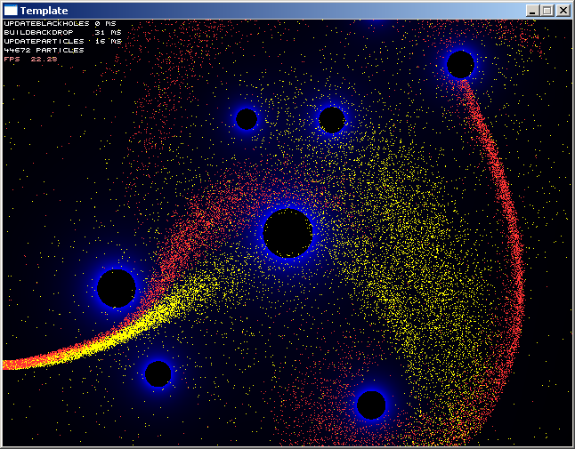
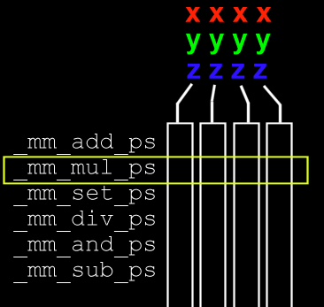

Ray Tracing for Games
Lecture 5
SIMD
SSE
_mm_rsqrt_ps
AoS & SoA
Vectorization
Masking: _mm_cmplt_ps
SIMD in ray tracing

Slide 34
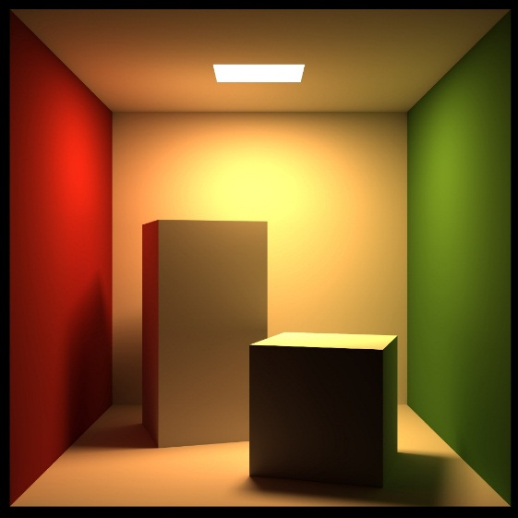
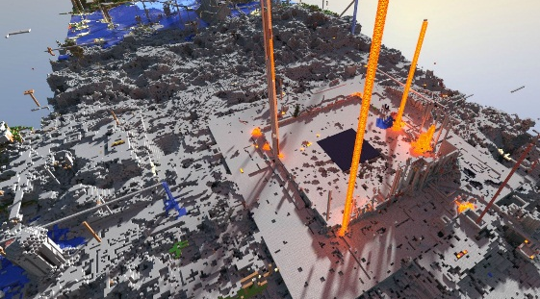
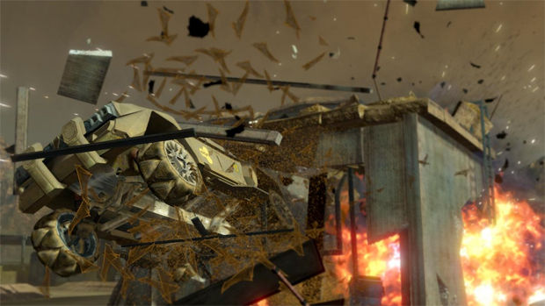
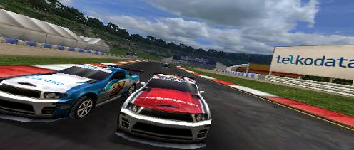
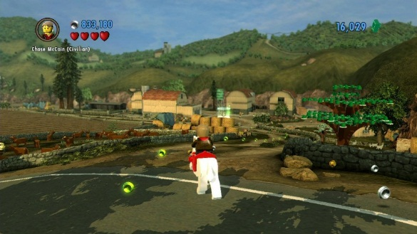
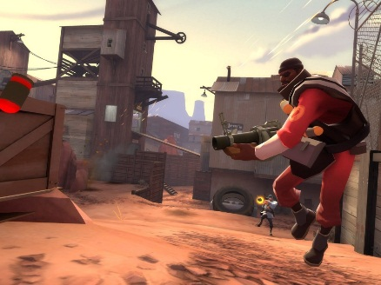
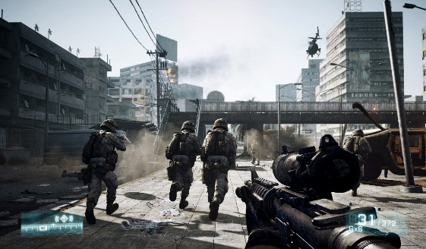
Ray Tracing for Games
Lecture 6
Top-level BVH
Geometry classification
Static, rigid, deforming
Refitting
Agglomerative clustering
Ray transform
Efficient traversal
Ray coherence
Ray packets for shadows
More optimizations…
Multithreading

Slide 35
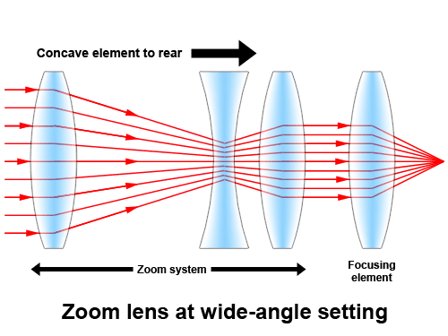
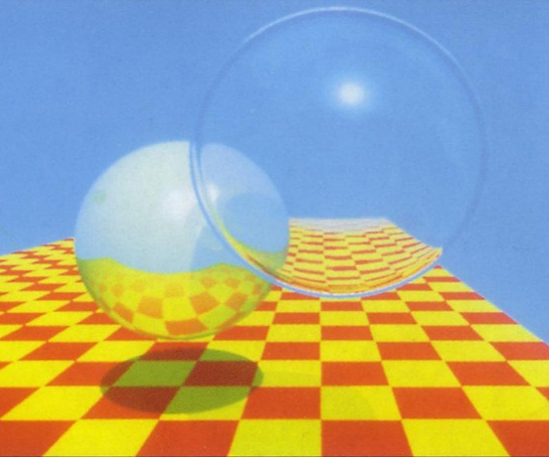

Ray Tracing for Games
Lecture 7
Whitted-style
Ray optics
Physical basis
Snell, Fresnel
Rendering equation
Monte-Carlo integration
Distributed ray tracing
Motion blur, depth of field

Slide 36
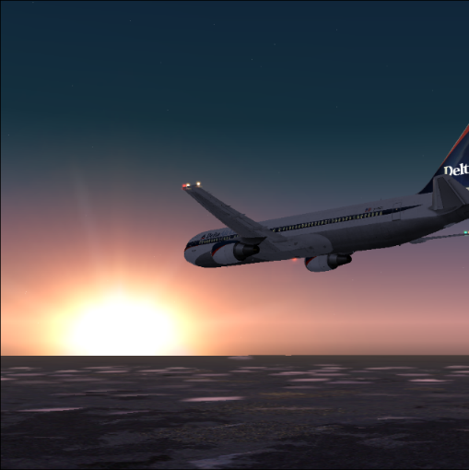
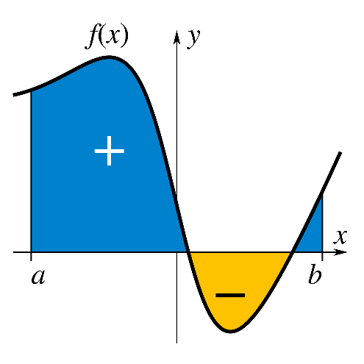
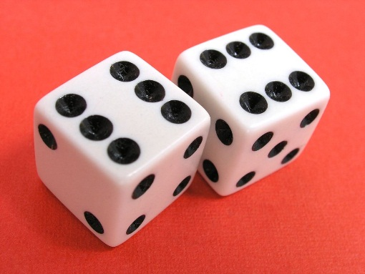
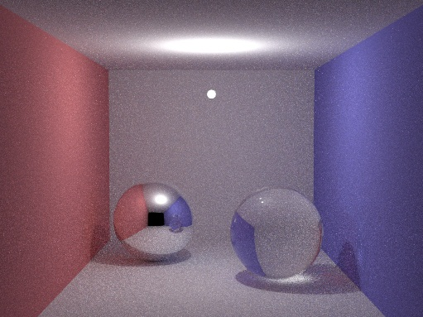

Ray Tracing for Games
Lecture 8
Sampling
Stratification
Explicit light paths
Importance
Cosine-weighted
Probability Density Function
Resampled Importance
Light array

Slide 37

Ray Tracing for Games
Lecture 9
Path classification
Instant Radiosity
Photon Mapping
Biased / unbiased
Consistent
Total Recap

Slide 38

Ray Tracing for Games

