Slide 1
Ray Tracing for Games
Dr. Jacco Bikker - FEL/CVUT, Prague, March 9 - 20
Monte Carlo

Slide 2
Ray Tracing for Games
Agenda:
Whitted-style Recap
Physically-based Rendering
Monte Carlo
Practical

Slide 3
Ray Tracing for Games
Whitted Recap
Whitted-style Ray Tracing
In 1980, “State of the Art” consisted of:
Rasterization
Shading: either diffuse (N · L) or specular ((N · H)^{n}), both not taking into account fall-off (Phong)
Reflection, using environment maps (Blinn & Newell *)
Stencil shadows (Williams **)
Goal:
Solve reflection and refraction
Improved model:
Based on classical ray optics
* : Blinn, J. and Newell, M. 1976. Texture and Reflection in Computer Generated Images. Communications of the ACM 19:10 (1976), 542—547.
** : Williams, L. 1978. Casting curved shadows on curved surfaces. In Computer Graphics (Proceedings of SIGGRAPH 78), vol. 12, 270–274.

Slide 4
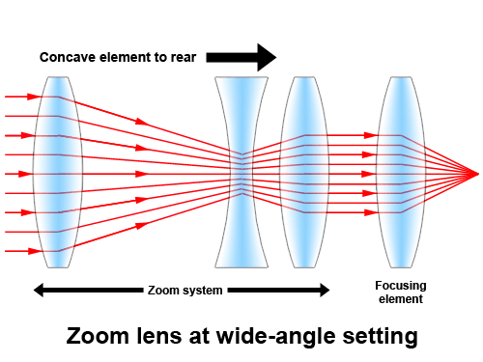
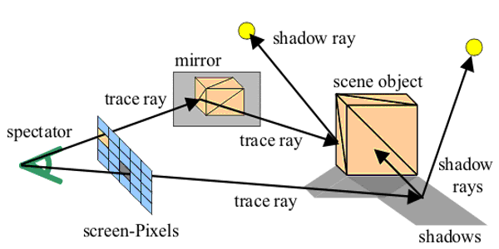
Ray Tracing for Games
Whitted Recap
Whitted-style Ray Tracing

Slide 5
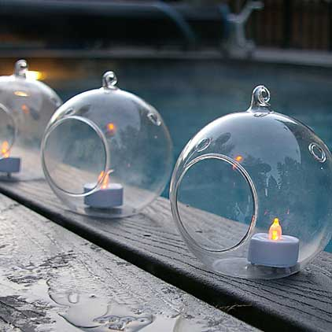
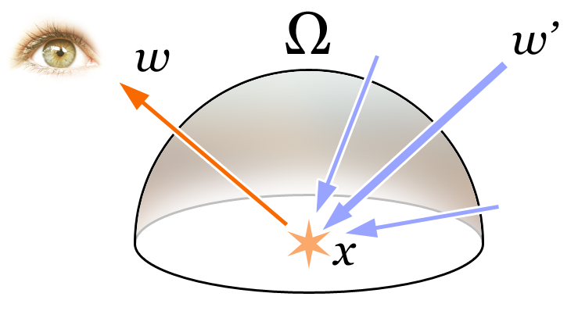
Ray Tracing for Games
Whitted Recap
Whitted-style Ray Tracing
Color at pixel:
sphere material color *
refracted ray
+ sphere material color * reflected ray
This is a recursive process.

Slide 6
Ray Tracing for Games
Whitted Recap
Fresnel equations
Snell’s law
Whitted-style Ray Tracing
Color at pixel:
sphere material color *
refracted ray
+ sphere material color * reflected ray
This is a recursive process.
color Trace( O, D )
I, N, mat = NearestIntersection( O, D )
if (mat == DIFFUSE)
return mat.color *
DirectIllumination( I, N )
if (mat == MIRROR)
return mat.color *
Trace( I, reflect( D, N ) )
if (mat == GLASS)
return mat.color *
(X * Trace( I, reflect( D, N ) ) +
(1–X) * Trace( I, refract( D, N ) ) )
color Trace( O, D )
I, N, mat = NearestIntersection( O, D )
if (mat == DIFFUSE)
return mat.color *
DirectIllumination( I, N )
if (mat == MIRROR)
return mat.color *
Trace( I, reflect( D, N ) )
if (mat == GLASS)
return mat.color *
(Trace( I, reflect( D, N ) ) +
Trace( I, refract( D, N ) ) )
angle of incidence = angle of reflection

Slide 7
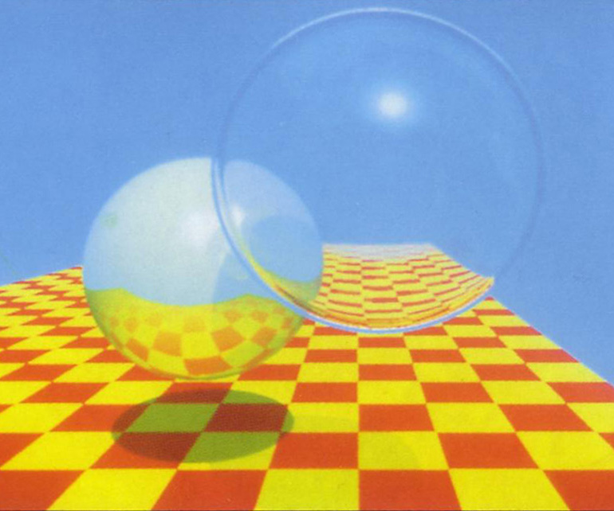
Ray Tracing for Games
Whitted Recap
Whitted-style Ray Tracing
Improved model:
Based on classical ray optics
Dust off your physics books.
Physical basis of Whitted-style ray tracing:
Light paths are generated (backwards) from the camera to the light sources, using rays to simulate optics.
Whitted-style ray tracing is deterministic: it cannot simulate area lights, glossy reflections, and diffuse reflections.

Slide 8
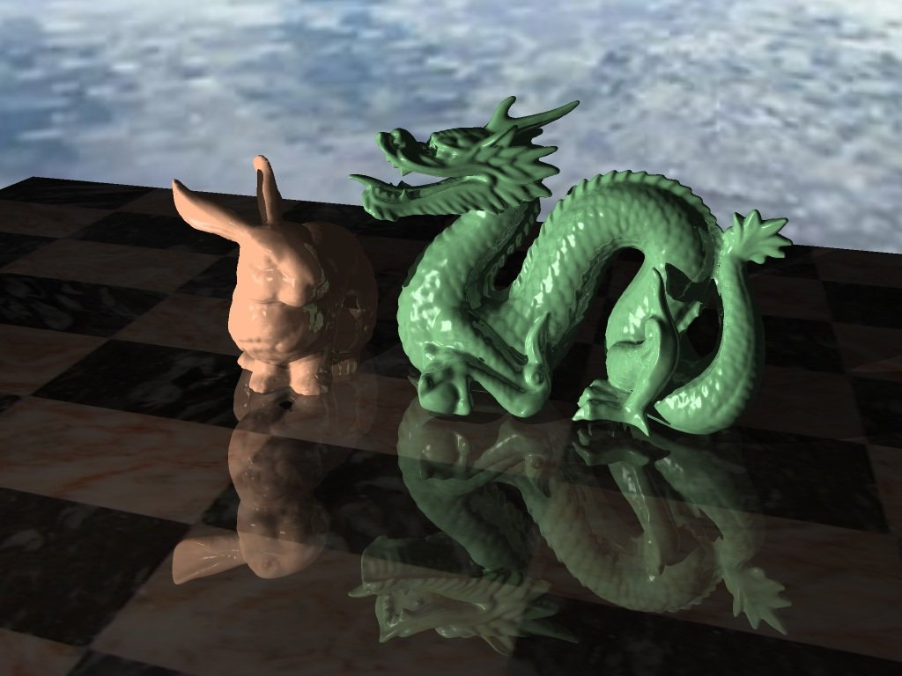
Ray Tracing for Games

Slide 9
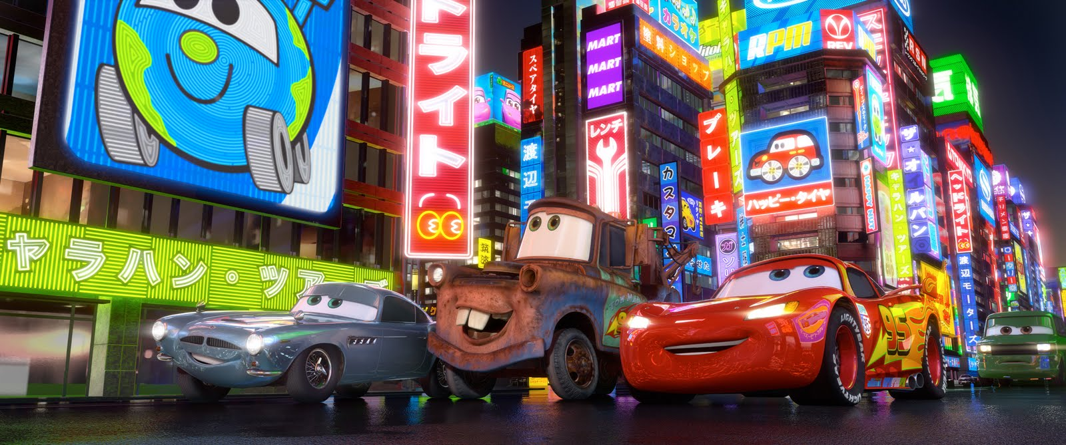
Ray Tracing for Games

Slide 10
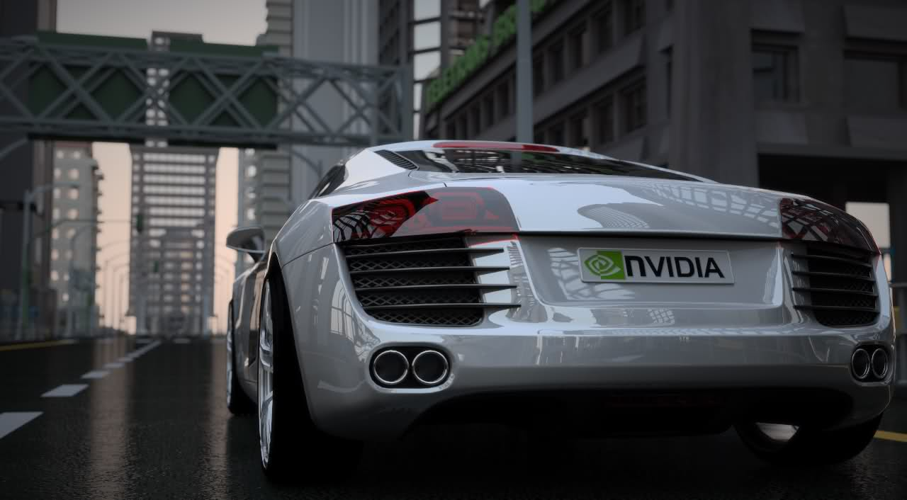
Ray Tracing for Games

Slide 11
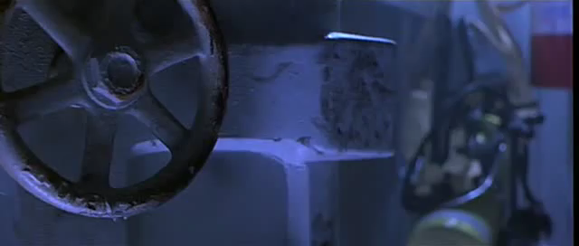
Ray Tracing for Games

Slide 12
Ray Tracing for Games
Agenda:
Introduction
Physically-based Rendering
Monte Carlo
Practical

Slide 13
Ray Tracing for Games
Physically Based
Solving “Rendering”
A 100 watt light bulb emits ~10²⁰ photons per second.
Simulating these, and recording which ones hit the camera film, yields a correct image.
Optimization:
We still get a correct image when we reverse photon paths.

Slide 14
Ray Tracing for Games

Slide 15
Ray Tracing for Games

Slide 16
Ray Tracing for Games

Slide 17
Ray Tracing for Games
Physically Based
Physically based rendering
Calculating light transport from the light sources to the camera, directly or via scene surfaces.
Nature solves this using a “random walk”: a large number of photons travelling through space from lights to sensors.

Slide 18
Ray Tracing for Games
Physically Based
P_{R}
P_{T}
P_{T} + P_{R} = 1
N ∙ L

Slide 19
Ray Tracing for Games
Physically Based
Path Tracing
Color Trace( vec3 O, vec3 D )
{
I,N,mat = Intersect( O, D );
if (mat.IsLight()) return mat.emissive;
vec3 R = RandomReflection( N );
BRDF = 2 * mat.color * dot( N, R );
return BRDF * Trace( I, R );
}

Slide 20
Ray Tracing for Games
Physically Based
Path Tracing
Color Trace( vec3 O, vec3 D )
{
I,N,mat = Intersect( O, D );
if (mat.IsLight()) return mat.emissive;
if (mat.IsMirror())
R = Reflection( D, N );
BRDF = 1 * mat.color;
else
R = RandomReflection( N );
BRDF = 2 * mat.color * dot( N, R );
return BRDF * Trace( I, R );
}

Slide 21
Ray Tracing for Games
Physically Based
Path Tracing
Color Trace( vec3 O, vec3 D )
{
I,N,mat = Intersect( O, D );
if (mat.IsLight()) return mat.emissive;
if (mat.IsMirror())
R = Reflection( D, N );
BRDF = 1 * mat.color;
else if (mat.IsDielectric())
R = ReflectOrRefract( D, N, mat );
BRDF = 1 * mat.color;
else
R = RandomReflection( N );
BRDF = 2 * mat.color * dot( N, R );
return BRDF * Trace( I, R );
}

Slide 22
Ray Tracing for Games
Physically Based
Using particles to ‘calculate’ light transport:
A stochastic process, yielding an estimate.
I = f ( x ) d( x )
≈ f ( x_{i} )
This is referred to as Monte Carlo integration.
∫
Ω
N
1
N
Σ
i=1

Slide 23
Ray Tracing for Games
Agenda:
Introduction
Physically-based Rendering
Monte Carlo
Practical

Slide 24
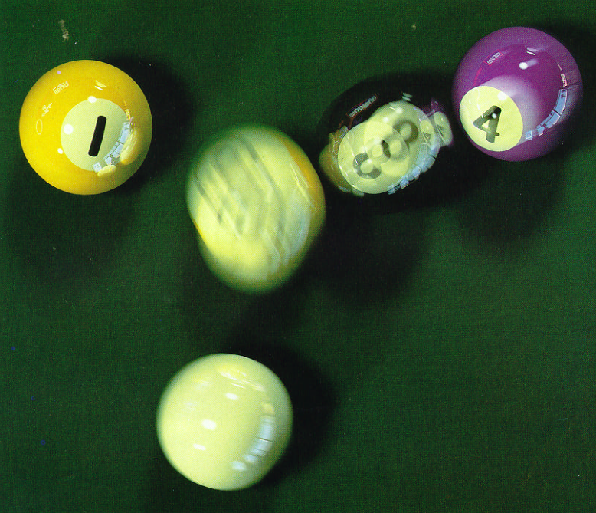
Ray Tracing for Games
Monte-Carlo
Distributed Ray Tracing*
Problem:
Ray tracing is currently limited to sharp shadows, sharp reflections, and sharp refraction.
Goal:
Augment Whitted-style ray tracing with glossy reflections and refractions, as well as soft shadows.
*: “Distributed Ray Tracing”, Cook et al., 1984.

Slide 25
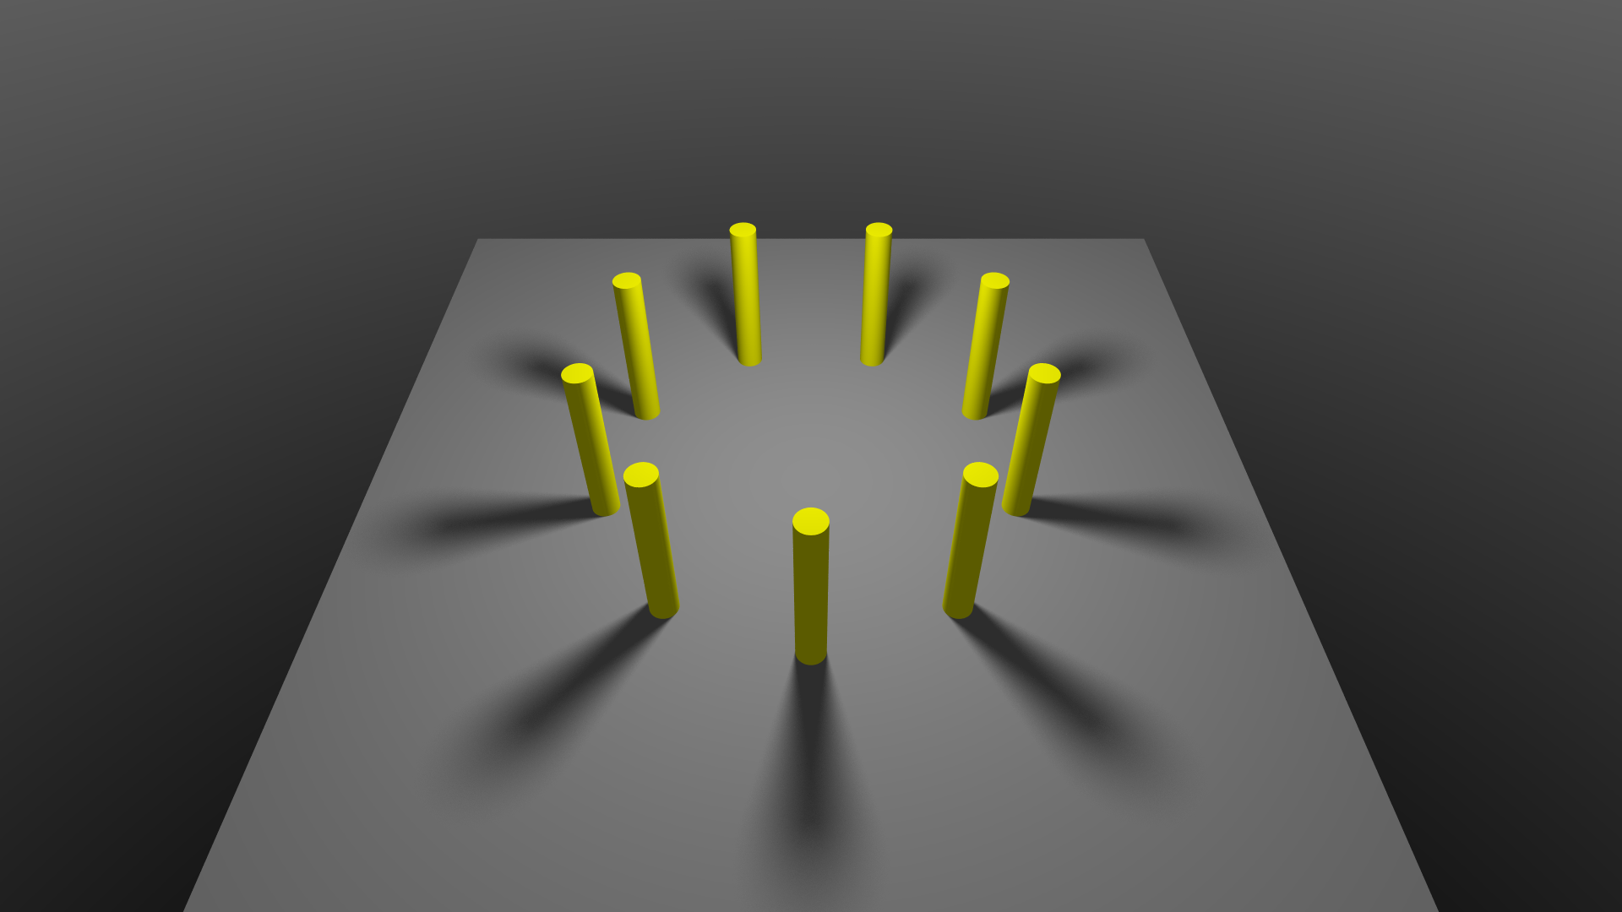
Ray Tracing for Games

Slide 26
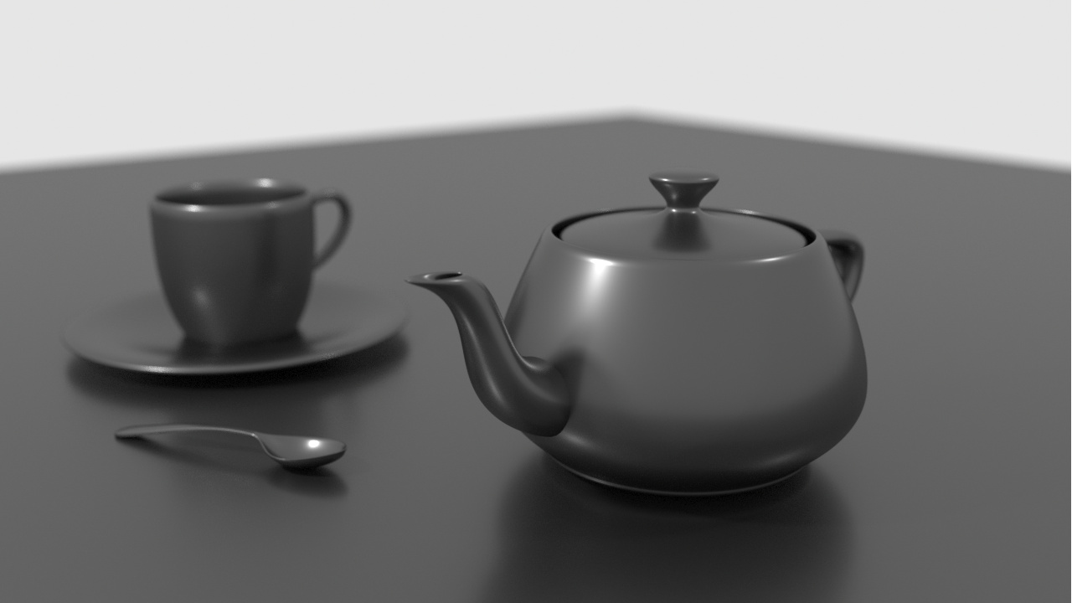
Ray Tracing for Games

Slide 27
Ray Tracing for Games
Monte Carlo
?

Slide 28
Ray Tracing for Games
Monte Carlo

Slide 29
Ray Tracing for Games
Monte Carlo
Stochastic shadows
For soft shadows, we want to know the visible area of a light source, which can be 0..100%.
The light source could be (partially) obscured by any number of objects.
We can approximate the visibility of the light source using a number of random rays.
Using 6 rays:
V = 1/6 * Σ_{i=1..6} V_{i}

Slide 30
Ray Tracing for Games
Monte Carlo
Stochastic shadows
We replaced an integral with the expected value of a random variable.
I = f ( x ) d( x )
≈ f ( x_{i} )
∫
When N approaches infinity, E(x) approaches the integral. Until that time, E(x) exhibits variance.
Ω
N
1
N
Σ
i=1

Slide 31
Ray Tracing for Games
Monte-Carlo
Distributed Ray Tracing
Integrating over area of light sources: soft shadows
Integrating over pixel: anti-aliasing
Integrating over reflection cone: glossy reflections
Integrating over time: motion blur
Integrating over film: depth of field
Integrating over wavelength: dispersion

Slide 32
Ray Tracing for Games
Monte Carlo
Distributed Ray Tracing
Improved model:
Still based on classical ray optics
Combined with probability theory to solve integrals
Physical basis of distributed ray tracing:
Light paths are generated (backwards) from the camera to the light sources, using rays to simulate optics.
Distributed ray tracing requires many rays to bring down variance to acceptable levels.

Slide 33
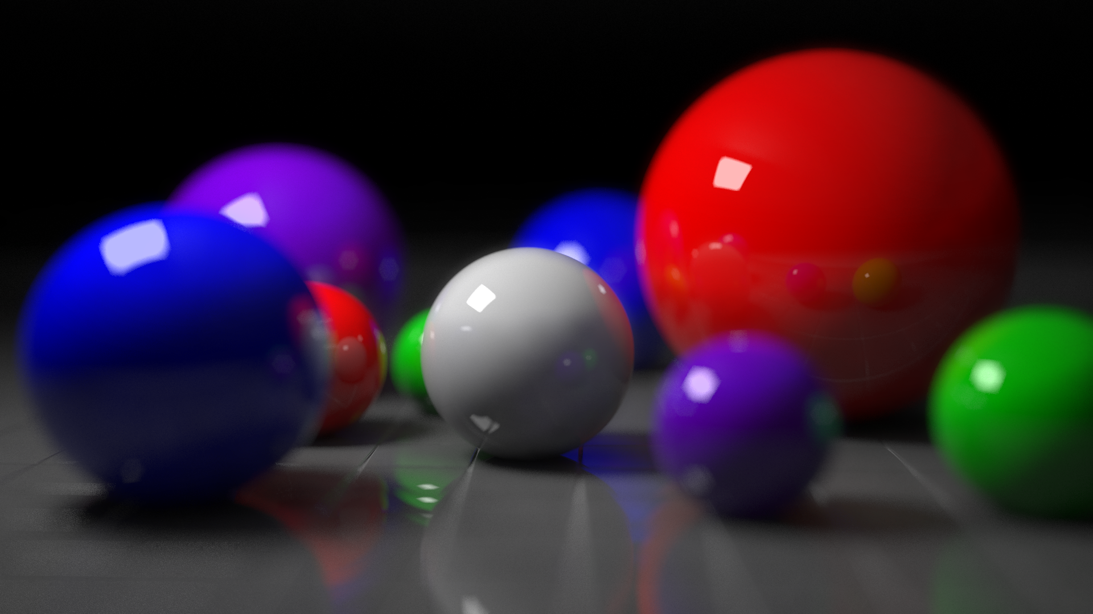
Ray Tracing for Games

Slide 34
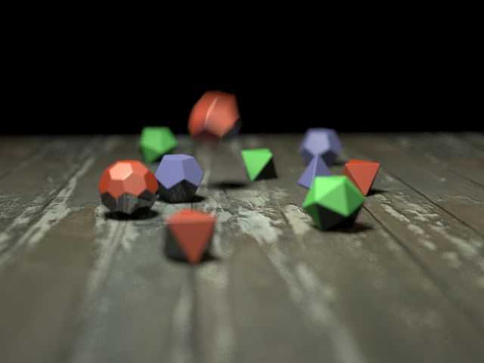
Ray Tracing for Games

Slide 35
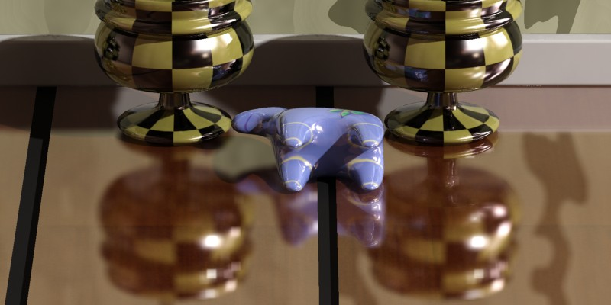
Ray Tracing for Games

Slide 36
Ray Tracing for Games
Agenda:
Introduction
Physically-based Rendering
Monte Carlo
Practical

Slide 37
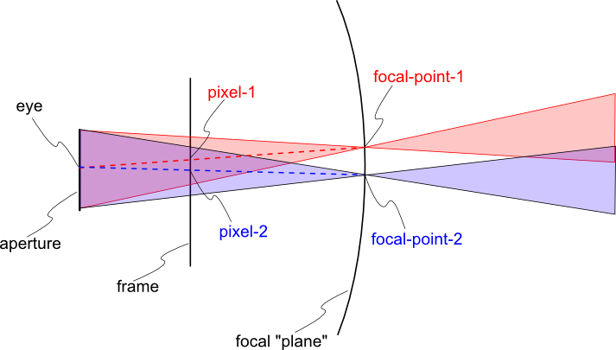
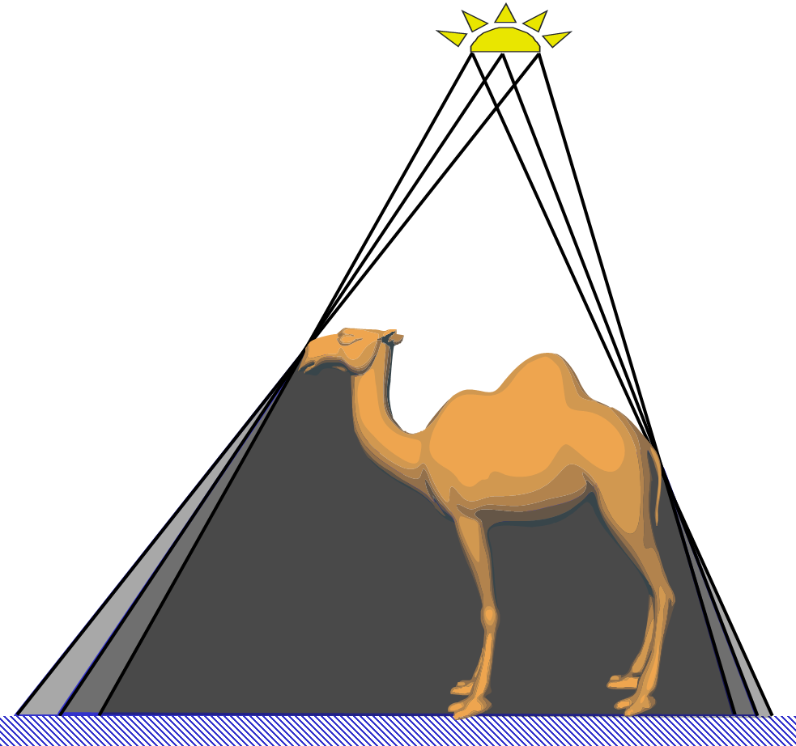
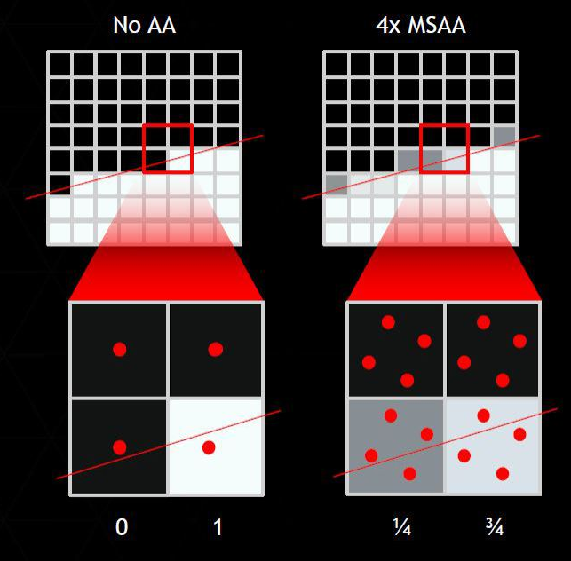
Ray Tracing for Games
Practical
Implementing Distributed Ray Tracing
Adding this to your ray tracer:
Aim primary rays at a random point inside the pixel
Add area lights, and sample them with multiple rays
Add a lens size / focal plane for depth of field
You will need some patience for your render to complete.

Slide 38
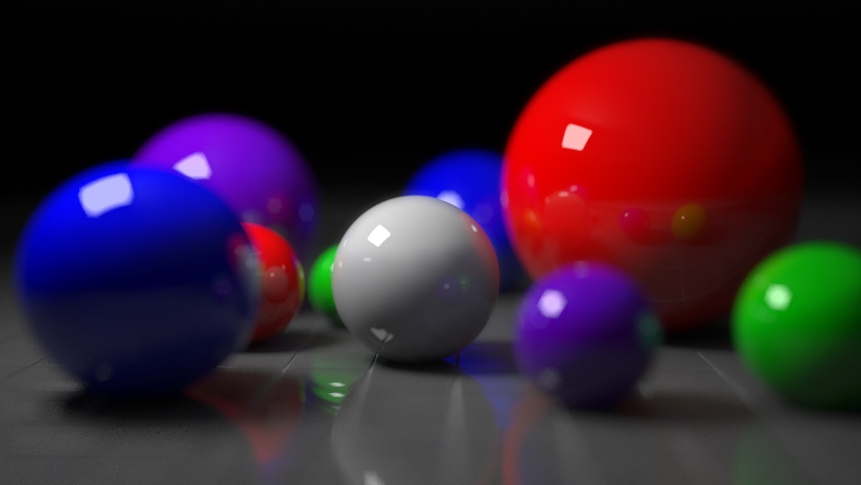
Ray Tracing for Games
Practical
Implementing Distributed Ray Tracing
Consider adding a third render mode:
Rasterization (real-time);
Ray tracing (interactive);
Stochastic ray tracing (offline).
Use the third one as a testbed for expensive features, and for creating portfolio material.

Slide 39
Ray Tracing for Games
Agenda:
Introduction
Physically-based Rendering
Monte Carlo
Practical

