Slide 1
Ray Tracing for Games
Dr. Jacco Bikker - FEL/CVUT, Prague, March 9 - 20
Reality Check

Slide 2
Ray Tracing for Games
Agenda:
Course Assessment
The Top-level BVH
Traversal Efficiency
Optimization in Practice
Template Multithreading

Slide 3
Ray Tracing for Games
Course Assessment
EXAM DAY
09.15: Exam.
10.30: Project Presentations.
Please prepare a demo of your project, and tell a bit about the tech. Ten minutes per team.
11.30: Lunch.
12.30: Oral exams (optional) for final 11 points.

Slide 4
Ray Tracing for Games
Course Assessment
PART1: Exam
The exam will be a multiple-choice exam, covering the theory presented in the lectures and summarized in the slides.
How to study for the exam:
Study the slides. The exam will cover high-level concepts. If you understand the material, you should not have a problem.

Slide 5
Ray Tracing for Games
Course Assessment
PART2: Practical Assignment
Your task is to create a game using the supplied rasterizer. The game must have the option to switch from rasterization to ray tracing at run-time.
Minimum requirements:
Your application must be a game. This may be broadly interpreted, but ‘interactivity’ and ‘multiple models’ are expected. A ‘win’ condition is not strictly necessary.
Your ray tracer must produce images at 800x600 within 2 seconds for a scene of at least 256 primitives. This requires an acceleration structure. For other window sizes, scale render time linearly. Render time does not include BVH construction.
Your ray tracer must at least support shadows from point lights and reflection. Your application must demonstrate this capability.
The rasterizer and ray tracer must use the same camera.

Slide 6
Ray Tracing for Games
Course Assessment
PART2: Practical Assignment
Your task is to create a game using the supplied rasterizer. The game must have the option to switch from rasterization to ray tracing at run-time.
Extra points for:
A polished game. Win condition, main menu / settings screen, good game design, integration of a physics engine, sound and attractive art all contribute to this. Good use of ray tracing features is also appreciated.
An advanced ray tracer. This could simply be a Whitted-style ray tracer fast enough to play the game, or a path tracer producing high quality images.
In general: display of passion for the subject (although effort by itself is not rewarded).

Slide 7
Ray Tracing for Games
Course Assessment
PART2: Practical Assignment
Your task is to create a game using the supplied rasterizer. The game must have the option to switch from rasterization to ray tracing at run-time.
The Team Factor:
You receive a grade for your project as a team. If for some reason you do not agree with this, you can indicate this, in which case we will decide on a case-by-case basis.

Slide 8
Ray Tracing for Games
Course Assessment
PART2: Practical Assignment
Your task is to create a game using the supplied rasterizer. The game must have the option to switch from rasterization to ray tracing at run-time.
Deliverables:
Hand in your project in the way that is normally used for software projects.
Present your project as a team on Friday: demonstrate the software, and tell a bit about its features. Provide some technical details.
Your grade will be based on this presentation, and a source review.
Given the time constraints, a report is not necessary.

Slide 9
Ray Tracing for Games
Course Assessment
BALANCING
Your final grade will be the total of points earned for each of the parts. For the exam, a maximum of 40 points can be obtained. For the practical project, a maximum of 39 points can be obtained. The final 11 points (for an A) may be earned in the oral examination.

Slide 10
Ray Tracing for Games
Agenda:
Course Assessment
The Top-level BVH
Traversal Efficiency
Optimization in Practice
Template Multithreading

Slide 11
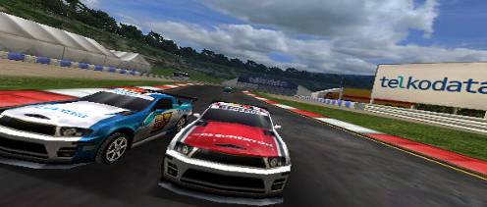
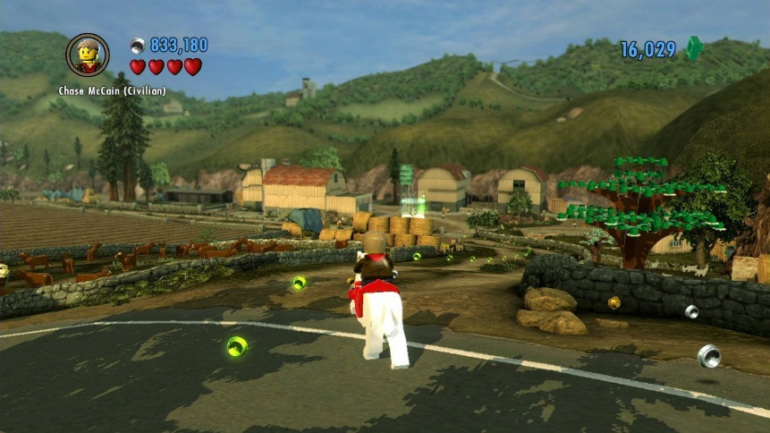
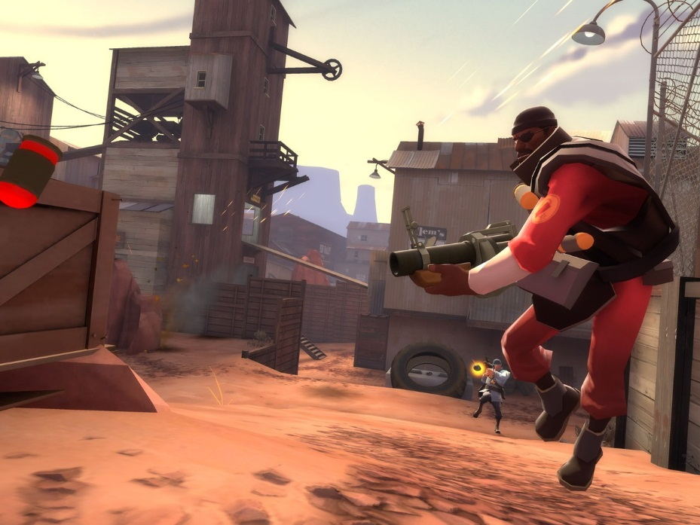
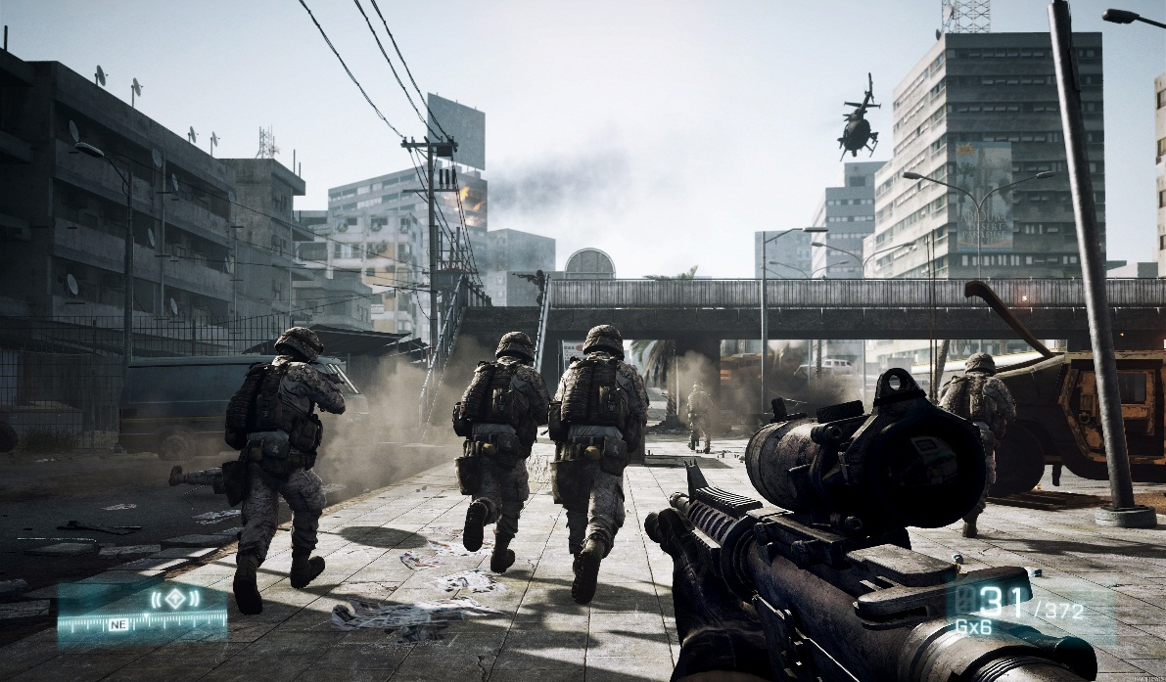
Ray Tracing for Games
Top-level BVH
Some additional notes on BVH construction
Good paper on efficient BVH construction:
“On Fast Construction of SAH-based Bounding Volume Hierarchies”, Wald, 2007.
In the average game, 90% of the geometry is static.

Slide 12
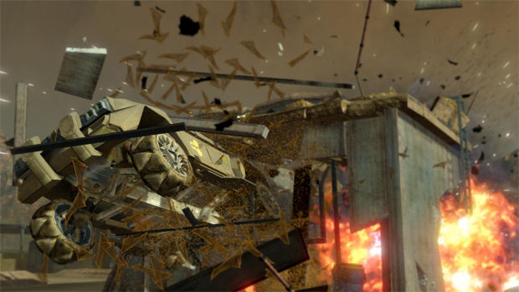
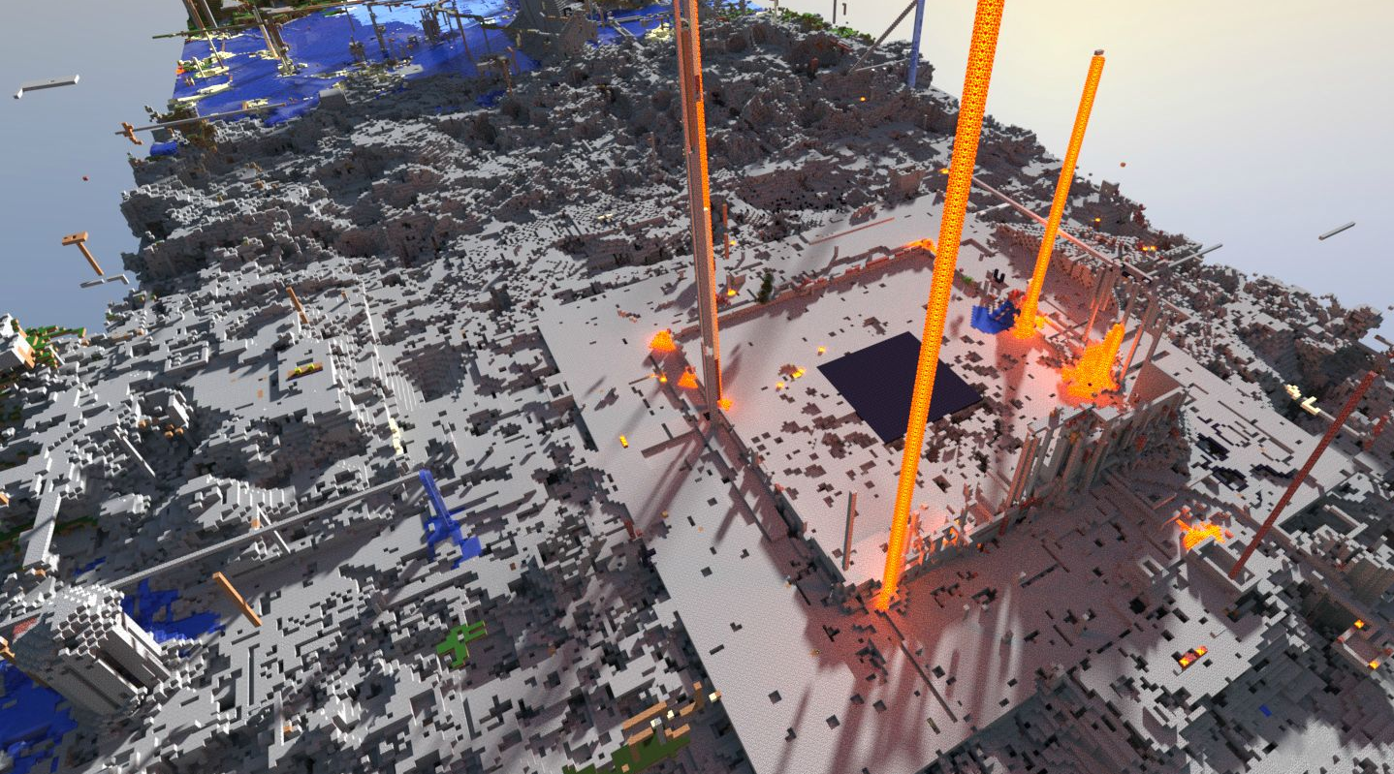
Ray Tracing for Games
Top-level BVH
“In the average game, 90% of the scenery is static”
Why?
Because it is hard to make a game engine that supports fully dynamic geometry
Because it makes it hard to ensure that the game remains playable
The alternative is destruction, which may distract from the intended gameplay.

Slide 14
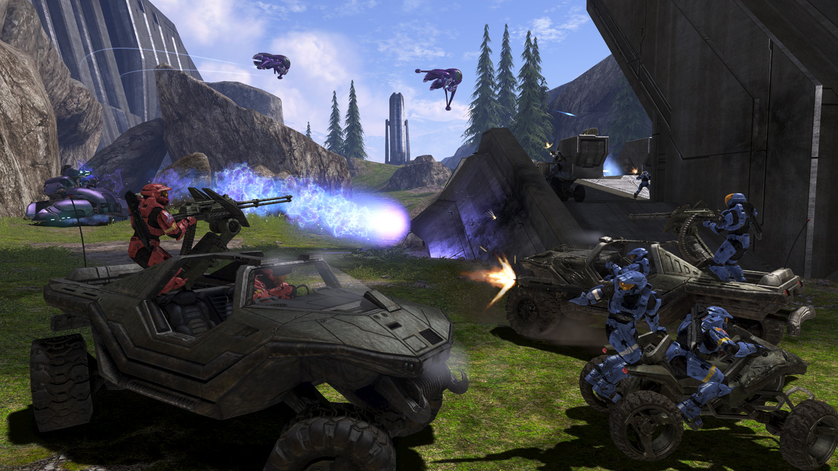
Ray Tracing for Games
Ray Tracing for Games
Top-level BVH
Game scenery: the scene graph
world
car
plane
car
plane
buggy
wheel
wheel
wheel
wheel
wheel
wheel
wheel
wheel
wheel
wheel
wheel
wheel
turret
turret
dude
dude
dude

Slide 15
Ray Tracing for Games
Ray Tracing for Games
Top-level BVH
Game scenery: mesh types
Static geometry:
Landscape, trees, sky dome
Dynamic objects:
Rigid: planes, car body, turret parts
Deforming: trees in the wind, water surface
Deforming (with changing topology): avatars
Dynamic: exploding objects, particles

Slide 16
Ray Tracing for Games
Ray Tracing for Games
Top-level BVH
Game scenery: mesh types
Mesh type | BVH quality | Construction
Static | very good | 3-axis SAH + spatial splits
Rigid | good | SAH + spatial splits
Deforming (minor) | good | SAH + refitting
Deforming | medium | Refitting, occasional rebuild
Dynamic | low | Per-frame rebuild

Slide 17
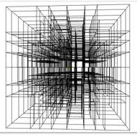
Ray Tracing for Games
Ray Tracing for Games
Top-level BVH
Combining BVHs
top-level
BVH
static rigid dynamic
“Fast Agglomerative Clustering for Rendering”, Walter et al., 2008

Slide 18
Ray Tracing for Games
Ray Tracing for Games
Top-level BVH
Top-level BVH implementation details:
A top-level BVH is constructed over the transformed bounding boxes of the scene graph nodes – i.e., transform the corners of the bounding box, then create an axis-aligned bounding box over those corners.
The leaves of the top-level BVH contain:
A pointer to a BVH for a single scene graph node;
An index for / pointer to the inverse transform for that node.
Traversal thus becomes a two-stage algorithm:
Use top-level BVH traversal to determine which scene graph nodes need to be tested;
Transform the rays in the packet with the inverse transform of the node;
Traverse the BVH node for the mesh in object space.

Slide 19
Ray Tracing for Games
Ray Tracing for Games
Top-level BVH
Using the top-level BVH
*: only the cost of updating the top-level BVH; 100s of node not a problem.
Mesh type | Update cost | Modified tris/frame
Static | n/a | 1-4M
Rigid | free* | 1-4M
Deforming (minor) | very low | 500k
Deforming | low | 200k
Dynamic | expensive | 50-100k

Slide 20
Ray Tracing for Games
Agenda:
Course Assessment
The Top-level BVH
Traversal Efficiency
Optimization in Practice
Template Multithreading

Slide 21
Ray Tracing for Games
Traversal
Notes on efficiently traversing a BVH:
struct TraversalStack { uint nodeIdx, firstActive; };
TraversalStack stack[64];
stack[0].nodeIdx = 99999; // terminator
int currentNode = 0; // root
int stackPtr = 1;
while (stackPtr)
{
if ( /* leaf */ )
{
// process leaf
...
// get task from stack
currentNode = stack[--stackPtr].nodeIdx;
firstActive = stack[stackPtr].firstActive;
}
else {} // currentNode = near; push far
}
Ray/box test: before putting node on the stack
Minimize stack traffic: push ‘far’ child only
Loop terminates when stack is empty.

Slide 22
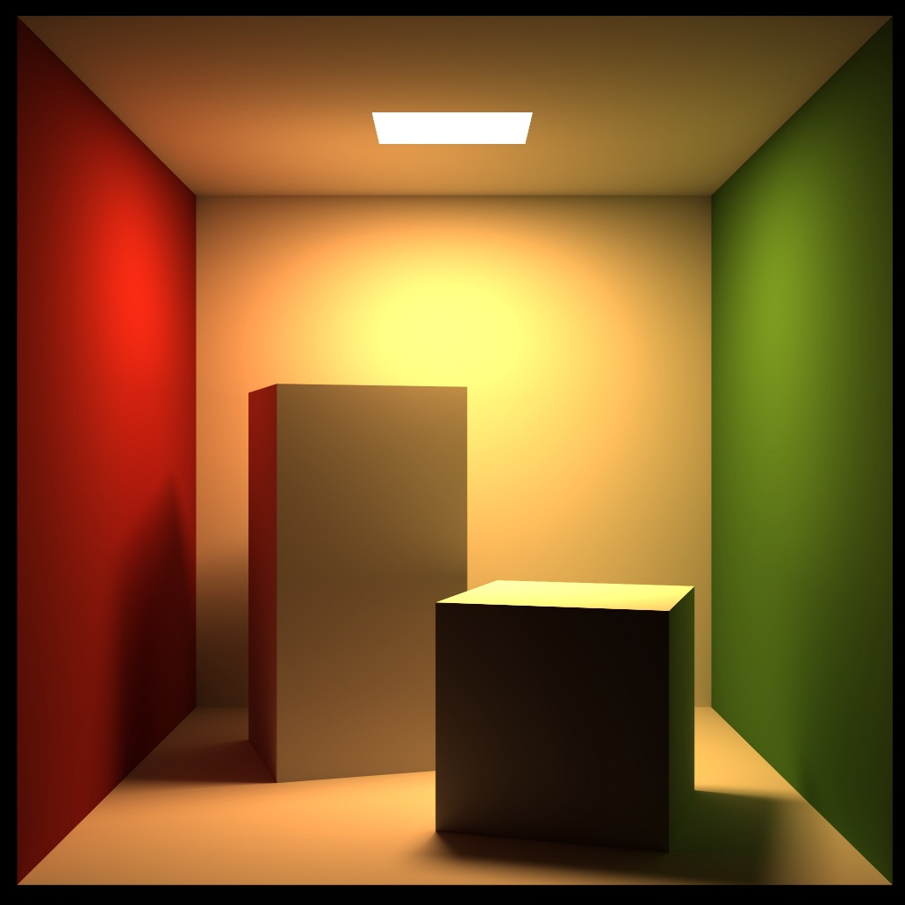
Ray Tracing for Games
Traversal
Notes on efficient ray packets
A ray packet is a square, not a line! (maximize ray coherence)
Even better: Morton order
What is the optimal ray packet size? 8x8 … 16x16 (any larger and L1 cache starts having issues remembering your packet)

Slide 23
Ray Tracing for Games
Traversal
Ray Packets for Shadows
The packet stays together, even after a bounce / for shadows
You will need a ‘ray active’ flag
Trace from the light source (to get a common ray origin)
Ignore divergence (it’s not worth it…)
“Large ray packets for real-time Whitted ray tracing”, Overbeck et al., 2008
“Geometric and Arithmetic Culling Methods for Entire Ray Packets”, Boulos et al., 2008

Slide 24
Ray Tracing for Games
Agenda:
Course Assessment
The Top-level BVH
Traversal Efficiency
Optimization in Practice
Template Multithreading

Slide 25
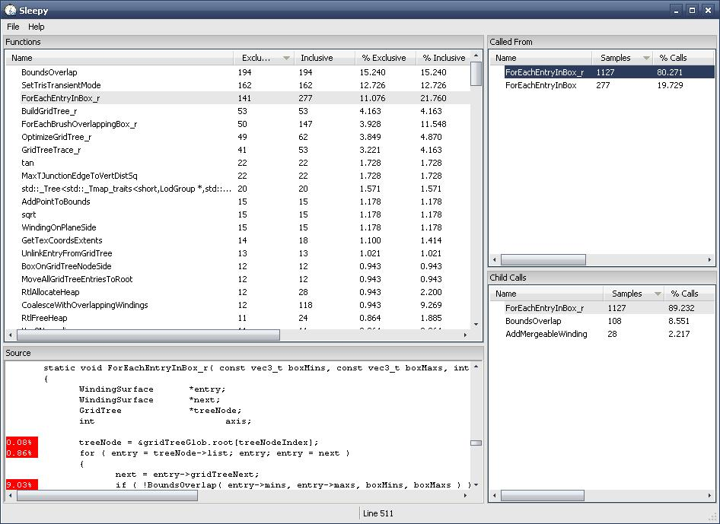
Ray Tracing for Games
Optimization
It’s still slow… Now what?
“1. Measure.”
Try: VerySleepy
Add counters:
Maximum tree depth (~20)
Average tree depth
Average prims/leaf
Average traversal depth
Maximum traversal depth
Average ray/box intersections
Average ray/tri intersections

Slide 26
Ray Tracing for Games
Optimization
It’s still slow… Now what?
Are your BVH nodes aligned?
void* _aligned_malloc(
size_t size,
size_t alignment
);
Check sizeof( BVHNode )
Is there any work you’re doing twice? (profiler might tell you that)

Slide 27
Ray Tracing for Games
Optimization
It’s still slow… Now what?
Look for opportunities for SIMD
For example: brute-force scan for first active ray:
bool CheckBox( vec3& bmin, vec3& bmax, vec3 O, vec3 rD, float t )
{
vec3 tMin = (bmin - O) * rD, tMax = (bmax - O) * rD;
vec3 t1 = min( tMin, tMax ), t2 = max( tMin, tMax );
float tNear = max( max( t1.x, t1.y ), t1.z );
float tFar = min( min( t2.x, t2.y ), t2.z );
return ((tFar > tNear) && (tNear < t) && (tNear > 0));
}
How should your ray packet be organized to minimize data reorganization?

Slide 28
Ray Tracing for Games
Optimization
It’s still slow… Now what?
Small things to look for:
If a variable doesn’t change, make it const
If a function doesn’t change member data, make it const
If a function argument doesn’t change, make it const
If a function argument is greater than 4 bytes (win32) or 8 bytes (x64), pass it by reference if possible
Virtual functions cannot be inlined
Do not trust the compiler too much when it comes to optimization
Minimize divisions
Precalculate common expressions (you are not recalculating rD for each box intersection, are you?)
…Did you measure?
“Real-time Ray Tracing through the Eyes of a Game Developer”, Bikker, 2007

Slide 29
Ray Tracing for Games
Agenda:
Course Assessment
The Top-level BVH
Traversal Efficiency
Optimization in Practice
Template Multithreading

Slide 30
Ray Tracing for Games
Multithreading
class Job
{
public:
virtual void Main() = 0;
protected:
friend class JobThread;
void RunCodeWrapper();
};
class RenderJob : public Job
{
public:
void Main();
void Init( ... );
};
In Game::Init():
CreateJobManager( 8 );
In your render function:
JobManager* jm = GetJobManager();
for( int i = 0; i < 8; i++ )
jm->AddJob2( &renderJob[0] );
jm->RunJobs();

Slide 31
Ray Tracing for Games
Multithreading
How to divide work over RenderJobs:
Quick and dirty:
Divide screen in rectangles, render one per thread
Drawback: not all threads will complete at the same time.
Better:
Divide the screen in ray packet sized rectangles
Let each RenderJob get a rectangle that is not being rendered yet
Continue until no rectangles are left.
Details in: “Ray Tracing for Real-time Games”, Bikker, 2012, page 46.
( but also on the next slide)

Slide 32
Ray Tracing for Games
Multithreading
Global scope:
static volatile LONG waiting;
In your render function:
waiting = totalTileCount;
In RenderJob::Main:
while (1)
{
if (waiting < 1) break;
volatile LONG w = AtomicDecrement( &waiting );
if (w >= 0) RenderTile( w );
}

Slide 33
Ray Tracing for Games
Multithreading
Note on multithreading:
Do not ‘new’ a job each time you need it – allocate once, keep for next use!

Slide 34
Ray Tracing for Games
Agenda:
Course Assessment
The Top-level BVH
Traversal Efficiency
Optimization in Practice
Template Multithreading

Slide 35
Ray Tracing for Games
LAB
Start working towards a playable game.
Dangers:
Featurecreep
Bugs in final build
Developer blindness
Bottlenecks in the team
Stop adding features after Tuesday
Store a fully working version on Wednesday
Only replace it by something better if you’re sure it works
Have someone else play your game
Don’t let any team member deliver something vital on the last day

Slide 36
End of lecture 6.
Konec je blízko

