Slide 1
Ray Tracing for Games
Dr. Jacco Bikker - FEL/CVUT, Prague, March 9 - 20
SIMD

Slide 2
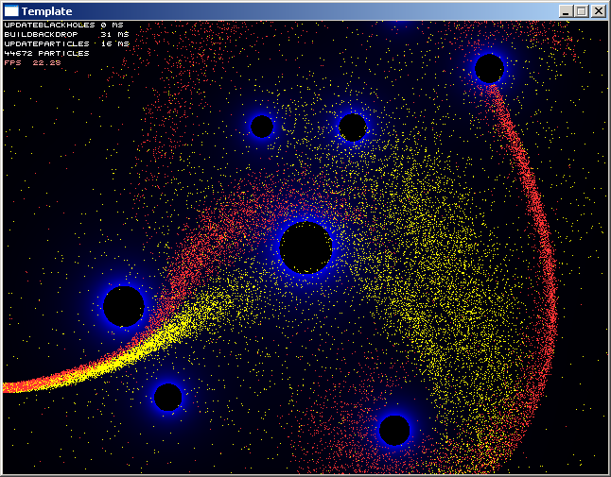
Ray Tracing for Games
Agenda:
Introduction to SIMD
AoS and SoA
From Scalar to Vectorized
Masking Streams
Applied SIMD: Ray Tracing

Slide 3
Ray Tracing for Games
Introduction to SIMD
Parallel processing using 32-bit integers:
union 00000001 00000001 00000001 00000001
{ 00000001 00000001 00000001 00000001
int a4; -------------------------------------- +
char a[4]; 00000010 00000010 00000010 00000010
};
32-bit integer vectorization: 4 streams
Problems:
Overflow
Limited range
Integer only (unsigned)
Not intuitive
Ideally:
Separated streams
Full range
All data types
Easy to use

Slide 4
Ray Tracing for Games
Introduction to SIMD
SSE
32-bit:
{ char, char, char, char } = int
128-bit:
{ float, float, float, float } = __m128
{ int, int, int, int } = __m128i
SSE: Streaming SIMD Extension
Introduced by Intel for P3 (1999)
70 assembler instructions
Operates on 128-bit registers
Allows you to work on four floats at a time

Slide 5
Ray Tracing for Games
Introduction to SIMD
SSE2
8/16/32/64 bit data
float, int, signed, unsigned
No overflow
Min, max, saturation
Faster than single
Practical:
#include “emmintrin.h”
__m128 a = _mm_set_ps( 1.5f, 2.0f, 3.14f, 4.01f );
__m128 b = _mm_set_ps( 1.0f, 1.0f, 1.0f, 1.0f );
__m128 c = _mm_add_ps( a, b );
union
{
__m128 a4;
float a[4];
};

Slide 6
Ray Tracing for Games
Introduction to SIMD
SSE2
8/16/32/64 bit data
float, int, signed, unsigned
No overflow
Min, max, saturation
Faster than single
Assembler-like syntax:
__m128 a, b;
__m128 c = a + b;
__m128 c = _mm_add_ps( a, b );
__m128 d = _mm_mul_ps( a, b );
__m128 e = _mm_div_ps( a, b );
__m128 f = _mm_sub_ps( a, b );
__m128 g = _mm_sqrt_ps( a );
__m128 h = _mm_rcp_ps( a );
__m128 i = _mm_rsqrt_ps( b );

Slide 7
Ray Tracing for Games
Introduction to SIMD
SSE2
8/16/32/64 bit data
float, int, signed, unsigned
No overflow
Min, max, saturation
Faster than single
Assembler-like syntax:
__m128 c = dx * dx + dy * dy;
__m128 c = _mm_add_ps(
_mm_mul_ps( dx, dx ),
_mm_mul_ps( dy, dy )
);

Slide 8
Ray Tracing for Games
Introduction to SIMD

Slide 9
Ray Tracing for Games
Agenda:
Introduction to SIMD
AoS and SoA
From Scalar to Vectorized
Masking Streams
Applied SIMD: Ray Tracing

Slide 10
Ray Tracing for Games
AoS and SoA
Moving a particle:
p[0].x += p[0].vx;
p[0].y += p[0].vy;
struct Particle
{
float x, y, vx, vy;
};
Particle p[64];
Moving four particles using SSE:
__m128 px4 = _mm_set_ps( p[0].x, p[1].x, p[2].x, p[3].x );
__m128 vx4 = _mm_set_ps( p[0].vx, p[1].vx, p[2].vx, p[3].vx );
px4 = _mm_add_ps( px4, vx4 );
…

Slide 11
Ray Tracing for Games
AoS and SoA
struct Particle
{
float x, y, vx, vy;
};
Particle p[64];
AoS
union {
union {
union {
union {
float x[64];
float y[64];
float vx[64];
float vy[64];
__m128 x4[16];
__m128 y4[16];
__m128 vx4[16];
__m128 vy4[16];
};
};
};
};
SoA
x4[0] = _mm_add_ps( x4[0], vx4[0] );
y4[0] = _mm_add_ps( y4[0], vy4[0] );

Slide 12
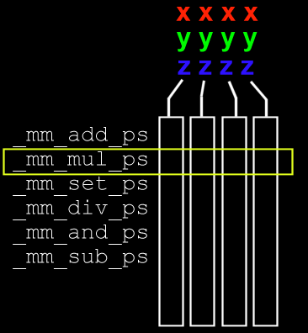
Ray Tracing for Games
AoS and SoA
AoS
SoA

Slide 13
Ray Tracing for Games
AoS and SoA
Vectorization:
“The Art of rewriting your algorithm so that it operates in four separate streams, rather than one.”
Note: compilers will apply SSE2/3/4 for you as well:
vector3f A = { 0, 1, 2 };
vector3f B = { 5, 5, 5 };
A += B;
This will marginally speed up one line of your code; manual vectorization is much more fundamental.

Slide 14
Ray Tracing for Games
Agenda:
Introduction to SIMD
AoS and SoA
From Scalar to Vectorized
Masking Streams
Applied SIMD: Ray Tracing

Slide 15
Ray Tracing for Games
Introduction to SIMD

Slide 16
Ray Tracing for Games
Agenda:
Introduction to SIMD
AoS and SoA
From Scalar to Vectorized
Masking Streams
Applied SIMD: Ray Tracing

Slide 17
Ray Tracing for Games
Masking Streams
What if not all streams do the same thing?

Slide 18
Ray Tracing for Games
Masking Streams
What if not all streams do the same thing?
_mm_cmpeq_ps ==
_mm_cmplt_ps <
_mm_cmpgt_ps >
_mm_cmple_ps <=
_mm_cmpge_ps >=
_mm_cmpne_ps !=
Result of a comparison: __m128 (so, 128 bits for four results)
Meaning: 32bits are set to 1 if ‘true’, or ‘0’ when false.
The purpose of this is masking.

Slide 19
Ray Tracing for Games
Masking Streams
What if not all streams do the same thing?
float a[4] = { 1, -5, 3.14f, 0 };
if (a[0] < 0) a[0] = 999;
if (a[1] < 0) a[1] = 999;
if (a[2] < 0) a[2] = 999;
if (a[3] < 0) a[3] = 999;
in SSE:
__m128 a4 = _mm_set_ps( 1, -5, 3.14f, 0 );
__m128 nine4 = _mm_set_ps1( 999 );
__m128 zero4 = _mm_setzero_ps();
__m128 mask = _mm_cmplt_ps( a4, zero4 );
00000000000000000000000000000000111111111111111111111111111111110000000000000000000000000000000000000000000000000000000000000000

Slide 20
Ray Tracing for Games
Masking Streams
What if not all streams do the same thing?
__m128 a4 = _mm_set_ps( 1, -5, 3.14f, 0 );
__m128 nine4 = _mm_set_ps1( 999 );
__m128 zero4 = _mm_setzero_ps();
__m128 mask = _mm_cmplt_ps( a4, zero4 );
00000000000000000000000000000000111111111111111111111111111111110000000000000000000000000000000000000000000000000000000000000000
__m128 part1 = _mm_and_ps( mask, nine4 );
// yields: { 0, 999, 0, 0 }
__m128 part 2 = _mm_andnot_ps( mask, a4 );
// yields: { 1, 0, 3.14, 0 }
a4 = mm_or_ps( part1, part2 );
// yields: { 1, 999, 3.14, 0 }

Slide 21
Ray Tracing for Games
Masking Streams
Broken streams
for ( int i = 0; i < 4; i++ ) if (alive[i])
{
vx[i] += 0.5f * g * m[i];
vy[i] += 0.5f * g * m[i];
}
…becomes:
for ( int i = 0; i < 4; i++ )
{
vx[i] += 0.5f * g * m[i] * (alive[i] & 1);
vy[i] += 0.5f * g * m[i] * (alive[i] & 1);
}

Slide 22
Ray Tracing for Games
Masking Streams
Broken streams
for ( int i = 0; i < 4; i++ )
{
vx[i] += 0.5f * g * m[i] * (alive[i] & 1);
vy[i] += 0.5f * g * m[i] * (alive[i] & 1);
}
Handling streams that should not update anything:
Just execute them, but mask out the results.

Slide 23
Ray Tracing for Games
Agenda:
Introduction to SIMD
AoS and SoA
From Scalar to Vectorized
Masking Streams
Applied SIMD: Ray Tracing

Slide 24
Ray Tracing for Games
Applied SIMD
SIMD in ray tracing:
Normalize 4 rays at the cost of 1
Intersect 4 rays with one primitive
Intersect 1 ray with four primitives
Check 4 bounding boxes at the cost of 1
Check 4 candidate planes in the binned BVH builder at the cost of 1
…
Applying SIMD to a ray tracer is relatively easy to do, and typically yields performance improvements of 400% or better.

