Slide 1
Ray Tracing for Games
Dr. Jacco Bikker - FEL/CVUT, Prague, March 9 - 20
Fast Ray Tracing
Nelze to přeložit

Slide 2
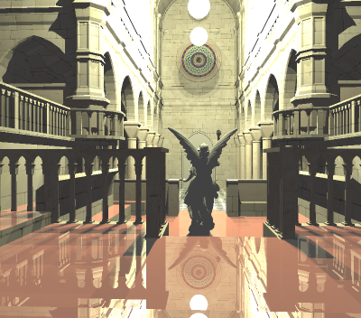
Ray Tracing for Games
Agenda:
Introduction
Acceleration Structures
Ray Packets
Binned BVH Construction

Slide 3
Ray Tracing for Games
Introduction
Optimizing a ray tracer
Analysis
High level optimization
Optimizing memory access patterns
Low level optimization
Let N = pixels; M = primitives; L = lights
Primary rays : O(N M)
Secondary rays : O(N ½M L)
Shading: O(N)

Slide 4
Ray Tracing for Games
Agenda:
Introduction
Acceleration Structures
Ray Packets
Binned BVH Construction

Slide 5

Ray Tracing for Games
Acceleration Structures
Reducing M by stepping through a regular grid
Note: cost of stepping through the grid is not 0.
Optimal grid resolution:
minimizes
C_{step} * N_{steps} + C_{intersect} * N_{intersect}
This is scene-dependent, and even region-dependent.
Let N = pixels; M = primitives; L = lights

Slide 6

Ray Tracing for Games
Acceleration Structures
Reducing M by stepping through a nested grid
The nested grid adapts itself to local scene complexity, but resolutions still require manual tweaking.
Let N = pixels; M = primitives; L = lights

Slide 7
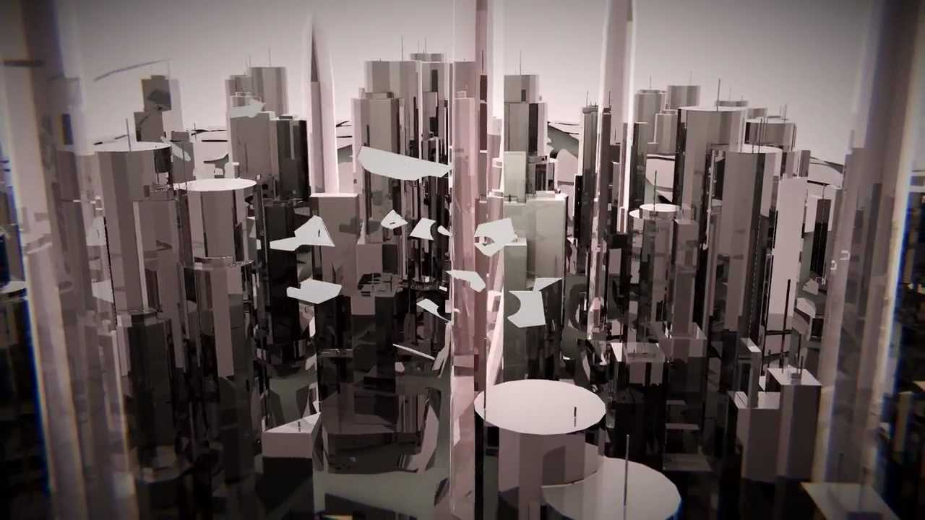
Ray Tracing for Games
Acceleration Structures
https://directtovideo.wordpress.com/2013/05/08/real-time-ray-tracing-part-2

Slide 8


Slide 9
Ray Tracing for Games
Acceleration Structures
Reducing M by traversing a binary tree
Let N = pixels; M = primitives; L = lights

Slide 10
Ray Tracing for Games
Acceleration Structures
Reducing M by traversing a binary tree
root
left
right
top
bottom
top
bottom
Let N = pixels; M = primitives; L = lights

Slide 11
Ray Tracing for Games
Acceleration Structures
Bounding Volume Hierarchy: data structure
struct BVHNode
{
BVHNode* left;
BVHNode* right;
aabb bounds;
bool isLeaf;
vector<Primitive*> primitives;
};
// 4 or 8 bytes
// 4 or 8 bytes
// 2 * 3 * 4 = 24 bytes
// ?
// ?

Slide 12
Ray Tracing for Games
Acceleration Structures
Bounding Volume Hierarchy: construction
Input: array of primitives. Options:
vector<Primitive> primitives;
vector<Primitive*> primitives;
Primitive* primitives;
int primCount;
Primitive** primitives;
int primCount;
Why this one? …We want:
control over our data types (so: no STL);
minimize data (so: no array of pointers);
our data in a contiguous memory block;
our BVH to be serializable / relocatable.

Slide 13
Ray Tracing for Games
Acceleration Structures
Bounding Volume Hierarchy: construction
void ConstructBVH( Primitive* primitives )
{
BVHNode* root = new BVHNode();
root->primitives = primitives;
root->bounds = CalculateBounds( primitives );
root->isLeaf = true;
root->Subdivide();
}
void BVHNode::Subdivide()
{
if (primitives.size() < 3) return;
this.left = new BVHNode(), this.right = new BVHNode();
…split ‘bounds’ in two halves, assign primitives to each half…
this.left->Subdivide();
this.right->Subdivide();
this.isLeaf = false;
}

Slide 14
Ray Tracing for Games
Acceleration Structures
Bounding Volume Hierarchy: construction
primitive array
0 1 2 …
primitive index array
… N-3 N-2 N-1
indices of primitives in ‘left’ child
indices of primitives in ‘right’ child
first count
first count
Construction consequences:
Construction happens in place:
primitive array is constant,
index array is changed
Very similar to Quicksort
(split plane = pivot)
Data consequences:
‘Primitive list’ for node becomes
offset + count
No pointers!
No pointers?
(what about left / right?)

Slide 15
Ray Tracing for Games
Acceleration Structures
Bounding Volume Hierarchy: data structure
struct BVHNode
{
BVHNode* left;
BVHNode* right;
aabb bounds;
bool isLeaf;
vector<Primitive*> primitives;
};
struct BVHNode
{
uint left; // 4 bytes
uint right; // 4 bytes
aabb bounds; // 24 bytes
bool isLeaf; // 4 bytes
uint first; // 4 bytes
uint count; // 4 bytes
}; // --------
// 44 bytes
0 1 2 …
BVH node pool

Slide 16
Ray Tracing for Games
Acceleration Structures
Bounding Volume Hierarchy: data structure
struct BVHNode
{
union // 4 bytes
{
uint left;
uint first;
};
aabb bounds; // 24 bytes
uint count; // 4 bytes
}; // --------
// 32 bytes
struct BVHNode
{
uint left; // 4 bytes
uint right; // 4 bytes
aabb bounds; // 24 bytes
bool isLeaf; // 4 bytes
uint first; // 4 bytes
uint count; // 4 bytes
}; // --------
// 44 bytes

Slide 17
Ray Tracing for Games
Acceleration Structures
Bounding Volume Hierarchy: data structure
struct BVHNode
{
float3 bmin; // bounds: minima
uint leftFirst; // or a union
float3 bmax; // bounds: maxima
uint count; // leaf if 0
}; // --------
// 32 bytes

Slide 18
Ray Tracing for Games
Acceleration Structures
Bounding Volume Hierarchy: data structure
struct BVHNode
{
union
{
struct { float3 bmin; uint leftFirst; };
__m128 bmin4;
};
union
{
struct { float3 bmax; uint count; };
__m128 bmax4;
};
};

Slide 19
Ray Tracing for Games
Acceleration Structures
Bounding Volume Hierarchy: construction
void ConstructBVH( Primitive* primitives )
{
// create index array
uint* indices = new uint[N];
for( int i = 0; i < N; i++ ) indices[i] = i;
// allocate BVH node pool
BVHNode* pool = (BVHNode*)_aligned_malloc( sizeof( BVHNode ) * (N * 2), 64 );
BVHNode* root = &pool[0];
poolPtr = 2; // skip one, keep pairs in the same cache line
// subdivide root node
root->firstFirst = 0;
root->count = N;
root->bounds = CalculateBounds( primitives );
root->Subdivide();
}

Slide 20
Ray Tracing for Games
Agenda:
Introduction
Acceleration Structures
Ray Packets
Binned BVH Construction

Slide 21

Ray Tracing for Games
Ray Packets
root
left
right
left
right
left
right
left
right
left
right

Slide 22
Ray Tracing for Games
Ray Packets
root
Bounding Volume Hierarchy: traversal
BVHNode::Traverse( Ray r, float& t )
If ray does not intersect bounds:
  return
If node is a leaf:
  intersect triangles, update t
else:
  traverse left child
  traverse right child
  better:
  traverse near child
  traverse far child
left
right
left
right
left
right
left
right
left
right

Slide 23
Ray Tracing for Games
Ray Packets
root
left
right
left
right
left
right
left
right
left
right

Slide 24
Ray Tracing for Games
Ray Packets
Bounding Volume Hierarchy: traversal
BVHNode::Traverse( RayPacket rp, float* t )
If no ray in rp intersects bounds:
  return
If node is a leaf:
  intersect triangles, update t
else:
  traverse near child
  traverse far child

Slide 25
Ray Tracing for Games
Ray Packets
Bounding Volume Hierarchy: traversal
class Ray
{
public:
vec3 O, D;
float t;
};
class RayPacket
{
public:
vec3 O[64], D[64];
float t[64];
int firstActive;
};

Slide 26
Ray Tracing for Games
Ray Packets
Bounding Volume Hierarchy: traversal
0. packet.firstActive = 0;
Traversal loop:
Early in: test first active ray against node bounds. If this is a hit:
  For a leaf: intersect primitives with all remaining rays
  For an interior node: traverse child nodes.
Early in failed: brute force find first ray that intersect this node. If one is found:
  Update packet.firstActive
  For a leaf: intersect primitives with all remaining rays
  For an interior node: traverse child nodes.
Optionally (as in: hard): add an early out test, where the bounding box is tested against a frustum enclosing the ray packet.

Slide 27
Ray Tracing for Games
Ray Packets
BVH + Ray Packets = real-time performance.
You now have the information to construct an interactive ray tracer, capable of handling millions of rays per second.
Ray tracing at 800x600 @ 20fps:
9.6M primary rays
9.6M shadow rays (at least)
Use multi-threading to push performance over 100M (easily):
Expect near linear scaling with the number of cores;
Expect ~20% for using HT ‘cores’.

Slide 28
Ray Tracing for Games
Agenda:
Introduction
Acceleration Structures
Ray Packets
Binned BVH Construction

Slide 29

Ray Tracing for Games
Binned BVH Construction

Slide 30
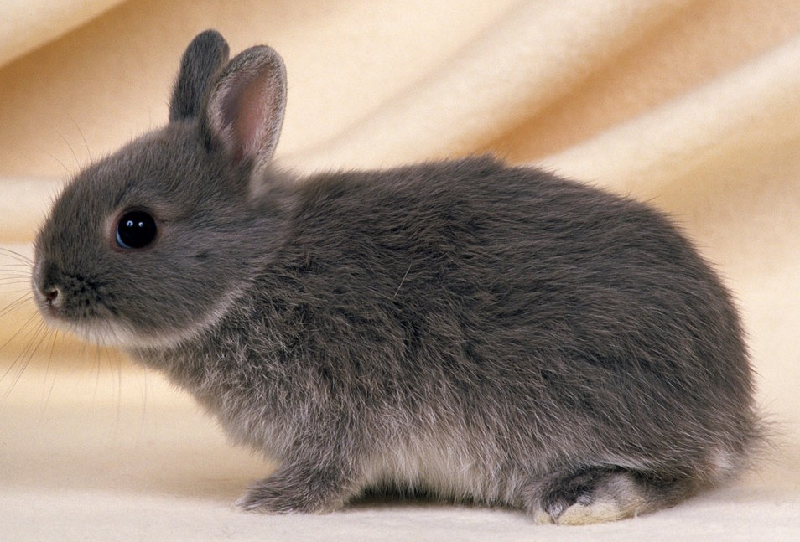
Ray Tracing for Games
Binned BVH Construction
Surface Area Heuristic (Or: what is the best way to slice a bunny?)

Slide 31
Ray Tracing for Games
Binned BVH Construction
Cost:
N_{left} * A_{left} + N_{right} * A_{right}
Select the split with the lowest cost.

Slide 32
Ray Tracing for Games
Ray Packets
BVH + Ray Packets = real-time performance.
Using the Surface Area Heuristic will double your performance.
It will also lead to much longer BVH construction times.
We need to go faster.

Slide 33
Ray Tracing for Games
Binned BVH Construction
Binned SAH:
Select axis of greatest extend
Evaluate cost function at N discrete intervals
Select best split plane.

Slide 34
Ray Tracing for Games
Ray Packets
BVH + Ray Packets = real-time performance.
Using the Surface Area Heuristic will double your performance.
Using binned SAH building yields a high quality BVH in little time:
Up to 100k triangles @ 30Hz is possible.

Slide 35
Ray Tracing for Games
Agenda:
Introduction
Acceleration Structures
Ray Packets
Binned BVH Construction

Slide 36
Ray Tracing for Games
LAB
Make your ray tracer real-time.
Steps:
Build a BVH per mesh over world-space transformed triangles.
  Create the BVH node class
  Add the BuildBVH method to the Mesh class
  Implement this function.
  Keep it simple at first: just do median splits.
Add single-ray traversal to the ray tracer.
  Implement a ray/box intersect function
  Use this to traverse your hierarchy
  Optional: visualize traversal depth to verify your tree.

Slide 37
Ray Tracing for Games
LAB
Make your ray tracer real-time.
Steps:
Handle multiple meshes
  Loop over the meshes in your scene, intersect each one in turn
  Optional: transform rays to object space
Add packet traversal
  Not hard if the rest is working already!
Be proud.

Slide 38
Ray Tracing for Games
LAB
Ray / box intersection:
bool CheckBox( vec3& bmin, vec3& bmax, vec3 O, vec3 rD, float t )
{
vec3 tMin = (bmin - O) * rD, tMax = (bmax - O) * rD;
vec3 t1 = min( tMin, tMax ), t2 = max( tMin, tMax );
float tNear = max( max( t1.x, t1.y ), t1.z );
float tFar = min( min( t2.x, t2.y ), t2.z );
return ((tFar > tNear) && (tNear < t) && (tNear > 0));
}

Slide 39

End of lecture 2.
Do nekonečna a za!

