Slide 1
Ray Tracing for Games
Dr. Jacco Bikker - FEL/CVUT, Prague, March 9 - 20
Optimization (1)

Slide 2
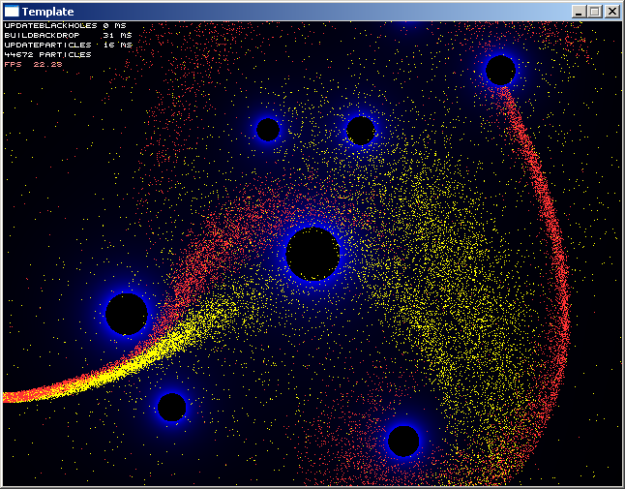
Ray Tracing for Games
Agenda:
The Art of Optimization
High-level
Data-centric
Low-level
Thread-level
Perceived performance

Slide 3
Ray Tracing for Games
The Art of Optimization
Why?
To make your game run fast enough
  Quake: as many FPS as possible
  Supreme Commander: as large armies as possible
  Far Cry 4: As much detail as possible
To be able to use algorithms that seem very expensive
  Would you use real-time fluid simulation for the smoke in your FPS?
  Would you use neural networks for your AI?
  Would you use ray tracing for your game?
To use offline algorithms in real-time
  Ambient occlusion
  Subdivision surfaces
  Fresnel (with Schlick)

Slide 4
Ray Tracing for Games
The Art of Optimization
How?
First of all: optimization can be applied as a structured process, with quite predictable ‘cost’, and often quite predictable gains.
1: Reduce algorithmic complexity
  (sometimes by reducing accuracy / approximating the real solution)
2: Write performance-critical code in a data-centric way
  (CPU: please the cache; GPU: mind the explicit memory hierarchy)
3: Thread-level parallelism
4: Instruction-level parallelism
5: Low-level optimizations

Slide 5
Ray Tracing for Games
Agenda:
The Art of Optimization
High-level
Data-centric
Low-level
Thread-level
Perceived performance

Slide 6
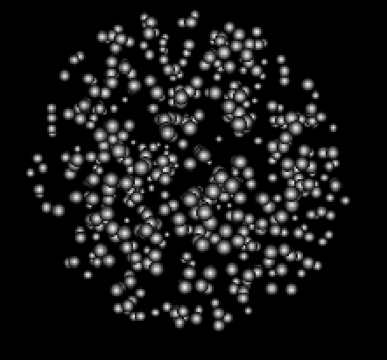
Ray Tracing for Games
High-level
High-level optimization example: particles
Problem: “In a software renderer, we want to draw as many particles as possible, correctly sorted.”
Question: what is the quickest way to draw 10k+ particles?

Slide 7
Ray Tracing for Games
High-level
High-level optimization example: particles

Slide 8
Ray Tracing for Games
High-level
“The most important optimization is that one where the program goes from a non-functional state to a functional state”
Monkey Sort – O( (e-1)N! )
Bubble Sort – O(N²)
stl::sort?

Slide 9
Ray Tracing for Games
High-level
“A specific sorting algorithm may outperform potentially stronger algorithms under specific circumstances”
Data set:
Large number of elements
12 bytes per element
Limited range
Uniformly distributed
Almost sorted (after first frame)

Slide 10
Ray Tracing for Games
High-level
Radix sort:
Repeated binning, O(N) complexity
Low level opportunities:
Integer comparisons
bool ismore(float a, float b) { return a > b; }
bool ismore(float a, float b) { return *(int*)&a > *(int*)&b; }
Swap indices rather than elements
Don’t sort too precise

Slide 11
Ray Tracing for Games
High-level
Search for the “God Algorithm”:
Don’t sort at all (i.e., O(1) ).
It’s possible, but how?
(exercise, solution tomorrow)

Slide 12
Ray Tracing for Games
High-level
High-level digest:
Any low-level optimizations would have been invalidated by a change of algorithm.
Algorithmic changes can have a huge impact on overall performance.
At this stage, we already need to look at precisely what it is we want to solve. Don’t do unnecessarily precise work.
We assumed sorting to be the bottleneck in this example. In real-life, this is wrong.

Slide 13
Ray Tracing for Games
High-level
0: Measure, to decide where your time is best spent.
1: Reduce algorithmic complexity.
2a: Measure.
2b: Write performance-critical code in a data-centric way.
3a: Measure.
3b: Apply Thread-level parallelism.
4a: Measure.
4b: Instruction-level parallelism.
5a: Measure.
5b: Low-level optimizations.

Slide 14
Ray Tracing for Games
Agenda:
The Art of Optimization
High-level
Data-centric
Low-level
Thread-level
Perceived performance

Slide 15
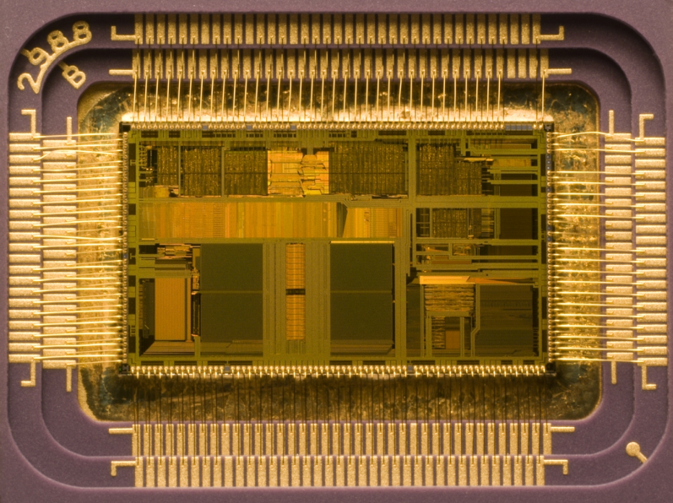
Ray Tracing for Games
Data-centric
“The goal of a cache is to keep the expensive CPU as busy as possible by minimizing the wait for reads and writes to and from slow memory”
Why is RAM slow?
Runs at a lower clock speed
Is too far from the CPU
    c = ~300.000 km/s
    At 4Ghz: 7.5cm per cycle
    c in copper is lower… ~5cm per cycle
    ➔ 2.5cm back and forth.

Slide 16
Ray Tracing for Games
Data-centric
Intel i7 Cache hierarchy:
Registers: on-die, 1 cycle to access
L1 cache: 32Kb, 4 cycles to access
L2 cache: 256Kb, 11 cycles to access
L3 cache: 2MB, 39 cycles to access
RAM: 4GB, 107 cycles

Slide 17
Ray Tracing for Games
Data-centric
Improving performance using the cache:
Ensure that work happens on a data set small enough to fit in 32Kb (L1).
Try to read memory sequentially.
A cache line is 64 bytes; amortize cache misses.
Consider prefetching.
Keep in mind that the cache is shared between all applications running on your system.

Slide 18
Ray Tracing for Games
Data-centric
Example: rotoscoping
void Game::Tick( float _DT )
{
Pixel* src = image.GetBuffer(), *dst = screen->GetBuffer();
vec2 p[3] = { { -1, -1 }, { 1, -1 }, { -1, 1 } }, r[3];
for( int i = 0; i < 3; i++ )
r[i].x = p[i].x * cosf( a ) + p[i].y * sinf( a ),
r[i].y = p[i].x * sinf( a ) - p[i].y * cosf( a );
vec2 dx = (r[1] - r[0]) * ((sinf( a * 2.0f ) + 1.1f) / SCRWIDTH);
vec2 dy = (r[2] - r[0]) * ((sinf( a * 2.0f ) + 1.1f) / SCRHEIGHT);
// plot pixels
for( int y = 0; y < SCRHEIGHT; y++ )
{
float x1 = dy.x * y, y1 = dy.y * y;
for( int x = 0; x < SCRWIDTH; x++, x1 += dx.x, y1 += dx.y )
{
int ix1 = ((int)((x1 + 100) * 512)) & 511;
int iy1 = ((int)((y1 + 100) * 512)) & 511;
*dst++ = src[ix1 + iy1 * 512];
}
}
}

Slide 19

Ray Tracing for Games
Data-centric
Best performance:
Linear access
Limited amount of data
➔ Upright, zoomed in

Slide 20
Ray Tracing for Games
Data-centric
Example: rotoscoping
Improving data locality: z-order / Morton curve
Method:
X = 1 1 0 0 0 1 0 1 1 0 1 1 0 1
Y = 1 0 1 1 0 1 1 0 1 0 1 1 1 0
--------------------------------
M = 1101101000111001110011111001

Slide 21
Ray Tracing for Games
Agenda:
The Art of Optimization
High-level
Data-centric
Low-level
Thread-level
Perceived performance

Slide 22
Ray Tracing for Games
Low-level
What is the cost of: +, -, *, /, sqrt, sin, cos, exp?
What is the cost of using float and double?
Should you use char / uchar or int / uint?
Low-level optimization check list:
Get rid of expensive calculations
Precalculate
Use the right data type
Use powers of two
Avoid conditional jumps
Get out early
Do things in parallel

Slide 23
Ray Tracing for Games
Agenda:
The Art of Optimization
High-level
Data-centric
Low-level
Thread-level
Perceived performance

Slide 24
Ray Tracing for Games
Thread-level
Compute potential:
4 cores, plus HT
Each core: 8-wide SIMD
1 GPU

Slide 25
Ray Tracing for Games
Thread-level
Parallel processing using 32-bit integers:
char a[4] = { 192, 168, 1, 1 };
int a4 = (a[0] << 24) + (a[1] << 16) + (a[2] << 8) + a[3];
union 00000001 00000001 00000001 00000001
{ 00000001 00000001 00000001 00000001
int a4; -------------------------------------- +
char a[4]; 00000010 00000010 00000010 00000010
};

Slide 26
Ray Tracing for Games
Thread-level
Parallel processing using 32-bit integers:
char argb[4] = { 0, 255, 255, 0 }; // yellow
int& a4 = (int&)argb;
31..24 23..16 15..8 7..0
red = (a4 >> 16) & 255;
green = (a4 >> 8) & 255;
blue = a4 & 255;
scaled_red = (red * scale) >> 8;
scaled_green = (green * scale) >> 8;
scaled_blue = (blue * scale) >> 8;
final_color = (scaled_red << 16) + (scaled_green << 8) + scaled_blue;

Slide 27
Ray Tracing for Games
Thread-level
Parallel processing using 32-bit integers:
red = (a4 >> 16) & 255;
green = (a4 >> 8) & 255;
blue = a4 & 255;
scaled_red = (red * scale) >> 8;
scaled_green = (green * scale) >> 8;
scaled_blue = (blue * scale) >> 8;
final_color = (scaled_red << 16) + (scaled_green << 8) + scaled_blue;
red_blue = a4 & 0xff00ff;
green = a4 & 0x00ff00;
red_blue_scaled = ((red_blue * scale) >> 8) & 0xff00ff;
green_scaled = ((green * scale) >> 8) & 0x00ff00;
final_color = red_blue_scaled + green_scaled;
7 x >>, <<
3 x &
3 x *
2 x +
2 x >>
4 x &
2 x *
1 x +

Slide 28
Ray Tracing for Games
Thread-level
Parallel processing using 32-bit integers:
char a[] = “optimizating string compare”;
char b[] = “optimization skills rule!!!”;
bool equal = true;
for ( int l = strlen(a), i = 0; i < l; i++ )
{
if (a[i] != b[i])
{
equal = false;
break;
}
}

Slide 29
Ray Tracing for Games
Thread-level
Parallel processing using 32-bit integers:
char a[] = “optimizating string compare”;
char b[] = “optimization skills rule!!!”;
int* a4 = (int*)a, b4 = (int*)b;
bool equal = true;
for ( int l = strlen(a) / 4, i = 0; i < l; i++ )
{
if (a4[i] != b4[i])
{
equal = false;
break;
}
}

Slide 30
Ray Tracing for Games
Agenda:
The Art of Optimization
High-level
Data-centric
Low-level
Thread-level
Perceived performance

Slide 31
Ray Tracing for Games
Perceived Performance
A task that takes 2 seconds may appear faster than a task that takes one second – if the application provides feedback before starting the 2 second task.
A more realistic visualization appears to run at a higher frame rate.
In graphics, motion blur greatly improves perceived performance.

Slide 32
Ray Tracing for Games
Agenda:
The Art of Optimization
High-level
Data-centric
Low-level
Thread-level
Perceived performance

Slide 33
Ray Tracing for Games
Optimization(1) overview
Optimize once functionality is final
Development time is limited; only optimize if needed, and only those sections that need it
Use profiling to pinpoint hotspots
Always optimize on a high level first
Object oriented is good for writing clear code, data-centric is good for writing fast code
Please the hardware: cache, instruction pipeline.
The average application can be made 10x faster using optimization –
You may want to take this into consideration during game design.

Slide 34
Ray Tracing for Games
LAB
Today’s LAB session:
CATCH UP.
Game engineers: proceed work on the game mechanics.
Graphics engineers: work towards a functional ray tracer.
Tomorrow: acceleration structures. You’ll need a functional ray tracer for that.

Slide 35

End of lecture 3.
začněme programování!

