Slide 1
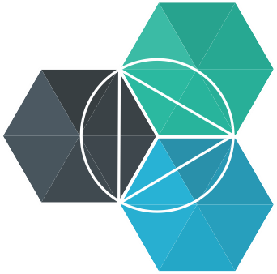
IBM Bluemix
Digital Innovation Platform
Mario Kamburov
IBM CEE Cloud Innovation Lab
mario.kamburov@cz.ibm.com
@_mario_kam_

Slide 2
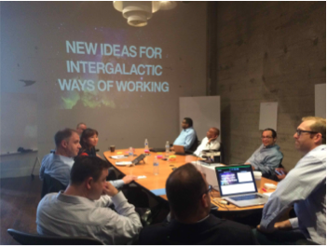
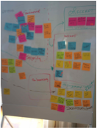
Innovation is the new currency
“Two guys in a coffee shop can have access to the same computing power as a Fortune 500 company.”
Jim Deters
Founder, Galvanize
The Digital Innovation Platform
IBM CEE Cloud iLab
© 2015 IBM Corporation

Slide 3
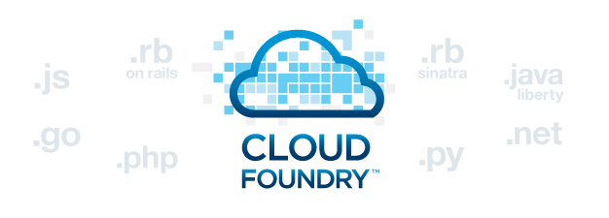
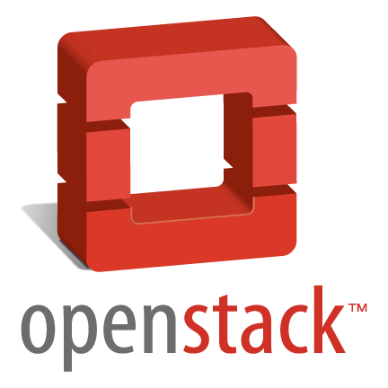
IBM Bluemix Overview
Infrastructure as a Service
Platform as a Service
Built on open technologies
With security in mind
Code
Code
Data
Data
Runtime
Runtime
Middleware
Middleware
OS
OS
Virtualization
Virtualization
Servers
Servers
Storage
Storage
Networking
Networking
IBM CEE Cloud iLab
https://console.ng.bluemix.net/catalog/
© 2015 IBM Corporation

Slide 4
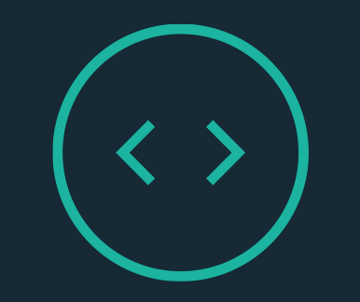
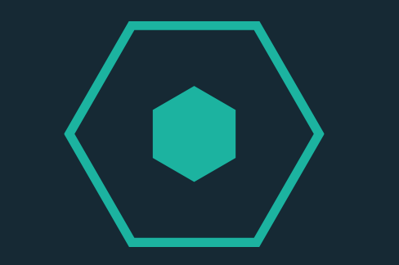
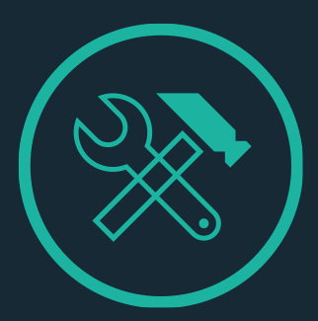
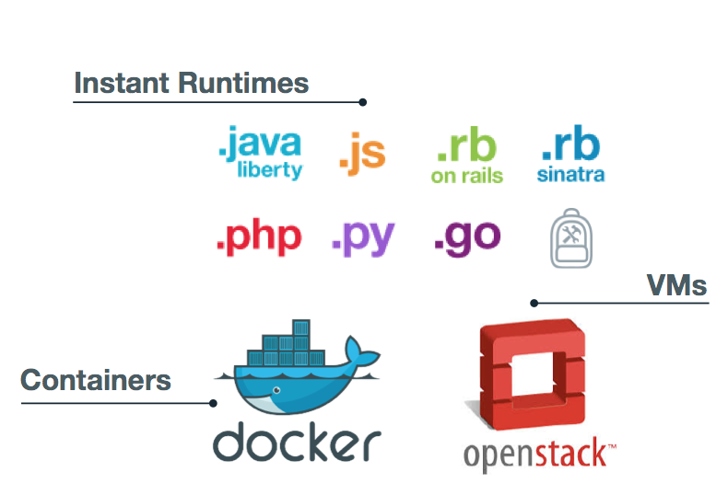
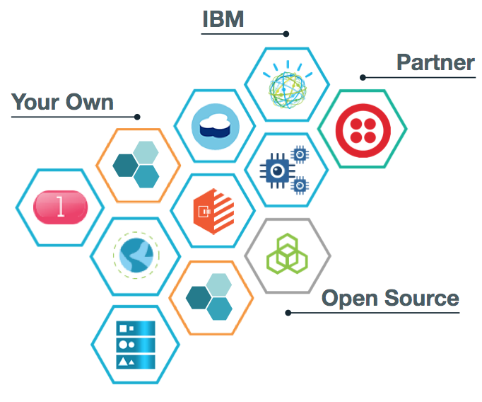
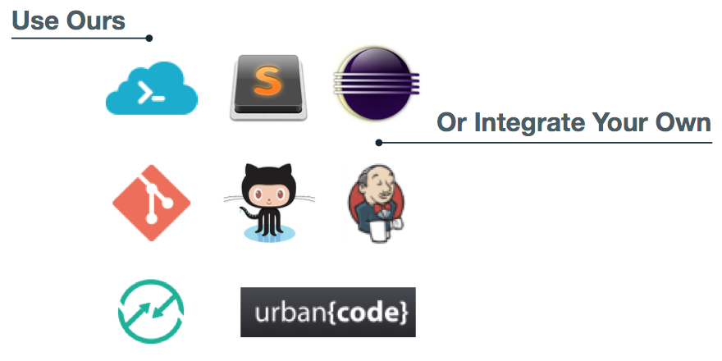
Build awesome app in no time
RUN APPS YOUR WAY
CATALOG OF SERVICES / APIs
FLEXIBLE TOOLING
IBM CEE Cloud iLab
© 2015 IBM Corporation
Notes:
Hybrid cloud – services part

Slide 5
Total cost of ownership
Customer Managed
o
perational Expense
Comparison between Dedicated and Local.
IBM Managed
c
apital Expense
Bluemix Dedicated
Bluemix Local
IBM Managed Single Tenant Platform
IBM Managed On-Prem Platform
Code
Code
Data
Data
~X / Month
X / Month
Runtime
o
Runtime
c
o
Bluemix Software
Mgmt Expense
Middleware
o
Middleware
c
o
OS
o
OS
c
o
Your IaaS Software
Virtualization
o
One Bill for Bluemix
Virtualization
c
o
Servers
o
Servers
c
o
Your Ops Staff
Storage
o
Storage
c
Your Hardware
o
Networking
o
Networking
c
o
~4X / Month*
*Based on 10 FTE + SoftLayer infrastructure costs
5
© 2015 IBM Corporation
IBM CEE Cloud iLab
5

Slide 6
Demo

Slide 7
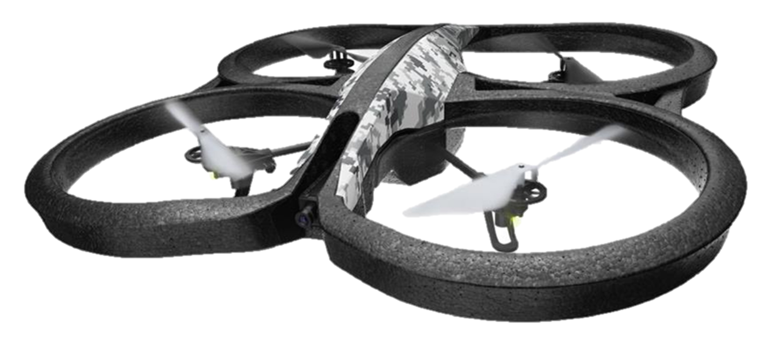
DEMO 2
IBM CEE iLABs
© 2015 IBM Corporation

Slide 8
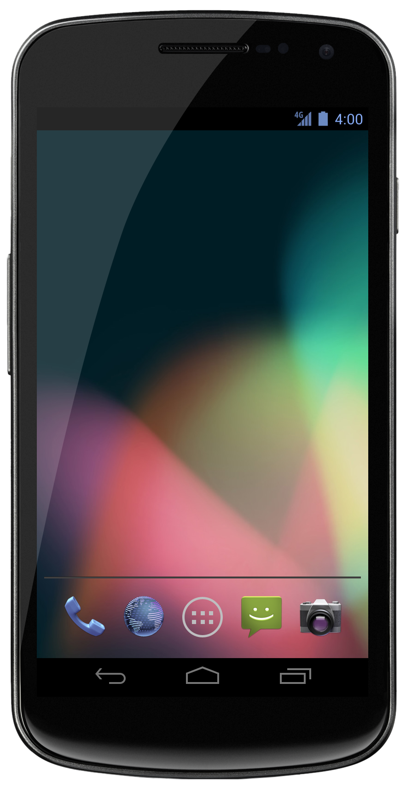
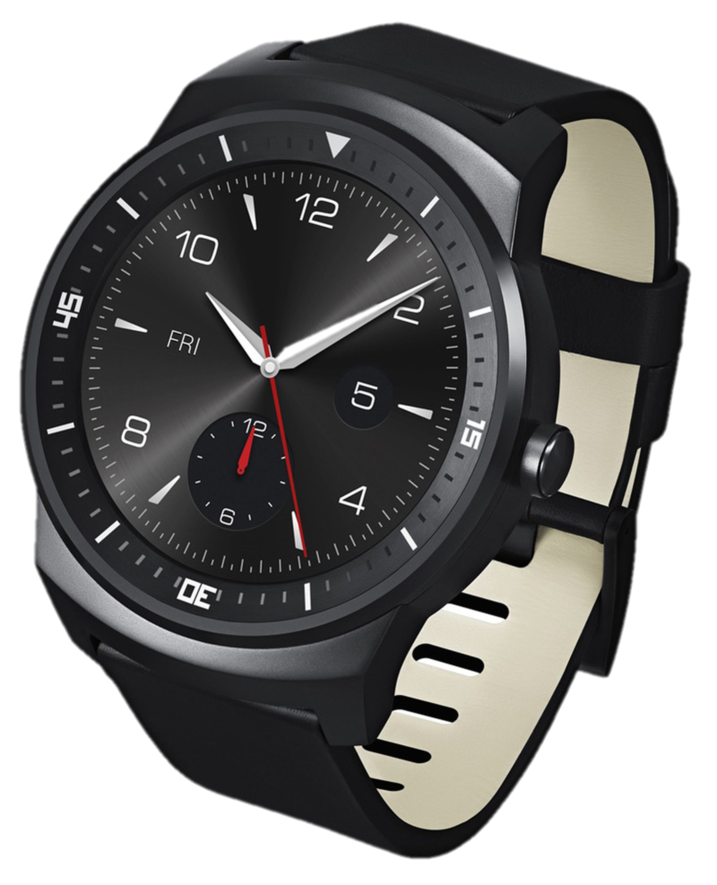
DEMO 2
IBM CEE iLABs
© 2015 IBM Corporation

Slide 9
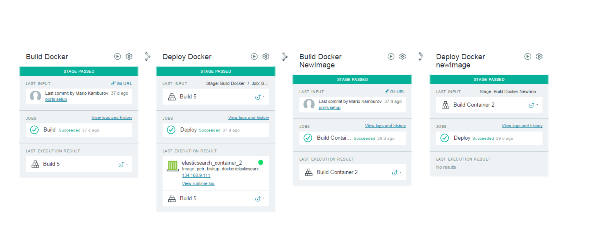
DevOps pipeline
IBM CEE Cloud iLab
© 2015 IBM Corporation

Slide 10
Under the hood

Slide 11
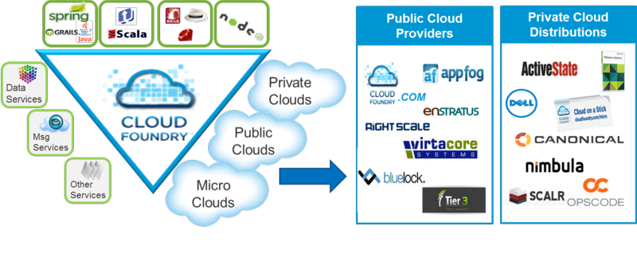
What is Cloud Foundry?
An open platform-as-a-service (PaaS). The system supports multiple frameworks, multiple application infrastructure services and deployment to multiple clouds.
Making Multi-Cloud a Reality
IBM CEE Cloud iLab
© 2015 IBM Corporation

Slide 12
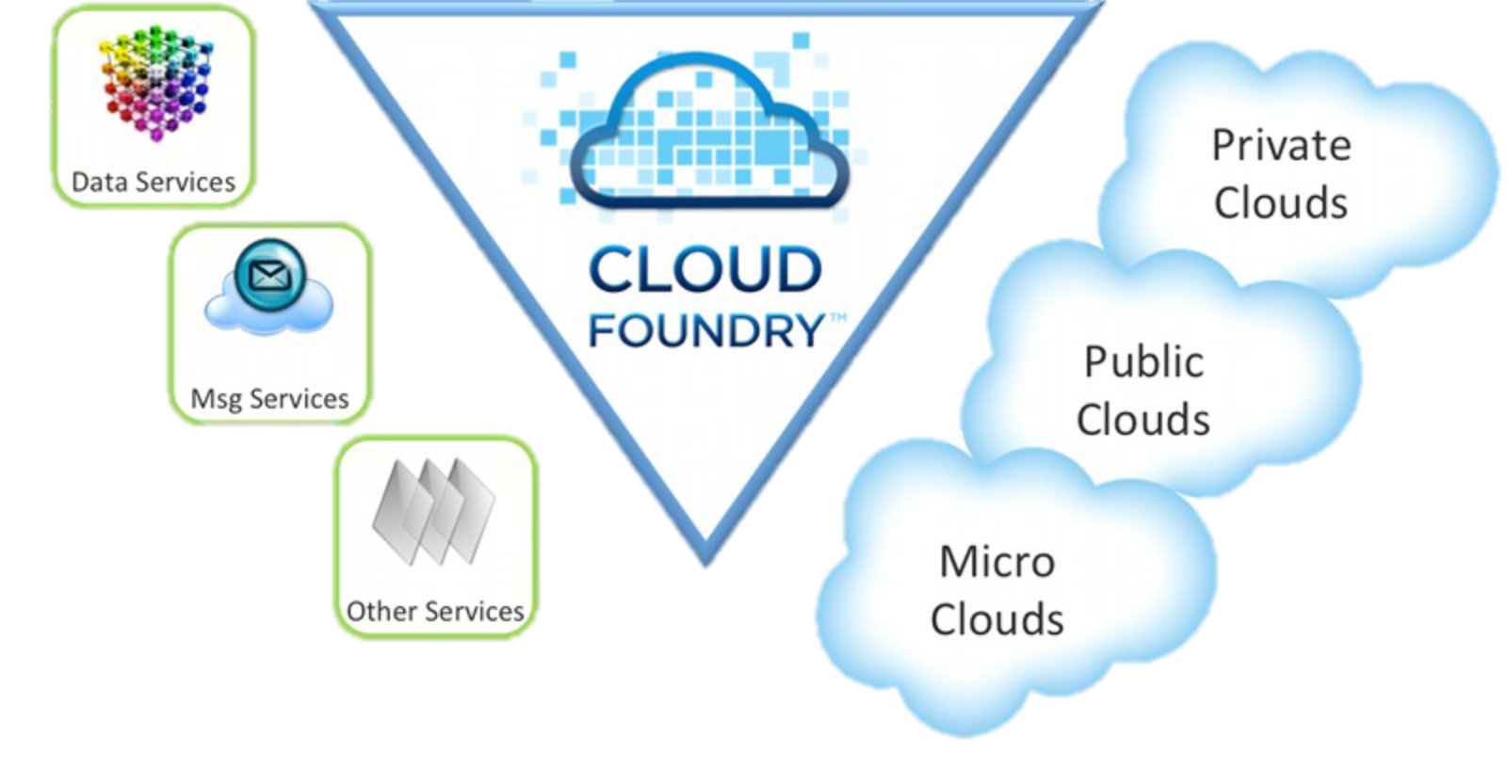
Languages/Frameworks/Services
Multi-Language
Ruby, Java, Scala, Node.js, Erlang, Python, PHP..
Multi-Framework
Rails, Sinatra, Spring, Grails, Express, Lift
Multi-Services
MySQL, Postgres, MongoDB, Redis, RabbitMQ
Multi-Cloud, Multi-IaaS
Public Cloud, MicroCloud, Private Cloud
IBM CEE Cloud iLab
© 2015 IBM Corporation

Slide 13
Cloud Foundry Goals & Principles
No single point of failure
Distributed state
Self healing
Horizontally scalable
Loose coupling
Event-driven
Asynchronous
Idempotent
Language independent communication
https://www.youtube.com/watch?v=Me2_-FIIYec
IBM CEE Cloud iLab
© 2015 IBM Corporation

Slide 14
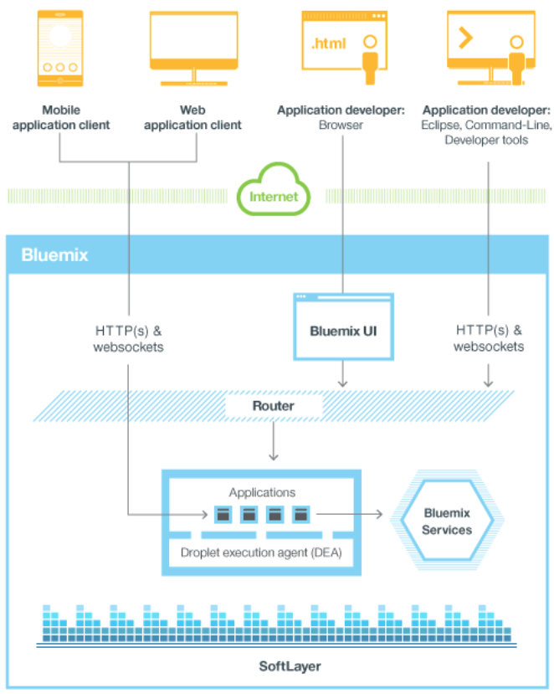
Bluemix High Level Architecture
IBM CEE Cloud iLab
© 2015 IBM Corporation

Slide 15
Cloud Foundry Layers
clients
Inner shell
Outer shell (BOSH)
Infrastructure as a Service
Hardware (CPU, Storage, Memory, Network)
IBM CEE Cloud iLab
© 2015 IBM Corporation
Notes:
Client talks to inner shell
Inner shell has all the components needed to run application, talk to the clients, make things consistent etc.
Inner shell stands on top of Outer Shell
Reason is that OS could be platform dependent.
OuterShell runs on IaaS.

Slide 16
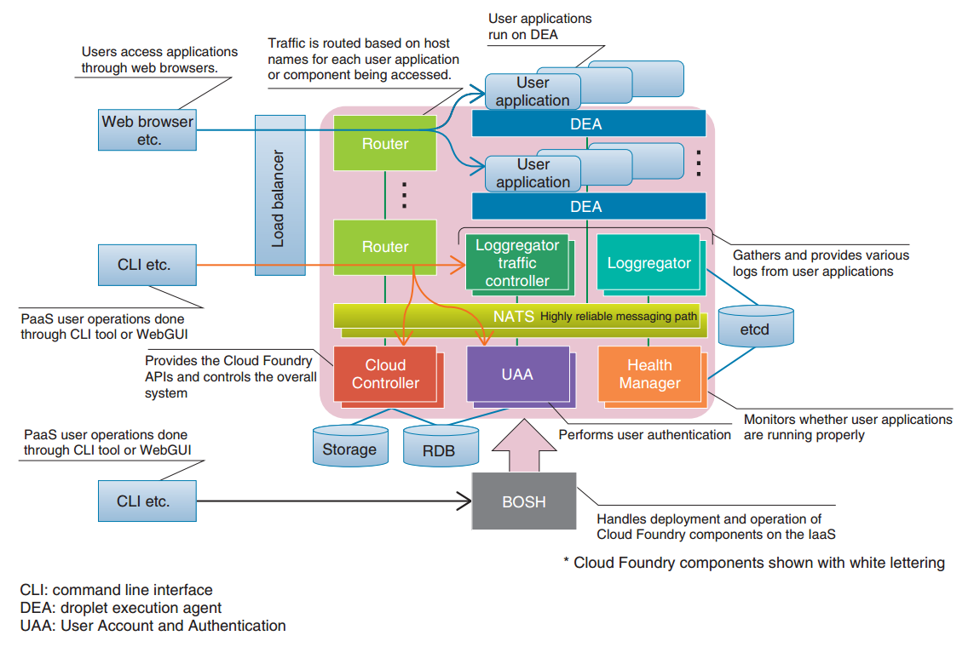
Cloud Foundry deep dive architecture
http://cloudacademy.com/blog/cloud-foundry-components/
IBM CEE Cloud iLab
© 2015 IBM Corporation
Notes:
A DEA will select the appropriate buildpack and use that to both stage your application, and ensure complete life cycle management of its application instance. An application instance consists of a 1) droplet and a 2) Warden container. A DEA will continually broadcast the application instance health status to the health manager, which communicates internally to the cloud controller.
Requests are directed to the DEA through the cloud controller.

Slide 17
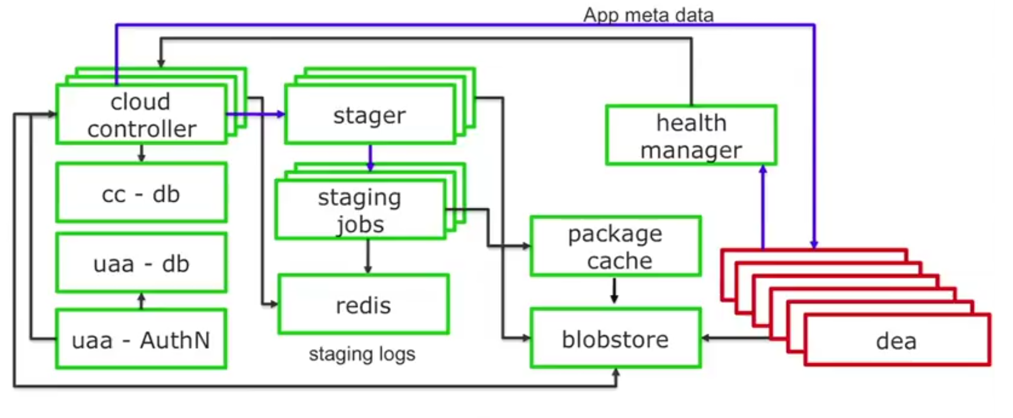
Cloud Foundry deep dive architecture
IBM CEE Cloud iLab
© 2015 IBM Corporation

Slide 18
Cloud Foundry deep dive architecture
IBM CEE Cloud iLab
© 2015 IBM Corporation

Slide 19
Buildpacks
Defines the rules to create a fully-contained execution environment
App
Buildpack
Droplet
A Droplet is a fully self-sufficient, referentially correct package that can be executed in an isolated environment
IBM CEE Cloud iLab
© 2015 IBM Corporation
Notes:
Buildpacks
Buildpacks are the scripts through which Cloud Foundry identifies the required runtime or framework for the application. Buildpacks are responsible for identifying an application’s related dependencies based on user-provided artefacts. They will then ensure everything is properly downloaded and configured.
So image that you want to push a WAR file to a Cloud Foundry environment. Buildpacks are smart enough to identify the programming language, framework, and application container you’ll need to properly deploy, and then automatically download everything for you from GitHub. If your application uses a language or framework that Cloud Foundry buildpacks do not support, you can write custom buildpacks.
Droplet
Droplet is the Cloud Foundry unit of execution. Once an application is pushed to Cloud Foundry and deployed using a buildpack, the result is a droplet. A droplet, therefore, is nothing but an abstraction on top of the application that contains information like metadata. Those droplets are stored in blob storage for further deployment processes.
Warden
Once the droplet is ready, it will need hosting in a suitable environment. In Cloud Foundry, this is called a Warden container. Wardens isolate ephemeral and resource-controlled environments.

Slide 20
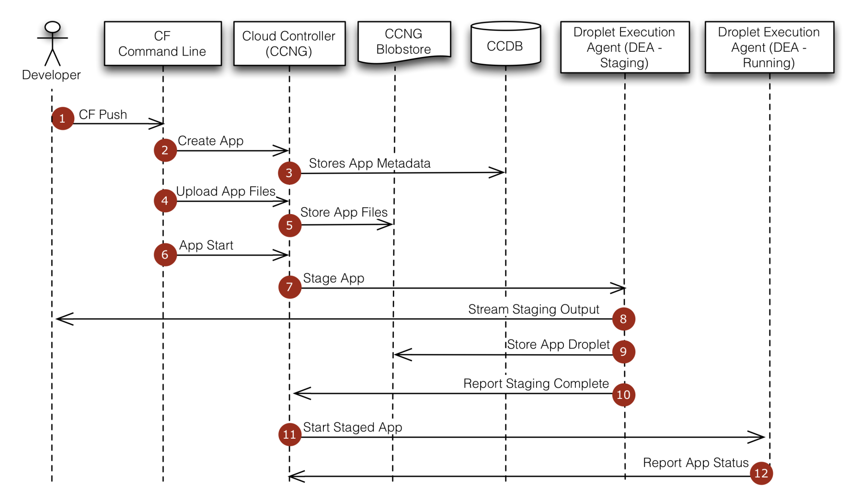
Cloud Foundry – Application Staging
IBM CEE Cloud iLab
© 2015 IBM Corporation
Notes:
At the command line, the developer enters the directory containing her application and uses the cf command line tool to issue a push command.
The cf command line tool tells the Cloud Controller to create a record for the application.
The Cloud Controller stores the application metadata (e.g. the app name, number of instances the user specified, and the buildpack).
The cf command line tool uploads the application files.
The Cloud Controller stores the raw application files in the blobstore.
The cf command line tool issues an app start command.
Because the app has not already been staged, the Cloud Controller chooses a DEA instance from the DEA pool to stage the application. The staging DEA uses the instructions in the buildpack to stage the application.
The staging DEA streams the output of the staging process so the developer can troubleshoot application staging problems.
The staging DEA packages the resulting staged application into a tarball called a “droplet” and stores it in the blobstore. The results are cached and used next time the application is staged.
The staging DEA reports to the Cloud Controller that staging is complete.
The Cloud Controller chooses one or more DEAs from the pool to run the staged application.
The running DEAs report the status of the application to the Cloud Controller.

Slide 21
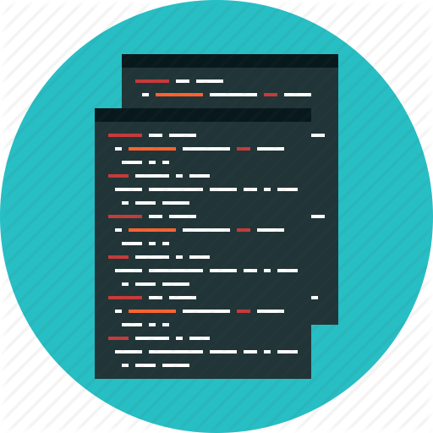
Cloud Foundry – Application Staging
Stager
Play
Spring
Rails
…..
IBM CEE Cloud iLab
© 2015 IBM Corporation

Slide 22
Staging process (Spring application)
DAE
Shell script
start
.war
agent
buildpack
stop
Facade
IBM CEE Cloud iLab
© 2015 IBM Corporation

Slide 23
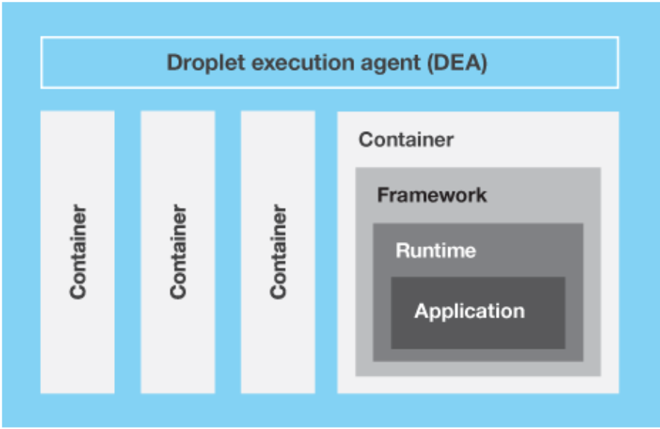
Design of a VM
IBM CEE Cloud iLab
© 2015 IBM Corporation

Slide 24
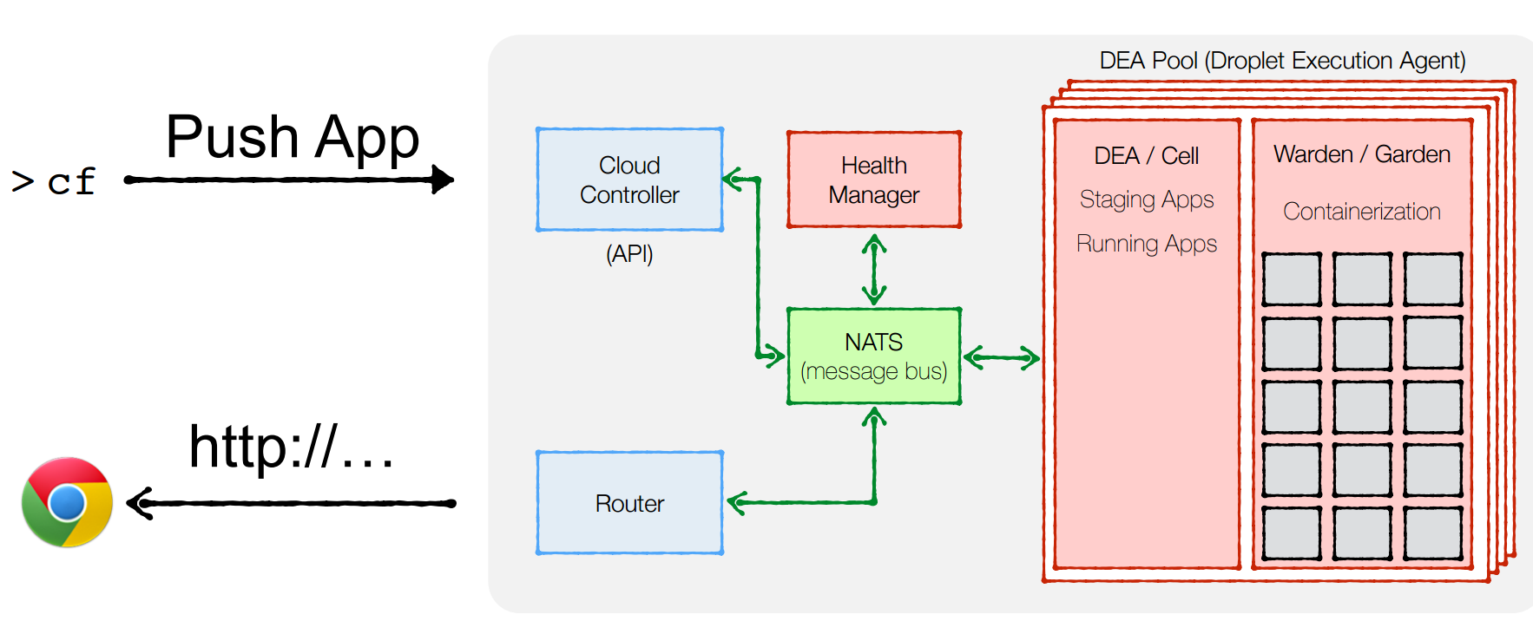
Workflow
IBM CEE Cloud iLab
© 2015 IBM Corporation

Slide 25
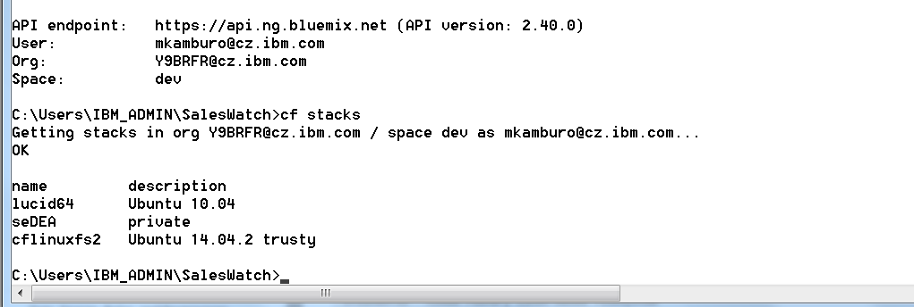
CF Stacks
A stack is a prebuilt root filesystem (rootfs) which works in tandem with a buildpack and is used to support running applications.
IBM CEE Cloud iLab
© 2015 IBM Corporation

Slide 26
Use Cases
&
Best practises

Slide 27
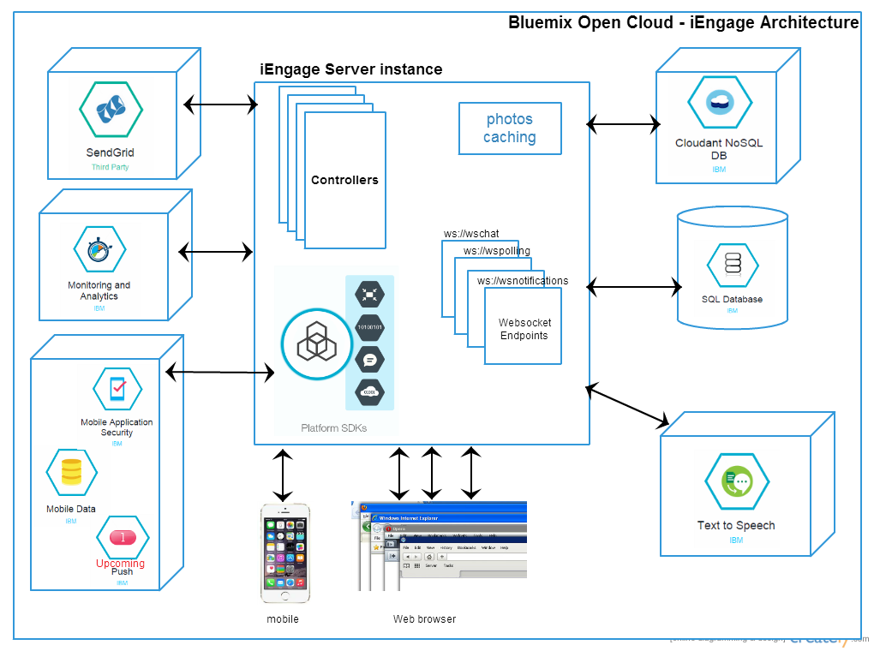
Solution Architecture
IBM CEE Cloud iLab
http://iengage.mybluemix.net/
© 2015 IBM Corporation

Slide 28
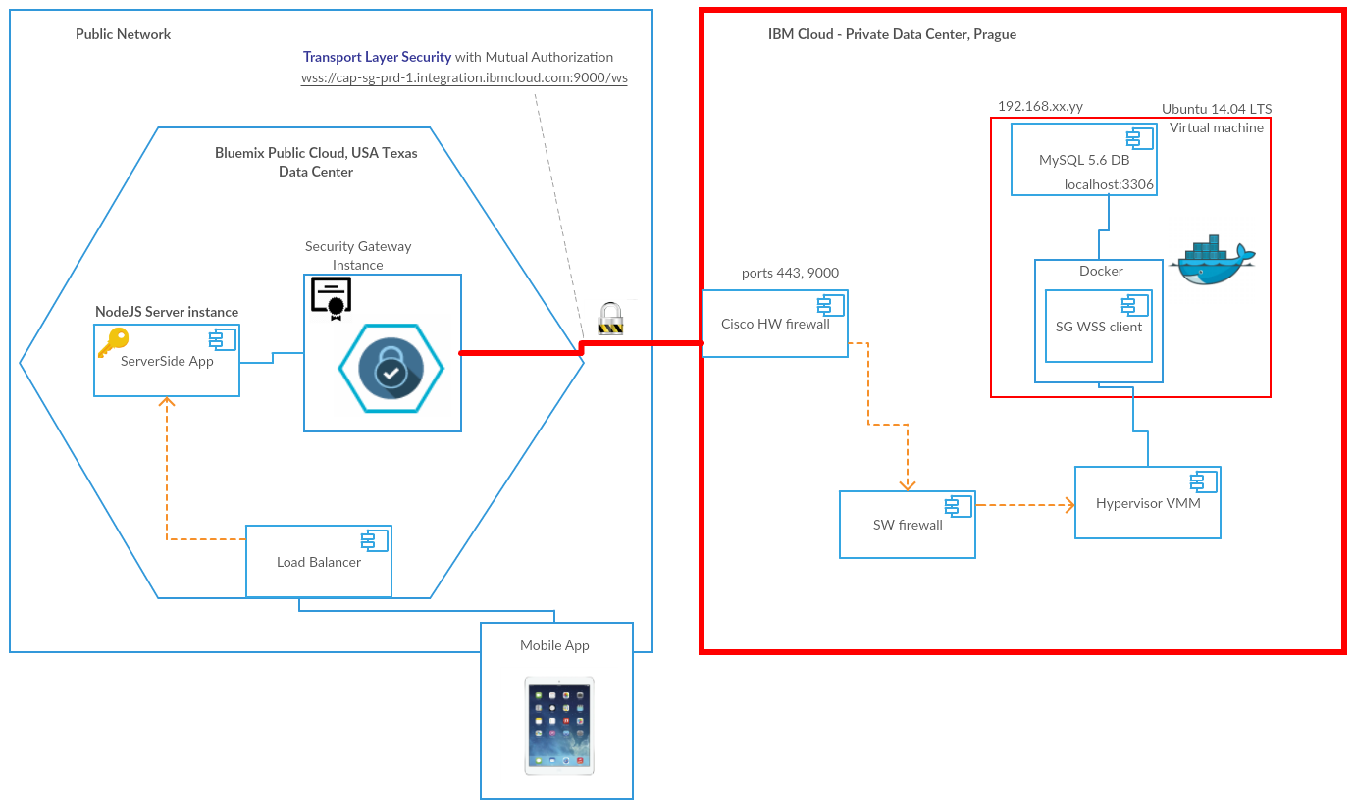
Hybrid cloud
IBM CEE Cloud iLab
© 2015 IBM Corporation

Slide 29
Parsing VCAP_SERVICES
Node
if (process.env.VCAP_SERVICES) {
var env = JSON.parse(process.env.VCAP_SERVICES);
var credentials = env['mysql-5.5'][0].credentials;
…
}
Ruby
mysql_dbs = JSON.parse(ENV['VCAP_SERVICES'])["mysql-5.5"]
credentials = mysql_dbs.first["credentials"]
Java
String vcap_services = System.getenv("VCAP_SERVICES");
if (vcap_services != null && vcap_services.length() > 0) {
JsonRootNode root = new JdomParser().parse(vcap_services);
JsonNode mysqlNode = root.getNode(”mysql-5.5");
JsonNode credentials = mysqlNode.getNode(0).getNode("credentials");
…
}
Note Java buildpack parses VCAP_SERVICES and can auto configure bound services – see Bluemix Liberty for Java documentation
IBM CEE Cloud iLab
© 2015 IBM Corporation

Slide 30
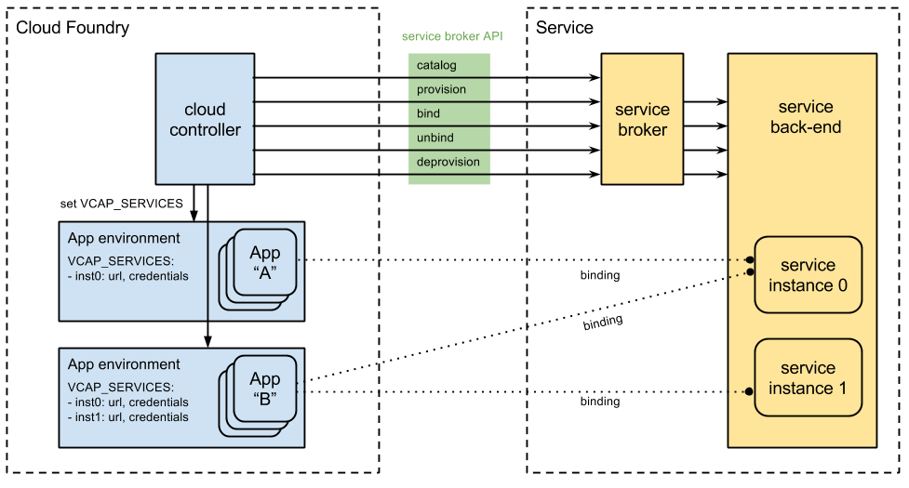
Cloud Foundry - Services
IBM CEE Cloud iLab
© 2015 IBM Corporation
Notes:
In general, service brokers advertise a catalog of service offerings and service plans to Cloud Foundry, and receive calls from Cloud Foundry for five functions: fetch catalog, provision (create), bind, unbind, and deprovision (delete). What a broker does with each call can vary between services; in general, ‘provision’ reserves resources on a service and ‘bind’ delivers information to an application necessary for accessing the resource. We call the reserved resource a Service Instance. What a service instance represents can vary by service; it could be a single database on a multi-tenant server, a dedicated cluster, or even just an account on a web application.
Architecture
How a service is implemented is up to the service provider/developer. Cloud Foundry only requires that the service provider implement the service broker API. A broker can be implemented as a separate application, or by adding the required http endpoints to an existing service.
Because Cloud Foundry only requires that a service implements the broker API in order to be available to Cloud Foundry end users, many deployment models are possible. The following are examples of valid deployment models.
Entire service packaged and deployed by BOSH alongside Cloud Foundry
Broker packaged and deployed by BOSH alongside Cloud Foundry, rest of the service deployed and maintained by other means
Broker (and optionally service) pushed as an application to Cloud Foundry user space
Entire service, including broker, deployed and maintained outside of Cloud Foundry by other means
Developing a Service Broker
Development Environment
You’ll need a Cloud Foundry instance to deploy and test your service broker as you are developing it. You must have admin access to your CF instance. You may use any existing install of CF as long you have admin access to it. Otherwise, we recommend deploying a new CF development instance using Bosh Lite.
Example Service Brokers
The following example service broker applications have been developed - these are a great starting point if you are developing your own service broker.
Ruby
GitHub repo service - this is designed to be an easy-to-read example of a service broker, with complete documentation, and comes with a demo app that uses the service. The broker can be deployed as an application to any Cloud Foundry instance or hosted elsewhere. The service broker uses GitHub as the service back end.
MySQL database service - this broker and its accompanying MySQL server are designed to be deployed together as a BOSH release. BOSH is used to deploy or upgrade the release, monitors the health of running components, and restarts or recreates unhealthy VMs. The broker code alone can be found here.
Java
Spring Service Broker - this repo provides a template for building v2 service brokers in Spring, and includes an example implementation for MongoDB.
MySQL Java Broker - a Java port of the Ruby-based MySQL broker above.

Slide 31
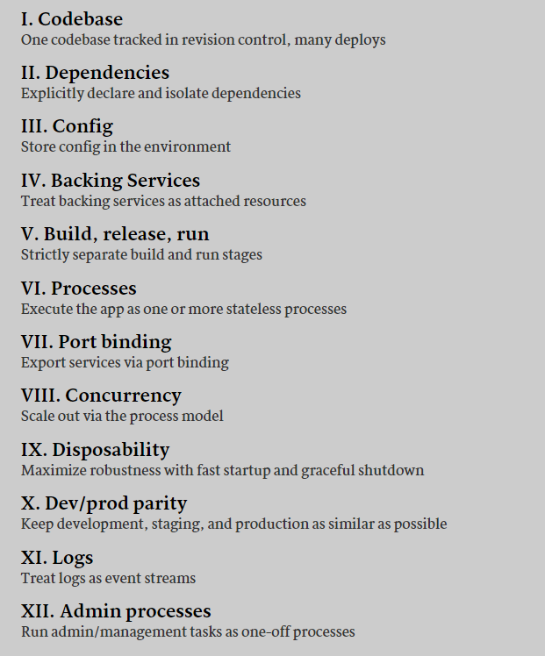
12 Factors for cloud development
IBM CEE Cloud iLab
http://12factor.net/
© 2015 IBM Corporation

Slide 32
9 rules for cloud applications
Don’t code your application directly to a specific topology
Don’t assume the local file system is permanent
Don’t keep session state in your application
Don’t log to the file system
Don’t assume any specific infrastructure dependency
Don’t use infrastructure APIs from within your application
Don’t use obscure protocols
Don’t rely on OS-specific features
Don’t manually install your application
Read the article : http://www.ibm.com/developerworks/websphere/techjournal/1404_brown/1404_brown.html
IBM CEE Cloud iLab
© 2015 IBM Corporation

Slide 33
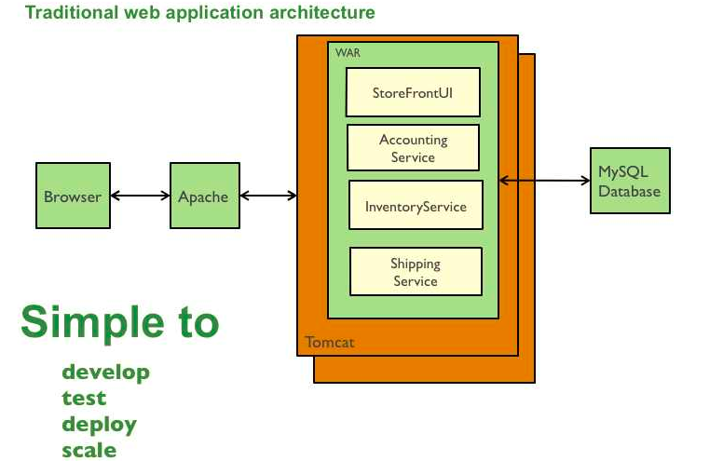
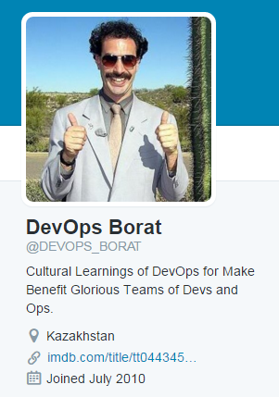
Monolith vs. Microservices
“To make error is human. To propagate error to all server in automatic way is
#devops.” –DevOps Borat.
With each service being completely different architecture wise and language it is in it would be near impossible for a central “ops” team to manage all the apps.
For example, if Dave a front-end dev wants to change the color of a button, it would require the whole app to be built, tested, and re-deployed for a tiny change.
IBM CEE Cloud iLab
© 2015 IBM Corporation

Slide 34
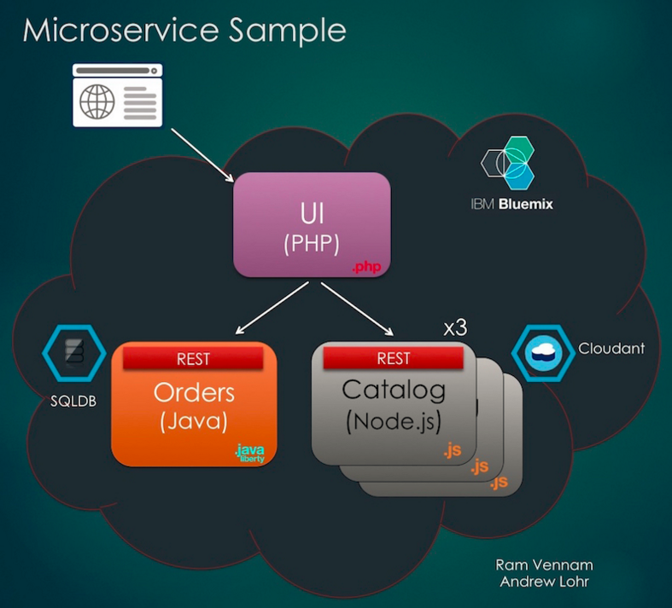
Microservices architecture example
http://microservices-ui-mkamburo-141.mybluemix.net/
http://microservices-catalogapi-mkamburo-142.mybluemix.net
http://microservices-ordersapi-mkamburo-141.mybluemix.net/rest/orders
IBM CEE Cloud iLab
© 2015 IBM Corporation

Slide 35
Links
https://www.youtube.com/watch?v=p48KslXmP7A
http://cloudacademy.com/blog/cloud-foundry-components/
https://developer.ibm.com/bluemix/2015/03/16/sample-application-using-microservices-bluemix/
https://www.youtube.com/watch?v=y4zor2y-yck
https://www.youtube.com/watch?v=oXExLtmw0q4
IBM CEE Cloud iLab
© 2015 IBM Corporation

Slide 36
Thank you!
Register at:
Bluemix.net
to get your 30 days free trial

