Slide 1
Amazon Web Services
Jan Šedivý

Slide 2
AWS
Application building blogs
Stable API
Proven Amazon infrastructure
Long-term investment
Keeping large sites scalable, operational
Adding new services on regular basis

Slide 3
What are developers facing
70% of Web development effort is:
Data centers
Bandwidth, power, cooling
Operations
Staffing
Scaling is difficult and expensive
Large upfront investments
Invest ahead of demand
Load unpredictable
This is based on research of Amazon between developers

Slide 4
Amazon Simple Storage Service
Objects
Opaque data to be stored (1 byte ..5G)
Authenticated access
Buckets – containers for objects
Object container – any number of objects – object is a file on local PC
Set permissions
100 buckets per account
Keys
Unique object identifier with bucket
Up to 1024 bytes long
Flat object model
Object based interface
REST, SOAP
URL addressability – every object has URL
Bit Torrent seed
99.999999999% durability and 99.99% availability of objects over a given year

Slide 5
S3 API
Service
ListAllMyBuckets
Buckets
CreateBucket
DeleteBucket
ListBucket
GetBucketAccesControlPolicy
SetBucketAccesControlPolicy
Objects
PutObject
PutObjectInline
GetObject
GetObjectExtended
DeleteObject
GetObjectAccesControlPolicy
SetObjectAccesControlPolicy

Slide 6
Create a bucket
Management console web page
Select S3
Sign in

Slide 7
Add object a bucket
Management console web page
Upload file
Set permissions

Slide 8
S3.rb create a conn object
Require ‘S3”
AWS_ACCESS_KEY = ‘<your key>’
AWS_SECRET_ACCESS_KEY = ‘<your key>’
Conn = S3:: AWSAuthConnection.new
(AWS_ACCESS_KEY_ID,
AWS_SECRET_ACCESS_KEY,
False)
BUCKET_NAME = ‘assets.example.com’
Conn.create_bucket (BUCKET_NAME)

Slide 9
S3.rb create bucket,
BUCKET_NAME = ‘assets.example.com’
Conn.create_bucket (BUCKET_NAME)

Slide 10
S3.rb open file+headers, URL+key
Datafile = File.open (path)
Key = path.basename
Conn.put (BUCKET_NAME, key, data.file.read,){“Content-Type” => mime,
“Content-Length” =>File.size(path).to_s,
“x-amz-acl” => “public-read”})
http://assets.sample.com/…

Slide 11
S3 libs
Go to google and search for the service name + favorite language …

Slide 12
S3 pricing

Slide 13
EC2 service
Virtual Compute Cloud (provision, kill, monitor)
Root-level System Access
Elastic Capacity
Management API
Scale in Minutes (provisioning in minutes, returns IP)
Third party tools to manage automatically scaling
Multiple instances sizes
Network security (hardwire connectivity for three tier model)
You are charged per hour
You are charged per GB of data transfer

Slide 14
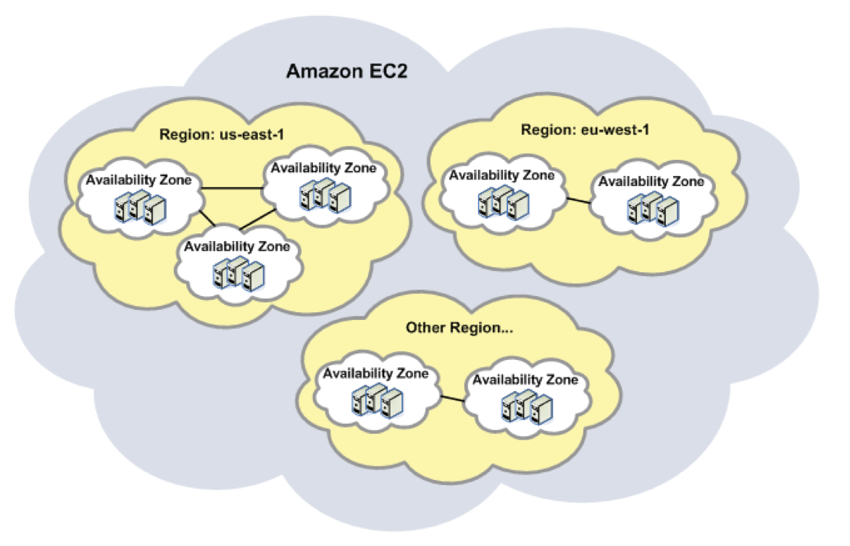
AMIs
Regions
Availability zones

Slide 15
Several types of EC2 instances
Standard instances
Instances of this family are well suited for most applications.
Small Instance (Default) 1.7 GB of memory, 1 EC2 Compute Unit (1 virtual core with 1 EC2 Compute Unit), 160 GB of local instance storage, 32-bit platform
Large Instance 7.5 GB of memory, 4 EC2 Compute Units (2 virtual cores with 2 EC2 Compute Units each), 850 GB of local instance storage, 64-bit platform
Extra Large Instance 15 GB of memory, 8 EC2 Compute Units (4 virtual cores with 2 EC2 Compute Units each), 1690 GB of local instance storage, 64-bit platform

Slide 16
AMI
Micro Instances
small amount CPU allow to burst CPU when available.
Micro Instance 613 MB of memory, up to 2 ECUs (for short periodic bursts), EBS storage only, 32-bit or 64-bit platform

Slide 17
AMI
High-Memory Instances
Instances of this family offer large memory sizes for high throughput applications, including database and memory caching applications.
High-Memory Extra Large Instance 17.1 GB memory, 6.5 ECU (2 virtual cores with 3.25 EC2 Compute Units each), 420 GB of local instance storage, 64-bit platform
High-Memory Double Extra Large Instance 34.2 GB of memory, 13 EC2 Compute Units (4 virtual cores with 3.25 EC2 Compute Units each), 850 GB of local instance storage, 64-bit platform
High-Memory Quadruple Extra Large Instance 68.4 GB of memory, 26 EC2 Compute Units (8 virtual cores with 3.25 EC2 Compute Units each), 1690 GB of local instance storage, 64-bit platform

Slide 18
AMI
High-CPU Instances
Instances of this family have proportionally more CPU resources than memory (RAM) and are well suited for compute-intensive applications.
High-CPU Medium Instance 1.7 GB of memory, 5 EC2 Compute Units (2 virtual cores with 2.5 EC2 Compute Units each), 350 GB of local instance storage, 32-bit platform
High-CPU Extra Large Instance 7 GB of memory, 20 EC2 Compute Units (8 virtual cores with 2.5 EC2 Compute Units each), 1690 GB of local instance storage, 64-bit platform

Slide 19
EC 2 concept
Amazon Machine Image (AMI)
Bootable root disk stored in S3
Pree-defined or user-built – catalog
OS: Fedora, Centos, Gentoo, Debian, Ubuntu, Win …
App Stack: LAMP, Hadoop
Instance
Running copy of an AMI
Launch < 2min
Start/stop under program control
Network security model:
Explicit access control
Security groups
Inter-service bandwidth free

Slide 20
EC2 API
http://docs.amazonwebservices.com/AWSEC2/latest/APIReference/
AMIs
Instances
Keypairs
Monitoring
Elastic Block Storage
Security
…

Slide 21
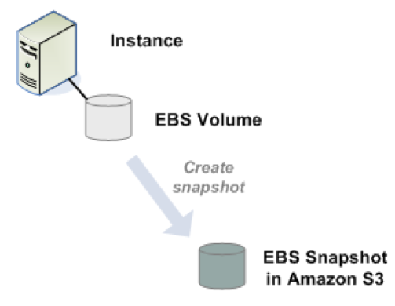
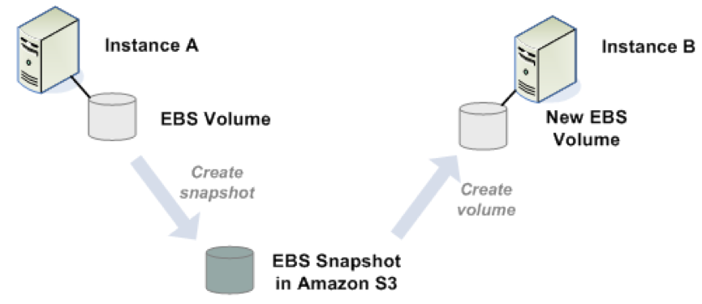
Amazon Elastic Block Storage
EBS are HD which can be attached to running AMIs
Create a snapshot and save it
Create
Detach
Attach

Slide 22
Services
Load-Management and Load Balancing Tools:
Right scale
WeoCeo
Processing management
Cruxy – Media transcoding
Padango – Podcast management
Science Research
Hadoop mapreduce
mpiBLAST

Slide 23
Firefox plug in

Slide 24
SSH to the AMI

Slide 25
Amazon Relational Database Service
Amazon RDS web service
set up, operate, and scale a relational database
Amazon RDS MySQL compatible
Amazon RDS automatically patches the database software
backs up your database, storing the backups for a user-defined retention period and enabling point-in-time recovery.
Scalability, replication
no up-front investments required, and you pay only for the resources you use.

Slide 26
Simple Queue Service
Scalable queuing
Elastic capacity
Reliable, Simple, Secure
Inter-process messaging, data buffering, scalable architecture component

Slide 27
SQS API
Queues
ListQueues
DeleteQueue
Messages
SendMessage
ReceiveMessage
DeleteMessage

Slide 28
AWS services - cooperation

Slide 29
Simple DB
Distribute Data Store
Structured Storage
Fully indexed
Redundant
Scalable
Elastic capacity
Quere language

Slide 30
Simple DB concepts
Domain
Collection of similar items (no schema)
Query language
Any number of items per domain (10GB)
100 domains per account
Item
Collection of key-value pairs (attributes)
Multiple values per attribute
Up to 256 attributes per item
Up to 1024 bytes per value

Slide 31
SimpleDB API
Domains
CreateDomain
ListDomains
DeleteDomain
Items
PutAttributes
GetAttributes
Query Sample
[‘Title’=‘The Right Stuff’]
[‘Number of Pagers’ <‘00310’]
[‘Year’ >’1950’ and ‘Year’,’1960’ or ‘Year’ starts-with ‘193’ or ‘Year’ = ‘2007’]

Slide 32
AWS Free Usage Tier
750 hours of Amazon EC2 Linux Micro Instance usage (613 MB of memory and 32-bit and 64-bit platform support) – enough hours to run continuously each month*
750 hours of an Elastic Load Balancer plus 15 GB data processing*
10 GB of Amazon Elastic Block Storage, plus 1 million I/Os, 1 GB of snapshot storage, 10,000 snapshot Get Requests and 1,000 snapshot Put Requests*
5 GB of Amazon S3 standard storage, 20,000 Get Requests, and 2,000 Put Requests*
30 GB per of internet data transfer (15 GB of data transfer “in” and 15 GB of data transfer “out” across all services except Amazon CloudFront)*
25 Amazon SimpleDB Machine Hours and 1 GB of Storage**
100,000 Requests of Amazon Simple Queue Service**
100,000 Requests, 100,000 HTTP notifications and 1,000 email notifications for Amazon Simple Notification Service**
10 Amazon Cloudwatch alarms**
In addition to these services, the AWS Management Console is available at no charge to help you build and manage your application on AWS.

Slide 33
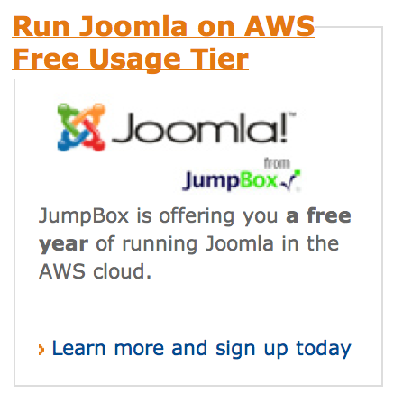
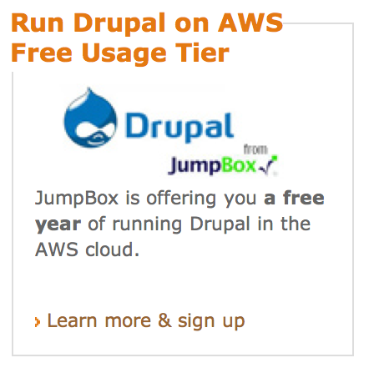
Free start

Slide 34
Available Public Data Sets on AWS
Federal Reserve Economic Data - Fred
Database of 20,059 U.S. economic time series.
Transportation Databases
Various transportation statistics
Labor Statistics Databases
Various Labor Statistics
2000 US Census
Data from the 2000 US Census
2003-2006 US Economic Data
US Economic Data for years 2003 to 2006
Business and Industry Summary Data
US Business and Industry Summary Data

Slide 35
http://www.infoq.com/presentations/amazon-web-services
Cost calculator http://calculator.s3.amazonaws.com/calc5.html
AWS Management control http://aws.amazon.com/console/

