Slide 1
WA 2
NoSQL databases
Martin Klíma

Slide 2
Codd’s relational algebra
Relational algebra
Relational databases
Strict data model
Tabular data organization
Nicely suiting large application area
Transactional ACID
“Standardized” query language
☺ ☺ ☺

Slide 3
Shortcomings of RDBs
Strict data model (can be advantage and disadvantage)
How to change the data model?
Extremely difficult
How does it scale
Big data – does not scale well
Scalability
Availability
Performance
NoSQL databases

Slide 4
What is BIG DATA?
Big is “too big to be processed using traditional systems”
What is “traditional system”?
Centralized
Signe HDD dependent
100 MB document – unable to send by mail
100 GB image – unable to view
100 TB video – unable to edit

Slide 5
Big data cont.
What do we typically do with “Big data”?
Where do they come from?
capture
search
share
store
transfer
analyze
visualize
change format
Users
Sensors
Systems
Applications

Slide 6
Examples
Facebook
30 TB od data daily (2012)
1 billion of active users (2012)
300 billion of emails sent every day
Twiter
97 000 Tweets per second (2012)
CERN
40TB per second

Slide 7
NoSQL databases basic types
Key Value Store
Tabular
Document Oriented
Memcache
Redis
BigTable
Hbase
Accumulo
MongoDB
Couch DB
Cloudant

Slide 8
Price for BIG data
Distributed => eventually consistent
MyHotelBooking.com
DB node 1
DB node 2
Book hotel H, room 1
Book hotel H, room 1

Slide 9
Price for BIG data – what is NOT available
No Joins
No complex transactions
do it on application level
No constraint support
do it on application level
DB node 1
DB node 2
DB node 3

Slide 10
What IS available
Query language
various querying languages (including SQL) => Not Only SQL
Fast performance
Horizontal scalability

Slide 11
Hadoop

Slide 12
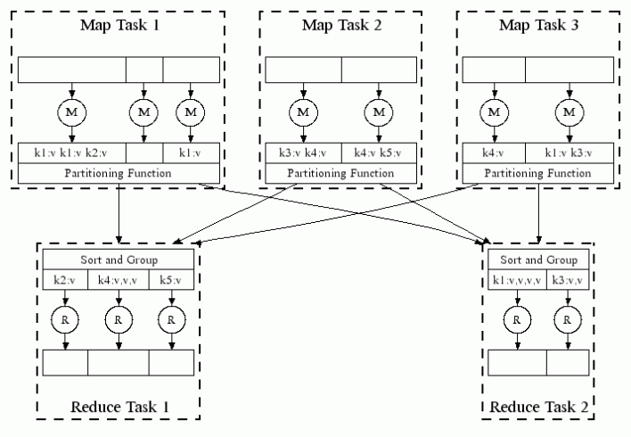
History of Hadoop
????
Google – secret and efficient approach to big data
2003 – Google released Google File System paper
2004 – Map Reduce paper

Slide 13
History of Hadoop cont.
Cutting an Cafarella from Yahoo built a Java based version
Named it Hadoop after Cutting’s son’s stuffed elephant
Donated to Apache

Slide 14
What is Hadoop
Map-Reduce
Computation – close to the data
File system
(HDFS)
Distributed FS
Projects
Tools, DBs, …

Slide 15
Distributed FS
Master
Task Tracker
Job Tracker
Application
Queue
Data Node
Name Node
Linux
Slaves
Manage jobs given to this node
Task Tracker
Task Tracker
Task Tracker
Task Tracker
Data Node
Data Node
Data Node
Data Node
Maintain local data
Linux
Linux
Linux
Linux

Slide 16
Hadoop
Job Tracker will assign jobs to Task Trackers
Each Task Tracker works on a small bit of data
They all run in parallel
Name node keeps and index of which data is residing where

Slide 17
Hadoop – fault tolerance
Failure is a feature
All data is available in 3 copies across the system
Slaves
Task Tracker
Task Tracker
Task Tracker
Task Tracker
Data Node
Data Node
Data Node
Data Node
Linux
Linux
Linux
Linux

Slide 18
Hadoop projects / tools
Hive
Data warehouse, query, analysis
Hbase
Non relational DB, similar to Big Table
Mahout
Machine learning
Pig
Query language like SQL – Pig Latin
Oozie
Workflow scheduler for Hadoop
Flume
Large amount of log data
Scoop
Transferring bulk data between RDB and Hadoop

Slide 19
Map & Reduce algorithms
Idea: move some computational logic to the data
Since all is distributed, it will all run in parallel
Two basic phases:
Map to the relevant data
Reduce them by applying some computation
Data is logical entities with multiple atributes

Slide 20
Map & Reduce Example
ID: 9623
Customer: Martin Klima
Order Items:
Cap 4 $12 $48
Shoes 2 $120 $240
Glowes 2 $80 $160
Shipping address …
Invoice address …
Cap
quantity: 4
price: 48
Map
Shoes
quantity: 2
price: 240
Glowes
quantity: 2
price: 80

Slide 21
Map & Reduce Example
Cap
quantity: 4
price: 48
Cap
Reduce
Cap
quantity: 2
price: 32
quantity: 12
price: 240
Cap
quantity: 6
price: 160

Slide 22
Map & Reduce
Reduce can run in parallel on different keys - partitioning
cap | 18
shoes | 34
cap | 9
shoes | 7
Bucket
cap | 18
shoes | 34
cap | 9
shirt | 8
shoes | 7
shirt | 8
shirt | 2
shirt | 45
pans | 3
Map
Reduce
shirt | 8
shirt | 2
shirt | 45
shoes | 12
cap | 6
shoes | 9
pans | 3
shoes | 12
cap | 6
shoes | 9
cap | 18
shoes | 34
cap | 9
shoes | 7
shoes | 12
cap | 6
shoes | 9
Bucket
Map
Reduce
shirt | 2
shirt | 45
pans | 3

Slide 23
Map & Reduce cont.
Reduce the amount of data transferred between nodes
Reduce
shirt | 2
shirt | 45
shoes | 12
cap | 6
shoes | 9
pans | 3
shoes | 21
cap | 6
Map
Combine
shirt | 47
pans | 3
Reduce

Slide 25
MyHotelBooking.com
DB node 1
DB node 2
Book hotel H, room 1
Book hotel H, room 1

Slide 26
MyHotelBooking.com
DB node 1
DB node 2
Book hotel H, room 1
Book hotel H, room 1
DB node 1
DB node 2
DB node 3

