Slide 1
Web applications 2
OI Master study

Slide 2
Introduction
Goals:
Introduction into the theory and praxis of cloud technologies
Demonstration of common and differences of various cloud types
Subject format
Lecture (1x), excercise, individual home preparation
Subject web
https://cw.fel.cvut.cz/wiki/courses/a4m39wa2

Slide 3
Schedule - lecturers
SOA, RESTFULL web services
Java EE, MVC, Servlets (IOC)
Frameworks - GWT
Java EE persistence (JPA, možno nahradit Hibernate)
Introduction to cloud
Google App Engine
Distributed databases (Lamport clock, clousters, paxos)
NoSQL Databases (Hadoop, M&R)
Visit to Česká pojišťovna
PaaS Azure
Persistence Azure (Blob, Table)
Distribuované systémy (Tannenbaum)
Host / student projects

Slide 4
Schedule – labs
RESTful API
Servlets and JSP
Hibernate
Frameworks in Java - GWT
Pisemka (10 min), Google App Engine
NoSQL - Hadoop and Pig
.NET Introduction, Windows Azure Platform basics
Windows Azure Platform data persistence basics (IOC in .NET)
Visit to Česká pojišťovna
Azure roles, Presentation of sem. works
Azure role II, Presentation of sem. works
Test 2, Presentation of sem. works
Odevzdání semestrálních prací, zápočet
Written test

Slide 5
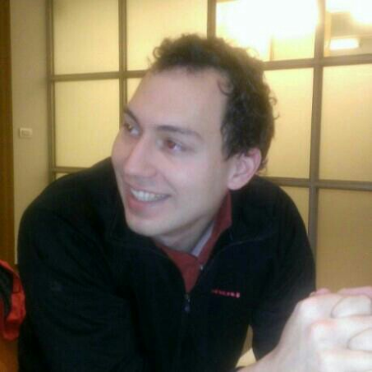
Lecturers
Guarantor:
Martin Klíma, xklima@fel.cvut.cz, KN:E 321
Labs:
Martin Mudra, mudrama1@fel.cvut.cz, KN:E 424

Slide 6
Conditions of success
To get the credit an attendee has to:
Have presence at least see bellow.
Pass two 10 minutes tests
Have the semestral work assigned
Have the semestral work passed first checkpoint.
Have the semestral work successfully submitted.

Slide 7
Assessment
Item | Min | Max
Home work | 0 | 10
Written test 1 | 0 | 10
Written test 2 | 0 | 10
Semester work | 10 | 20
Written exam | 10 | 25
Oral exam | 0 | 25
Total | 20 | 100
Grade | From | To | Grade name
A | 91 | 100 | výborně
B | 81 | 90 | velmi dobře
C | 71 | 80 | dobře
D | 61 | 70 | uspokojivě
E | 51 | 60 | dostatečně
F | less than 51 |  | nedostatečně

Slide 8
Specialties
You can choose any cloud platform.
You can come with your own topics.

Slide 9
Good luck

