Slide 1
Introduction to clouds
Martin Klíma

Slide 2
Cloud computing what it is
New form of IT outsourcing
Replacement for server rental, webhosting, managed applications
Pay per use, well defined accounting
Self service
Horizontal and vertical scalability (vertical through virtualization)

Slide 3
When do we want it?
Public vs private cloud
On premise – I have it all under my own roof
Why not to have it on premise?
Licenses
Capacity designed for the worst scale
IT staff designed for 24 / 7 / 365
Why not cloud
Data out of the company
Simple app may be costly

Slide 4
Where is the advantage?
Try and leave
Do not worry to scale
Scale on demand
Available anywhere
My business is getting worldwide

Slide 5
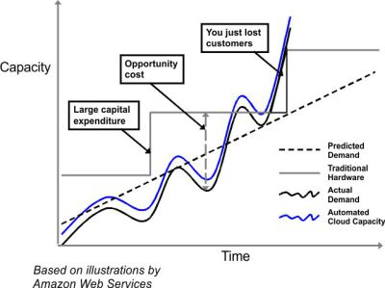
Scenarios

Slide 6
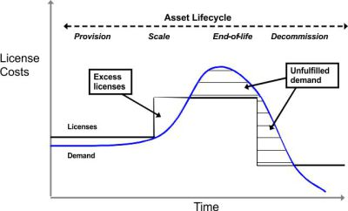
Scenarios cont

Slide 7
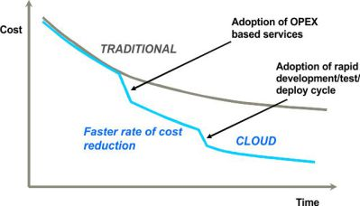
Scenarios cont

Slide 8
Types of cloud
IaaS = Infrastructure as a Service
Rack Space
Amazon AWS
PaaS = Platform as a Service
Google app engine
Microsoft Azure
Software as a Service = SaaS

Slide 9
Cloud vs on premise
On presmise
Cloud
Hybrid

Slide 10
Uptime and SLA
SLA = Service Level Agreement
99.9%, 99.99%, 99.999%
IT Disaster recovery – 2-4% of budget
Secondary recovery center
RPO = Recovery Point Objective – maximum period of time for which data can be lost >>> zero
RTO = Recovery Time Objective – maximum amount of time that my business can sustain without the data

Slide 11
Virtualization
Virtualization is a very effective method for resource utilization.

Slide 12
Google App Engine - GAE

Slide 13
Google App Engine
Google – well known ☺
Large datacenters
Sells computing power that it does not need for itself
The initial design of the datacenter is web analysis, harvesting, indexing, searching

Slide 14
Core google functions
Googlebot, crowlers
Visit a web page, download it
Google download a vast majority of visible web
Search for new resources automatically
A new resource can be added manually
Sophisticated logic to discover cheating
Hidden text
Meta data
Different content for bots and other users
Various policies for vising
How often to come back and download?
How to match the same pages on different servers?

Slide 15
Core Google functions
Google Indexer
Builds an index of existing words and urls of pages
Some words are not indexed (conjunctions, prepositions, …)
Google Query Processor
Uses PageRank of pages
The more URLs pointing to the page, the higher PageRank
The more trusted page points, the higher PageRank
PageRank considers about 100 other aspects of a page
Google keeps them secret
Use of spelling corrector
Prefers terms that are physically near to each other

Slide 16
Core Google functions
Google Doc Servers
Stores the data itself
HUGE amount of data
Caching of history of internet

Slide 17
Google App Engine
Offers the basic infrastructure
Scalability
To scale up/down resources when needed
Reliablity
Capability to survive failure, recovery

Slide 18
Infrastructure
App Master
Front End
App Server
Data Store
Front End
App Server
Front End
App Server
Memchache
…
…
Images
Users
Static Files
URL Fetch
Task Queue

Slide 19
Best practice
Non-Relational DB BigTable
App design
Fast request handling
Low resource utilization
Fyzical HW independence

Slide 20
Google Front End
Data Center #1
Data Center #2
App Master
Edge Cache
Static Servers
App Servers
Application Instances
ISP
Google Front End
App Engine Front End
„Optics“
Load Balancing
GFE is physically close to the user

Slide 21
Using Edge Cache
HTTP headers
…it is in fact a HTTP cache ☺
Define content as static
class MyHandler (webapp.RequestHandler):
def get(self):
self.response.headers.add_header(
‘cache-control’,
‘public, max-age=‘7200’) #2 hodiny
appegnine-web.xml
…
<static>
<include path=“/**.png” />
<exclude path=“/data/**.png” />
</static>

Slide 22
App Server
Data Center #1
Data Center #2
App Master
Edge Cache
Static Servers
App Servers
Application Instances
ISP
Google Front End
App Engine Front End
Optics
Load Balancing
GFE is physically close to the user

Slide 23
App Server
Application running environment
Sandbox
Dedicated memory
Container controls the app live cycle
App does not see out of container
App master
Monitors how apps run
Scales them up/down
Makes instance visible to each other

Slide 24
App Server – types of instances
Front End instance
Good for fast request serving
Max lifetime 60 sec
Typical for web application
Stateless, easy to scale
Back End instance
Good for larger computing tasks
Stateful
Batch data processing, not time limitted
Costly, difficult to scale
Communication
Queues
Careful with big libraries

Slide 25
App Server – Scaling
Scaling front end instances
Request queues
Idle Instances
Pending Latency

Slide 26
App Engine parameters
Pending Latancy
Time a request spends in a queue
Over a given threshold a new front end instance is created
The longer PL, the worse the response time
The shorter PL, the more expensive ☹
Iddle Instances
How many instance do we keep when there is no utilization
Stand-by readiness

Slide 27
WA 2
Google High Replication Data Store
Martin Klíma
Zdroj: http://www.youtube.com/watch?v=xO015C3R6dw

Slide 28
The main data storages in GAE
Master/Slave
One master node
Number of slaves replicating the content o master
High replication
No central/control node
All instances are equal

Slide 29
Datastore Software Stack
App Engine Datastore
Schema-less storate
Advanced query engine
Megastore
Multi-row transactions
Across multiple machines
Entity Groups
Simple indexes/queries
Strict schema
Bigtable
Distributed key/value store
Next generation distributed file system
Datastore
Megastore
Bigtable
GFS v2

Slide 30
Entitity Group
Logical grouping of entities
Parent/child key relationship
Unit of Transactionality
Transactions can only read/write entities in a single grup
Unit of consistency
Strong serial consistency
What you write you will always get.
No partial success of transaction

Slide 31
Entity groups
Transaction on one entity group are guaranteed
Transaction across entity groups are not quaranteed
Entity Group A
Entity Group B
Transaction OK
Transaction OK
Transaction NOT OK

Slide 32
Entity group example
Users
Users
User
Users
Users
Users
Users
Users
Users
Photo
Document
Blog Post
Users
Users
Users
Users
Users
Users
Users
Users
Comment
Revision History
Comment
Comment

Slide 33
Entity group example
NON-Ancestor Query
SELECT * FROM Comment WHERE UserId = user.id()
Users
Users
User
Users
Users
Users
Users
Users
Users
Photo
Document
Blog Post
Users
Users
Users
Users
Users
Users
Users
Users
Comment
Revision History
Comment
Comment
Notes:
NON-Ancestor querires:

Slide 34
Entity group example
Ancestor Query
SELECT * FROM Comment WHERE ancestor IS user.key()
Users
Users
User
Users
Users
Users
Users
Users
Users
Comment
Comment
Comment
Users
Users
Users
Users
Users
Users
Photo
Users
Users
Blog Post
Document
Revision History

Slide 35
Master/Slave write/read model
Datacenter A
Datacenter B
My Application can see all its writes
because they were made to its Master DB
My Application
Write
Read
1
2
Master DB
Slave DB
Asynchronous replication
at some later time

Slide 36
High Replication engine
Write
Write to at least majority of nodes
Minority may not get writes synchronously
Asynchronous replication
On demand replication
Read
Read from fastest (mostly local)
Catch up on demand

Slide 37
High replication read model
Datacenter A
Datacenter B
Datacenter C
My Application
Write
Read
1
1
1
Master DB
Slave DB
Slave DB

Slide 38
High replication read model
Datacenter A
Datacenter B
Datacenter C
My Application
Write
Read
2
2
2
Usually the fastest
Master DB
Slave DB
Slave DB

Slide 39
High replication write model
Datacenter A
Datacenter B
Datacenter C
My Application
Write
Read
1
1
1
Master DB
Slave DB
Slave DB

Slide 40
High replication write model
Datacenter A
Datacenter B
Datacenter C
My Application
Write
Read
2
2
2
Master DB
Slave DB
Slave DB

Slide 41
High replication
There is no guarantee that a given database has all the written data at a given time.

Slide 42
Datastore performance
 |  | Master/Slave | High Replication
Average Latency | Read | 15 ms | 15 ms
 | Write | 20 ms | 45 ms
Average Error Rate | Read | 0.1% | 0.001%
 | Write | 0.1% | 0.001%
8.7 hours/year
5 minutes/year
SLA !!!

Slide 43
Maintenance
Master/Slave
Switch master
One hour of read-only datastore

Slide 44
Master/Slave maintenance
Datacenter A
Step 1: Read Only
Datacenter B
My Application
Write
Read
1
Master DB
Slave DB
Step 2
Flush all

Slide 45
Master/Slave maintenance
Datacenter A
Datacenter B
My Application
Write
Read
4
3
Maintenance
Master DB
Asynchronous replication
at some later time

Slide 46
High replication
Almost not affected by maintenance time
Memcache flush (1 minute)

