Slide 1
WA 2
GWT
Martin Klíma

Slide 2
GWT – What is it?
Google Web Toolkig
  Compiler from Java to JavaScript + HTML
  Set of JavaScript and Java scripts / classes
  Development environment – SDK
  Integration with IDE – Eclipse, Netbeans, …
Driving idea:
Let’s code everything in just one language– Java
Client side will be translated as needed
Write the GUI in a Swing style
Use the classical event handlers in GUI

Slide 3
Architecture – AJAX in the main role
Java code
Translation to
JavaScript, …
Client code
Asynchronous
communication
Server – side
Java code

Slide 4
GWT
GWT is pronounced “gwit”
Open source project with Apache Licence 2.0
Created by Google
Many inspired and derived projects
  Vaadin
  Smart GWT
  Sencha GXT
IDE integration GWT4NB – for NetBeans
Links:
  www.gwtproject.org

Slide 5
GWT Modules
Project divided to models
A module is a coherent functionality
Java like naming convention
Each module has a descriptor in XML .gwt.xml
  Inheritance
  Entry-point class
  Source paths
    classes will be translated to javaScript
  Class paths
  External JavaScript
  CSS
  Servlets, other „properties“
Notes:
Mohou existovat i moduly, které nemají žádnou entry-point třídu. Ty mohou být použity pro dědění, jejich funkcionalita se nám může hodit jinde, nemůžeme je ale samostatně spouštět.
Třídy, které používáme na klientovi, smějí používat jen třídy z GWT JRE emulation library http://code.google.com/intl/cs/webtoolkit/doc/latest/RefJreEmulation.html

Slide 6
How does it work?
gwt.properties
Main.gwt.xml
gwt.module
…
entry-point class
…
cz.cvut.fel.client.MainEntryPoint
GWT Compiler
HTLM+JavaScript
HTLM+JavaScript
Deferred Binding
HTLM+JavaScript
HTLM+JavaScript
HTLM+JavaScript
Notes:
Defered binding – jazyk JavaScript nepodporuje dynamické načítání tříd, proto kompilátor dopředu připraví všechny možné varianty pro různé prohlížeče, různé jazyky.

Slide 7
GWT Properties
# The name of the module to compile
gwt.module=cz.cvut.fel.dama
# Folder within the web app context path where the output
# of the GWT module compilation will be stored.
# This setting is only used for GWT 1.5. For newer versions please use
# the rename-to attribute in the GWT module file (.gwt.xml).
gwt.output.dir=/cz.cvut.fel.dama
# Script output style: OBF[USCATED], PRETTY, or DETAILED
gwt.compiler.output.style=OBF
# Additional JVM arguments for the GWT compiler
gwt.compiler.jvmargs=-Xmx256M
# Specifies the number of local workers to use whe compiling permutations and module(s)
gwt.compiler.local.workers=1
# The level of logging detail: ERROR, WARN, INFO, TRACE, DEBUG,
gwt.compiler.logLevel=WARN
# Script output style: OBF[USCATED], PRETTY, or DETAILED
gwt.shell.output.style=OBF
# The level of logging detail: ERROR, WARN, INFO, TRACE, DEBUG,
gwt.shell.logLevel=WARN
# Additional JVM arguments for the GWT shell/GWT hosted mode (GWT 1.6)
# Add -d32 here and use at least GWT 1.7.1 to debug on a Mac
# (32-bit JRE is required by GWT for debugging)
gwt.shell.jvmargs=-Xmx256M
# GWT version: 1.5,1.6,1.7 or 2.0
gwt.version=2.0
# GWT 2.0 only
# Specifies the TCP port for the code server
gwt.shell.code.server.port=9997
# GWT 2.0 only
# Specifies the TCP port for the embedded web server
gwt.shell.port=8888

Slide 8
GWT - module entry point
<?xml version="1.0" encoding="UTF-8"?>
<!DOCTYPE module PUBLIC "-//Google Inc.//DTD Google Web Toolkit 1.7.0//EN" "http://google-web-toolkit.googlecode.com/svn/tags/1.7.0/distro-source/core/src/gwt-module.dtd">
<module>
<inherits name="com.google.gwt.user.User"/>
<inherits name='com.google.gwt.user.theme.standard.Standard'/>
<!-- Inherit the default GWT style sheet. You can change -->
<!-- the theme of your GWT application by uncommenting -->
<!-- any one of the following lines. -->
<!-- <inherits name='com.google.gwt.user.theme.standard.Standard'/> -->
<!-- <inherits name="com.google.gwt.user.theme.chrome.Chrome"/> -->
<!-- <inherits name="com.google.gwt.user.theme.dark.Dark"/> -->
<entry-point class="cz.cvut.fel.client.damaEntryPoint"/>
<source path="client"/>
<source path="shared"/>
<!-- Do not define servlets here, use web.xml -->
</module>
Main class
Client package
Classes schared for client-server communication

Slide 9
Class loading
Browser loads the starting HTML page
Will interpret the script tag
<script src=”<Module Name>.nocache.js”> , and load the JavaScript
In JavaScript there is the deferred binding condition leading to loading particular .cache.html
.cache.html creates a hidden <iframe> and loads into it
After loading .cache.html the main application code is started

Slide 10
Loading HTML page example
<!DOCTYPE html PUBLIC "-//W3C//DTD XHTML 1.0 Strict//EN"
"http://www.w3.org/TR/xhtml1/DTD/xhtml1-strict.dtd">
<html>
<head>
<meta http-equiv="content-type" content="text/html; charset=UTF-8">
<link type="text/css" rel="stylesheet" href="dama.css">
<title>Dáma na webu</title>
<!-- Nahrání klientské logiky v javascriptu -->
<script type="text/javascript" language="javascript" src="cz.cvut.fel.dama/cz.cvut.fel.dama.nocache.js"></script>
</head>
<body>
<!-- iframe pro podporu historie -->
<iframe src="javascript:''" id="__gwt_historyFrame" tabIndex='-1' style="position:absolute;width:0;height:0;border:0"></iframe>
<h1>Webová dáma</h1>
<div id="ovladani"></div>
<div id="sachovnice"></div>
</body>
</html>

Slide 11
Example – client code
The entry point is a java class implementing EntryPoint interface
Interface
EntryPoint
onModuleLoad()
Implements
Class
MyEntryPoint
onModuleLoad()
My UI here

Slide 12
Implementation
package cz.cvut.fel.client;
import com.google.gwt.core.client.EntryPoint;
import com.google.gwt.user.client.ui.Button;
import com.google.gwt.user.client.ui.Label;
import com.google.gwt.user.client.ui.RootPanel;
import com.google.gwt.event.dom.client.ClickEvent;
import com.google.gwt.event.dom.client.ClickHandler;
public class MainEntryPoint implements EntryPoint {
public MainEntryPoint() { }
public void onModuleLoad() {
final Label label = new Label("Hello, GWT!!!");
final Button button = new Button("Click me!");
button.addClickHandler(new ClickHandler() {
public void onClick(ClickEvent event) {
label.setVisible(!label.isVisible());
}
});
RootPanel.get().add(button);
RootPanel.get().add(label);
}
}
Code is similar to Swing
UI on the client side driven by events

Slide 13
User interface

Slide 14
UI similar to Swing
RootPanel – container of other components
FlowPanel – simple <div> on the page
HTMLPanel – builds HTML structure
FormPanel – a form
ScrollPanel – panel with scroll
PopupPanel, DialogBox - dialogs
Grid, FlexTable – tables
LayoutPanel, DockLayoutPanel, SplitLayoutPanel, StackLayoutPanel, TabLayoutPanel,
More info here:
http://www.gwtproject.org/javadoc/latest/

Slide 15
Attention
GWT layout works well only in standard browser mode, avoid quirk mode.

Slide 16


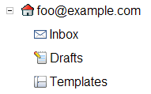
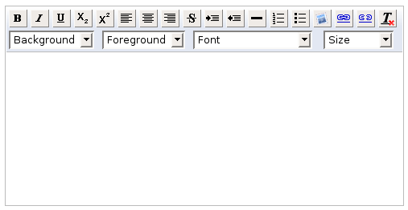
GUI components
Button
TextBox
Tree
RichTextArea

Slide 17
Events
public void anonClickHandlerExample() {
Button b = new Button("Click Me");
b.addClickHandler(new ClickHandler() {
public void onClick(ClickEvent event) {
// handle the click event
}
});
}
Jiný způsob
Annonymous internal class
attention – use the final modifier
class MojeTrida implements ClickHandler {
public void onClick(ClickEvent event) {
// tady si odchytnu udalost a udelam s ni co potrebuji
}
}

Slide 18
Server communication

Slide 19
GWT - RPC
RPC = Remote Procedure Call
  calling server code from client code
  Client – JavaScript
  Server – Servlet
  Asynchronous communication using AJAX
  Serialized objects mediate the communication
    char, byte, short, int, long, boolean, float, double
    String, Date, Character, Byte, Short, Integer, Long, Boolean, Float, Double
    array of serialized values
    serialized class (IsSerializable or java.io.Serializable)
    a class having at leas one serializable subclass

Slide 20
GWT – RPC cont.
Synchronous interface
Asynchronous interface
Implementation of asynchnronous interface on server = contract
Calling the asynchronous interface by java code from the client
Implementation of synchronous interface by the server

Slide 21
GWT - RPC
Client
Server
Synchronní rozhraní
String pozpatku(string s)
GWT
PozpatkuServiceAsync
create (Class trida)
RemoteServiceServlet
processCall(String s)
…
Client code
Server code
final PozpatkuServiceAsync pozpatkuServiceAsync =
GWT.create(PozpatkuService.class);
pozpatkuServiceAsync.pozpatku(textbox.getText(), new AsyncCallback<String>() {
public void onFailure(Throwable caught) {
// udelej neco pri chybe
}
public void onSuccess(String result) {
// udelame neco s vracenym retezcem
}
});
public class PozpatkuServiceImpl extends RemoteServiceServlet
implements PozpatkuService {
public String pozpatku(String s) {
StringBuffer reverse =
new StringBuffer(s.length());
for (int i = (s.length() - 1); i >= 0; i--) {
reverse.append(s.charAt(i));
}
return reverse.toString();
}
}

Slide 22
Application state
By Ajax the application state is stored by the client
Refresh page problem
Must backup the client state at the server side

Slide 23
Sessions
HTTPServlet
AbstractRemoteServiceServlet
RemoteServiceServlet
PozpatkuServiceImpl

Slide 24
Working with the session on the server
public class PozpatkuServiceImpl extends RemoteServiceServlet implements PozpatkuService {
public String pozpatku(String s) {
StringBuffer reverse = new StringBuffer(s.length());
for (int i = (s.length() - 1); i >= 0; i--) {
reverse.append(s.charAt(i));
}
String toReturn = reverse.toString();
// ulozim si posledni string do session
getThreadLocalRequest().getSession().setAttribute("lastString", toReturn);
return toReturn;
}
public String getLast() {
return (String)getThreadLocalRequest().getSession().getAttribute("lastString");
}
}
Set the session
Reading the

Slide 25
GWT and history in browser
ProblEm: Ajax based application do not generate standard history in the browser
Solution in GWT: iframe will store the history on command
How it works:
  We insert an iFrame into HTML
  Based on event X we actively record the history as a String
  We react on event of transition in history by reading the strings, decoding the history and setting a new state.

Slide 26
  Insert a frame to HTML iframe
<!DOCTYPE HTML PUBLIC "-//W3C//DTD HTML 4.01 Transitional//EN">
<html>
<head>
<meta name='gwt:module' content='cz.cvut.fel.Main=cz.cvut.fel.Main'>
<title>Main</title>
</head>
<body>
<script type="text/javascript" src="cz.cvut.fel.Main/cz.cvut.fel.Main.nocache.js"></script>
<!-- include this if you want history support -->
<iframe id="__gwt_historyFrame" style="width:0;height:0;border:0"></iframe>
</body>
</html>

Slide 27
  Write the history description to the record
textbox.addValueChangeHandler(new ValueChangeHandler<String>() {
public void onValueChange(ValueChangeEvent<String> event) {
History.newItem("text_" + event.getValue());
}
});

Slide 28
Use the history description, set application state
History.addValueChangeHandler(new ValueChangeHandler<String>() {
public void onValueChange(ValueChangeEvent<String> event) {
String historyToken = event.getValue();
// Parse the history token
if (historyToken.substring(0, 5).equals("text_")) {
String historyString =
historyToken.substring(5, historyToken.length());
// Nastavime historickou hodnotu
textbox.setText("History: "+historyString);
} else {
textbox.setText("");
}
}
});

Slide 29
Compilation and Debugging

Slide 30
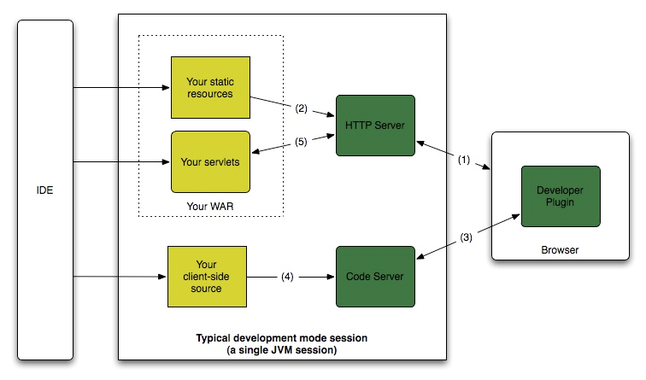
Debugging in Development mode

Slide 31
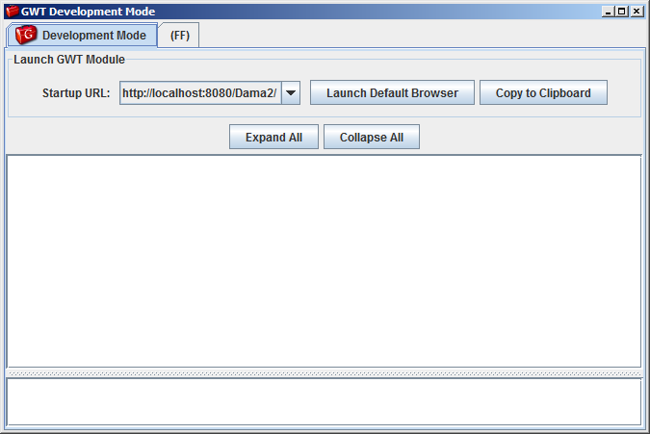

Slide 32
Speed Tracer
Addon to Chrome
!!! need for some historical version
Similar in FF
  --enable-extension-timeline-api

Slide 33
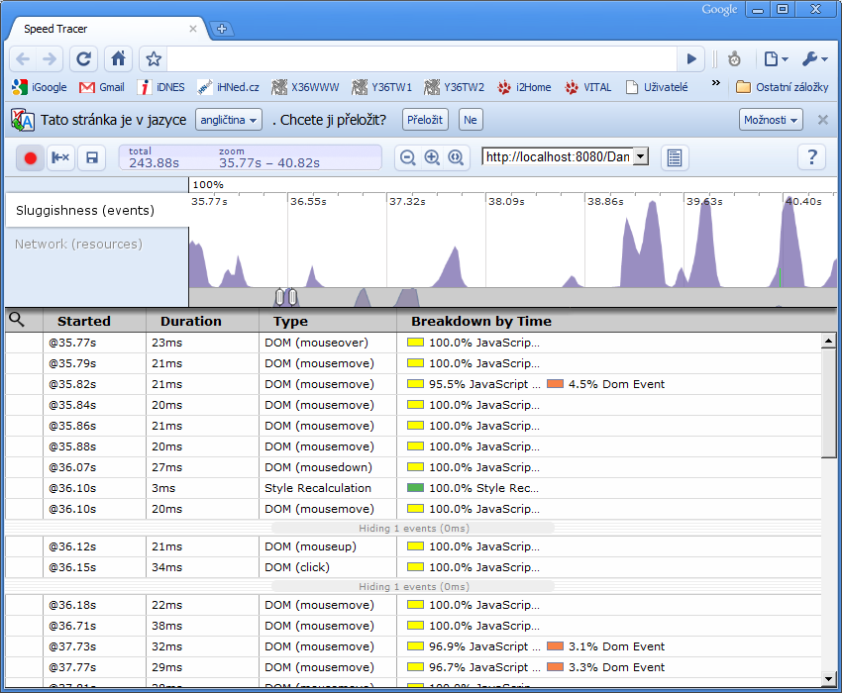

Slide 34
