Slide 1
Taskalicious
the project manager
Tomáš Frček
Petr Stuchlík

Slide 2
Taskalicious - Aims & Objectives
Decentralized project task manager for Android
Useful for team projects
Takes advantages of Google Calendar
Divide the work, assign the tasks, enter the deadlines
Easily control the work of your team, check the progress of team members, successfully finish your project
NMS - Taskalicious, 2012/12/17
2

Slide 3
Taskalicious - requirements
You can log in using your Google Account
You can create and manage the project and its tasks
You can plan the meetings of the team
The events are synchronized with Google Calendar
Everything shared with your team members
or you can be a member of a team and see what to do
NMS - Taskalicious, 2012/12/17
3

Slide 4
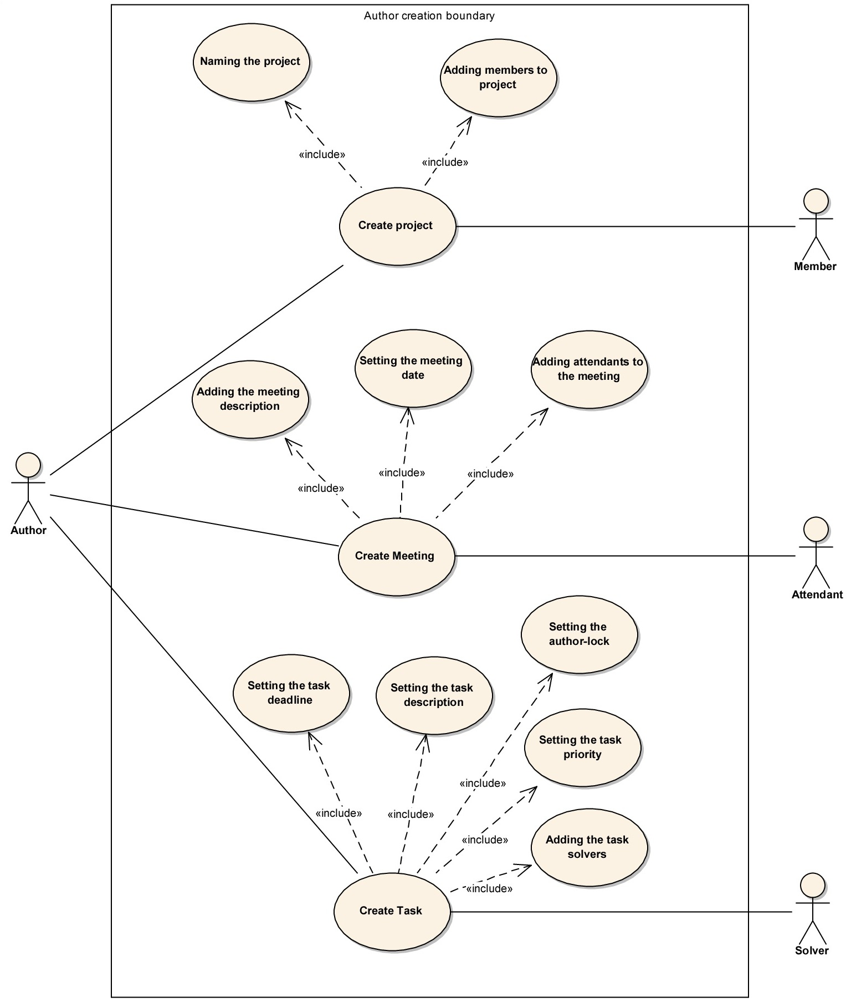
Design – Use cases
NMS - Taskalicious, 2012/12/17
4

Slide 5
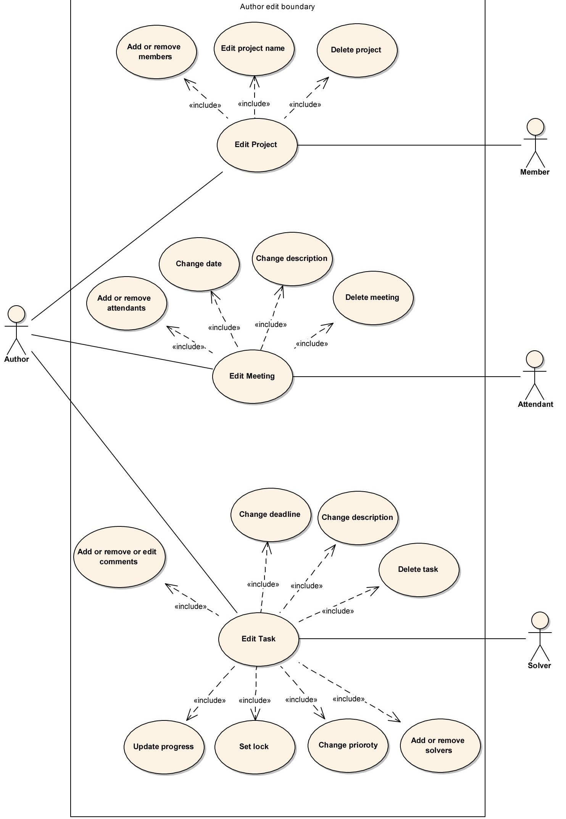
Design – Use cases (2)
NMS - Taskalicious, 2012/12/17
5

Slide 6
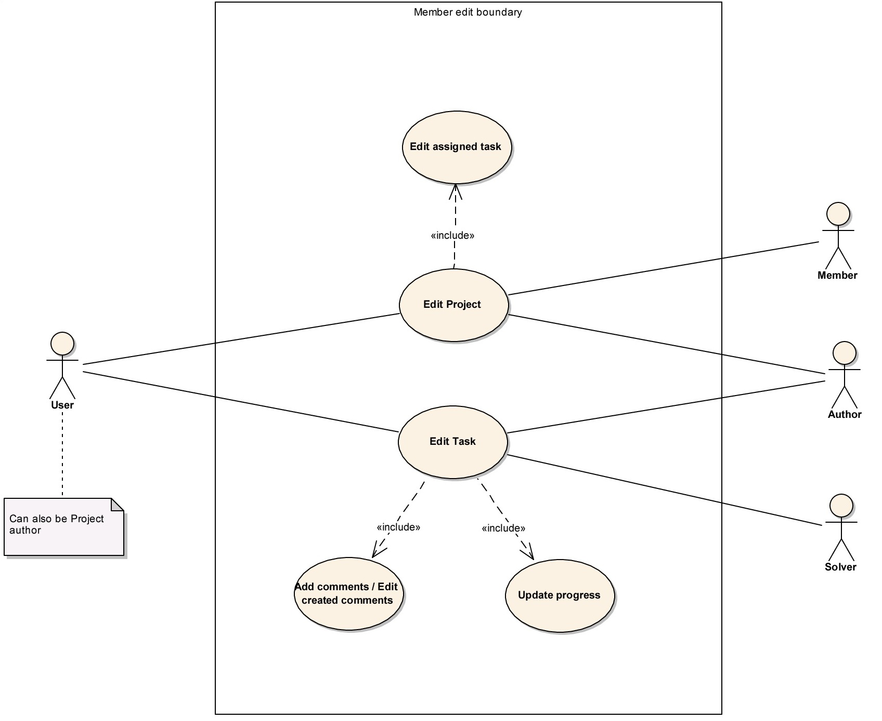
Design – Use cases (3)
NMS - Taskalicious, 2012/12/17
6

Slide 7
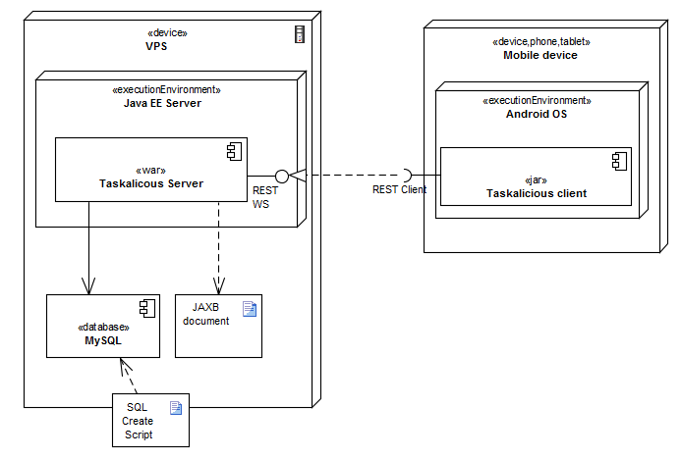
Design – Deployment
NMS - Taskalicious, 2012/12/17
7

Slide 8
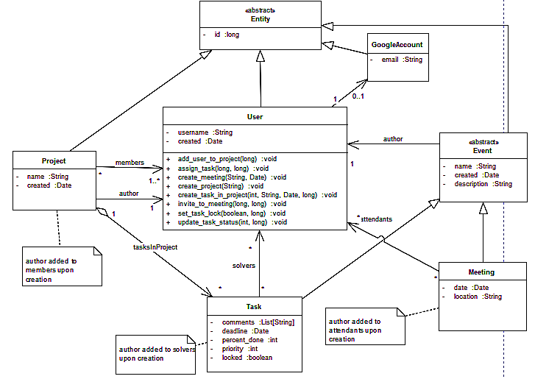
Design – Class view (entity)
NMS - Taskalicious, 2012/12/17
8

Slide 9
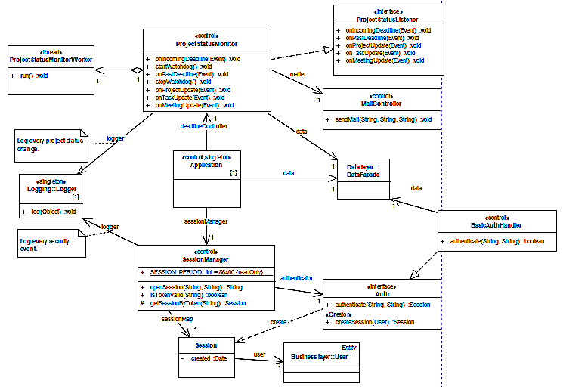
Design – Class view (control)
NMS - Taskalicious, 2012/12/17
9

Slide 10
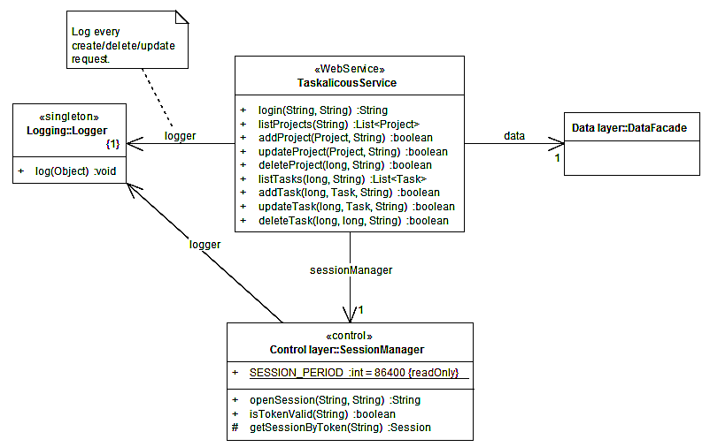
Design – Class view (service)
NMS - Taskalicious, 2012/12/17
10

Slide 11
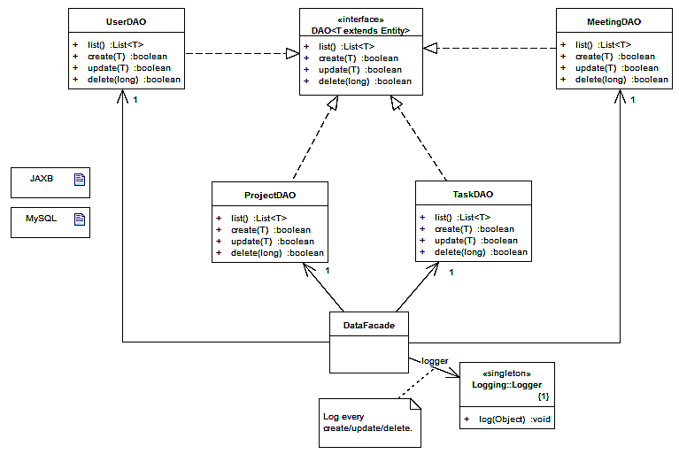
Design – Class view (data)
NMS - Taskalicious, 2012/12/17
11

Slide 12
Taskalicious – Current status
85 % of server code complete and running at Redhat OpenShift
Android client connected
Google calendar sync’
NMS - Taskalicious, 2012/12/17
12

Slide 13
Thank you for your attention

