Slide 1
Distributed Constraint Optimization
Michal Jakob
Agent Technology Center, Dept. of Computer Science and Engineering, FEE, Czech Technical University
A4M33MAS Autumn 2011
(based largely on tutorial on IJCAI 2011 Optimization in Multi-Agent Systems)

Slide 2
From (Dis)CSP to (D)COP
CSP: Constraints are Boolean predicates
$$P_{i}\left(y_{1},…,y_{j}\right)→\{true, false\}$$
COP: Constraints are real-valued functions
$$c_{i}\left(y_{1},…,y_{j}\right)→ℝ_{0}^{+}$$
Overall cost of assignment
$$C(x_{1},…,x_{k})=\sum_{i,y_{j}∈var(c_{i})}{c_{i}\left(y_{1},…,y_{j}\right)}$$
Solution: assignment with (user-defined) acceptable cost
Optimum solution: assignment with minimum cost
Notes:
acceptable cost is user-dependent

Slide 3
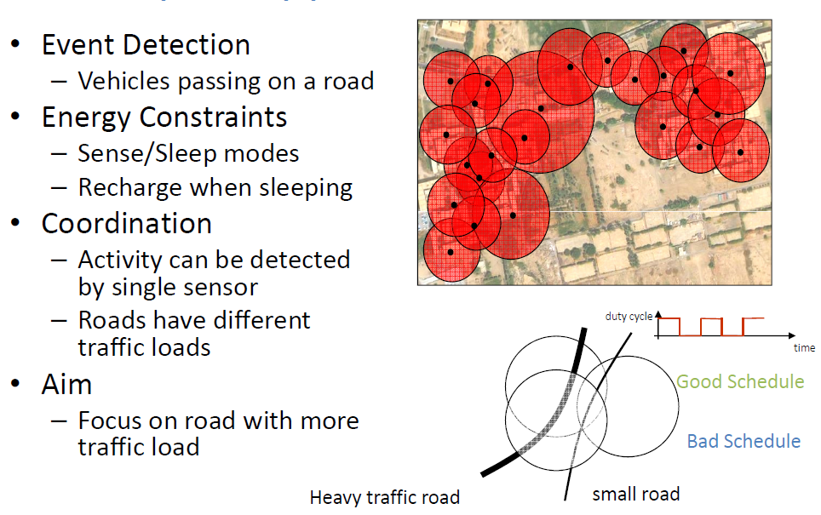
Example: Sensor Surveillance

Slide 4
Complete Algorithms

Slide 5
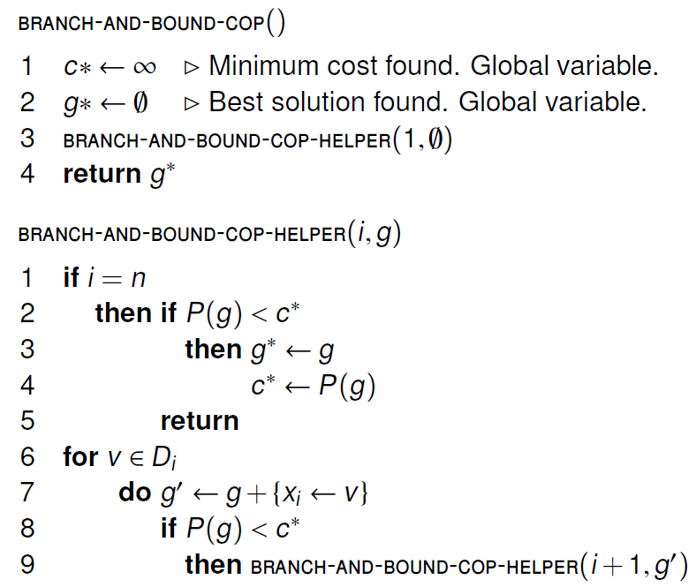
Synchronous/Centralized BnB
C
C
C

Slide 6
Ineffective Asynchronous DCOP
(Assuming integer costs)
DCOP: sequence of DisCSP, with decreasing thresholds: DisCSP cost = k, DisCSP cost = k-1, DisCSP cost = k-2, ...
ABT asynchronously solves each instance until finding the first unsolvable instance
Synchrony on solving sequence instances: cost k instance is solved before cost k-1 instance
Very inefficient

Slide 7
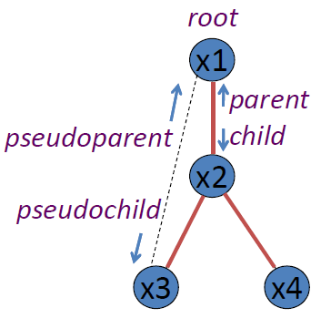
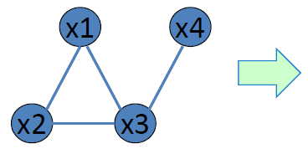
ADOPT: DFS Tree
ADOPT assumes that agents are arranged in a DFS tree:
constraint graph → rooted graph (select a node as root)
some links form a tree / others are back edges
two constrained nodes must be in the same path to the root by tree links (same branch)
Every graph admits a DFS tree

Slide 8
ADOPT Description
Asynchronous algorithm
Each time an agent receives a message:
Processes it (the agent may take a new value)
Sends VALUE messages to its children and pseudochildren
Sends a COST message to its parent
Context: set of (variable value) pairs (as ABT agent view) of ancestor agents (in the same branch)
Current context:
Updated by each VALUE message
If current context is not compatible with some child context, the latter is initialized (also the child bounds)

Slide 9
ADOPT: Messages
value(parent→children U pseudochildren, a): parent informs descendants that it has taken value a
cost(child→parent, lower bound, upper bound, context): child informs parent of the best cost of its assignement; attached context to detect obsolescence;
threshold (parent→child, t): minimum cost of solution in child is at least t
termination (parent→children): LB = UB

Slide 10
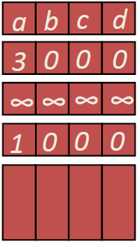
ADOPT: Data Structures
x_{i}
Current context (agent view): values of higher priority constrained agents
Bounds: for each <value, child> pair
Stored contexts must be active:
(left-hand side $⊆$the current context)
If a context becomes inactive, it is removed: lb,th←0, ub←∞
x_{j}
lower bounds lb(x_{k})
upper bounds ub(x_{k})
thresholds th(x_{k})
contexts context(x_{k})

Slide 11
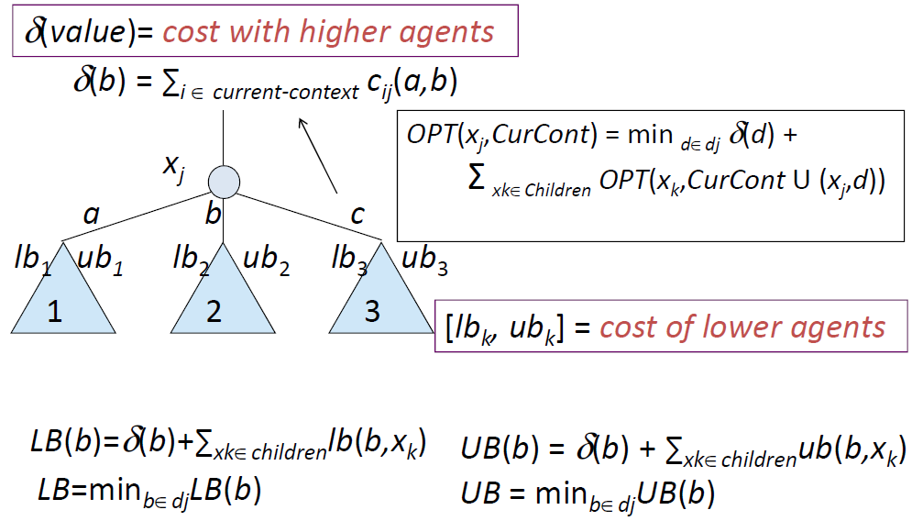
ADOPT: Bounds

Slide 12
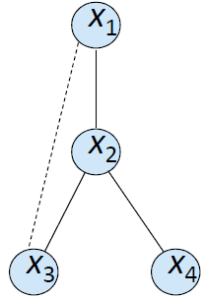
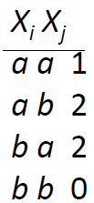
ADOPT: Example
4 Variables (4 agents) x₁, x₂, x₃ x₄ with D = {a, b}
4 binary identical cost functions
Constraint graph:

Slide 13
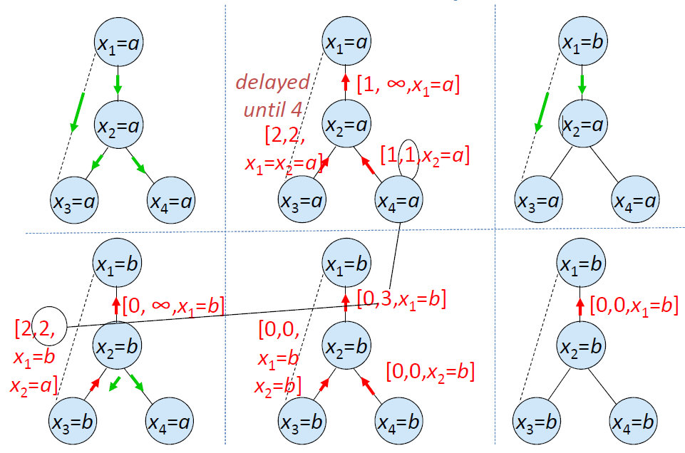
ADOPT: Example
Notes:
Leaves always return lb=up;
step 3: x_1 changes to b because lb for x_1 = b is initially set to zero
simplified – not all messages shown

Slide 14
ADOPT Properties
For finite DCOPs with binary non-negative constraints, ADOPT is guaranteed to terminate with the globally optimal solution.

Slide 15
ADOPT: Value Assignment
An ADOPT agent takes the value with minimum LB
Best-first search with eager behavior:
Agents may constantly change value
Generates many context changes
Threshold:
lower bound of the cost that children have from previous search
parent distributes threshold among children
incorrect distribution does not cause problems: the child with minor allocation would send a COST to the parent later, and the parent will rebalance the threshold distribution

Slide 16
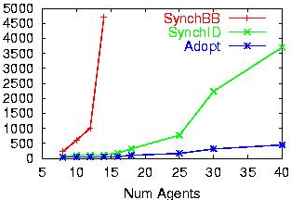
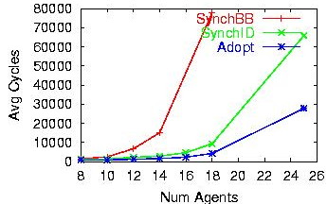
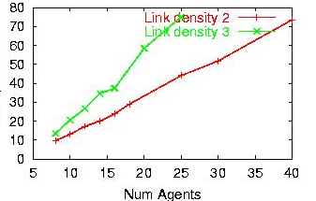
Performance on Graph Coloring
Avg. number of cycles, link density = 2
Avg. number of cycles, link density = 3
Avg. messages per cycle
ADOPT’s lower bound search method and parallelism yields significant efficiency gains.
Sparse graphs (density 2) solved optimally and efficiently by ADOPT.
Communication only grows linearly
thanks to the sparsity of constraint graph

Slide 17
Adopt summary – Key Ideas
Optimal, asynchronous algorithm for DCOP
polynomial space at each agent
Weak Backtracking
lower bound based search method
Parallel search in independent subtrees
Efficient reconstruction of abandoned solutions
backtrack thresholds to control backtracking
Bounded error approximation
sub-optimal solutions faster
bound on worst-case performance

Slide 18
Approximate Algorithms

Slide 19
Why Approximate Algorithms
Motivations
Often optimality in practical applications is not achievable
Fast good enough solutions are all we can have
Example – Graph coloring:
Medium size problem (about 20 nodes, three colors per node)
Number of states to visit for optimal solution in the worst case 3^20 = 3 billions of states
Problem: Provide guarantees on solution quality

Slide 20
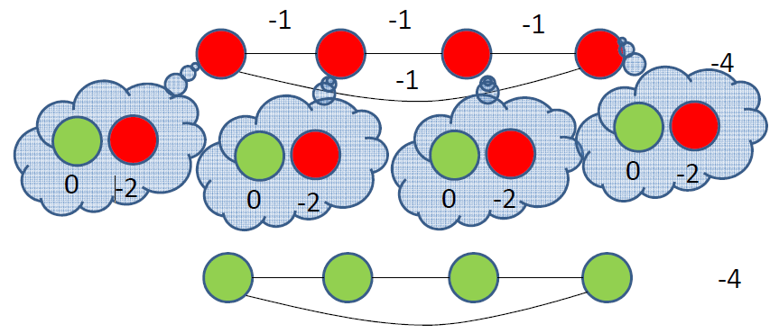
Issues with Distributed Local Greedy Alg
Parallel execution: A greedy local move might be harmful/useless
➔ Need coordination

Slide 21
Distributed Stochastic Algorithms
Greedy local search with activation probability to mitigate issues with parallel executions
DSA-1: change value of one variable at time
Initialize agents with a random assignment and communicate values to neighbors
Each agent:
Generates a random number and execute only if rnd less than activation probability
When executing changes value maximizing local gain
– Communicate possible variable change to neighbors

Slide 22
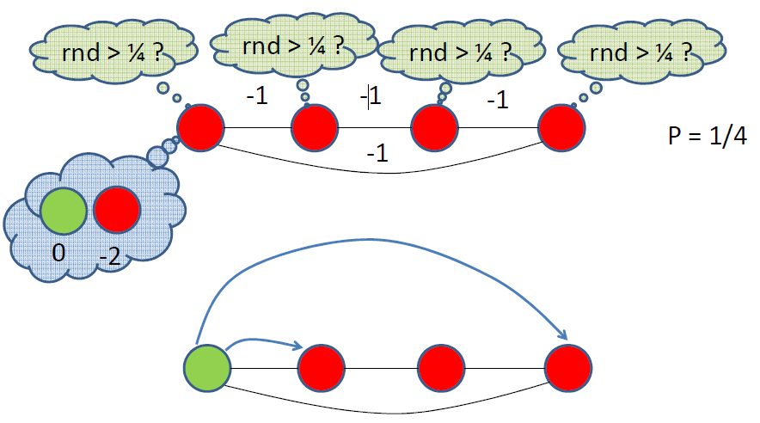
DSA-1: Execution Example

Slide 23
DSA-1: Discussion
Extremely “cheap” (computation/communication)
Good performance in various domains
e.g. target tracking [Fitzpatrick Meertens 03, Zhang et al. 03],
Shows an anytime property (not guaranteed)
Benchmarking technique for coordination
Problems
Activation probablity must be tuned [Zhang et al. 03]
No general rule, hard to characterise results across domains

Slide 24
Maximum Gain Message (MGM-1)
Coordinate to decide who is going to move
Compute and exchange possible gains
Agent with maximum (positive) gain executes
Analysis [Maheswaran et al. 04]
Empirically, similar to DSA
More communication (but still linear)
No Threshold to set
Guaranteed to be monotonic (Anytime behavior)

Slide 25
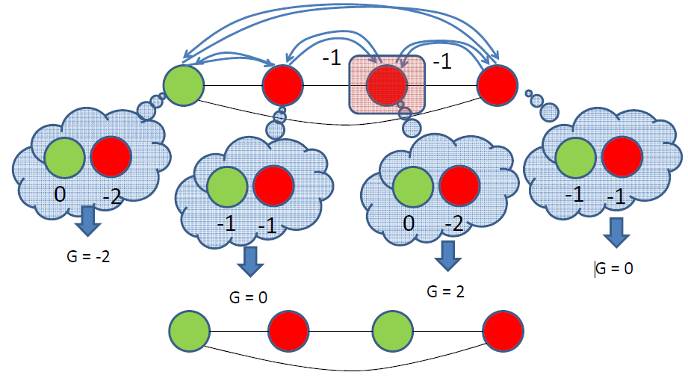
MGM-1: Example

Slide 26
Local Greedy Approaches
Exchange local values for variables
Similar to search based methods (e.g. ADOPT)
Consider only local information when maximizing
Values of neighbors
Anytime behavior
But: Could result in very bad solutions

Slide 27
Conclusions

Slide 28
Conclusion
Distributed constraint optimization generalizes distributed constraint satisfaction by allowing real-valued constraints
Both complete and approximate algorithms exist
complete can require exponential number of message exchanges (in the number of variables)
approximate can return (very) suboptimal solutions
Very active areas of research with a lot of progress – new algorithms emerging frequently
Reading: [Vidal] – Chapter 2, [Shoham] – Chapter 2, IJCAI 2011 Optimization in Multi-Agent Systems tutorial, Part 2: 37-61min and Part 3: 0-38min

