Slide 1
Distributed Constraint Satisfaction
Michal Jakob
Agent Technology Center, Dept. of Computer Science and Engineering, FEE, Czech Technical University
A4M33MAS Autumn 2011
(based partially on slides by Jose M. Vidal and IJCAI tutorial on Optimization in Multi-Agent Systems)

Slide 2
Intro
Distributed constraint reasoning is a very powerful general framework for describing and solving a wide range of planning, scheduling and coordination problems
At the end of 2-lecture series you will
will be able to express problems as distributed constraint processing problems
will be able to use basic solution algorithms for constraint satisfaction and optimization
Notes:
Many solution algorithms with different properties and performance trade-offs are available

Slide 3
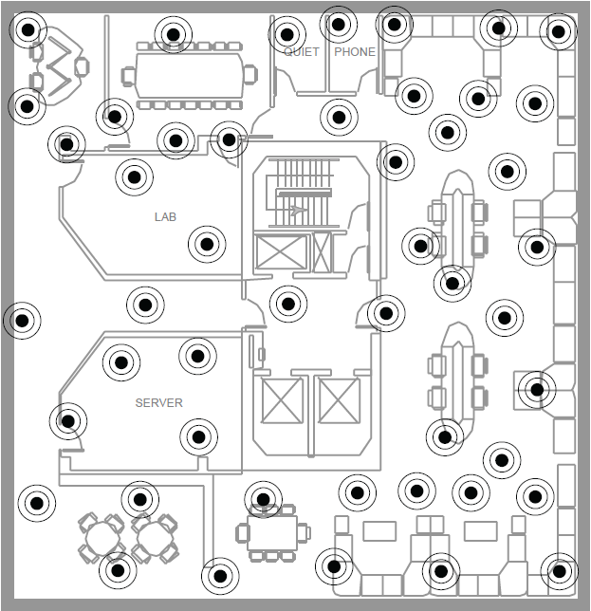
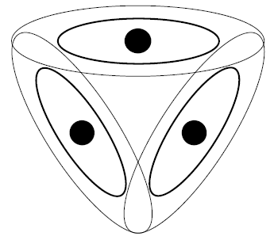
Example: Channel Allocation in Sensor Networks
Find a non-conflicting assignment of communication channels assuming local communication only
Notes:
Can be viewed as graph coloring problem
Low-power, short-range communication
Want to do it just-in-place, not ahead of deployment

Slide 4
Example: Meeting Scheduling
from http://cs.smu.ca/~pawan/wi07/petcu.pdf
Notes:
Constraint satisfaction:
Goal: find just one assignment of meetings to (time,place) pairs that works
Formulation as constraint satisfaction problem: Each meeting represented by a variable with domain being all (time,place) pairs
Constraints: manager schedules, meetings overlapping in attending persons cannot be scheduled at the same time, travel to a meeting must be possible for attendees
DisCSP variant: assign a manager to each meeting with the task of scheduling it

Slide 5
Extension: Private constraints and preferences
from http://cs.smu.ca/~pawan/wi07/petcu.pdf

Slide 6
Constraint Satisfaction Problem
Problem specification:
${X=\{x}_{i},…,x_{m}\}$ set of variables
$D=\{D_{i},…,D_{m}\}$ set of domains for the variables, i.e. $x_{i}∈D_{i}$; if $D_{i}$is finite, let $D_{i}=\left\{v_{i,1},…,v_{i,d\left(i\right)}\right\}$
$C=\{c_{1},…,c_{k}\}$ set of constraints over $X$; the constraint $c_{i}$ is represented as a Boolean predicate $P_{i}\left(y_{1},…,y_{j}\right), \left\{y_{1},…,y_{j}\right\}⊆X$ that determines whether a given value assignment combination for $y_{1},…,y_{j}$ fulfill the particular constraint
Solution:
find an assignment of variables ${\{x}_{i},…,x_{m}\}$ such that all constraints are satisfied

Slide 7
Distributed Constraint Satisfaction Problem
$A=\{A_{1},…,A_{n}\}$ set of agents
Each agent is responsible for one variable
extension to multiple variables per agent possible
Agent can communicate by sending messages
We assume cooperative setting

Slide 8
When is Distributed Constraint Reasoning Needed?
Limits/restrictions on communication between agents
Privacy (constraints)
Dynamism and problem size (depends on the problem)

Slide 9
Distributed Solution Algorithms
Top-Down
Prunning
Bottom-Up
Search
Filtering, Hyper-resolution
Asynchronous backtracking, Asynchronous weak-commitment search
e.g. Distributed breakout

Slide 10
Requirements on a good algorithm
Soundness/Correctness: the solution returned is valid
Completeness: finds a solution if it exists
Termination: in a finite number of steps

Slide 11
Distributed Algorithms
Synchronous: agents take steps following some fixed order (or computing steps are done simultaneously, following some external clock).
Asynchronous: agents take steps in arbitrary order, at arbitrary relative speeds.
Partially synchronous: there are some restrictions in the relative timing of events

Slide 12
Synchronous vs Asynchronous
Synchronous
A few agents are active, most are waiting
Asynchronous
Active agents take decisions with updated information
Low degree of concurrency / poor robustness
Algorithms: direct extensions of centralized ones
All agents are active simultaneously
Information is less updated, obsolescence appears
High degree of concurrency / robust approaches
Algorithms: new approaches

Slide 13
Asynchronous Backtracking Algorithm
Notes:
Backtracking = zpětné vyhledávání, metoda pokusů a oprav, metoda zpětného sledování, metoda prohledávání do hloubky

Slide 14
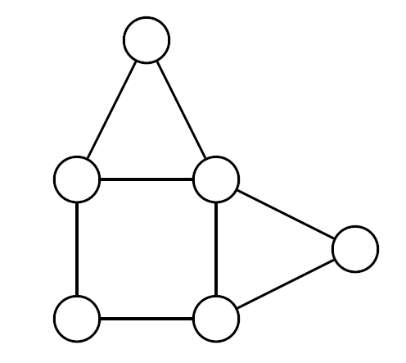
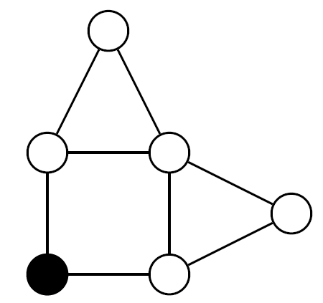
Backtracking Illustration
Notes:
V33-V40
Choice/ordering of variables and values in their domains have a huge impact on perfromance.

Slide 15
Synchronous Backtracking
Total order of n agents: like a railroad with n stops
Current partial solution: train with n seats, forth/back
One place for each agent: when train reaches a stop
selects a new consistent value for the agent of this stop (wrt previous agents), it moves forward
otherwise, it moves backwards
Solution
Notes:
TODO: requires previous explanation of sychronous vs. asynchronous algorithms

Slide 16
Assumptions
Agents communicate by sending messages
An agent can send messages to others, iff it knows their identifiers (directed communication / no broadcasting)
The delay transmitting a message is finite but random
For any pair of agents, messages are delivered in the order they were sent
Agents know the constraints in which they are involved, but not the other constraints
Each agent owns a single variable (agents = variables)
Constraints are binary (2 variables involved)
Notes:
6 and 7 can be relaxed, they are in primarily to simplify explanation

Slide 17
Asynchronous Backtracking (ABT)
Asynchronous algorithm
all agents active, take a value and inform
no agent has to wait for other agents
Total order among agents (to avoid cycles) → priorities
Constraints are directed: from higher-priority to lower-priority agents
ABT plays in asynchronous distributed context the same role as backtracking in centralized
Notes:
[TODO]: simplify terminology

Slide 18
ABT: Core Principles
Higher priority agent (j) informs the lower one (k) of its assignment
Lower priority agent (k) evaluates the constraint with its own assignment
If permitted ➔ no action
else ➔ look for a value consistent with j
If it exists ➔ k takes that value
else ➔ the agent view of k is a nogood ➔ backtrack

Slide 19
ABT: NoGoods
Nogoods are required to ensure systematic traversal of search space in asynchronous, distributed context
Nogood: conjunction of (variable, value) pairs of higher priority agents, which removes a value of the current one
Example:
x ≠ y, D_{x}=D_{y}={a, b}, x higher-priority than y:
when [x ← a] arrives to y, the agent y generates the nogood x=a => y≠a that removes value a of D_{y}.

Slide 20
ABT: NoGood Resolution
When all values of variable y are removed, the conjunction of the left-hand sides of its nogoods is also a nogood.
Resolution: the process of generating a new nogood that is a logical consequence of existing ones
Example:
x ≠ y, z ≠ y, D_{x}=D_{y}=D_{z}={a, b}, x, z higher priority than y x=a => y≠a; x=a ∧ z=b is a nogood z=b => y≠b; x=a => z≠b (assuming x higher-priority than z)

Slide 21
How ABT Works
ABT agents: asynchronous action; spontaneous assignment
Assignment: j takes value a, j informs lower priority agents
Backtrack: k has no consistent values with higher-priority agents, k resolves nogoods and sends a backtrack message
New links: j receives a nogood mentioning i, unconnected with j; j asks i to set up a link
Stop: “no solution” detected by an agent, stop
Solution: when agents are silent for a while (quiescence), every constraint is satisfied => solution;
detected by specialized algorithms

Slide 22
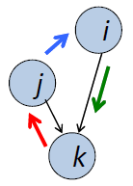
ABT: Messages
Ok?(i→k,a): i informs k that it takes value a j
NoGood(k→j, i=a => j≠b):
all k’s values are forbidden,
k requests j to backtrack,
k forgets j value, k takes some value,
j may detect obsolescence
AddLink(j→i): set a link from i to j, to know i value
Stop: there is no solution

Slide 23
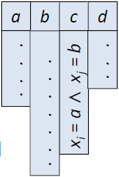
ABT: Data Structures
Cung current context / agent view: values of higher-priority constrained agents
NoGood store: each removed value has a justifying nogood
$$x_{i}=a∧x_{j}=b⇒x_{k}≠c$$
Stored nogoods must be active:
(left-hand side in the current context)
If a nogood is no longer active, it is removed (and the value is available again)

Slide 24
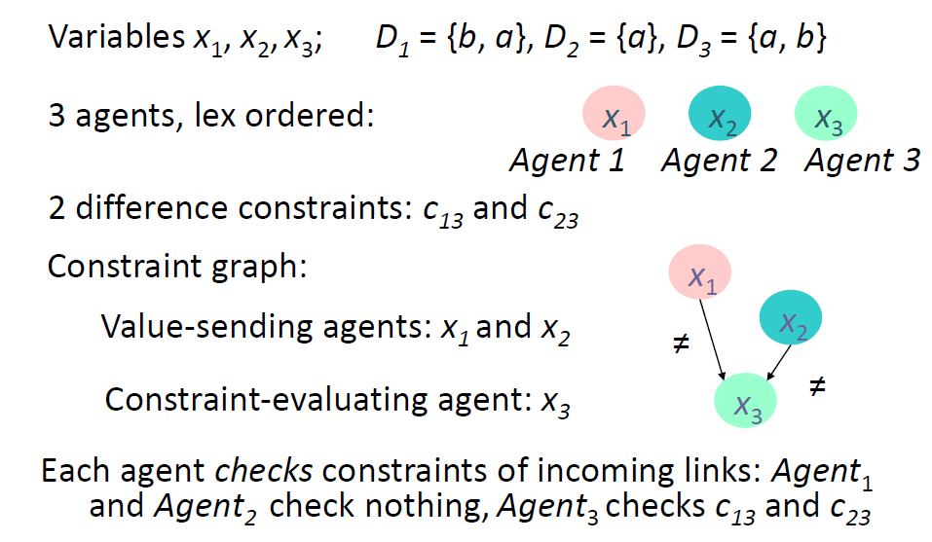
ABT: Graph Coloring Example

Slide 25
%

Slide 26
ABT Propoerties
Soundness/Correctness
silent network <=> all constraints are satisfied
Completeness
ABT performs an exhaustive traversal of the search space
Parts not searched: those eliminated by nogoods
Nogoods are legal: logical consequences of constraints
Therefore, either there is no solution => ABT generates the empty nogood, or it finds a solution if exists
Termination
there is no infinite loop (by induction in the depth of the agent)

Slide 27
Asynchronous Weak-Commitment Search (AWC)
ABT problem: highly constraint variables can be assigned very late
Solution: Use dynamic priorities
Change ok? messages to include agent’s current priority
Use min-conflict heuristic: choose assignment minimizing the number of violations

Slide 28
Distributed Breakout Algorithm

Slide 29
ABT Issues
Uneven division of labor: lowest-priority agents do most of the work
Generating nogoods is complex and computationally expensive operation (also for AWC)
Cannot scale to large problems (100’s of variables at most)
➔ What if we sacrifice completeness?

Slide 30
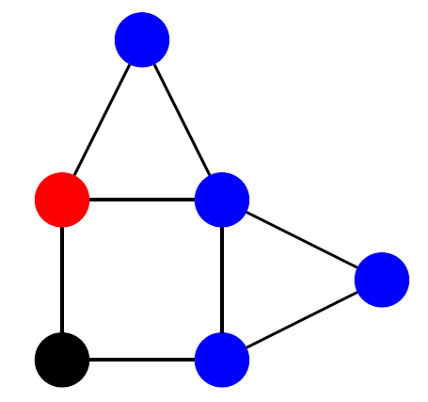
Hill Climbing

Slide 31
Hill Climbing
Agents asynchronously change their assignments so that they reduce the number of their violated constraints
Can get stuck in local optima ➔ use techniques to escape local optima
But: detection of local optima expensive in a distributed system

Slide 32
Quasi-Local Minimum
Definition (Quasi-local minimum) An agent is in a quasi-local minimum if it is violating some constraint and neither it nor any of its neighbors can make a change that results in lower cost for all.
Quasi-local minimum can be detected locally

Slide 33
Distribute Breakout Algorithm
Key idea: If in a quasi-local minimum, increase the weight of violated constrainst
Messages:
handle-ok?(i→ j, x_i) where i is the agent and x_i is its current value
handle-improve(i, improve) where improve is the maximum i could gain by changing to some other color

Slide 34
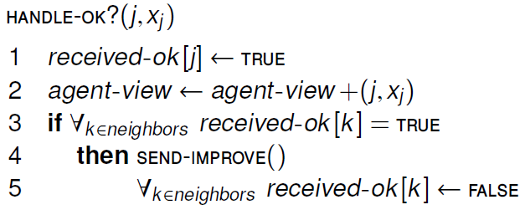

Slide 35
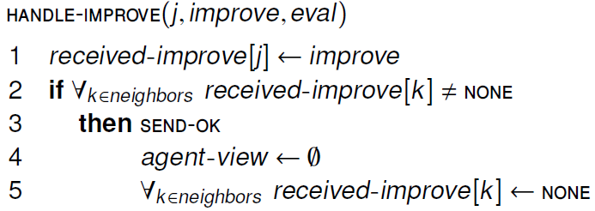

Slide 37
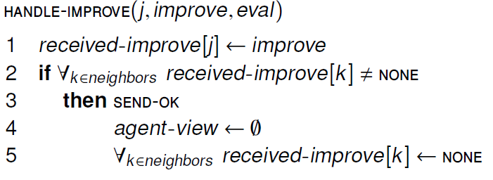

Slide 38
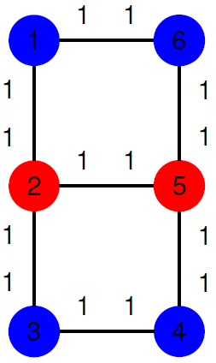
Distributed Breakout Example

Slide 39
Properties
Theorem (Distributed Breakout is not Complete) Distributed breakout can get stuck in local minimum. Therefore, there are cases where a solution exists and it cannot find it.

Slide 40
Conclusions

Slide 41
Conclusion
(Distributed) constraint satisfaction (CSP) is a general, widely applicable framework to model problems in terms of Boolean constraints over variables
Distributed CSP is required if there are constraints on communication or disclosure of private information
Top-down and bottom-up techniques exist
top-down are complete but computationally more intensive on most problems
bottom-up are faster but can get stuck in local minima
Very active areas of research with a lot of progress – new algorithms emerging frequently
Reading: [Vidal] – Chapter 2, [Shoham] – Chapter 1, IJCAI 2011 Optimization in Multi-Agent Systems tutorial, Part 2, 0-35min

