Slide 1
Architecture of Software Systems – Lecture 8 Massively Distributed Architectures Reliability, Failover … and failures
Martin Rehák

Slide 2
Motivation
Internet-based business models imposed new requirements on computational architectures and inspired new solutions
Extreme low cost – service is free
Extreme user numbers
Versatility of queries
New collaboration patterns

Slide 3
Overview
Three approaches to massively distributed systems:
Google: Map-Reduce, GFS, …
Yahoo/Apache: Hadoop (Map-Reduce, HFS, …)
Kazaa (P2P example, Filesharing, Skype,…)

Slide 4
Distributed Map-Reduce
Inspired and originally used by Google
Patent (?) on the technology
Massively parallel approach based on functional programming primitives
Used to perform data storage, manipulation and search in high-volume, simple-structure databases
Dean and Ghemawat: MapReduce: Simplied Data Processing on Large Clusters, 2004

Slide 5
Map/Reduce primitives
Originally inspired by Lisp/functional programming primitives
Operations on key/value pairs
Two phases:
Map: Applies a function (filter) to set of records/elements in the list
Reduce: shortens the list by applying an aggregation function
Following example from: http://ayende.com/Blog/archive/2010/03/14/map-reduce-ndash-a-visual-explanation.aspx

Slide 6
Map/Reduce Example
{ "type": "post",
"name": "Raven's Map/Reduce functionality",
"blog_id": 1342,
"post_id": 29293921,
"tags": ["raven", "nosql"], "post_content": "<p>...</p>", "comments": [ { "source_ip": '124.2.21.2',
"author": "martin", "txt": "..." }]}
Set of blog posts
Count the number of comments per blog
… distributed on cluster
… millions of blogs

Slide 7
The query (C#)
Map
Reduce
from post in docs.posts
select new { post.blog_id,
comments_length = comments.length
};
from agg in results
group agg by agg.key into g
select new {
agg.blog_id,
comments_length = g.Sum(x=>x.comments_length)
};

Slide 8
Map

Slide 10
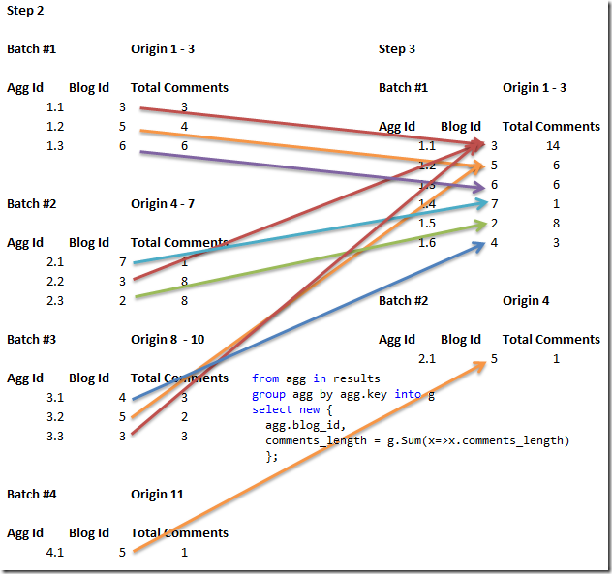

Slide 11
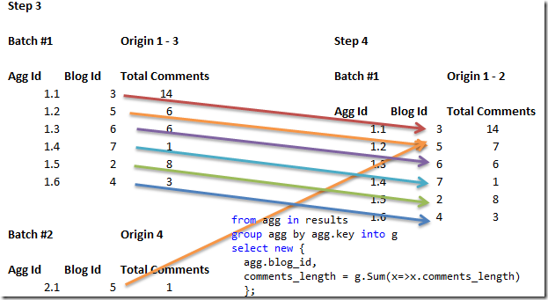

Slide 12
Deployment
Google: large farms of commodity (now custom built) hardware
Distributed storage
Asynchronous interface
Map: parallelized by splitting the data and assigning them to different nodes to process
Reduce: Partition the keys using pseudo-random partition with uniform distribution into R pieces
Hash(key) mod R

Slide 13
Runtime

Slide 14
Runtime
Split input files into M pieces
(S)elect master node, other nodes are workers
Workers read assigned tasks/data and applies map. Results stored in memory as (key,value)
Results are periodically written to local disk storage. Already partitioned to R regions.
Reduce worker notified by master about data location
Reduce worker reads out the buffered data by RPC
Data is sorted by key
Iterate over sorted data and apply reduce to all subsets with the same key
Reduce results appended to final results
Another Map-Reduce may follow

Slide 15
Applications
Distributed Grep
URL access/reference counting
Reverse web-link graph (behind google search)
Semantic search – term vector per host
Inverted index
Distributed sort
From the original Google paper

Slide 16
KaZaA and Other Peer-To-Peer
Family of protocols and technologies
The “most typical” peer-to-peer variant
Used in a variety of products and applications
Filesharing
Skype
Botnet Command&Control
…
Reading & Resources:
Liang, Kumar, Ross: Understanding KaZaA
Barabasi/Bonabeau Scale Free Networks, SciAm May 2003

Slide 17
Napster and Gnutella
Napster: peer-to-peer network with centralized directory element
Obvious security (and legal) implications
Gnutella-like flat peer-to-peer:
Peers (Nodes) are equal
Bootstrapping upon startup – looking for other peers
Horizontal scanning –is a bad design choice
Use of local cache, web/UDP cache or IRC
System creates random connections to a specific number of currently active peers
Peers exchange info about other peers

Slide 18
Search (Gnutella)
User specifies search terms
Search is sent to and performed on actively connected peer nodes
Low number of connections (less than 10) implies the need for request forwarding
High overhead of search communication, even with hop limits
Introduction of “ultrapeers” in recent versions
Nodes (hubs) with high number of connections
Dense interconnection between ultrapeers
Design influenced by more recent architectures

Slide 19
Random Graphs
A.-L. Barabási, Scale-Free Networks, SciAm 288

Slide 20
FastTrack Protocol
Respects the Scale Free nature of real-world networks
Introduces two populations of nodes: Ordinary Nodes and Supernodes
Functionally separates:
network maintenance – hub selection, connenction etc…
lookup (equivalent to service discovery/directory)
business logic (high-volume P2P transmissions)

Slide 21
Initial Protocol Stages/Operations
ON connects to SN upon startup
SN selected randomly from the list of available SN
Share service list (file names/hashes) with the selected SN
SN maintains the database based on connected ON updates
SN database: file name, file size, content hash, metadata (descriptor), node (IP)
Peers are heterogeneous – influence on SN role selection: bandwidth, CPU, latency, NAT,…

Slide 22
Search
In most implementations, Supernodes only hold the information about the directly connected ON
This is due to caching, scalability and explosive size growth problems
Search and downloads are un-coupled in the architecture
Both operations are associated through content hash – (assumed) unique resource ID

Slide 23
Search Operation
User specifies the content
ON sends the query to its SN (through TCP connection)
SN returns the IP address and metadata (list)
SN maintain an overlay core network between themselves
Topology changes very frequently
Queries can be forwarded to other SN
Queries cover a small subset of SN (long-term stable due to topology changes)

Slide 24
Connections/traffic
Signaling: handshakes, metadata exchange, supernode lists exchanges, queries, replies
File transfer traffic (phone calls): ON to ON directly. Reflector may be used to get through firewalls (Skype).
Advertisement (HTTP, original Kazaa only)
Instant messaging, base 64 encoded (original Kazaa)
Skype encodes all traffic, maintains persistent UDP connections between ON and SN

Slide 25
Search vs. Connectivity
Some peer implementations may re-connect to different SN during the search for a particular file/resource
CPU and communication intensive
Filelists are exchanged with the new SN
(Remember that ON state is not cached by SN)
User activity can create second-order effects in the network
Massive searches for a scarce resource

Slide 26
Search & Content Hash
User (ON) performs metadata search
ON receives the list of DB records
User selects the best resource
Resource is described by ContentHash
The system uses the ContentHash to identify the best ON(s) with the desired resource
Transparent download optimization
Transparent content management

Slide 27
Nodes and Supernodes

Slide 28
Random Node Failure, Random Networks

Slide 29
Random node failure, SF networks

Slide 30
Attacks on Hubs

Slide 31
Reliability
“We have determined that, as part of the signalling traffic, KaZaA nodes frequently exchange with each other lists of supernodes. ONs keep a list of up 200 SNs whereas SNs appear to maintain lists of thousand of SNs. When a peer A (ON or SN) receives a supernode list from another peer B, peer A will typically purge some of the entries from its local list and add entries sent by peer B.”
Liang et al, Understanding KaZaA

Slide 32
Importance

