Slide 1
Architecture of Software Systems HTTP APIs: REST and SOA
Martin Rehák

Slide 2
Essentials
HTTP-based interfaces are an evolution of the RPC/RMI/CORBA approaches discussed earlier
These approaches became a de-facto standard for business OLTP (on-line transaction processing) currently designed
They benefit from the increased computational power and bandwidth in order to provide simpler and easier integration model than earlier technologies

Slide 3
Overview
HTTP(S) protocol in general
… see last lecture
REST, HTTP APIs
Service-Oriented Architectures
Web Services

Slide 4
Disruptive Innovation to ORB
HTTP usage allows departure from the ORB model used in previous technologies:
RPC, RMI and CORBA all rely on the middleware-based integration
ORB(s)/middleware is essential and difficult to replace
Typically requires bi-directional connections and configuration, testing and debugging
SOA/REST model provides efficient platform and language independence by violating some of the ORB/Distributed Objects assumptions
…that were rendered invalid by the context anyway
The context has changed due to the dramatic decrease of bandwidth costs, CPU cost, availability of open source and security model of intra-enterprise collaboration.
Term Disruptive Innovation is coined in Christensen, Clayton: The Innovator’s Dilemma,
When New Technologies Cause Great Firms to Fail, Harvard BR Press, 1977

Slide 5
Security
&
Firewalls
ORB: CORBA/RMI/DCOM
HTTP
HTTP APIs:
SOA
&
REST
Better CPU/programmer cost ratio

Slide 6
HTTP uptake was enabled two major innovations
Binary to Text: Transition from fast and efficient binary representation of data in transit towards inefficient, but universally comprehensible text representation
Performance factor of 100+ 10 years ago, less than 2 now
Stateful to Stateless: (Almost) Stateless approach to system API definition allows vastly simpler model for state maintenance. State maintenance no longer bloats the communication protocol.
Some state is obviously still necessary, but is typically limited and its maintenance has been pushed to application level
The change of the paradigm(s) has enabled radical simplification of the communication paradigm that has been formalized in the REST model

Slide 7
REST Model
REST: Representational State Transfer: “… a set of architectural constraints that, when applied as a whole, emphasizes scalability of component interactions, generality of interfaces, independent deployment of components, and intermediary components to reduce interaction latency, enforce security, and encapsulate legacy systems”
Two meaning of the term are used, confusingly enough:
REST as the underlying architectural model for the W3C/HTTP specs REST as a term describing “non-SOAP” HTTP APIs of web services
Fielding, Roy T.; Taylor, Richard N. (May 2002), "Principled Design of the Modern Web Architecture" (PDF), ACM Transactions on Internet Technology (TOIT) ACM, 2 (2): 115–150
and Roy Fieldings dissertation, 2000, UC Irvine (quote) …read with caution…

Slide 8
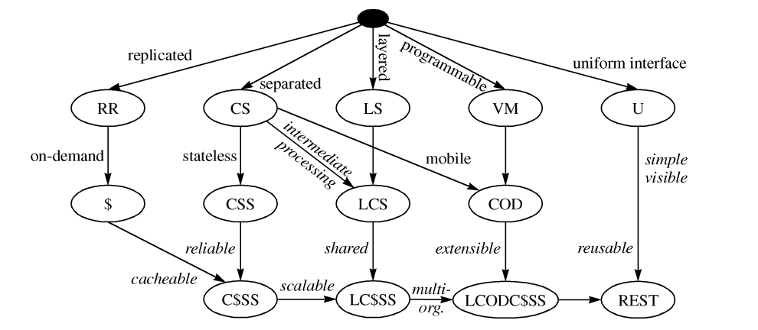
REST Principles

Slide 9
REST Properties
Client-Server: Separation of Client and Server execution contexts
Stateless: REST architecture does not help to maintain coherent state across successive API calls
Application-Level State can be maintained and managed by explicit mechanisms (session variables, cookies, requests with explicit state)
Replicated (Cached): Caching must be taken into account by the model in order to improve the performance if possible, and not to disrupt the interaction if inappropriate
Layered: Firewalls, load-balancers and proxies will get in the middle. Live with it…
Programmable: Server can provide the client with code to execute locally. Applets didn’t work. Javascript does.
Uniform Interface: see next slide

Slide 10
Enabling Successive Innovation
Proxies and
Load Balancers
Javascript,
AJAX
Caching
Scalability
Maintainability

Slide 11
Uniform Interface
Separation of internal and external representation of data. Protocol participants should not make any assumptions regarding the internal representation or processing applied by the other party, but rely solely on the public specification of the interface.
Resources are identified by URI
Resources are manipulated through representations (JSON, XML, HTML,…)
Self-Descriptive messages, understandable without the context.
Application state transitions are (dynamically) managed by the server.

Slide 12
REST API – no secrets

Slide 13
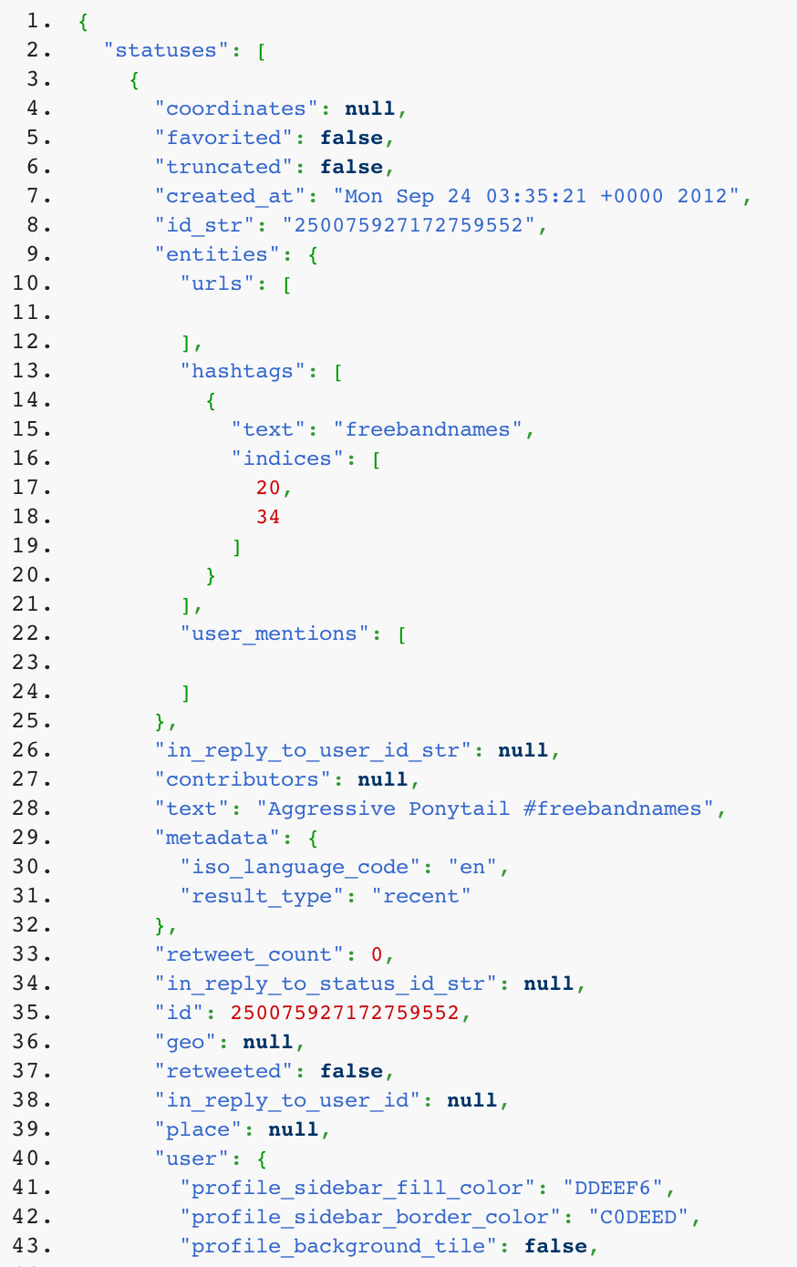
Twitter API example
https://api.twitter.com/1.1/search/tweets.json?
q=%23freebandnames&
since_id=24012619984051000&
max_id=250126199840518145&
result_type=mixed&count=4
Stateless: the whole business context specified inside the request
Not quite the whole context… authentication, authorisation and session information is managed with cookies
https://dev.twitter.com/docs/api/1.1/get/search/tweets

Slide 14
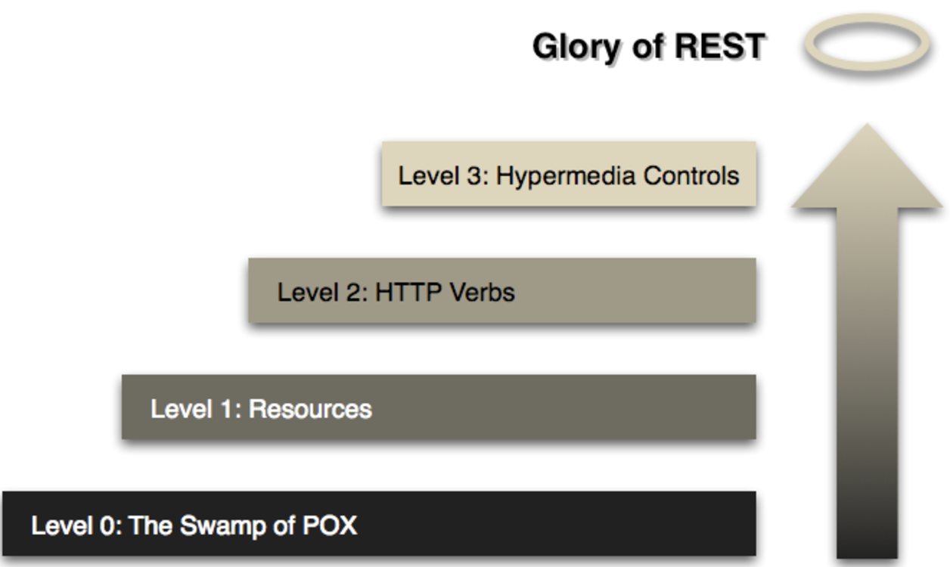
The idea behind REST
Martin Fowler, Richardson Maturity Model, 2010
https://martinfowler.com/articles/richardsonMaturityModel.html

Slide 15
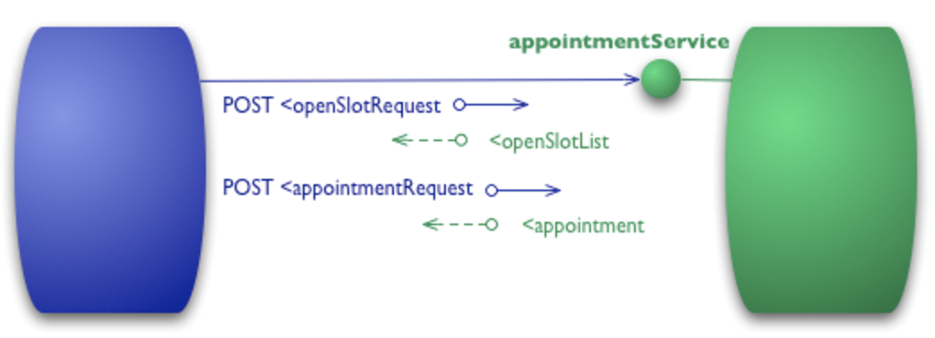
Level 0 Example: (apologies for XML)
POST /appointmentService HTTP/1.1
[various other headers]
<openSlotRequest date = "2010-01-04" doctor = "mjones"/>
HTTP/1.1 200 OK
[various headers]
<openSlotList>
<slot start = "1400" end = "1450">
<doctor id = "mjones"/>
</slot>
…
</openSlotList>

Slide 16
Reply if success
HTTP/1.1 200 OK
[various headers]
<appointment>
<slot doctor = "mjones" start = "1400" end = "1450"/>
<patient id = "jsmith"/>
</appointment>
Booking request
POST /appointmentService HTTP/1.1
[various other headers]
<appointmentRequest>
<slot doctor = "mjones" start = "1400" end = "1450"/>
<patient id = "jsmith"/>
</appointmentRequest>
Reply if failure
HTTP/1.1 200 OK
[various headers]
<appointmentRequestFailure>
<slot doctor = "mjones" start = "1400" end = "1450"/>
<patient id = "jsmith"/>
<reason>Slot not available</reason>
</appointmentRequestFailure>

Slide 17
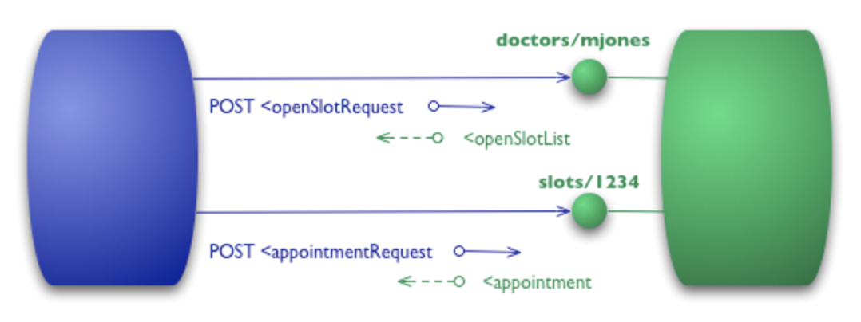
Level 1: Introducing Resources
POST /doctors/mjones HTTP/1.1
[various other headers]
<openSlotRequest date = "2010-01-04"/>
HTTP/1.1 200 OK
<openSlotList>
<slot id = "1234" doctor = "mjones" start = "1400" end = "1450"/>
…
</openSlotList>

Slide 18
Booking request
Reply if success
POST /slots/1234 HTTP/1.1
[various other headers]
<appointmentRequest>
<patient id = "jsmith"/>
</appointmentRequest>
HTTP/1.1 200 OK
[various headers]
<appointment>
<slot id = "1234" doctor = "mjones" start = "1400" end = "1450"/>
<patient id = "jsmith"/>
</appointment>

Slide 19
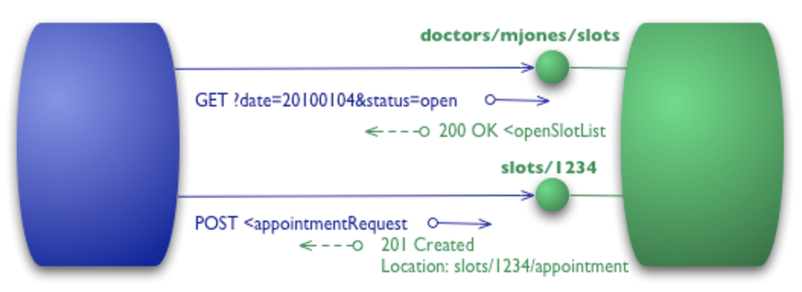
Level 3: Verbs (METHODS)
GET /doctors/mjones/slots?date=20100104&status=open HTTP/1.1
Host: royalhope.nhs.uk
HTTP/1.1 200 OK
<openSlotList>
<slot id = "1234" doctor = "mjones" start = "1400" end = "1450"/>
…
</openSlotList>

Slide 20
Reply if success
HTTP/1.1 201 Created
Location: slots/1234/appointment
[various headers]
<appointment>
<slot id = "1234" doctor = "mjones" start = "1400" end = "1450"/>
<patient id = "jsmith"/>
</appointment>
Booking request
POST /slots/1234 HTTP/1.1
[various other headers]
<appointmentRequest>
<patient id = "jsmith"/>
</appointmentRequest>
Reply if failure
HTTP/1.1 409 Conflict
[various headers]
<openSlotList>
<slot id = "5678" doctor = "mjones" start = "1600" end = "1650"/>
</openSlotList>

Slide 21
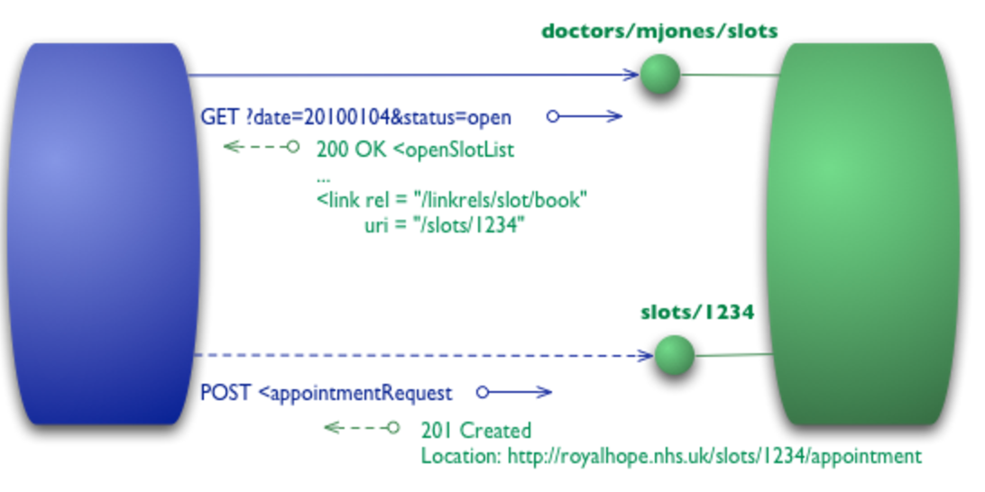
Crawling through the response
HTTP/1.1 200 OK
[various headers]
<openSlotList>
<slot id = "1234" doctor = "mjones" start = "1400" end = "1450">
<link rel = "/linkrels/slot/book"
uri = "/slots/1234"/>
…
</openSlotList>
GET /doctors/mjones/slots?date=20100104&status=open HTTP/1.1
Host: royalhope.nhs.uk

Slide 22
HTTP/1.1 201 Created
Location: http://royalhope.nhs.uk/slots/1234/appointment
[various headers]
<appointment>
<slot id = "1234" doctor = "mjones" start = "1400" end = "1450"/>
<patient id = "jsmith"/>
<link rel = "/linkrels/appointment/cancel"
uri = "/slots/1234/appointment"/>
<link rel = "/linkrels/appointment/addTest"
uri = "/slots/1234/appointment/tests"/>
<link rel = "self"
uri = "/slots/1234/appointment"/>
<link rel = "/linkrels/appointment/changeTime"
uri = "/doctors/mjones/slots?date=20100104@status=open"/>
<link rel = "/linkrels/appointment/updateContactInfo"
uri = "/patients/jsmith/contactInfo"/>
<link rel = "/linkrels/help"
uri = "/help/appointment"/>
</appointment>

Slide 23
Service Oriented Architectures as a Principle The theory behind the REST services and Web Services

Slide 24
Defining the SOA
What it IS NOT: SOA ≠ Web Service(s) What it IS: a flexible set of design principles used during the phases of system development and integration or: A set of components which can be invoked, and whose interface descriptions can be published and discovered (W3C)
or: The policies, practices, frameworks that enable application functionality to be provided and consumed as sets of services published at a granularity relevant to the service consumer. Services can be invoked, published and discovered, and are abstracted away from the implementation using a single, standards-based form of interface. (CBDI)

Slide 25
SOA Paradigm
SOA encourages loose coupling between distributed systems, hidden behind a well-defined interface
Functionality is broken-down into coherent, self-sufficient services that are made accessible across the network
Encourage distributed (dynamic) assembly of services across the network of providers

Slide 26
Combining Services
SOA allow users to combine and reuse them in the production of applications
services and their corresponding consumers communicate with each other by passing data in a well-defined, shared format, or by coordinating an activity between two or more services
services comprise unassociated, loosely coupled units of functionality that have no calls to each other embedded in them
a service may encompass several operations each service operation implements one action
instead of services embedding calls to each other in their source code they use defined protocols that describe how services pass and parse messages, using description metadata

Slide 27
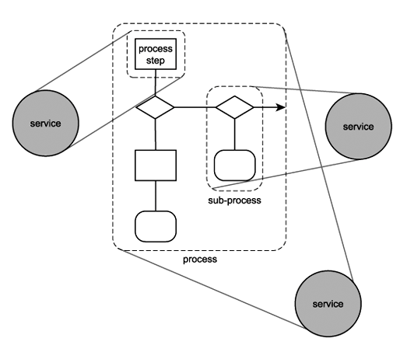

Slide 28
Services and Objects
services represent natural building blocks that allow us to organize capabilities in ways that are familiar to us services, just like classes
combine information and behavior,
hide the internal workings,
presents a relatively simple interface to the rest of the “application”.
services can create hierarchies

Slide 29
Pros and Con’s
When SOA make sense
… and when they don’t.
component reuse
simplify usage of legacy applications
platform independence — allows for arbitrary SW/HW
avoid vendor lock-in one can use the existing software and build atop
high scalability, evolvable systems
when you have homogeneous environment when real-time processing is critical
“if it works, don’t mess with it”
when tight coupling is a plus or is necessary

Slide 30
Principles of Services
Reuse - a service once created can be reused for various application
Granularity - a question of the optimal choice of granularity
fine-grained means large overhead, coarse-grained means small reusability
Modularity - services can be deployed independently
Composability & Componentization- services are simple, recombinant units and can be selected and assembled in various combinations
Interoperability - services are capable of working together

Slide 31
Principles of Services (2)
Standard compliance: APIs and services shall comply with industry standards to allow easy dynamic composition
Language and platform independence pushed to the next level – commoditization
Autonomy & Abstraction of Business Logic: Services shall hide the underlying business logic from the user and can dynamically change their implementation.
SLA/Contract:
services adhere to a communications agreement, as defined collectively by one or more service-description documents
header (name, version, responsible organization, type), functional (functionality, invocation) and non-functional (security, QoS) description

Slide 32
Session Types, Dependencies
Stateless service: each message that a consumer sends to a provider must contain all necessary information for the provider to process it. Each request can be treated as generic. There are no intermediate states to worry about, so recovery from partial failure is also relatively easy. This makes a service more reliable.
Stateful service: holds a session between a consumer and a provider. Stateful services require both the consumer and the provider to share the same context. It may reduce the overall scalability of the service as it needs to remember shared context for each consumer.
Idempotent requests: repeated execution has the same effect as a single execution

Slide 33
WeB SERVICES

Slide 34
Components of the WS Stack
Web services are defined very broadly, but we will concentrate on the following elements:
WSDL – Web Services Definition Language. An XML-based language that allows us to describe the Web Services API.
SOAP – (Simple Object Access Protocol full name has been deprecated). An evolution of the earlier XML-RPC standard, it allows exchange of standardized messages between Web Services.
CORBA/RMI Mapping:
Web Service | CORBA Equivalent | RMI Equivalent
WSDL | IDL | Remote Interface (approx.)
SOAP | IIOP | RMI protocol/IIOP

Slide 35
WSDL
Used to define Services, their interfaces and bindings to messages:
Types: Describes the structure of messages that the service will send and receive [abstract]
Interface: Describes the abstract functionality provided by the service [abstract]
Binding: Describes how to access the service.[concrete]
Service: Describes where to access the service [concrete]
WSDL example based on: http://www.w3.org/TR/wsdl20-primer/

Slide 36
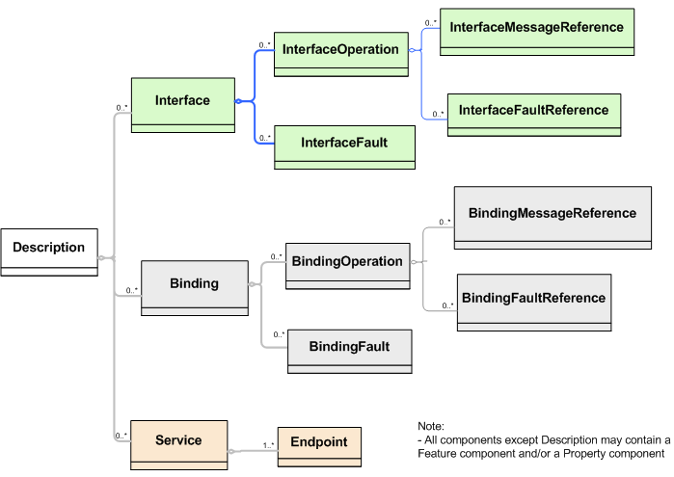
WSDL

Slide 37
WSDL Example – Hotel Reservation
<types>
<xs:schema
xmlns:xs="http://www.w3.org/2001/XMLSchema"
targetNamespace="http://greath.example.com/2004/schemas/resSvc"
xmlns="http://greath.example.com/2004/schemas/resSvc">
<xs:element name="checkAvailability" type="tCheckAvailability"/>
<xs:complexType name="tCheckAvailability">
<xs:sequence>
<xs:element name="checkInDate" type="xs:date"/>
<xs:element name="checkOutDate" type="xs:date"/>
<xs:element name="roomType" type="xs:string"/>
</xs:sequence>
</xs:complexType>
<xs:element name="checkAvailabilityResponse" type="xs:double"/>
<xs:element name="invalidDataError" type="xs:string"/>
</xs:schema>
</types>
In section:
Used to check for availability
Out section:
Used to reply

Slide 38
WSDL Example – Hotel Reservation
<interface name = "reservationInterface" >
<fault name = "invalidDataFault"
element = "ghns:invalidDataError"/>
<operation name="opCheckAvailability"
pattern="http://www.w3.org/ns/wsdl/in-out"
style="http://www.w3.org/ns/wsdl/style/iri"
wsdlx:safe = "true">
<input messageLabel="In"
element="ghns:checkAvailability" />
<output messageLabel="Out"
element="ghns:checkAvailabilityResponse" />
<outfault ref="tns:invalidDataFault" messageLabel="Out"/>
</operation>
</interface>
Business part of
the interface

Slide 39
WSDL Example – Hotel Reservation
<binding name="reservationSOAPBinding"
interface="tns:reservationInterface"
type="http://www.w3.org/ns/wsdl/soap"
wsoap:protocol="http://www.w3.org/2003/05/soap/bindings/HTTP/">
<fault ref="tns:invalidDataFault” wsoap:code="soap:Sender"/>
<operation ref="tns:opCheckAvailability"
wsoap:mep="http://www.w3.org/2003/05/soap/mep/soap-response"/>
</binding>
<service name="reservationService"
interface="tns:reservationInterface”>
<endpoint name="reservationEndpoint"
binding="tns:reservationSOAPBinding"
address ="http://greath.example.com/2004/reservation"/>
</service>
Protocol is bound
Operation linked
Service defined

Slide 40
SOAP
Protocol specification for exchanging structured information for WS Relies on XML for its message format
Uses other application layer protocols (RPC, HTTP)
Originally designed as an object-access protocol
Underlying layer for Web Services, based on WSDL and UDDI

Slide 41
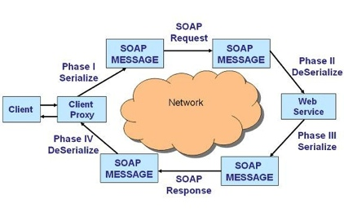
SOAP Message Flow

Slide 42
Content Encoding (Both SOAP/REST)
Many Critiques of Web Services (of any kind) concentrate on the encoding CPU cost and bandwidth overhead
These are, recently, becoming negligible cost factors according to our experience
Commonly used formats are:
JSON: Java Script Object Notation, i.e. simple text format describing objects originally for js use, then generalized. Easy to read, can be compressed for efficiency.
XML: Extensible Markup Language. The default option, in general the least efficient.
YAML: Extension of JSON, more features, “nicer” syntax
pbuffer, AVRO,…: Google and Apache BINARY-encoded formats
Notice the full circle to Binary…

Slide 43
Conclusions
Two philosophical models for Web Services:
Simple REST HTTP APIs
About 90+% of current APIs
Elaborate Web Services
complex APIs for elaborate tasks
We find a pattern similar to P2P systems:
Seek efficiency where it matters (data encoding)
Seek transparency/readability anywhere else (signaling, administration, addressing,…)

Slide 44
Design Recommendations
Simple REST API with JSON data format is typically a safe way to go for most public-facing services
Consider binary encoding for large data (pbuff/avro)
Use Web Services when you require tighter contracts or design a highly complex, stateful, multi-party system
RMI/RPC can still be relevant within your distributed system
In-depth security models can be an issue for the future
Use distributed data processing for large-data handling (Map-Reduce or P2P if necessary)
Prefer simplicity to sophistication
Concentrate on the top problem first

