Slide 1
Two-Player Games A4B33ZUI, LS 2016
Branislav Bošanský, Ondřej Vaněk, Štěpán Kopřiva
{name.surname}@agents.fel.cvut.cz
Artificial Intelligence Center, Czech Technical University

Slide 2
Minimax
function minimax(node, depth, Player)
if (depth = 0 or node is a terminal node) return evaluation value of node
if (Player = MaxPlayer)
for each child of node
v := max(v, minimax(child, depth-1, switch(Player) ))
return v
else
for each child of node
v := min(v, minimax(child, depth-1, switch(Player) ))
return v

Slide 3
Alpha-Beta Pruning
function alphabeta(node, depth, α, β, Player)
if (depth = 0 or node is a terminal node) return evaluation value of node
if (Player = MaxPlayer)
for each child of node
v := max(v, alphabeta(child, depth-1, α, β, switch(Player) ))
α := max(α,v); if (β≤α) break
return v
else
for each child of node
v := min(v, alphabeta(child, depth-1, α, β, switch(Player) ))
β := min(β,v); if (β≤α) break
return v

Slide 4
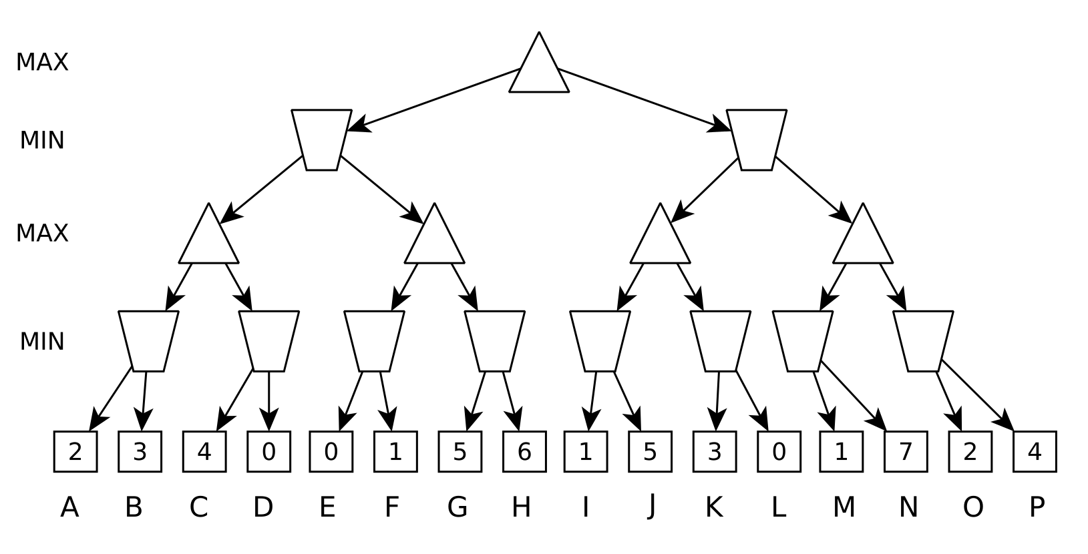
Game

Slide 5
Negamax
function negamax(node, depth, α, β, Player)
if (depth = 0 or node is a terminal node) return evaluation value of node
if (Player = MaxPlayer)
for each child of node
v := max(v, -negamax(child, depth-1, -β, -α, switch(Player) ))
α := max(α,v); if (β≤α) break
return v
else
for each child of node
v := min(v, alphabeta(child, depth-1, α, β, switch(Player) ))
β := min(β,v); if (β≤α) break
return v

Slide 6
NegaScout – Main Idea
enhancement of the alpha-beta algorithm
assumes some heuristic that determines move ordering
the algorithm assumes that the first action is the best one
after evaluating the first action, the algorithm checks whether the remaining actions are worse
the “test” is performed via null-window search
[α, α+1]
the algorithm needs to re-search, if the test fails (i.e., there might be a better outcome for the player when following the tested action)

Slide 7
Alpha-Beta vs. Negascout
[4, +∞]
MAX
[-∞, +∞]
4
[-∞, 4]
4
3
MIN
[-∞, +∞]
[4, +∞]
[4, 3]
[4, 7]
[5, 4]
[-∞, 4]
[7, +∞]
[0, 4]
[4, +∞]
[-∞, +∞]
[4, 7]
MAX
[4, +∞]
4
5
7
3
4
2
0
5
7
2
3
0

Slide 8
Alpha-Beta vs. Negascout
[4, +∞]
MAX
[-∞, +∞]
4
4
[4, 3]
3
MIN
[-∞, 4]
[4, 5]
[-∞, +∞]
[3, 4]
[7, 5]
[5, 4]
[4, 5]
[-∞, +∞]
[4, 5]
MAX
[4, +∞]
4
5
7
3
4
2
0
5
7
X
2
3
0

Slide 9
Alpha-Beta vs. Negascout
[4, +∞]
MAX
[-∞, +∞]
7
re-search with [4, +∞]
4
[4, 5]
7
MIN
[-∞, 4]
[4, 5]
[-∞, +∞]
[3, 4]
[7, 5]
[5, 4]
[4, 5]
[9, 5]
MAX
[-∞, +∞]
[4, 5]
[4, +∞]
4
5
7
9
4
2
0
5
7
X
X
2
9
0

Slide 10
NegaScout
also termed Principal Variation Search (PVS)
dominates alpha-beta
never evaluates more different nodes than alpha-beta
can evaluate some nodes more than once
depends on the move ordering
can benefit from transposition tables
generally 10-20% faster compared to alpha-beta

Slide 11
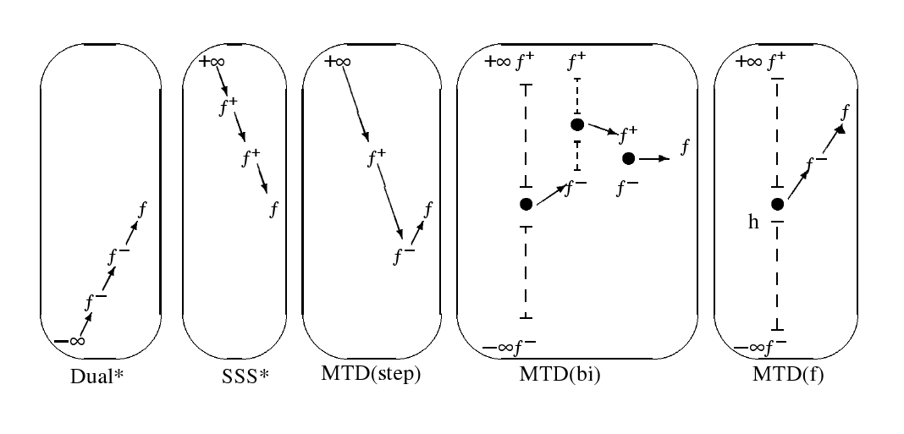
MTD
Memory-enhanced Test Driver
Best-first fixed-depth minimax algorithms. Plaat et. al. , In Artificial Intelligence, Volume 87, Issues 1-2, November 1996, Pages 255-293

Slide 12
Further Topics
more advanced algorithms
Monte Carlo Tree Search (leading algorithm for many games)
further enhanced with many heuristics and techniques
more complex games
games with uncertainty
chance (Nature player), calculating expected utilities
imperfect information (players cannot distinguish certain states)
search in games vs. game theory
online vs. offline approach
game theory – studied in Mgr. OI (A4M36MAS)

Slide 13
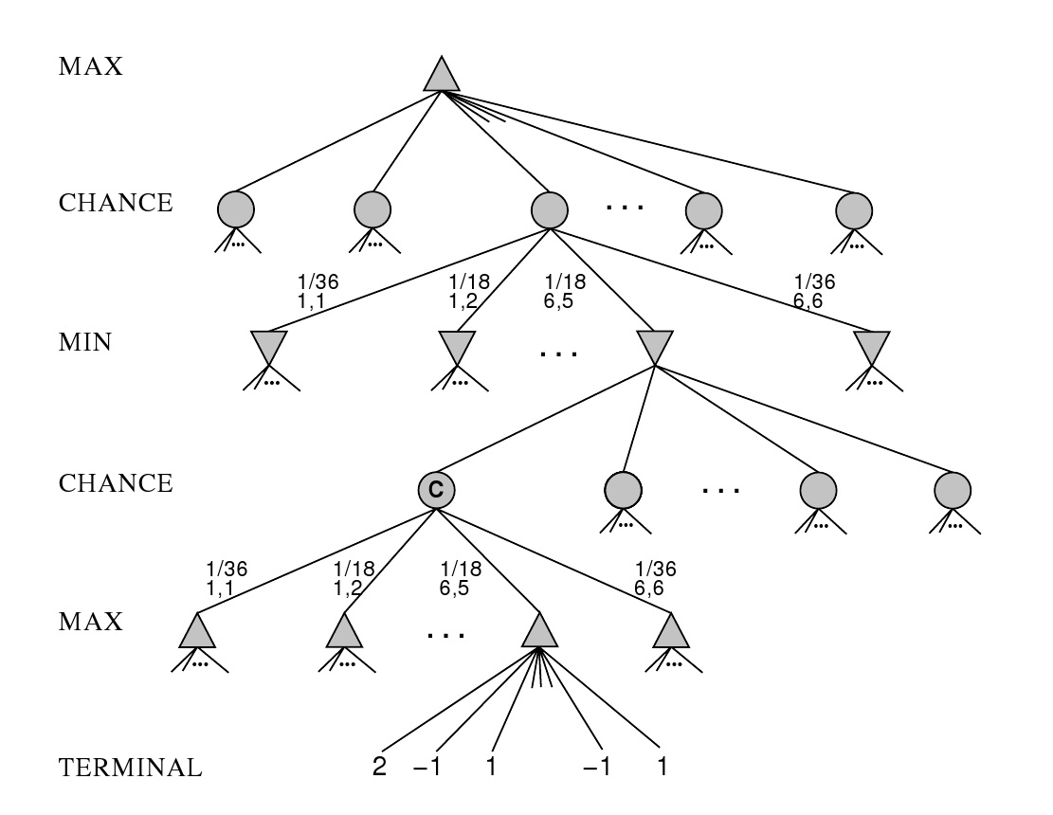
Other Games - Chance nodes

Slide 14
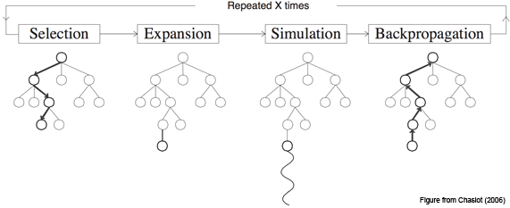
MCTS

Slide 15
Computational Game Theory in AIC
application of game-theoretic approaches in security domains
Maritime Security (Pirates), Patrolling, Border Protection, Computer Network Security, Fare Evasion
more fundamental research
general algorithms for solving sequential games with imperfect information
implementation of domain independent algorithms
general game playing
BP/DP and further collaboration – Plug-in 6.4.2016 16:15

