Slide 1
(Un)informed State Space Search
Ondrej Vanek
A4B33ZUI LS 2013

Slide 2
Problem Solving
problem
state
actions
goal

Slide 3
State Space
Formulation
Problem
Initial state – $s_{0}$
Successor function – $x∈S →succ\left(x\right)∈2^{S}$
Goal test –$x∈S →goal\left(x\right)=T | F$
Arc cost –$c\left(x,succ(x)\right)$
Solution is set of actions leading from initial state to a goal state

Slide 4
Tree Search Algorithm
Basic Idea

Slide 5
Tree Search Algorithm
Formulation

Slide 6
Tree Search Algorithm
Formulation
BFS
Insert at the end
DFS
Insert at the beginning

Slide 7
Graph Search
Using a closed list

Slide 8
Searching the State Space
Algorithms
Breadth first search BFS
Depth first search DFS
Depth limited search (DFS with search limit l )
Iterative deepening search (Iteratively increase l )
Uniform cost search

Slide 9
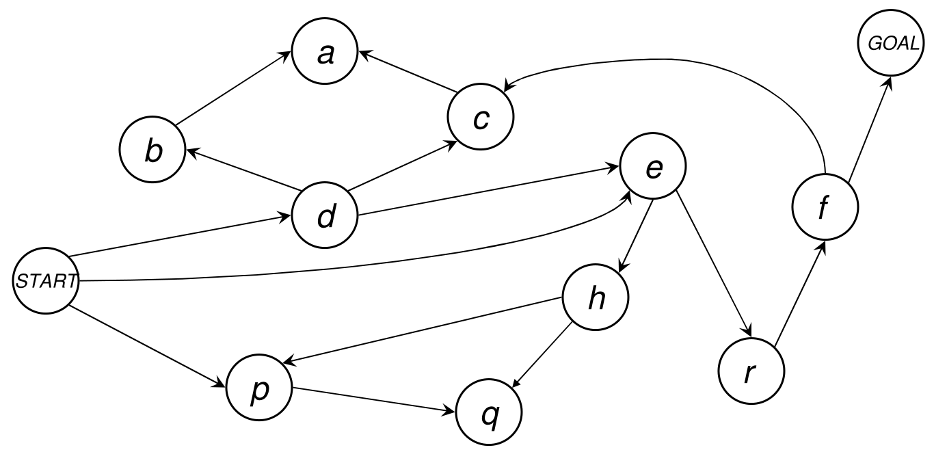
BFS/DFS Exercises

Slide 10
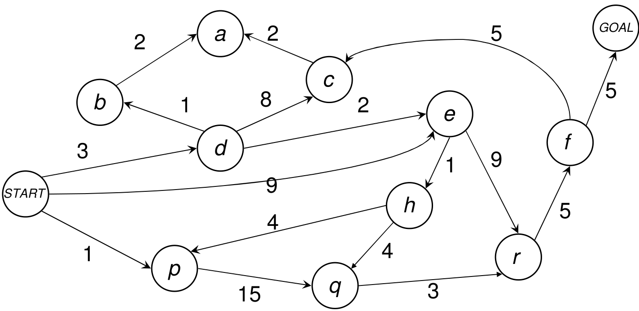
Uniform-Cost Search Exercise

Slide 11
Informed Search Problems
Problem
Initial state – $s_{0}$
Successor function – $x∈S →succ\left(x\right)∈2^{S}$
Goal test –$x∈S →goal\left(x\right)=T | F$
Arc cost –$c\left(x,succ(x)\right)$
g(s): cost to reach the state s
h(s): estimated cost to get from state s to goal state
Heuristic $s∈S:h\left(s\right)→R$

Slide 12
Heuristic
Wikipedia: “A heuristic function, or simply a heuristic, is a function that ranks alternatives in various search algorithms at each branching step based on the available information (heuristically) in order to make a decision about which branch to follow during a search.”

Slide 13
Heuristic
Evaluation function for each node h(N)
Value is independent of the current search tree
Expressing desirability
Estimates the cost from N to a goal state G
$$h\left(N\right)≥0$$
Goal of heuristic design:
As close to the real cost as possible!

Slide 14
Best-first Search Algorithms
Evaluation function f(n) for each state/node
$$f\left(n\right)=g\left(n\right)+h(n)$$
→ Selecting best node first – “best-first search”
COST
HEURISTIC
Uniform cost search: h(N) = 0
Greedy search: g(N) = 0, h(N) arbitrary
A search: g(N), h(N) arbitrary
A* search: g(N), h(N) admissible

Slide 15
General Search Algorithm Template
If GOAL?(initial-state) then return initial-state
INSERT(initial-node,FRINGE)
Repeat:
If empty(FRINGE) then return failure
N ← REMOVE(FRINGE)
s ← STATE(N)
If GOAL?(s) then return path or goal state
For every state s’ in SUCCESSORS(s)
Create a new node N’ as a child of N
INSERT(N’,FRINGE)

Slide 16
General Search Algorithm Template
If GOAL?(initial-state) then return initial-state
INSERT(initial-node,FRINGE)
Repeat:
If empty(FRINGE) then return failure
N ← REMOVE(FRINGE)
s ← STATE(N)
If GOAL?(s) then return path or goal state
For every state s’ in SUCCESSORS(s)
Create a new node N’ as a child of N
INSERT(N’,FRINGE)

Slide 17
Best-first search
If GOAL?(initial-state) then return initial-state
INSERT(initial-node,FRINGE)
Repeat:
If empty(FRINGE) then return failure
N ← REMOVE(FRINGE)
s ← STATE(N)
If GOAL?(s’) then return path or goal state
For every state s’ in SUCCESSORS(s)
Create a new node N’ as a child of N
INSERT(N’,FRINGE)
Fringe: Sorted List – lowest values first
N – inserted according to its value $f\left(n\right)=g\left(n\right)+h\left(n\right)$

Slide 18
A* Search
Idea: Avoid extending paths that seem to be expensive
Evaluation function f(n) for each state/node
$$f\left(n\right)=g\left(n\right)+h(n)$$
g(n): cost to reach the node n
h(N) – admissible and consistent heuristic

Slide 19
H(N) – Heuristic function
We know the cost to the node g(n) – nothing to tune here
We don’t know the exact cost from n to goal h(n) – if we knew, no need to search – estimate it!
H(N) – admissible and consistent heuristic
Admissible = optimistic – it never overestimates the cost to the goal
$$0≤h\left(N\right)≤h^{∗}(N)$$
Consistent = Triangle inequality is valid
$$a+b≥c$$
$$g\left(N,M\right)+h\left(M\right)≥h(N)$$
➔ once a node is expanded, the cost
by which it was reached is the lowest possible
N
a
c
M
b

Slide 20
Informed Search Exercises

Slide 21
Path in a maze
What are possible heuristics?

Slide 22
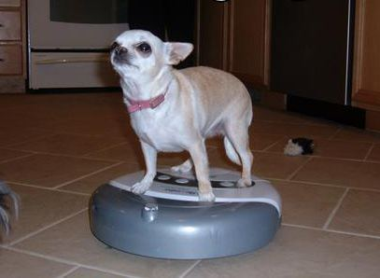
Roomba Robot path planning

Slide 23
The ferryman problem
Notes:
Převozník
http://freeweb.siol.net/danej/riverIQGame.swf
Na voru se mohou vézt najednou jen dvě osoby.
Otec nemůže zůstat ani s jednou dcerou bez přítomnosti jejich matky.
Matka nemůže zůstat ani s jedním synem bez přítomnosti jejich otce.
Kriminálník (osoba v proužkovaném obleku) nemůže zůstat ani s jedním členem rodiny, když tam není policajt.
Jen otec, matka a policajt se umí přeplavit (tj. ovládat vor).

Slide 24
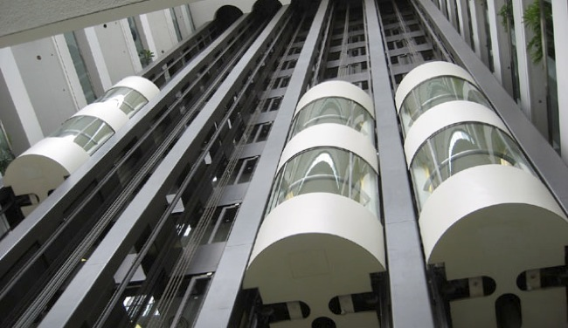
Escaping the World Trade Center
Imagine a huge skyscraper with several elevators. As the input you have:
set of elevators, where for each you have:
- range of the floors that this elevator is operating in
- how many floors does this elevator skip (e.g. an elevator can stop only on every second floor, or every fifth floor, etc.)
- speed (time in seconds to go up/down one floor)
- starting position (number of the floor)

Slide 25
Escaping the World Trade Center
Let us assume, that transfer from one elevator to another one takes the same time (given as input - t).
You are starting in kth floor and you want to find the quickest way to the ground floor.
You can assume that you are alone in the building and elevators do not run by themselves.
What are the states?
What is the initial state and the goal state?
What is the cost function?

Slide 26
Stock Exchange Problem
As the input data you have a set of requests that contains a set of 4-tuples:
(STOCK_BUY/STOCK_SELL, STOCK_ID, STOCK_AMOUNT, STOCK_PRICE)
that describe a request to either sell or buy given amount of given stock for given price. The price is interpreted as minimal in case the request is to sell stocks and maximal, in case the request is to buy.
Your task is to find appropriate price for each STOCK_ID that would maximize the sum of amount of the traded stocks.

Slide 27
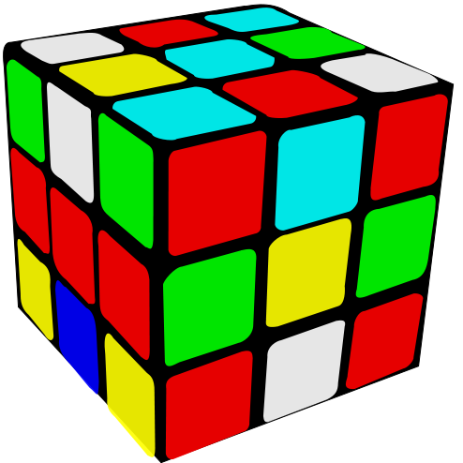
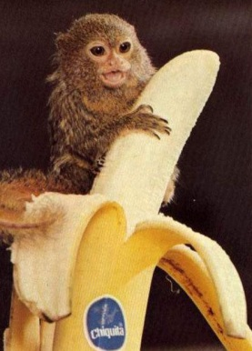
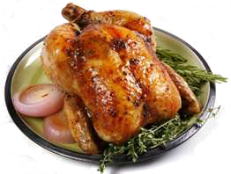
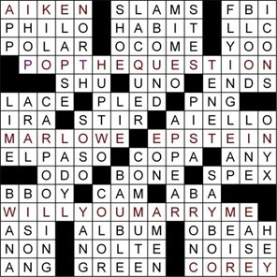
State Space
More examples
“Perfect” Spam filter
Spellcheck suggestion design
Solving a puzzle
Rubik’s cube
Monkey & Bananas
Crossword puzzles
Knapsack problem
Traveling Salesman problem
Baking a chicken
App. Moving with friends
Notes:
Monkey&Bananas - Room, chair stick, bananas on the ceiling:
http://en.wikipedia.org/wiki/Monkey_and_banana_problem

