Slide 1
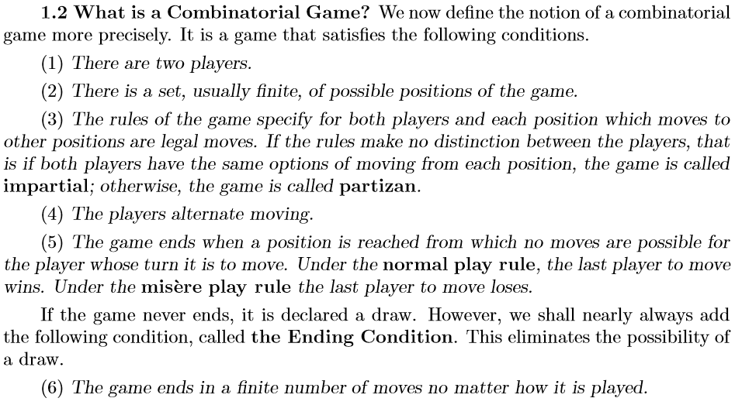

Slide 2
Game example and analysis
Game rules
Three piles with 4, 2, 1, pegs(s).
In one move, a player
can remove 1 or 2 pegs from any pile(s).
Player who removes the last peg wins.
4
2
1
Game representation
Represent the piles by a triple of integers, number of pegs in the piles,
the initial state (position) is then [4,2,1].
The states (positions) accesible in a single move are connected
by (directed) edges.
421
420
401
411
321
221

Slide 3
421
420
411
321
410
401
320
311
221
4
2
1
400
310
301
220
211
121
Each player
can remove
1 or 2 pegs.
Player who
removes
the last peg
wins.
300
210
201
120
111
021
200
110
101
020
011
100
010
001
000

Slide 4
421
Winning move!
420
411
321
410
401
320
311
221
4
2
1
400
310
301
220
211
121
Each player
can remove
1 or 2 pegs.
Player who
removes
the last peg
wins.
300
210
201
120
111
021
200
110
101
020
011
100
010
001
000

Slide 5
P positions are positions that are winning for the
Previous player (the player who just moved to the position)
N positions are positions that are winning for the
Next player (the player who will move to some next position).
421
420
411
321
410
401
320
311
221
4
2
1
400
310
301
220
211
121
Each player
can remove
1 or 2 pegs.
Player who
removes
the last peg
wins.
300
210
201
120
111
021
200
110
101
020
011
100
010
001
000

Slide 6
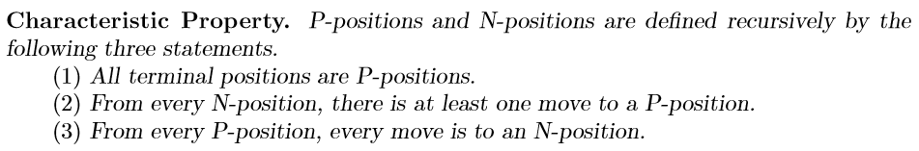
420
411
321
410
401
320
311
221
4
2
1
400
310
301
220
211
121
Each player
can remove
1 or 2 pegs.
Player who
removes
the last peg
wins.
300
210
201
120
111
021
200
110
101
020
011
100
010
001
000

Slide 7
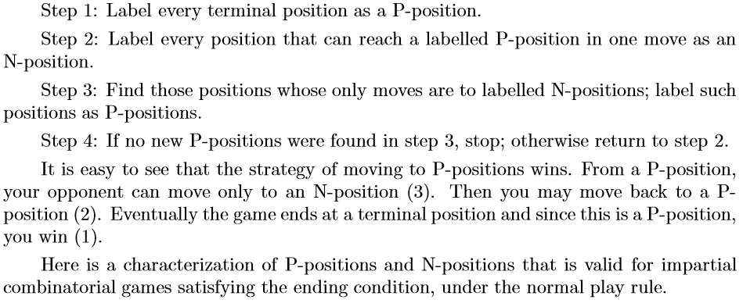
Determining P and N positions

Slide 8
421
420
411
321
410
401
320
311
221
4
2
1
400
310
301
220
211
121
Each player
can remove
1 or 2 pegs.
Player who
removes
the last peg
wins.
300
210
201
120
111
021
200
110
101
020
011
100
010
001
000

Slide 9
421
420
411
321
410
401
320
311
221
4
2
1
400
310
301
220
211
121
Each player
can remove
1 or 2 pegs.
Player who
removes
the last peg
wins.
300
210
201
120
111
021
200
110
101
020
011
100
010
001
000

Slide 10
421
420
411
321
410
401
320
311
221
4
2
1
400
310
301
220
211
121
Each player
can remove
1 or 2 pegs.
Player who
removes
the last peg
wins.
300
210
201
120
111
021
200
110
101
020
011
100
010
001
000

Slide 11
421
420
411
321
410
401
320
311
221
4
2
1
400
310
301
220
211
121
Each player
can remove
1 or 2 pegs.
Player who
removes
the last peg
wins.
300
210
201
120
111
021
200
110
101
020
011
100
010
001
000

Slide 12
421
420
411
321
410
401
320
311
221
4
2
1
400
310
301
220
211
121
Each player
can remove
1 or 2 pegs.
Player who
removes
the last peg
wins.
300
210
201
120
111
021
200
110
101
020
011
100
010
001
000

Slide 13
421
420
411
321
410
401
320
311
221
4
2
1
400
310
301
220
211
121
Each player
can remove
1 or 2 pegs.
Player who
removes
the last peg
wins.
300
210
201
120
111
021
200
110
101
020
011
100
010
001
000

Slide 14
421
Winning move!
420
411
321
410
401
320
311
221
4
2
1
400
310
301
220
211
121
Each player
can remove
1 or 2 pegs.
Player who
removes
the last peg
wins.
300
210
201
120
111
021
200
110
101
020
011
100
010
001
000

Slide 15
Subtraction Games
Let S be a set of positive integers.
The subtraction game with subtraction set S is played as follows.
From a pile with a large number, say n, of chips, two players alternate moves. A move consists of removing s chips from the pile where s ∈ S.
Last player to move wins.
Example
17
16
15
14
13
12
11
10
9
8
7
6
5
4
3
2
1
0
P- and N- positions in subtraction game with subtraction set {2, 5, 8}.
From state K there is a transition to the states K−2, K−5 and K−8
(if those are non-negative).

Slide 16
17
16
15
14
13
12
11
10
9
8
7
6
5
4
3
2
1
0
P- and N-
positions in
subtraction
game with
subtraction
set {2, 5, 8}.
From state K
there is a transition
to the states
K−2, K−5 and
K−8
(if those are
non-negative).

Slide 17
Generate P and N positions in the subtraction game with subtraction set {2, 5, 8}.
2
1
9
8
7
6
5
4
3
2
1
0
9
8
7
6
5
4
3
2
1
0
9
8
7
6
5
4
3
2
1
0
8
5
2
2
5
8
2
5
8
2
5
8
2
5
8

Slide 18
Generate P and N positions in the subtraction game with subtraction set {2, 5, 8}.
2
1
9
8
7
6
5
4
3
2
1
0
9
8
7
6
5
4
3
2
1
0
9
8
7
6
5
4
3
2
1
0
2
5
8
2
5
8
2
5
8
2
5
8
2
5
8
2
5
8
etc...

