Slide 1
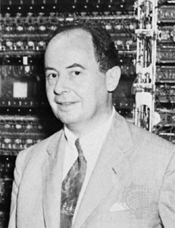
Pseudorandom numbers
John von Neumann:
Any one who considers
arithmetical methods of producing random digits
is, of course, in a state of sin.
For, as has been pointed out several times,
there is no such thing as a random number
— there are only methods to produce random numbers, and a strict arithmetic procedure of course is not such a method.
"Various Techniques Used in Connection with Random Digits,", in Monte Carlo Method (A. S. Householder, G. E. Forsythe, and H. H. Germond, eds.), National Bureau of Standards Applied Mathematics Series, 12, Washington, D.C.: U.S. Government Printing Office, 1951, pp. 36–38.
Advanced Algorithms, A4M33PAL, ZS 20152016, FEL ČVUT
1

Slide 2


Join at slido.com
#784396
ⓘ Start presenting to display the joining instructions on this slide.

Slide 3

Audience Q&A Session
ⓘ Start presenting to display the audience questions on this slide.

Slide 4

Pseudorandom number generator
Random vs. pseudorandom behaviour
Random behavior -- Typically, its outcome is unpredictable and the parameters
of the generating process cannot be determined by any known method.
Examples:
Parity of number of passengers in a coach in rush hour.
Weight of a book on a shelf in grams modulo 10.
Direction of movement of a particular N₂ molecule in the air in a quiet room.
Pseudo-random -- Deterministic formula,
-- Local unpredictability, "output looks like random",
-- Statistical tests might reveal more or less "random behaviour"
Pseudorandom integer generator
A pseudo-random integer generator is an algorithm which produces a sequence
${\left\{x_{n}\right\}=x}_{0}, x_{1},x_{2}, …$
of non-negative integers, which manifest pseudo-random behaviour.
Advanced Algorithms, A4M33PAL, ZS 20152016, FEL ČVUT
2

Slide 5
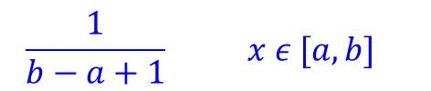
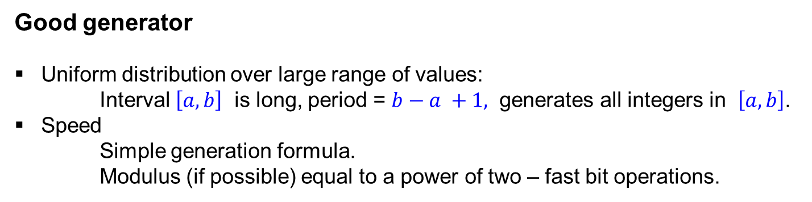
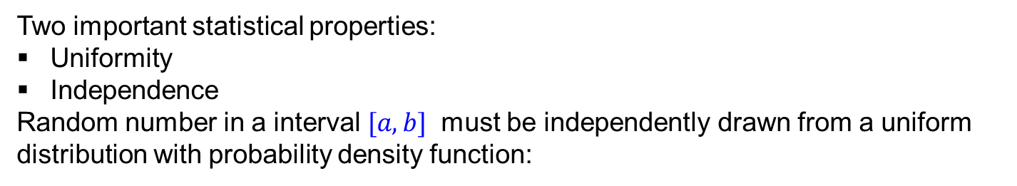



Pseudorandom number generator
Pseudorandom integer generator
Two important statistical properties:
Uniformity
Independence
Random number in a interval $[a, b]$ must be independently drawn from a uniform distribution with probability density function:
$$\frac{1}{b−a+1} x ε [a, b]$$
$$f\left(x\right)=$$
$$0$$
$$elsewhere$$
Good generator
Uniform distribution over large range of values:
Interval $\left[a, b\right]$ is long, period = $b−a +1,$ generates all integers in $\left[a, b\right]$.
Speed
Simple generation formula.
Modulus (if possible) equal to a power of two – fast bit operations.
Advanced Algorithms, A4M33PAL, ZS 20152016, FEL ČVUT
3

Slide 6
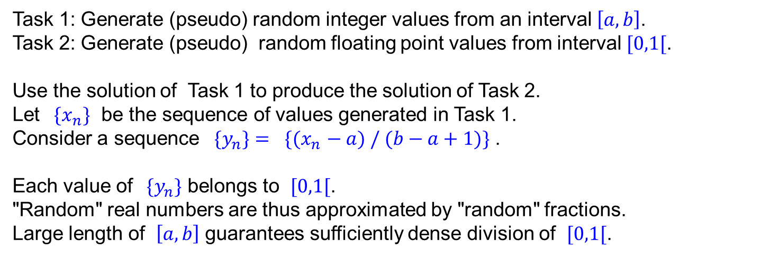
Pseudorandom number generator
Random floating point number generator
Task 1: Generate (pseudo) random integer values from an interval $\left[a, b\right]$.
Task 2: Generate (pseudo) random floating point values from interval $[0,1[$.
Use the solution of Task 1 to produce the solution of Task 2.
Let ${ \{x}_{n}\}$ be the sequence of values generated in Task 1.
Consider a sequence ${ \{y}_{n}\}{= \{(x}_{n}− a) / (b−a+1)\}$ .
Each value of ${ \{y}_{n}\}$ belongs to $[0,1[$.
"Random" real numbers are thus approximated by "random" fractions.
Large length of $\left[a, b\right]$ guarantees sufficiently dense division of $[0,1[$.
Example 1
$\left[a, b\right]=[0, 1024]$.
$${ \{x}_{n}\}=\{712, 84, 233, 269, 810, 944, …\}$$
${ \{y}_{n}\}$ $=$ {712/1023, 84/1023, 233/1023, 269/1023, 810/1023, 944/1023, ... }
= {0.696, 0.082, 0.228, 0.263, 0.792, 0,923, ...}
Advanced Algorithms, A4M33PAL, ZS 20152016, FEL ČVUT
4

Slide 7






Linear Congruential Generator
Linear congruential generator
Linear congruential generator produces a sequence defined by relations
${ \{x}_{n}\}$
$0{≤x}_{0}<M,$
$x_{n+1}=\left(Ax_{n}+C\right) mod M, n≥0.$
Modulus
$M,$
seed
$x_{0},$
multiplier and increment
$A,C .$
Example 2
$M=18, A=7, C=5.$
$x_{0}=4,$
$x_{n+1}=\left(7x_{n}+5\right) mod 18, n≥0.$
$\left\{x_{n}\right\}=$
4, 15, 2, 1, 12, 17, 16, 9, 14, 13, 6, 11, 10, 3, 8, 7, 0, 5, 4, 15, 2, 1, 12, 17, 16, ...
sequence period, length = 18
Advanced Algorithms, A4M33PAL, ZS 20152016, FEL ČVUT
5

Slide 8



Linear Congruential Generator
Example 3
$M=15, A=11, C=6.$
$x_{0}=8,$
$x_{n+1}=\left(11x_{n}+6\right) mod 15, n≥0.$
$\left\{x_{n}\right\}=$
8, 14, 5, 11, 2, 8, 14, 5, 11, 2, 8, 14, ...
sequence period, length = 5
Example 4
$M=13, A=5, C=11.$
$$x_{0}=7,$$
$x_{n+1}=\left(5x_{n}+11\right) mod 13, n≥0.$
$\left\{x_{n}\right\}=$
7, 7, 7, 7, 7, ...
sequence period, length = 1
Advanced Algorithms, A4M33PAL, ZS 20152016, FEL ČVUT
6

Slide 9






Linear Congruential Generator
Misconception
Prime numbers are "more random" than composite numbers, therefore
using prime numbers in a generator improves randomness.
Counterexample: Example 4, all parameters are primes:
$$x_{0}=7,$$
$x_{n+1}=\left(5x_{n}+11\right) mod 13.$
Maximum period length
Hull-Dobell Theorem:
The lenght of period is maximum, i.e. equal to M, iff conditions 1. - 3. hold:
1. C and M are coprimes.
2. A−1 is divisible by each prime factor of M.
3. If 4 divides M then also 4 divides A−1.
Example 5
1.
$M=18, A= 7, C=6.$
Condition 1. violated
2.
$M=20, A=17, C=7.$
Condition 2. violated
3.
$M=17, A= 7, C=6.$
Condition 2. violated
4.
$M=20, A=11, C=7.$
Condition 3. violated
5.
$M=18, A= 7, C=5.$
All three conditions hold
Advanced Algorithms, A4M33PAL, ZS 20152016, FEL ČVUT
7

Slide 10
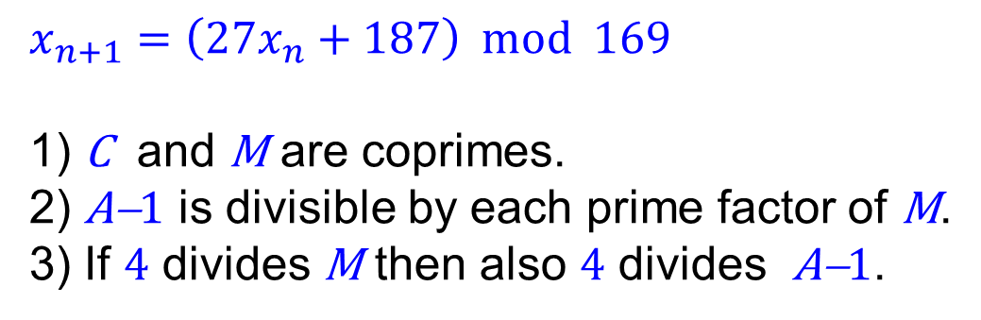
Linear Congruential Generator
$$x_{n+1}=\left(27x_{n}+187\right) mod 169$$
1) C and M are coprimes.
2) A−1 is divisible by each prime factor of M.
3) If 4 divides M then also 4 divides A−1.
Advanced Algorithms, A4M33PAL, ZS 20152016, FEL ČVUT
7

Slide 11

Vyberte správnou odpověď.
ⓘ Start presenting to display the poll results on this slide.

Slide 12





Linear Congruential Generator
Randomness issues
Example 6
$x_{0}=4,$
$x_{n+1}=\left(7x_{n}+5\right) mod 18, n≥0.$
$\left\{x_{n}\right\}=$
4, 15, 2, 1, 12, 17, 16, 9, 14, 13, 6, 11, 10, 3, 8, 7, 0, 5, 4, 15, 2, 1, 12, 17, 16, ...
sequence period, length = 18
$\left\{x_{n} mod 2\right\}=$
0, 1, 0, 1, 0, 1, 0, 1, 0, 1, 0, 1, 0, 1, 0, 1, 0, 1, 0, 1, 0, 1, 0, 1, 0, ...
$\left\{x_{n} mod 3\right\}=$
1, 0, 2, 1, 0, 2, 1, 0, 2, 1, 0, 2, 1, 0, 2, 1, 0 ,2, 1, 0, 2, 1, 0, 2, 1, ...
$\left\{x_{n} div 4\right\}=$
0, 3, 0, 0, 3, 4, 4, 2, 3, 3, 1, 2, 2, 0, 2, 1, 0 ,1, 0, 3, 0, 0, 3, 4, 4, ...
Trouble
Low order bits of values generated by LCG exhibit significant lack of randomness.
Remedy
Disregard the lower bits in the output (not in the generation process!).
Output the sequence , where H $≥$ ¼ log₂(M).
$\left\{y_{n}\right\}=\left\{x_{n} div 2^{H}\right\}$
Advanced Algorithms, A4M33PAL, ZS 20152016, FEL ČVUT
8

Slide 13
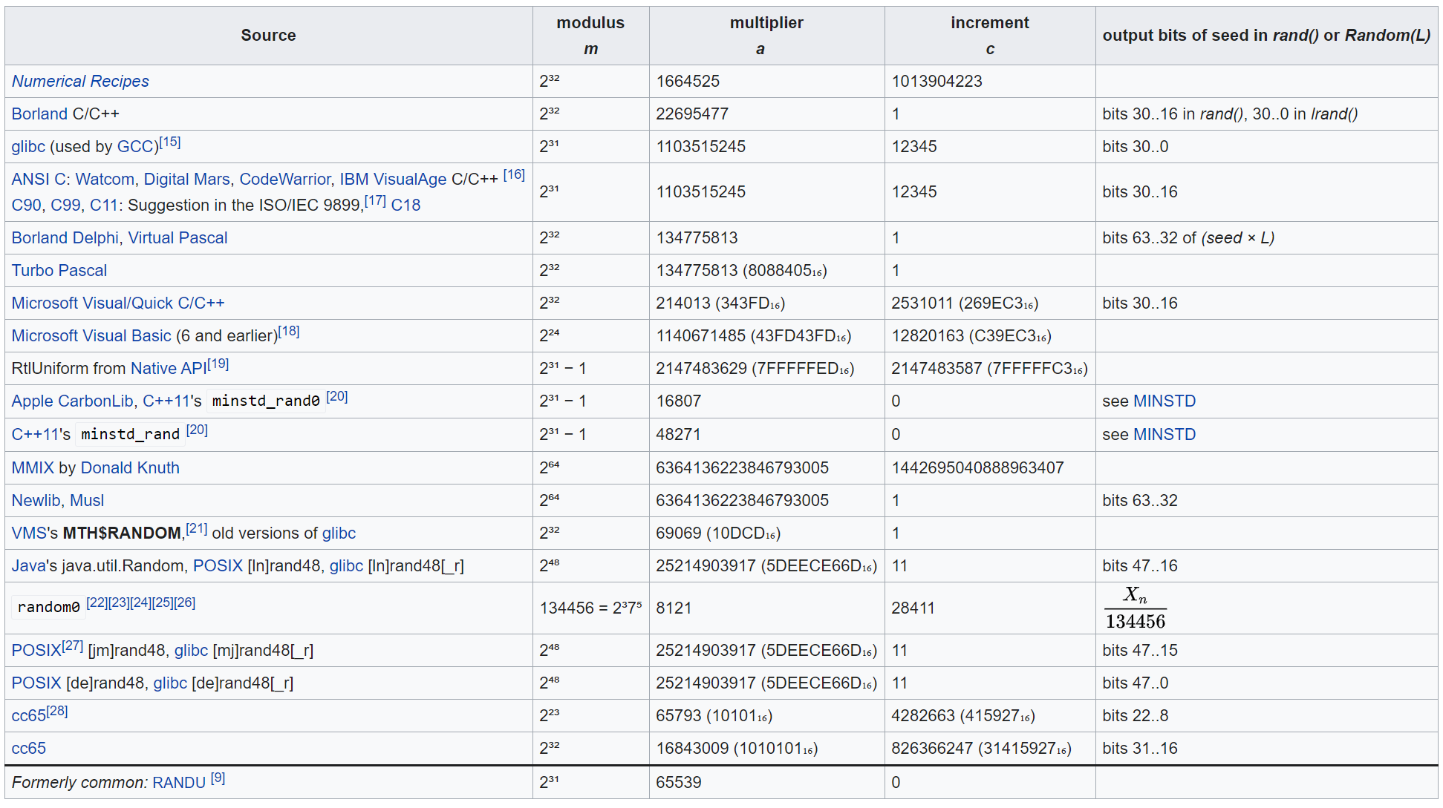
Examples of LCGs in common use
https://en.wikipedia.org/wiki/Linear_congruential_generator
Advanced Algorithms, A4M33PAL, ZS 20152016, FEL ČVUT
9

Slide 14

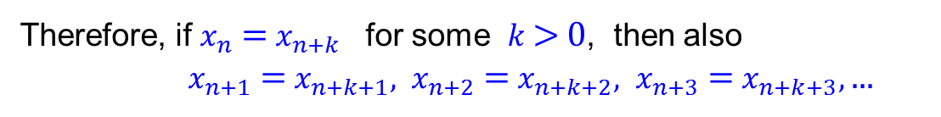
Sequence period
Many generators produce a sequence {$x_{n}$} defined by the general recurrence rule
$x_{n+1}=f(x_{n}) n≥0.$
Therefore, if $x_{n}$ = $x_{n+k}$ for some $k$> 0, then also
$x_{n+1} \text{=} x_{n+k+1}, x_{n+2}$ = $x_{n+k+2}, x_{n+3}$ = $x_{n+k+3},$ ...
Sequence period
Subsequence of minimum possible length p > 0, $\{x_{n}\text{,} x_{n+1}, x_{n+2}$, ${… x}_{n+p−1}\}$
such that for any $n≥0$: $x_{n}=x_{n+p}$ .
Advanced Algorithms, A4M33PAL, ZS 20152016, FEL ČVUT
10

Slide 15
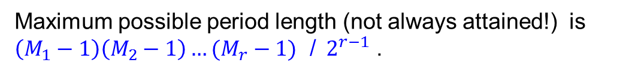
Combined Linear Congruential Generator
Definition
Let there be r linear congruential generators defined by relations
$0{≤y}_{k,0}< M_{k}$
$y_{k,n+1}=\left(A_{k}y_{k,n}+C_{k}\right) mod M_{k}, n≥0,$
$1 ≤k ≤r.$
The combined linear congruential generator is a sequence${ \{x}_{n}\}$ defined by
$x_{n}={(y}_{1,n} − y_{2,n}+ y_{3,n} −y_{4,n} + ...{ \left(−1\right)}^{r−1} ∙y_{r,n} ) mod (M_{1}−1), n≥0.$
Fact
Maximum possible period length (not always attained!) is
$\left(M_{1}−1\right)\left(M_{2}−1\right)…(M_{r}−1)$ /${ 2}^{r−1}$ .
Example 7
$r=2, { 1≤ y}_{1,0} ≤ 2147483562, 1≤ { y}_{2,0} ≤ 2147483398$
$y_{1,n+1}=\left(40014y_{1,n}+0\right) mod 2147483563, n≥0,$
$y_{2,n+1}=\left(40692y_{2,n}+0\right) mod 2147483399, n≥0,$
$x_{n}={(y}_{1,n} − y_{2,n}) mod 2147483562, n≥0.$
Period length is $\frac{\left(M_{1}−1\right)\left(M_{2}−1\right)}{2}=2305842648436451838$ .
Advanced Algorithms, A4M33PAL, ZS 20152016, FEL ČVUT
11

Slide 16
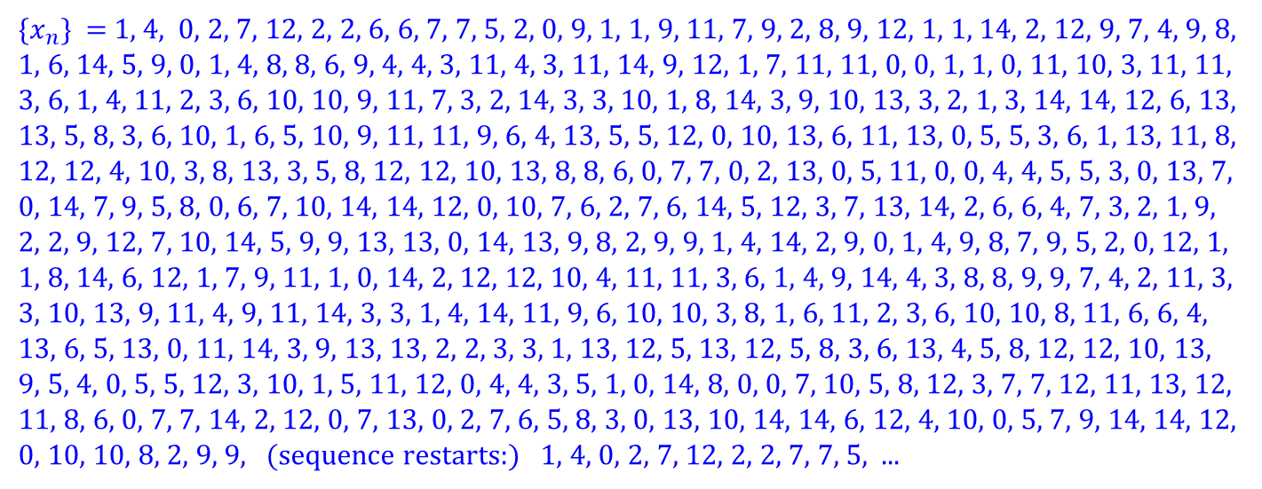
Combined Linear Congruential Generator
Example 8
$r=3, { y}_{1,0}= y_{2,0} {=y}_{3,0} =1,$
$y_{1,n+1}=\left(9y_{1,n}+11\right) mod 16, n≥0,$
$y_{2,n+1}=\left(7y_{2,n}+5\right) mod 18, n≥0,$
$y_{3,n+1}=\left(4y_{3,n}+8\right) mod 27, n≥0,$
$x_{n}={(y}_{1,n} − y_{2,n}+ y_{3,n} ) mod 15, n≥0.$
${\{x}_{n}\}$ = 1, 4, 0, 2, 7, 12, 2, 2, 6, 6, 7, 7, 5, 2, 0, 9, 1, 1, 9, 11, 7, 9, 2, 8, 9, 12, 1, 1, 14, 2, 12, 9, 7, 4, 9, 8, 1, 6, 14, 5, 9, 0, 1, 4, 8, 8, 6, 9, 4, 4, 3, 11, 4, 3, 11, 14, 9, 12, 1, 7, 11, 11, 0, 0, 1, 1, 0, 11, 10, 3, 11, 11, 3, 6, 1, 4, 11, 2, 3, 6, 10, 10, 9, 11, 7, 3, 2, 14, 3, 3, 10, 1, 8, 14, 3, 9, 10, 13, 3, 2, 1, 3, 14, 14, 12, 6, 13, 13, 5, 8, 3, 6, 10, 1, 6, 5, 10, 9, 11, 11, 9, 6, 4, 13, 5, 5, 12, 0, 10, 13, 6, 11, 13, 0, 5, 5, 3, 6, 1, 13, 11, 8, 12, 12, 4, 10, 3, 8, 13, 3, 5, 8, 12, 12, 10, 13, 8, 8, 6, 0, 7, 7, 0, 2, 13, 0, 5, 11, 0, 0, 4, 4, 5, 5, 3, 0, 13, 7, 0, 14, 7, 9, 5, 8, 0, 6, 7, 10, 14, 14, 12, 0, 10, 7, 6, 2, 7, 6, 14, 5, 12, 3, 7, 13, 14, 2, 6, 6, 4, 7, 3, 2, 1, 9, 2, 2, 9, 12, 7, 10, 14, 5, 9, 9, 13, 13, 0, 14, 13, 9, 8, 2, 9, 9, 1, 4, 14, 2, 9, 0, 1, 4, 9, 8, 7, 9, 5, 2, 0, 12, 1, 1, 8, 14, 6, 12, 1, 7, 9, 11, 1, 0, 14, 2, 12, 12, 10, 4, 11, 11, 3, 6, 1, 4, 9, 14, 4, 3, 8, 8, 9, 9, 7, 4, 2, 11, 3, 3, 10, 13, 9, 11, 4, 9, 11, 14, 3, 3, 1, 4, 14, 11, 9, 6, 10, 10, 3, 8, 1, 6, 11, 2, 3, 6, 10, 10, 8, 11, 6, 6, 4, 13, 6, 5, 13, 0, 11, 14, 3, 9, 13, 13, 2, 2, 3, 3, 1, 13, 12, 5, 13, 12, 5, 8, 3, 6, 13, 4, 5, 8, 12, 12, 10, 13, 9, 5, 4, 0, 5, 5, 12, 3, 10, 1, 5, 11, 12, 0, 4, 4, 3, 5, 1, 0, 14, 8, 0, 0, 7, 10, 5, 8, 12, 3, 7, 7, 12, 11, 13, 12, 11, 8, 6, 0, 7, 7, 14, 2, 12, 0, 7, 13, 0, 2, 7, 6, 5, 8, 3, 0, 13, 10, 14, 14, 6, 12, 4, 10, 0, 5, 7, 9, 14, 14, 12, 0, 10, 10, 8, 2, 9, 9, (sequence restarts:) 1, 4, 0, 2, 7, 12, 2, 2, 7, 7, 5, ...
Period length is $432<15∙17∙26 / 4$ .
Advanced Algorithms, A4M33PAL, ZS 20152016, FEL ČVUT
12

Slide 17







Lehmer Generator
Lehmer generator produces sequence defined by relations
${\{x}_{n}\}$
$0{<x}_{0}< M,$
$x_{0} coprime to M.$
$x_{n+1}=Ax_{n} mod M, n≥0.$
Modulus
$M,$
seed
$x_{0},$
multiplier
$A .$
Example 9
$x_{0}=1,$
$x_{n+1}=6x_{n} mod 13.$
$\left\{x_{n}\right\}=$
1, 6, 10, 8, 9, 2, 12, 7, 3, 5, 4, 11, 1, 6, 10, 8, 9, 2, 12, ...
sequence period, length = 12
Example 10
$x_{0}=2,$
$x_{n+1}=5x_{n} mod 13.$
$\left\{x_{n}\right\}=$
2, 10, 11, 3, 2, 10, 11, 3, 2, 10, 11, 3, ...
sequence period, length = 4
Advanced Algorithms, A4M33PAL, ZS 20152016, FEL ČVUT
13

Slide 18
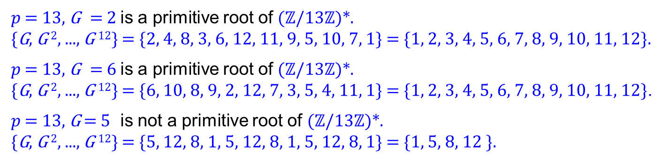
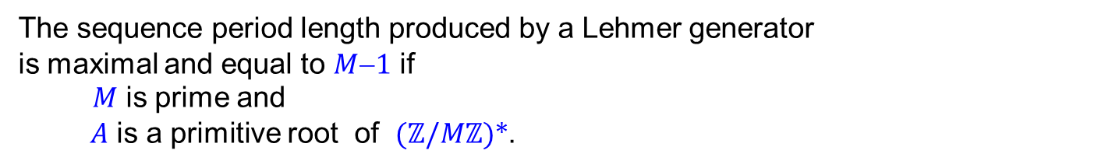

Lehmer Generator
$0{<x}_{0} < M,$
$x_{0} coprime to M.$
$x_{n+1}=Ax_{n} mod M, n≥0.$
Fact
The sequence period length produced by a Lehmer generator
is maximal and equal to $M$−$1$ if
$M$ is prime and
$A$ is a primitive root of ($ℤ$/$Mℤ$)*.
Notation Multiplicative group of integers modulo prime $p$: ($ℤ$/$pℤ$)*
Primitive root G is a primitive root of ($ℤ$/$pℤ$)* if
{G, G ², G ³, ..., G ^{p−1}} = {$1, 2, 3,$ ..., $p$−$1$} (powers are taken modulo $p$).
Example 11
$p$ = 13, G = 2 is a primitive root of ($ℤ$/13$ℤ$)*.
{G, G ², ..., G ¹²} = {2, 4, 8, 3, 6, 12, 11, 9, 5, 10, 7, 1} = {1, 2, 3, 4, 5, 6, 7, 8, 9, 10, 11, 12}.
$p$ = 13, G = 6 is a primitive root of ($ℤ$/13$ℤ$)*.
{G, G ², ..., G ¹²} = {6, 10, 8, 9, 2, 12, 7, 3, 5, 4, 11, 1} = {1, 2, 3, 4, 5, 6, 7, 8, 9, 10, 11, 12}.
$p$ = 13, G = 5 is not a primitive root of ($ℤ$/13$ℤ$)*.
{G, G ², ..., G ¹²} = {5, 12, 8, 1, 5, 12, 8, 1, 5, 12, 8, 1} = {1, 5, 8, 12 }.
Advanced Algorithms, A4M33PAL, ZS 20152016, FEL ČVUT
14

Slide 19
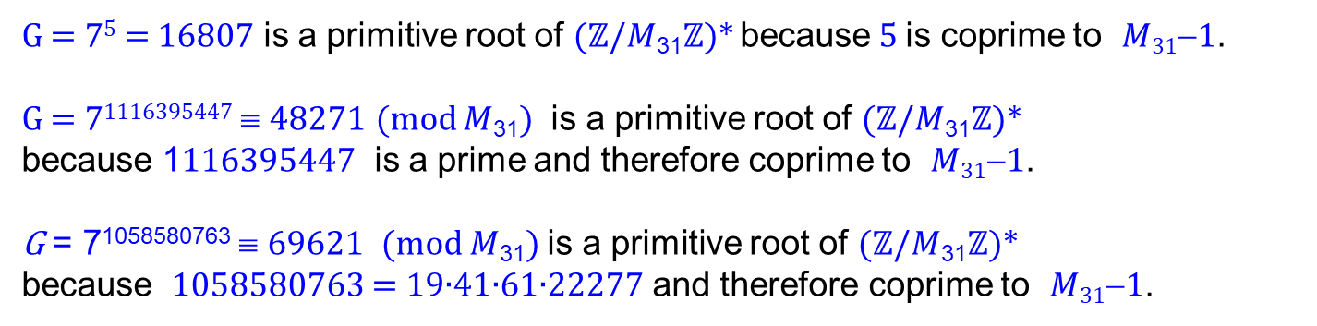
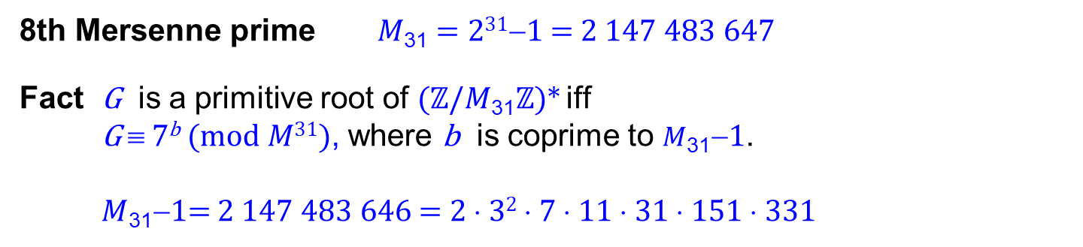
Lehmer Generator
Finding group primitive roots
No elementary and effective method is known. Some cases has been studied in detail.
8th Mersenne prime $M$₃₁ = 2³¹−1 = 2 147 483 647
Fact G is a primitive root of ($ℤ$/$M$₃₁$ℤ$)* iff
G ≡ 7^{b} (mod $M$³¹), where b is coprime to $M$₃₁−1.
$M$₃₁−1= 2 147 483 646 = 2 ⋅ 3² ⋅ 7 ⋅ 11 ⋅ 31 ⋅ 151 ⋅ 331
Example 12
G = 7⁵ = 16807 is a primitive root of ($ℤ$/$M$₃₁$ℤ$)* because 5 is coprime to $M$₃₁−1.
G = 7¹¹¹⁶³⁹⁵⁴⁴⁷ ≡ 48271 (mod $M$₃₁) is a primitive root of ($ℤ$/$M$₃₁$ℤ$)*
because 1116395447 is a prime and therefore coprime to $M$₃₁−1.
G = 7¹⁰⁵⁸⁵⁸⁰⁷⁶³ ≡ 69621 (mod $M$₃₁) is a primitive root of ($ℤ$/$M$₃₁$ℤ$)*
because 1058580763 = 19∙41∙61∙22277 and therefore coprime to $M$₃₁−1.
Advanced Algorithms, A4M33PAL, ZS 20152016, FEL ČVUT
15

Slide 20
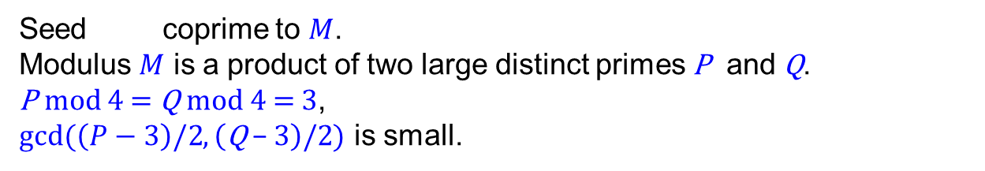








Blum Blum Shub Generator
Blum Blum Shub generator produces sequence defined by relations
${\{x}_{n}\}$
$2{≤x}_{0} < M,$
$x_{0} coprime to M.$
$$x_{n+1}=$$
$$x_{n}^{2} mod M$$
Modulus
$M,$
seed
$x_{0}.$
Seed coprime to $M$.
Modulus $M$ is a product of two large distinct primes P and Q.
P mod 4 = Q mod 4 = 3,
gcd($\left(P−3\right)/2$, $\left(\text{Q} \text{−} \text{3}\right)/2$) is small.
$x_{0}$
Example 13
$x_{0}=4, M=11∙47, \text{gcd}\text{(4, 22)}=2,$
$$x_{n+1}=$$
$x_{n}^{2} mod 517$.
$\left\{x_{n}\right\}=$
4, 16, 256, 394, 136, 401, 14, 196, 158, 148, 190, 427, 345, 115, 300, 42, 213, 390, 102, 64, 477, 49, 333, 251, 444, 159, 465, 119, 202, 478, 487, 383, 378, 192, 157, 350, 488, 324, 25, 108, 290, 346, 289, 284, 4, 16, 256, 394, 136, ...
sequence period, length = 44
Advanced Algorithms, A4M33PAL, ZS 20152016, FEL ČVUT
16

Slide 21
Audience Q&A Session
ⓘ Start presenting to display the audience questions on this slide.

Slide 22





Algebrogram
Advanced Algorithms, A4M33PAL, ZS 20152016, FEL ČVUT
17

Slide 23

Vyřešte algebrogram.
ⓘ Start presenting to display the poll results on this slide.

Slide 24
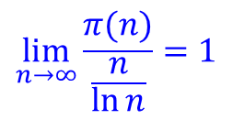

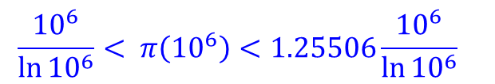

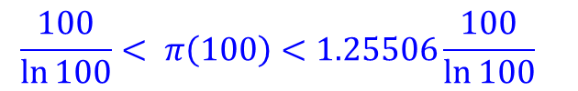
Primes related notions
Prime counting function π(n)
Counts the number of prime numbers less than or equal to n.
Example 14
π(10) = 4. Primes less than or equal to 10: 2, 3, 5, 7.
π(37) = 12. Primes less than or equal to 37: 2, 3, 5, 7, 11, 13, 17, 19, 23, 29, 31, 37.
π(100) = 25. Primes less than or equal to 100: 2, 3, 5, 7, 11, 13, 17, 19, 23, 29, 31, 37, 41,
43, 47, 53, 59, 61, 67, 71, 73, 79, 83, 89, 97.
Estimate
$$\frac{n}{\ln{n}}< π\left(n\right)<1.25506\frac{n}{\ln{n}} for n>16.$$
Example 15
$$\frac{100}{\ln{100}}< π\left(100\right)<1.25506\frac{100}{\ln{100}}$$
$$\frac{{10}^{6}}{\ln{{10}^{6}}}< π\left({10}^{6}\right)<1.25506\frac{{10}^{6}}{\ln{{10}^{6}}}$$
$$21.715< π\left(100\right)=25 <27.253$$
$$72382.4< π\left({10}^{6}\right)=78498<90844.3$$
Limit behaviour
$$\lim_{n→∞}{\frac{π(n)}{\frac{n}{\ln{n}}}=1}$$
Prime number theorem:
Advanced Algorithms, A4M33PAL, ZS 20152016, FEL ČVUT
18

Slide 25
Sieve of Eratosthenes
1 | 2 | 3 | 4 | 5 | 6 | 7 | 8 | 9 | 10
11 | 12 | 13 | 14 | 15 | 16 | 17 | 18 | 19 | 20
21 | 22 | 23 | 24 | 25 | 26 | 27 | 28 | 29 | 30
31 | 32 | 33 | 34 | 35 | 36 | 37 | 38 | 39 | 40
41 | 42 | 43 | 44 | 45 | 46 | 47 | 48 | 49 | 50
51 | 52 | 53 | 54 | 55 | 56 | 57 | 58 | 59 | 60
61 | 62 | 63 | 64 | 65 | 66 | 67 | 68 | 69 | 70
71 | 72 | 73 | 74 | 75 | 76 | 77 | 78 | 79 | 80
81 | 82 | 83 | 84 | 85 | 86 | 87 | 88 | 89 | 90
91 | 92 | 93 | 94 | 95 | 96 | 97 | 98 | 99 | 100
Advanced Algorithms, A4M33PAL, ZS 20152016, FEL ČVUT
19

Slide 26
Sieve of Eratosthenes
1 | 2 | 3 | 4 | 5 | 6 | 7 | 8 | 9 | 10
11 | 12 | 13 | 14 | 15 | 16 | 17 | 18 | 19 | 20
21 | 22 | 23 | 24 | 25 | 26 | 27 | 28 | 29 | 30
31 | 32 | 33 | 34 | 35 | 36 | 37 | 38 | 39 | 40
41 | 42 | 43 | 44 | 45 | 46 | 47 | 48 | 49 | 50
51 | 52 | 53 | 54 | 55 | 56 | 57 | 58 | 59 | 60
61 | 62 | 63 | 64 | 65 | 66 | 67 | 68 | 69 | 70
71 | 72 | 73 | 74 | 75 | 76 | 77 | 78 | 79 | 80
81 | 82 | 83 | 84 | 85 | 86 | 87 | 88 | 89 | 90
91 | 92 | 93 | 94 | 95 | 96 | 97 | 98 | 99 | 100
Advanced Algorithms, A4M33PAL, ZS 20152016, FEL ČVUT
20

Slide 27
Sieve of Eratosthenes
1 | 2 | 3 | 4 | 5 | 6 | 7 | 8 | 9 | 10
11 | 12 | 13 | 14 | 15 | 16 | 17 | 18 | 19 | 20
21 | 22 | 23 | 24 | 25 | 26 | 27 | 28 | 29 | 30
31 | 32 | 33 | 34 | 35 | 36 | 37 | 38 | 39 | 40
41 | 42 | 43 | 44 | 45 | 46 | 47 | 48 | 49 | 50
51 | 52 | 53 | 54 | 55 | 56 | 57 | 58 | 59 | 60
61 | 62 | 63 | 64 | 65 | 66 | 67 | 68 | 69 | 70
71 | 72 | 73 | 74 | 75 | 76 | 77 | 78 | 79 | 80
81 | 82 | 83 | 84 | 85 | 86 | 87 | 88 | 89 | 90
91 | 92 | 93 | 94 | 95 | 96 | 97 | 98 | 99 | 100
Advanced Algorithms, A4M33PAL, ZS 20152016, FEL ČVUT
21

Slide 28
Sieve of Eratosthenes
1 | 2 | 3 | 4 | 5 | 6 | 7 | 8 | 9 | 10
11 | 12 | 13 | 14 | 15 | 16 | 17 | 18 | 19 | 20
21 | 22 | 23 | 24 | 25 | 26 | 27 | 28 | 29 | 30
31 | 32 | 33 | 34 | 35 | 36 | 37 | 38 | 39 | 40
41 | 42 | 43 | 44 | 45 | 46 | 47 | 48 | 49 | 50
51 | 52 | 53 | 54 | 55 | 56 | 57 | 58 | 59 | 60
61 | 62 | 63 | 64 | 65 | 66 | 67 | 68 | 69 | 70
71 | 72 | 73 | 74 | 75 | 76 | 77 | 78 | 79 | 80
81 | 82 | 83 | 84 | 85 | 86 | 87 | 88 | 89 | 90
91 | 92 | 93 | 94 | 95 | 96 | 97 | 98 | 99 | 100
Advanced Algorithms, A4M33PAL, ZS 20152016, FEL ČVUT
22

Slide 29
Sieve of Eratosthenes
1 | 2 | 3 | 4 | 5 | 6 | 7 | 8 | 9 | 10
11 | 12 | 13 | 14 | 15 | 16 | 17 | 18 | 19 | 20
21 | 22 | 23 | 24 | 25 | 26 | 27 | 28 | 29 | 30
31 | 32 | 33 | 34 | 35 | 36 | 37 | 38 | 39 | 40
41 | 42 | 43 | 44 | 45 | 46 | 47 | 48 | 49 | 50
51 | 52 | 53 | 54 | 55 | 56 | 57 | 58 | 59 | 60
61 | 62 | 63 | 64 | 65 | 66 | 67 | 68 | 69 | 70
71 | 72 | 73 | 74 | 75 | 76 | 77 | 78 | 79 | 80
81 | 82 | 83 | 84 | 85 | 86 | 87 | 88 | 89 | 90
91 | 92 | 93 | 94 | 95 | 96 | 97 | 98 | 99 | 100
Advanced Algorithms, A4M33PAL, ZS 20152016, FEL ČVUT
23

Slide 30

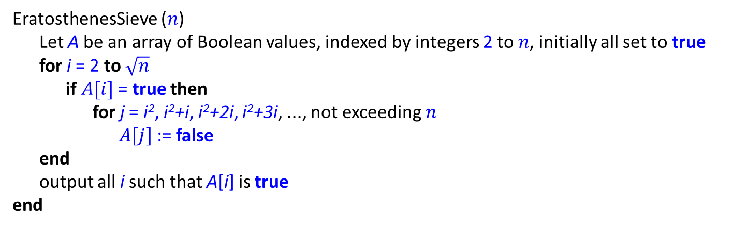
Sieve of Eratosthenes
Algorithm
EratosthenesSieve ($n$)
Let A be an array of Boolean values, indexed by integers 2 to $n$, initially all set to true
for i = 2 to$\sqrt{n}$
if $A[i]$ = true then
for j = i², i²+i, i²+2i, i²+3i, ..., not exceeding $n$
$A[j]$ := false
end
output all i such that A[i] is true
end
Time complexity: $O(n log log n)$.
Advanced Algorithms, A4M33PAL, ZS 20152016, FEL ČVUT
24

Slide 31
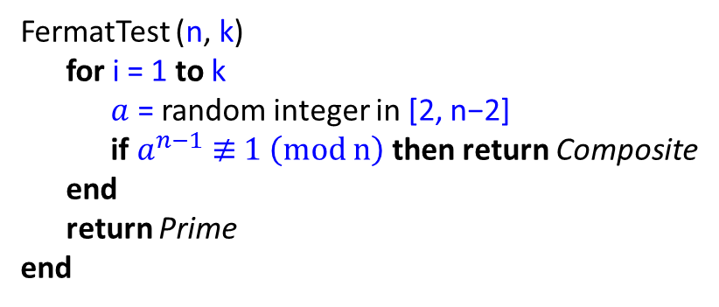

Randomized primality tests
n
Composite (definitely)
General scheme
Test
Prime (most likely)
Fermat (little) theorem
If p is prime and 0 < $a$ < p, then $a_{}^{p−1 }\text{≡} 1 (mod p)$.
Fermat primality test
FermatTest (n, k)
for i = 1 to k
$a$ = random integer in [2, n$\text{−}$2]
if $a_{}^{n−1} \text{≢} 1 \left(mod n\right)$then return Composite
end
return Prime
end
Flaw There are infinitely many composite numbers for which the test always fails:
Carmichael numbers: 561, 1105, 1729, 2465, 2821, 6601, 8911, 10585, ....
(sequence A002997 in the OEIS )
Note OEIS = The On-Line Encyclopedia of Integer Sequences, ( https://oeis.org )
Advanced Algorithms, A4M33PAL, ZS 20152016, FEL ČVUT
25

Slide 32
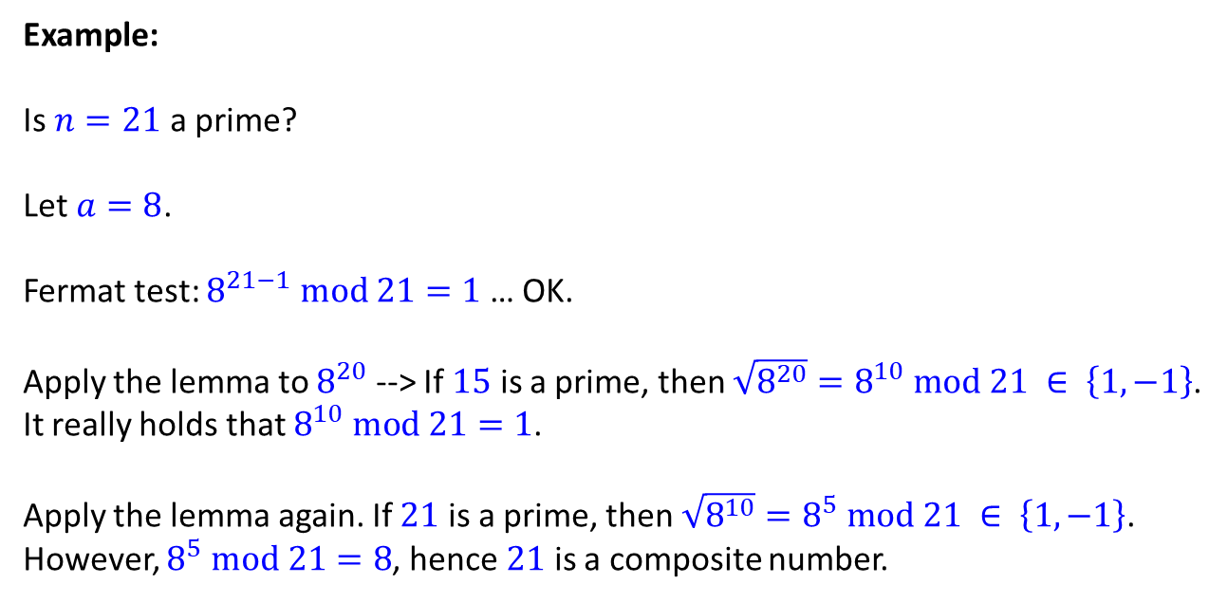
Randomized primality tests
Miller-Rabin primality test
Fermat: If p is prime and 0 < $a$ < p, then $a_{}^{p−1 }\text{≡} 1 (mod p)$.
Lemma: If p is prime and $x_{}^{2 }\text{≡} 1 (mod p)$ then $x \text{≡} 1 (mod p)$ or $x \text{≡} \text{−}1 (mod p)$.
Example:
Is $n=21$ a prime?
Let $a=8$.
Fermat test: $8^{21−1} \text{mod} 21=1$ … OK.
Apply the lemma to $8^{20}$ --> If $15$ is a prime, then $\sqrt{8^{20}}=8^{10} mod 21 ∈ \left\{1,−1\right\}$.
It really holds that $8^{10} mod 21=1$.
Apply the lemma again. If $21$ is a prime, then $\sqrt{8^{10}}=8^{5} mod 21 ∈ \left\{1,−1\right\}$.
However, $8^{5} mod 21=8$, hence $21$ is a composite number.
Advanced Algorithms, A4M33PAL, ZS 20152016, FEL ČVUT
26

Slide 33
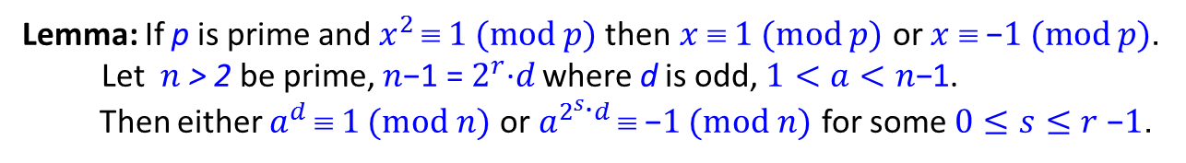


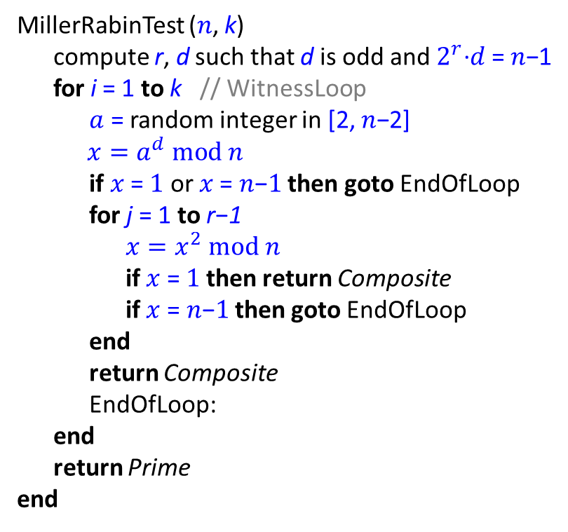
Randomized primality tests
Miller-Rabin primality test
Lemma: If p is prime and $x_{}^{2 }\text{≡} 1 (mod p)$ then $x_{}^{ }\text{≡} 1 (mod p)$ or $x_{}^{ }\text{≡} \text{−}1 (mod p)$.
Let $n$ > 2 be prime, ${n\text{−1} \text{=} 2}_{}^{r}\text{·}d \text{where}$ d is odd, $1<a<n\text{−}$1.
Then either $a_{}^{d }\text{≡} 1$ $(mod n)$ or $a_{}^{2_{}^{s}\text{·}d }\text{≡} \text{−}1$ $(mod n)$ for some $0≤s≤r$ $\text{−}1$.
MillerRabinTest ($n$, k)
compute r, d such that d is odd and $2_{}^{r}\text{·}d$ = $n\text{−}$1
for i = 1 to k // WitnessLoop
$a$ = random integer in [2, $n\text{−}$2]
${ x=a}_{}^{d} mod n$
if $x \text{=} 1 \text{or} x \text{=} n\text{−}1$ then goto EndOfLoop
for j = 1 to r$\text{−}$1
${x=x}_{}^{2} mod n$
if $x \text{=} 1$ then return Composite
if $x \text{=} n\text{−}1$ then goto EndOfLoop
end
return Composite
EndOfLoop:
end
return Prime
end
Examples:
$$n \text{=}\text{ 1105 =}{\text{2}}_{}^{4}\text{·}\text{69+1}$$
$a$ = 389
$x_{0}$ $\text{=}\text{ 1039}$
$x_{1}$ $\text{=} \text{1041}$
$x_{2}$ $\text{=} \text{781}$
$x_{3}$ $\text{=} \text{1}$ -> Composite
$$n \text{=} \text{1105} \text{=}{\text{2}}_{}^{4}\text{·}\text{69+1}$$
$a$ = 390
$x_{0}$ $\text{=} \text{539}$
$x_{1}$ $\text{=} \text{10}\text{1}\text{1}$
$x_{2}$ $\text{=} \text{1101}$
$x_{3}$ $\text{=} \text{1}\text{6}$
-> Composite
$$n \text{=}\text{ 13 =}{\text{2}}_{}^{2}\text{·}\text{3+1}$$
$a$ = 7
$x_{0}$ $\text{=}\text{ 5}$
$x_{1}$ $\text{=} \text{12 }\text{≡} \text{−1 (}\text{mod}\text{ 13)}$
WitnessLoop passes
Advanced Algorithms, A4M33PAL, ZS 20152016, FEL ČVUT
27

Slide 34
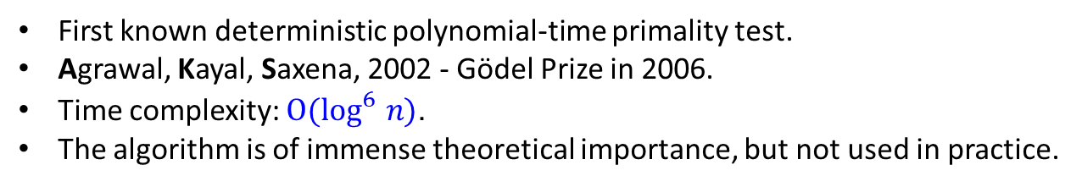
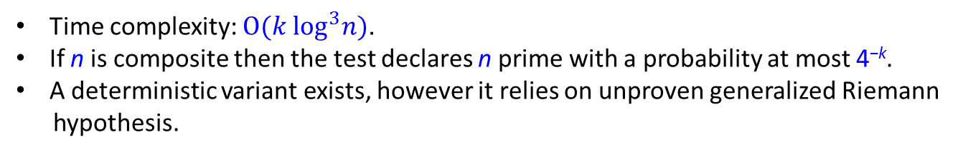
Randomized primality tests
Miller-Rabin primality test
Time complexity: $O(k \log_{}^{3}n)$.
If n is composite then the test declares n prime with a probability at most 4^{−k}.
A deterministic variant exists, however it relies on unproven generalized Riemann
hypothesis.
AKS primality test
First known deterministic polynomial-time primality test.
Agrawal, Kayal, Saxena, 2002 - Gödel Prize in 2006.
Time complexity: $O(\log_{}^{6}n)$.
The algorithm is of immense theoretical importance, but not used in practice.
Advanced Algorithms, A4M33PAL, ZS 20152016, FEL ČVUT
28

Slide 35
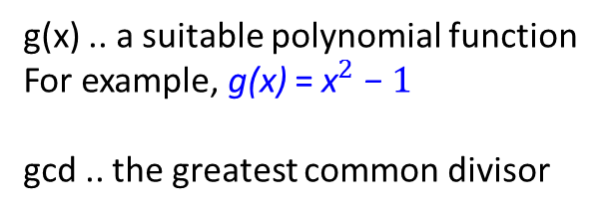
Integer factorization
Difficulty of the problem
No efficient algorithm is known.
The presumed difficulty is at the heart of widely used algorithms in cryptography (RSA).
Pollard’s rho algorithm
Effective for a composite number having a small prime factor.
PollardRho (n)
x = y = 2; d = 1
while d = 1
x = g(x) mod n
y = g(g(y)) mod n
d = gcd (|x-y|, n)
end
if d = n return Failure
else return d
end
g(x) .. a suitable polynomial function
For example, g(x) = ${\text{x}}_{}^{2} \text{−} 1$
gcd .. the greatest common divisor
Advanced Algorithms, A4M33PAL, ZS 20152016, FEL ČVUT
29

Slide 36
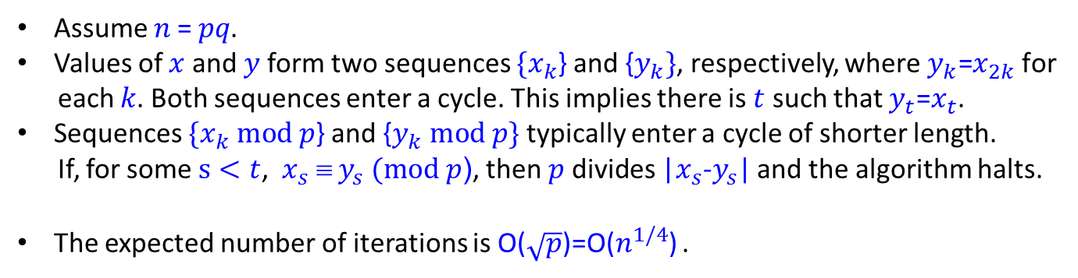
Integer factorization
Pollard’s rho algorithm – analysis
Assume $n \text{=} pq\text{.}$
Values of $x$ and $y$form two sequences $\{x_{k}$} and {$y_{k}\}$, respectively, where $y_{k}\text{=}x_{2k} \text{for}$
$\text{each}$ $k\text{.}$ Both sequences enter a cycle. This implies there is $t$ such that $y_{t}\text{=}x_{t}\text{.}$
Sequences $\{x_{k} mod p$} and {$y_{k} mod p\}$ typically enter a cycle of shorter length.
If, for some $s<t$, ${x_{s}}_{}^{ }\text{≡}{ y}_{s} (mod p$), then $p \text{d}\text{i}\text{vides}$|$x_{s}$-$y_{s}$| and the algorithm halts.
The expected number of iterations is O($\sqrt{p}$)=O($n_{}^{1/4}$) .
References
T. H. Cormen, C. E. Leiserson, R. L. Rivest, C. Stein: Introduction to Algorithms,
3rd ed., MIT Press, 2009, Chapter 31 Number-Theoretic Algorithms
OEIS, The On-Line Encyclopedia of Integer Sequences (https://oeis.org)
Stephen K. Park, Keith W. MIller: Random number generators: good ones are hard to find,
Communications of the ACM, Volume 31 Issue 10, Oct. 1988
Pierre L'Ecuyer: Efficient and portable combined random number generators,
Communications of the ACM, Volume 31 Issue 6, June 1988
Advanced Algorithms, A4M33PAL, ZS 20152016, FEL ČVUT
30

Slide 37
Audience Q&A Session
ⓘ Start presenting to display the audience questions on this slide.

