Slide 1
fMR Processing(1)
Ing. Jan Šanda

Slide 2
fMR processing (1. excercise) Pipeline
Conversion of data: DICOM -> NIFTI ✓ (done; *.nii suffix)
Slice Timing: temporal correction (TR vs. HRF) ✗ (skipping this step)
Realignment of functional data - spatial correction of data in time
Smooth with Gauss filter kernel
Model specification + Review
Estimate Model
Results + Display
DICOM = Digital Imaging and Comminications in Medicine
NIFTI = Neuroimaging Informatics Technology Initiative

Slide 3
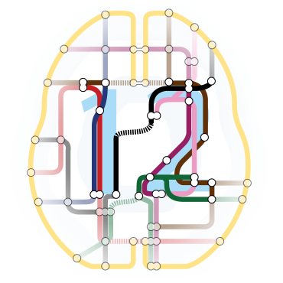
Necessary SW: Matlab + SPM12 toolbox (Win, MacOS)
Statistical Parametric Mapping
SPM12 download:
https://www.fil.ion.ucl.ac.uk/spm/software/spm12/
SPM12 manual:
„../toolbox/spm12/man/manual.pdf“
4 basic SPM windows: - Menu
- Results
- Graphic
- Batch Editor

Slide 4
Recommended resources
SPM12
https://www.fil.ion.ucl.ac.uk/spm/doc/
GLM
https://www.fil.ion.ucl.ac.uk/mfd_archive/2011/page1/mfd2011_GLM.pdf

Slide 5
fMR processing Data
Paradigm:
FingerTapping (upper extremities fingers) 150vol, TR=2000ms, 60 slices
Volunteer data: folders Subj01, Subj02, … Subj08
Folder structure: fMR_HK (150 nii-files: “fMR_hk_[XXX].nii”)
t1 (1 nii-file: “t1.nii”)
Subj01 | V-B | 2000 | 1.3.2023
Subj02 | P-D | 1999 | 1.3.2023
Subj03 | T-G | 1998 | 8.3.2023
Subj04 | P-K | 2000 | 15.3.2023
Subj05 | M-K | 2000 | 8.3.2023
Subj06 | K-P | 2000 | 8.3.2023
Subj07 | M-S | 2000 | 1.3.2023
Subj08 | J-V | 2000 | 15.3.2023

Slide 6
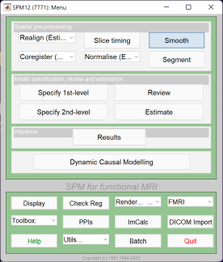
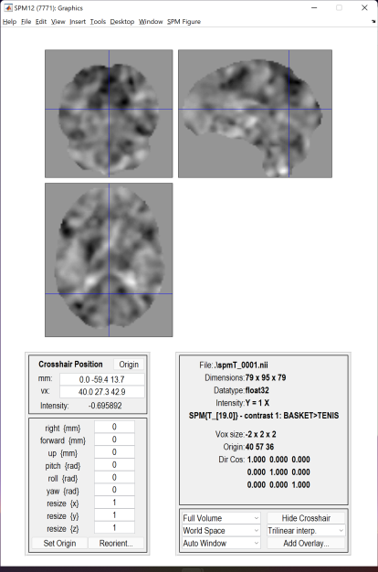
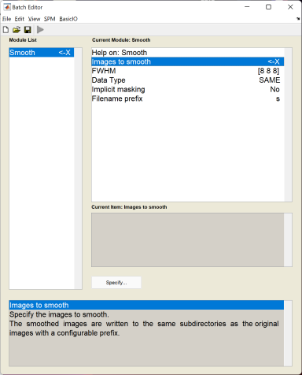
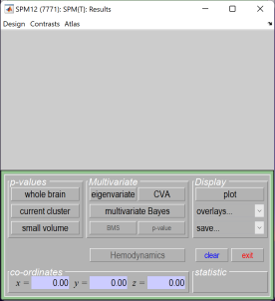

Slide 7
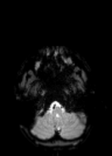
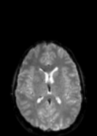
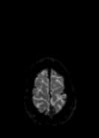
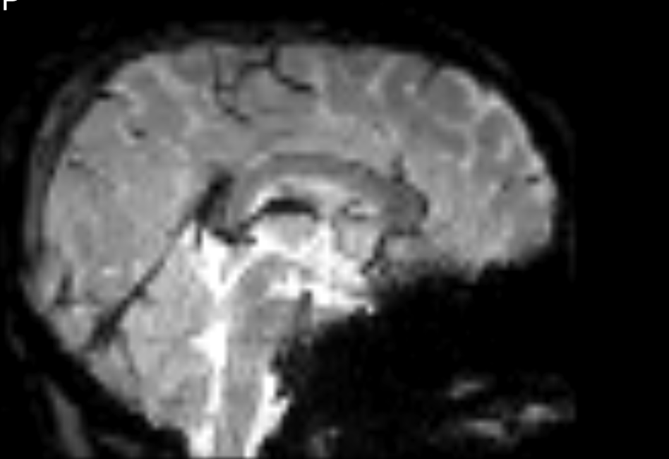
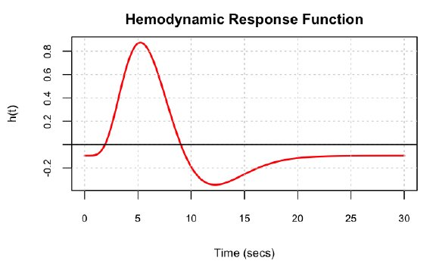
Slice timing (skipping this step, TR=2s)
1. volume
2. volume
3. volume
4. volume
. . . . .
60
TR = 6000ms
1

Slide 8
Realign data
This routine realigns a time-series of images acquired from the same subject using a least squares approach and a 6 parameter (rigid body) spatial transformation. The first image in the list specified by the user is used as a reference to which all subsequent scans are realigned. The reference scan does not have to the the first chronologically and it may be wise to chose a "representative scan" in this role.
The aim is primarily to remove movement artefact in fMRI and PET time-series (or more generally longitudinal studies). The headers are modified for each of the input images, such that. they reflect the relative orientations of the data. The details of the transformation are displayed in the results window as plots of translation and rotation. A set of realignment parameters are saved for each session, named rp_*.txt. These can be modelled as confounds within the general linear model

Slide 9
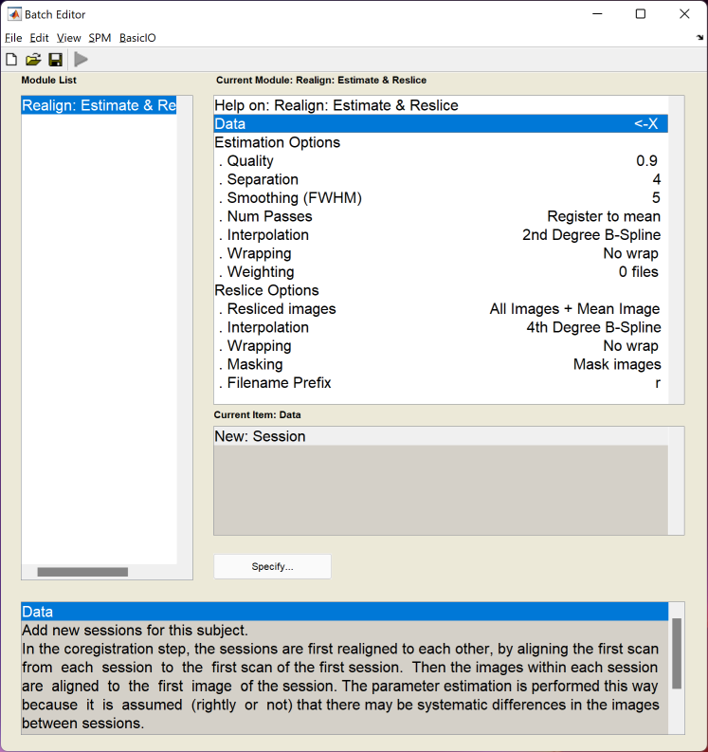
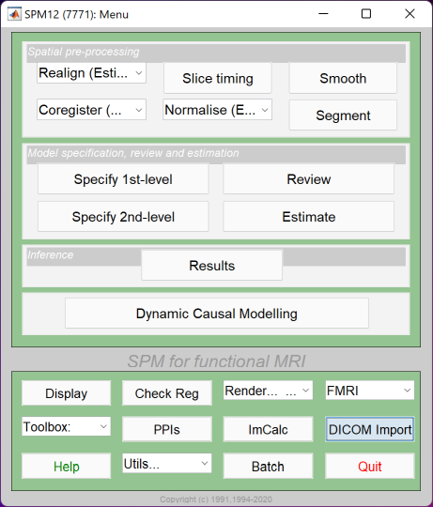
Realign data

Slide 10
Realign data
MENU: Realign (Estimate & Reslice)
BATCH EDITOR:
Data – Session … all fMR files
Run batch
Output:
Resliced files (prefix „r*.nii“)
„mean*.nii“ file (mean of all fMR files)
Realign parameters file „rp_*.txt“

Slide 11
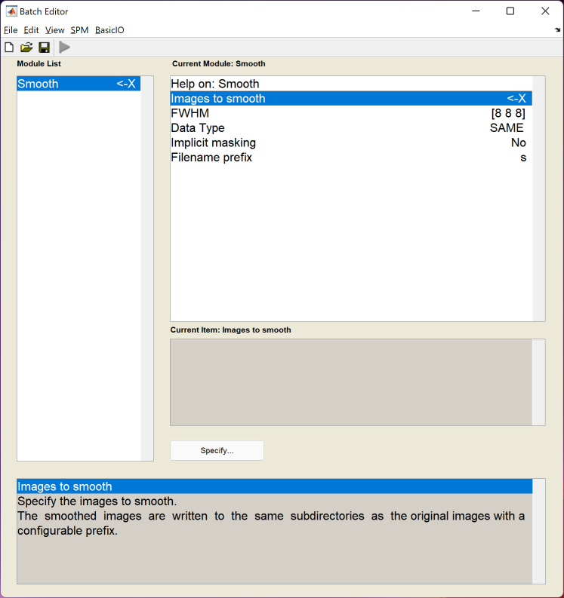
Smooth

Slide 12
Smooth
MENU: Smooth
BATCH EDITOR:
Images to smooth … select all r*.nii files
FWHM … [4 4 4] (Full width at half maximum of the Gaussian smoothing kernel in mm, doubled size of voxel recommended)
Run batch
Output:
Smoothed files (all with prefix „s*.nii“)

Slide 13
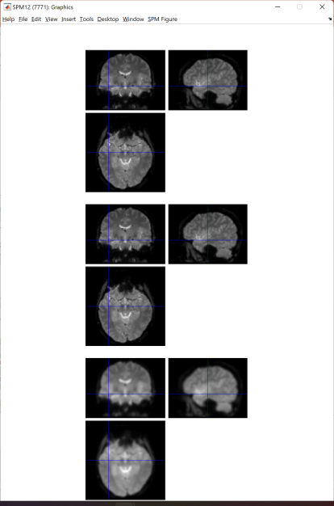
Data check (!)

Slide 14
GLM – General Linear Model
y = Xβ + e
Error (Residuals)
Variancein the data (y), which is not explained
By the linear combination of predictors (x)
Dependent variable
BOLD signal in particular voxels
Independent variable (Predictor)
Experiment conditions
Beta parameters (regression coeff.)
Quantifies how much each predictor (X)
independently influences
the dependent variable (Y)
https://www.fil.ion.ucl.ac.uk/mfd_archive/2011/page1/mfd2011_GLM.pdf

Slide 15
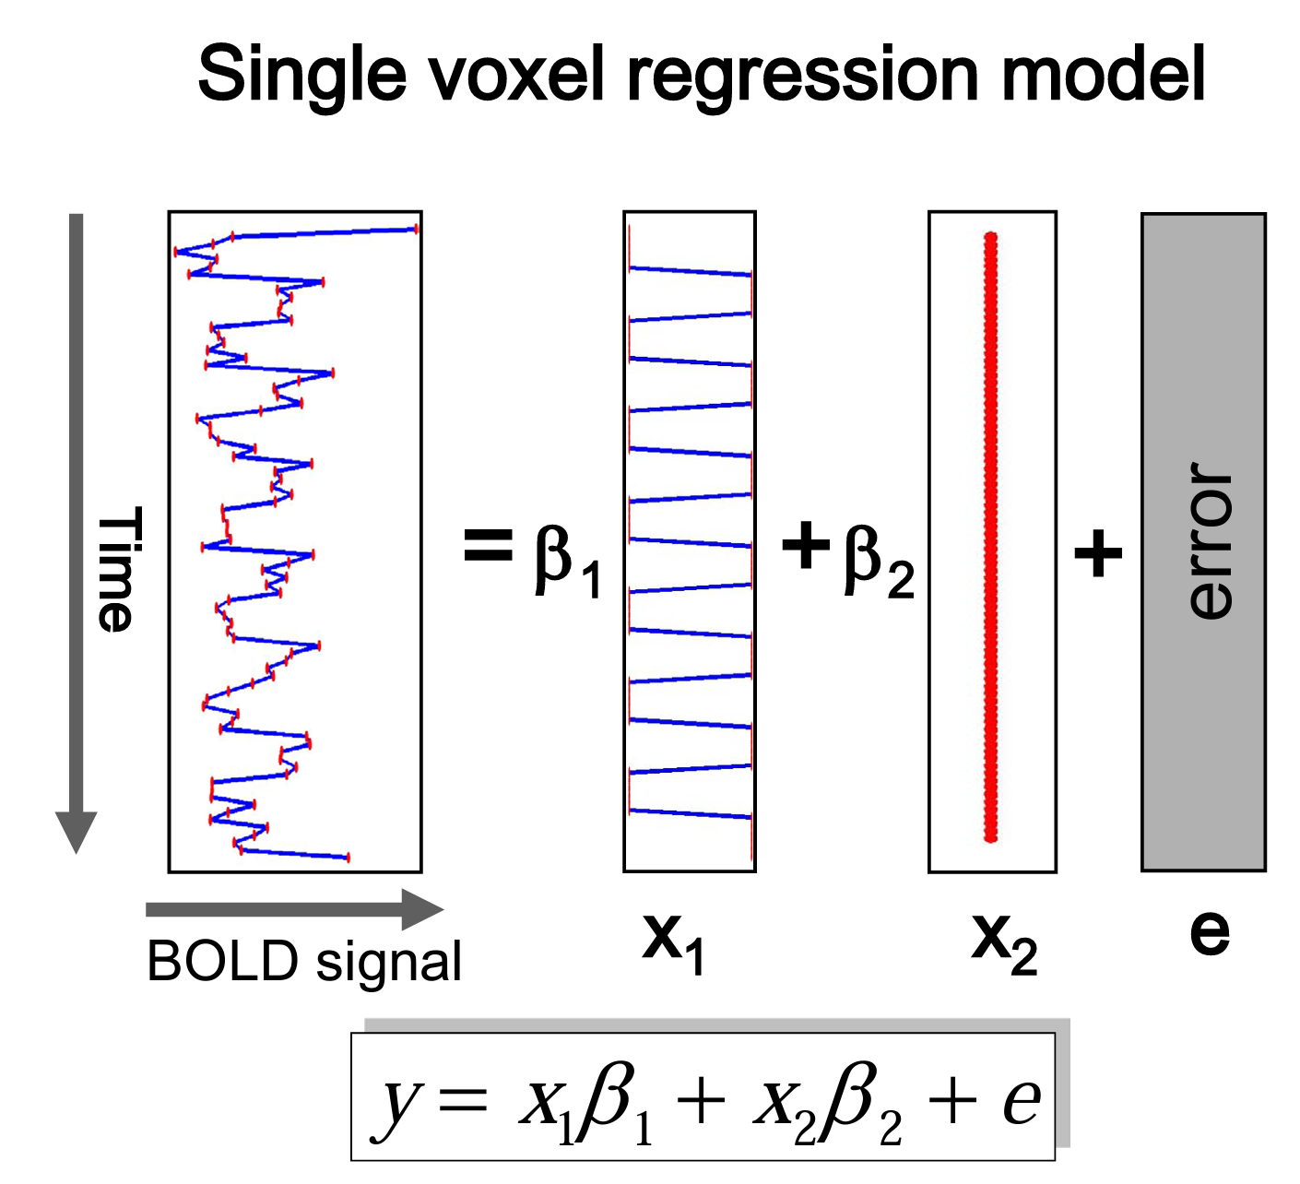

Slide 16
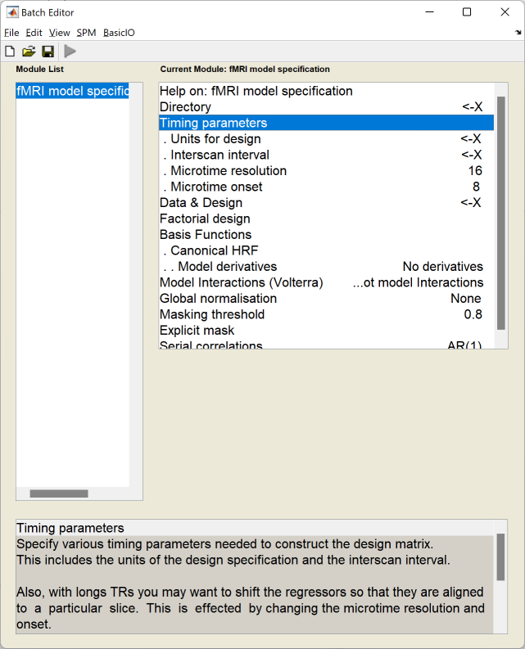
fMR Statistics Model specification

Slide 17
fMR Statistics Model specification
MENU: Specify 1st-level
BATCH EDITOR:
Directory … select (pre-created) folder “model” to store model and statistics results
Units for design … Scans
Interscan interval … 2 (equals to TR)
Data & Design
Scans … select sr*.nii data
Conditions
Condition
Name … name of processed paradigm, for example “RightHand”, “LeftHand”
Onset … vector of scans where the activations begins
Durations … duration of activation (in scans)
Run batch
Output:
SPM.mat file (GLM model)

Slide 18
fMR Statistics Model specification
Condition LeftHand
Name … LeftHandFingerTapping
Onset … [16 61 106]
Durations … 15
Condition RightHand
Name … RightHandFingerTapping
Onset … [31 76 121]
Durations … 15

Slide 19
fMR Motor paradigm (in scans; scan = 2s)
15
15
15
left
fingertapping
right
fingertapping
rest
1
16
31
46
61
76
91
106
121
136
150

Slide 20
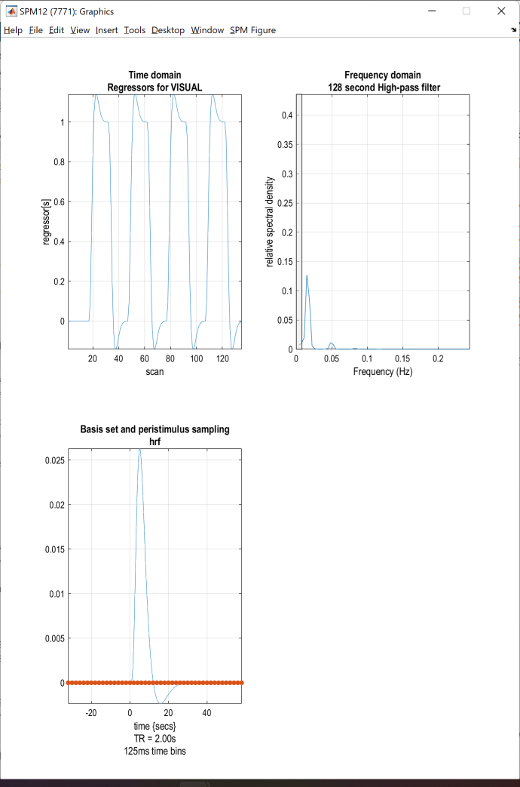
fMR Statistics Model review

Slide 21
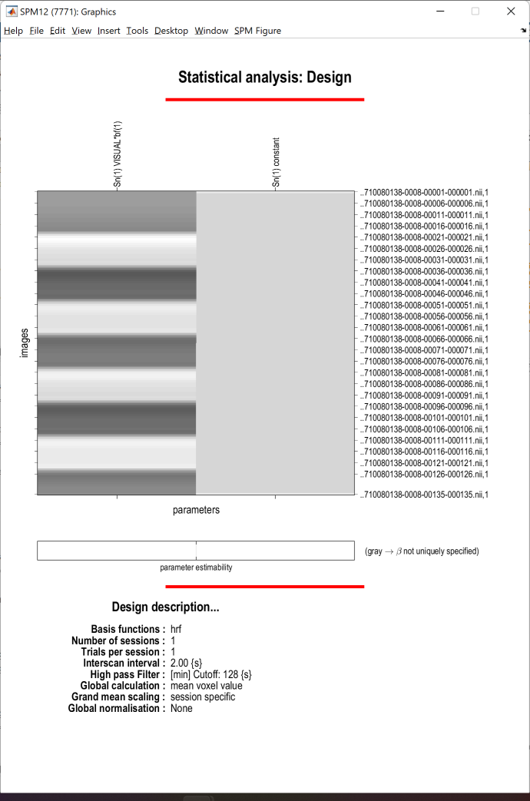
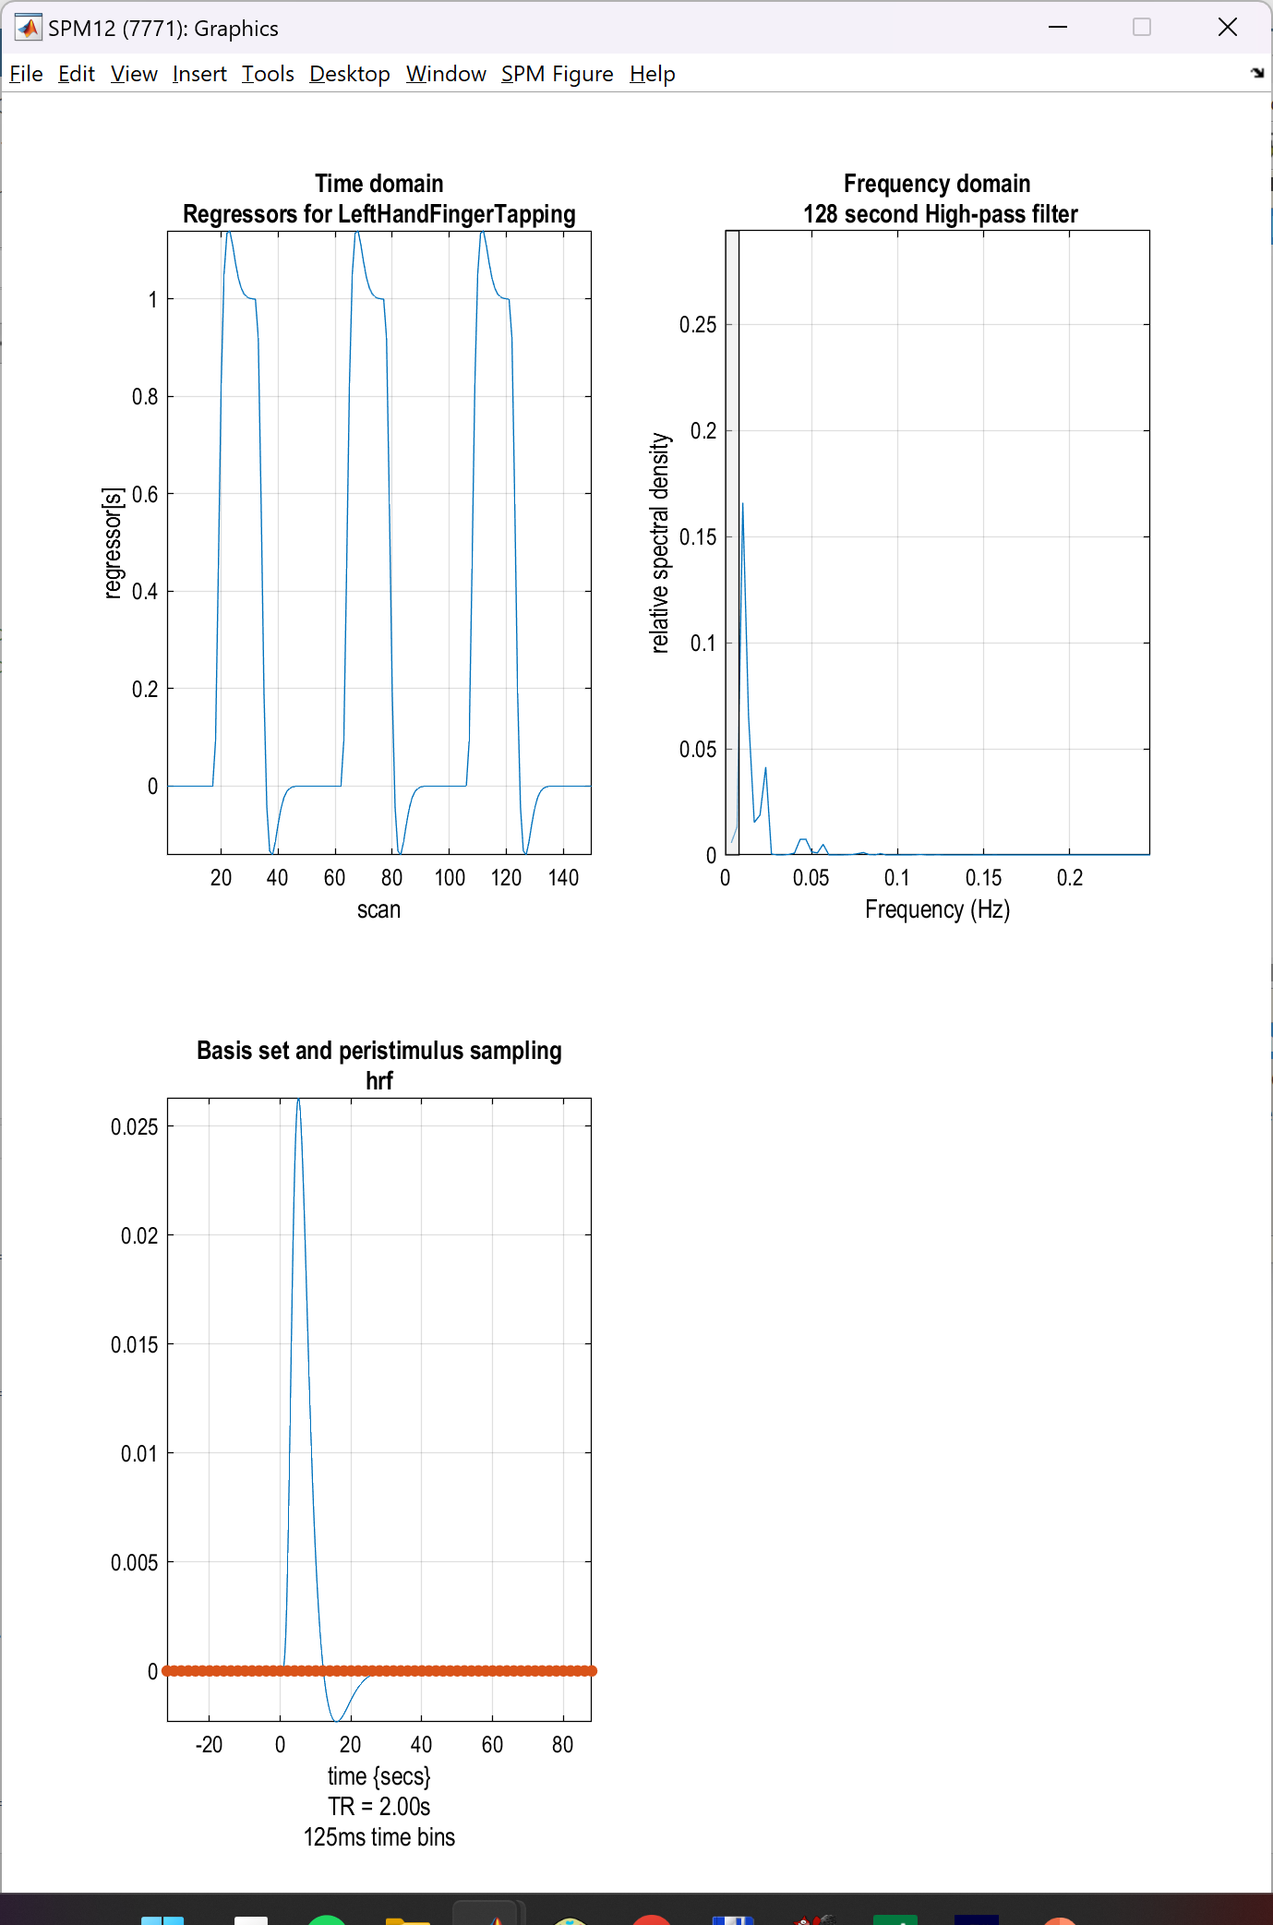
fMR Statistics Model review

Slide 22
fMR Statistics Model review
MENU: Review
BATCH EDITOR:
Select SPM.mat … select SPM.mat
Run batch
RESULTS:
Design – Design Matrix (model design for selected parameters)
Design – Explore – Session 1 – LeftHandFingerTapping (time and frequency domain of the model)
Design – Explore – Session 1 – RightHandFingerTapping (time and frequency domain of the model)

Slide 23
fMR Statistics Model estimation

Slide 24
fMR Statistics Model estimation
MENU: Estimate
BATCH EDITOR:
Select SPM.mat … select SPM.mat
Run batch

Slide 25
fMR Statistics Results

Slide 26
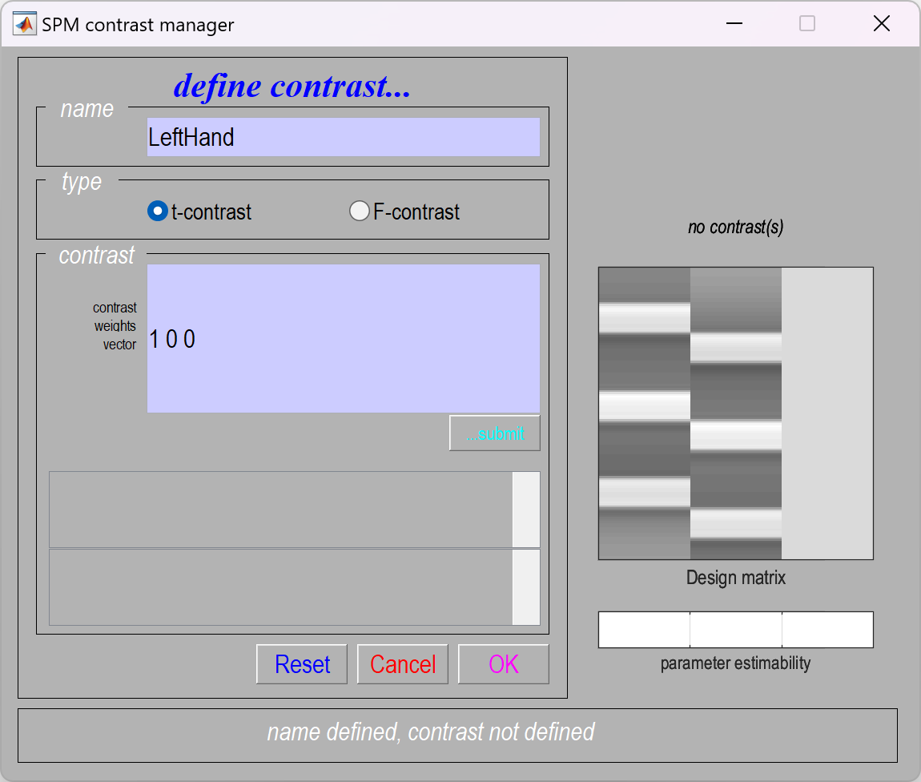
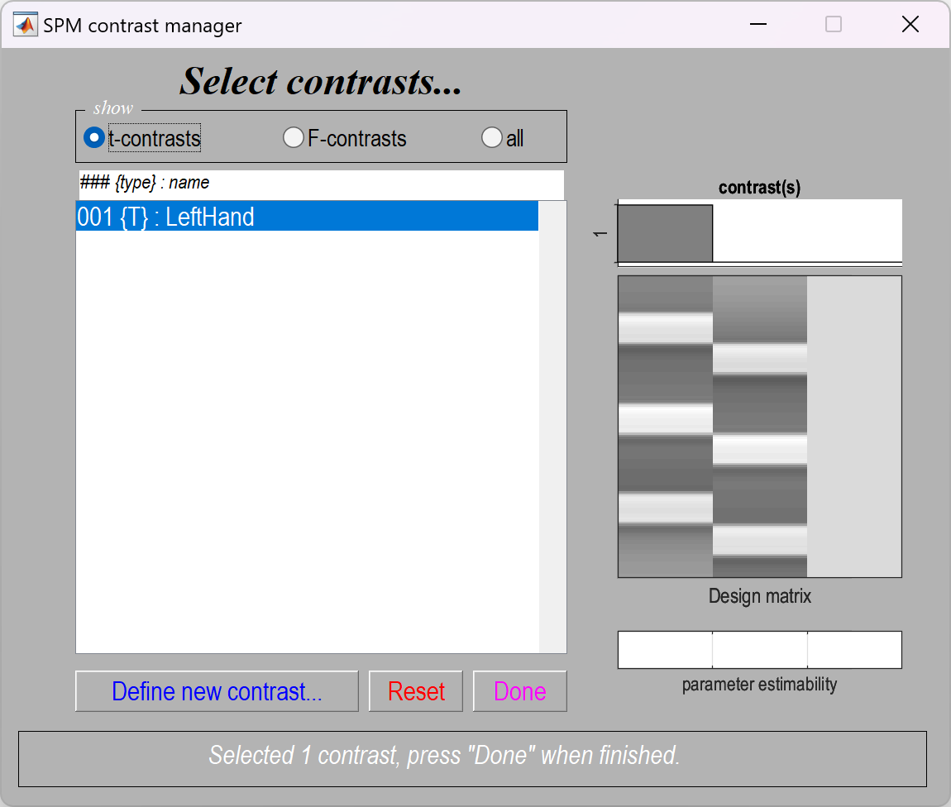
fMR Statistics Model estimation
MENU: Results
Select SPM.mat
SPM contrast manager:
Define new contrast
Name: LeftHand / RightHand
type: t-contrast
contrast: 1 0 0 / 0 1 0 …submit
OK
Done

Slide 27
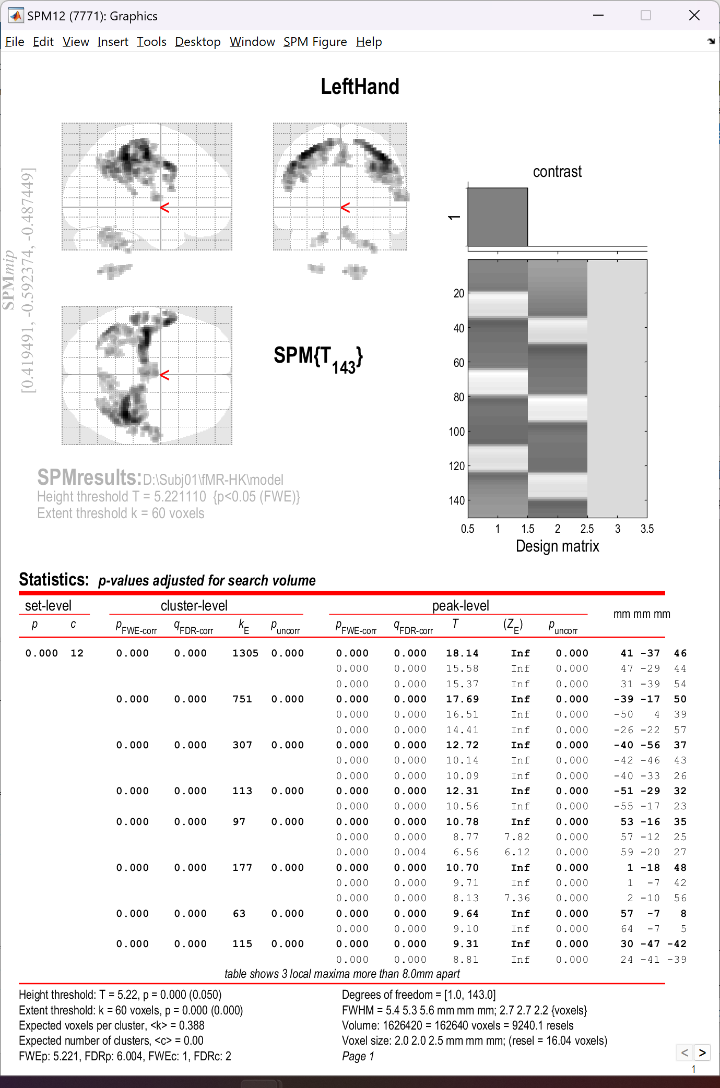
fMR Statistics Model estimation
RESULTS:
apply masking … none
P value adjustment to control … FWE
P value (FWE) … 0.05
& extent threshold {voxels} … 60

Slide 28
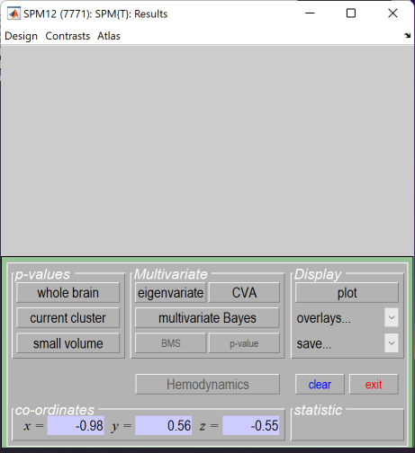
fMR Statistics Display
overlays…:
Slices
Sections (multiplanar)
Montage (Axial / Coronal / Sagittal)
mean*.nii
plot:
Plot … Fitted responses – adjusted
Plot against … scan or time

Slide 29
