Slide 1
B4M36SAN Dimensionality reduction
Anh Vu Le & Jan Blaha

Slide 2
Outline
PCA
motivational example (BreastCancer dataset)
PCA principles with an artificial dataset
BreastCancer dataset revisited
PCA vs LDA
tSNE
gentle introduction

Slide 3
Dimensionality reduction principles
Benefits of reducing dimensionality
faster and often more accurate learning of classifiers
removing redundancy
visualization

Slide 4
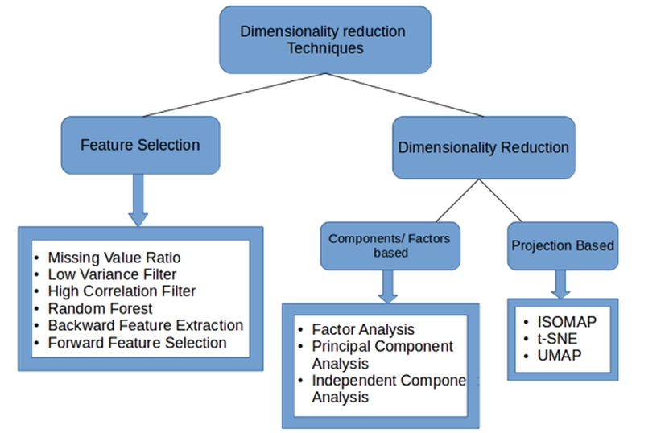
Dimensionality reduction principles
Benefits of reducing dimensionality
faster and often more accurate learning of classifiers
removing redundancy
visualization
Dimensionality Reduction Techniques | Python (analyticsvidhya.com)

Slide 5
Dimensionality reduction principles
Benefits of reducing dimensionality
faster and often more accurate learning of classifiers
removing redundancy
visualization
Cost of reducing dimensionality
information loss
new axes may be difficult to interpret

Slide 6
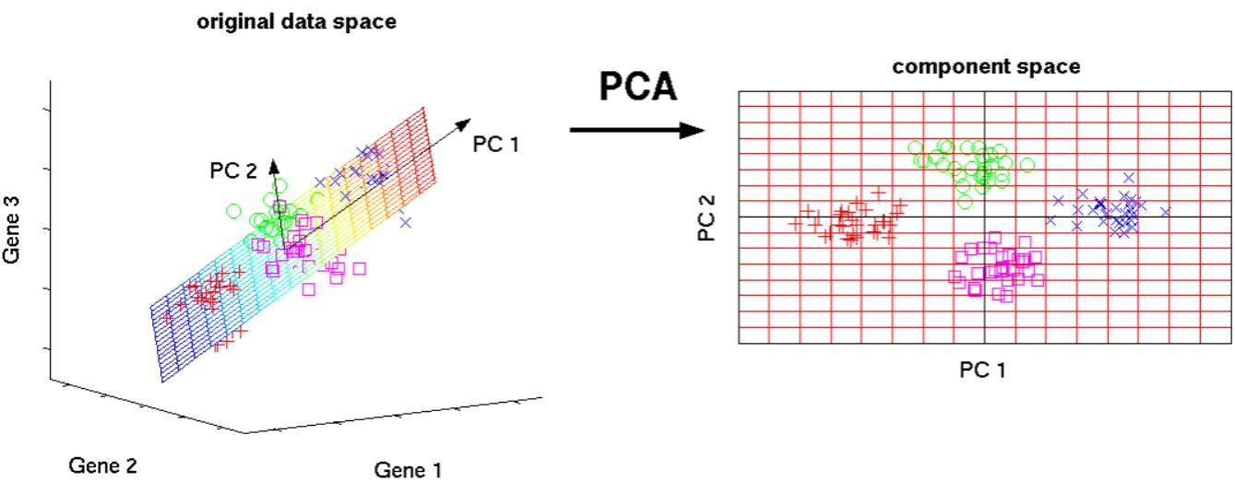
Ph.D. thesis - Matthias Scholz - Max Planck Institute of Molecular Plant Physiology (matthias-scholz.de)

Slide 7
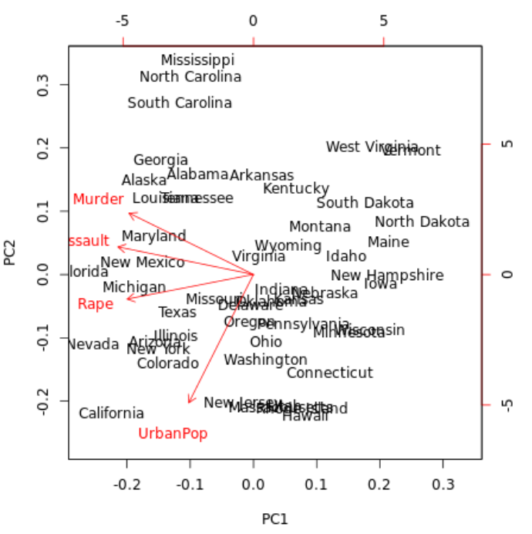

Slide 8
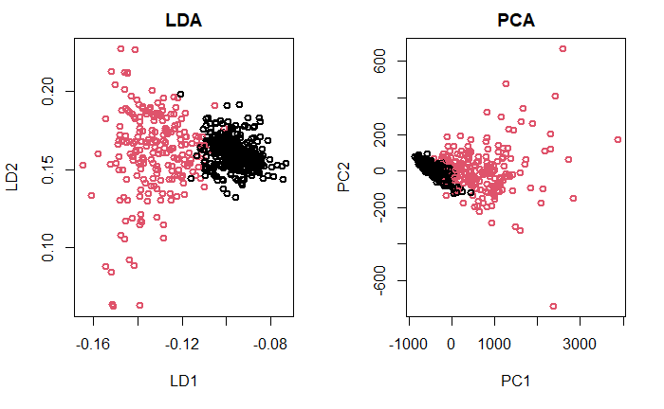
PCA
LDA
Finds axes/directions of:
max scatter between
AND
min scatter within classes
max scatter of the entire data set
Eigenproblem
leading to the new axes
$$Cov(X)$$
$${S_{w}^{−1}S}_{B}$$
Projection (BreastCancer)

Slide 9
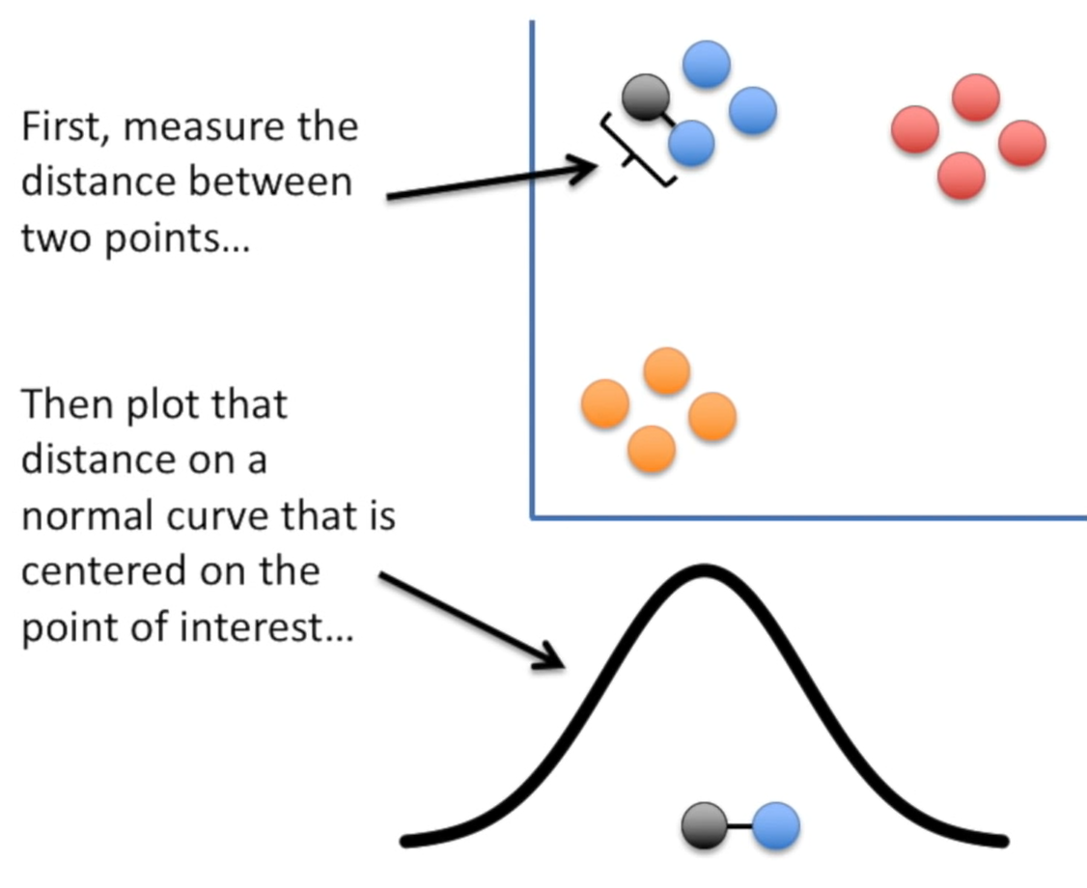
t-SNE
PCA focuses on data as whole
“Makro” method
cannot capture finer details of the topology of the data
Project into a lower dimension while preserving neighborhood relationships
t-SNE, ISOMAP
https://www.youtube.com/watch?v=NEaUSP4YerM

