Slide 1
B4M36SAN LDA and Logistic Regression
Anh Vu Le & Jan Bláha

Slide 2
Outline
From Linear to Logistic regression
How is LDA approach different?
What assumptions are relaxed in QDA?
LDA as dimensionality reduction technique

Slide 3
From Linear to Logistic regression
What we have
Linear model
Simple to fit
Predicts on the scale from 0 to $∞$
What we want
To predict probabilities
Scale 0 to 1
$$Y=β_{0}+β_{1}X_{1}+β_{2}X_{2}+…$$
Examples of odds:
Prob. of heads in a coin toss p=0.5
odds = $\frac{0.5}{1−0.5}=1$
Prob. of 6 in a dice roll p=1/6
odds = $\frac{1/6}{1−1/6}=0.2$
Prob. of passing SAN p=0.9
odds = $\frac{0.9}{1−0.9}=9$
Derivation:
Adapter function:
Sigmoid
$$Y=\frac{p}{1−p}=\text{odds}$$
$$p=\frac{1}{1+e^{−Y}} \\ p=\frac{1}{1+e^{−(β_{0}+β_{1}X_{1}+β_{2}X_{2}+…)}}$$
$$Y=\log\left(\frac{p}{1−p}\right)=\text{logit}$$
Now express p to get the sigmoid

Slide 4
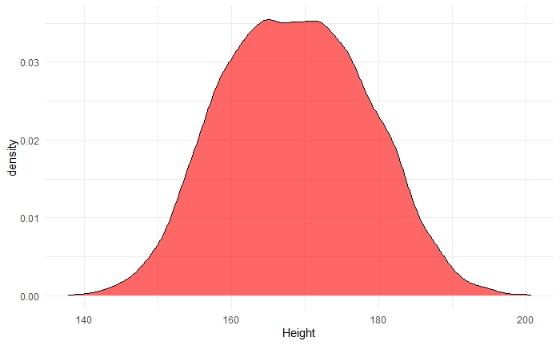
LDA approach
To which class c the instance with features x most likely belongs to?
$$P(Y=y_{c}|X=x)$$
$$P(sex=Male|Height=184)$$
Bayes formula
$P\left(sex=Male | Height=184\right)=\frac{P(Height=184|sex=male)P(sex=male)}{\sum_{{sex}_{i}}{P(Height=184|sex={sex}_{i})P(sex={sex}_{i})}}$
$$P\left(male\right)=0.45 \\ P\left(female\right)=0.55$$
Assuming same „sizes“
same for all classes
$$P\left(Height=184 | sex=male\right)$$
LDA/QDA
$$\sim N(μ_{male},σ^{2})$$

Slide 5
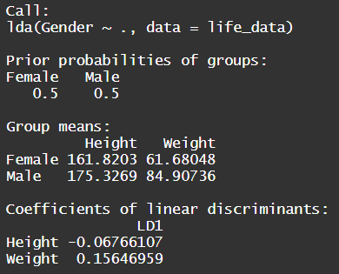
LDA summary
Assumes data have a normal distribution (within each class)
Decision boundary = region of equal posterior probability
Boundary linear if covariances are the same
But what are the “linear discriminants”?
Let’s check Elhabian_LDA09.pdf

Slide 6
macbookpro_1477920514956.jpeg (800×533) (gadgets360cdn.com)
19" CRT monitor SAMSUNG SyncMaster 997MB LH19ISBBS/EDC slono | kak.cz
87b9db78647912d4bf3bca0309e86648.png (480×359) (pinimg.com)

