Slide 1
B4M36SAN LDA and Logistic Regression
Anh Vu Le

Slide 2
Outline
From Linear to Logistic regression
How is LDA approach different?
What assumptions are relaxed in QDA?
From Logistic regression to Generalized Linear Models
Basic idea

Slide 3
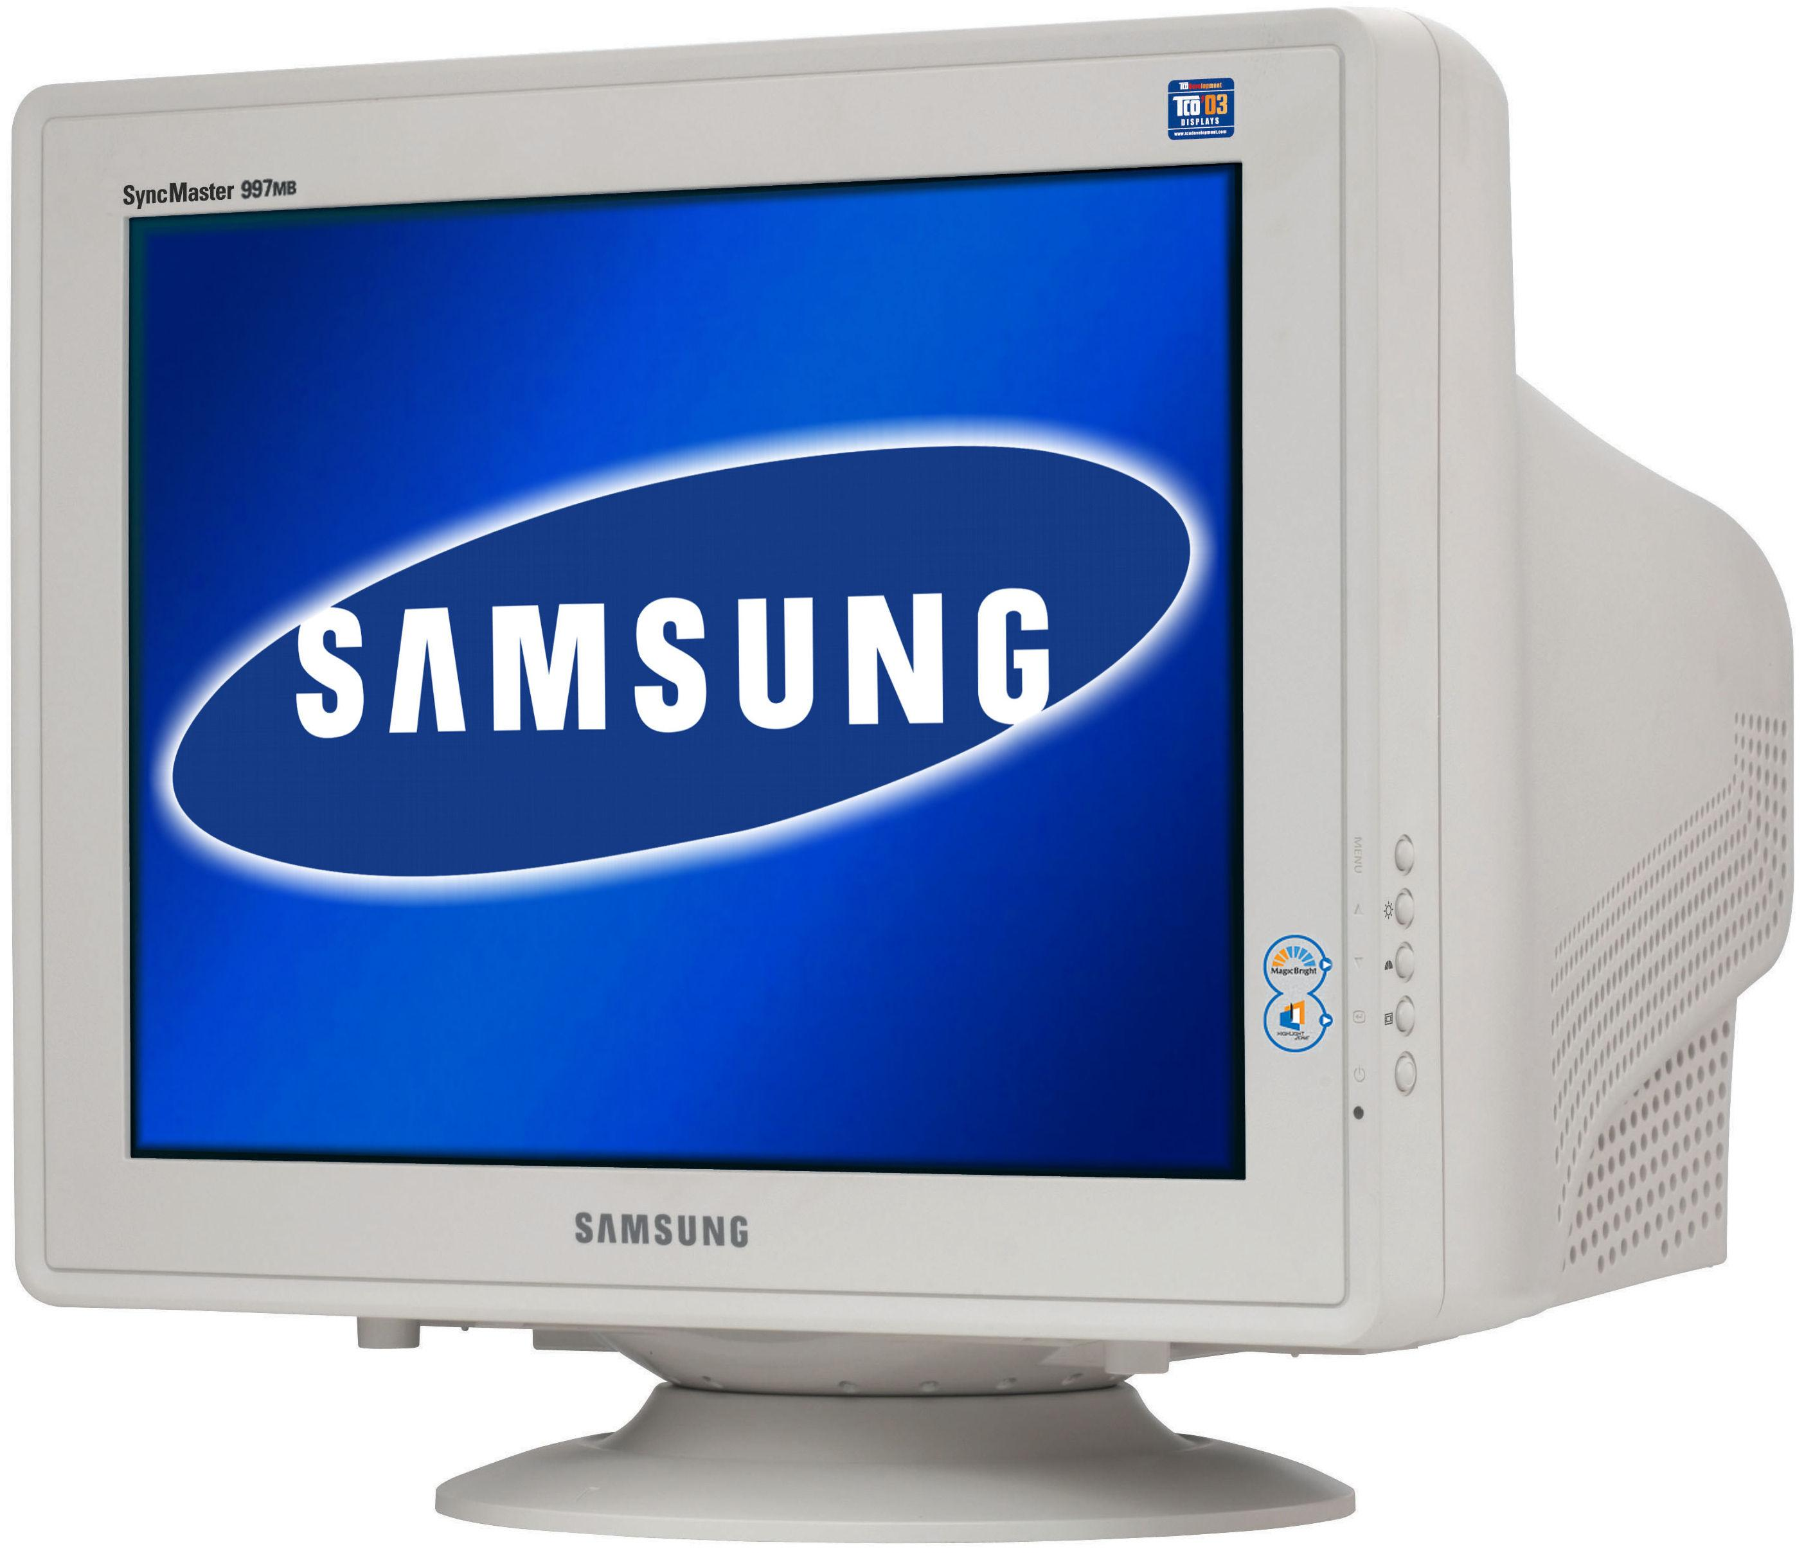
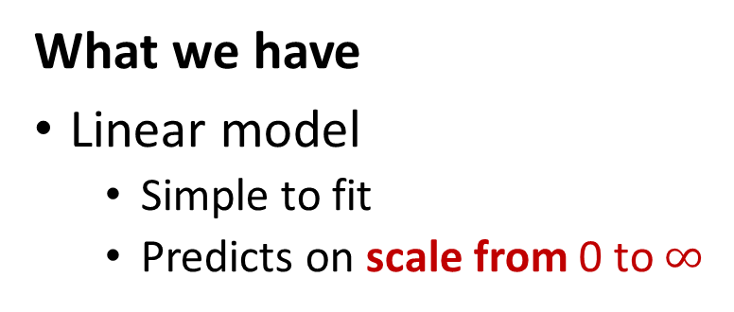
From Linear to Logistic regression
What we have
Linear model
Simple to fit
Predicts on scale from 0 to $∞$
What we want
To predict probabilities
Scale 0 to 1
$$Y=β_{0}+β_{1}X_{1}+β_{2}X_{2}+…$$
Examples:
Probability of heads in a coin toss p=0.5
odds = $\frac{0.5}{1−0.5}=1$
Probability of 6 in a dice roll p=1/6
odds = $\frac{1/6}{1−1/6}=0.2$
Probability of passing SAN p=0.9
odds = $\frac{0.9}{1−0.9}=9$
Adapter function:
Logit
$$Y=log⁡\left(\frac{p}{1−p}\right)$$
Where $\frac{p}{1−p}$are odds
p is probability
continuous scale from 0 to $∞$
Express p with Y

Slide 4
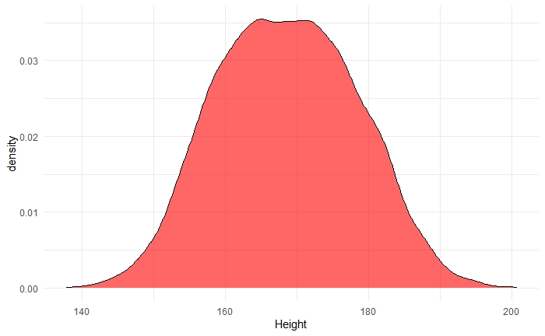
LDA approach
To which class c the instance with features x most likely belongs to?
$$P(Y=y_{c}|X=x)$$
$$P(sex=Male|Height=184)$$
Bayes formula
$P\left(sex=Male | Height=184\right)=\frac{P(Height=184|sex=male)P(sex=male)}{\sum_{{sex}_{i}}{P(Height=184|sex={sex}_{i})P(sex={sex}_{i})}}$
$$P\left(male\right)=0.45 \\ P\left(female\right)=0.55$$
Assuming same „sizes“
same for all classes
$$P\left(Height=184 | sex=male\right)$$
LDA/QDA
$$\sim N(μ_{male},σ^{2})$$

Slide 5
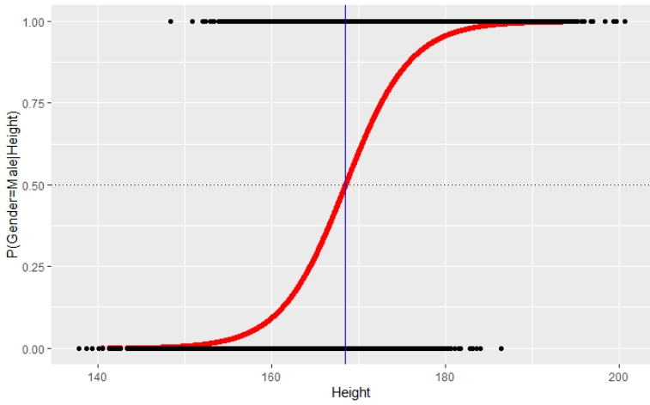
From Linear regression to Generalized Linear Models
What we have
Linear model
Simple to fit
Predicts on continuous scale
What we want
To predict probabilities
Scale 0 to 1
$$Y=β_{0}+β_{1}X_{1}+β_{2}X_{2}+…$$
Adapter function:
Logit
$$Y=log⁡\left(\frac{p}{1−p}\right)$$
Express p with Y

Slide 6
From Linear regression to Generalized Linear Models
What we have
Linear model
Simple to fit
Predicts on continuous scale
What we want
To predict counts
Discrete
Variance not constant
$$Y=β_{0}+β_{1}X_{1}+β_{2}X_{2}+…$$
Adapter function:
Log
$$Y=log⁡\left(c\right)$$
Express c with Y

Slide 7
From Linear regression to Generalized Linear Models
What we have
Linear model
Simple to fit
Predicts on continuous scale
What we want
To predict continuous var.
Scale $−∞$ to $∞$
$$Y=β_{0}+β_{1}X_{1}+β_{2}X_{2}+…$$
Adapter function:
Identity
$$Y=Y$$

Slide 8
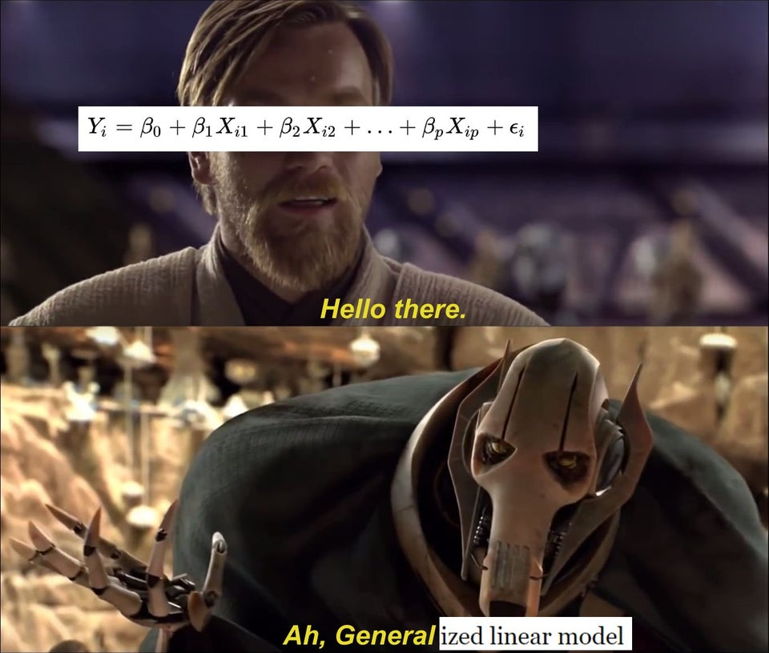

Slide 9
macbookpro_1477920514956.jpeg (800×533) (gadgets360cdn.com)
https://preview.redd.it/61qzo3egumo11.jpg?width=960&crop=smart&auto=webp&s=445019148a08059959f25ed33e6d5fa6c8e522ed
19" CRT monitor SAMSUNG SyncMaster 997MB LH19ISBBS/EDC slono | kak.cz
87b9db78647912d4bf3bca0309e86648.png (480×359) (pinimg.com)
https://bookdown.org/roback/bookdown-BeyondMLR/ch-poissonreg.html

