Slide 1
Cloud
for Beginners
Profinit Big Data tým
Alisa Benešová
2020

Slide 2
Content
Cloud
Cloud vendors
Terraform
Cloud use cases
Azure, AWS cost calculator

Slide 3
Cloud

Slide 4
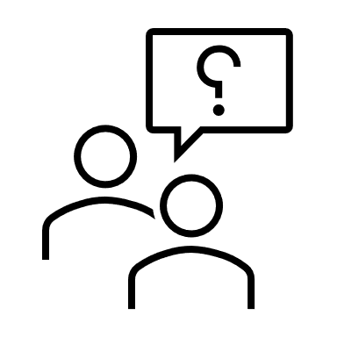
Do you know what cloud is?

Slide 5
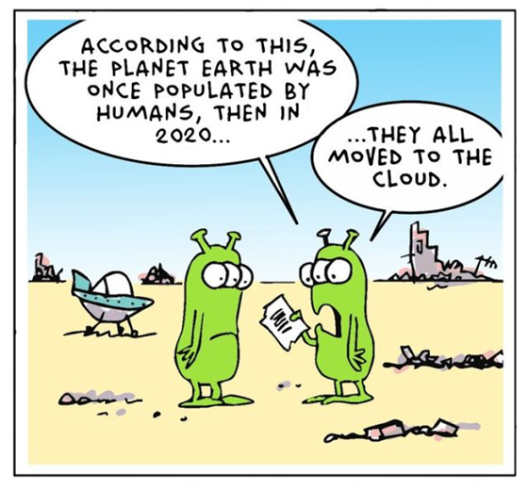
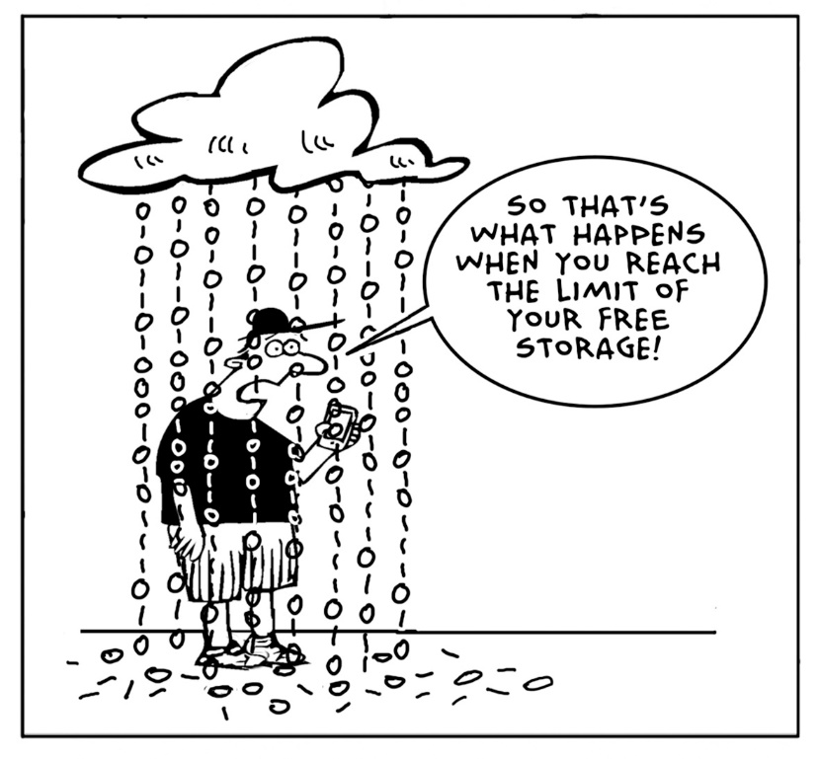
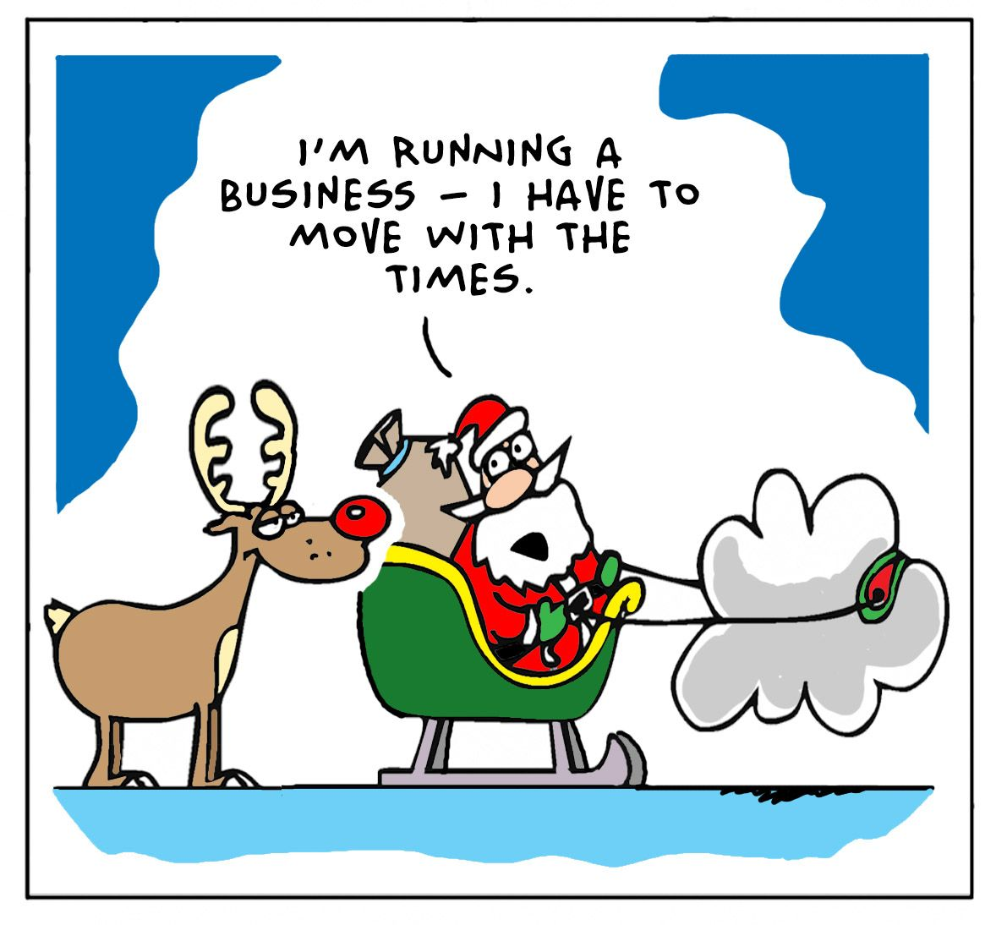

Slide 6
Cloud
What Cloud is?
Almost unlimited space in cloud,
Collection of different servers, tools,
Infrastructure orchestration etc.
“pay what you use” (GB, cores, security…)
BigData and Cloud?
Scalability of computing power and storage,
Cost prediction,
Click and Go solutions.

Slide 7
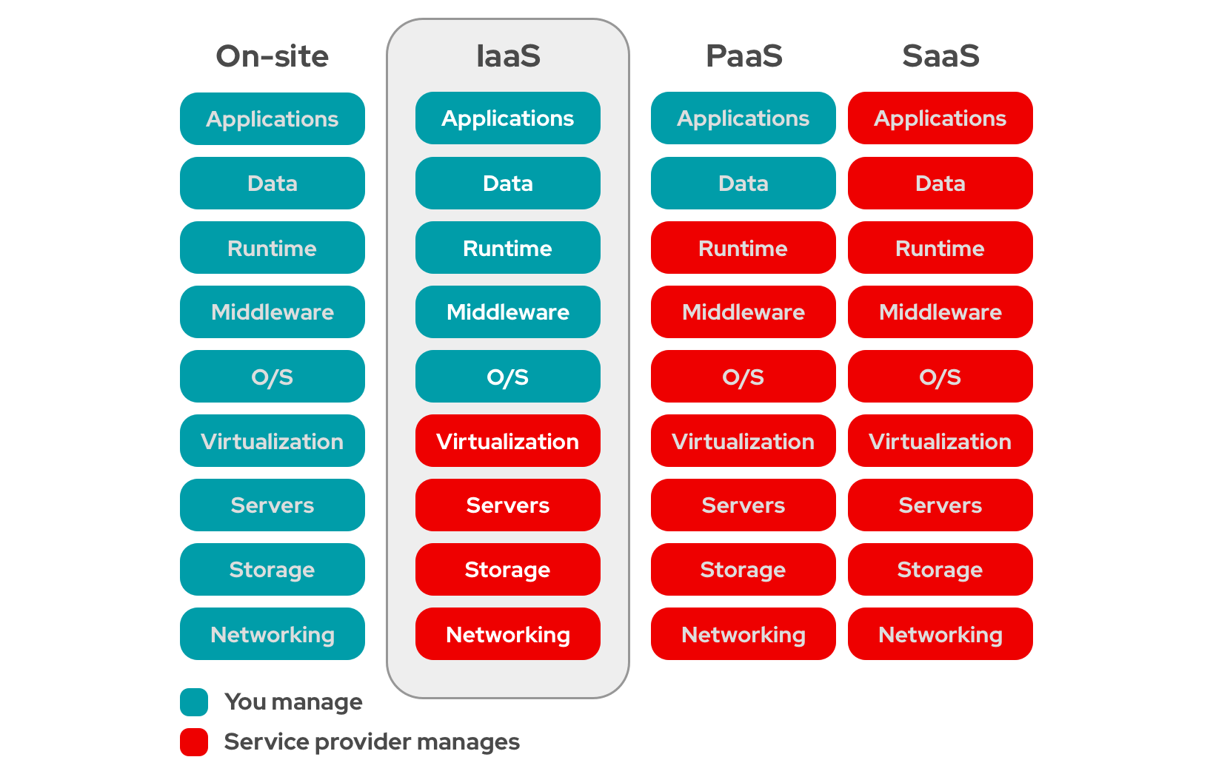
Cloud services
Cloud service = service provided by a cloud provider via Internet.
Cloud vendor manages services together with user
3 different levels
IaaS – Infrastructure as a Service
PaaS – Platform as a Service
SaaS – Software as a Service

Slide 8
Cloud service vendors
Amazon, Microsoft, Google = world-wide leaders
AWS
Leader in cloud computing (first in 2008),
AI, Serverless deployments, IaaS
Microsoft Azure
Leader in SaaS (MS platform)
Enterprise customers
Google
Google platform services
Alibaba Cloud
Primary cloud in China ;)

Slide 9
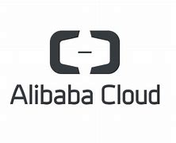
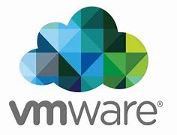
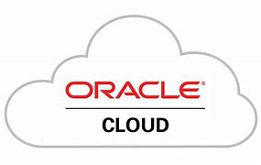
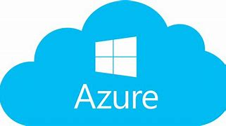
Cloud has changed IT world (hardware, software, security, dataflow, infrastructure…)
Almost every big player offers a cloud, cloud solution, cloud services to be hosted on cloud

Slide 10
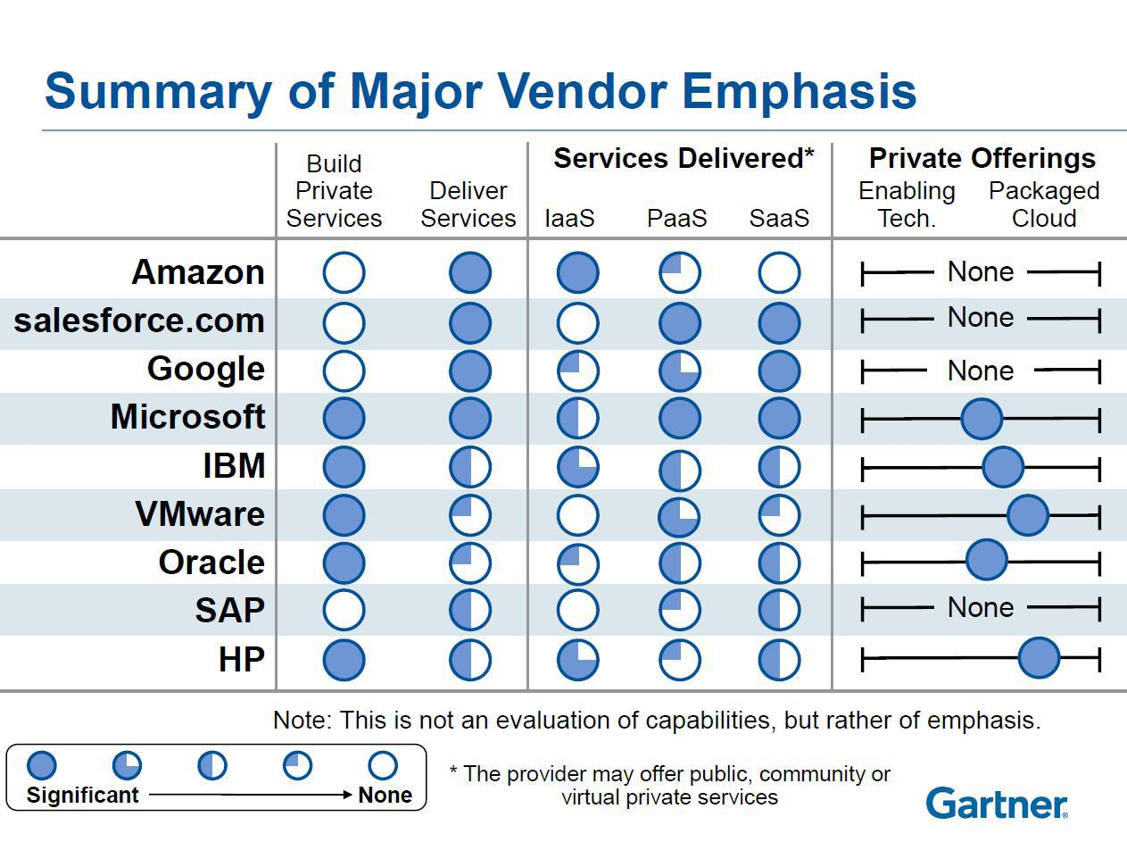
Cloud vendors differs…

Slide 11
Terraform

Slide 12
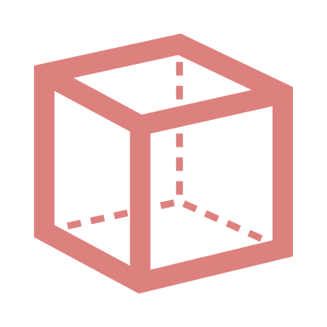
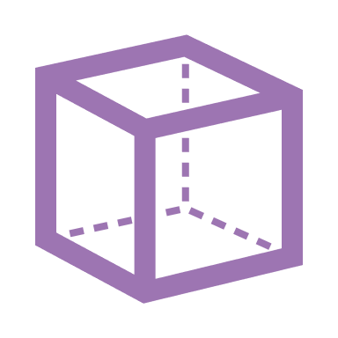
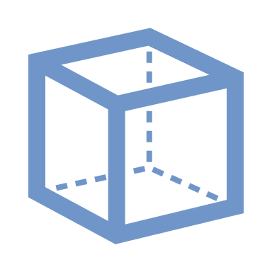
Terraform
Open-Source automatization and management of your
(cloud) infrastructure
Your platform
Services
Declarative language used – define WHAT result you want
Declarative
Define what you have
Red, violet, blue cube
Define what you want
A tower od red, violet, blue cubes
Procedural
Define what you have
Red, violet, blue cube
Define how to make what you want
Put blue cube
Put violet cube on blue cube
Put red cube on violet cube

Slide 13
Ansible vs. Terraform
Infrastructure as Code
DevOps usually use both tools
Ansible | Terraform
Mainly a config tool (once infra is done) | Mainly infra provisioning
Deploy apps | Can deploy apps
Install/update software
More mature | Relatively new tool
 | Advanced in orchestration
Better for configuring infrastructure | Better for provisioning infrastructure

Slide 14
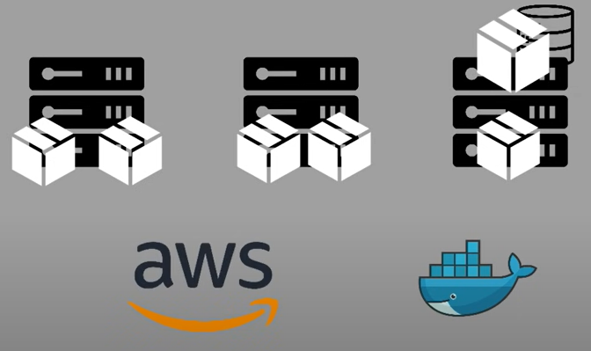
Terraform, case study
3 servers,
Several microservices and database in Docker
In usual, you must do steps:
Prepare private network
EC2 server instances
Install Docker, tools
Security, firewalls etc.
Deploy Docker containers.
2 separate teams, usually
Adding new servers, security setup, replicating from dev to prod…
AUTOMATION VIA TERRAFORM
1. PROVISIONING INFRACSTRUCTURE
2. DEPLOY APPS

Slide 15
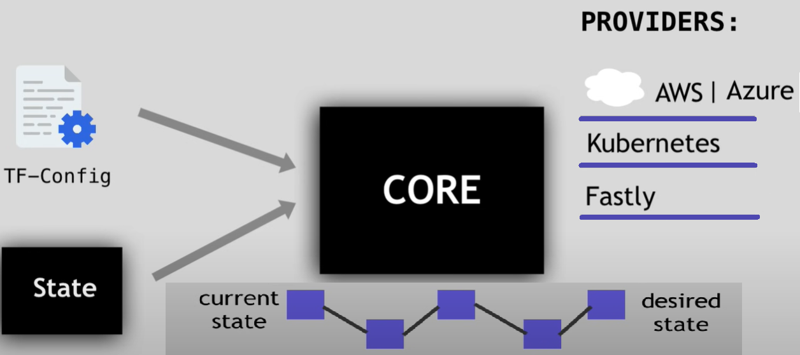
Terraform, how it works
Core takes input and plans what needs to be created, updated, destroyed… from current state = execution plan
Steps are executed with platform specific tools
Providers (100 providers)
AWS, Azure (IaaS)
Kubernetes (Paas)
Fastly (SaaS)
Each provider offers resources you can
work with

Slide 16
Cloud Architectures

Slide 17
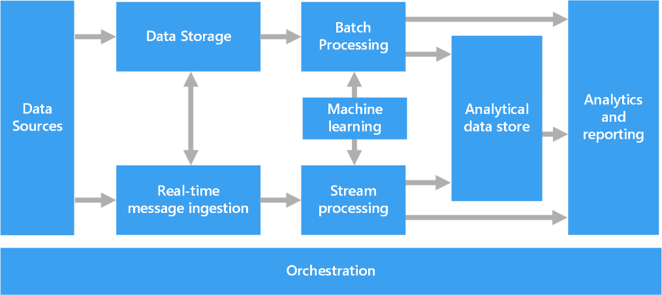
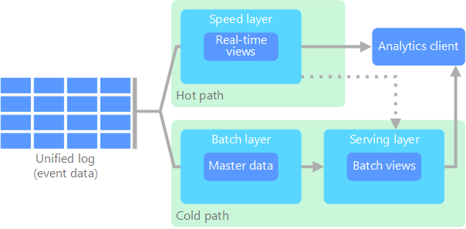
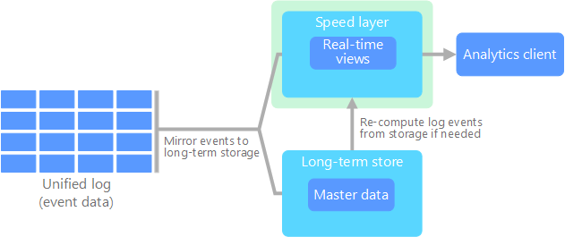
Big Data Architectures
Cloud fits to BD architectures
Native components
Services
Hybrid solutions
Lambda and Kappa, IoT

Slide 18
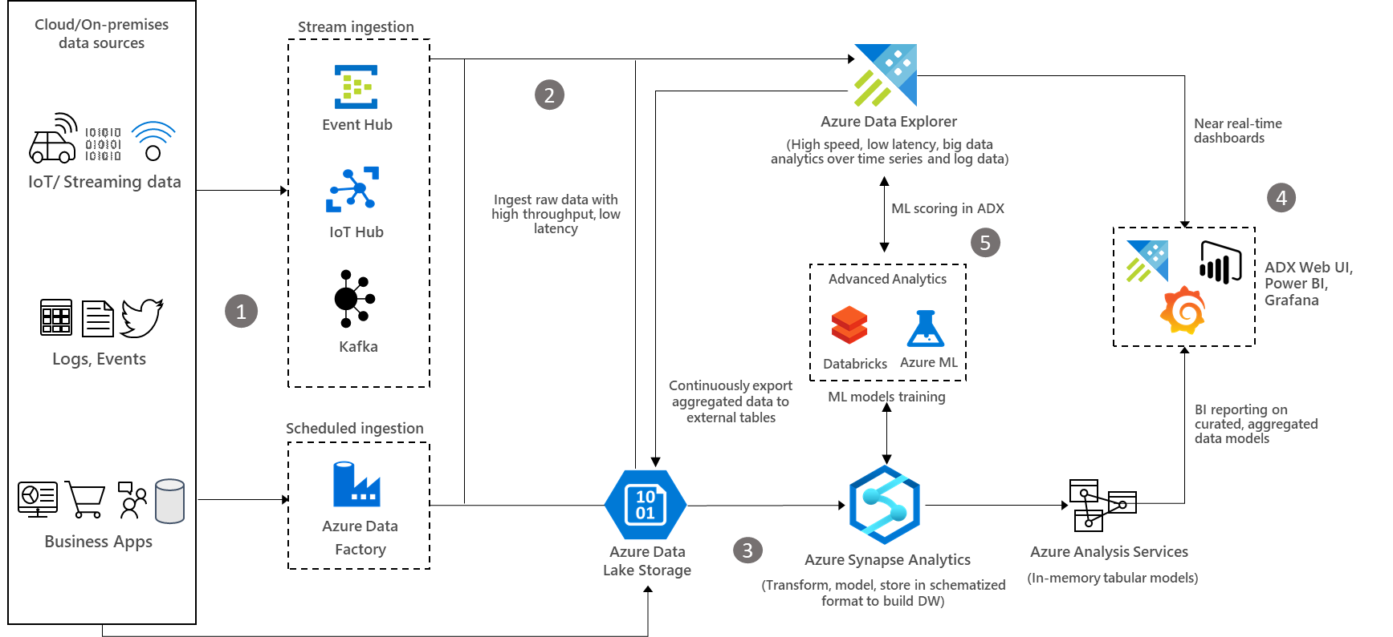
Example of complex Azure BD analytic architecture

Slide 19
Use cases in real world
Prototyping (POC), Dev, Testing
BD Architecture is summoned when you need it and comply your project needs
When you are not sure
what to use (sizing),
not ready to invest to hardware,
If big data architecture is right for your project.
Usually cloud native tools, such as HDInsight, Databricks etc.
quick launch,
you do not care about underlay infrastructure,
Minimal administration.
This might not be most cost effective, if you’re summoning too often for a long time.

Slide 20
Use cases in real world
Cloud Server instances with installed BD tools
Long-term running, almost same as on-premise solution
Development, Testing, Production
Easy to boost server instances, if you need
Long-term running might be more cost effective (long term plans)
You have care about infrastructure, administration etc.

Slide 21
Calculator
Check how much you will pay what for
Total Cost of Ownership (TCO) Calculator | Microsoft Azure
Even electricity cost etc.
AWS Pricing Calculator
Just UseCase of your setup.

Slide 22
For next hands-on Azure-cloud course
Create a NEW account as a student for free
Free space, free computing etc.
https://azure.microsoft.com/en-us/free
Alternative:
Create a NEW FREE account with 200USD to spend for 30 days
Be careful, you have to add your credit card
https://azure.microsoft.com/en-us/free/

Slide 23
Dotazy

