Slide 1
Intro to Prolog
Simply Logical – Chapter 2
© Peter Flach, 2000
Slides compiled from first two lectures of Peter Flach’s Simply Logical course

Slide 2
Link: http://people.cs.bris.ac.uk/~flach/SimplyLogical.html

Slide 3
Propositional clausal logic: syntax
Simply Logical – Chapter 2
p.18
© Peter Flach, 2000
“Clausal logic”: all formulas are clauses
“Somebody is married or a bachelor if he is a man and an adult.”
married ∨ bachelor <− man & adult
married ∨ bachelor ∨ ¬man ∨ ¬adult
atoms
Same clause in Prolog style
married;bachelor:-man,adult.
head = positive literals
body = negative literals

Slide 4
Propositional clausal logic: semantics
Simply Logical – Chapter 2
p.19
© Peter Flach, 2000
Herbrand base: set of atoms
{married,bachelor,man,adult}
Herbrand interpretation: set of true atoms
{married,man,adult}
So H.I. provides a valuation on atoms (c.f. 1st lecture)
A clause is false in an interpretation if all body-literals are true and all head-literals are false…
bachelor:-man,adult. VS married;bachelor:-man,adult.
…and true otherwise: the interpretation is a model of the clause.

Slide 5
Exercise 2.2
Simply Logical – Chapter 2
p.20
© Peter Flach, 2000
A clause C is a logical consequence of a program (set of clauses) P iff every model of P is a model of C.
Let P be
married;bachelor:-man,adult.
man.
:-bachelor.
married:-adult is a logical consequence of P;
married:-bachelor is a logical consequence of P;
bachelor:-man is not a logical consequence of P;
bachelor:-bachelor is a logical consequence of P.

Slide 6
Propositional resolution
Simply Logical – Chapter 2
p.22
© Peter Flach, 2000
has_wife:-man,married
married;bachelor:-man,adult
has_wife;bachelor:-man,adult
square:-rectangle,equal_sides
rectangle:-parallelogram,right_angles
square:-parallelogram,right_angles,equal_sides

Slide 7
Propositional clausal logic: meta-theory
Simply Logical – Chapter 2
p.23
© Peter Flach, 2000
Propositional resolution is
sound: it derives only logical consequences.
incomplete: it cannot derive arbitrary tautologies like a:-a…
…but refutation-complete: it derives the empty clause from any inconsistent set of clauses.
Proof by refutation: add the negation of the assumed logical consequence to the program, and prove inconsistency by deriving the empty clause.

Slide 8
Relational clausal logic: syntax
Simply Logical – Chapter 2
p.25
© Peter Flach, 2000
“Peter likes anybody who is his student.”
atoms
clause
likes(peter,S):-student_of(S,peter).
constant
variable
terms
No quantifiers. All variables in a clause are assumed to be quantified universally.

Slide 9
Substitutions
Simply Logical – Chapter 2
p.26
© Peter Flach, 2000
A substitution maps variables to terms:
{S->maria}
A substitution can be applied to a clause:
likes(peter,maria):-student_of(maria,peter).
The resulting clause is said to be an instance of the original clause, and a ground instance if it does not contain variables.
Each instance of a clause is among its logical consequences.

Slide 10
Relational clausal logic: semantics
Simply Logical – Chapter 2
p.26
© Peter Flach, 2000
Herbrand universe: set of ground terms (i.e. constants)
{peter,maria}
Herbrand base: set of ground atoms
{likes(peter,peter),likes(peter,maria),likes(maria,peter), likes(maria,maria),student_of(peter,peter),student_of(peter,maria), student_of(maria,peter),student_of(maria,maria)}
Herbrand interpretation: set of true ground atoms
{likes(peter,maria),student_of(maria,peter)}
An interpretation is a model for a clause if it makes all of its ground instances true
likes(peter,maria):-student_of(maria,peter).
likes(peter,peter):-student_of(peter,peter).

Slide 11
Relational resolution
Simply Logical – Chapter 2
p.29
© Peter Flach, 2000
:-likes(peter,N)
likes(peter,S):-student_of(S,peter)
{S->N}
:-student_of(N,peter)
student_of(S,T):-follows(S,C),teaches(T,C)
{S->N,T->peter}
:-follows(N,C),teaches(peter,C)
follows(maria,ai_techniques)
{N->maria,C->ai_techniques}
:-teaches(peter,ai_techniques)
teaches(peter,ai_techniques)
[]
N->maria is the answer substitution.

Slide 12
Full clausal logic: syntax
Simply Logical – Chapter 2
p.30
© Peter Flach, 2000
“Everybody loves somebody.”
Skolemization to avoid an existential quantifier
loves(X,person_loved_by(X)).
functor
term
complex term
loves(peter,person_loved_by(peter)).
loves(anna,person_loved_by(anna)).
loves(paul,person_loved_by(paul)).
…

Slide 13
Full clausal logic: semantics
Simply Logical – Chapter 2
p.31-3
© Peter Flach, 2000
Herbrand universe: set of ground terms
{0,s(0),s(s(0)),s(s(s(0))),…}
Herbrand base: set of ground atoms
{plus(0,0,0), plus(s(0),0,0), …, plus(0,s(0),0), plus(s(0),s(0),0), …, …, plus(s(0),s(s(0)),s(s(s(0)))), …}
Herbrand interpretation: set of true ground atoms
{plus(0,0,0), plus(s(0),0,s(0)), plus(0,s(0),s(0))}
Some clause sets have only infinite models
plus(0,X,X).
plus(s(X),Y,s(Z)):-plus(X,Y,Z).

Slide 15
Now we can also get subtraction from addition (using X-Y=Z iff X=Y+Z):
minus(X,Y,Z):-plus(Y,Z,X).

Slide 16
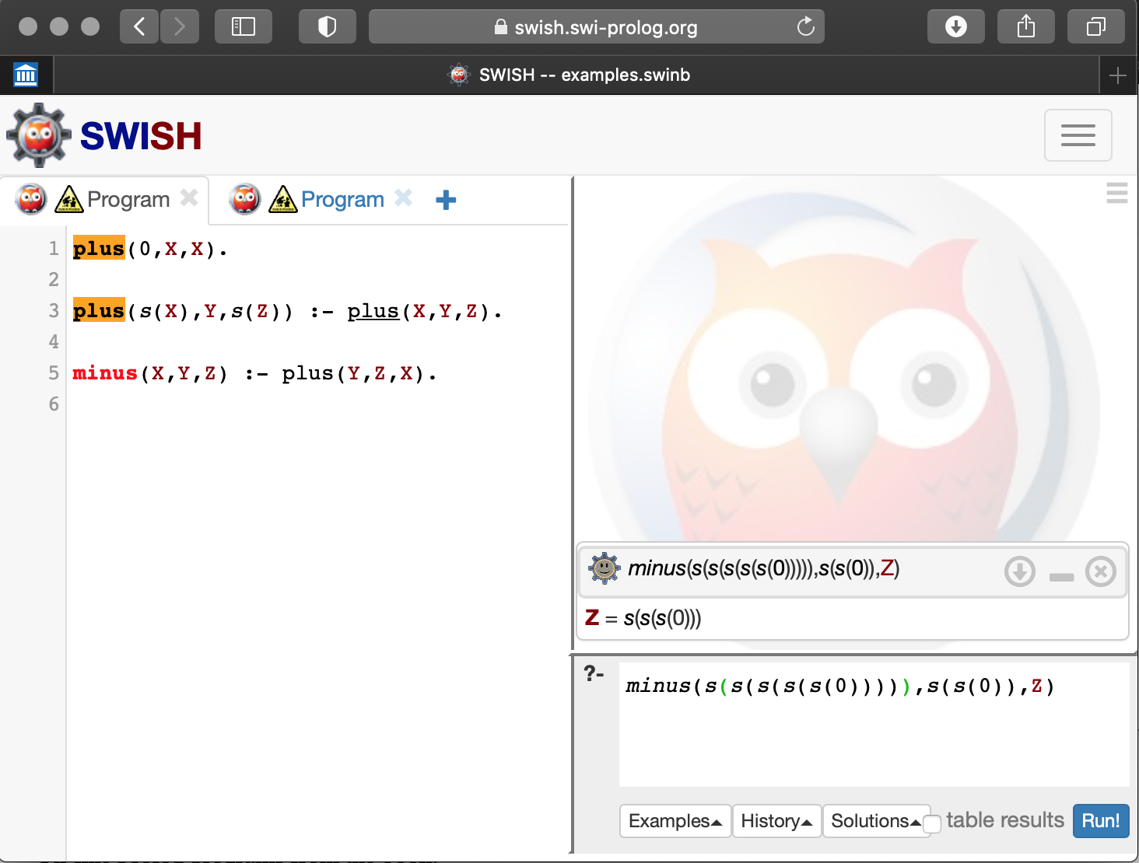

Slide 17
London Underground example
Simply Logical – Chapter 1
p.4
© Peter Flach 2000
JUBILEE
BAKERLOO
NORTHERN
Oxford
Circus
CENTRAL
Bond
Street
Tottenham
Court Road
PICCADILLY
Green
Park
Piccadilly
Circus
Leicester
Square
Charing
Cross
VICTORIA
UNDERGROUND
LRT Registered User No. 94/1954

Slide 18
London Underground in Prolog (1)
Simply Logical – Chapter 1
p.3
© Peter Flach 2000
connected(bond_street,oxford_circus,central). connected(oxford_circus,tottenham_court_road,central). connected(bond_street,green_park,jubilee). connected(green_park,charing_cross,jubilee). connected(green_park,piccadilly_circus,piccadilly). connected(piccadilly_circus,leicester_square,piccadilly). connected(green_park,oxford_circus,victoria). connected(oxford_circus,piccadilly_circus,bakerloo). connected(piccadilly_circus,charing_cross,bakerloo). connected(tottenham_court_road,leicester_square,northern). connected(leicester_square,charing_cross,northern).

Slide 19
London Underground in Prolog (2)
Simply Logical – Chapter 1
p.3-4
© Peter Flach 2000
Two stations are nearby if they are on the same line with at most one other station in between:
nearby(bond_street,oxford_circus). nearby(oxford_circus,tottenham_court_road). nearby(bond_street,tottenham_court_road). nearby(bond_street,green_park). nearby(green_park,charing_cross). nearby(bond_street,charing_cross). nearby(green_park,piccadilly_circus). …
or better
nearby(X,Y):-connected(X,Y,L). nearby(X,Y):-connected(X,Z,L),connected(Z,Y,L).

Slide 20
Exercise 1.1
Simply Logical – Chapter 1
p.5
© Peter Flach 2000
Compare
nearby(X,Y):-connected(X,Y,L). nearby(X,Y):-connected(X,Z,L),connected(Z,Y,L).
with
not_too_far(X,Y):-connected(X,Y,L). not_too_far(X,Y):-connected(X,Z,L1),connected(Z,Y,L2).
This can be rewritten with don’t cares:
not_too_far(X,Y):-connected(X,Y,_). not_too_far(X,Y):-connected(X,Z,_),connected(Z,Y,_).

Slide 21
Proof tree
Simply Logical – Chapter 1
Fig.1.2, p.7
© Peter Flach 2000
query
clause
?-nearby(tottenham_court_road,W)
nearby(X1,Y1):-connected(X1,Y1,L1)
{X1->tottenham_court_road, Y1->W}
?-connected(tottenham_court_road,W,L1)
connected(tottenham_court_road, leicester_square,northern)
{W->leicester_square, L1->northern}
[]
answer substitution
fact
empty query
substitution

Slide 22
Recursion (1)
Simply Logical – Chapter 1
p.8
© Peter Flach 2000
A station is reachable from another if they are on the same line, or with one, two, … changes:
reachable(X,Y):-connected(X,Y,L). reachable(X,Y):-connected(X,Z,L1),connected(Z,Y,L2). reachable(X,Y):-connected(X,Z1,L1),connected(Z1,Z2,L2), connected(Z2,Y,L3). …
or better
reachable(X,Y):-connected(X,Y,L). reachable(X,Y):-connected(X,Z,L),reachable(Z,Y).

Slide 23
Recursion (2)
Simply Logical – Chapter 1
Fig. 1.3, p.9
© Peter Flach 2000
:-reachable(bond_street,W)
reachable(X1,Y1):-connected(X1,Z1,L1),
reachable(Z1,Y1)
{X1->bond_street, Y1->W}
:-connected(bond_street,Z1,L1),
reachable(Z1,W)
connected(bond_street,
oxford_circus, central)
{Z1->oxford_circus, L1->central}
:-reachable(oxford_circus,W)
reachable(X2,Y2):-connected(X2,Z2,L2),
reachable(Z2,Y2)
{X2->oxford_circus, Y2->W}
:-connected(oxford_circus,Z2,L2),
reachable(Z2,W)
connected(oxford_circus,
tottenham_court_road,
central)
{Z2->tottenham_court_road, L2->central}
:-reachable(tottenham_court_road,W)
reachable(X3,Y3):-connected(X3,Y3,L3)
{X3->tottenham_court_road, Y3->W}
:-connected(tottenham_court_road,W,L3)
connected(tottenham_court_road,
leicester_square,
northern)
{W->leicester_square, L3->northern}
[]

Slide 24
Structured terms
Simply Logical – Chapter 1
p.12
© Peter Flach 2000
reachable(X,Y,noroute):-connected(X,Y,L).
reachable(X,Y,route(Z,R)):-connected(X,Z,L), reachable(Z,Y,R).
?-reachable(oxford_circus,charing_cross,R). R = route(tottenham_court_road,route(leicester_square,noroute)); R = route(piccadilly_circus,noroute); R = route(picadilly_circus,route(leicester_square,noroute))
route
functor
tottenham_court_road
route
leicester_square
noroute

Slide 25
Lists
Simply Logical – Chapter 1
p.13-4
© Peter Flach 2000
reachable(X,Y,[]):-connected(X,Y,L).
reachable(X,Y,[Z|R]):-connected(X,Z,L), reachable(Z,Y,R).
?-reachable(oxford_circus,charing_cross,R). R = [tottenham_court_road,leicester_square]; R = [piccadilly_circus]; R = [picadilly_circus,leicester_square]
.
list functor
tottenham_court_road
.
leicester_square
[]

Slide 26
Lists (2)
Simply Logical – Chapter 1
p.14
© Peter Flach 2000
This list can be written in many ways:
.(a,.(b,.(c,[])))
[a|[b|[c|[]]]]
[a|[b|[c]]]
[a|[b,c]]
[a,b,c]
[a,b|[c]]
…
.
a
.
b
.
c
[]

Slide 27
Summary
Simply Logical – Chapter 1
© Peter Flach 2000
Prolog has very simple syntax
constants, variables, and structured terms refer to objects
variables start with uppercase character
functors are never evaluated, but are used for naming
predicates express relations between objects
clauses express true statements
each clause independent of other clauses
Queries are answered by matching with head of clause
there may be more than one matching clause
query answering is search process
query may have 0, 1, or several answers
no pre-determined input/output pattern (usually)

