Slide 1
B4M36SAN
2. lab

Slide 2
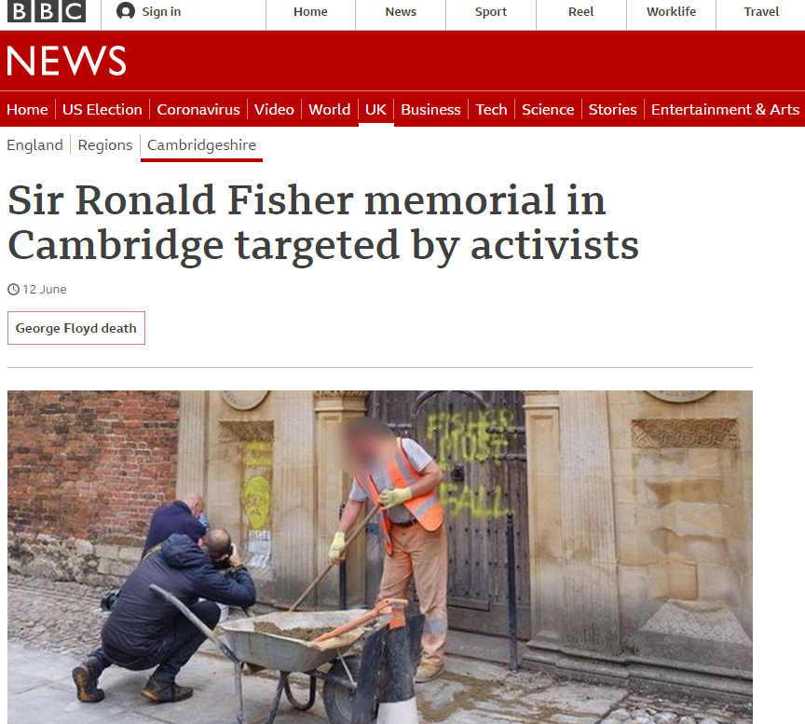
This week
Visualization basics
Statistics basics
Explore penguins dataset

Slide 3
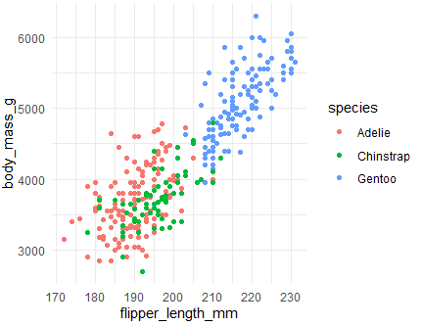
Task – try scatter plots
Replicate following graphs. How each penguin species look like according to them?

Slide 4
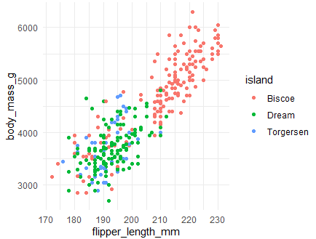
Task – explore more palletes
too subjective – no points

Slide 5
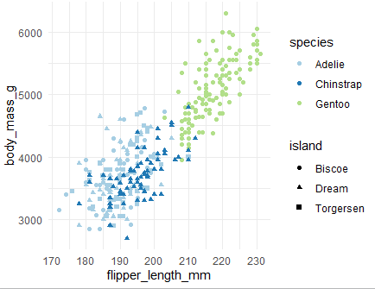
Merging two plots

Slide 6
Statistical part

Slide 7
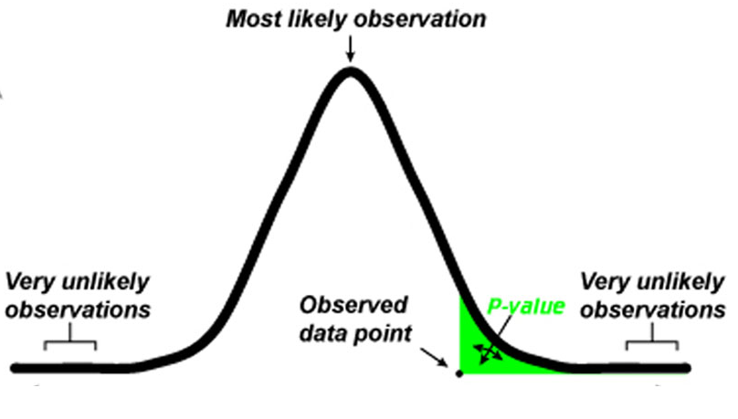
Statistical part – hypothesis testing
The bird is a penguin – keep it
H₀: Hypothesis we are assuming is true (aka null hypothesis)
H_{A}: Alternative hypothesis
If the observation is too unlikely under H₀, we say we
“reject the null hypothesis in favor of the alternative hypothesis”
What is likely/unlikely?
p-value
probability of the observation (or more extreme one) under H₀
α-level (significance level)
Intuitively threshold for p-value
It’s up to us!
Point unlikely when p < α (or 1- α < p)
The bird we just caught is NOT a penguin - release
How likely/unlikely is that a penguin would have such a weight?
http://med.stanford.edu/content/dam/sm-news/images/2016/03/p-value-index.jpg

Slide 8
Excercies
State null hypothesis and alternative hypothesis. How would proceed to reject/not reject the null hypothesis.
Bartender with following beers is unfair
490ml, 452ml, 466ml, 492ml, 460ml, 523ml, 488ml, 492ml, 480ml
Older people (60+) vote more for ANO, than younger people
Remdesivir makes patients with Covid better

Slide 9
Summary
How to create basic plots with ggplot
How it resembles dplyr
What aes()does
Understand the role of standard deviation (variance) in normal distribution
What terms like p-value, alpha level, null hypothesis mean

