Slide 1
Functional Magnetic Resonance Imaging
Jan Petr
(Jan Kybic, Emily Falk, Tor Wager, Scott Huettel)
Department of Position Emission Tomography
Institute of Radiopharmaceutical Cancer Research
Helmholtz-Zentrum Dresden-Rossendorf

Slide 2
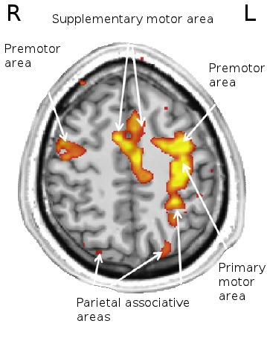
What is functional MRI (fMRI)
Using a standard MRI scanner to image brain activity through changes in blood oxygenation or perfusion.
Non-invasive, no ionizing radiation.
Good combination of spatial and temporal resolution.
  3x3x3 mm³ voxels.
  Repetition time in order of seconds.

Slide 3
Contents
Brain anatomy
Motivation to study brain
Applications
Methods of function localization
Hypercapnia BOLD
Arterial spin labeling

Slide 4
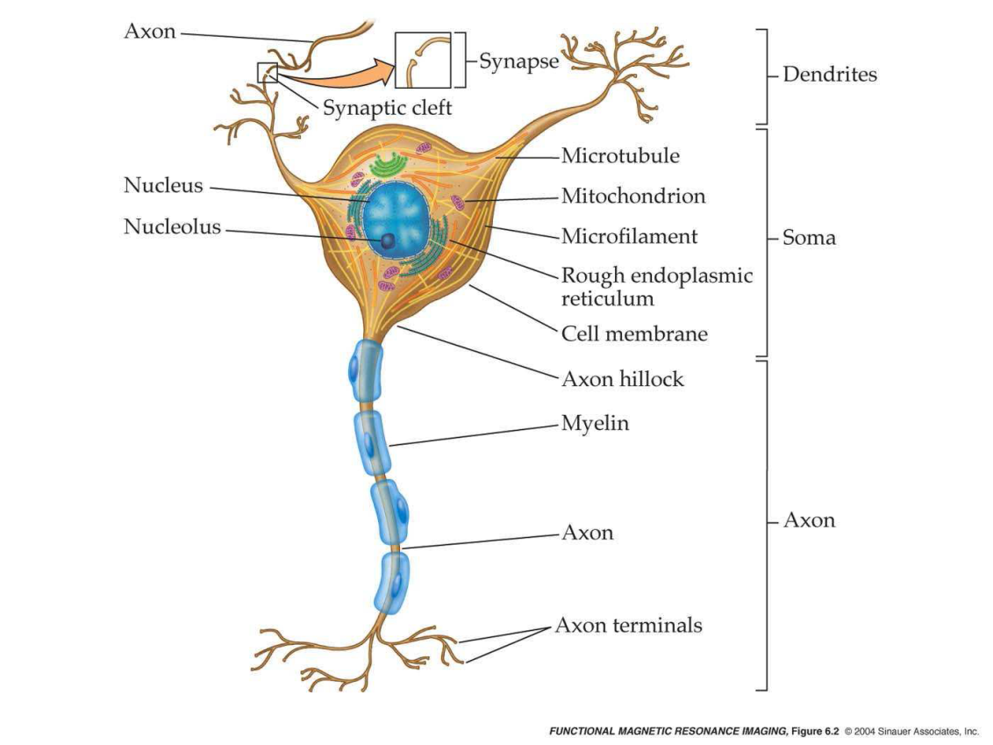
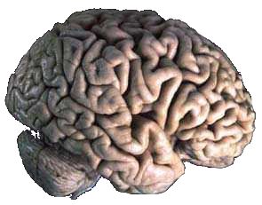
Brain anatomy
Brain – center of nervous system.
Composed of neurons and neuroglia.
Neurons communicate through axons using electrochemical processes (from mm to m).

Slide 5
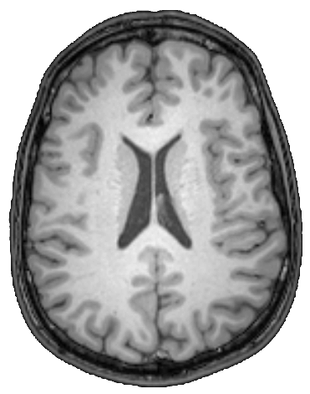
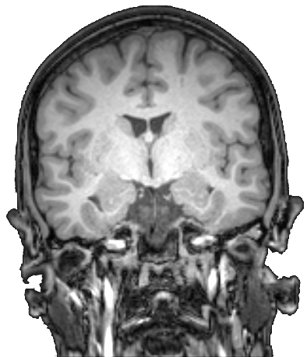
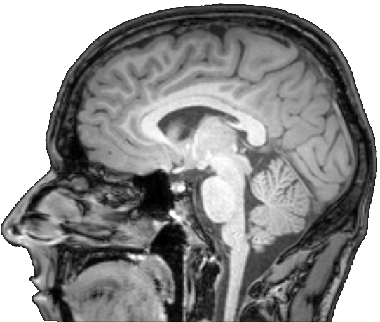
Brain anatomy
Gray matter
  Consists mostly of neurons.
  Cerebral cortex of cerebrum and cerebellum.
  Processing and cognition function.
White matter
  Consists mostly of axons.
  Connects gray matter regions.

Slide 6
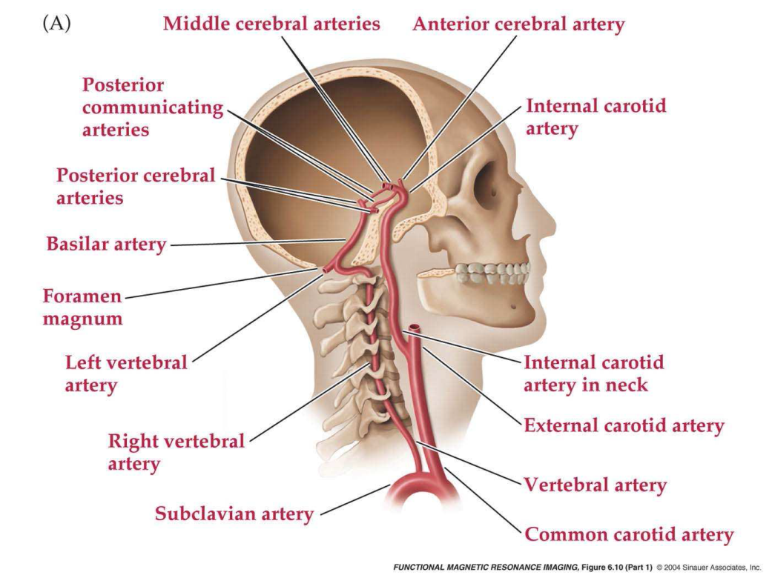
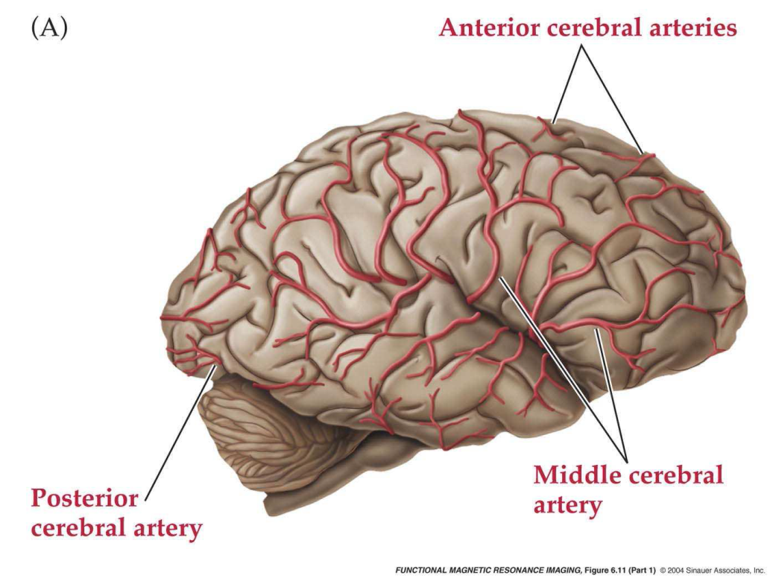
Brain anatomy
Blood supplies brain with oxygen, glucose and other nutrients.

Slide 7
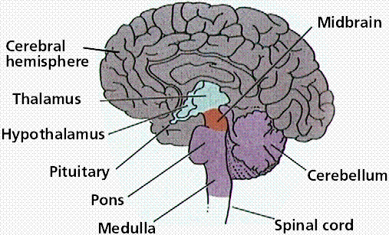
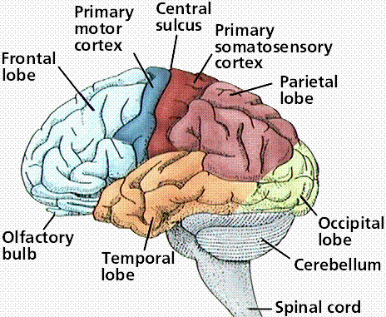
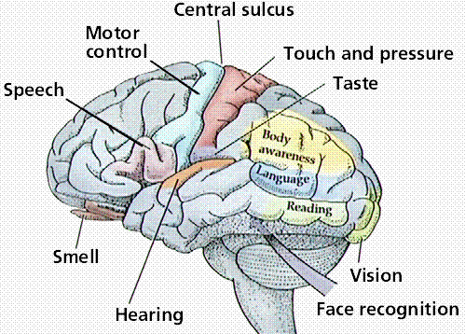
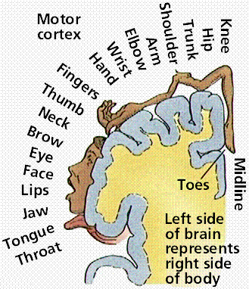
Brain anatomy
Brain regions
Purves et al., Life: The Science of Biology, 4th Edition

Slide 8
Motivation
Investigating brain physiology
Understanding the cognition processes
Studying brain development
Improving clinical procedures

Slide 9
Applications
Brain Tumors
  Direct: Mapping of functional properties of adjacent tissue
  Indirect: Understanding of likely consequences of a treatment
Drug Abuse/Addiction
  Understanding of brain effects of long-term use
  Development of treatment strategies for abusers
Drug Studies
  What are the effects of a given medication on the brain?
  How does a drug affect cognition? … our measures of cognition?
Neuropsychological disorders
  Understanding brain function may allow distinction among subtypes.
  Identifying markers for a disorder may help in treatment
Aging and brain development
  Which are normal changes are which are pathological

Slide 10

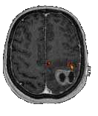
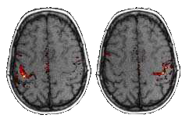

Applications
Surgery planning
Volunteer
Patient with glioblastoma

Slide 11
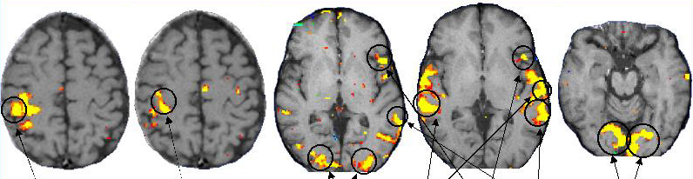
Applications
Standard brain mapping tasks
Sensory | Motor | Language |  | Vision
Touch | Finger tapping | Picture naming | Listening to words | Reversing checkerboard
passive | Active | active | passive | passive
From Hirsch, J. et al; Neurosurgery 47: 711-22, 2000.

Slide 12
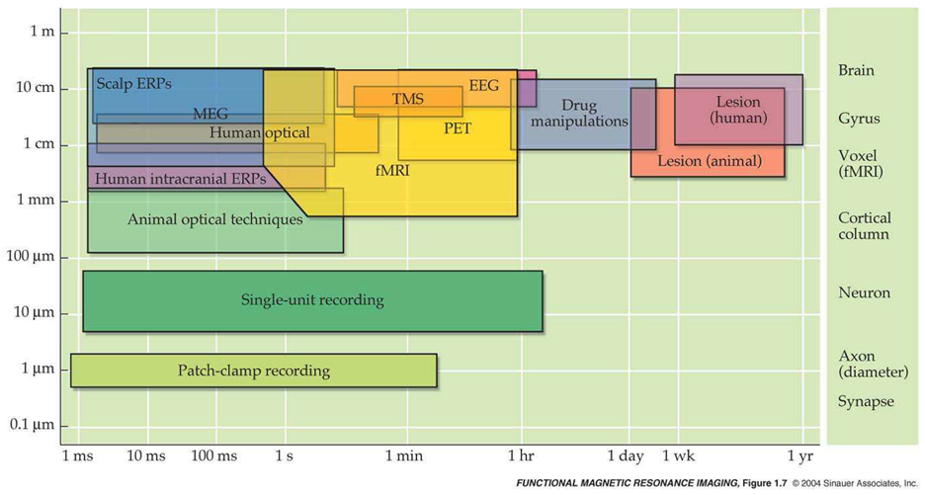
Methods for localizing brain function
Invasive
  Consequences of accidents or surgeries.
  Direct cortical stimulation.
Non-invasive
  MEG, EEG
  fMRI
  PET
  NIRS

Slide 13
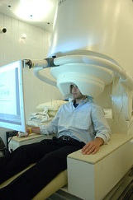
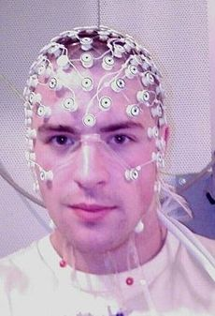
MEG/EEG
Measuring postsynaptic potentials of neurons.
Order of 100.000 neurons are needed to generate detectable change.
EEG – Electrical activity on the scalp.
MEG – magnetic fields.
EEG
MEG at NIH

Slide 14
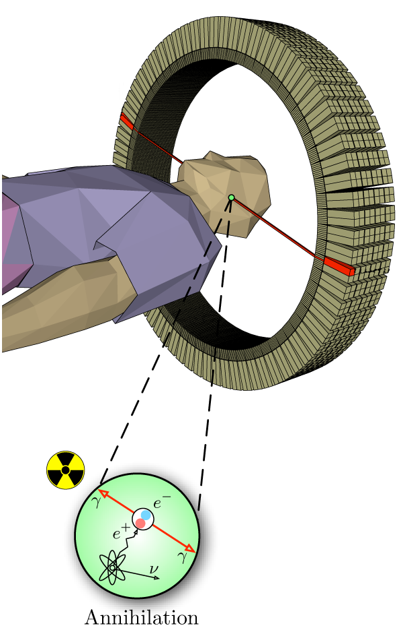
Positron emission tomography (PET)
Injection of a tracer (e.g. ¹⁸F-FDG)
  + Biologically active molecule (e.g. glucose)
  + radioisotope (e.g. fluorine-18 isotope)
Tracer accumulation in cells.
β⁺ decay → a positron is emitted
Positron + electron annihilation
Pair of γ photons emitted in opposite direction (energy 511keV)
Detection coincidences using scintillator and photomultiplier.
Reconstruction of 3D decay distribution using EM algorithm or filtered back-projection.

Slide 15
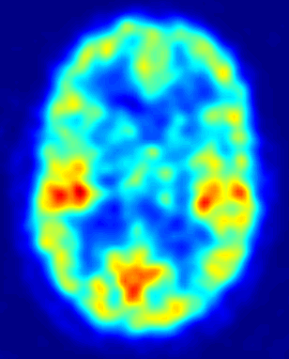
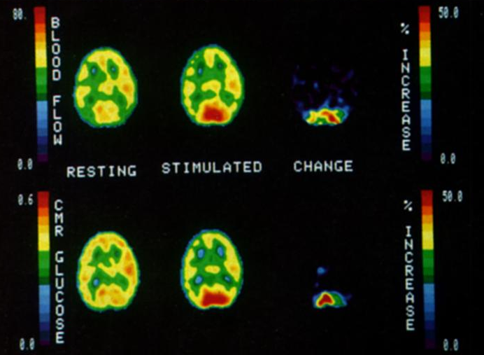
Functional studies with PET
Quantitative study of metabolic rates.
Previous PET images – static PET
  cca 1h waiting after injections
  Decay corrected measurement of activity, normalized to SUV
¹⁵O-H₂O (half-life 122 seconds)
  Oxygen metabolism.
¹⁸F-FDG
  Glucose metabolism.
Advantages
  Absolute metabolic rates.
Disadvantages
  Invasive
  Limited repeatability
  Very low temporal resolution
Duke UNC

Slide 16
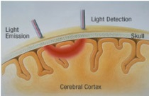
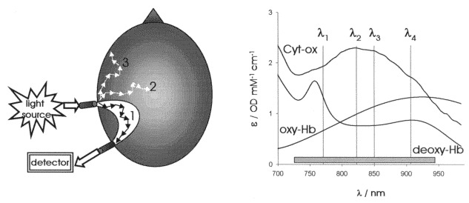
NIRS
Near infrared spectroscopy (Jöbsis, 1977).
Biological tissue is relatively transparent to light with 700-900nm.
Can penetrate skull and brain several cm deep.
Is scattered and partly absorbed on the way.
Oxygenated and deoxygenated hemoglobin, cytochrome-C-oxidase
Images: Stefanie Zechner, Ceyhun Burak Akgül.

Slide 17
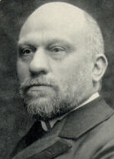
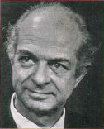
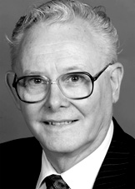
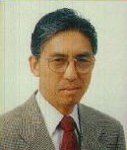
History of fMRI
Blood Oxygenation Level Dependent.
Indirect measurement correlated with neuronal activity.
Angelo Mosso
1881 – Observed changes of cerebral blood flow during mental activity
Linus Pauling
1936 – Discovered magnetic properties of haemoglobin
Peter Mansfield
1973 – Participated in discovery of Magnetic resonance imaging
1977 – Proposed Echo Planar Imaging (EPI)
Siege Ogawa
1991 – Discovered BOLD signal

Slide 18
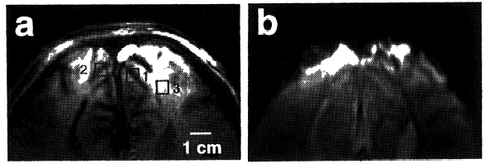
First BOLD measurements
Ogawa et al., 1990
  Mice and rats at 7T MRI
  Contrast on gradient-echo images influenced by proportion of oxygen in breathing gas.
  Increasing oxygen content → reduced contrast.
Ogawa et al., 1992
  Humans at 4T MRI
  Visual stimulation
  Changes of contrast in visual cortex

Slide 19
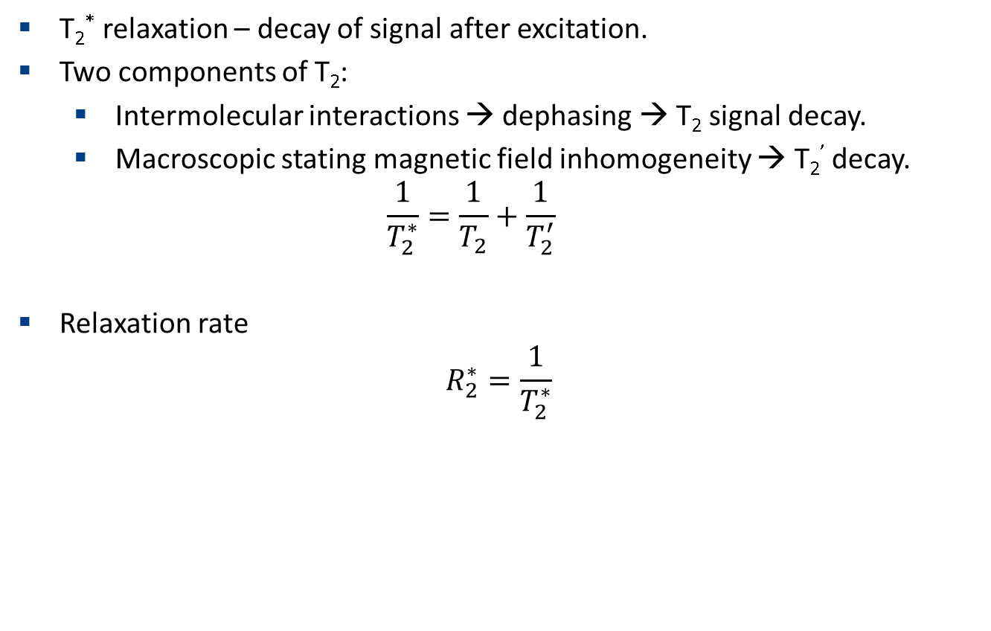
BOLD signal and T₂*
T₂* relaxation – decay of signal after excitation.
Two components of T₂:
  Intermolecular interactions → dephasing → T₂ signal decay.
  Macroscopic stating magnetic field inhomogeneity → T₂’ decay.
  $$\frac{1}{T_{2}^{∗}}=\frac{1}{T_{2}}+\frac{1}{T_{2}^{′}}$$
Relaxation rate
  $$R_{2}^{∗}=\frac{1}{T_{2}^{∗}}$$

Slide 20
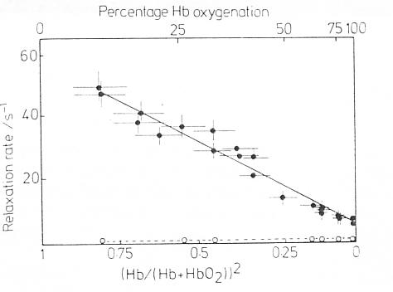
BOLD signal and T₂*
Deoxyhaemoglobin is paramagnetic, oxyhaemoglobin is diamagnetic.
  Irons binds the oxygen.
Higher dxHgb concentration → increased magnetic susceptibility → increased magnetic field inhomogeneities → decrease T₂* → decreases signal.
Thulborn et al., 1982
Decreasing relaxation time
Decreasing signal
Increasing blood oxygentation

Slide 21
BOLD during neuronal activity
Brain function
Metabolic rates
Physiological effects
Physical effects
MR properties
Neuronal activity
Glucose and oxygen metabolism
Cerebral blood volume (CBV)
Magnetic field uniformity
Decay Time (T₂*)
Cerebral blood flow (CBF)
Blood oxygenation
T₂* weighted image intensity
-
+

Slide 22
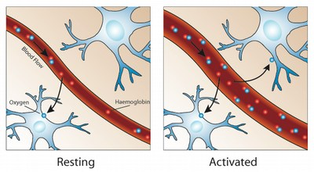
BOLD during neuronal activity
Increased CBF in the activated region.
Increased production of dxHgb (removed by increased CBF).
Per volume concentration of dxHgb decreases.
Mainly in veins.
Image:psychcentral.com

Slide 23
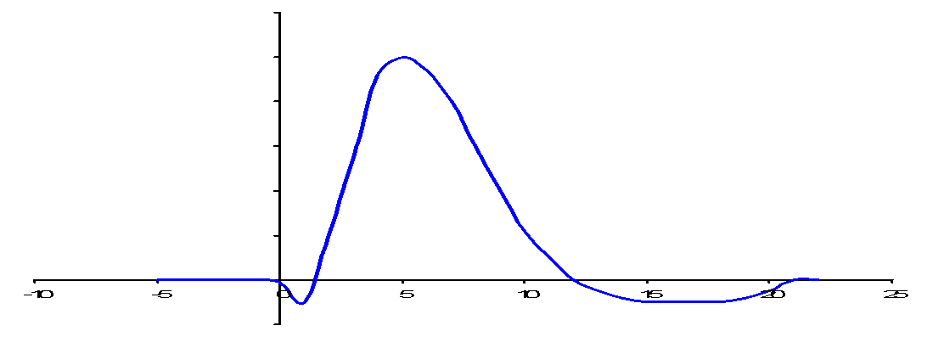
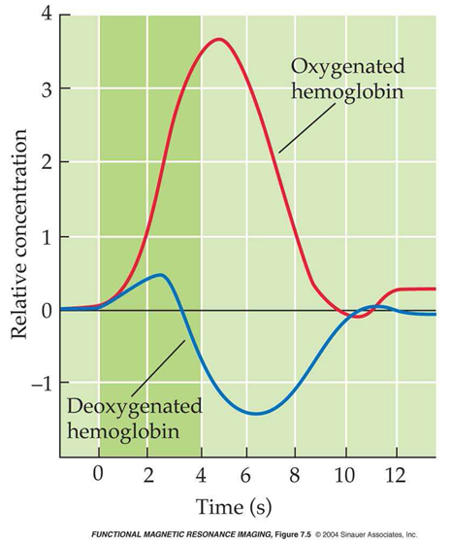

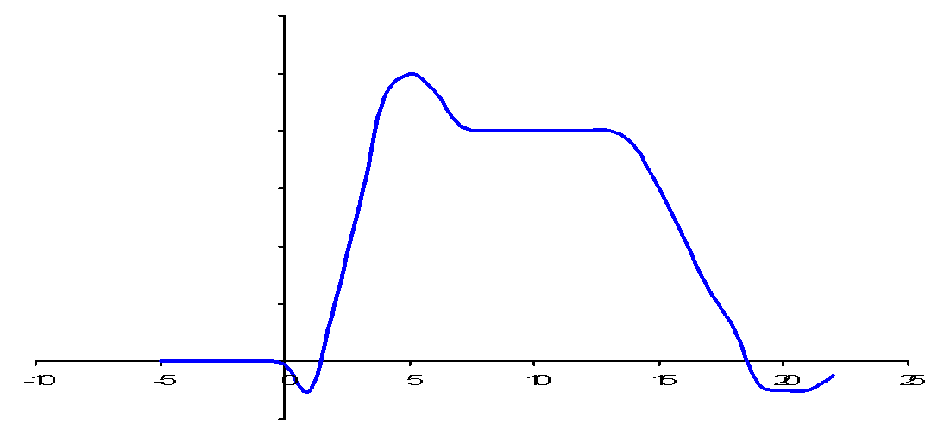

Hemodynamic response
Change in BOLD signal is not immediately after activation.
Differs between subjects and within subject.
Initial dip – increase in oxygen consumption before CBF increase.
Undershoot – CBF decrease faster than CBV.
Peak
Rise
Baseline
Undershoot
Peak
Sustained
response
Rise
Baseline
Initial dip
Undershoot

Slide 24
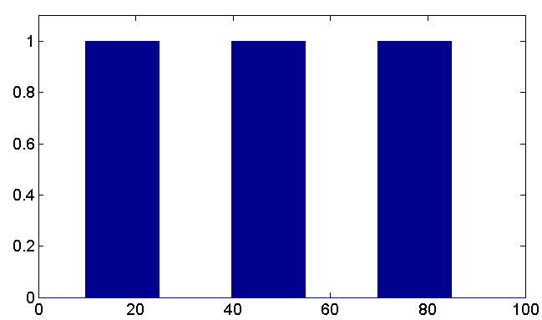
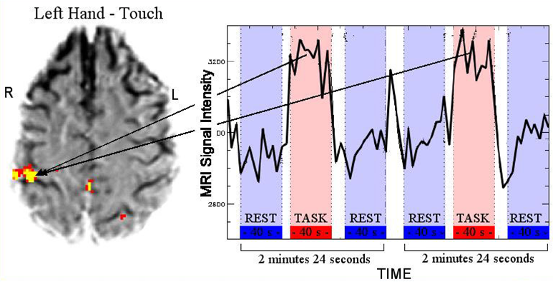
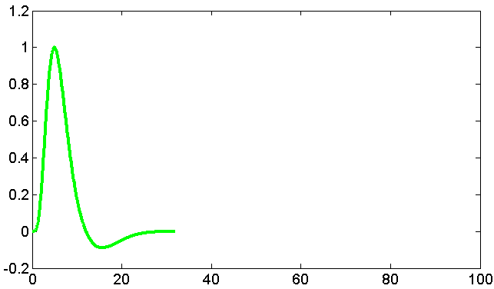
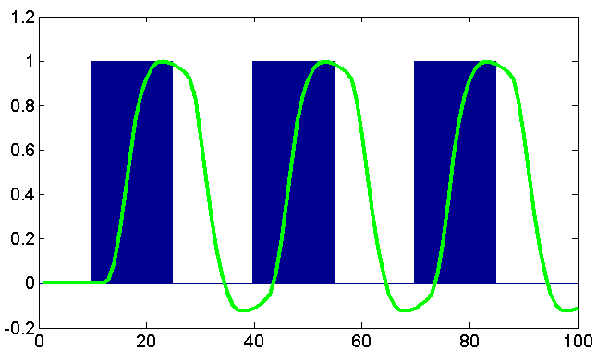
fMRI study design
BOLD signal – combination of many things – CBV, CBF, O₂ metabolism rate (CMRO₂) etc.
Cannot be simply quantified.
Observe change of BOLD signal as a reaction on a task or event.
Stimulus
HRF
Expected
response
Images:Tor Wager
Hirsch J. et al. Neurosurgery 47. 711-22.2000

Slide 25
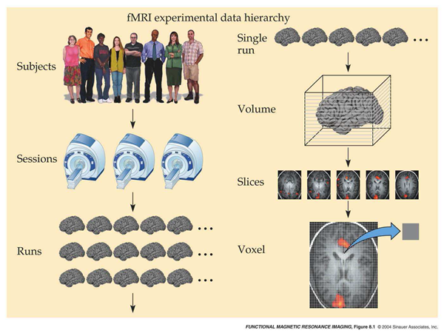
Terminology

Slide 26
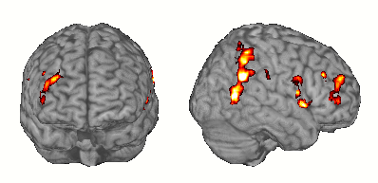
fMRI experimental design
Goals: To detect what is active.

Slide 27
Block design
Different cognitive processes segregated into distinct time periods
  Task A/ Task B / Task A / Task B
    Good to differentiate between conditions.
    Do not see common activity.
  Task A/ rest / Task A / rest …
Disadvantages:
  Sensitive to choice of baseline, signal drift, head motion.

Slide 28
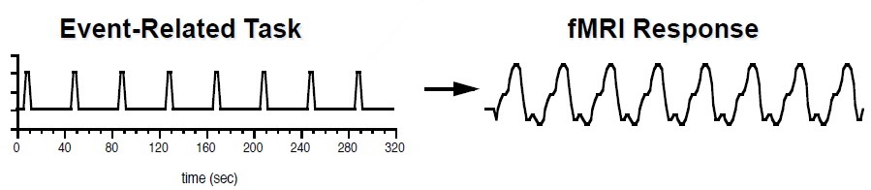
Event-related design
Associate brain processes with discrete events that may occur at any point in the scanning session.
Responses to brief event are almost always weaker than responses to blocks of events.

Slide 29
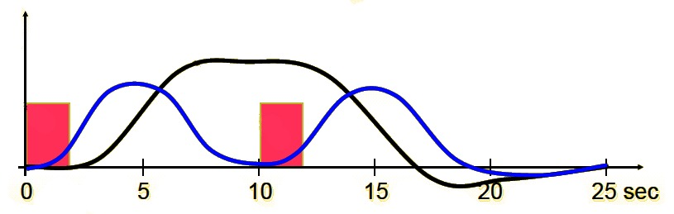
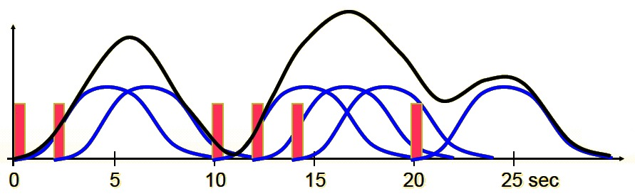
Event-related design
Long constant response
shows memory maintenance
Items to
remember
Consider that HRF has long delay (2-3 s) and duration (8-16 s).
Event-related fMRI with fixed timing (typically 10-20s) or with randomized timing (jittered).
Distinguishing between subtasks.
Overlapping responses superimpose.
Memory probe
Response to each
stimuli show item
encoding/recognition
Combined response
by superposition
of individual responses
Responses to
individual events
Events

Slide 30
Event-related design
Advantages
  Avoids habituation issues.
  Flexible.
  Self-paced tasks.
  Can analyze correct/incorrect responses separately.
Disadvantages
  Reduced sensitivity relative to blocked design.
  Sensitive to accuracy of shape of HRF.
  Short intervals may cause non-linear behavior.

Slide 31
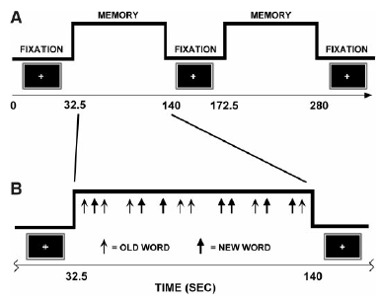
Mixed design
Combination of block and event-related designs.
Best combination for detection and estimation.
Donaldson et al., 2001

Slide 32
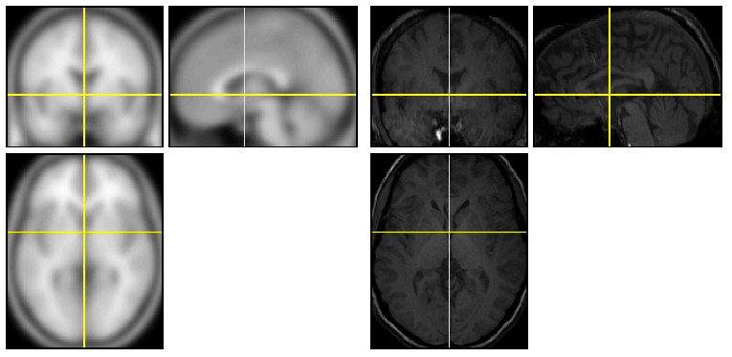
Preprocessing
Correcting for non-task related variability in data.
Correct for head motion
  6 parameters rigid transformation – 3 translations, 3 rotations.
Spatial normalization
  To MNI template (Montreal Neurological Institute) – approximated to the Talairach space (single segmented subject)
  Larger population – detect more than in single subjects.
MNI template Normalized data

Slide 33
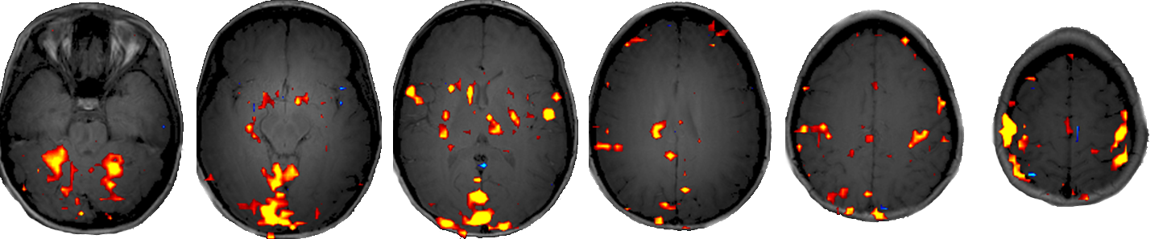
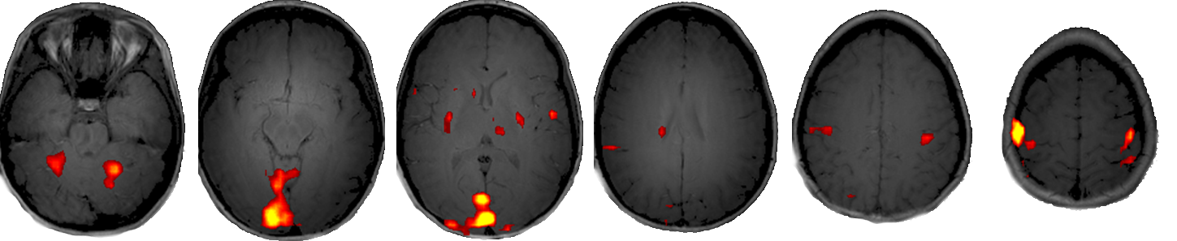
Preprocessing
Temporal filtering with high pass filter – to avoid baseline changes.
Spatial smoothing
  Convolution with a Gaussian kernel.
  Improves SNR/reduces spatial resolution.

Slide 34
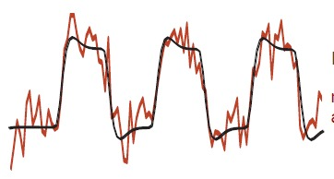
fMRI evaluation
Block design → expected response.
Correlate model at each voxel separately.
Measure residual noise variance
t-statistic = model fit / noise amplitude
Threshold t-stats and display map

Slide 35
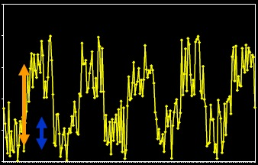
fMRI signal and noise
Types of noise:
  Thermal noise
  Head motion
  Physiological changes
  Artifacts
Signal to noise ratio (SNR)
Task-related variability
SNR =
Non-task-related variability

Slide 36
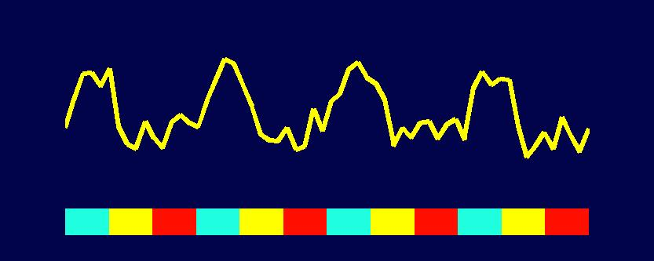



fMRI Generalized linear model (GLM)
Block design experiment with a language task.
3 tasks:
  Word generation: Noun presented on screen – verb generated.
  Word shadowing: Noun presented on screen – thinking on it.
  Rest.
Generation
Shadowing
Rest
Images: Jesper Andersson
Time

Slide 37

Generalized linear model
Generalized linear regression model.
    $$y=Xβ+ε$$
Noise
Measured data
Amplitude (to solve for)
Design model

Slide 38



GLM – regressors – X
Voxel with this response is responsible for word generation
Word shadowing voxel
Resting voxel

Slide 39





Generalized linear model
Fitting the model to the measured data – estimating betas.
2
3
4
0
1
0
1
0
1
2
≈
β₁∙
+ β₂∙
+ β₃∙
    $$y=Xβ+ε$$

Slide 40


Generalized linear model
Bad fit.
2
3
4
0
1
0
1
0
1
2
≈
β₁∙
+ β₂∙
+ β₃∙
0
0
3
    $$β=[0,0,3]$$

Slide 41


Generalized linear model
Active in word generation.
2
3
4
0
1
0
1
0
1
2
≈
β₁∙
+ β₂∙
+ β₃∙
0.83
0.16
2.98
    $$β=[0.83, 0.16, 2.98]$$

Slide 42


Generalized linear model
Active in word generation and shadowing.
1
2
3
0
1
0
1
0
1
2
≈
β₁∙
+ β₂∙
+ β₃∙
0.68
0.82
2.17
    $$β=[0.68, 0.82, 2.17]$$

Slide 43


Generalized linear model
Voxel not active.
1
2
3
0
1
0
1
0
1
2
≈
β₁∙
+ β₂∙
+ β₃∙
0.03
0.06
2.04
    $$β=[0.03, 0.06, 2.04]$$

Slide 44









Generalized linear model – fitting error
beta_0001.img
Time-series
...
beta_0002.img
$$β=\left[\begin{matrix}0.83 \\ 0.16 \\ 2.98\end{matrix}\right]$$
beta_0003.img
...
$$σ^{2}∝\sum_{i=1}^{n}{e^{2}=9.47}$$
ResMS.img

Slide 45




Generalized linear model
Why is error important?
Which series should we trust?
β1=1
σ=0.2
n=60
β1=1
σ=0.5
n=60
β1=0.3
σ=0.2
n=60
β1=1
σ=0.2
n=15

Slide 46


GLM – statistics
Is there some effect? c =[1 0 0]. Is $β_{1}≠0?$
Alternative hypothesis – what we expect to find in the data.
Null hypothesis – what you not expect to find if the alternative hypothesis is consistent with reality.
We want to reject the null hypothesis.
Calculate the t-contrast:
$$t=\frac{c^{T}β}{σ\sqrt{c^{T}{(X^{T}X)}^{−1}c}}$$
$$H_{0}: c^{T}β=\left[\begin{matrix}1 & 0 & 0\end{matrix}\right]\left[\begin{matrix}0.83 \\ 0.16 \\ 2.98\end{matrix}\right]=0$$
$$H_{a}: c^{T}β≠0$$

Slide 47



Statistics
t-contrast – follows Student’s t-distribution with n-1 degrees of freedom.
P-value - How likely is to draw $x if the$null hypothesis is true.
For 100 observations, we can reject the null hypothesis at 95% confidence for t>2.009

Slide 48

GLM – t-contrast

Slide 49


GLM – t-contrast
Voxels activated in word generation.
c = [1 0 0]

Slide 50


GLM – t-contrast
Voxels activated in more in word generation than in shadowing.
c = [1 -1 0]

Slide 51

Types of error
$α=0.05$ → there is 5% chance that we reject H₀ that is true (false positive). Threshold ${α=P(T>u}_{α}\left|H_{o}\right).$
p-value. Probability of drawing a sample if Null is true. Cannot get Type I error rate without knowing prior probability!
${{P(T>u}_{α}∩H_{o})= P(T>u}_{α}\left|H_{o}\right)P(H_{o}$)
Truth
H_{a} (Active)
H₀ (Inactive)
HIT
Type I Error
Reject H₀ (Active)
Output of Statistical Test
Accept H₀ (Inactive)
Type II Error
Correct Rejection

Slide 52

Multiple-comparisons
Multiple comparisons – performing multiple statistical test simultaneously.
$α=0.$1, test on 64x64 pixels → we have 360 false positives on average.
Bonferroni correction
  Divide p by the number of test-> $p_{FWER}=\frac{α}{n}=2{×10}^{−5}$
  No false positives!
  Type II error greatly increase.

Slide 53




Family wise error (FWE) correction
Family wise null hypothesis: activation is zero everywhere.
If we reject a voxel null hypothesis at any voxel, we reject the family-wise null hypothesis.
Control the $α$ – rate of false positives in the whole image, by thresholding t-contrast with $u_{α}$
$α=P\left(\bigcup_{i}{\left\{t_{i}>u_{α}\right\}|H_{0}}\right)$
Get the distribution of t_{i} across the whole volume. Pick the $α$ best ones.
$$u_{α}$$

Slide 54



False discovery rate (FDR)
Control false positive among voxels declared positive.
Order uncorrected p-values for all voxels
  p₁<p₂<p₃<…<p_{N}
FDR controlled at α → find largest k that:
$$p_{k}<\frac{\text{α}k}{N}$$
Take all p₁…p_{k}.

Slide 55
BOLD fMRI summary
PROS:
  3D with good spatial resolution.
  Noninvasive , in-vivo and repetitive acquisitions.
CONS:
  Cost.
  Poor temporal resolution.
  Strong magnetic field.
  Not really comfortable.
  Averaging (cannot be used for single events).

Slide 56




Hypercapnia BOLD
Blood Oxygenation Level Dependent
Block-design experiment
  Repeated acquisition every 3s
  alternating phases of normal breathing/breath-hold (15s)
Breath-hold → increases level of C0₂ → vasodilation →increase in signal
Hypercapnia – separate change in vessels from oxygen metabolism
normal breathing
Breath-hold
Notes:
Increased oxygen consumption CMRO2 -> increase of dHb and increase in CO2.
BOLD – initial dip (CMRO2 because of increased consumption), followed by increased CBF which is the main source of signal increase.
Hypercapnia: breathhold -> the CO2 stays in blood, increased partial pressure PCO2. CMRO2 doesn’t change -> no change in dHb. Increase in PCO2 -> dilatation of vessel -> increased CBF -> increased signal.
Study the vascular component of BOLD signal – reaction of vessels on CO2, rather than the metabolism and activity in the tissue itself.

Slide 57
Arterial spin labeling
Drawbacks of BOLD:
  Not quantitative.
  No baseline – relative changes.
Alternative:
  Arterial spin labeling.
  Native method for measuring perfusion.

Slide 58

Arterial spin labeling
Perfusion - process of delivery of blood to biological tissue.
Assessment of ischemia, dementia, tumors.
Arterial spin labeling (ASL).
Magnetically labeled blood is used as a “tracer”.
Excite protons in a thick (~15cm) slab (180° RF pulse).
After short delay ~1s, images are acquired.
Imaged area
Labeled blood
Labeled area
labeling
delay
acquisition

Slide 59


Arterial spin labeling
Acquired images contain signal from both labeled blood and static tissue.
Two acquisitions – with/without blood labeling.
Difference is perfusion-weighted.
-
=
without labeling
with labeling
perfusion-weighted

Slide 60




ASL quantification
Similar principle as in PET – Ketty-Schmidt one compartment model.
Inflow of “tracer” – c
Exchange with tissue – r
Relaxation of the signal - m

Slide 61
ASL vs BOLD
Quantitative
Low task frequency
Lower temporal resolution
Higher noise
Good temporal resolution
High functional contrast
No baseline
No single physiological parameter
Pros
Cons
Notes:
ASL - a single physiological parameter, not a mix of parameters like with BOLD.
ASL - Very low task frequency (days).
BOLD – not good in slow paradigms because it drifts, and auto-regression destroys the signal taking it as drift.

Slide 62


HZDR
Research center 15 km east of Dresden.
500+ researchers
Ion-Beam Physics, High Magnetic Field, Fluid Dynamics, Radiopharmacy, Radiation Physics
Helmholtz association
Dpt of Radiopharmaceutical cancer research. PET center.
PET/MRI
Cooperation with TU Dresden, Uniklinikum Dresden, OncoRay.
Looking for talented Master and PhD students!
Possibility for joint supervision with Jan Kybic.
Contact:
  j.petr@hzdr.de

