Slide 1
Applications of Evolutionary Algorithms

Slide 2
What you will learn
Common traits of problems which can be solved by EAs efficiently
“HUMIES” competition with few examples of winning solutions of various problems
When EAs can be competitive with Reinforcement Learning techniques when solving various control problems
EAs play nicely with other methods to solve complex problems
See other students’ projects

Slide 3
Evolutionary Algorithms
metaheuristics and black box optimization techniques
explore a space of parameters to find solutions that score well according to a fitness function
maintain a population, and use evolution-inspired approaches like mutation and cross-over to change individuals in the population
due to their random nature, evolutionary algorithms are never guaranteed to find an optimal solution for any problem

Slide 4
When are Evolutionary Algorithms Useful?
EAs typically provide good approximate solutions to problems that cannot be solved easily using other techniques
many optimization problems fall into this category
it may be too computationally-intensive to find an exact solution but sometimes a near-optimal solution is sufficient
EAs can be used to tackle problems that humans don't really know how to solve
it is merely necessary that we can recognize a good solution if it were presented to us, even if we don't know how to create a good solution
they are free of any human biases, can generate surprising solutions that are comparable to, or better than, the best human-generated efforts
EAs play nicely with other techniques

Slide 5
Examples of problems solved by EA

Slide 6
HUMIES
Annual “HUMIES” awards for human-competitive results produced by genetic and evolutionary computation held at the Genetic and Evolutionary Computation Conference (GECCO)
Entries present human-competitive results that have been produced by any form of genetic and evolutionary computation (including, but not limited to genetic algorithms, genetic programming, evolution strategies, evolutionary programming, learning classifier systems, grammatical evolution, gene expression programming, differential evolution, etc.) and that have been published in the open literature.
Human-competitive results awarded in areas:
- Analog circuit design - Game strategies
- Quantum circuit design - Image processing
- Physics - Antenna design
- Digital circuits/programs - Classical optimization
- Chemistry - …
http://www.genetic-programming.org/combined.html

Slide 7
2017 Human-Competitive Awards in Genetic and Evolutionary Computation
http://www.genetic-programming.org/gecco2004hc.html
$5000 – Gold
Robin Harper, Robert J. Chapman, Christopher Ferrie, Christopher Granade, Richard Kueng, Daniel Naoumenko, Steven T. Flammia, Alberto Peruzzo: Explaining quantum correlations through evolution of causal models
$3000 – Silver
Shin Yoo, Xiaoyuan Xie, Fei-ching Kuo, Tsong Yueh Chen, Mark Harman: Human Competitiveness of Genetic Programming in Spectrum Based Fault Localisation: Theoretical and Empirical Analysis
$1000 – Bronze
Michael Fenton, Ciaran McNally, Jonathan Byrne, Erik Hemberg, James McDermott, Michael O’Neill: Automatic innovative truss design using grammatical evolution
Risto Miikkulainen, Neil Iscoe, Aaron Shagrin, Ron Cordell, Sam Nazari, Cory Schoolland Et Al.: Conversion Rate Optimization through Evolutionary Computation

Slide 8
Automated Design of Electrical Circuits
Automated “What You Want Is What You Get” process for circuit synthesis.
Genetic programming used to synthesize both
the structure/topology, and
sizing (numerical component values)
for circuits that duplicate the patented inventions’ functionality.
Method
Starts from a high-level statement of a circuit’s desired behaviour and characteristics and only minimal knowledge about analogue electrical circuits.
Then, a fitness measure is created that reflects the invention’s performance and characteristics – it specifies the desired time- or frequency-domain outputs, given various inputs.
Employs a circuit simulator for analyzing candidate circuits, but does not rely on domain expertise or knowledge concerning the synthesis of circuits.

Slide 9
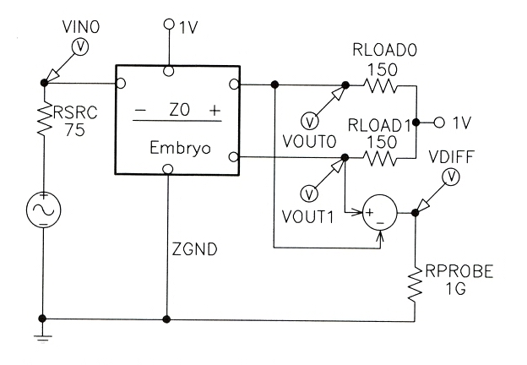
Automated Design of Electrical Circuits
Method
For each problem, a test fixture consisting of appropriate hard-wired components (such as a source resistor or load resistor) connected to the input ports and desired output ports is used.
Test fixture

Slide 10
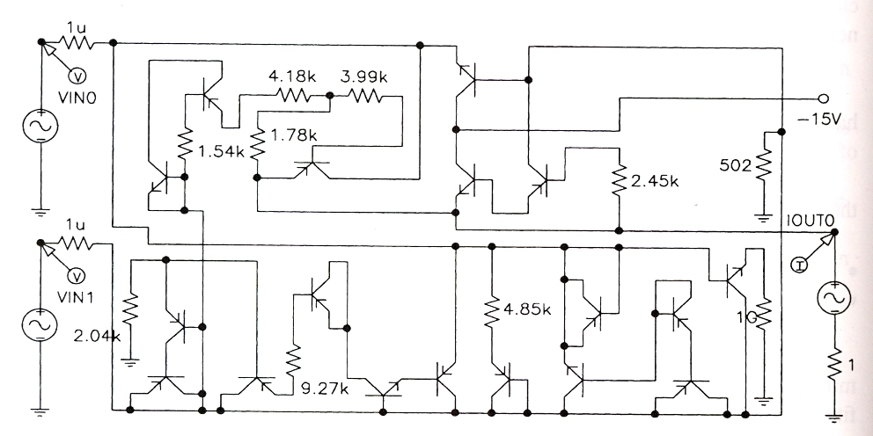
Voltage-Current Conversion Circuit
Voltage-current conversion circuit’s purpose is to take two voltages as input and to produce as output a stable current whose magnitude is proportional to the difference between the voltages.
Fitness measure is based on four time-domain input signals.
Genetically evolved circuit
has roughly 62 percent of the average (weighted) error of the patented circuit and
outperformed the patented circuit on additional previously unseen test cases.
John R. Koza et al.: What's AI Done for Me Lately? Genetic Programming's Human-Competitive Results.

Slide 11
High-Current Load Circuit
The genetically evolved circuit shares some features found in the patented solution
a variable, high-current, low-voltage, load circuit for testing a voltage source, comprising … a plurality of high-current transistors having source-to-drain paths connected in parallel between a pair of terminals and a test load.
However, the remaining elements of the genetically evolved circuit bear hardly any resemblance to the patented circuit.
GP produced a circuit that duplicates the patented circuit’s functionality using a different structure.
John R. Koza et al.: What's AI Done for Me Lately? Genetic Programming's Human-Competitive Results.

Slide 12
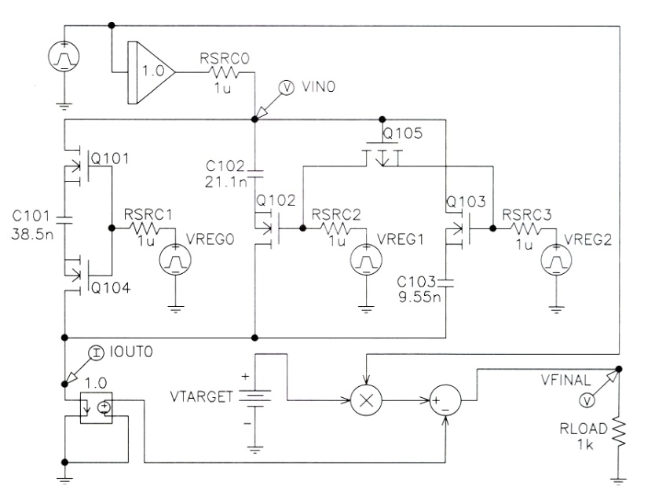
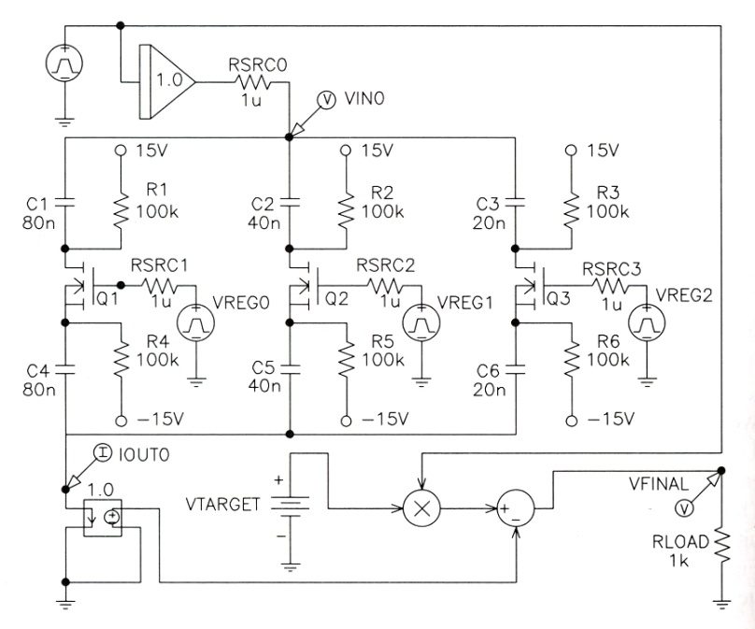
Mixed Analog-Digital Register-Controlled Variable Capacitor
Mixed analog-digital variable capacitor circuit has a capacitance controlled by the value stored in a digital register.
Fitness measure was based on the error accumulated by 16 combinations of time-domain test signals ranging over all eight possible values of a 3-bit digital register for two different analog input signals.
The evolved circuit performs as well as the patented circuit.
Evolved circuit Patented circuit
John R. Koza et al.: What's AI Done for Me Lately? Genetic Programming's Human-Competitive Results.

Slide 13
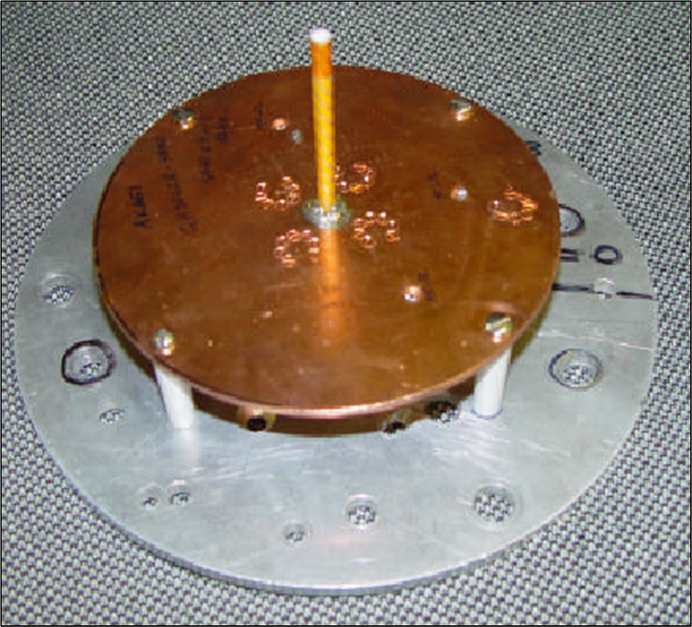
Evolved Antennas for Deployment on NASA’s Space Technology 5 Mission
Original ST5 Antenna Requirements
Transmit: 8470 MHz
Receive: 7209.125 MHz
Gain:
>= 0dBic, 40 to 80 degrees
>= 2dBic, 80 degrees
>= 4dBic, 90 degrees
50 Ohm impedance
Voltage Standing Wave Ratio (VSWR):
< 1.2 at Transmit Freq
< 1.5 at Receive Freq
Fit inside a 6” cylinder
ST5 Quadrifilar Helical Antenna
designed by a team of human designers
won the contract
© Jason D. Lohn, Gregory S. Hornby, Derek S. Linden: Human-Competitive Results: Evolved Antennas for Deployment on NASA’s ST5 Misson

Slide 14
Evolved Antenna for Space Technology 5 mission
Branching EA: Antenna Genotype
Genotype is a tree-structured encoding that specifies the construction of a wire form
Genotype specifies design of 1 arm in 3-space:
f
rx
f
f
rz
rx
5.0cm
f
f
Branching in genotype results in branching
in wire form
Feed Wire
2.5cm
© Jason D. Lohn, Gregory S. Hornby, Derek S. Linden: Human-Competitive Results: Evolved Antennas for Deployment on NASA’s Space Technology 5 Misson

Slide 15
Evolved Antenna for Space Technology 5 mission
Branching EA: Antenna Construction Commands
forward(length radius)
rotate_x(angle)
rotate_y(angle)
rotate_z(angle)
Forward() command can have 0,1,2, or 3 children.
Rotate_x/y/z() commands have exactly 1 child (always non-terminal).
Fitness function (to be minimized):
F = VSWR_Score * Gain_Score * Penalty_Score
f
rx
f
f
rz
rx
f
f

Slide 16
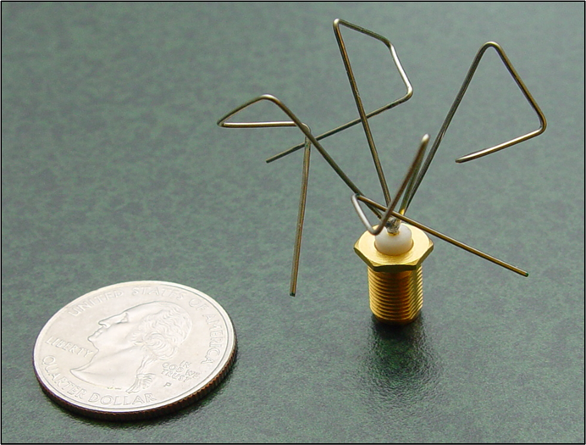
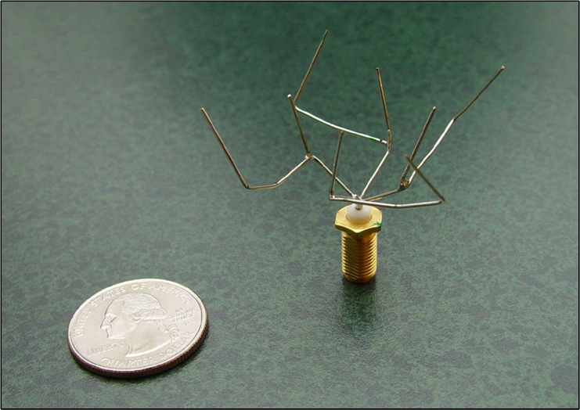
Evolved Antenna for Space Technology 5 mission
1st Set of Genetically Evolved Antennas
© Jason D. Lohn, Gregory S. Hornby, Derek S. Linden: Human-Competitive Results: Evolved Antennas for Deployment on NASA’s Space Technology 5 Misson
Non-branching:
ST5-4W-03
Branching:
ST5-3-10

Slide 17
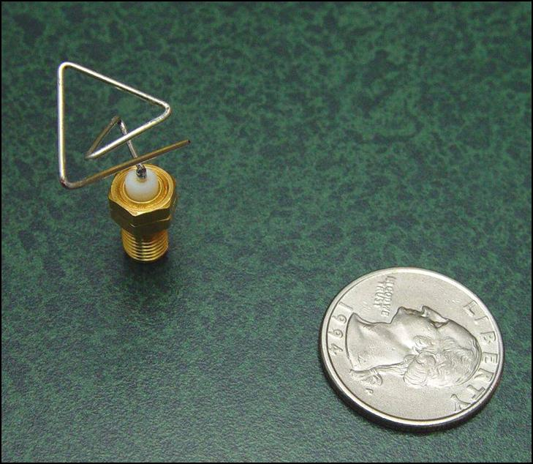
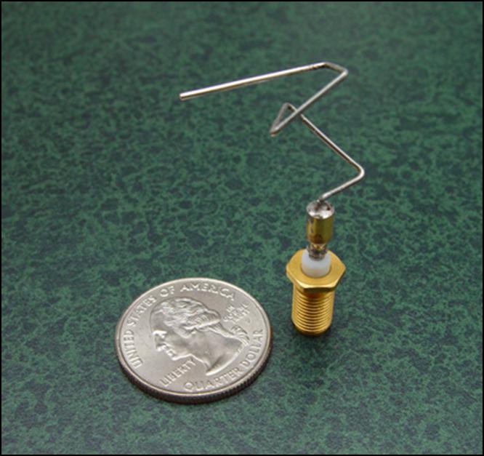
Evolved Antenna for Space Technology 5 mission
2nd Set of genetically evolved antennas for new mission requirements
© Jason D. Lohn, Gregory S. Hornby, Derek S. Linden: Human-Competitive Results: Evolved Antennas for Deployment on NASA’s Space Technology 5 Misson
EA 1 – Vector of Parameters
EA 2 – Constructive Process

Slide 18
Evolved Antenna for Space Technology 5 mission
Conclusion
Meets mission requirements.
Better than conventional design.
Successfully passed space qualification.
First Evolved Hardware in Space when mission launched in 2005.
Direct competition: The antenna designed by the contracting team of human designers for the Space Technology 5 mission - which won the bid against several competing organizations to supply the antenna - did not meet the mission requirements while the evolved antennas did meet these requirements.
Evolutionary design:
Fast design cycles save time/money (4 weeks from start-to-first-hardware).
Fast design cycles allow iterative “what-if”.
Can rapidly respond to changing requirements.
Can produce new types of designs.
May be able to produce designs of previously unachievable performance.

Slide 19
Automatically Finding Patches Using GP
Fully automated method for locating and repairing bugs in software
Set of testcases consists of both
a set of negative testcases – that characterize a fault
A set of positive testcases that encode functionality requirements.
Special GP representation of evolved repaired programs.
An abstract syntax tree including all of the statements in the program (CIL toolkit for manipulating C programs)
A weighted path through the program – a list of pairs [statement, weight] where the weight is based on that statement’s occurences in the tescases.
Program locations visited when executing the negative testcases are favored to program locations visited while executing the positive testcases.
Genetic operators realize insertion, deletion, and swapping program statements and control flow. Insertions based on the existing program structures are favored.
After a primary repair that passes all negative and positive testcases has been found, it is further minimized w.r.t. the number of differences between the original and repair program.

Slide 20
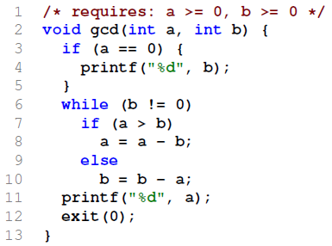
Automatically Finding Patches Using GP
Example: Euclid’s greatest common divisor
Original program

Slide 21
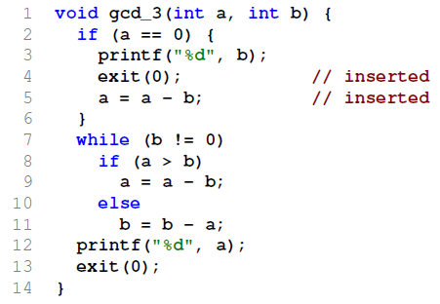
Automatically Finding Patches Using GP
Example: Euclid’s greatest common divisor
Original program Primary repair
generated given the bias towards modifying lines that are involved in producing the faults and the preference for insertions similar to existing code.

Slide 22
Automatically Finding Patches Using GP
Example: Euclid’s greatest common divisor
Original program Primary repair
generated given the bias towards modifying lines that are involved in producing the faults and the preference for insertions similar to existing code.
After repair minimization

Slide 23
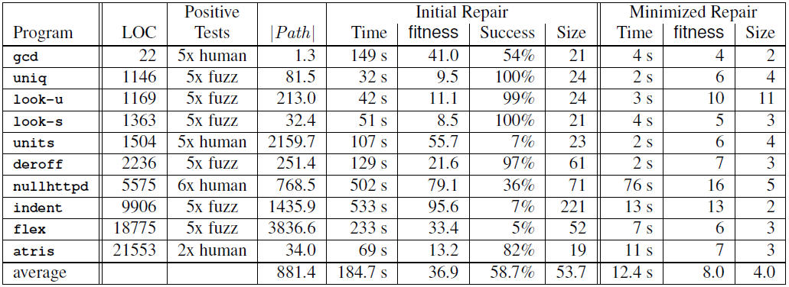
Automatically Finding Patches Using GP
10 different C programs of different size totaling 63,000 lines of code (LOC)

Slide 24
Survive in environment (1994)

Slide 25
Improving trading strategies with EAs

Slide 26
EA vs Reinforcement Learning

Slide 27
EAs vs RL
Differences
agents can learn during their lifetimes; it’s not necessary to wait to see if they “live” or “die”
every state can be evaluated and its reward is propagated back to mark all the choices that were made leading up to that state
Similarities
there is a choice made between exploring new things and exploiting the information learned so far
EAs explore via mutation
RL exploration is via allowing the probability of choosing new actions

Slide 28
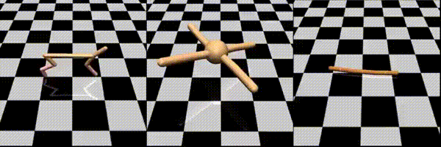
ES as a Scalable Alternative to RL
evolution strategies rivals the performance of standard RL techniques on modern RL benchmarks (e.g. Atari/MuJoCo), while overcoming many of RL’s inconveniences
backpropagation in Neural Network was replaced by ES (much easier to parallelize)
ES does not suffer in settings with sparse rewards, and has fewer hyperparameters
ES is simpler to implement and it is easier to scale in a distributed setting
“Running on a computing cluster of 80 machines and 1,440 CPU cores, our implementation is able to train a 3D MuJoCo humanoid walker in only 10 minutes (A3C on 32 cores takes about 10 hours). Using 720 cores we can also obtain comparable performance to A3C on Atari while cutting down the training time from 1 day to 1 hour.”

Slide 29
EA play nicely with other techniques

Slide 30
Neuroevolution
technique that applies evolutionary algorithms to construct artificial neural networks, taking inspiration from the evolution of biological nervous systems in nature
uses evolutionary algorithms to generate artificial neural networks parameters, topology, and rules
is highly general; it allows learning without explicit targets, with only sparse feedback, and with arbitrary neural models and network structures
can be applied more widely than supervised learning algorithms, which require a syllabus of correct input-output pairs
requires only a measure of a network's performance at a task
works great on RL problems,
used for robotic tasks

Slide 31
MarI/O

Slide 32
Galactic Arms Race

Slide 33
Google’s Deep Dream
each layer of ANN progressively extracts higher and higher-level features of the image, until the final layer essentially makes a decision on what the image shows.
For example, the first layer maybe looks for edges or corners. Intermediate layers interpret the basic features to look for overall shapes or components, like a door or a leaf. The final few layers assemble those into complete interpretations—these neurons activate in response to very complex things such as entire buildings or trees.
one way to visualize what goes on is to turn the network upside down and ask it to enhance an input image in such a way as to elicit a particular interpretation.
Say you want to know what sort of image would result in “Banana.” Start with an image full of random noise, then gradually tweak the image towards what the neural net considers a banana
neural networks that were trained to discriminate between different kinds of images have quite a bit of the information needed to generate images too

Slide 34
Google’s Deep Dream

Slide 35
Students’ videos

