Slide 1
VORONOI DIAGRAM
PETR FELKEL
FEL CTU PRAGUE
felkel@fel.cvut.cz
https://cw.felk.cvut.cz/doku.php/courses/a4m39vg/start
Based on [Berg] and [Mount]
Version from 28.11.2013

Slide 2
Talk overview
Definition and examples
Applications
Algorithms in 2D
  D&C O(n log n)
  Sweep line O(n log n)
www.cguu.com
Notes:
80-85 minut
B111 – asi 85 minut – zkusil jsem otázky
Slajdy 28, 33, 39 – překvapili mne, že zas tolik pozor nedávají…

Slide 3
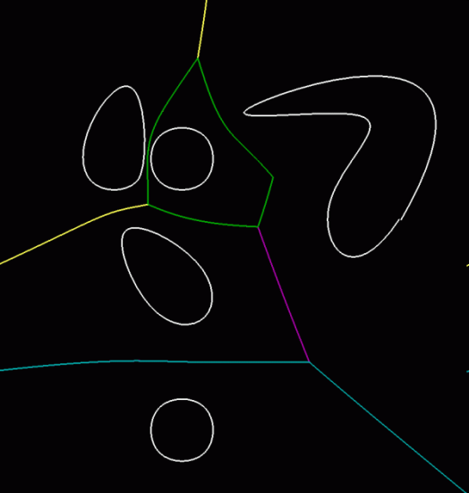
Voronoi diagram (VD)
One of the most important structure in Comp. geom.
Encodes proximity information
What is close to what?
Standard VD – this lecture
  Set of points - nDim
  Euclidean space & metric
Generalizations
  Set of line segments or curves
  Different metrics
  Higher order VD’s (furthest point)
Gershon Elber: IRIT

Slide 4
Voronoi cell (for points in plane)
Let P = {p₁, p₂,…, p_{n}} be a set of points (sites) in dDim space … 2D space (plane) here
Voronoi cell V(p_{i}) – is open!
= set of points closer to p_{i} than to any other site:
, where
is the Euclidean distance between p and q
= intersection of open halfplanes
= open halfplane
= set of pts strictly closer to p_{i} than to p_{j}
[Berg]
Notes:
Cell = oblast, buňka – possibly unbounded convex polygon
Site = original points

Slide 5
Voronoi diagram (in plane)
Voronoi diagram Vor(P) of points P
= what is left of the plane after removing all the
open Voronoi cells
= collection of line segments
(possibly unbounded)
Edge
Vertex
Region around
the site is cell
Site (given point)
VoroGlide demo
Notes:
TODO: Je VD jen collection of line segments, or cell complex (with borders) or planar graph
http://www.pi6.fernuni-hagen.de/GeomLab/VoroGlide/
D:\const\STAZENO\VYPOCETNI_GEOMETRIE\Voronoi\Vorogolide applett\VoroGlide\index.html

Slide 6
Voronoi diagram examples
1 point
2 points
3 points
Cell
The whole plain for 1 point
Halfplane or strip for collinear points
Convex (possibly unbounded) polygon
Edges of VD
|| lines for collinear points
Halflines (for CH points)
Line segments (for bounded cells)

Slide 7
Voronoi diagram examples
16 points
17 points
[Håkan Jonsson]
Vertex with O(n) incident edges
From total |n_{e}| ≤ 3n – 6
Cell with O(n) vertices
From total |n_{v}| ≤ 2n-5

Slide 8
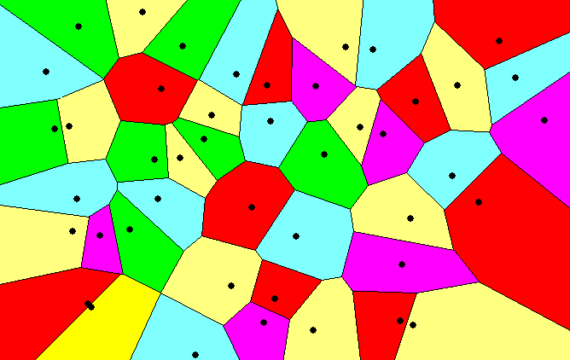
Voronoi diagram examples

Slide 9
Voronoi diagram (in plane)
= planar graph
  Subdivides plane into n cells (n = num. of input sites |P|)
  Edge = locus of equidistant pairs of points (cells)
  = part of the bisector of these points
  Vertex = center of the circle defined by ≥ 3 points
  => vertices have degree ≥ 3
  Number of vertices n_{v} ≤ 2n – 5 => O(n)
  Number of edges n_{e} ≤ 3n – 6 => O(n)
  (only O(n) from O(n²) intersections of bisectors)
  In higher dimensions complexity from O(n) up to O(n^{|d/2|})
  Unbounded cells belong to sites (points) on convex hull

Slide 10
Voronoi diagram O(n) complexity derivation
For n collinear sites n_{v} = 0, n_{e} = (n-1) – both hold
For non-collinear sites
  Add extra VD vertex v in infinity m_{v} = n_{v} + 1
  Apply Euler’s formula: m_{v} – m_{e} + m_{f} = 2
  Obtain (n_{v} + 1) – n_{e} + n = 2
  Every VD edge has 2 vertices => n_{v} = 2n_{e}
  Each VD vertex has degree  3
  Sum of vertex degrees = 2x number of edges n_{e}
  (each counted twice) 2n_{e}  3 (n_{v} + 1)
  => n_{v} ≤ 2n – 5

Slide 11
Voronoi diagram and convex hull
Convex hull
Connects points from unbounded cells

Slide 12
Delaunay triangulation
point set triangulation (straight line dual to VD)
maximize the minimal angle (tends to equiangularity)

Slide 13
Edges, vertices and largest empty circles
Largest empty circle C_{P}(q) with center in
In VD vertex q: has 3 or more sites on its boundary
On VD edge: contains exactly 2 sites on its boundary and no other site
[Berg]
[Berg]

Slide 14
Some applications
Nearest neighbor queries in Vor(P) of points P
  Point q  P … search sites across the edges around
  the cell q
  Point q  P … point location queries – see Lecture 2
  (the cell where point q falls)
Facility location (shop or power plant)
  Largest empty circle
Neighbors and Interpolation
  Interpolate with the nearest neighbor,
  in 3D: surface reconstruction from points
Art
…

Slide 15
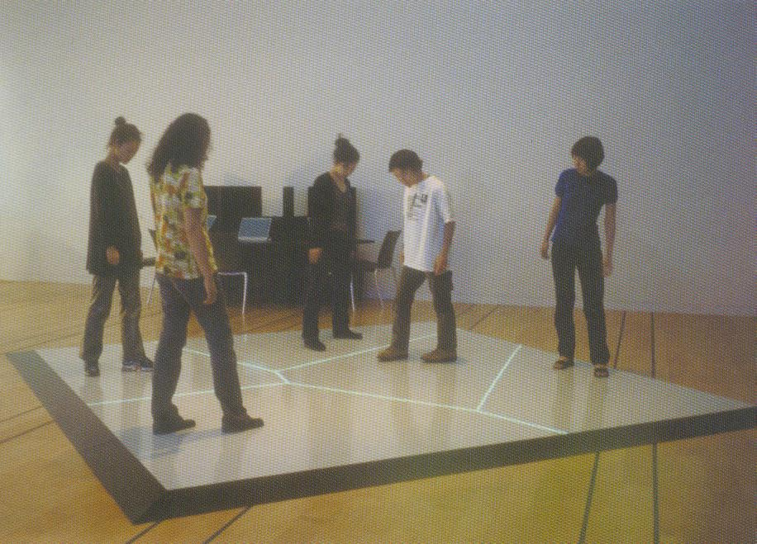
Voronoi Art
Boundary Functions
Scott Snibbe, 1998

Slide 16
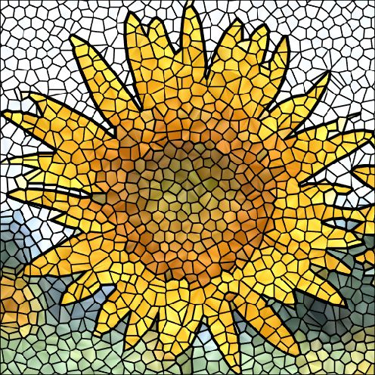
Voronoi Art
Courtesy [Gold]

Slide 17
Algorithms in 2D
D&C O(n log n)
Fortune’s Sweep line O(n log n)

Slide 18
Voronoi diagram (VD)
Divide and Conquer method
Split points based on x-coord into L and R
Recursion on L and R
1-3 points => return
>3 points => recursion
Merge VD_{L} and VD_{R}
  monotone chain
  trim intersected edges
  Add new edges from the chain
O(n log n)

Slide 19
Voronoi diagram (VD)
Divide and Conquer method
Split points based on x-coord into L and R
Recursion on L and R
1-3 points => return
>3 points => recursion
Merge VD_{L} and VD_{R}
  monotone chain
  trim intersected edges
  Add new edges from the chain
O(n log n)
VD_{L}
VD_{P}

Slide 20
Voronoi diagram (VD)
Divide and Conquer method
Split points based on x-coord into L and R
Recursion on L and R
1-3 points => return
>3 points => recursion
Merge VD_{L} and VD_{R}
  monotone chain
  trim intersected edges
  Add new edges from the chain
O(n log n)
VD_{L}
VD_{P}

Slide 21
Voronoi diagram (VD)
Divide and Conquer method
Split points based on x-coord into L and R
Recursion on L and R
1-3 points => return
>3 points => recursion
Merge VD_{L} and VD_{R}
  monotone chain
  trim intersected edges
  Add new edges from the chain
O(n log n)
VD_{L}
VD_{P}

Slide 22
Voronoi diagram (VD)
Divide and Conquer method
Split points based on x-coord into L and R
Recursion on L and R
1-3 points => return
>3 points => recursion
Merge VD_{L} and VD_{R}
  monotone chain
  trim intersected edges
  Add new edges from the chain
O(n log n)
VD_{L}
VD_{P}
Notes:
Při hledání hran ke zkrácení prohledáváme všechny hrany všech buněk. Tedy max O(n^2).
Není to pravda. V té buňce, ve které zůstanu, nemusím prohledávat pokaždé od začátku, ale pamatuju si, kde jsem skončil a tam pokračuju v hledání… Viz o 2 slajdy dál.

Slide 23
Voronoi diagram (VD)
Divide and Conquer method
Split points based on x-coord into L and R
Recursion on L and R
1-3 points => return
>3 points => recursion
Merge VD_{L} and VD_{R}
  monotone chain
  trim intersected edges
  Add new edges from the chain
O(n log n)
Notes:
O(log n) pater rekurze
O(n) každý merge

Slide 24
Monotone chain search in O(n)
Avoid repeated rescanning of cell edges
Start in the last tested edge (each edge tested at max once)
Continue CW in the l_{i} left, CCW in the r_{i} right cell
CW
CCW
left cell
right
cell
l₀
CCW
CW
CW
[Mount]
Notes:
http://www.personal.kent.edu/~rmuhamma/Compgeometry/MyCG/Voronoi/DivConqVor/divConqVor.htm
Školní příklad – ořezaný na minimum – z pravého VD chybí průsečíky, z levého je jen jedna buňka

Slide 25
Fortune’s sweep line algorithm
Differs from “typical” sweep line algorithm
Unprocessed sites ahead from sweep line may generate Voronoi vertex behind the sweep line
DONE
TODO
Fortune’s applet
[Mount]
Notes:
http://www.personal.kent.edu/~rmuhamma/Compgeometry/ MyCG/Voronoi/Fortune/fortune.htm - nejde mi ve Firefoxu
http://www.personal.ken
t.edu/~rmuhamma/Compgeometry/compgeom.html - i jiné alg
Problém – sweep line alg je až v průsečících 9. týden – a tohle je 6.

Slide 26
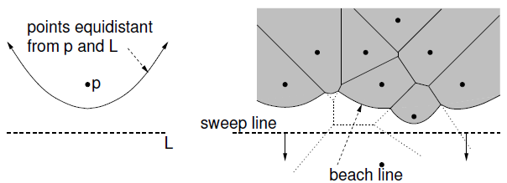
Fortune’s sweep line algorithm idea
DONE
UNSOLVED
TODO
Subdivide the halfplane above the sweep line l into 2 regions
  Points closer to some site above than to sweep line l (solved part)
  Points closer to sweep line l than any point above
  (unsolved part – can be changed by sites below l)
Border between these 2 regions is a beach line
l
l
[Mount]

Slide 27
Sweep line and beach line
Straight sweep line l
  Separates processed and unprocessed sites (points)
Beach line (Looks like waves rolling up on a beach)
  Separates solved and unsolved regions above sweep line
  (separates sites above l that can be changed from sites that cannot be changed by sites below l)
  x-monotonic curve made of parabolic arcs (max 2n-1)
  Follows the sweep line
  Prevents us from missing unanticipated events until the sweep line encounters the corresponding site

Slide 28
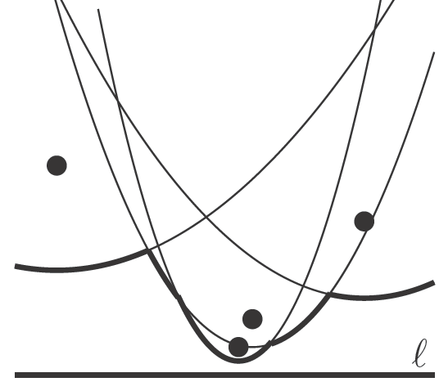
Beach line
Every site p_{i} above l defines a complete parabola
Beach line is the function, that passes through the lowest points of all the parabolas (lower envelope)
Q: How many arcs may the beach line have at mximum?
x
[Berg]
Notes:
Když budou body (sites) nad sebou, rozělí každá nová parabola předchozí oblouk na dva. Celkem 2n-1 oblouků (poslední zůstane celý)
Q: Kolik oblouků může mít maximálně beach line? 2n-1

Slide 29
Break point (bod zlomu)
= Intersection of two arcs on the beach line
Equidistant to 2 sites and sweep line l
Lies on Voronoi edge of the final diagram
x
[Berg]
Notes:
Tady jsme skončili 25.10.

Slide 30
Events
There are two types of events:
Site events (SE)
  When the sweep line passes over a new site p_{i},
    new arc is added to the beach line
    new edge fragment added to the VD.
  All SEs known from the beginning (sites sorted by y)
Voronoi vertex event ([Berg] calls a circle event)
  When the parabolic arc shrinks to zero and disappears, new Voronoi vertex is created.
  Created dynamically by the algorithm
  for triples or more neighbors on the beach line
  (triples changed by both types of events)
Notes:
Site event – creates arc, deletes some Circle events and possibly creates CE for 2 neighbors
Circle event – deletes an arc,

Slide 31
Site event
beach line
sweep line
[Mount]
Generated when the sweep line passes over a site p_{i}
  New parabolic arc created,
  it starts as a vertical ray from p_{i} to the beach line
  As the sweep line sweeps on, the arc grows wider
  The entry ↑…, p_{j} ,… on the sweep line status is replaced by the triple ↑…, p_{j} , p_{i} , p_{j} ,…
  Dangling future VD edge created on the bisector (p_{i}, p_{j} )
Notes:
Začíná se formovat hrana oblasti. Jakmile jeden arc zanikne, vznikne roh oblasti – Voronoiův vrchol
Vznikne nový oblouk a s ním dva zlomové body (break-pointy) na pobřežní čáře a jeden fragment hrany VD (dangling edge)

Slide 32
Voronoi vertex event (circle event)
beach line
sweep line
[Mount]
Generated when l passes the lowest point of circle
  Sites p_{i} , p_{j} , p_{k} appear consecutively on the beach line
  Circumcircle lies partially below the sweep line
  (Voronoi vertex has not yet been generated)
  This circumcircle contains no point below the sweep line
  (no future point will block the creation of the vertex)
  Vertex & bisector (p_{i}, p_{k} ) created, (p_{i}, p_{j} ) & (p_{j}, p_{k})deleted
  One parabolic arc removed from the beach line
Notes:
by triples of neighbors on the beach line
The only place where an arc can disappear Lemma 7.7 in Berg
Zanikne jeden oblouk – potkají se jeho dva break points – vznikne jeden vrchol VD
TODO: Přeformulovat
– 3 body *kružnici, a se neuplatní, když bude obsahovat site – zabije ji site event
- V nejspodnějším bodě – vznikne VD vertex, zanikne beach line arc

Slide 33
Data structures
(Partial) Voronoi diagram
Beach line data structure
Event queue Q
hrany VD vznikají site event circle event
vrcholy VD vznikají site event circle event
Site events jsou známy předem ano ne
Circle events jsou známy předem ano ne
Notes:
Q: hrany VD vznikaji při site event circle event
vrcholy VD vznikaji při site event circle event
Site events jsou známy předem nejsou známy předem
Circle events jsou známy předem nejsou známy předem

Slide 34
1. (Partial) Voronoi diagram data structure
Any PSLG data structure, e.g. DCEL (planar stright line graph)
Stores the VD during the construction
Contain unbounded edges
  dangling edges during the construction (managed by the beach line DS) and
  edges of unbounded cells
  at the end
  => create a bounding box
[Berg]

Slide 35
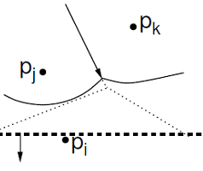
2. Beach line tree data structure
Used to locate the arc directly above a new site
E.g. Binary tree T
  Leaves - ordered arcs along the beach line (x-monotone)
    T stores only the sites p_{i} in leaves, T does not store the parabolas
  Inner tree nodes - breakpoints as ordered pairs <p_{j}, p_{k}>
    p_{j}, p_{k} are neighboring sites
    Breakpoint position computed on the fly
    from p_{j}, p_{k} and y-coord of the sweep line
  Pointers to other two DS
    In leaves – pointer to event queue, point to node
    when arc disappears via Voronoi vertex event – if it exists
    In inner nodes - pointer to half-edge in DCEL of VD, that is being traced out by the break point
[Mount]
Notes:
Binary tree or skip list
Kružnice daná 2 body a y-souřadnicí tangenty

Slide 36
3. Event queue Q
Priority queue, ordered by y-coordinate
For site event
  stores the site itself
  known from the beginning
For Voronoi vertex event (circle event)
  stores the lowest point of the circle
  stores also pointer to the leaf in tree T
  (represents the parabolic arc that will disappear)
  created by both events, when triples of points become neighbors (possible max three triples for a site)
  p_{i}, p_{j}, p_{k}, p_{l}, p_{m} insert of p_{k} can create up to 3 triples
  and delete up to 2 triples (p_{i}, p_{j}, p_{l}) and (p_{j}, p_{l}, p_{m} )

Slide 37
Fortune’s algorithm
FortuneVoronoi(P)
A set of point sites P = {p₁, p₂,…, p_{n}} in the plane
Voronoi diagram Vor(P) inside a bounding box in a DCEL struct.
Init event queue Q with all site events
while( Q not empty) do
consider the event with largest y-coordinate in Q (next in the queue)
if( event is a site event at site p_{i} )
then HandleSiteEvent(p_{i})
else HandleVoroVertexEvent(p_{i}), where p_{i} is the lowest point
of the circle causing the event
remove the event from Q
Create a bbox and attach half-infinite edges in T to it in DCEL.
Traverse the halfedges in DCEL and
add cell records and pointers to and from them

Slide 38
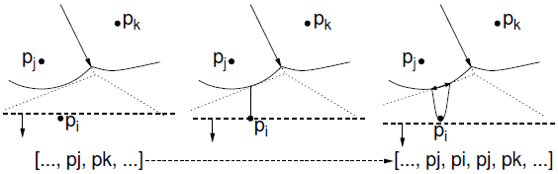
Handle site event
HandleSiteEvent(p_{i})
event site p_{i}
updated DCEL
Search in T for arc  vertically above p_{i}. Let p_{j} be the correspond. site
Apply insert-and-split operation, inserting a new entry of p_{i} to the beach line T (new arc), thus replacing ↑…, p_{j} ,… with ↑…, p_{j} , p_{i} , p_{j} ,…
Create a new (dangling) edge in the Voronoi diagram, which lies on the bisector between p_{i} and p_{j}
Neighbors on the beach line changed -> check the neighboring triples of arcs and insert or delete Voronoi vertex events (insert only if the circle intersects the sweep line and it is not present yet).
Note: Newly created triple p_{j} , p_{i} , p_{j} cannot generate an event because it only involves two distinct sites.
[Mount]
Notes:
3. two halfedges

Slide 39
Handle Voronoi vertex (circle) event
HandleVoroVertexEvent(p_{j})
event site p_{j}
updated DCEL
Let p_{i} , p_{j} , p_{k} be the sites that generated this event (from left to right).
Delete the entry p_{j} from the beach line (thus eliminating its arc ),
i.e.: Replace a triple ↑…, p_{i} , p_{j} , p_{k} ,… with ↑…, p_{i} , p_{k},… in T.
Create a new vertex in the Voronoi diagram (at circumcenter of
↑p_{i} , p_{j} , p_{k}) and join the two Voronoi edges for the bisectors ↑p_{i} , p_{j} and ↑p_{j} , p_{k} to this vertex (dangling edges – created in step 3 above).
Create a new (dangling) edge for the bisector between ↑p_{j} , p_{k}
Delete any Voronoi vertex events (max. three) from Q that arose from triples involving the arc  of p_{j} and generate (two) new events corresponding to consecutive triples involving p_{i}, and p_{k}.
[Mount]
Q: Struktura pobřežní čáry obsahuje: abcdef
Když vymažu d, které trojice zmizí a které přibudou?
Notes:
Abcdef – byly triply abc, bcd, cde, def
– smažu d a bcd, cde a def
Abcef – zůstane abc, přibude bce a cef
Q: Pro abcdef ve struktuře pobřežní čáry, když vymažu d, které trojice zmizí a které přibudou?
Nová hrana VD je polopřímkou vycházející ze středu kružnice (vrcholu VD)

Slide 40
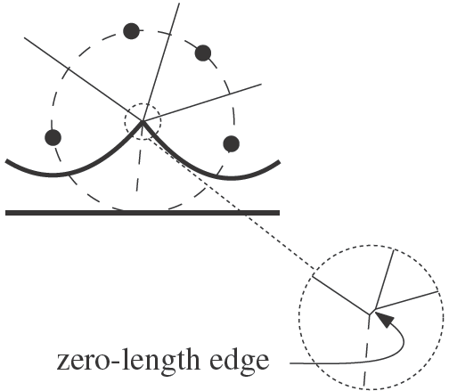
Handling degeneracies
Algorithm handles degeneracies correctly
2 or more events with the same y
  if x coords are different, process them in any order
  if x coords are the same (cocircular sites)
  process them in any order,
  it creates duplicated vertices with
  zero-length edges,
  remove them in post processing step
degeneracies while handling an event
  Site below a beach line breakpoint
  Creates circle event of zero diameter,
  remove zero-length edges in post processing step
[Berg]
[Berg]

Slide 41
References
[Berg] Mark de Berg, Otfried Cheong, Marc van Kreveld, Mark Overmars: Computational Geometry: Algorithms and Applications, Springer-Verlag, 3rd rev. ed. 2008. 386 pages, 370 fig. ISBN: 978-3-540-77973-5, Chapter 7, http://www.cs.uu.nl/geobook/
[Mount] David Mount, - CMSC 754: Computational Geometry, Lecture Notes for Spring 2007, University of Maryland, Lectures 12 and 29.
http://www.cs.umd.edu/class/spring2007/cmsc754/lectures.shtml
[Preparata] Preperata, F.P., Shamos, M.I.: Computational Geometry. An Introduction. Berlin, Springer-Verlag,1985. Chapter 5
[VoroGlide] VoroGlide applet:
http://www.pi6.fernuni-hagen.de/GeomLab/VoroGlide/
[Fortune] Fortune’s algorithm applet: http://www.personal.kent.edu/~rmuhamma/Compgeometry/ MyCG/Voronoi/Fortune/fortune.htm
[Muhama] http://www.personal.kent.edu/~rmuhamma/Compgeometry/ compgeom.html

