Slide 1
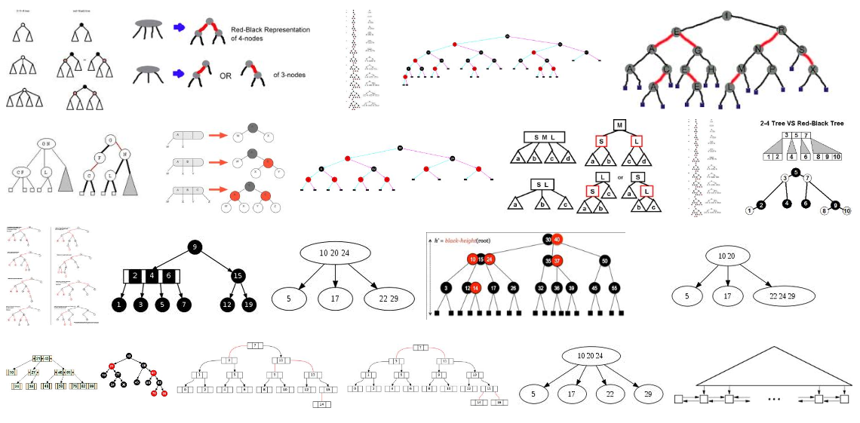
Skip List
Skip List
ACM ICPC Maraton
Prague 2015
p
2<1
?/
x+y
Hi!
A
A
C
E
E
G
H
I
L
M
N
P
R
S
X
Marko Berezovský
x--y
To read
- Robert Sedgewick: Algorithms in C++, Parts 1–4: Fundamentals, Data Structure, Sorting, Searching,
Third Edition, Addison Wesley Professional, 1998
- William Pugh. Skip lists: A probabilistic alternative to balanced trees. Communications of the ACM,
33(6):668–676, 1990.
- William Pugh: A Skip List Cookbook [http://cglab.ca/~morin/teaching/5408/refs/p90b.pdf]
- Bradley T. Vander Zanden: [http://web.eecs.utk.edu/~huangj/CS302S04/notes/skip-lists.html]

Slide 2
Skip list
Motivation
1
Problem: Find(N) in your list.
A regular linked list
A
A
C
E
E
G
H
I
L
M
N
P
R
S
X
A linked list with faster search capability
A
A
C
E
E
G
H
I
L
M
N
P
R
S
X
A linked list with even faster search capability
A
A
C
E
E
G
H
I
L
M
N
P
R
S
X

Slide 3
Skip list
Improved linked list
2
A
A
C
E
E
G
H
I
L
M
N
P
R
S
X
Z
A linked list with log(N) search capability.
Note the shape similarity to a balanced binary search tree.
Problem:
Subsequent Insert/Delete operations would destroy this favourable list shape.
The cost of restauration is huge -- Θ(N).
Solution:
Create a randomized shape, roughly similar to the optimal one.
Random deviations from the nice shape in the long run nearly cancel each other
resulting again in a nearly favourable list shape.

Slide 4
Skip list
Definition
3
A skip list is an ordered linked list where each node contains a variable number of links, with the k-th link in the node implementing singly linked list that skips (forward) the nodes with less than k links.
[Sedgewick]
Each element points to its immediate successor (= next element).
Some elements also point to one or more elements further down the list.
A level k element is a list element that has k forward pointers.
the j-th pointer points to the next level j element.
A
A
C
E
E
G
H
I
L
M
N
P
R
S
X
Level 1
elements
Level 4
element
Level 2
elements
Level 3
elements

Slide 5
Skip list
Linked list data structure
4
A
A
C
E
E
G
H
I
L
M
N
P
R
S
X
The Skip List data structure contains also:
-- Header: A dummy skip list node with the initial set of forward pointers
-- Level: The current number of levels in the skip list.
-- MaxLevel: The maximum number of levels to which a skip list can grow

Slide 6
Skip list
Random level
5
Basic randomness
The level of an element is chosen by flipping a coin.
Flip a coin until it comes up tails.
We count one plus the number of times
the coin came up heads
before it comes up tails.
This result represents the level of the element.
Sixpence of Queen Elizabeth I,
struck in 1593 at the Tower Mint.
[wikipedia.org]
x
x
x
x
x
x
x
x
x
x
x
x
x
x
x
x
x
x
x
x
x
x
x
x
Example of an experimental independent levels calculation (p = 0.5, see bellow) .

Slide 7
Skip list
Random level
6
This scheme corresponds
to flipping a coin that has
p chance of coming up heads,
(1−p) chance of coming up tails.
More general randomness
Choose a fraction p between 0 and 1.
Rule: Fraction p of elements with level k pointers
will have level k+1 elements as well.
On average: (1−p) elements will be level 1 elements,
(1−p)^2 elements will be level 2 elements,
(1−p)^3 elements will be level 3 elements, etc.
x
x
x
x
x
x
x
x
x
x
x
x
x
x
x
x
x
x
x
x
x
x
x
x
Example of an experimental independent levels calculation with p = 0.33.

Slide 8
Skip list
Random level
7
Choosing a Random Level
A level is chosen for an element in effect by flipping a coin that has probablility p of coming up heads. We keep flipping until we get "tails" or until the maximum number of levels is reached.
int randomLevel(List list) {
//random() returns a random value in [0..1)
int newLevel = 1;
while (random() < list.p) // no MaxLevel check
newLevel++;
return min(newLevel, list.MaxLevel); // efficiency!
}

Slide 9
Skip list - Search
Example
8
Search
We scan through the top list until we find the search key or a node
with a smaller key that has a link to a node with a larger key.
Then, we move to the second-from-top list and iterate the procedure, continuing until the search key is found
or a search miss happens on the bottom level.
Find R
A
A
C
E
E
G
H
I
L
M
N
P
R
S
X

Slide 10
Skip list - Search
Pseudocode
9
Search
Start with the coarsest grain list and find where in that list the key resides, then drop down to the next less coarse grain list and repeat the search.
Node search(List list, int searchKey) {
Node x = list.header;
// loop invariant: x.key < searchKey
for( int i = list.level; i >= 1; i--)
while (x.forward[i].key < searchKey)
x = x.forward[i];
// x.key < searchKey <= x.forward[1].key
x = x.forward[1];
if (x.key == searchKey) return x;
else return null;
}

Slide 11
Skip list - Structure
Sentinel
10
Keeping the code simple
while(x.forward[i].key < searchKey) // x.forward[i] == null?
Add a sentinel at the tail of the list with infinite key value.
The level of the sentinel is the same as the whole list level.
Note that in the other
diagrams the sentinel is not displayed to spare space
in the presentation.
A
C
E
G
H
I
N
R
S
A
C
E
G
H
I
N
R
S
∞

Slide 12
Skip list - Insert
Example
11
Insert
Find the place for the new element.
Assign to it its level k computed by flipping the coin.
Insert the element into each of those k lists, starting at the bottom.
Insert L
A
A
C
E
E
G
H
I
M
N
P
R
S
X
A
A
C
E
E
G
H
I
L
M
N
P
R
S
X

Slide 13
Skip list - Insert
Example
12
Insert A, S, E, R, C, H, I, N, G.
The nodes,
in the order of insertion,
were assigned levels
1,3,2,1,1,3,1,3,2.
(A,S,E,R,C,H,I,N,G)
A
A
S
A
E
S
A
E
R
S
A
C
E
R
S
A
C
E
H
R
S
A
C
E
H
I
R
S
continue...

Slide 14
Skip list - Insert
Example
13
.. continued
Insert A, S, E, R, C, H, I, N, G.
The nodes,
in the order of insertion,
were assigned levels
1,3,2,1,1,3,1,3,2.
(A,S,E,R,C,H,I,N,G)
A
C
E
H
I
R
S
A
C
E
H
I
N
R
S
A
C
E
G
H
I
N
R
S

Slide 15
Skip list - Insert
Example
14
Insert A, C, E, G, H, I, N, R, S. (Same values, different order)
A
A
C
A
C
E
A
C
E
G
A
C
E
G
H
A
C
E
G
H
I
A
C
E
G
H
I
N
A
C
E
G
H
I
N
R
continue...

Slide 16
Skip list - Insert
Example
15
.. continued
The nodes,
in the order of insertion,
were assigned levels
1,3,2,1,1,3,1,3,2.
(A,C,E,G,H,I,N,R,S)
A
C
E
G
H
I
N
R
S
The nodes were inserted in sorted order.
The result of the previous example
The nodes,
in the order of insertion,
were assigned levels
1,3,2,1,1,3,1,3,2.
(A,S,E,R,C,H,I,N,G)
A
C
E
G
H
I
N
R
S
The nodes were inserted in random order.
The shapes of the lists are different, the probabilistic properties are the same.

Slide 17
Skip list - Insert
Pseudocode
16
// Utilise update which is a (vertical) array
// of pointers to the elements which will be
// predecessors of the new element.
void insert(List list, int searchKey, Data newValue){
Node x = list.header;
for (int i = list.level; i >= 1; i--) {
while (x.forward[i].key < searchKey)
x = x.forward[i];
//note: x.key < searchKey <= x.forward[i].key
update[i] = x;
}
x = x.forward[1];
if (x.key == searchKey)
x.value = newValue;
else { // key not found, do insertion here:
continue...

Slide 18
Skip list - Insert
Pseudocode
17
.. continued
... else { // key not found, do insertion here:
int newLevel = randomLevel(list);
/* If the newLevel is greater than the current level
of the list, knock newLevel down so that it is only
one level more than the current level of the list.
In other words, we will increase the level of the
list by at most one on each insertion. */
if (newLevel > list.level) {
newLevel = list.level + 1; list.level = newLevel;
update[newLevel] = list.header;
}
Node x = makeNode(newLevel, searchKey, newValue);
for (int i = 1; i <= newLevel; i++) {
x.forward[i] = update[i].forward[i];
update[i].forward[i] = x; }
}
}} // of insert

Slide 19
Skip list - Delete
Example
18
Delete L
A
C
E
G
H
L
N
R
S
registered in the
update array
A
C
E
G
H
L
N
R
S
A
C
E
G
H
N
R
S

Slide 20
Skip list - Delete
Pseudocode
19
Deleting in a skip list is like deleting the same value independently from each list in which forward pointers of the deleted element are involved.
The algorithm finds the element's predecessor in the list,
makes the predecessor point to the element that the deleted element points to,
and finally deletes the element. It is a regular list delete operation.
// update is an array of pointers to the
// predecessors of the element to be deleted.
void delete(List list, int searchKey) {
Node x = list.header;
for (int i = list.level; i >= 1; i--) {
while (x.forward[i].key < searchKey)
x = x.forward[i];
update[i] = x;
}
x = x->forward[1];
if (x.key == searchkey) { // go delete ...
continue...

Slide 21
Skip list - Delete
Pseudocode
20
(**) If the element to be deleted is a level k node, break out of the loop when level (k+1) is reached. Since the code does not store the level of an element, we determine that we have exhausted the levels of an element when a predecessor element points past it, rather than to it.
.. continued
for (int i = 1; i <= list.level; i++) {
if (update[i].forward[i] != x) break; //(**)
update[i].forward[i] = x.forward[i];
}
destroy_remove(x);
/* if deleting the element causes some of the
highest level list to become empty, decrease the
list level until a non-empty list is encountered.*/
while ((list.level > 1) &&
(list.header.forward[list.level] == list.header))
list.level--;
}} // deleted

Slide 22
Skip list - Properties
Parameter p
21
Choosing p
One might think that p should be chosen to be 0.5.
If p is chosen to be 0.5, then roughly half our elements will be level 1 nodes,
0.25 will be level 2 nodes, 0.125 will be level 3 nodes, and so on.
This will give us
-- on average log(N) search time and
-- on average 2 pointers per node.
However, empirical tests show that choosing p to be 0.25
results in
-- roughly the same search time
-- but only an average of 1.33 pointers per node,
-- somewhat more variability in the search times.
There is a greater chance of a search taking longer than expected, but the decrease in storage overhead seems to be worth it sometimes.

Slide 23
Skip list - Properties
Complexity/experiment
22
Notes on size and compexity
The average number of links in a randomized skip list with parameter p is
(p/(p − 1)) ∙ N
The average number of comparisons in search and insert
in a randomized skip list with parameter p is on average
(p log_{p} (N)) / 2 = log(N) * p / (2 log (p))
Experimental time comparisons:
 | Search | Insert | Delete
Skip list | 0.051 (1.0) | 0.065 (1.0) | 0.059 (1.0)
AVL tree | 0.046 (0.91) | 0.100 (1.55) | 0.085 (1.46)
2-3 tree | 0.054 (1.05) | 0.210 (3.2) | 0. 21 (3.65)
Splay tree | 0.490 (9.6) | 0.510 (7.8) | 0.53 (9.0)
Times in ms on some antiquitated HW [Pugh, 1990]

Slide 24
Skip list - Properties
Complexity/memory
23
Notes on compexity
The probabilistic analysis of skip lists is rather advanced.
However, it can be shown that the expected times of
search, insert, delete are all
O(lg n).
The choice of p determines the variability of these search times.
Intuitively, decreasing p will increase the variability since it will decrease the number of higher-level elements (i.e., the number of "skip" nodes in the list).
The Pugh paper contains a number of graphs that show the probability of a search taking significantly longer than expected for given values of p. For example, if p is 0.5 and there are more than 256 elements in the list, the chances of a search taking 3 times longer than expected are less than 1 in a million. If p is decreased to 0.25, the chances rise to about 1 in a thousand.

Slide 25
Skip list References
24
erikdemaine.org/
erikdemaine.org/
- Erik Demaine's presentation at MIT
http://videolectures.net/mit6046jf05_demaine_lec12/
- Robert Sedgewick: Algorithms in C++, Parts 1–4: Fundamentals, Data Structure,
Sorting, Searching, Third Edition, Addison Wesley Professional, 1998
- William Pugh: Skip lists: A probabilistic alternative to balanced trees.
Communications of the ACM, 33(6):668–676, 1990.
- William Pugh: A Skip List Cookbook [http://cglab.ca/~morin/teaching/5408/refs/p90b.pdf]
- Bradley T. Vander Zanden: [http://web.eecs.utk.edu/~huangj/CS302S04/notes/skip-lists.html]

