Slide 1
Basics of echocardiography
Robert Holaj
Center for research, diagnosis and treatment of arterial hypertension,
3rd Dpt. of Medicine – Dpt. of endocrinology and metabolism,
General University Hospital and 1st Faculty of Medicine
Charles University in Prague
ČVUT Prague, 17. 4. 2023

Slide 2
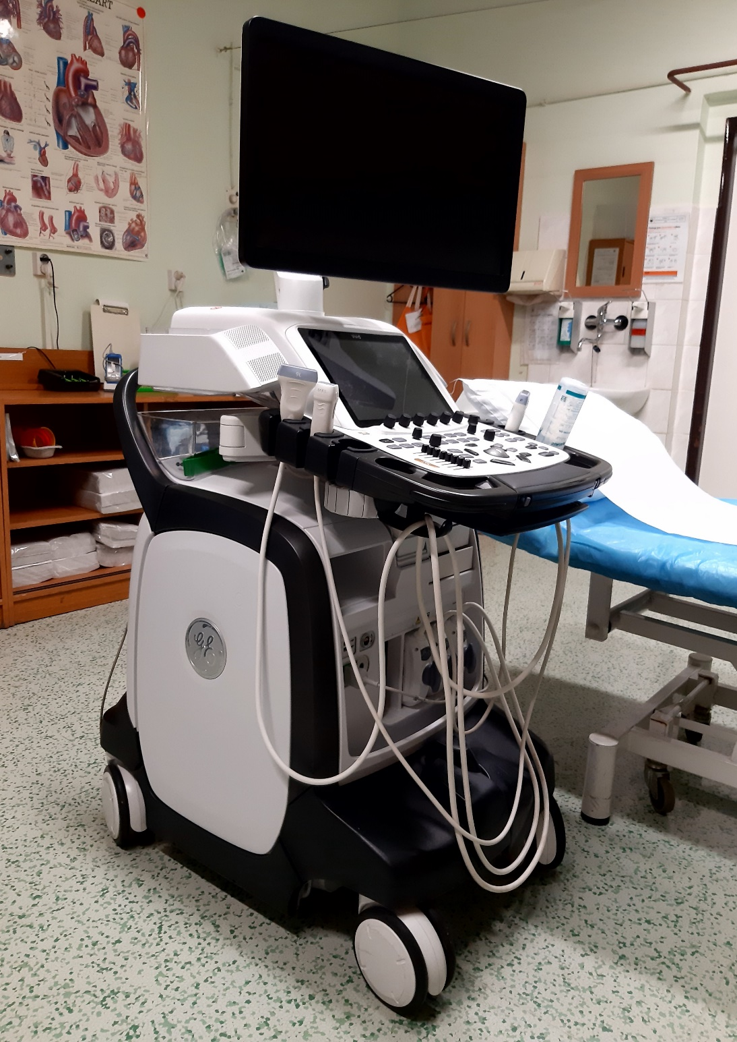
Ultrasound machine Vivid E95
Monitor
Touch panel
Speaker
Probes
Keyboard
Printer
USB ports
Ports for probes
Brake
Wheels

Slide 3
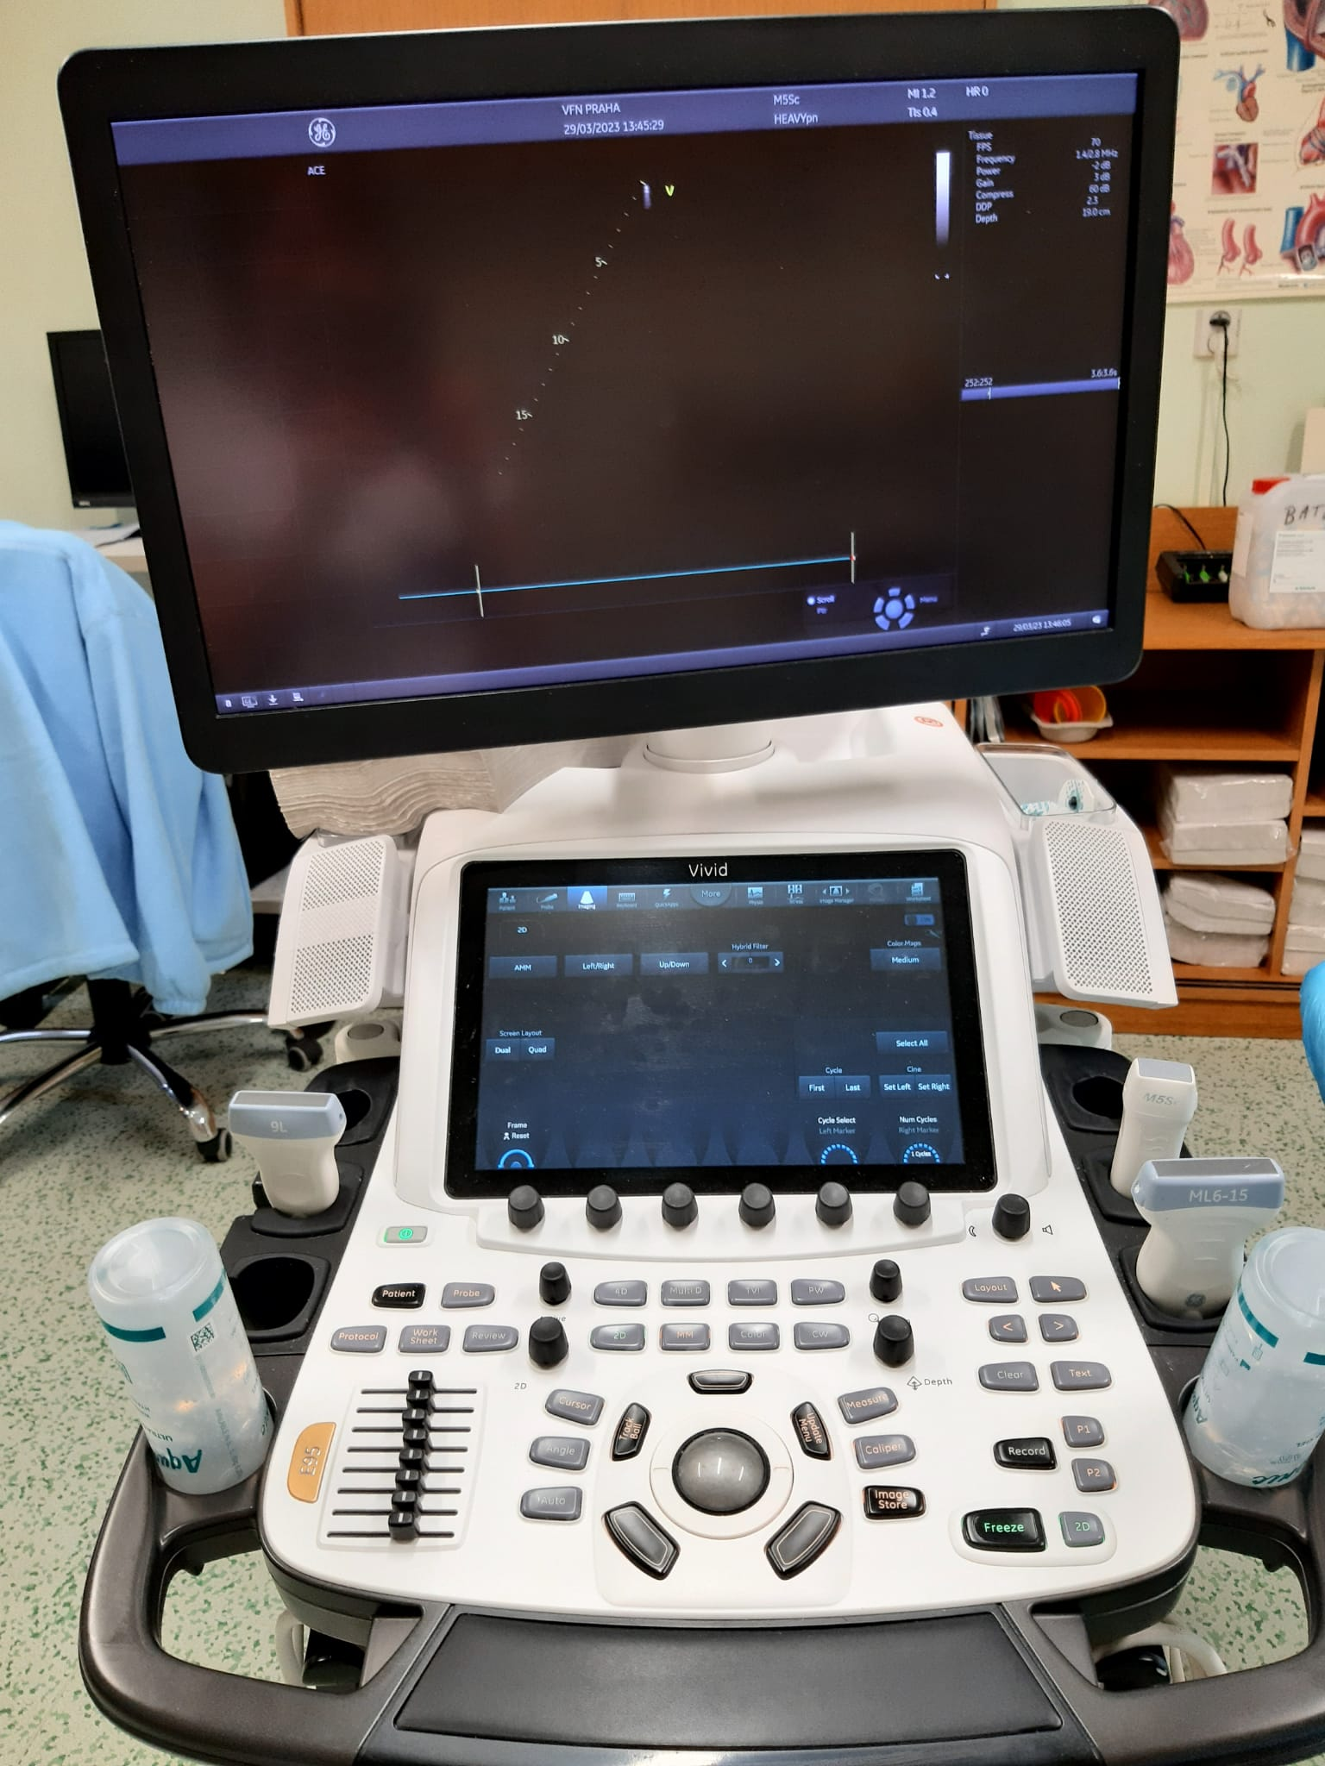
Ultrasound machine Vivid E95
Monitor
Speaker
Touch panel
Probe
Ultrasound gel
Controls
Slide-out keyboard

Slide 4
Modalities of ultrasound imaging
2D (2-dimensional)
3D (3-dimensional)
M mode
CD (colour Doppler)
PW (Pulse wave)
CW (Continuous wave)
Speckle tracking echocardiography

Slide 5
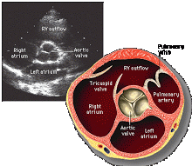
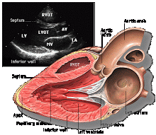
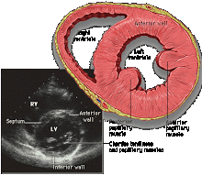
2D basic projections: parasternal long and short axis view
PLAx
PSAx

Slide 6
Parasternal long axis view : PLAx

Slide 7
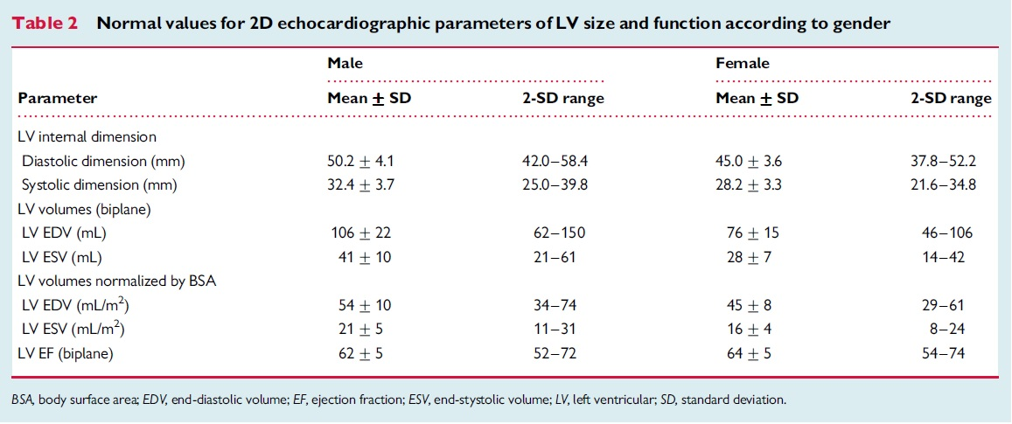
Left ventricle: basic parameters

Slide 8
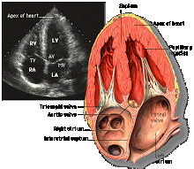
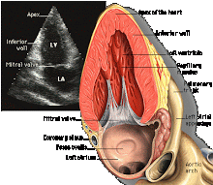
2D basic projections: Apical 4-chamber and 2-chamber view
A4C
A2C

Slide 9
Apical 4-chamber and 2-chamber view:

Slide 10
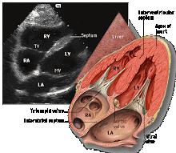
2D basic projections: subxiphoideal

Slide 11
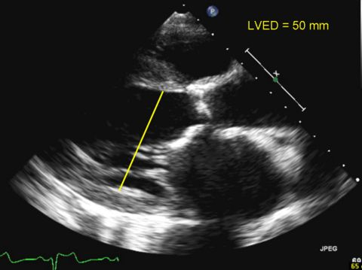
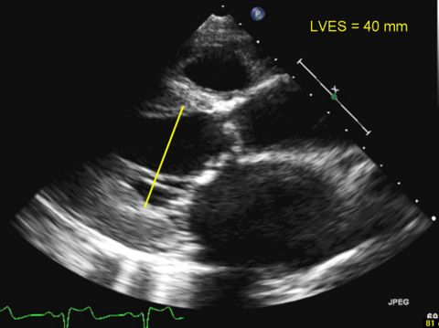
Left ventricle: basic parameters
Diastolic diameter (LVDd) Systolic diameter (LVSd)
and volume (LVEDV) and volume (LVESV)
Ejection fraction (EF)
Normal systolic function: EF ≥ 0.55

Slide 13
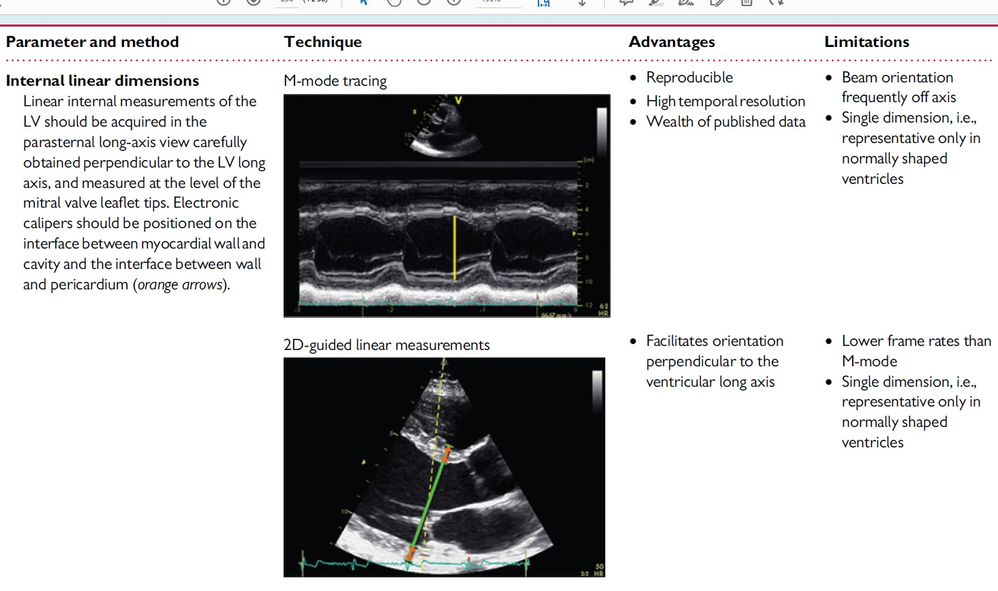

Slide 14
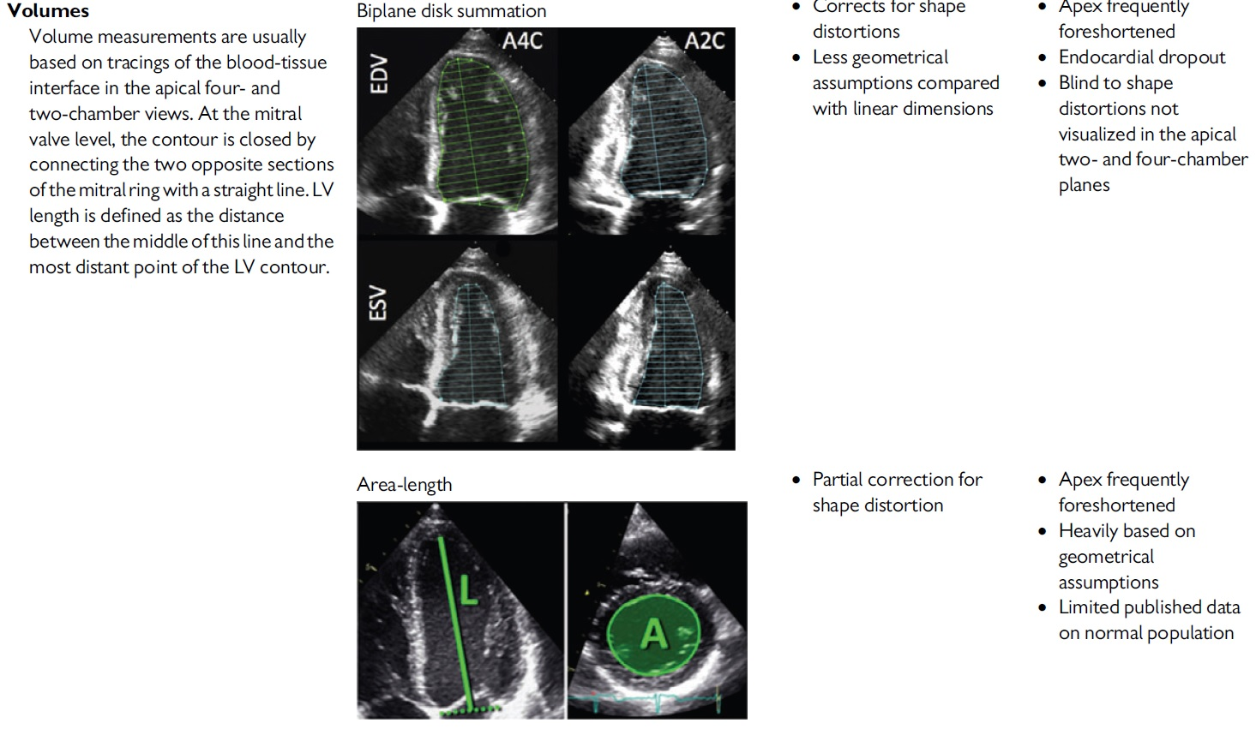

Slide 15
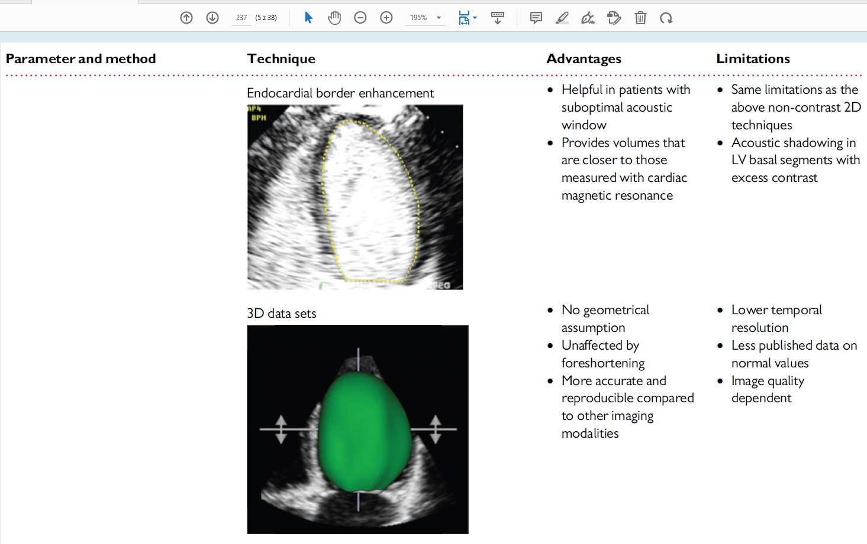

Slide 16
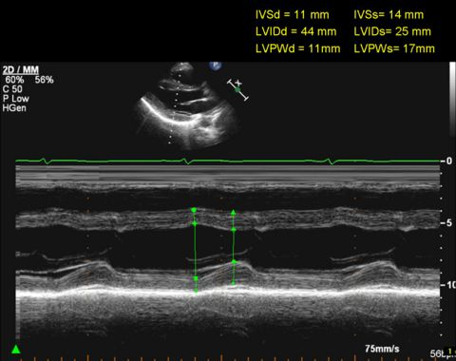
Left venctricle ejection fraction: Teichholz method M-mode

Slide 17
Apical akinesis: EF overestimated by Teichholz method

Slide 18
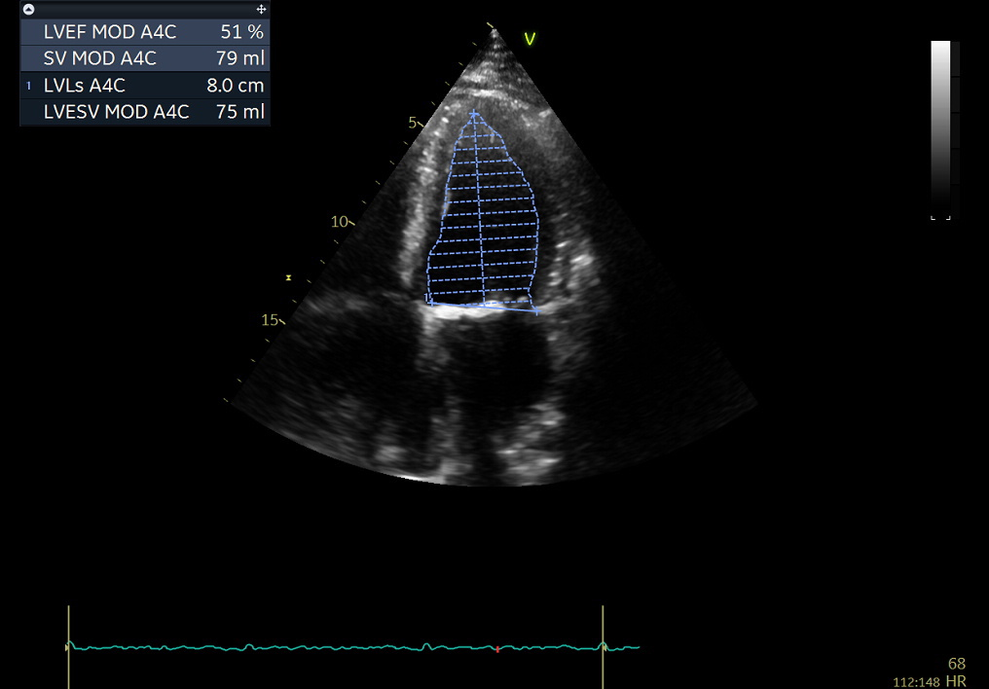
EF measured by Simpsons method (by authomatic method in next slide)

Slide 21
3D planimetric measurement of EF

Slide 22
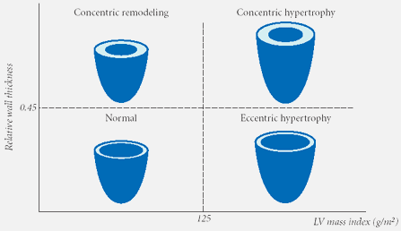
Left ventricle hypertrophy
Concentric remodelling
Concentric hypertrophy
LVDd
wall
RWT
Normal
Eccentric hypertrophy
LVmass index g/m2
women 95, men 105
LVmass index g/m2

Slide 23
2D + CD imagine: Mitral regurgitation

Slide 24
3D + CD imagine: Mitral regurgitation

Slide 25
3D: Stenosis of mitral bioprosthesis

Slide 26
3D: Stenosis of mitral bioprosthesis with atrial thrombus

Slide 27
3D imagine: Prolapsus of mitral valve

Slide 28
2D + CD: Acute endocarditis of aortic valve

Slide 29
2D imagine: Acute endocarditis – release of mechanical aortic prosthesis

Slide 30
Heart infiltrated by lymphoma

Slide 31
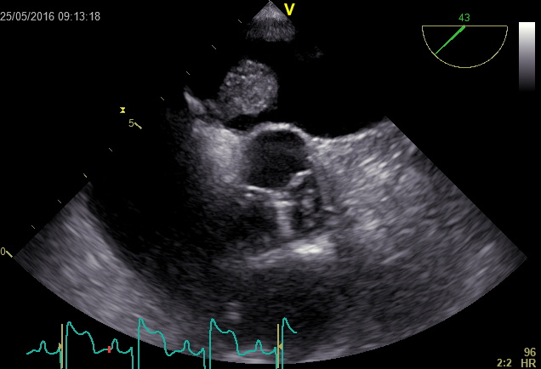
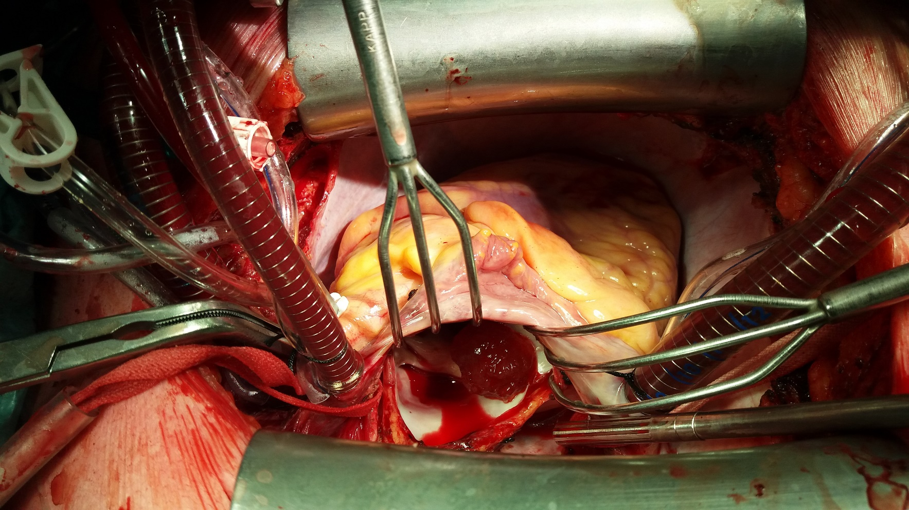
Left atrium myxoma

Slide 32
2D + CD: Severe tricuspid regurgitation

Slide 33
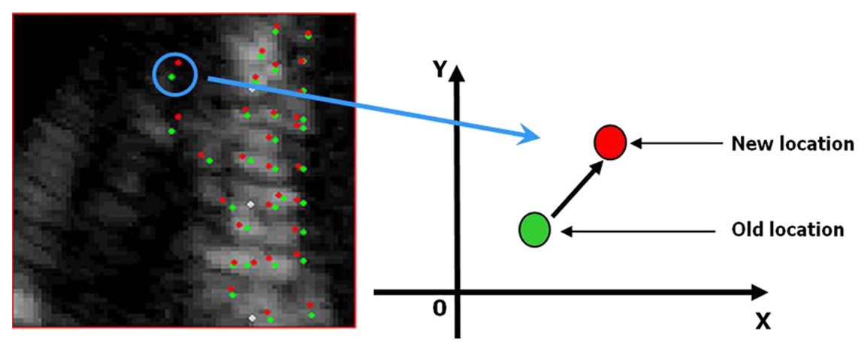
The principle of assessment of LV systolic function by the "speckle tracking" echocardiography
The evaluation of the movement of certain parts of the myocardium relative to each other, namely their extent is called "strain" and the speed at which this change occurs is called "strain rate".
The principle of "speckle tracking" of echocardiography consists in identifying and evaluating the movement of individual acoustic points (so-called speckles) that make up the echocardiographic image.
The term "speckle tracking" could therefore be understood as „observation of echocardiographic points or reflections".

Slide 34
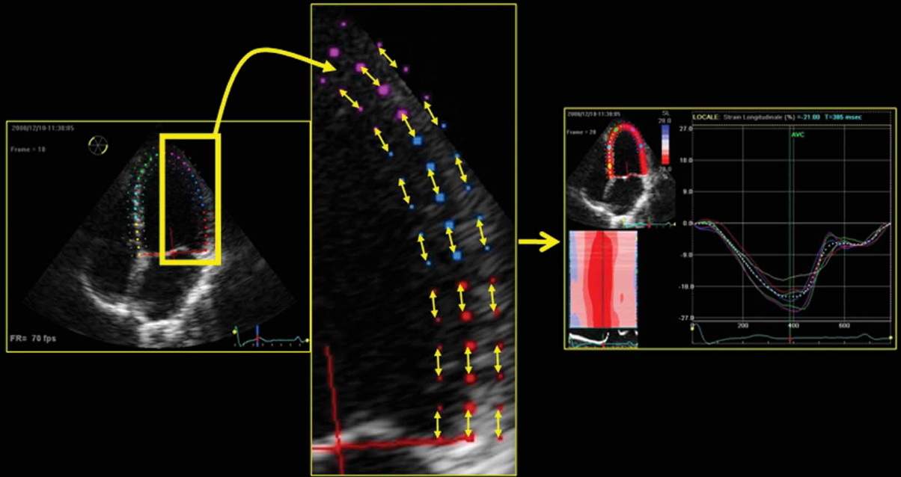
Longitudinal, circumferential and radial direction of movement of the LV myocardium
Strain parameters can be evaluated in different directions of movement of the LV myocardium.
Longitudinal strain
Circumferential strain
Strain can be calculated as the difference between the new and initial distances of these structures divided again by their initial distance. Thus, positive values are obtained when myocardial structures are moving away from each other, and negative values are obtained when they are brought closer together.
Radial strain

Slide 35
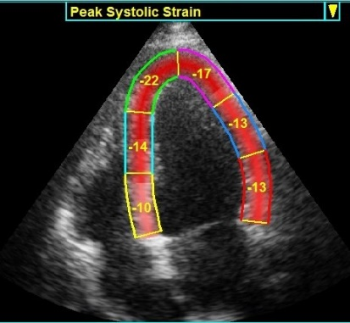
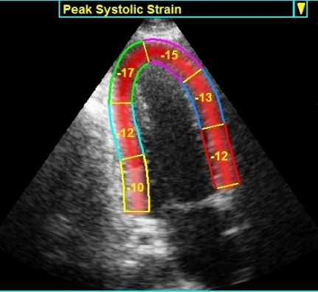
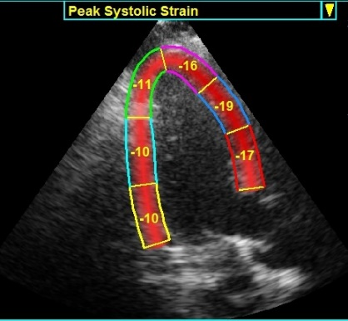
ASSESSMENT OF CARDIAC LV FUNCTION USING STRAIN
Global longitudinal strain (GLS):
gives the possibility of evaluating individual segments in individual projections.
3 apical projections required to calculate the GLS value
apical four-chamber - apical two-chambre - apical on the long axis
A4CH A2CH APLAX
Rated segments:
Apical
Mid-ventricular
Basal

Slide 36
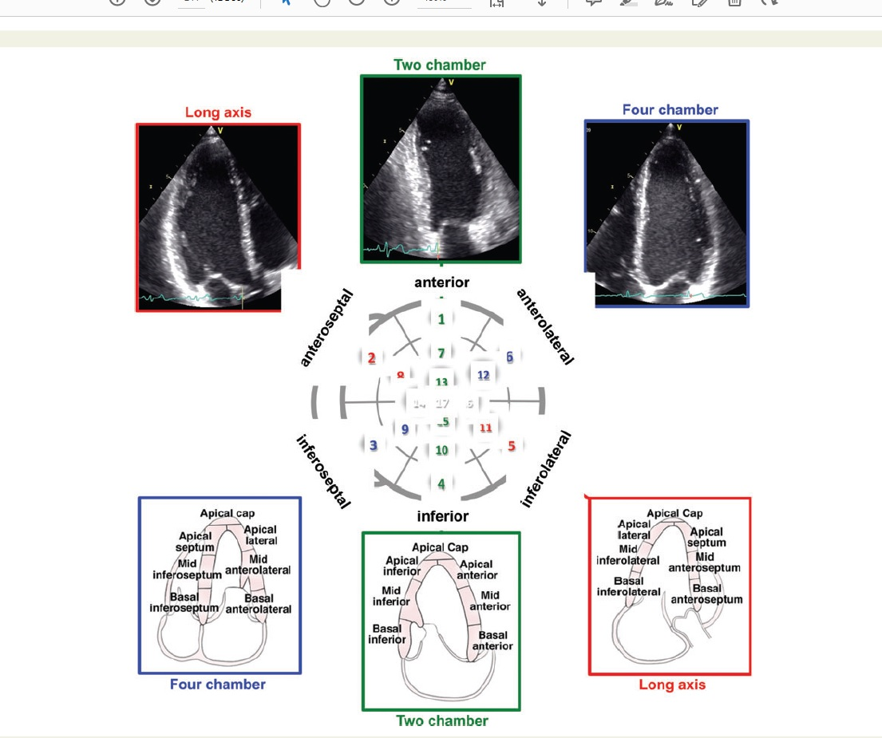

Slide 37
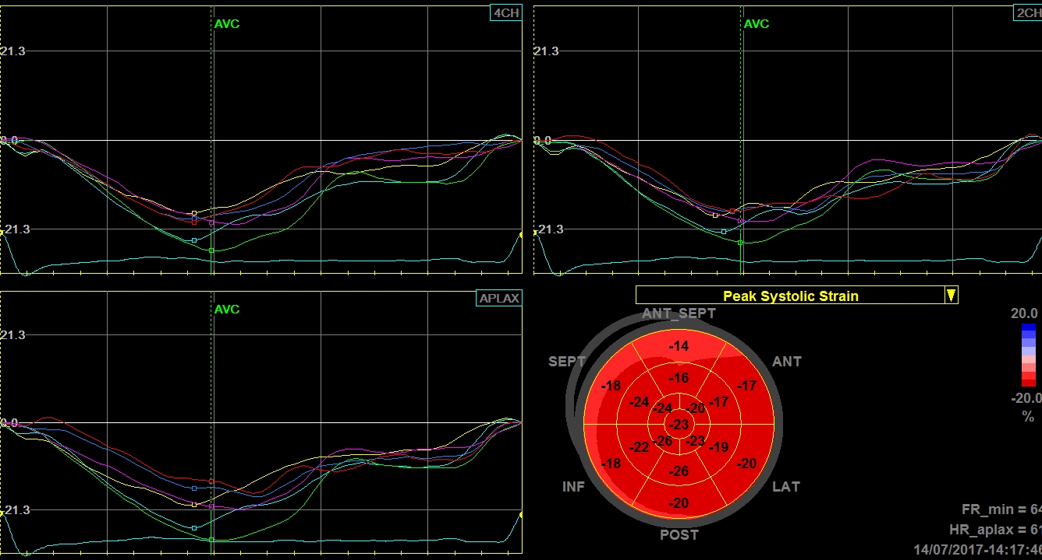
ASSESSMENT OF CARDIAC LV FUNCTION USING STRAIN
Global longitudinal strain (GLS):
General standards: - 15.9% – 22.1%
Yingchonchareon et al. J Am Soc Echocardiography 2013;26:185-91
Standard for GE appliances : -18.0% až -21.5% ± 3.7%
Farsalinos et al. J Am Soc Echocardiography 2015;28:1171-81
Deformation curves of individual LV segments from the three necessary echocardiographic projections for the evaluation of global longitudinal strain and the resulting seventeen-segment model for the "bull's eye" LV.
A4CH
A2CH
APLAX

Slide 38
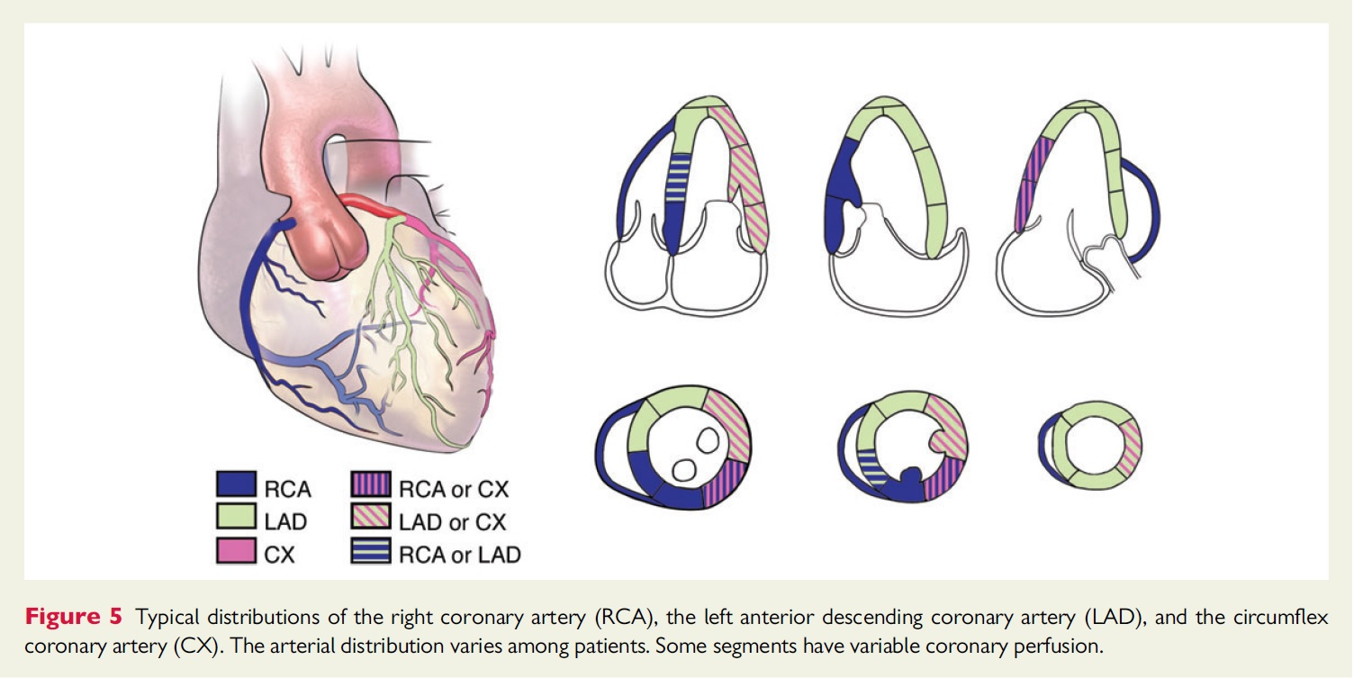

Slide 39
Thank you for your atention
Echokardiografická laboratoř
3. interní kliniky VFN a 1. LF UK v Praze Kontaktní telefon: 224 962 949

