Slide 1
Graphviz http://www.graphviz.org/
An introduction with a few examples
How it works in theory:
Text file with graph description in DOT language --> Graphviz --> graph picture.
In practice:
1.
...\graphviz\bin\dot -Tjpg myGraph.dot -o myGraph.jpg
<graphviz command> <options> <DOT text file> <output>
2.
Display/process the result in your favourite image viewer/processor.
3.
Consult the documentation for (much) more options.

Slide 2
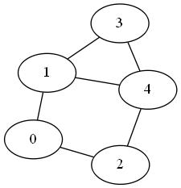
Graphviz http://www.graphviz.org/
Input DOT text file
Output
graph Example01 {
0 -- 1
0 -- 2
1 -- 3
1 -- 4
2 -- 4
3 -- 4
}
The Input code examples should be more or less self-explanatory.
For more details see the documentation
http://www.graphviz.org/Documentation.php
or the web/google in general.

Slide 3
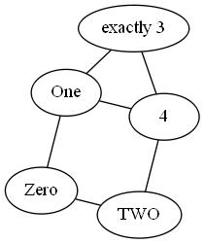
Graphviz http://www.graphviz.org/
Input DOT text file
Output
// Node names may be arbitrary.
// Comments (also /* and */ )
// are not processed.
graph Example02 {
Zero -- One
Zero -- TWO
One -- "exactly 3"
One -- 4
TWO -- 4
"exactly 3" -- 4
}
The nodes and edges layout and position is controlled by Graphviz.
It is an automated process with no guarantee that the user will be happy with the result.
More advanced option of Graphviz and DOT language allow the user to control graph layout nearly(!) perfectly. Be aware that "nearly" can be sometimes quite far from ideal.

Slide 4
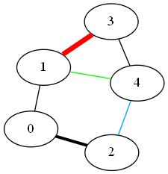
Graphviz http://www.graphviz.org/
Input DOT text file
Output
// Various edge attributes
// can be specified in [] brackets.
graph Example03 {
0 -- 1
0 -- 2 [penwidth=3]
1 -- 3 [penwidth=5, color=red]
1 -- 4 [color=green]
2 -- 4 [color="#00A0FF"] // follows
//usual RGB scheme
3 -- 4
}

Slide 5
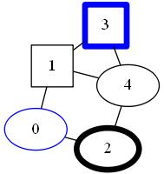
Graphviz http://www.graphviz.org/
Input DOT text file
// Nodes might be listed separately
// and their attributes might be specified
// like those of the edges.
graph Example04 {
0 [color=blue]
1 [shape=square]
2 [penwidth=5]
3 [color=blue,shape=square,penwidth=5]
// unlisted nodes assume default attributes
0 -- 1
0 -- 2
1 -- 3
1 -- 4
2 -- 4
3 -- 4
}
Output

Slide 6
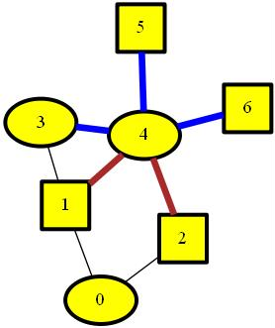
Graphviz http://www.graphviz.org/
Input DOT text file
// Default node and edge attributes might be redefined.
// Note the keywords 'node' and 'edge'.
// All subsequently listed nodes/edges are affected.
graph Example05 {
node [style=filled,fillcolor=yellow,penwidth=3]
0 3 4
node [shape=square]
1 2
// Node 5 and 6 attributes will be
// [style=filled,fillcolor=yellow, penwidth=3,shape=square]
0 -- 1
0 -- 2
1 -- 3
edge [penwidth=5,color=brown]
1 -- 4
2 -- 4
edge [color=blue] // penwidth=5 still holds:
3 -- 4
4 -- 5
4 -- 6
}
Output

Slide 7
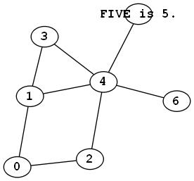
Graphviz http://www.graphviz.org/
Input DOT text file
// Some other useful node atributes:
// Smaller node sizes and a different font.
graph Example06 {
node [
shape=oval // try point, circle, house, octagon ...
fixedsize=true
width=0.40
height=0.30
fontname="Courier-Bold"
]
0 -- 1
0 -- 2
1 -- 3
1 -- 4
2 -- 4
3 -- 4
4 -- "FIVE is 5." // text overflows the shape
4 -- 6
}
Output

Slide 8
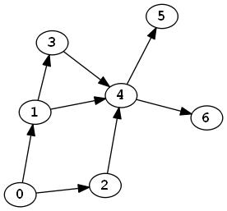
Graphviz http://www.graphviz.org/
Input DOT text file
// Directed graphs differ from undirected ones
// by the keyword "digraph"
// and the edge symbol "->".
digraph Example07 {
node [
shape=oval
fixedsize=true
width=0.40
height=0.30
fontname="Courier-Bold"
]
0 -> 1
0 -> 2
1 -> 3
1 -> 4
2 -> 4
3 -> 4
4 -> 5
4 -> 6
}
Output

Slide 9
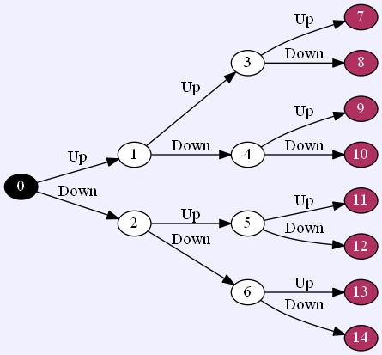
Input DOT text file
Graphviz http://www.graphviz.org/
// Binary tree. Note the edge labels
// and the global graph attributes.
digraph Example08 {
graph [rankdir=LR,bgcolor="#F0F0FF"]
// LR ... drawing direction: Left-Right
node [shape=oval,fixedsize=true,
width=0.40, height=0.30, style=filled]
0 [fillcolor=black,fontcolor=white ]
node [fillcolor=white,fontcolor=black ]
1 2 3 4 5 6
node [fillcolor=maroon,fontcolor=white ]
7 8 9 10 11 12 13 14
0 -> 1 [label="Up"]
0 -> 2 [label="Down"]
1 -> 3 [label="Up"]
1 -> 4 [label="Down"]
// ...
// few lines missing to fit the text to the slide
6 -> 13 [label="Up"]
6 -> 14 [label="Down"]
}
Output

Slide 10
Where to go next?
Easy intro: http://www.tonyballantyne.com/graphs.html
http://www.graphviz.org/pdf/dotguide.pdf
Try experimenting online:
http://graphs.grevian.org/graph
All Details:
http://www.graphviz.org/Gallery.php
http://www.graphviz.org/Documentation.php
http://www.graphviz.org/content/faq
Warning
Graphviz comes with seven graph picture generating engines based on different strategies and algorithms: Circo, dot, fdp, neato, osage, sfdp, twopi.
Often, dot and fdp work best but that also depends on the particular graph.
Experimentation and patience are recommended to get the desired result.
The pictures in this presentation were produced by different engines.

