Slide 1
Ray Tracing for Games
Dr. Jacco Bikker - FEL/CVUT, Prague, March 9 - 20
Light Transport
Dělat pěkné obrázky

Slide 2
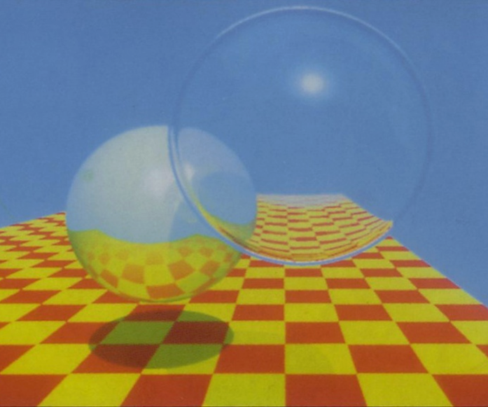
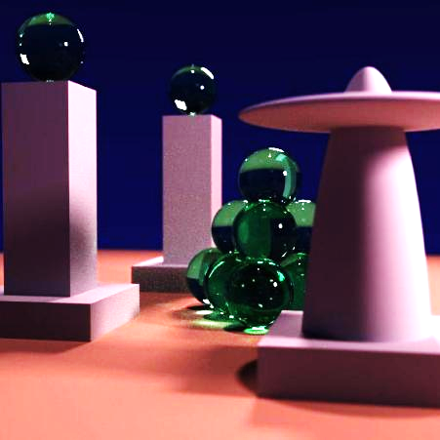
Ray Tracing for Games
Agenda:
Introduction
RT State-of-the-Art
RT Ingredients
Lab

Slide 3
Ray Tracing for Games
Introduction

Slide 4
Ray Tracing for Games
Introduction
What to fix in the basic 3D engine:
No shadows
No reflections / refractions
No anti-aliasing
How to fix the basic 3D engine:
Stencil shadows / shadow volumes / cascading shadow maps
Environment mapping
…

Slide 5
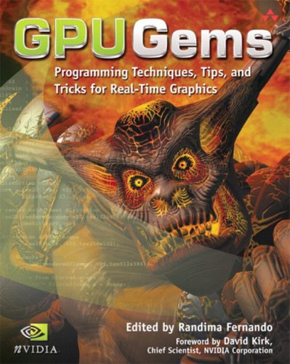
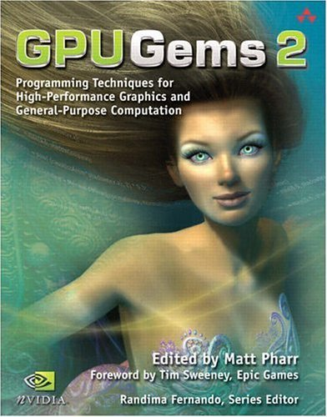
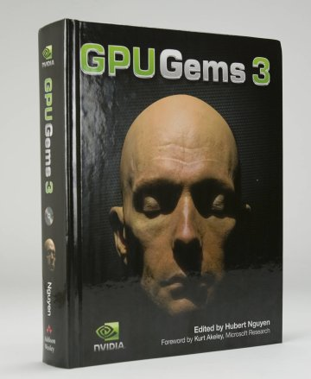
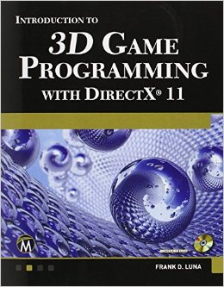
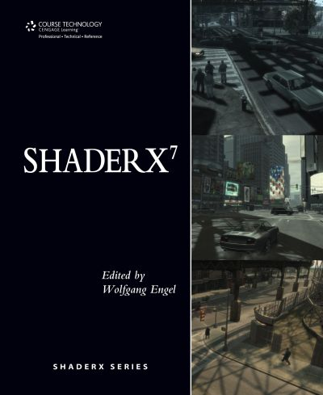
Ambient occlusion – Depth
Culling – Scissor tests – Por tals - Importance sampling -
Stentil buffer – Shadow maps – R
adiosity – Bump maps – Pixel shade
rs – Blur buffer – Render passes – Cube
map – Deferred shading – Tone mapping –
Render target – Steep paralax mapping – Hier
archical z-buffer - Occlusion query – BSP – Post pr
ocessing – Depth of field – Texture shadowing – Pre-ba
cked lightmaps – Volumetric lighting – Frustum culling – Ba
ckface removal – Far clipping plane – Level of detail – Volumetric f
og – Chunks – Indoor/outdoor rendering – Portals – Animated textures
Precomputed light transport – Global illumination – Frameless rendering – Shad
er parameters – t-buffer – c-buffer – g-buffer – normal mapping – geometry shader – subdivi
sion surfaces – Octree – kD-tree – Geometry instancing – Mesh deformation – Delaunay trianglulation – Ambi
Ray Tracing for Games
Introduction
What to fix in the basic 3D engine:
No shadows
No reflections / refractions
No anti-aliasing
How to fix the basic 3D engine:
Stencil shadows / shadow volumes / cascading shadow maps
Environment mapping
…

Slide 6
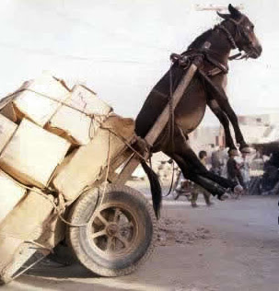
Ray Tracing for Games
Introduction
Modern 3D engines:
Large collection of algorithms
Millions of lines of code
Many man-years of development
What if you don’t have man years?

Slide 7

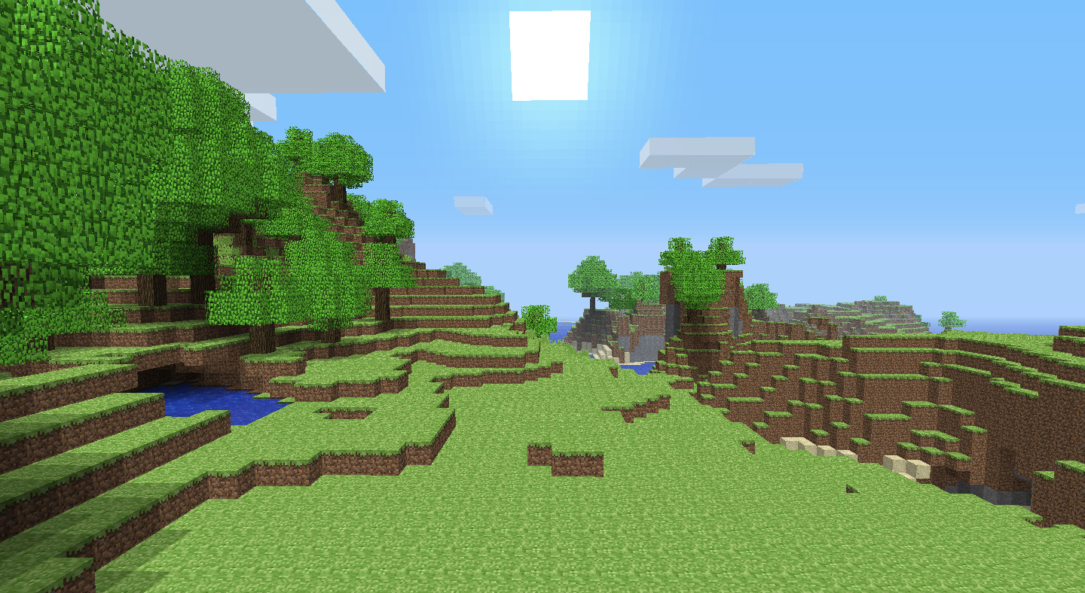
Ray Tracing for Games
Introduction
Minecraft: trading realism for development time

Slide 8
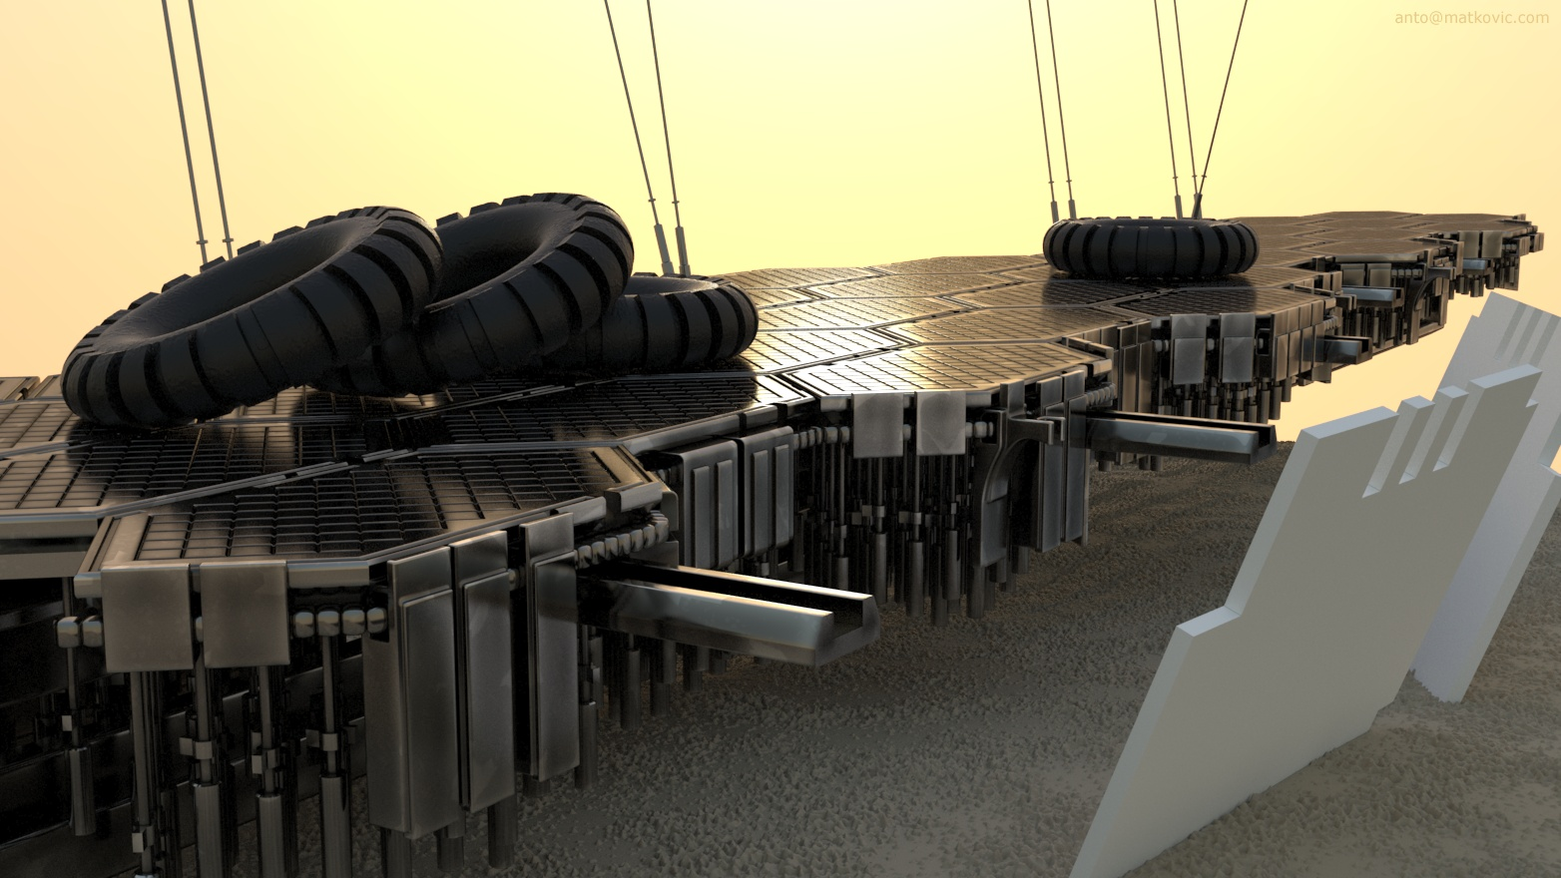
Ray Tracing for Games
Introduction
Ray tracing: trading rendering speed for development time

Slide 9
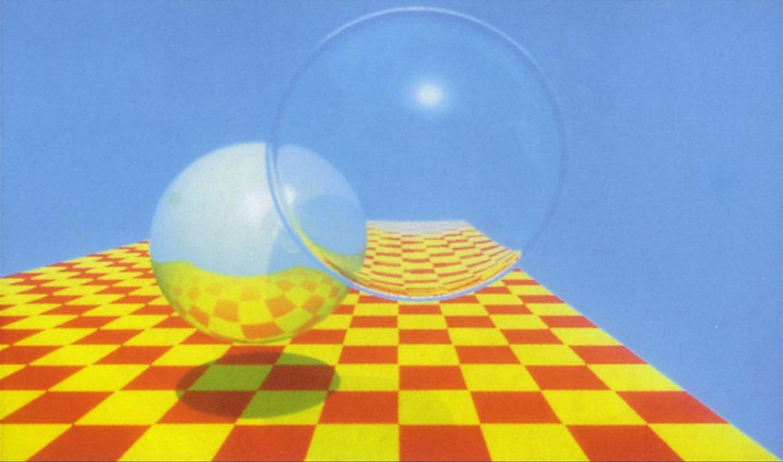
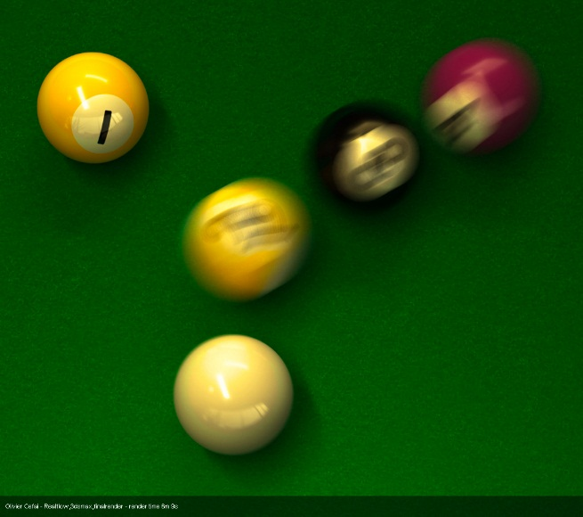
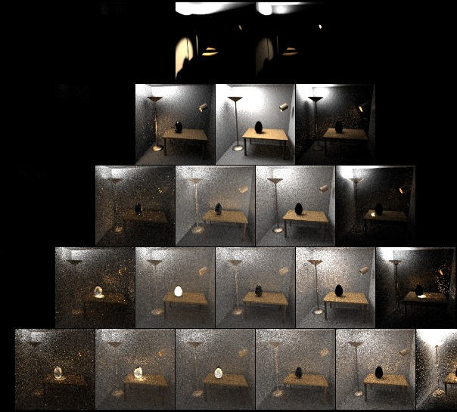
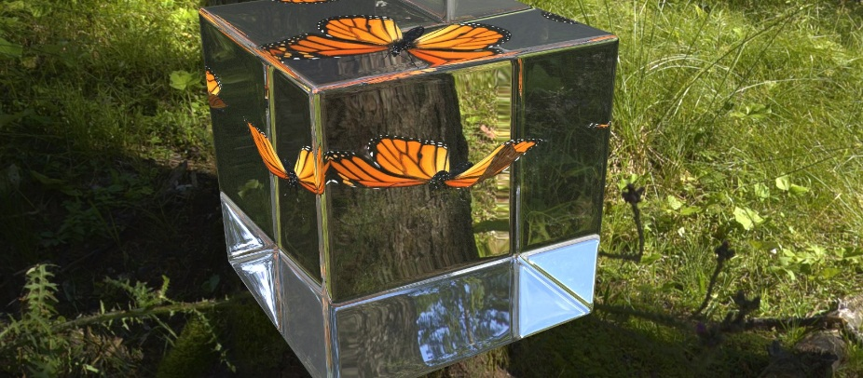
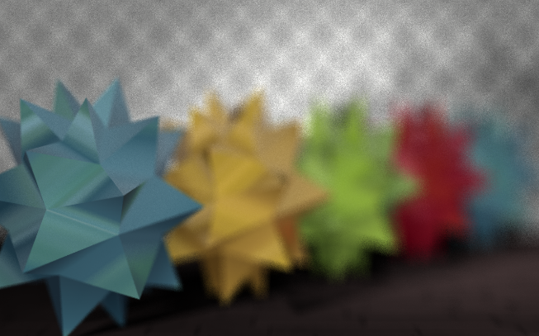
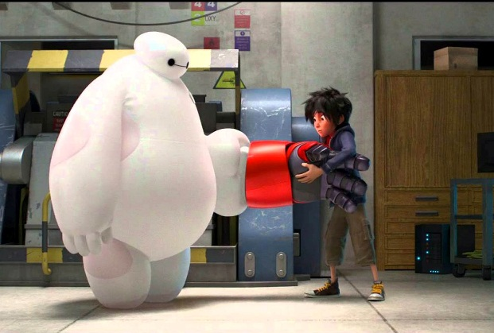
Ray Tracing for Games
Introduction
1979
1984
1986
1997

Slide 10

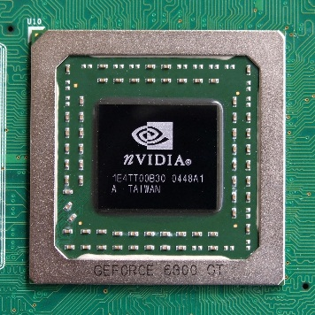
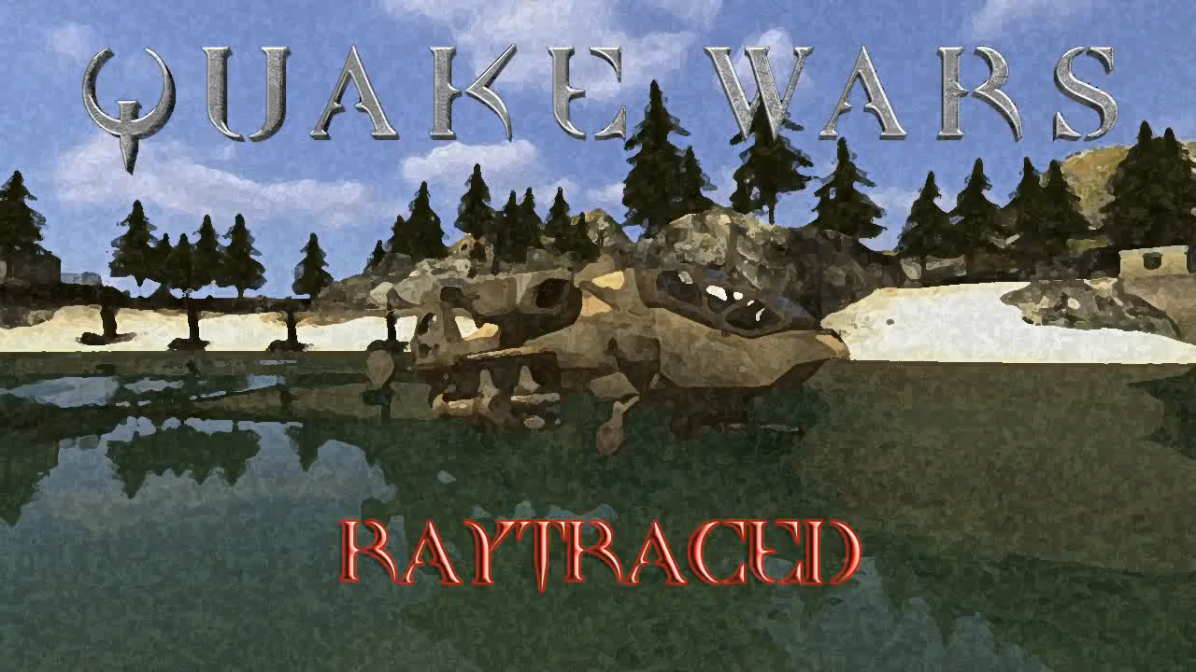
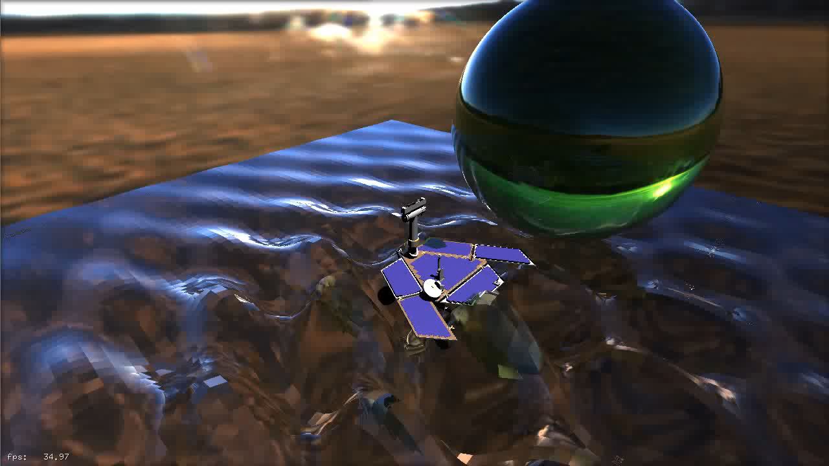
Ray Tracing for Games
Introduction

Slide 11
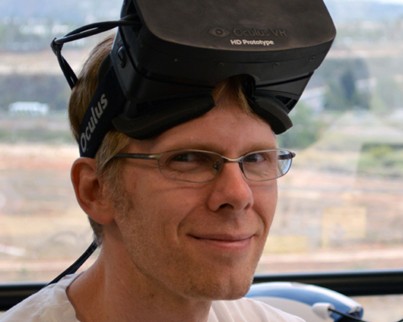
Ray Tracing for Games
Introduction
”I do think that some form of ray tracing will eventually win because there’s so many things that just get magically better there. There’s so much crap that we deal with in rasterisation with, okay let’s depth fade or fake our atmospheric stuff using environment maps, use shadows. And when you just say “well just trace a ray” a lot of these problems vanish.”

Slide 12
Ray Tracing for Games
Introduction
Ray Tracing in Games:
Elegant
‘Ground truth’
But:
Slow
(a) purpose of this course:
To get some first hand experience with the use of ray tracing in games.

Slide 13
Ray Tracing for Games
Agenda:
Introduction
RT State-of-the-Art
RT Ingredients
Lab

Slide 14
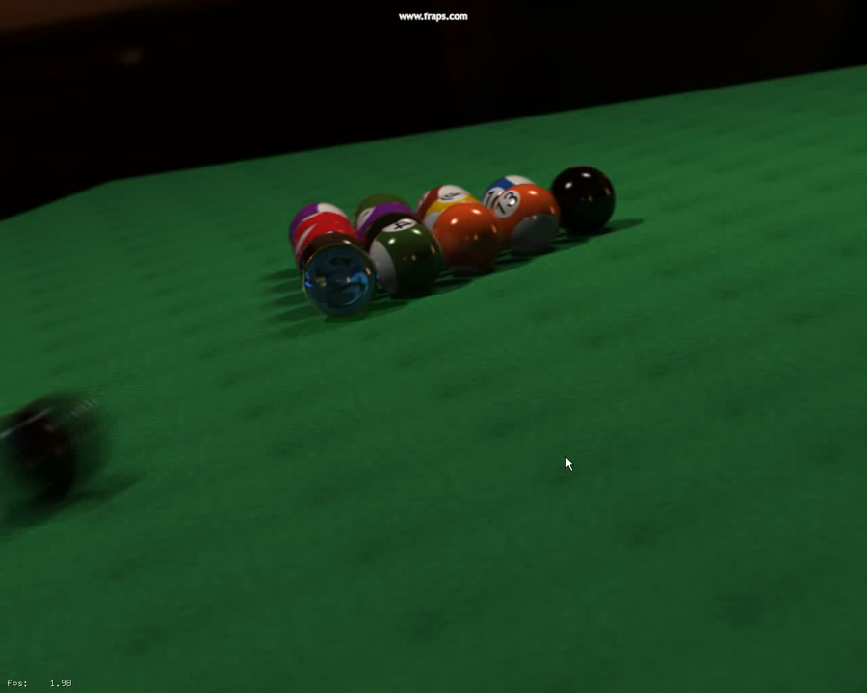
Ray Tracing for Games
State of the Art
State of the Art (1)
Performance:
NVidia / OptiX

Slide 15
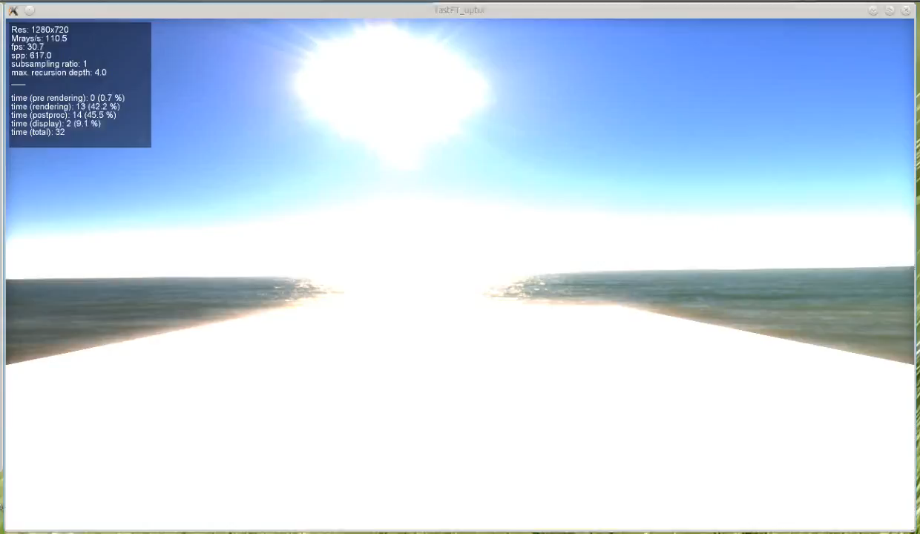
Ray Tracing for Games
State of the Art
State of the Art (1)
Performance:
NVidia / OptiX

Slide 16

Ray Tracing for Games
State of the Art
State of the Art (1)
Performance:
Arauna

Slide 17

Ray Tracing for Games
State of the Art
State of the Art (1)
Performance:
Brigade 2

Slide 18

Ray Tracing for Games
State of the Art
State of the Art (2)
Quality:
Big Hero 6

Slide 19
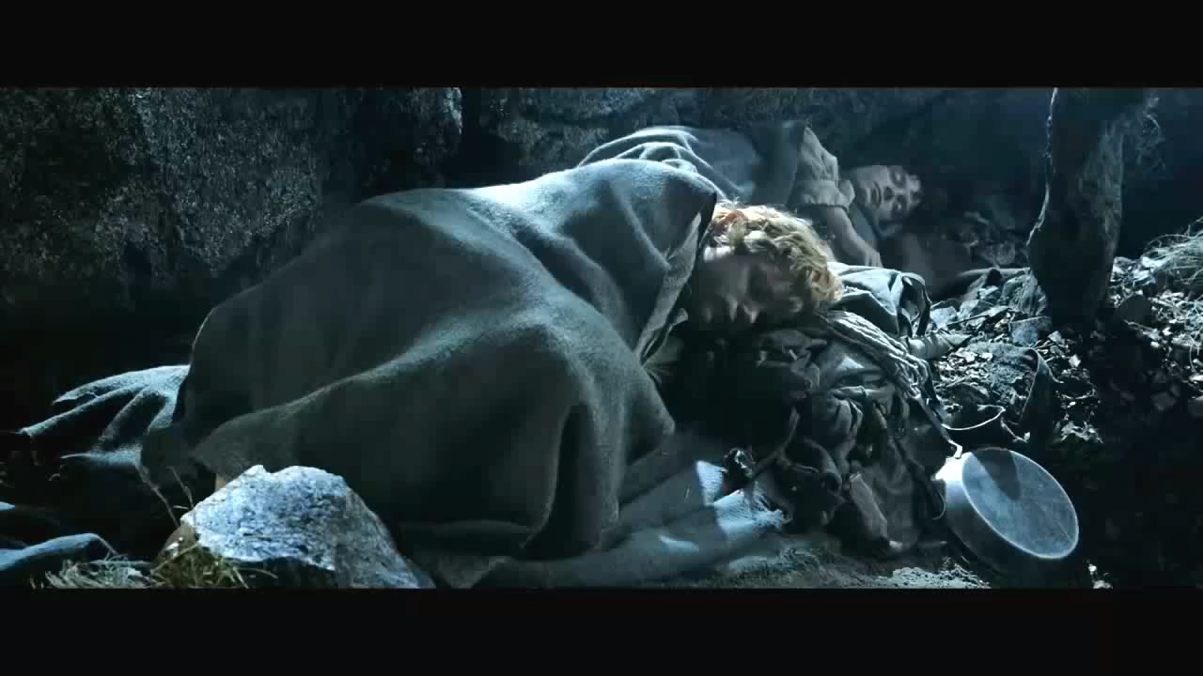
Ray Tracing for Games
State of the Art
State of the Art (2)
Quality:
Lord of the Rings

Slide 20
Ray Tracing for Games
State of the Art
State of the Art:
Offline: photo-realism
Movies: near photo-realism within time budget (~1 hour per frame)
Interactive:
  For very basic scenes, real-time
  For Whitted-style, real-time
  Anything else: noise and/or slow.

Slide 21


Slide 22
Ray Tracing for Games
Agenda:
Introduction
RT State-of-the-Art
RT Ingredients
Lab

Slide 23
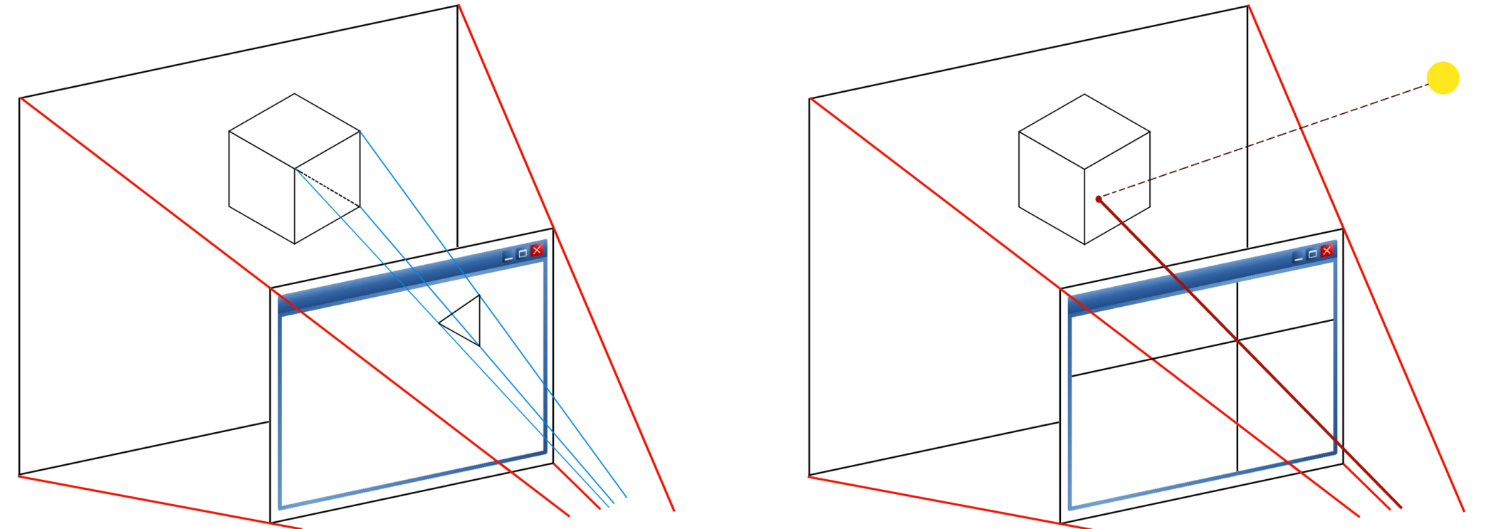
Ray Tracing for Games
Ingredients

Slide 24

Ray Tracing for Games
Ingredients
Needful things:
Setting up a ray
Aiming it at a pixel
Intersecting it with the primitives in the scene…
…to find the nearest surface
Check line of sight for the light source
If unoccluded, calculate light transport
Plot pixel

Slide 25
Ray Tracing for Games
Ingredients
Needful things:
Setting up a ray
Aiming at a pixel
p(t) = O + t D
O: camera position
D: normalize( P_{pixel} – O )
t: distance along ray, > 0

Slide 26
Ray Tracing for Games
Ingredients
Needful things:
Intersecting it with the primitives in the scene…
Ray: P = O + t D
Plane: P ∙ N + d = 0
Substitute for P, to get:
(O + t D) ∙ N + d = 0
t = -(O ∙ N + d) / (D ∙ N)
Triangle intersection:
for each triangle edge
V₁ = A – O
V₂ = C – O
N₁ = normalize( V₂ × V₁ )
d₁ = O ∙ N₁
if ((P ∙ N₁ + d₁) < 0)
return false;
B
P
A
C
O

Slide 27
Ray Tracing for Games
Ingredients
Needful things:
Intersecting it with the primitives in the scene…
Ray: P = O + t D
Plane: P ∙ N + d = 0
Substitute for P, to get:
(O + t D) ∙ N + d = 0
t = -(O ∙ N + d) / (D ∙ N)
Triangle intersection:
P = α(B-A) + β(C-A)
Compute α, β
Point is in triangle if
0 ≤ α ≤ 1, and
0 ≤ β ≤ 1
B
P
A
C
O

Slide 28
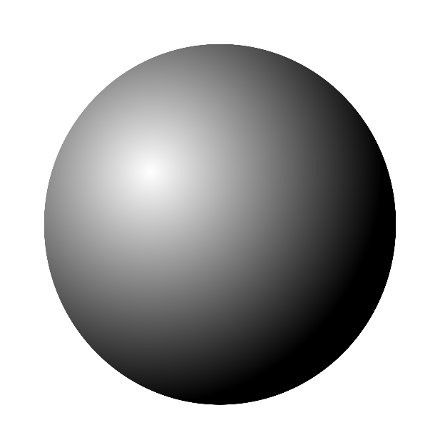
Ray Tracing for Games
Ingredients
Needful things:
Intersecting it with the primitives in the scene…
Ray: P = O + t D
Sphere: ǁP – Cǁ² = r²
Substitute to get:
ǁP + t D – Cǁ² = r²
Solve:
a = D · D
b = 2 (l · (O – C))
c = (O - C) · (O - C) - r²
t = (-b + sqrt( b² – 4ac)) / 2a
Note: miss if b² – 4ac < 0.

Slide 29
Ray Tracing for Games
Ingredients
Needful things:
Setting up a ray
Aiming it at a pixel
Intersecting it with the primitives in the scene…
…to find the nearest surface
Check line of sight for the light source
If unoccluded, calculate light transport
Plot pixel

Slide 30
Ray Tracing for Games
Ingredients
Ray tracing algorithm
Color Trace( vec3 O, vec3 D )
{
I, N, mat = IntersectScene( O, D );
if (!I) return BLACK;
return DirectIllumination( I, N ) *
mat.diffuseColor;
}
Color DirectIllumination( vec3 I, vec3 N )
{
vec3 L = lightPos – I;
float dist = length( L );
L /= dist;
if (!IsVisibile( I, L, dist )) return BLACK;
float attenuation = 1 / (dist * dist);
return lightColor * dot( N, L ) * attenuation;
}

Slide 31
Ray Tracing for Games
Ingredients
Ray tracing algorithm - reflections
Color Trace( vec3 O, vec3 D )
{
I, N, mat = IntersectScene( O, D );
if (!I) return BLACK;
if (mat.isMirror())
{
return Trace( I, reflect( D, N ) ) *
mat.diffuseColor;
}
else
{
return DirectIllumination( I, N ) *
mat.diffuseColor;
}
}

Slide 32
Ray Tracing for Games
Agenda:
Introduction
RT State-of-the-Art
RT Ingredients
Lab

Slide 33
Ray Tracing for Games
Lab
Building a ray tracer in a day
Stage one: primary rays, depth map
Stage two: N ∙ L shading, shadow for 1 light
Stage three: texture, distance attenuation, N lights
Stage four: reflections
(there’s much more obviously, but these steps take image quality well beyond the capabilities of a simple rasterizer)

Slide 34
Ray Tracing for Games
(Add states to your actors! E.g., a Pacman ghost can be:
0. Chasing, 1. Evading, 2. Blinking after Pacman ate it, 3. Returning to spawn after it died.)
Lab
Building a ray tracer in a day
0. Preparing work: setting up the game for ray tracing
Add a state machine to Game::Tick
Add a key or button to get from ‘rasterizer’ state to ‘ray tracer’ state
When ray tracing, update a scanline (or even pixel) per frame
class Game
{
public:
void SetTarget( Surface* _Surface );
void Init();
void HandleInput( float dt );
void Tick( float dt );
void TickRasterize( float dt );
void TickRaytrace( float dt );
...
private:
Surface* screen;
int state; // 0 = rasterizing; 1 = ray tracing
};
void Game::Tick( float dt )
{
screen->Clear( 0 );
if (state == 0) TickRasterize( dt );
if (state == 1) TickRaytrace( dt );
}
if (GetAsyncKeystate(‘R’)) state = (state + 1) & 1;
Better:
static bool r_is_down = false;
if (!GetAsyncKeystate(‘R’)) r_is_down = false; else
{
if (!r_is_down) state = (state + 1) & 1;
r_is_down = true;
}

Slide 35
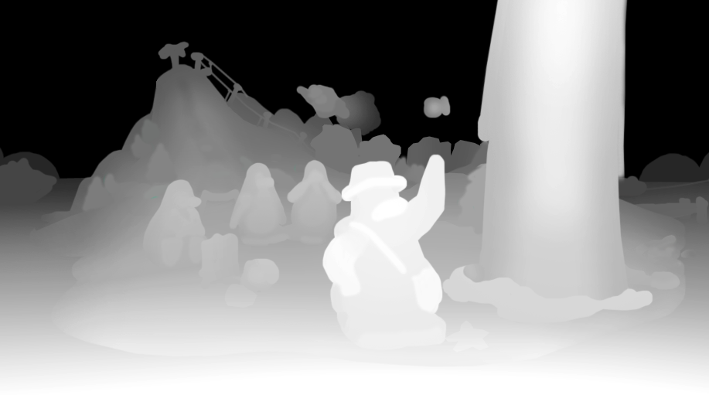
Ray Tracing for Games
Lab
Creating a primary ray:
Assume your camera is at (0,0,0).
Assume your screen is at (-1,-1)..(1,1), at z = 1:
top_left = { -1, -1, 1 }
top_right = { 1, -1, 1 }
bottom_left = { -1, 1, 1 }
bottom_right = { 1, 1, 1 }
Now transform the corners using the camera transform (not the inverse transform, like in the rasterizer).
Ray targets on the image plane can now be constructed using interpolation.
Getting vertices for a triangle:
In Mesh::Render:
// transform vertices
for( int i = 0; i < verts; i++ )
tpos[i] = vec3( T * vec4( pos[i], 1 ) );
Accessing triangle i:
int index0 = tri[i * 3 + 0];
int index1 = tri[i * 3 + 1];
int index2 = tri[i * 3 + 2];
vec3 worldPos0 = tpos[index0];
vec3 worldPos1 = tpos[index1];
vec3 worldPos2 = tpos[index2];
Building a ray tracer in a day
Stage one: primary rays, depth map
ToDo:
Setup a camera and screen plane, all in world space
Loop over your screen pixels:
  Create a primary ray (O, D)
  Don’t forget to normalize it!
  Intersect it with the primitives in your scene
  Visualize the nearest intersection distance.
Tip: present the window after rendering each scanline.
Actual intersection:
http://en.wikipedia.org/wiki/M%C3%B6ller%E2%80%93Trumbore_intersection_algorithm
(first hit for Google “wikipedia triangle intersection”)

Slide 36
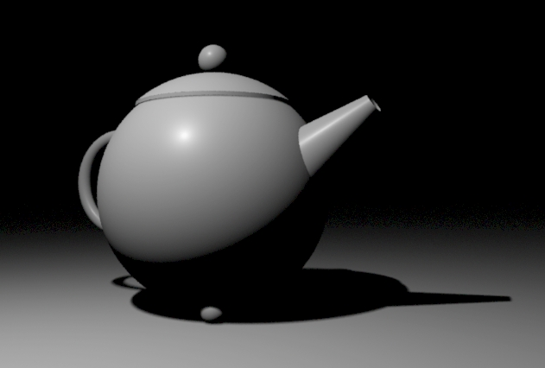
Ray Tracing for Games
Lab
Building a ray tracer in a day
Stage two: N ∙ L shading, shadow for 1 light
ToDo:
Assume the light is at a fixed location, e.g. (0,0,0).
Replace simple distance visualization:
  Calculate primary intersection: P = O + t D
  Construct a ray to the ‘light’ (normalize!)
  Intersect it with the primitives in your scene
  Use the result to shade.
Note: the light itself is not visible, unless you draw something to represent it
Tip: shadow rays are blocked if they find any occlusion
Tip: prevent finding occluders at t=0 (start at t=EPSILON).

Slide 37
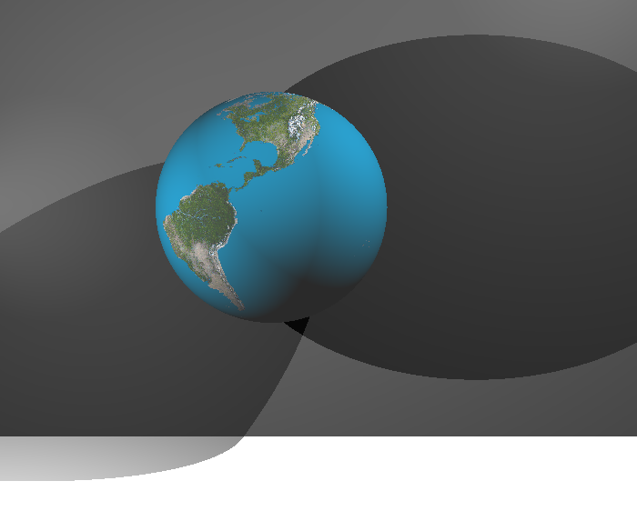
Ray Tracing for Games
Lab
Building a ray tracer in a day
Stage three: texture, distance attenuation, N lights
ToDo:
Properly represent lights in the scene
Replace simple shading:
  Get texture for primary intersection
  Enhance the N.L shading, add attenutation
  Loop over the lights, sum their contribution.

Slide 38
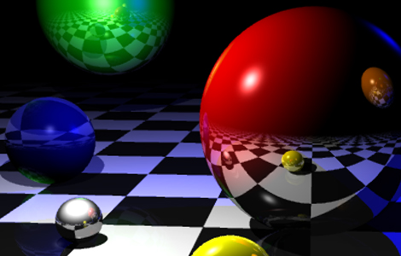
Ray Tracing for Games
Lab
Building a ray tracer in a day
Stage four: reflections
ToDo:
Review the slide with the ray tracing algorithm and add reflections (this is trivial).

Slide 39

End of lecture 2.
začněme programování!

