Slide 1
Synchronization Patterns
Zdeněk Kouba

Slide 2
Pattern-Oriented Software Architecture, Patterns for Concurrent and Networked Objects Volume 2
Douglas Schmidt, Michael Stal, Hans Rohnert and Frank Buschmann
ISBN: 0471606952 John Wiley & Sons © 2000 (633 pages)

Slide 3
Synchronization Patterns
Scoped Locking in C++
Strategized Locking
Thread-Safe Interface
Double-Checked Locking Optimization

Slide 4
Scoped Locking in C++
Problem ?
Notes:
Hit count – how many times a URL was accessed over a period of time
Problem:
1) The programmer may forget to release the lock in all if-then-else branches
2) The implementation is not exception-safe.

Slide 5
Scoped Locking in C++
Notes:
Solution to the problem introduced on the previous slide:
Define a guard class
1) whose condtructor automatically acquires the lock when control enters a scope
AND
2) The destructructor automatically releases the lock when the control leaves the scope

Slide 6
Scoped Locking in C++

Slide 7
Strategized locking – polymorfic lock
Example: file cache that maps URL to (i) either memory-mapped files or
(ii) file handles of opened files
The implementation must be supported on multiple single-threaded or multi-threaded operating systems.
One way (not recommended) is to develop multiple file cache classes that differ in their synchronization strategy (mutexes, reader/writer locks, semaphores).
Better solutiuon: pluggable synchronization strategies
Problem:
When integrating synchronization mechanisms with component functionality, the following aspects have to be considered:
Different apps may require different synchr. strategies => component’s synchronization mechanisms must be customizable (according to app’s needs).
To avoid version-skew when adding enhancements and/or bug fixes, changes should apply consistently and automatically to all members of the component family.
Notes:
Example:
File cache that maps URL to (i) either memory-mapped files or (ii) file handles of opened files
The implementation must be supported on multiple single-threaded or multi-threaded operating systems. One way (not recommended) is to develop multiple file cache classes that differ in their synchronization strategy

Slide 8
Strategized locking – polymorfic lock
Problem:
When integrating synchronization mechanisms with component functionality, the following aspects have to be considered:
Different apps may require different synchr. strategies => component’s synchronization mechanisms must be customizable (according to app’s needs).
To avoid version-skew when adding enhancements and/or bug fixes, changes should apply consistently and automatically to all members of the component family.
Solution:
Parametrize the synchronization aspect by making them “pluggable” types
Instances of these pluggable types contained within the component
The component uses them to synchronize its methods implementations efficiently
Notes:
Example:
File cache that maps URL to (i) either memory-mapped files or (ii) file handles of opened files
The implementation must be supported on multiple single-threaded or multi-threaded operating systems. One way (not recommended) is to develop multiple file cache classes that differ in their synchronization strategy

Slide 9
Strategized locking – polymorfic lock
Abstraktní třída, od níž budou dědit třídy reprezentující jednotlivé strategie
zamykání:
Mutex
Semaphore
Reader/writer lock;

Slide 10
Strategized locking – polymorfic lock
Notes:
Example:
File cache that maps URL to (i) either memory-mapped files or (ii) file handles of opened files
The implementation must be supported on multiple single-threaded or multi-threaded operating systems. One way (not recommended) is to develop multiple file cache classes that differ in their synchronization strategy

Slide 11
Strategized locking - parametrized type

Slide 12
Strategized locking - parametrized type

Slide 13
Thread-Safe Interface
minimizes locking overhead
ensures that intra-component method calls don’t incure self-deadlock

Slide 14
Thread-safe Interface
Problém:
Buď rekursivní mutex, ale pak velká režie
Nebo self-deadlock
Řešení?

Slide 15
Thread-safe Interface
Solution:
Interface methods check – all public components acquire/release componenet’s locks on the component’s border
Implementation method trust – private and protected methods if called by an interface (public) method, they trust that the interface method did the synchronization work properly.

Slide 16
Double-Checked Locking Optimization
Pattern reduces synchronization overhead whenever a critical section has to acquire a lock just once per program execution
Typically applied to Singletons
Solution:
Introduce a flag that informs if it is necessary to execute the critical section at all.

Slide 17
Double-Checked Locking Optimization
Takovýto singleton není threadově bezpečný !

Slide 18
Double-Checked Locking Optimization
Takovýto singleton je threadově bezpečný,
ale režie se synchronizací je při každém volání, ačkoliv
svou užitečnou roli sehrála pouze při prvním volání

Slide 19
Double-Checked Locking Optimization
Takovýto singleton není threadově bezpečný,
test na existenci instance musí být v kritické sekci!

Slide 20
Double-Checked Locking Optimization
Zlatý hřeb návrhového vzoru, aneb to by němej neřek’:

Slide 21
Concurrency Patterns

Slide 22
Pattern-Oriented Software Architecture, Patterns for Concurrent and Networked Objects Volume 2
Douglas Schmidt, Michael Stal, Hans Rohnert and Frank Buschmann
ISBN: 0471606952 John Wiley & Sons © 2000 (633 pages)

Slide 23
Concurrency patterns
Active Object design pattern
Monitor Object design pattern

Slide 24
Active Object
Klienti, kteří přistupují k objektu běží v samostatných vláknech
Active Object vykonává své metody ve svém vlastním threadu (tedy nikoliv ve threadu klienta)

Slide 25
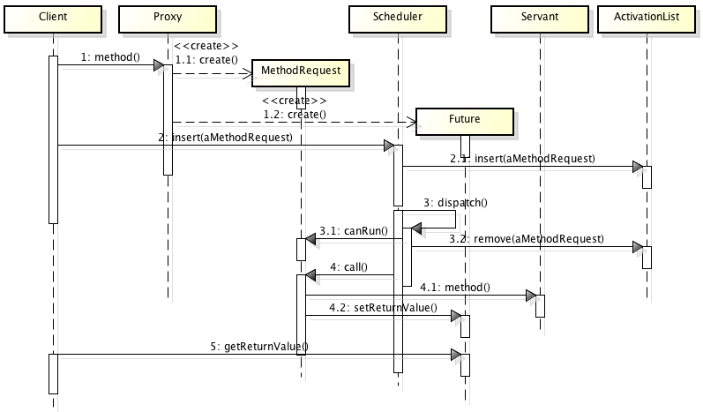
Active Object

Slide 26
Active Object
Zajímavá varianta:
Pokud active object implementuje více rolí tak, že jednotliví klienti mohou mít různé role,
tak co?

Slide 27
Active Object
Zajímavá varianta:
Pokud active object implementuje více rolí tak, že jednotliví klienti mohou mít různé role,
pro každou roli existuje samostatná proxy.

Slide 28
Monitor aka Thread-safe Passive Object
Pokud je scheduling primitivní, je možná aktivní objekt zbytečně složitým návrhovým vzorem.
Jiný (jednodušší) způsob řešení: Monitor

Slide 29
Monitor
Několik vláken přistupuje současně k témuž objektu
Metoda objektu není (narozdíl od aktivního objektu) vykonávána v samostatném vláknu, ale je vykonávána ve vláknu klienta.
API objektu musí definovat “rámec synchronizace” – množinu synchronizovaných metod.
Zámek monitoru - současně může být vykonávána pouze jediná synchr. metoda.
Monitor conditions:
Pokud by měla synchr. metoda blokovat při čekání na splnění nějaké monitor condition, musí se objekt dobrovolně vzdát zámku monitoru a poté odevzdat procesor (přejít do stavu sleeping). Nutná podmínka pro to je, aby byl objekt v konzistentním stavu.
Vzbuzení:
timeout
notifikace ostatními vlákny ( notify(), notifyall() )
Po vzbuzení nutnost ověřit znovu splnění podmínky “monitor condition”

Slide 30
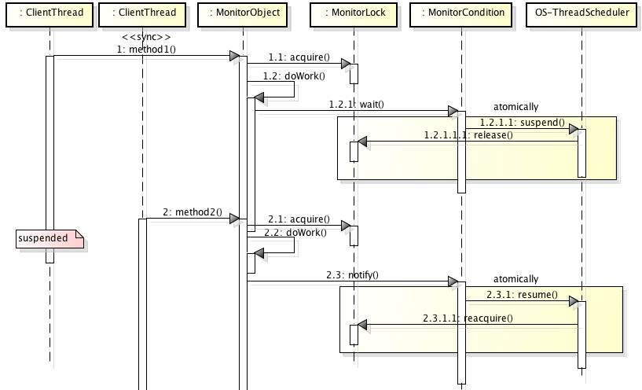
Monitor

