Slide 1
Design Patterns

Slide 2
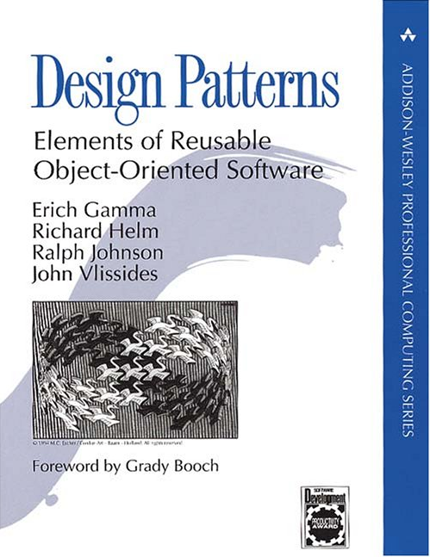
Thinking in Patterns with Java
Bruce Eckel
http://www.mindview.net/Books/TIPatterns/

Slide 3
Design Patterns Classification
Creational Design Patterns
Structural Design Patterns
Behavioral Design Patterns

Slide 4
Creational Design Patterns
Singleton
Factory Method
Factory Pattern
Abstract Factory
Builder
Reusable Pool
Prototype

Slide 5
Singleton
Class Singleton {
private static Singleton instance = null;
private Singleton() {}; //private constructor
public static
synchronized
Singleton getInstance() {
if (instance == null) {
instance = new Singleton();
}
return instance;
}
}

Slide 6
Abstract Factory Pattern

Slide 7
Abstract Factory Pattern

Slide 8
Builder

Slide 9
Prototype

Slide 10
Prototype
Shallow copy

Slide 11
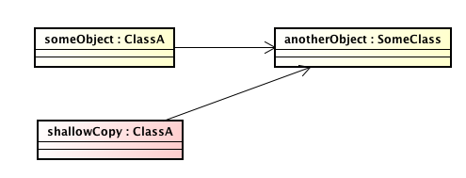
Prototype
Shallow copy
copy

Slide 12
Prototype
Deep copy

Slide 13
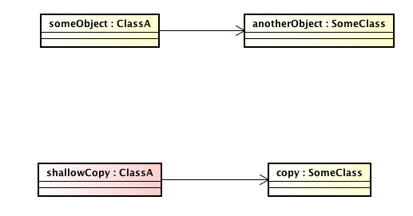
Prototype
Deep copy
copy
copy

Slide 14
Reusable Pool

Slide 15
Structural Design Patterns
Adapter
Bridge (sometimes considered to be a behavioral DP)
Decorator
Composite
Facade
Proxy
and more

Slide 16
Adapter

Slide 17
Adapter

Slide 18
Adapter

Slide 19
Adapter

Slide 20
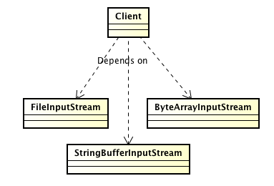
The Dependency Inversion Principle
High level modules should not depend upon low level
modules; both should depend on abstractions.
Abstractions should not depend upon details; details should depend upon abstractions.

Slide 21
Dependency Inversion Principle
Dependency inversion principle
specific form of decoupling where conventional dependency relationships established from high-level are inverted (e.g. reversed) for the purpose of rendering high-level modules independent of the low-level module implementation details. The principle states:
High-level modules should not depend on low-level modules. Both should depend on abstractions.
Abstractions should not depend upon details. Details should depend upon abstractions.
(From Wikipedia, the free encyclopedia)

Slide 22
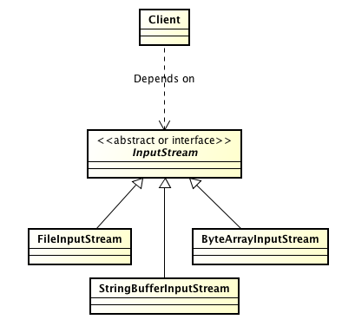
The Dependency Inversion Principle

Slide 23
The Dependency Inversion Principle
Depends on

Slide 24
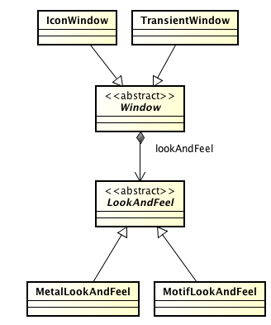
Bridge
Jednoduché rozšíření předešlého diagramu
design pattern Bridge

Slide 25
Bridge
Depends on
Does not depend on
Depends on

Slide 26
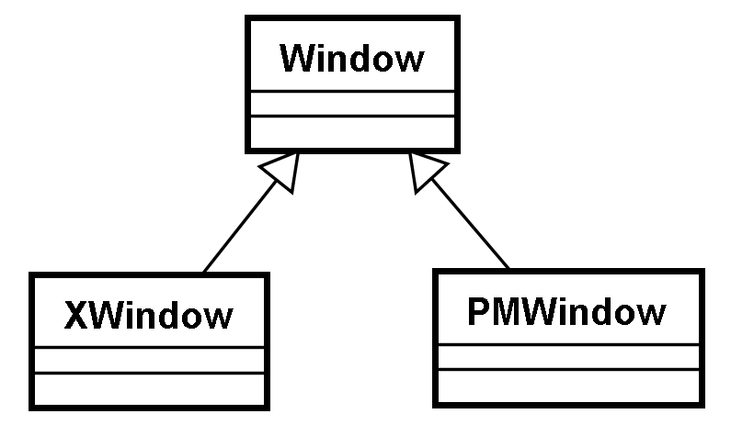
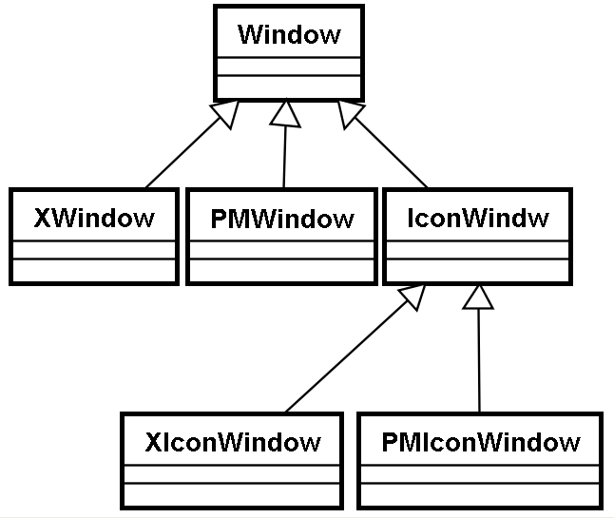
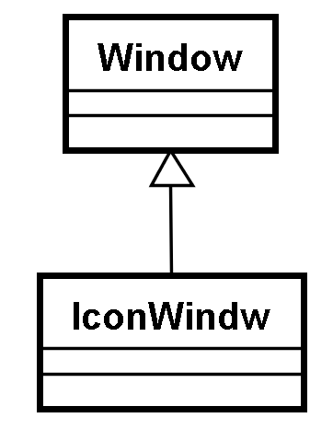
Bridge
Implementation
Máme více hledisek klasifikace.
Pokud bychom je chtěli zohlednit v jedné inheritanční hierarchii, došlo by k explozi počtu tříd (pro různé kombinace).
Řešení – oddělit klasifikační hlediska.
Abstraction refinement

Slide 27
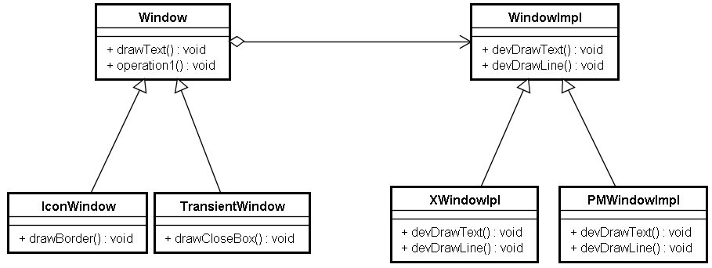
Bridge
Bridge
imp
+ drawLine(): void

Slide 28
Bridge
imp.devDrawLine();
imp.devDrawLine();
imp.devDrawLine();
imp.devDrawLine();
Bridge
imp
+ drawRect(): void
DrawRect();
DrawText();
XDrawLine();
XDrawString();

Slide 29
Bridge

Slide 30
Bridge
1. The Bridge pattern is intended to keep the interface to your client class constant while allowing you to change the actual kind of class you use.
2. You can extend the implementation class and the bridge class separately, and usually without much interaction with each other (avoiding permanent binding between abstraction and its implementation).
3. You can hide implementation details from the client class much more easily.

Slide 31
Decorator
InputStream
ObjectInputStream
BufferedInputStream
ObjectBufferedInputStream
Possible class explosion
(hard to maintain)
Decorator patterns helps ...

Slide 32
The Open-Close Design Principle
Software entities like classes, modules and functions should be open for extension but closed for modifications.
Adding new functionality should involve minimal changes to existing code.
=> adding new functionality will not break the old
functionality
=> old functionality need not be re-tested
Most changes will be handled as new methods and new classes. Designs following this principle would result in resilient code which does not break on addition of new functionality.

Slide 33
Decorator (structural)
InputStream

Slide 34
Decorator (structural)
Buffered
InputStream

Slide 35
Decorator (structural)
Object
S cukrem
InputStream
Buffered
Káva

Slide 36
Decorator (structural)

Slide 37
Decorator (structural)
Object
InputStream
Buffered

Slide 38
Decorator (structural)
InputStream is = new FileInputStream ("fff");
BufferedInputStream bis = new BufferedInputStream(is);
ObjectInputStream ois = new ObjectInputStream(bis);
BufferedInputStream bis = new BufferedInputStream(new FileInputStream("fff"));

Slide 39
Decorator (structural)
The Decorator Pattern attaches additional functionalities
to an object dynamically.
Decorators provide a flexible alternative to subclassing
for extending functionality.
Decorator prevents explosion of (sub)classes.

Slide 40
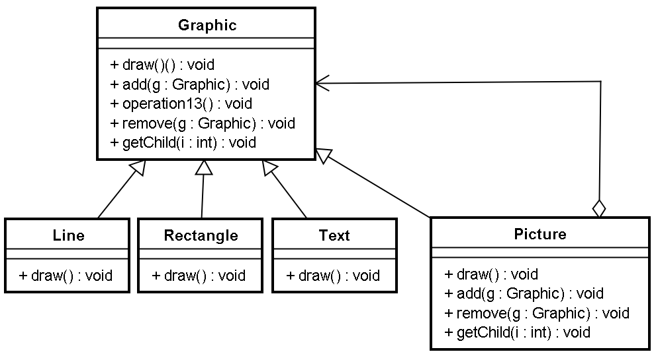
Composite (structural)
Abstract or interface
graphic
Returns Graphic

Slide 41
Composite (structural)
graphic
Forall g in graphic
g.draw();
Add g to the graphic
list

Slide 42
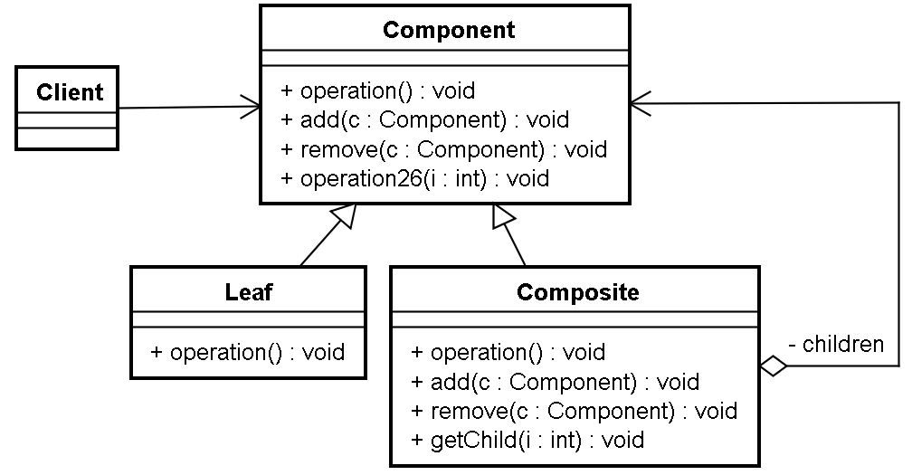
Composite (structural)

Slide 43
Composite (structural)
Views all components uniformly regardless whether leaf or composite
Default empty implementation
Forwards the operation to all children

Slide 44
Façade (structural)
The façade provides a unified interface that is easier to use
A complex subsystem

Slide 45
Façade (structural)
The Façade Pattern provides a unified interface to a set
of interfaces in a subsystem. Façade defines a higher-level
interface that makes the system easier to use.
Design Principle
Principle of least knowledge - talk only to your immediate
friends.

Slide 46
Proxy (structural)
The Proxy Pattern provides a surrogate or placeholder for another object to access control to it.

Slide 47
Proxy (structural)
With Remote Proxy, the proxy act as a local representative for an object that lives in a different JVM.

Slide 48
Proxy (structural)
Virtual Proxy acts as a representative for an object that may be expensive to create. The virtual proxy often defers creation of the object until it is needed. After that, the virtual proxy delegates requests to the RealSubject.

Slide 49
Proxy (structural)

Slide 50
Flyweight (structural)
Intrinsic state is stored in the ConcreteFlyweight object
Extrinsic state is stored or computed by Client objects. Clients pass this state to the flyweight when they invoke they operations
Clients should not instantiate ConcreteFlyweights directly. Clients must obtain ConcreteFlyweights from the FlyweightFactory to ensure they are shared properly.
not all Flyweight objects need to be shared. It is common for UnsharedConcreteFlyweight objects to have ConcreteFlyweight objects as children.

Slide 51
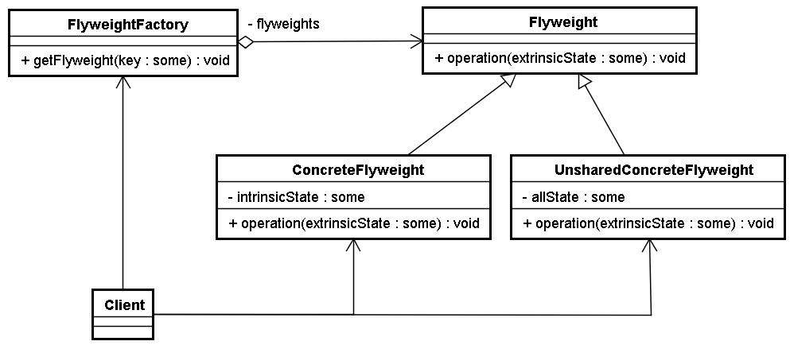
Flyweight (structural)
Pool of flyweights

Slide 52
Flyweight (structural)

Slide 53
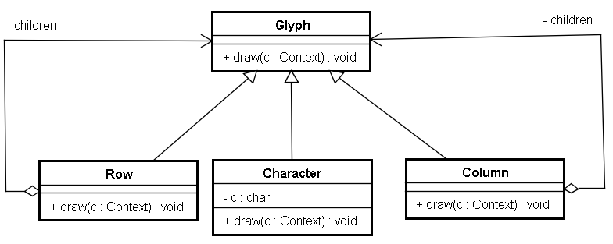
Flyweight (structural)

Slide 54
Flyweight (structural)
Flyweight
UnsharedFlyweight
UnsharedFlyweight
SharedFlyweight

Slide 55
Behavioral Design Patterns
Command
Interpreter
Iterator
Mediator
Observer
State
Strategy
Visitor

Slide 56
Command (behavioral)
Command represents an abstract algorithm independent on:
1) The application of the command (Client)
2) The particular implementation of the command (Receiver)

Slide 57
Command (behavioral)
Command
execute() {
receiver.action();
}
Receiver
action()
Command encapsulates a request as an object, thereby letting you parametrize other objects with different requests, queue or log requests and support undoable operations.

Slide 58
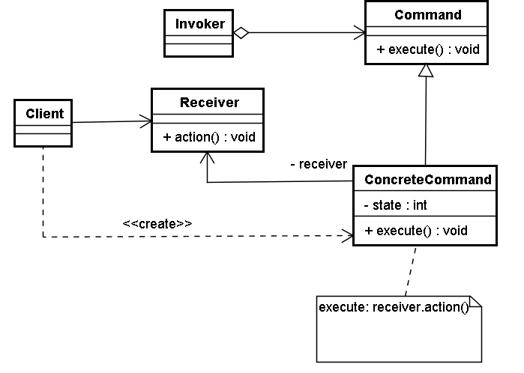
Command (behavioral)

Slide 59
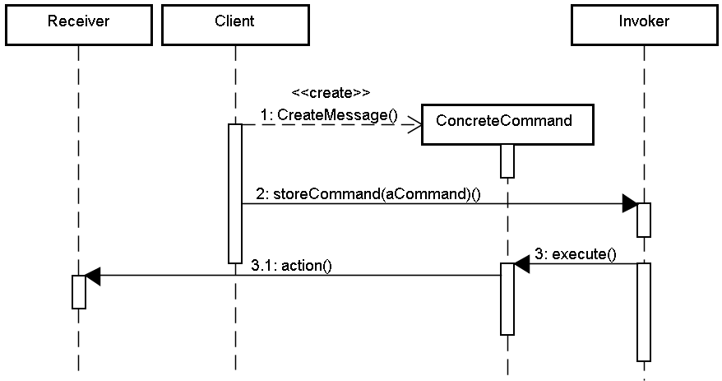
Command (behavioral)

Slide 60
Command (behavioral)
Command decouples the object that invokes the operation from the one that knows how to perform it.
You can assemble commands into a composite command (composite commands are instances of Composite pattern)
Easy to add new commands.

Slide 61
Behavioral Design Patterns
Behavioral Class Patterns
Use inheritance to distribute behaviour between classes
Template Method
Interpreter
Behavioral Object Patterns
Use composition rather than inheritance to distribute behaviour between objects
Mediator
Chain of Responsibility
Observer
Other Behavioral Patterns
Strategy
Command
Visitor
Iterator

Slide 62
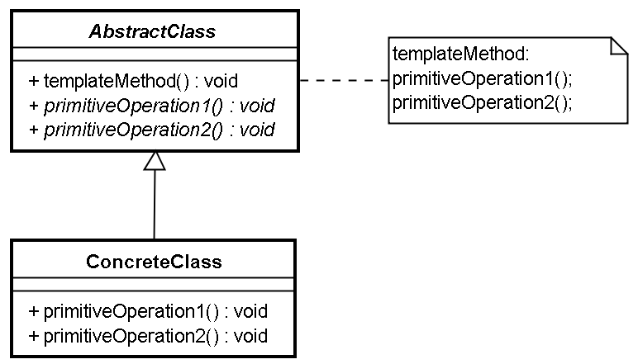
Template Method

Slide 63
Strategy (behavioral)

Slide 64
Strategy (behavioral)
The Strategy Pattern defines a family of algorithms, encapsulates each one, and makes them interchangeable. Startegy lets the algorithm vary independently from clients that use it.
Desing Principal
Favor composition over inheritance.

Slide 65
Observer (behavioral)
Observer1
notify()
Subject
notify()
Observer2
An object holding
a state and notifying
its observers about state’s
change.
notify()
Observer3
The aim is to make subject independent on observers
- loose coupling.

Slide 66
Observer (behavioral)

Slide 67
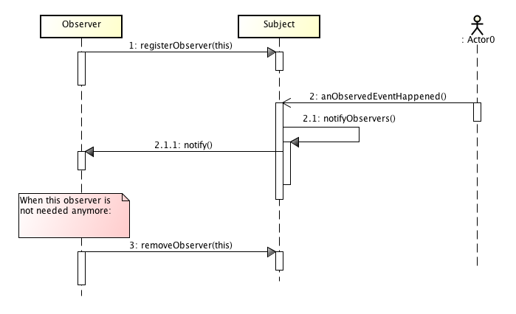
Observer (behavioral)

Slide 68
Observer (behavioral)
Desing Principle
Loosely coupled designs allows us to build flexible OO systems that can handle change because they minimize the interdependency between objects.

Slide 69
Mediator (behavioral)
define an object that encapsulates how a set of objects interacts
mediator promotes loose coupling by keeping objects from refering to each other explicitly
it lets you vary their interactions independently
Mediator

Slide 70
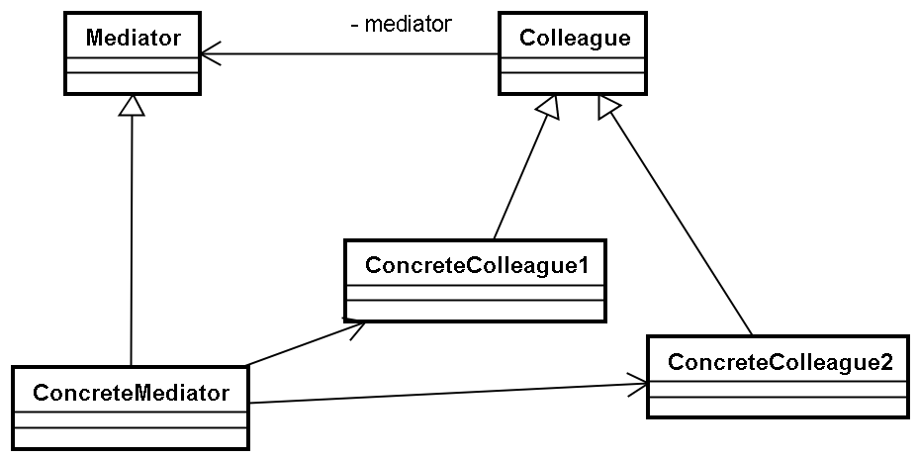
Mediator (behavioral)

Slide 71
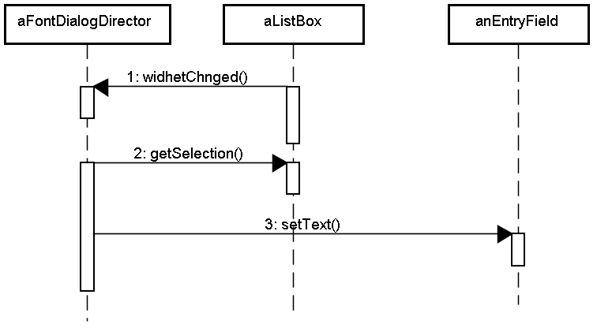
Mediator (behavioral)

Slide 72
State (behavioral)
State Pattern allows an object to alter its behavior when its internal state changes.

Slide 73
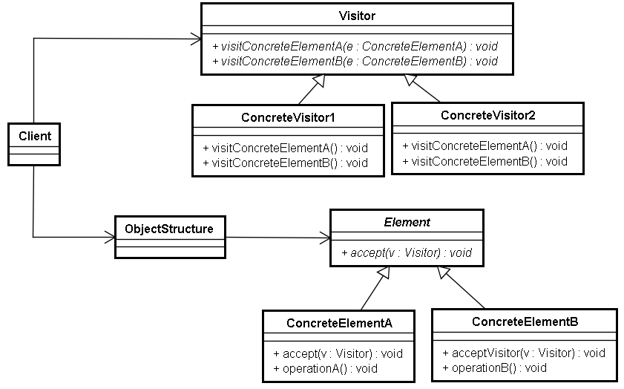
Visitor (behavioral)
v.visitConcreteElementA(this)

Slide 74
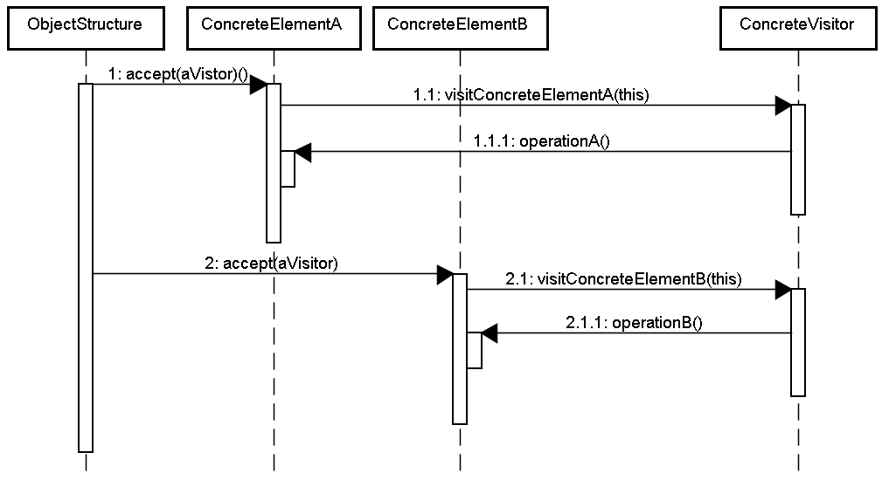
Visitor (behavioral)

Slide 75
Visitor (behavioral)
Visitor makes adding new operations easy
simply by adding a new visitor
A visitor gathers related operations and separates unrelated ones
Adding new ConcreteElement classes is hard
Is mostly likely to change the algorithm or the classes of objects that make up the structure?
Visitor can accumulate state as they visit each element

