Slide 1
Architecture of Software Systems – Lecture 4 Design Patterns for Distributed Systems
Martin Rehák

Slide 2
Overview
Selected Design & Architectural patterns for Distributed/Multiplatform computing
Content based on:
Douglas C. Schmidt, Pattern Oriented Software Engineering
Gang of Four: Gamma, Helm, Johnson, Vlissides; Design Patterns: Elements of Reusable Object-Oriented Software
(Guerraoui/Rodrigues: Introduction to Reliable Distributed Programming)
…

Slide 3
Paradigm Shift
From local to distributed
Explicit vs. implicit
Latency
Failures
Safety: a property is a safety property if it can never be restored once it is broken (e.g. the link will never insert a non-existing message into the media)
Liveliness: can be restored anytime in the future (e.g. subsystem will answer the request)

Slide 4
Distribution Issues
Remote resource localization
Remote resource creation and usage
State synchronization management
Failure detection
Failure management, recovery and failover
Resource destruction

Slide 5
Facade
Façade pattern hides the complexity and heterogeneity of system, subsystem or library behind a simple interface
Typically replaces/hides more than one object
Simplifies client access
Allows transparent resource management
Allows transparent lazy initialization

Slide 6
Facade vs. Interface
Interface (in Java sense) is far more restricted than Façade
Only defines a contract between the library/implementing class and its user – programmer
Façade pattern allows active handling of more complex issues than actual business logic
Most of the code in distributed applications is NOT directly related to business logic

Slide 7
(Wrapper) Façade Example: JDBC
Java Database Connectivity provides a unified API for most database work in Java
Unified methods and constants
Uses the Adapter pattern to incorporate third-party DBMS drivers
Successfully hides most of the connection complexity/decisions from the Application Developer

Slide 8
Adapter/Wrapper
The Adapter pattern provides mapping between two (isofunctional) interfaces
Ensures syntactic and semantic compatibility of calls

Slide 9
Wrapper Façade
The Wrapper Facade design pattern encapsulates the functions and data provided by existing non-object-oriented APIs within more concise, robust, portable, maintainable, and cohesive object-oriented class interfaces
Douglas C. Schmidt, C++ Report 1999
Usages:
Java Swing
ACE/ORB
Platform independent threading/synchronization libraries
ACE Library

Slide 10
Proxy
Proxy pattern is a local representation of a remote object, interface or library
Rarely used alone, frequently combined with Façade, Wrappers and other Patterns
AbstractService
service
Client
Proxy
Service
service
1
1
service
The Proxy Pattern (Douglas Schmidt, POSA)

Slide 11
Implicit vs. Explicit Distribution

Slide 12
Implicit vs. Explicit Distribution

Slide 13
Failure Propagation (1)
An example of (easy) failure in a distributed system – why distribution matters
Two components:
(A) Thermometer, with HTTP REST API, returns temperature as string
(B) Client, using the thermometer to measure swimming pool temperature
What could go wrong?

Slide 14
Failure Propagation (2)
Thermometer breaks down and system generates random noise.
In case of thermometer failure, some pools got to boil…

Slide 15
Failure Propagation (3)
Thermometer breaks down and system generates random noise.
In case of thermometer failure, some pools got to boil…
Solution: Use -1 in the reply as a failure indicator, as text handling is unsupported in pool controllers

Slide 16
Failure Propagation (4)
BUT: Thermometers are also used in Europe (on ski slopes), with Celsius scale instead of Fahrenheit
-1 is completely plausible value and leads to shutdown of snow canons for ski resort customers

Slide 17
Stateful vs. Stateless design
State consistency and resource management are the points where most abstractions break in real life:
CORBA
COM/DCOM/OLE
Alternative approaches make the distribution EXPLICIT and incorporate it into the design from the beginning
Messaging
HTTP-based architectures/APIs

Slide 18
Active Object
The Active Object design pattern decouples method execution from method invocation to enhance concurrency and simplify synchronized access to objects that reside in their own threads of control.
D. Schmidt, et al. 2007
Agents/Multi-Agent Systems and OLTP systems are most frequently based on Active Objects (Messaging)

Slide 19
Active Object

Slide 20
What is the downside of AO?
Asynchronous operation handling is pushed to client
Scalability and efficiency.
Active Object is based on the assumption that the task performed by the object has a uniform resource consumption.
This assumption is almost never true, especially in case of web servers or other IO-heavy systems.
Hence the motivation for Reactor and Proactor.
Reactor and Proactor provide transparent sync-async transition and efficient resource allocation.

Slide 21
Reactor
The Reactor architectural pattern allows event-driven applications to demultiplex and dispatch service requests that are delivered to an application from one or more clients.
(Schmidt)
Reactor
*
Event Handler
handle_events()
register_handler()
remove_handler()
dispatches
handle_event ()
get_handle()
*
Handle
owns
*
notifies
handle set
<<uses>>
Concrete Event Handler A
Concrete Event Handler B
Synchronous
Event Demuxer
handle_event ()
get_handle()
handle_event ()
get_handle()
select ()

Slide 22
Proactor
The Proactor architectural pattern allows event-driven applications to efficiently demultiplex and dispatch service requests triggered by the completion of asynchronous operations, to achieve the performance benefits of concurrency without incurring certain of its liabilities. (Schmidt)
Initiator
<<uses>>
<<uses>>
<<uses>>
<<invokes>>
is associated with
Asynchronous
Operation Processor
Asynchronous
Operation
Handle
Completion
Handler
execute_async_op()
async_op()
*
handle_event()
<<enqueues>>
<<executes>>
<<demultiplexes
& dispatches>>
Asynchronous
Event Demuxer
Proactor
Concrete
Completion
Handler
Completion
Event Queue
handle_events()
get_completion_event()
<<dequeues>>

Slide 23
Reactor/Proactor – Web server
Concurrency – The server must perform multiple client requests simultaneously;
Efﬁciency – The server must minimize latency, maximize throughput, and avoid utilizing the CPU(s) unnecessarily.
Programming simplicity – The design of the server should simplify the use of efﬁcient concurrency strategies;
Adaptability – Integrating new or improved transport protocols (such as HTTP 1.1 [3]) should incur minimal maintenance costs.
Schmidt, 1997
(NOT a Proactor/Reactor)

Slide 24
Reactor

Slide 25
Reactor – Connection
The Web Server registers an Acceptor with the Initiation Dispatcher to accept new connections;
The Web Server invokes event loop of the Initiation Dispatcher;
A client connects to the Web Server;
The Acceptor is notified by the Initiation
Dispatcher of the new connection request and the Acceptor accepts the new connection;
The Acceptor creates an HTTP Handler to service the new client;
HTTP Handler registers the connection with the Initiation Dispatcher for reading client request data (that is, when the connection becomes “ready for reading”);
The HTTP Handler services the request from the new client.

Slide 26
Reactor – Request Processing
The client sends an HTTP GET request;
The Initiation Dispatcher notifies the HTTP Handler when client request data arrives at the server;
The request is read in a non-blocking manner such that the read operation returns EWOULDBLOCK if the operation would cause the calling thread to block (steps 2 and 3 repeat until the request has been completely read);
The HTTP Handler parses the HTTP request;
The requested file is synchronously read from the file system;
The HTTP Handler registers the connection with the Initiation Dispatcher for sending file data (that is, when the connection becomes “ready for writing”);
The Initiation Dispatcher notifies the HTTP Handler when the TCP connection is ready for writing;
The HTTP Handler sends the requested file to the client in a non-blocking manner such that the write operation returns EWOULDBLOCK if the operation would cause the calling thread to block (steps 7 and 8 will repeat until the data has been delivered completely).

Slide 27
Proactor

Slide 28
Proactor - Connection
The Web Server instructs the Acceptor to initiate an asynchronous accept;
The Acceptor initiates an asynchronous accept with the OS and passes itself as a Completion Handler and a reference to the Completion Dispatcher that will be used to notify the Acceptor upon completion of the asynchronous accept;
The Web Server invokes the event loop of the Completion Dispatcher;
The client connects to the Web Server;
When the asynchronous accept operation completes, the Operating System notifies the Completion Dispatcher;
The Completion Dispatcher notifies the Acceptor;
The Acceptor creates an HTTP Handler;
The HTTP Handler initiates an asynchronous operation to read the request data from the client and passes itself as a Completion Handler and a reference to the Completion Dispatcher that will be used to notify the HTTP Handler upon completion of the asynchronous read.

Slide 29
Proactor - Processing
The client sends an HTTP GET request;
The read operation completes and the Operating System notifies the Completion Dispatcher;
The Completion Dispatcher notifies the HTTP Handler (steps 2 and 3 will repeat until the entire request has been received);
The HTTP Handler parses the request;
The HTTP Handler synchronously reads the requested file;
The HTTP Handler initiates an asynchronous operation to write the file data to the client connection and passes itself as a Completion Handler and a reference to the Completion Dispatcher that will be used to notify the HTTP Handler upon completion of the asynchronous write;
When the write operation completes, the Operating System notifies the Completion Dispatcher;
The Completion Dispatcher then notifies the Completion Handler (steps 6-8 continue until the file has been delivered completely).

Slide 30
Reactor vs. Proactor
Processing connections in web server. Reactor (left) vs. Proactor (right)

Slide 31
Proactor (Details)
: Initiator
: Asynchronous
: Asynchronous
: Completion
: Proactor
Completion
Operation
Operation
Event Queue
Handler
Processor
Initiate operation
Process operation
Run event loop
Generate & queue completion event
Dequeue completion event & perform completion processing
Completion
Handler
Completion
Ev. Queue
async_operation()
exec_async_
operation ()
handle_events()
event
Result
Result
event
Result
Result
service()
handle_
event()

Slide 32
PRACTICAL Examples
From design to code and towards reactive programming

Slide 33
Runnable – Simplest Async Execution
new Thread(
new Runnable(){ public void run() { try { Thread.sleep(1000); System.out.println("inside");}
catch (InterruptedException e) { e.printStackTrace();} } }
).start();
Thread
Runnable instance
Method
See details in David’s presentation

Slide 34
Using Callable and Future
We might need to return value…
Callable<Long> callable = new Callable<Long>() { public Long call() throws Exception { Long a = new Long(System.currentTimeMillis() % 5); Thread.sleep(1000 * a); return a;} };
And run it using an ExecutorService
ExecutorService executorService = Executors.newSingleThreadExecutor(); Future<Long> fRes = executorService.submit(callable);
…[exception handling]...
Long aLong = fRes.get();
Callable instance
Method

Slide 35
Executors
Key ExecutorService methods:
execute(Runnable) – execute Runnable
submit(Runnable) – execute Runnable and return null Future on success
submit(Callable) – execute a callable
invokeAny(collection of Callable) – execute Callables and wait for any (the first) result
invokeAll(collection of Callable) – execute Callables and wait for all results
Executors are provided in many flavors, can be extended (build your own):
Single Threads, Thread pools, …

Slide 36
Lambda functions - motivation
Callback interfaces are traditional in Java:
something.subscribe(new CallbackListener(){
public int sum(int a, int b){
return a+b;
};
});
One trivial operation:
one class, one method, 5 lines
how many tests?
Similar pattern for filters, search, comparators,…

Slide 37
Lambda functions (for those who don’t know it yet)
Procedural (Imperative ) vs. Functional programming
In Java, everything is an object
Object-oriented approach is compatible with both Imperative and Functional styles
Until recently, Imperative approaches were dominant
Not (so much) today…due to changing nature of IT
Java was, until very recently, a procedural, object-oriented language
Competition from Scala, .NET and other factors pushed it to adopt more functional paradigm

Slide 38
Lambda functions under the hood
Couple of issues:
To which class (class structure) does the function belong to
Important for access control and other issues
There are two ways how to approach the problem:
Create anonymous inner class under the hood at compile time
But (even anonymous/inner) classes are not free – they consume memory
invokedynamic – build the representation at runtime (on first invocation) and call it one or more times
Static method + factory instance
Inner class (still theoretically possible…)
… anything that any compiler might deem efficient in the future

Slide 39
Reactive programming and Observables
Observer: (very traditional) pattern where an object (subject) holds a list of listeners that get notified by the object about (any) state changes
ReactiveX: Functional-like reactive programming approach that allows efficient decoupling between
Event happening
Transformations on the event data
Reaction to an event
Similar to Java 8 Streams, but on a different level
Exists across many programming languages

Slide 40
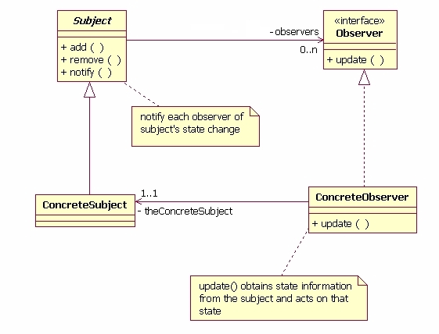
Observer
Subject keeps reference to 0-n Observers
add(), remove()
Observers get notified about any status change w.r.t. subject - update()
David Geary, An inside view of Observer, Javaworld, 2003 – very old!

Slide 41
Modern Incarnation
Reactive Rx framework takes the Observer framework forward by combining it with multiple inspiration sources:
Observer
Null Pointer exceptions and hanging references
Functional programming
map, reduce, operator chaining
lambda functions make syntax bearable
Scala, Java streams
Agent (Active object), Actor models, Erlang, Reactor
asynchronous execution, scheduling
Future-based programming, CompletableFuture…[not so clean]
Android/Mobile Apps
notification handling, battery-life requirements

Slide 42
ReactiveX
“ReactiveX is a library for composing asynchronous and event-based programs by using observable sequences.”
“It extends the observer pattern to support sequences of data and/or events and adds operators that allow you to compose sequences together declaratively while abstracting away concerns about things like low-level threading, synchronization, thread-safety, concurrent data structures, and non-blocking I/O."
reactivex.io/intro.html, March 2016

Slide 43
How does it work?
Observable<T>:
Provides 0 or more instances of T.
Does have a list of subscribers
Each subscriber gets an onNext call for each new instance of T provided
Subscriber
Implements Interface or lambda (for onNext)
onNext(): called for each instance of T
onComplete(): called after the last instance
onError(): called upon error

Slide 44
New Observable for String items
Observable<String> source =
Observable.from(new String[]{"1","2","3","4","5"});
Observable<Integer> io =
source.map( s -> Integer.parseInt(s)).reduce((i, i2) -> i+i2);
io.subscribe(
integer -> {System.out.println("integer = " + integer);}
)
Creates an Observable from a collection
lambda converts String to Integer
Reduces items
to a single value
map applies lambda to all items from source
Creates a consumer for the Observable

Slide 45
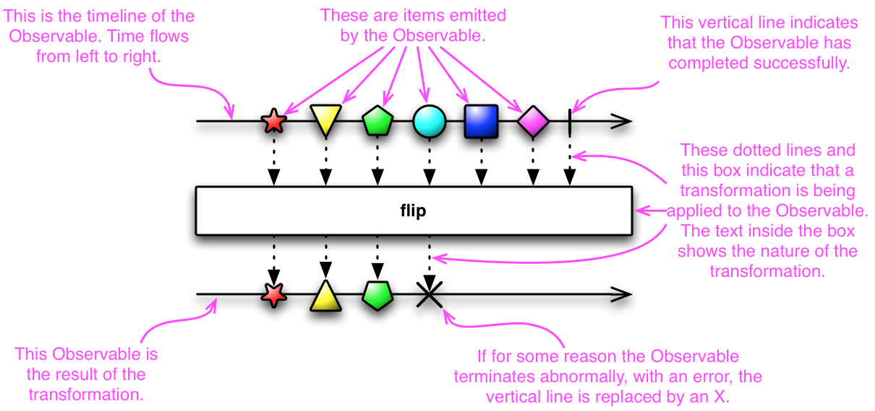
http://reactivex.io/documentation/observable.html

Slide 46
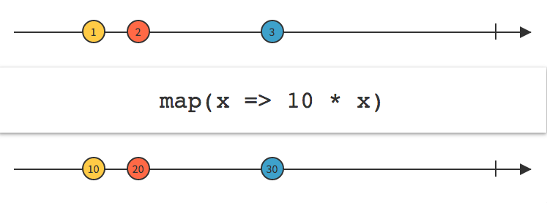
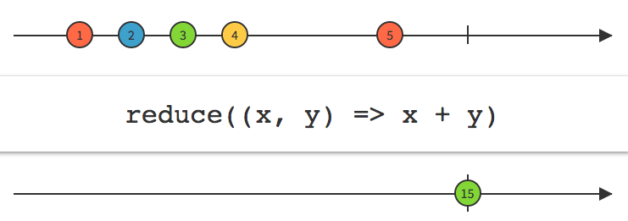
http://reactivex.io/documentation/operators/

Slide 47
So, what is the big change?
Operators: (Most often) transform an Observable into another observable of the same of different type
Chaining: Observables can be chained using operators that either transform the items or manage the handling of the observables
Buffer, merge, on

Slide 48
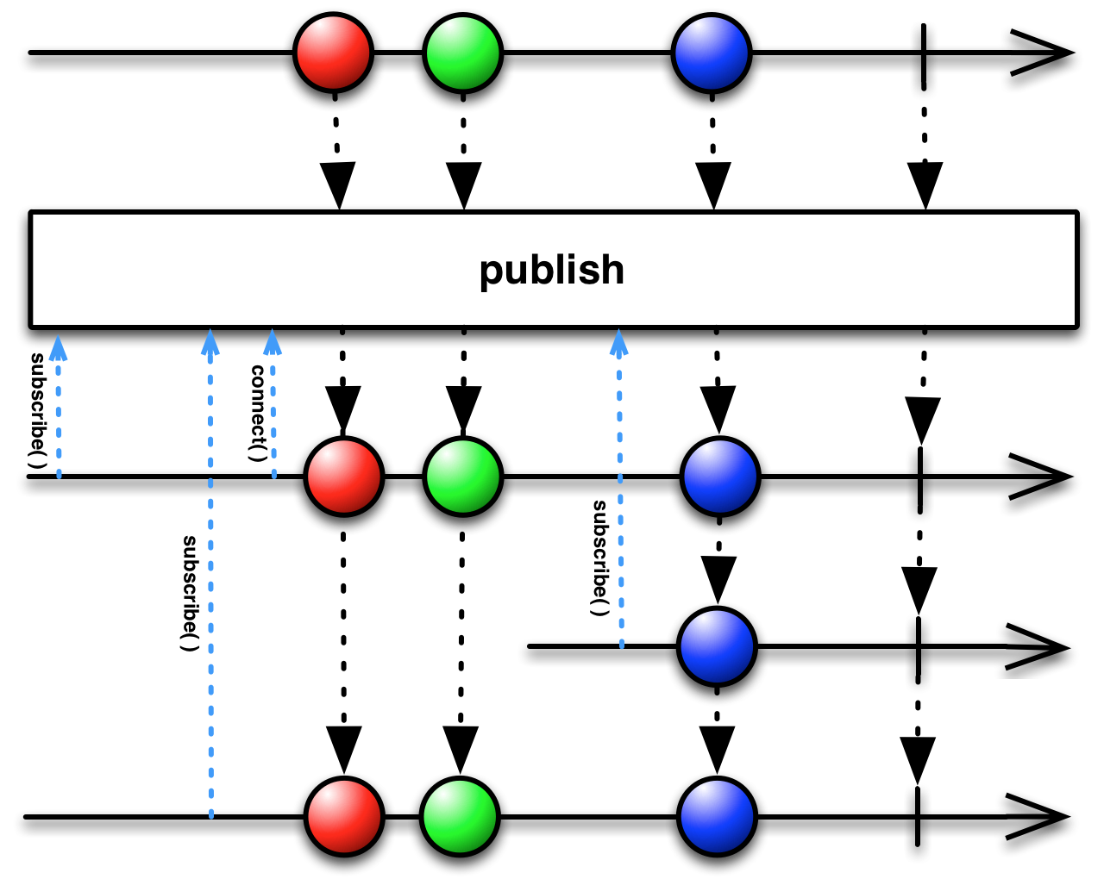
More than one subscriber?
ConnectableObservable only starts issuing items after the connect() is called
replay() ensures that all futures subscribers all get the same sequence
Created from Observable by publish()

Slide 49
Execution Models
subscribeOn() – specifies the Scheduler used by the observable itself
from the beginning of the chain of observables, regardless of the position
observeOn() – specifes the scheduler on which the notifications are delivered to subscribers
from the observeOn position in the chain onwards

Slide 50
Example – parallel processing (?)
private static Integer calc(Integer i){ try { Thread.sleep(100*i); System.out.println("Processing i = " + i + " on thread " + Thread.currentThread().getId()); } catch (InterruptedException e) { e.printStackTrace();} return i; };
ExecutorService es = Executors.newFixedThreadPool(5); Observable<Integer> map = Observable.range(0, 20).map(i -> calc(i)).subscribeOn(Schedulers.from(es)); Observable<Integer> map1 = map.map(integer -> { System.out.println("integer = " + integer + “ on " + Thread.currentThread().getId()); return integer; }); Observable<Integer> obs = map1.reduce((integer, integer2) -> integer + integer2); obs.subscribe(integer -> System.out.println("result = " + integer));

Slide 51
Example – parallel processing (?)
private static Integer calc(Integer i){ try { Thread.sleep(100*i); System.out.println("Processing i = " + i + " on thread " + Thread.currentThread().getId()); } catch (InterruptedException e) { e.printStackTrace();} return i; };
ExecutorService es = Executors.newFixedThreadPool(5); Observable<Integer> map = Observable.range(0, 20).map(i -> calc(i)).observeOn(Schedulers.from(es)); Observable<Integer> map1 = map.map(integer -> { System.out.println("integer = " + integer + “ on " + Thread.currentThread().getId()); return integer; }); Observable<Integer> obs = map1.reduce((integer, integer2) -> integer + integer2); obs.subscribe(integer -> System.out.println("result = " + integer));

Slide 52
Parallel Processing – Observable Splitting
ExecutorService es = Executors.newFixedThreadPool(10); System.out.println("Started on " + Thread.currentThread().getId()); Observable<Integer> range = Observable.range(0, 22); Observable<Integer> map = range.flatMap
(i -> Observable.just(i).
subscribeOn(Schedulers.from(es))
.map(integer -> calc(integer)));
map.reduce((ir, i2) -> ir + i2).subscribe(integer -> System.out.println("result = " + integer));
New Observables created inside flatMap
…and collected by flatMap

Slide 53
Distribution and Reliability
Light introduction to

Slide 54
Distributing Workload
Single server – baseline, obviously prone to failures
Single server with standby backup
Activity/liveliness monitoring
Consistency Update
Quality tiers:
Cold: HW ready and wired, no SW stack
Warm: Wired, installed, powered, with no state
Hot: State maintained, system operational, but not servicing request
Active-Active: Load Balanced, parallel processing of requests

Slide 55
HW Cost Implications
Configuration | HW Config/requirements
Cold | N+1 (or N+x). Resources can be pooled. Failover to AWS/cloud possible.
Warm | N + 1 (or x) per each system tier, (web server, app server, db server)
Hot | 2N (or more) – system duplicated
Active-Active | N + 1 (or N+x)

Slide 56
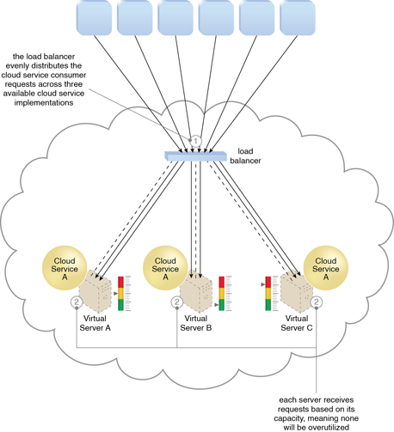
Why not use Active-Active all over?
Load-balancing
Easy for isolated, stateless requests
More complex for sticky sessions
We need to maintain per session state
Consistent distribution for long-term-stage
Individual duplication necessary for each unique resource

Slide 57
Corollaly
Uniqueness is expensive
Pooling is efficient and scalable
State persistence/management incurs non-trivial costs and constraints

Slide 58
Conclusion
Remote resource localization
Yellow pages, Singleton
Remote resource creation and usage
Factory, Façade, Reactor, Proactor, Half-Sync/Async
State synchronization management
Façade, Proxy, Active Object
Failure detection
Failure management, recovery and failover
Resource destruction
Proxy, Façade, Garbage collection, …

