Slide 1
Advanced Computer Architectures
04
Superscalar Techniques –
Instruction prefetching (Branch prediction etc.)
Czech Technical University in Prague, Faculty of Electrical Engineering
Slides authors: Michal Štepanovský, update Pavel Píša
Notes:
A4M36PAP
2010

Slide 2
Superscalar Techniques…
The goal is to achieve a maximum throughput of the instruction processing
Instruction processing can be analyzed as instructions flow or data flow, more precisely:
  register data flow – data flow between processor registers
  instruction flow through the pipeline
  memory data flow – to/from memory
It roughly matches to:
  Arithmetic-logic (ALU) and other computational instructions (FP, bit-field, vector) processing
  Branch instruction processing
  Load/store instruction processing
maximizing the throughput of these three ﬂows (or complete flow) correspond to the minimizing penalties and latencies of above three instructions types
Today’s lecture
topic

Slide 3
Control Flow Graph
The program described as a Control Flow Graph (CFG):
CFG has to be mapped into sequential memory:
Address
Addr + offset
…
And what about object-oriented programming???
Virtual methods ???

Slide 4
Control Flow Graph
The program described as a Control Flow Graph (CFG):
CFG has to be mapped into sequential memory:
Problem No 1
Fetch group current address
Fetch group next address
Problem No 2
Next?
And what about object-oriented programming???
Virtual methods ???
Problem No 3
pipelining

Slide 5
Branch prediction – Motivation
the penalty of three cycles in fetching the next instruction;
number of empty instruction slots multiplied by the width of the superscalar machine;
Amdahl’s law..
Fetch
Instruction / decode buffer
Decode
Dispatch buffer
Dispatch
Reservation stations
Issue
Branch
Execute
Finish
Reorder / Completion buffer
Complete
Store buffer
Retire

Slide 6
Branch prediction – Motivation
Fetch
PC-
relative
Instruction / decode buffer
Register indirect
Decode
Dispatch buffer
Register indirect with offset
Dispatch
Reservation stations
Issue
Branch
Execute
Finish
Reorder / Completion buffer
Complete
AMD Athlon: 10 stages in integer pipeline
Intel NetBurst (Pentium 4): 20 stages
Store buffer
Retire

Slide 7
Branch prediction
Two fundamental components:
  branch target speculation (where is next instruction),
  branch condition speculation (if the branch is taken).
Branch target speculation:
  BTB (Branch Target Buffer) – cache (associative memory) with two fields: BIA (Branch Instruction Address) and BTA (Branch Target Adress) – accessed during the instruction fetch using the instruction fetch address (PC)
  When BIA matches with current PC, the corresponding BTA is accessed and if the branch instruction is predicted to be taken, BTA is used to modify PC

Slide 8
Branch Target Speculation
Branch Target Buffer (BTB)
PC
BIA
BTA
into instruction cache
Predicted address

Slide 9
Branch prediction
Branch condition speculation (taken/not-taken):
  Static prediction (70%-80%)
    BTFNT (Backwards Taken / Forwards Not-Taken) – for, while, do-while,.. - relatively to PC, branch delay slot… the compiler places unlikely branches after likely path through function.
    Heuristics used to analyze the program (NULL pointer, equality, inline functions…) – branch hints coded in branch instructions (if supported by ISA)
    Profilation – runs with different inputs - statistics
  Dynamic prediction (80%-97%)
  Hybrid (combination of static and dynamic prediction. Static prediction in the initial phase, when the dynamic prediction is not available, the first pass through code or when prediction slot is reused for later PC address).

Slide 10

Branch prediction
Actual direction of the branch
…
Predictor
Predicted direction
Local history
Branch Target Buffer (BTB)
PC
BIA
BTA
Branch hist.
Global history
+4
Branch history
Address into instruction cache
Direction prediction
Predicted address
FSM

Slide 11
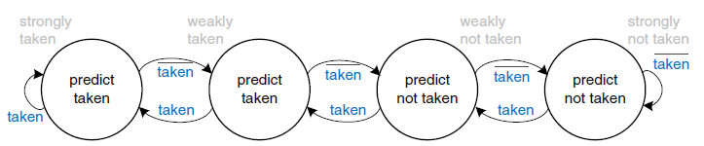
Branch condition prediction – local predictor
Smith’s algorithm (Saturating counter)
2 ^{m} k-bit counters
Branch address
Updated value
m
incrementation / decrementation of counter
Prediction (MSB bit)
Actual branch outcome

Slide 12
Branch condition prediction – local predictor
Smith’s algorithm
Problem ???
If Program Counter is 32 bits wide, we will need (1/8)*k*2^32 B of memory to store the state of all saturating counters (if k==2, we need 1GB of memory), much smaller n-way associative branch history table is used.
Conflict aliasing:
  Neutral interference
  Negative interference
Compulsory aliasing in addition – we will see it later… (because of indexing by address-history combination)

Slide 13
Branch condition prediction – global predictor
Global-History Two-Level Branch Predictor with a 4-bit Branch History Register
PHT (Pattern History Table)
Branch Address
000000
000001
PC = 0101001110111101
000010
01 0110
010110
BHR (Branch History Register)
111101
111110
0110
111111
Prediction (MSB bit)
What is the optimal number of bits for BHR a for BA?

Slide 14
Branch condition prediction – global predictor
Global-History Two-Level Branch Predictor with a 4-bit Branch History Register
Why use global history for PHT indexation?
    a=0;
    if(condition #1) a=3;
    if(condition #2) b=10;
    if(a <= 0) F();
The behavior of a branch may be connected (or correlated) with a different branches conditions evaluation in the past.
In our example, execution of function F() depends on the condition #1. The condition #2 is irrelevant. Predictor must be able to learn this behavior (distinguish these branch conditions).

Slide 15
Branch condition prediction
Local-History Two-Level Predictor with a 3-bit Branch History Table
Branch Address
PHT (Pattern History Table)
PC = 0101001110111010
000000
000001
n bits
000010
BHT (Branch History Table)
m bits
000
010 110
010110
001
010
110
011
111101
100
111110
101
111111
Prediction (MSB bit)
110
111
Intel P6 uses 4 bits for BHR

Slide 16
Branch condition prediction
Local-History Two-Level Predictor with a 3-bit Branch History Table
Why local history for PHT indexation?
    do{
    ...
    }while(condition);
Because the behavior of a branch may be closely related to its own history…

Slide 17
Branch condition prediction
Local-History Two-Level Predictor with a 3-bit Branch History Table – An example:
Let’s suppose that at the address 0xC0A5 is the „loop-closing branch“ with the pattern: 11101110111011101..., where 1 means taken branch. How many cycles needs the predictor to learn this pattern? Initially, BHT and PHT contain zeros.
PHT (Pattern History Table)
Branch Address
000000
PC = 1100000010100101
000001
000010
BHT (Branch History Table)
000
101 000
101000
001
010
011
111101
100
111110
101
000
111111
Prediction (MSB bit)
110
111

Slide 18
Branch condition prediction
Index-sharing predictors… (hash of BHR and PC) – better use of the index bits (it tends to contain more information due to the nonuniform distribution of PC values and branch histories)
For example, gshare predictor:
PHT (Pattern History Table)
Branch Address
000000
000001
PC = 0101001110111101
000010
hash
010110
BHR (Branch History Register)
111101
111110
101011
111111
Prediction (MSB bit)
gshare: Hash: XOR

Slide 19
Branch condition prediction
Index-sharing predictors…
bi-Mode predictor – two separated PHT – the same index or hash:
PHT 0
PHT 1
Branch Address
000000
000000
Choice predictor
000001
000001
PC = 0101001110111101
000010
000010
xor
010110
010110
BHR (Branch History Register)
111101
111101
111110
111110
101011
111111
111111
MSB bit
MSB bit
MSB bit
Prediction
Choice predictor – Smith. The branches with a taken bias are placed in PHT1 and other ones into PHT0. Negative interference => neutral interference. (the statistic of branches has this property)

Slide 20
Branch condition prediction
alloyed predictor
Combination of PC, local history and global history as an index into PHT
PHT (Pattern History Table)
Branch Address
PC = 1100000010100101
BHT ( Local Branch History Table)
000
101 000 110
001
010
011
100
101
000
Prediction (MSB bit)
110
111
110
Global BHR

Slide 21
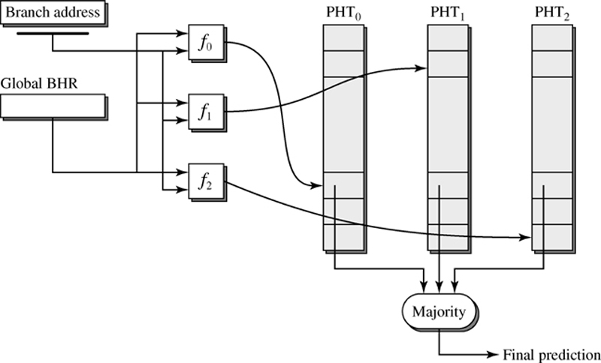
Branch condition prediction
gskewed predictor
Hash functions f0, f1 and f2 have this property:
if f0(x1)=f0(x2) for x1≠x2, then f1(x1) ≠ f1(x2) and f2(x1) ≠ f2(x2)
Total update (update of all banks by branch outcome) and
partial update (better) – does not update a bank if that particular bank mispredicted, but the overall prediction was correct.
Non-conflict access to at least two PHTs is guaranteed

Slide 22
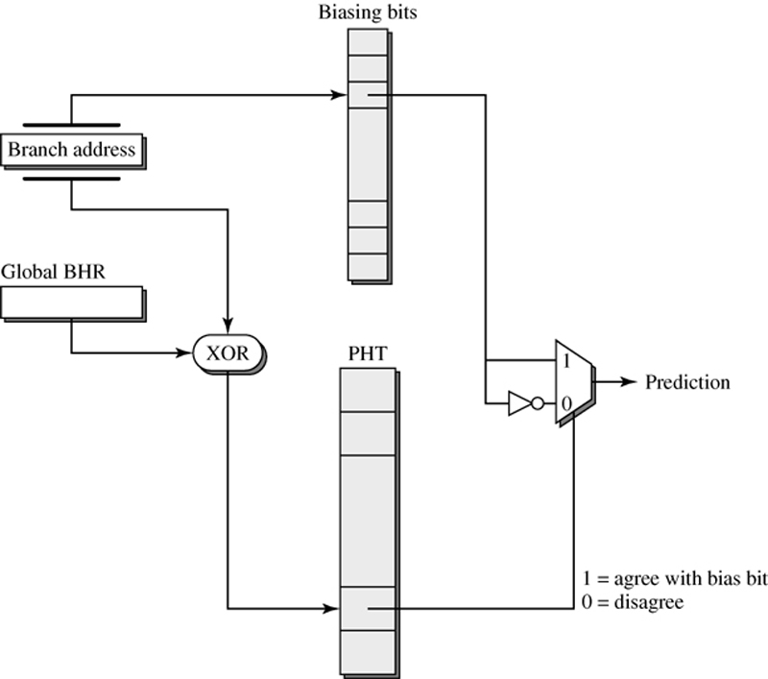
Branch condition prediction
agree predictor
Branches tend to be heavily biased in one direction or the other (taken/not-taken).
Biasing bit initialized to the outcome of the first instance of the branch, or a branch hint inserted by the compiler. PHT predicts whether the branch outcome will agree with the biasing bit. (Negative interference elimination)

Slide 23
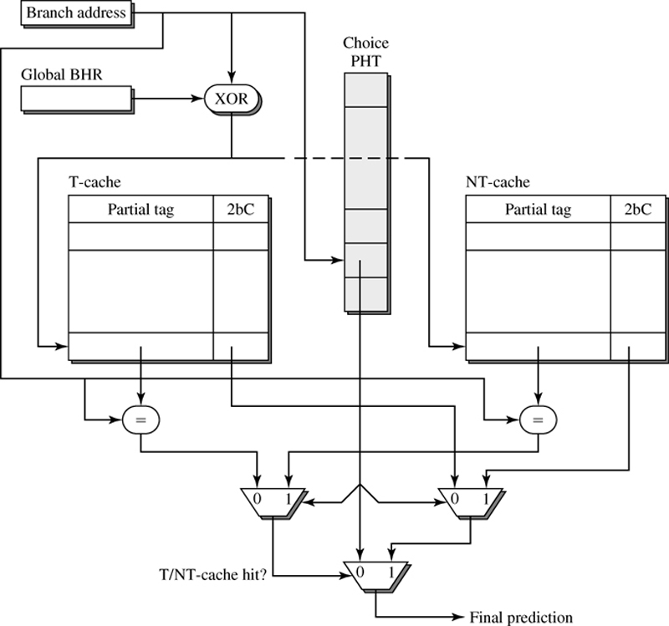
Branch condition prediction
YAGS predictor
Extension of Bi-mode predictor… but with the significant difference!
If PHT indicates “taken”, then “Not-Taken” (NT) cache is used for prediction. Both caches store only the branches which do not agree with PHT…

Slide 24
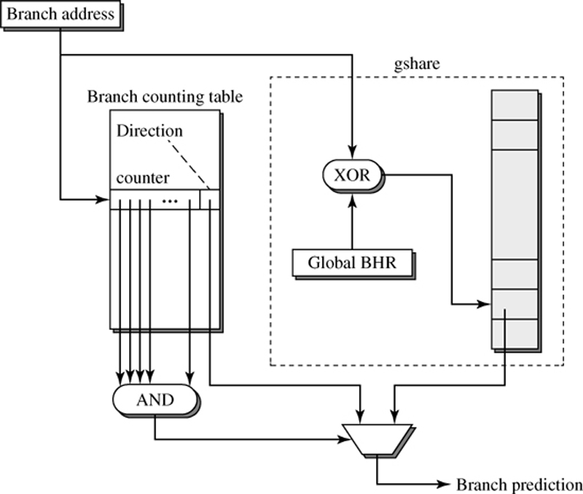
Branch condition prediction
Branch Filtering predictor
Branches tend to be heavily biased in one direction or the other. Expensive HW structures are not required for these saturating branches and can be used only for more complicated ones.
If the counter in BCT has been incremented to its max
value, then this branch will no longer update the PHT.
If BCT makes miss-prediction, then the counter is reset.

Slide 25
Branch condition prediction
Pattern-Based Predictors
They extend the idea of 1-bit or in general n-bit predictors to recognize specific branch pattern
Example. Consider these patterns (0-not taken branch, 1-taken):
0101010101, 110110110, 00111010011101, …
These patterns are hard to predict (by 1 or 2-bit predictors) - the bias of the branch develops in time…
0101010101 – after 0 comes 1, after 1 comes 0
110110110 – after 11 comes 0, after 10 comes1, after 01 comes 1
00111010011101 – after 100 comes 1, after 001 comes 1, after 011 comes 1, after 111 comes 0, after 110 comes 1, after 101 comes 0, after 010 comes 0
Did previous predictors the prediction on these patterns well ???
Note: All predictors which use the combination of local and global history are called correlating predictors.

Slide 26
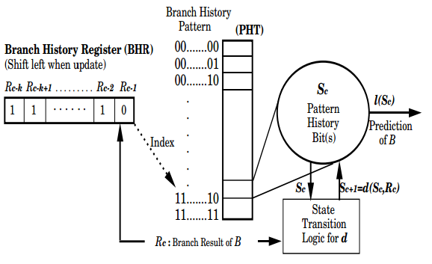
Branch condition prediction
Two-level adaptive branch predictor (Correlating/ed predictor)
Authors: Yeh and Patt from University of Michigan
First level – history of last K branches (for example last K branch instructions or last K resolutions of single instruction) – builds the pattern
Second level – the behavior of last N appearances of the pattern indexes PHT
BHR is associated with given branch instruction

Slide 27
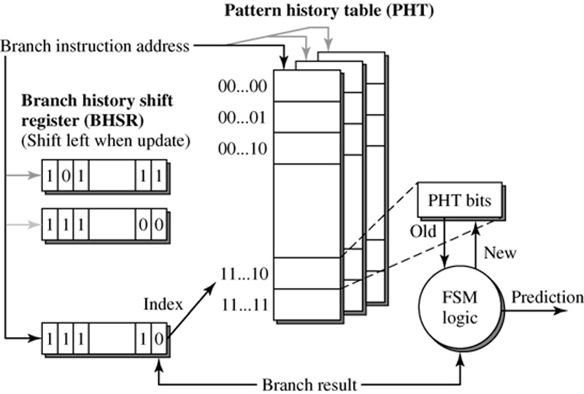
Branch condition prediction
Two-level adaptive branch predictor (Correlating/ed predictor)
Authors: Yeh and Patt from University of Michigan
The “same” picture:
(Intel P6)
Sometimes, PHT is drawn as a matrix, where rows (columns) are indexed by PC and columns (rows) are indexed by BHR. Global BHR may also be used

Slide 28
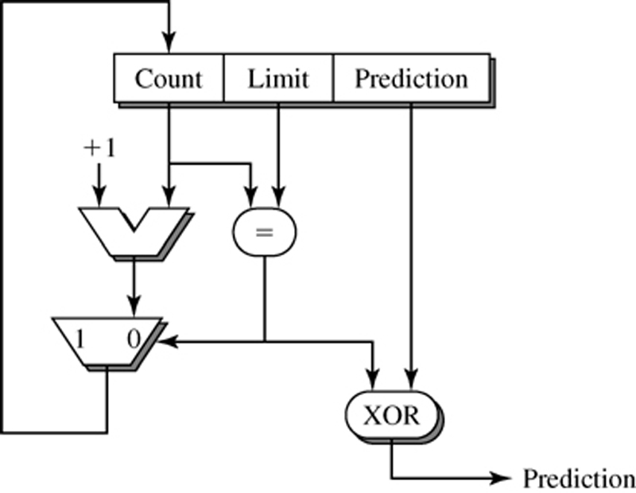
Branch condition prediction
Loop Counting predictor
Many iterations
Only in combination with other predictors (see hybrid predictors)
Pentium M

Slide 29
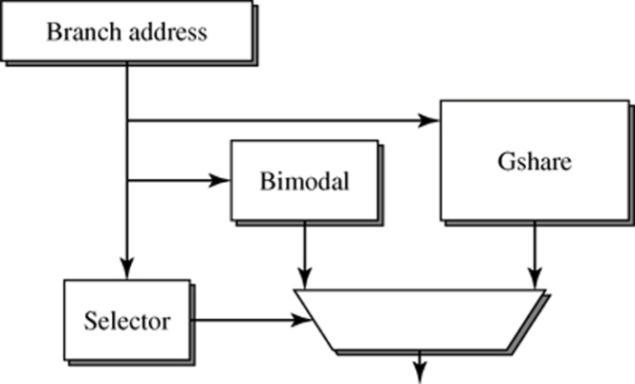
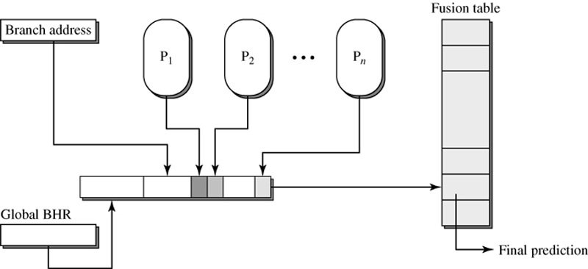
Branch condition prediction
Advanced predictors take into account negative (and neutral) interference (bi-Mode predictor and others …)
Some other dynamic predictors:
Perceptron predictor (longer history, correlated branches detected)
Data flow predictor – explicitly tracks inter-register dependences
Hybrid, multi-hybrid and fusion-based predictors:
Tournament predictor – two predictors P0 and P1 and meta-predictor M (Smith)
(a) Hybrid: Tournament predictor in this example uses Bimodal and Gshare predictor
(b) Fusion-Based Hybrid Predictor – replaces multiplexer (which selected only single predictor) with Fusion

Slide 30
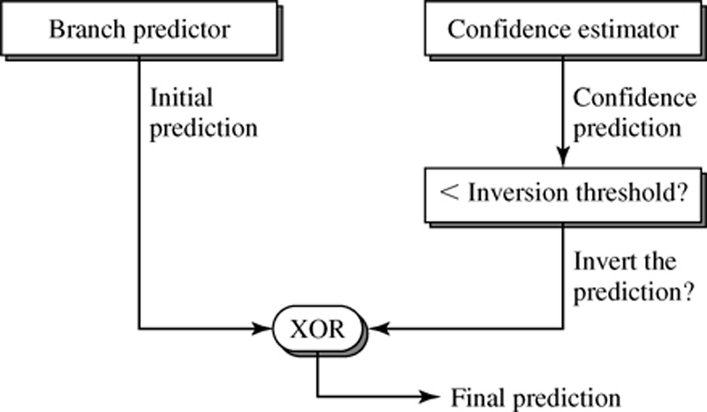
Branch condition prediction
Selective branch inversion (SBI)
Does not focus primarily on interference reduction but to minimise interference impact/consequences
It evaluates (estimates) confidence of prediction of predictor
For example: SBI Bi-Mode predictor provides better results than plain Bi-Mode (reasons: interference avoidance + interference correction)

Slide 31
Branch prediction
Two fundamental components:
  branch condition speculation (if),
  branch target speculation (where)
Branch target speculation:
  BTB (Branch Target Buffer) – associative cache with two fields: BIA (Branch Instruction Address) and BTA (Branch Target Adress)
(from slide 10 till now)
The topic from now
Branch Target Buffer (BTB)
PC
BIA
BTA
into instruction cache
Predicted address

Slide 32
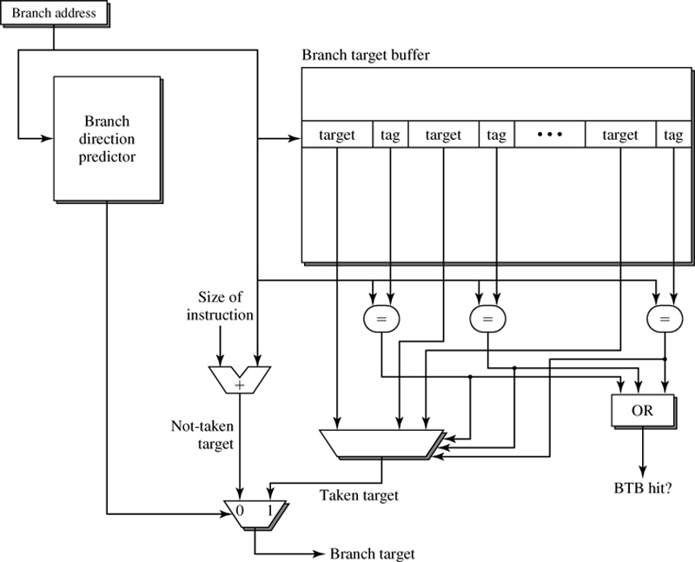
Branch target speculation
Branch Target: PC-relative branches or indirect branches (run-time address determination)
Store the targets of taken branches, cache location or the first target instructions, …
There are more option

Slide 33
Branch target speculation – Indirect branches?
MIPS: jalr $rX or jr $rX - what it is the target address???
Object-oriented programming and polymorphism… The result is a lot of indirect branches (in comparison with imperative programming)
The key idea:
Indexation of BTB (Branch Target Buffer)
The hash function can be the “simple” concatenation
Another point of view: It is the two-level predictor, but the cache stores branch target addresses (not the branch history)
Branch Address
Target Cache
PC = 0101001110111101
Target Address
hash
History
101011

Slide 34
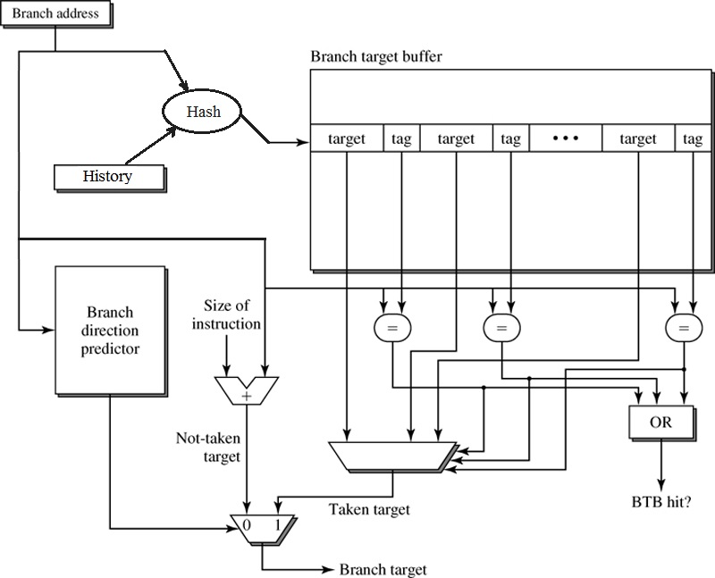
Branch target speculation – Collisions in cache…
Branch target buffer (BTB) is usually n-way set associative

Slide 35
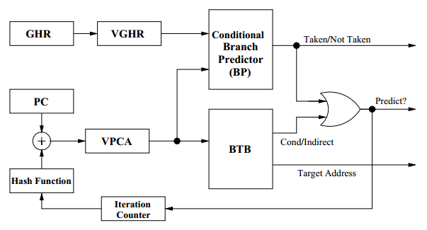
Virtual Program Counter (VPC) Prediction
An example:
Instead of expensive HW reuse simple taken/not taken logic which is iterated MAX_ITER times (proposed 4 to 12) for indirect branch
Notes:
  GHR – Global History Register, VGHR – virtual GHR
  VPCA – Virtual PC Address (distinct for different virtual branches)
In first iteration: VPCA = PC; and VGHR = GHR; next VPCA ← Hash(PC, iter); VGHR ← Left-Shift(VGHR); repeat to find taken prediction or MAX_ITER

Slide 36
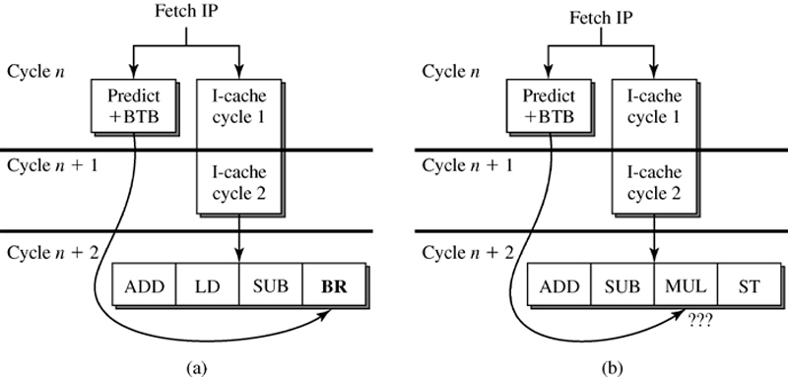
Phantom branch / bogus branch
What cause these bogus predictions?
Only the part of the instruction address is used as a tag and its compare to reduce HW resources, but then BTB entry can be selected for incorrect address. If there is no branch instruction in the fetch block, then it is found 2 cycles later after fetch and instead of predicted address next fetch block is loaded. But this optimization is source of Spectre and Meltdow security vulnerabilities. Full PC address or some randomly selected hash have to be used instead.

Slide 37
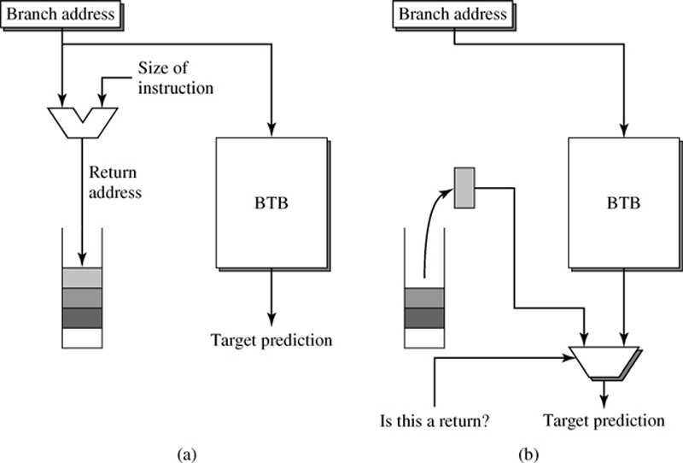
Branch target speculation
RAS predictor - return address stack – specialized predictor
For the prediction of return address (MIPS jr $ra, x86 ret, etc) – HW stack. The stack depth of 8 gives >97% of prediction success
(MIPS R10000 stack depth: 1, Alpha 21164 stack depth: 12, Intel Pentium III stack depth: 16)

Slide 38
Speculation may be wrong!!!
Modern processors use:
Control speculation (conditional branches)
Data speculation (Load/Store speculation)
  The load is executed before the store address of previous store instruction is computed (e.g. Itanium, Power 5, Core 2)
Sequential semantics of executed program have to be satisfied
It means: execution of program satisfies
  Condition #1 – the processor produces exactly the same results as the processor executing the program strictly instruction-by-instruction in program order
  Condition #2 – the processor generates the same exceptions as…
Next sufficient conditions exist to warrant this goal:

Slide 39
Sufficient conditions
Cond. A – respect the data dependencies
  Instructions wait for resolving data dependencies
Cond. B – respect the control dependencies
  Do not branch until the branch address is known and the branch condition is computed (and satisfied)
Cond. C – Precise exception for interrupts and exceptions
During the speculation, the conditions A and B are not partially or temporarily fulfilled, but the result after retire phase has to be correct
The program execution has to be correct, and Condition C have to be guaranteed in any case
Wrong Speculation?
Misprediction recovery/restart has to happen. Both options are expensive, even ten or more cycles. Two options with additional queues
  History Buffer HB - M88110,…
  Reorder Buffer RB – the most of today architectures. Our focus…

Slide 40
History Buffer
WB
(out of order)
ID
(operands read)
Results
shift register
Register
file
Source
Results
Registers
(from functional units)
to functional units
Correct (Roll-back) values in the register file in case of exception
History
buffer
The old value of destination register

Slide 41
Reorder Buffer
Results are stored in the Reorder buffer during Write-Back
Commit: Complete the instruction in-order (Results are stored in the Register file only when all preceding instructions are complete
Note: Holding the renamed values in Reorder buffer (ROB) is not the only possibility. Recall that it exists: Stand-alone rename register file and Merged register file => in these cases, ROB is also used (in-order complete)
WB
(out-of-order)
COMMIT
(in-order)
ID
(operand read)
Register file
Reorder buffer
Results
(from ALU,…)
Source registers
(to ALU,…)
forwarding

Slide 42
History Buffer vs Reorder Buffer
Advantages of HB
  Values from HB is not necessary to forward (no associative search in HB) ⇒ simpler forwarding
  HB access not on the critical path
Disadvantages of HB
  Need to unwind the history buffer upon an exception (increased latency to handle the exception)
  Additional read port for register file to read previous value of destination register (problem to scale into superscalar)
Throughput (for execution) is similar for both approaches. Some additional latency for the exception for HB. Problem with STORE instruction.

Slide 43
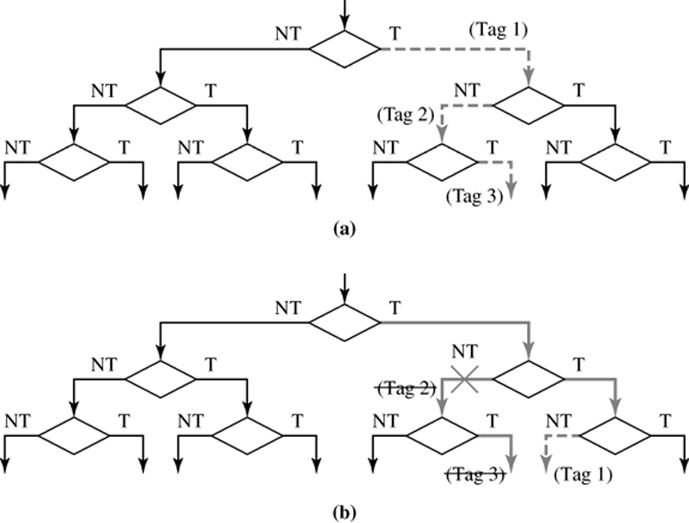
Branch validation/recovery
Branch speculation – frond-end stages of the pipeline – discussed till now
Branch validation/recovery – when the direction is finally resolved?
What to do then
During Branch speculation, all instructions have to be identified by the unique Tag related to certain speculative block. These tagged instructions keep information if they are speculative and to which speculative block belongs.
During Branch speculation addresses of all branch instructions are stored (in the buffer) – it is required for Branch recovery

Slide 44
Branch validation/recovery
Branch validation/recovery – when the actual direction of a branch is resolved
Correct speculation (prediction):
speculation tag is deallocated, instructions become nonspeculative (allowed to complete)
Incorrect speculation (prediction) :
Two actions: the incorrect path must be terminated and the correct path must be initiated.
The termination of the incorrect path: Discarding of all instructions (by using speculation Tags) in decode and dispatch buffers, in reservation stations, etc.
The initiation of the correct path: Update of PC with a new address (computed branch target address or buffered sequential address during Branch speculation)

Slide 45
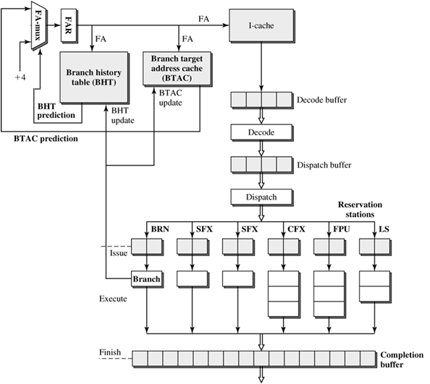
Branch prediction - PowerPC 604
4-wide superscalar processor (4 instructions can be decoded or completed in one cycle)
Execute 6 instructions/cycle
BTAC – Branch Target address cache (fully associative, 64 entries)
BHT – Branch History Table (direct mapped, 512 entries)
BTAC – one cycle, BHT – two cycles
Organization FA-mux is more complex than in the picture

Slide 46
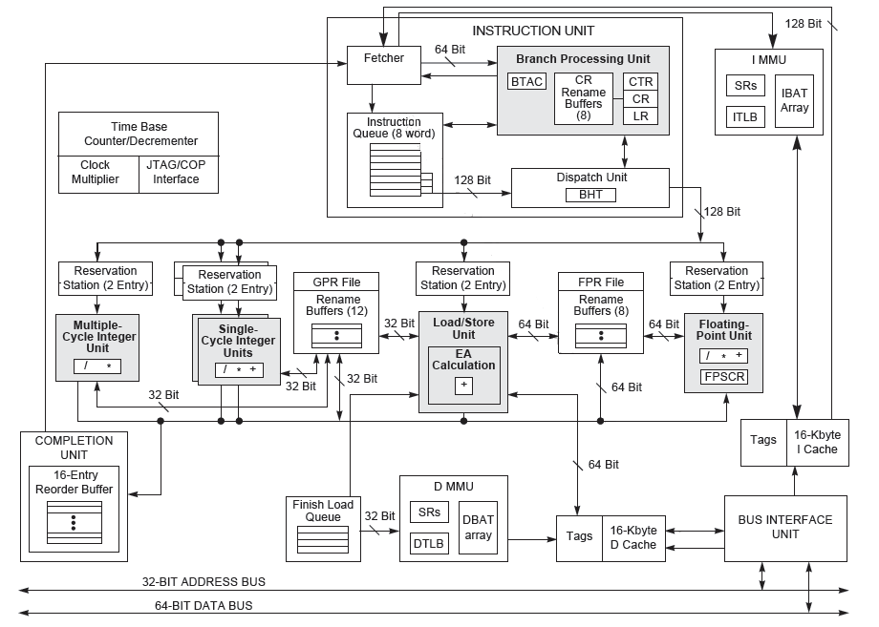
PowerPC 604 – different view

Slide 47
Instruction prefetching…
For the superscalar processor, it is very important to predict the direction and the target of the branch correctly!
In one cycle, it may be required to process several branch instructions (depending on the fetch group size). For example, for fetch group size 4 instructions, all can be branches. The optimal solution is to use all branch instruction addresses. Only the first one is often used.
Another mechanism is a predication (or eager execution) – instructions from both paths can be executed. The instruction will only be completed if the predicate is true.
  It ensures that CPU use cycles to process instructions from right target, but ensures that time to process another is wasted
  Not useful for highly predictable branches
  Power consumption

Slide 48
High-Bandwidth Fetch Mechanism
Assuming a limit of one i-cache access per cycle, the number of instructions fetched from the i-cache is bounded by the line size.
Typically, the fetch group contains branch instruction (for typical applications, 20% are branches). Usual distance to the branch target is 5 to 6 instructions for typical applications.
Only if the taken branch is the last instruction in the fetch group, the whole fetch group contain useful instructions.. Otherwise, the fetch group (or i-cache) do not provide N instructions (where N is the fetch group width). What is the consequence?
A similar problem is a situation where a block of instructions is split across cache lines.
The solution is:
  Collapsing buffer – alignment of instructions from non-sequential addresses
  Trace cache – which stores the actual sequence of instructions following given branch – these are (speculatively) executed instead of cache access

Slide 49
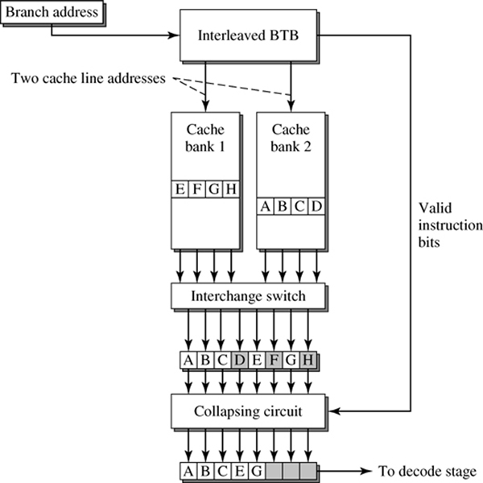
High-Bandwidth Fetch Mechanism
  Collapsing buffer – aligns not consecutive instruction into block
It requires a banked instruction cache – more than one cache line accessible in parallel
and interleaved BTB.
Suppose that we want to execute the sequence of instructions:
A, B, C, E, G – i.e. C and E are branches, E and G are their targets
Conventional cache:
  1.cycle: A,B,C,D (three useful inst.)
  2.cycle: E,F,G,H (two useful inst.)
BTB has to provide the information (valid instruction bits) that specify which instructions in the cache line are the part of the predicted path
It is hard to scale the Collapsing buffer over more than 2 cache lines / cycle

Slide 50
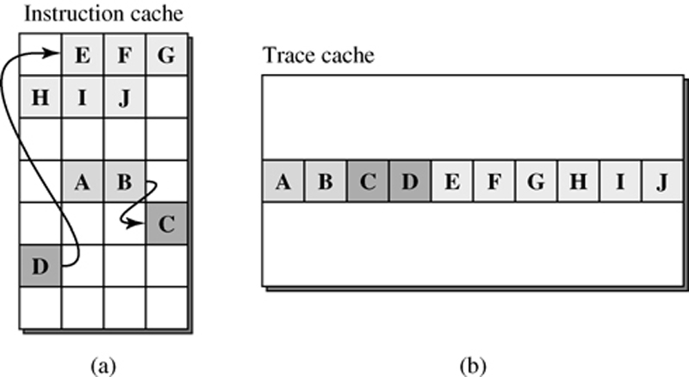
High-Bandwidth Fetch Mechanism
Trace cache – it traces sequence of the following executed instructions for given branch/jump – in the case of trace cache hit we do not fetch from the instruction cache…
The idea is depicted in the picture:
The task to solve – how to fill this trace cache ???

Slide 51
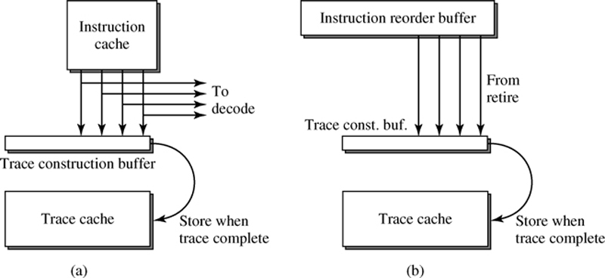
High-Bandwidth Fetch Mechanism – Trace cache
Two possibilities from where to include fill of Trace cache: (a) and (b)
When a Trace construction buffer is full (it may be determined not only by the number of instructions in the buffer, but also by the number of branches – mainly in the case (a)), the trace is stored in the trace cache
Every trace in trace cache has to provide the starting addresses of individual blocks included in the trace. The fetch unit has to provide starting addresses of the predicted path. If all addresses match, then there is a trace cache hit. In the case of the partial match, the only subset of the trace is provided.

Slide 52
Trace cache
Conventional Instruction Fetch Unit without Trace Cache:
trace cache
i-cache
B
i-cache
trace prediction
fill unit
branch prediction
decoder
decoder
branch prediction
A
register renaming
register renaming
execution units
execution units
A: entries in the trace cache can be already decoded, content can be fed directly into register renaming stage in such case ..
B: there is one another possibility how to fill the Trace cache – from reorder buffer – after Commit as shown on previous slide

Slide 53
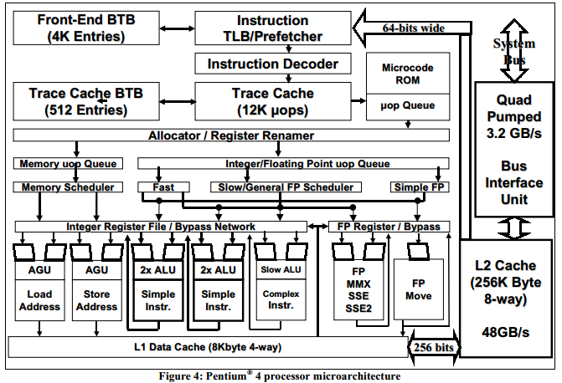
Trace cache - Pentium 4 processor, NetBurst microarchitecture

Slide 54
Instead of conclusion benchmark the code
Try to measure the time:
for (int i = 0; i < max; i++)
if (cond) /* use -O0 else compiler optimizes the loop */
sum++;
cond | pattern | time
(i & 0×80000000) == 0 | always T
(i & 0xffffffff) == 0 | always F
(i & 1) == 0 | TF
(i & 3) == 0 | TFFF
(i & 2) == 0 | TTFF
(i & 4) == 0 | TTTTFFFF
(i & 8) == 0 | 8T 8F
(i & 32) == 0 | 32T 32F

Slide 55
Instead of conclusion …
Try to measure the time :
    for (int i = 0; i < max; i++){
    a=0;
    if(cond n.1) a=3;
    if((i & 2) == 0) b=10;
    if(a <= 0) sum++; //if(cond n.1) sum++;
    }
Cond. n.1 | pattern | Time A | Time B
(i & 0×80000000) == 0 | always T
(i & 0xffffffff) == 0 | always F
(i & 1) == 0 | TF
(i & 3) == 0 | TFFF
(i & 4) == 0 | 4T 4F

Slide 56
Typical values for today CPUs
 | AMD FX-8150 | Intel i7 2600
Instruction Decode Width | 4-wide | 4-wide
Single Core Peak Decode | 4 instructions | 4 instructions
Instruction Decode Queue | 16 entry | 18+ entry
Buffers | 40-entry load queue 24-entry store queue | 48 load and 32 store buffers
pipeline depth | 18+ stages | 14 stages
branch misprediction penalty | 20 clock cycles for conditional and indirect branches 15 clock cycles for unconditional jumps and returns | 17 cycles
reservation station | 40-entry unified integer, memory scheduler; 60-entry unified floating point scheduler | 36-entry centralized reservation station shared by 6 functional unit
reorder buffer | 128-entry retirement queue | 128-entry reorder buffer

Slide 57
References:
PowerPC604 RISC Microprocessor Technical Summary: http://www.freescale.com/files/32bit/doc/data_sheet/MPC604.pdf
Karel Driesen: Accurate Indirect Branch Prediction
http://citeseerx.ist.psu.edu/viewdoc/download?doi=10.1.1.89.4874&rep=rep1&type=pdf
Hyesoon Kim et al.: VPC Prediction: Reducing the Cost of Indirect Branches via Hardware-Based Dynamic Devirtualization
http://users.ece.cmu.edu/~omutlu/pub/kim_isca07.pdf
TseYu Yeh and Yale N Patt: Alternative Implementations of Two-Level Adaptive Branch Prediction http://www.eecg.toronto.edu/~moshovos/ACA05/read/isca-92.2-level-adaptive.pdf
Shen, J.P., Lipasti, M.H.: Modern Processor Design : Fundamentals of Superscalar Processors, First Edition, New York, McGraw-Hill Inc., 2005
Glenn Hinton et al.: The Microarchitecture of the Pentium 4 Processor. http://www.ecs.umass.edu/ece/koren/ece568/papers/Pentium4.pdf

