Slide 1
AI Planning, PDDL Theory and practice
ČVUT FEL, 2023-Mar-13
Jan Dolejsi, Derek Long, Michal Štolba

Slide 2
Jan Dolejsi - bio
Formal education
FJFI ČVUT
École Centrale Paris
Work experience
slb.com (21 years)
2001 | 2002 | 2003 | 2004 | 2005 | 2006 | 2007 | 2008 | 2009 | 2010 | 2011 | 2012 | 2013 | 2014 | 2015 | 2016 | 2017
Fr | Cambridge | Abingdon | Vienna | Houston | Oslo |  | MS Teams (physical in Prague)
Intern | Well Completions and Productivity Answer Products Software Developer |  | Production Operations Architect | Production in Petrel Project Manager | Extensibility Architect | Director Open Technology and Platform Engineering |  | Planning Engine Architect

Slide 3
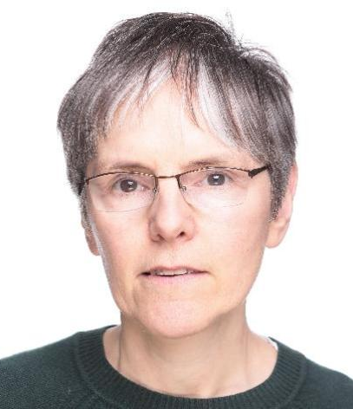
+ work (and slides) from many more at
Josef Bajada
Filip Dvořák
Derek Long
Scientific Advisor - Planning and Automation
at SLB Cambridge Research
Professor of Computer Science
at King’s College London
Michal Štolba
AI Planning R&D Consultant
Research Scientist
Maria Fox

Slide 4
Why AI? Why Planning?
Most companies talk about:
“Digital Transformation”, “Service Delivery”, “Reliability”, “Safety first”
What do they mean (and measure):
Improve operational reliability
Decrease non-productive time
Increase asset utilization
Improve people productivity
Reduce preventable injuries, eradicate fatalities
Automated Decision Making
Autonomous Execution

Slide 5
Automation or autonomy?
No! Not that kind.

Slide 6
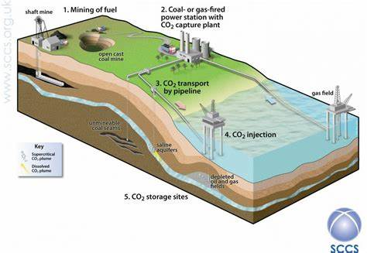
Underground CO² storage

Slide 7
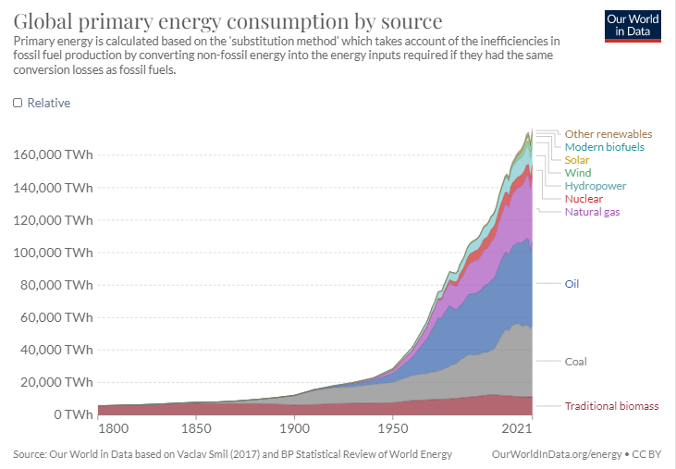
Sustainable
About 20% of total
1000 TWh global solar
2000 TWh global wind
CO₂ producing
50x increase in solar+wind replaces fossil fuels
It has doubled in the past 5 years
Proportion of total energy that is electrical:
Grid infrastructure will need to scale more than 5x

Slide 8
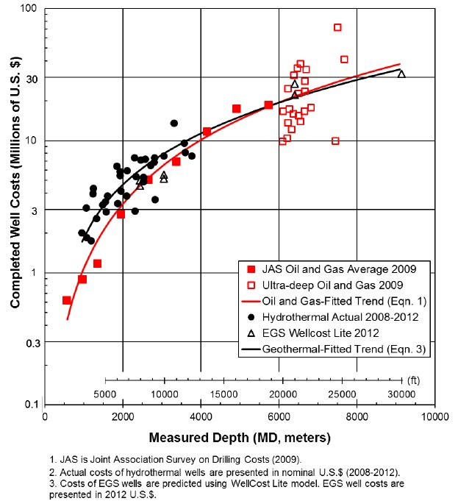
Holes in the ground?
Holes are drilled to 1000s of meters
Typical cost of a 3000m hole is about $7M (2012 US dollars)
How to make it safer, cheaper, how to always hit the target?

Slide 9
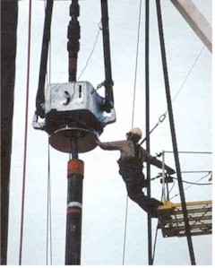
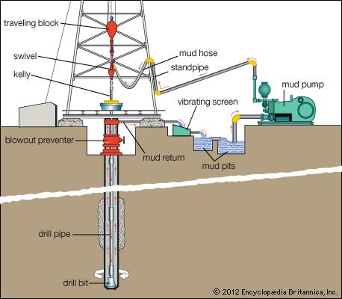
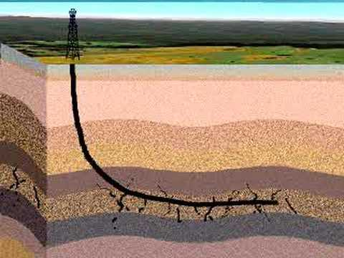
Drilling Deep Holes: Today’s Standard
Uncontrolled environment, uncertain operations, big pieces of dumb iron and humans in dangerous roles

Slide 10
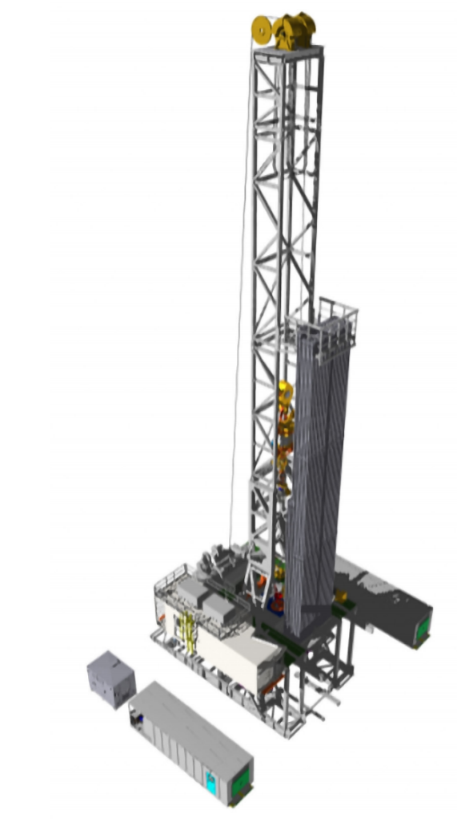
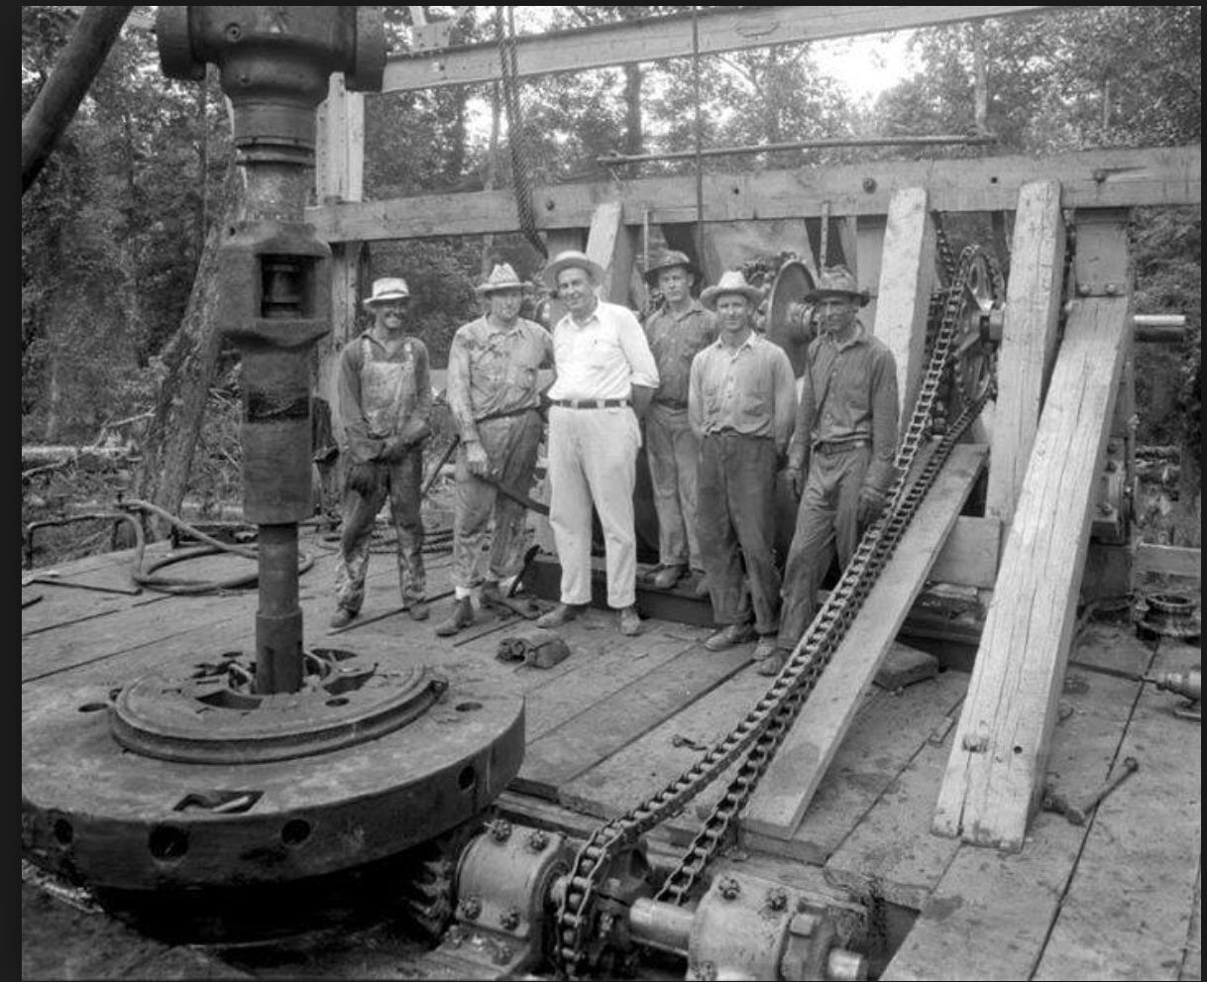
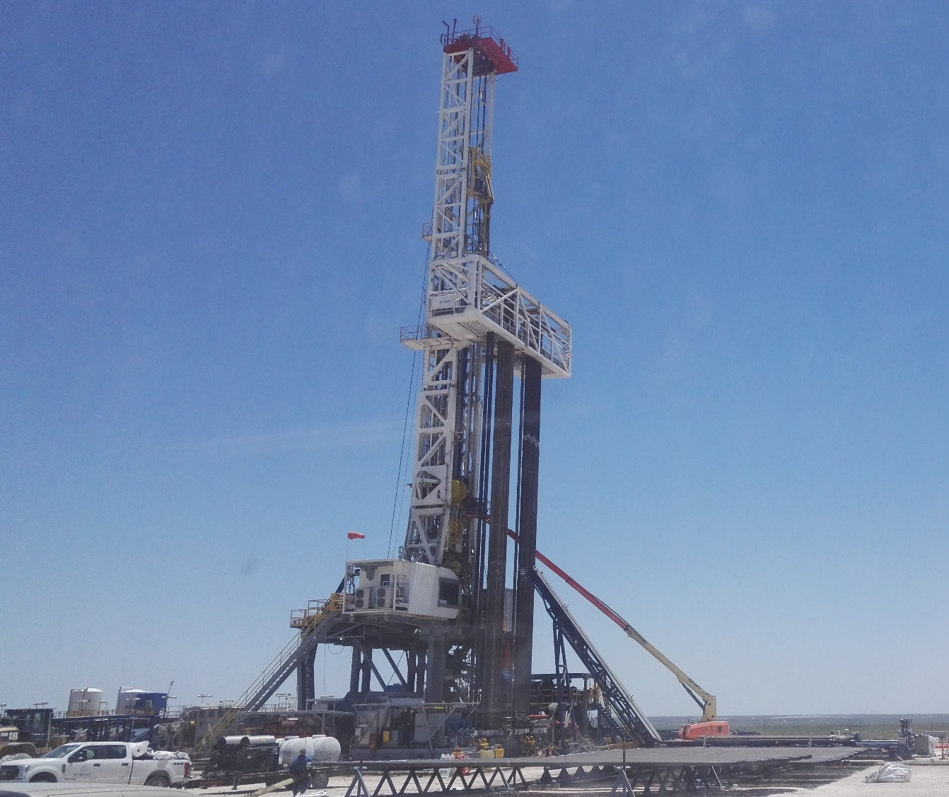
Automation
New rigs with modern coupled control and sensor systems offer the opportunity to raise the level of control abstraction
Dangerous drilling floor operations can be shifted to automated systems
The challenge is to coordinate these operations to achieve the goal of safely drilling one length – then many lengths – of pipe into the hole
5x

Slide 11
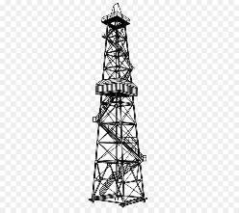
Well Construction 101--
Planning of a well:
Geometry
Casing plan
Mud plan
BHA design (Bottom Hole Assembly)
Actual drilling process

Slide 12
Which AI again?

Slide 13
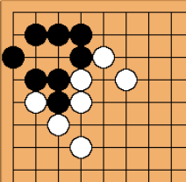
Artificial Intelligence Value Pyramid
Deep Learning (patterns discovery)
Data Science (predictive models)
Data Analytics (statistical analysis)
Reasoning
Explainable Decisions
Job plan,
Remedial action plan
Knowledge
Rules
Procedures
State, Diagnosis
Sensor data
GPS positions
IoT Data
Vacation requests
Inventory
Job design
Context
13

Slide 14
Combining different automated decision support approaches
Strategic Tactical/Operational
Knowledge
Rules
Procedures
Optimization
Stochastic local search
Genetic algorithm
LP
MIP
…
3 weeks, country scope
Reasoning
AI Planning
Scheduling
Solving temporal, logical, numeric constraints
6 hrs, 1 job
Plan-based automation
Now,
here
Plans
Optimality
Constraints
State Inference
-ML
- Rule Engine
Slow-loop learning
ML
…
(Operational)
Data
Simulators

Slide 15
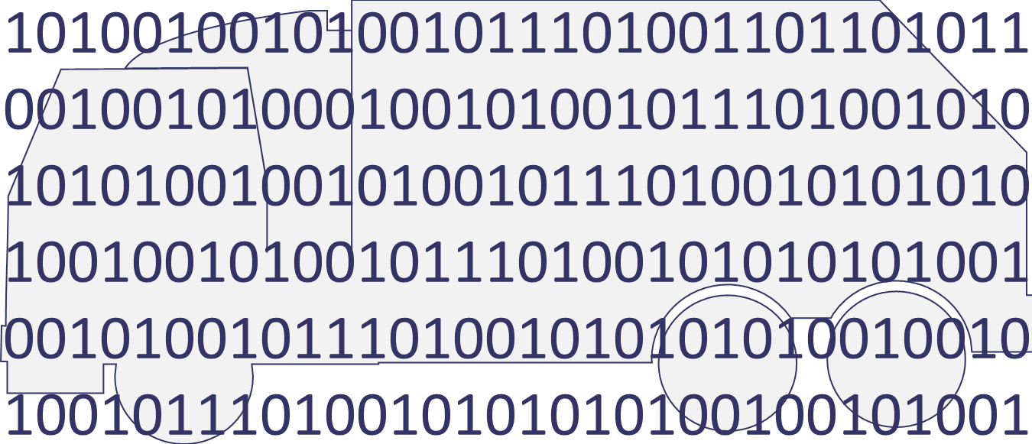
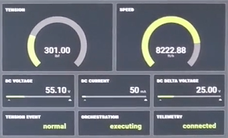
Wireline job design
Goal setting
Wireline Knowledge base
(re-) planning
Plan dispatch
Control
Sensing
State Inference
Equipment and well Digital Avatar
AI Planning = Heuristic-guided search for plans
Wireline equipment

Slide 16
Automated decision-making continuum triangle
How?
Rubik’s Cube
Automated Drilling
Machining
Automated Manufacturing
SLB Tool Selection
Sudoku
Project Management
What?
When?
Scheduling
Timetabling
The different forms of problems that involve organizing activity to achieve efficiency, timeliness and cost reduction
Notes:
Planning problems require decisions about how to achieve goals (selection of the right actions), what resources to use to perform those actions and when to perform the actions
Challenges:
For some problems, the how decisions are already made, but the what and when are critical (scheduling); scaling is vital
Targeting applications that involve more metric resources (eg carbon costs) requires greater sophistication in handling numeric constraints
Modeling physics is hard – where the planner has to reason about complex physics, it needs to use existing external models
----
Although Rubik's cube is a "toy" example, I think that there is some benefit in that particular corner being seen as quite an artificial extreme – there are few problems that are entirely 'how' with no concern for 'what' or 'when’

Slide 17
Planning vs Scheduling: What, When, How?
Planning
Scheduling
How? | When? | What?
Which operations are needed to achieve the goal? | When and in which order to best perform the operations? | Which resources to use?
Scales to much larger problems!
Notes:
Planning is more versatile (takes more sophisticated and elaborated models); scheduling scales much better.
We should note that there is often a challenging difference in scale: the schedules often have 100s of actions, while plans are often only 10s of actions.
Less to decide? Scales to much larger problems.

Slide 18
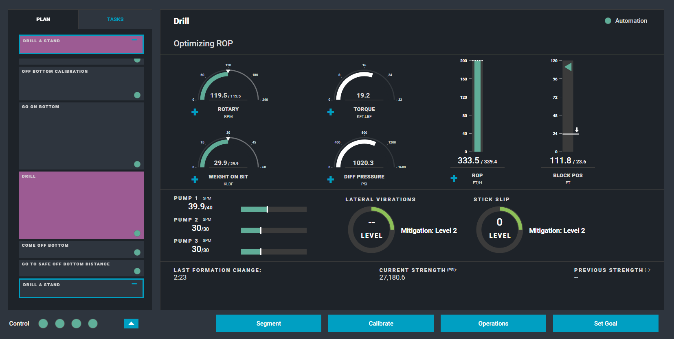
Planning vs Scheduling: under the hood
AI Planner under the hood of the Wireline truck or drilling rig
Heuristic-guided search from empty to full plan
AI Scheduler UI
Optimization of resource assignment
Notes:
… to show in practice, how do the different solvers work.
Planning starts with an empty plan and looks for suitable actions that lead to the given goal. It searches in the action space as well as the resource space and the timeline.
In contrast, Scheduling (on the right) is given the list of tasks (e.g. “drill a well”) and optimizes the resource assignment as well as the timing and order of the tasks.
And just to avoid confusion: no end-user is interested in seeing the inner workings on the left – the interface for the wireline engineer or the driller looks like this.

Slide 19
Why Planning? Why PDDL?

Slide 20
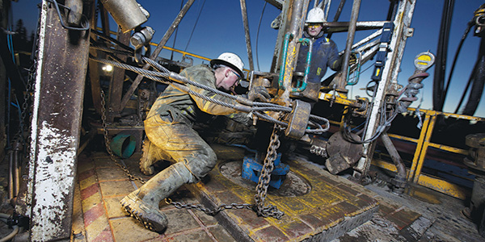
What has Planning Got to Offer?
Early attempts to automate were based on scripting the activities for drilling slips-to-slips
As more and more “failure modes” were identified and responses to them constructed, the script became impractically complex to validate, to maintain or to trust
Planning offers a rapid response to a dynamic situation, identifying the appropriate course of action from the current state to achieve the goal – essentially, dynamically rescripting from whatever state is observed
Consistency
Safety
Efficiency
Alignment with standard procedues
Reduced Non-Productive Time (NPT)

Slide 21
What do we bring to the problem?
Coordination of several separate controlled systems (top drive, draw works, pumps, slips etc), each executing asynchronously, requires a temporal plan, coordinating starts and ends of parallel activities
Temporal planning with constrained concurrent activity is essential to managing these systems
Modelling Language [PDDL2.1: Syntax, Semantics, Tools]
Temporal Planning [Planning Systems: LPGP, Crikey]
Managing resources over time [Planners: COLIN, POPF, Optic]
Derek Long
Maria Fox
Andrew Coles
Amanda Coles

Slide 22
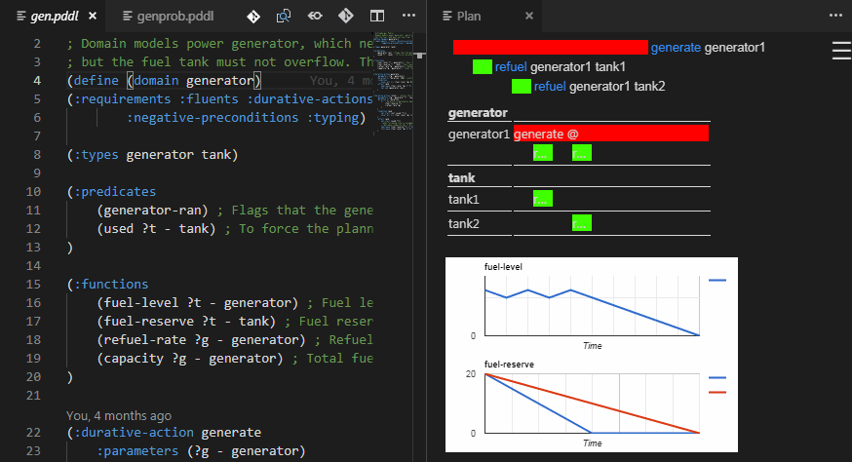
Modelling
We have found PDDL is accessible and practical for our applications, but there has been a critical lack of support tools for modellers
A planner and a text editor, and possibly VAL, have been the traditional tools of research modellers
New challenges:
Models built by multiple modellers
Models maintained and modified over time
Models extending to capture more activities as scope extends
VS Code PDDL Plug-in
Modelling Support
Jan Dolejsi

Slide 23
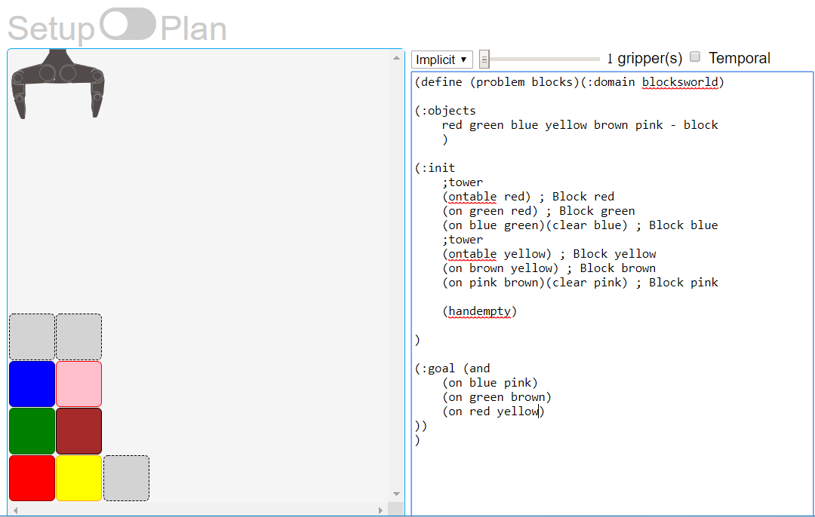
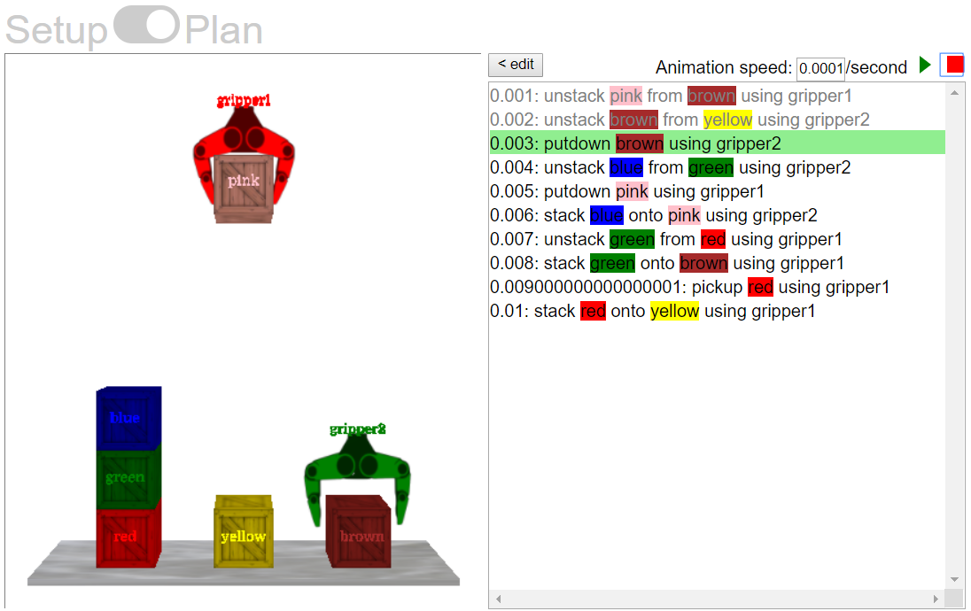
Blocksworld exercise
https://blocks-dot-ai-planning.appspot.com/

Slide 24
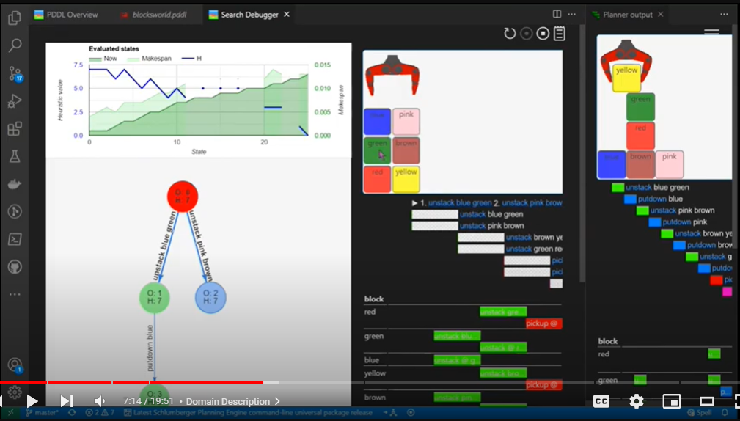
Demo: PDDL tools in VS Code
Blocks world: visualization of search tree and relaxed plans
https://www.youtube.com/watch?v=_NOVa4i7Us8&list=PL1Q0jeuU6XppflOPFx1qQVuWbXTcjxevU&index=7

Slide 25
Deploying plan-based automation: 80-20 rule²
0% | 20% | 40% | 60% | 80% | 100%
PDDL Model
Instrumentation, sensors, controller integration, integration testing, data integration
0% | 20% | 40% | 60% | 80% | 100%
Happy path
PDDL
Augmenting for re-planning from failure states

Slide 26
Continuous Processes
Some activities that execute concurrently with drilling are executed while within certain depth windows
Planning these requires the activities to be planned against a model of increasing depth while drilling
Planning with continuous change
PDDL+
Processes and Events
Dan Magazzeni
Josef Bajada
Wiktor Piotrowski
Drilling action
Depth
Survey
Depth constraint
Time

Slide 27
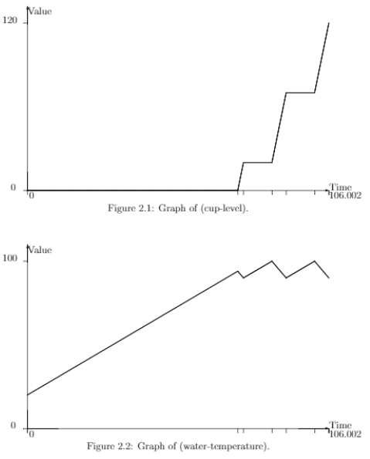
Coffee machine planning – solving opposing LP constraints

Slide 28
Demo: planning with rich numeric constraints
https://youtu.be/BFlCz49ETcA?t=682

Slide 29
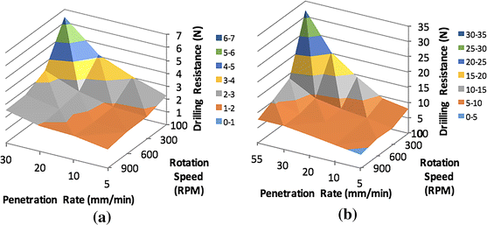
External Solvers
Complex physical constraints affect the control of some processes:
eg selection of drilling speed, including weight-on-bit and drill string rotation speed
Modelling these directly in PDDL is not practical or necessary: we exploit external solvers linked to the planner to capture some of these constraints and their implications
Linking external solvers to a temporal planner
Chiara Piacentini

Slide 30
Plan Execution
Execution by time-based dead reckoning is impractically brittle
Instead, we have to consider the causal structures that drive execution
When can an action be dispatched?
How do we know whether an action has completed?
0.00000: (getoutofslips) [1.00000]
1.00100: (breakcirculation c0) [3.00000]
4.00200: (takesurveyoffbottom c0) [5.00000]
9.00300: (goonbottom c0) [10.00000]
19.00400: (drilltosteeringdemand steeringdemand1 survey2 c0) [20.66666]
39.67166: (sendsteeringdemandonbottom c0 steeringdemand1 steeringdemand2) [10.00000]
39.67266: (drilltosurvey steeringdemand2 survey2 survey3 c0) [46.66666]
ROSPlan and plan execution
Michael Cashmore
Bram Ridder

Slide 31
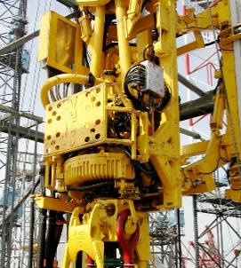
Plan Execution
Planner
Protection from connection failures
Durative-actions:
Self-contained or externally controlled?
Eg:
Set rotation speed and do not change until a new request is sent
or
set rotation speed to drilling speed until sensing this signal, then stop
Dispatcher
Controllers
What initiates this control signal?
Actuators
Rotate drill string
Start rotation
Stop rotation

Slide 32
Plan Execution – action ends
Planner
Dispatcher
Controllers
Actuators

Slide 33
Plan Execution
Not all actions are dispatched on observable signals: sometimes the clock does matter
Time depends on predicted duration of logistical support action and the remaining duration of current job
When to dispatch request to crew?
Perform local job
Perform next job
Ship in support crew

Slide 34
Plan Execution – Vacation traveling
Buy ticket
Check-in
Travel to the airport
Enjoy the flight
Buy ticket
Check-in
Travel to airport
Flight
P.S., if we add some arrows, what does the diagram represent in terms of computer science?
Simple Temporal Network (STN)

Slide 35
Timed Automaton: Semantics
∀i. predec(i) →HID_{i}
t ≥ ET
t ≤ AT_{A}
In Scope Early
.
= 1
.
t
In Scope Late
x_{i} = 1 ↔ HID_{i}
.
= 1
∀i. predec(i) →HID_{i}
t ≥ ET
.
t
t ≤ ET
t ≤ AT_{B}
t ≤ AT_{A}
x_{i} = 1 ↔ HID_{i}
t < ET
x_{i} ≤ XT_{i}
x_{i} ≤ XT_{i}
.
Dormant
t ≤ AT_{A}
x_{i} = 1 ↔ HID_{i}
t ≤ AT_{A}
.
∃i. succ(i) ∧ HID_{i}
t
= 1
∨
∃i. succ(i) ∧ HID_{i}
∨ x_{i} ≥ XT_{i}
¬FBCOND
∨
∨
t ≥ AT_{A}
∨
t ≥ AT_{A}
∃i. succ(i) ∧ HID_{i}
∨ x_{i} ≥ XT_{i}
∨
∀i. succ(i) → ¬HID_{i} ∧ t ≤ AT_{A}
∨
¬FBCOND
∧
∨
((AUTH
∧ ∧ x_{i} ≥ MT_{i}) ∨ t ≥ AT_{B})
t ≥ AT_{A}
Failed
∀i. succ(i) → ¬HID_{i} ∧ t ≤ AT_{A}
∧
((AUTH
∧ ∧ x_{i} ≥ MT_{i}) ∨ t ≥ AT_{B})
Authorised
¬FBCOND ∨ ¬AUTH
Dispatched
HID
Done

Slide 36
Planning vs Plan Execution
Failed-by
Confirmed-by
“overall” conditions
Truck at destination
Goods at destination
Fuel > 0
Driver is awake
Truck available at departure
Truck loaded
Truck fueled
Driver in truck
Drive
Truck not at departure
Goods not at departure
Fuel getting consumed
Driver getting tired
“At start” conditions
Authorized-by
Notes:
How does the action language look like? It consists of action declarations. Each action has a (pre-)condition and has effect.
Let’s take the transportation domain example and define the drive action.
Pre-conditions must be met before the action is allowed to start.
Suppose we start the action i.e. we start driving, then further conditions must be met throughout the driving activity. When any of them fails, the activity and consequently the plan shall fail. Often such conditions are based on measurements. Some of them can be measured directly (fuel level), others are inferred indirectly (sleepiness).
Then the action has effects. Some effects happen when the action start, some progressively through out and some after the action stops.
Domains may contain dozens or hundreds of actions to describe the real world. The main task is to pick the right level of abstraction/granularity to keep the modeling convenient (i.e. domain maintainable) and planning efficient.

Slide 37
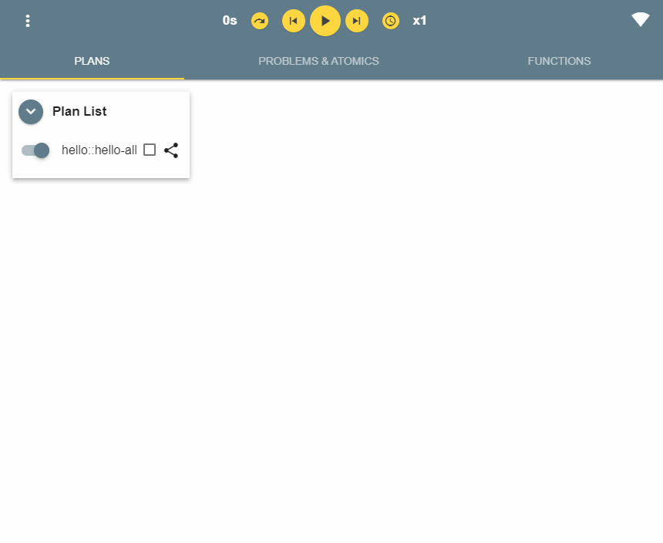
Demo: Plan execution tools
Notes:
https://web.microsoftstream.com/video/3bff7770-7a16-4eb2-be22-fcae71a27544?st=258
code c:\NotBackedUp\c\VSTS\git\ai-planning-xpop-tutorial\hello-world2
atomics.xpd -> right click, Open XPOP in context of .xpd

Slide 38
One Plan to Rule Them All
Planner
The challenge of multiple rigs with different interfaces is approached via rig adaptors
Dispatcher
Command Interface
Abstraction
Generic
Behaviour Trees manage low level coordination
Controllers
Actuator Control
Layer
Rig specific
Actuators

Slide 39
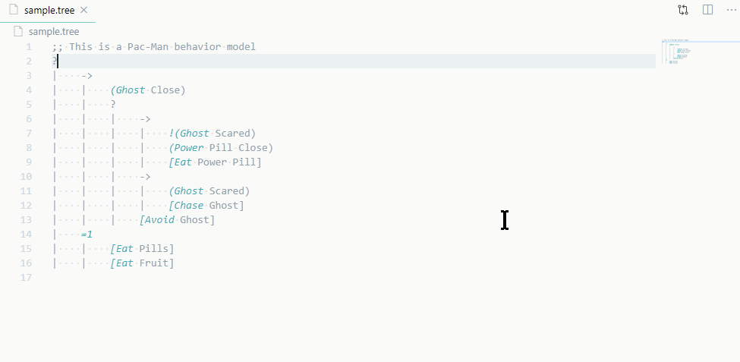
Demo: Behavior Trees
https://marketplace.visualstudio.com/items?itemName=jan-dolejsi.btree

Slide 40
Progress on Automation
Plan-based control of the drilling process:
SLB successfully field tested a plan-based drilling system in 2016
Since then, multiple field tests have hardened the automated drilling function and the system is now in production use
Driller releases control to the autonomous system

Slide 41
Progress on Automation
Driller sets a goal

Slide 42
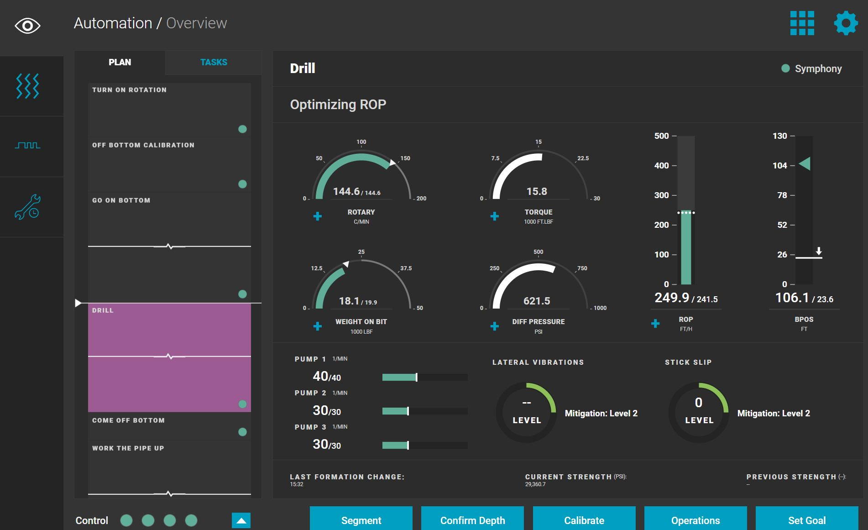
Progress on Automation
Plan is constructed from current state and begins automatic dispatch to execution

Slide 43
Further Applications
In addition to drilling automation, the same technology has been used to automate “Wireline logging” – this is the process of using tools in a drilled section of well to survey geology and other features
The same planner was also used to automate sand logistics for Schlumberger’s North American stimulation business, OneStim, before it was sold

Slide 44
Architecture: PDDL in business applications
Docker container
Cloud lambda function
Web service
PDDL Domain
PDDL Problem
JSON request
Web service
Jinja2 templating
PDDL Planning service
Line-of-business / Engineering application
JSON
response
Plan
Jinja2* tempalte
Transient file
* Or any other templating language

Slide 45
Demo: Declarative template-based PDDL problem generation
https://www.youtube.com/watch?v=Uh5Idw0b-N8&list=PL1Q0jeuU6XppflOPFx1qQVuWbXTcjxevU&index=6
Notes:
code c:\NotBackedUp\c\GitHub\vscode-btree\node_modules\behavior_tree_service\sample.tree
C:\NotBackedUp\c\VSTS\git\ai-planning-service\run.cmd
code c:\NotBackedUp\c\GitHub\vscode-pddl-samples
code c:\NotBackedUp\c\VSTS\git\ai-planning-xpop-tutorial
code c:\NotBackedUp\c\VSTS\git\ai-planning-xpop-tutorial\hello-world2

Slide 46
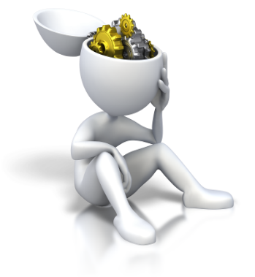
Planning and Optimisation
An optimisation problem is solved using an iterative scheme in which steps are one of three types
Search
Infer
Relax
Search: Add a new constraint or its negation
Infer: Add a constraint that is implied by the existing constraints
Relax: Remove constraints, solve simpler problem, then use this to guide search
Prof. John Hooker at CMU has developed this framework over the past two decades

Slide 47
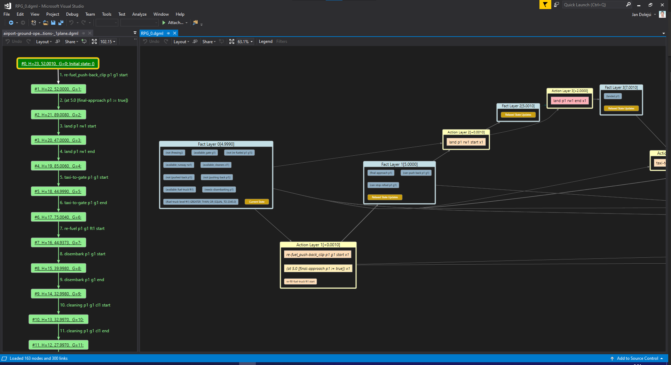

Slide 48
Recent Developments
Combined planning and scheduling:
Use a relaxation of a planning problem to project it onto an embedded scheduling problem
Solve the scheduling problem and then complete a relaxed plan solution for the entire planning problem
Guide search for a finished solution to the planning problem, concluding with a solution to the scheduling problem included in a plan
The same strategy allows us to tackle Subset Selection problems well, too (eg decide which subset of jobs will give best reward for limited cost and plan for them)

Slide 49
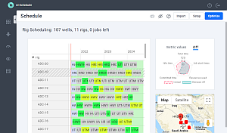
Architecture of a job-resource scheduling app
Work-orders
Rules, policies, procedures,
constraints,
objectives
AI Scheduler
AI Schedule Optimizer
Operational data

Slide 50
Resources
https://blocks-dot-ai-planning.appspot.com/
https://github.com/AI-Planning/modeling-in-pddl
YouTube: Modeling in PDDL, back to the basics.
VS Code + PDDL Extension
https://icaps23.icaps-conference.org/ letos v červenci v Praze!
JDolejsi@slb.com

